Slide 1

Unit 1: Animals
Review and Practice 1
Page 18

Slide 2
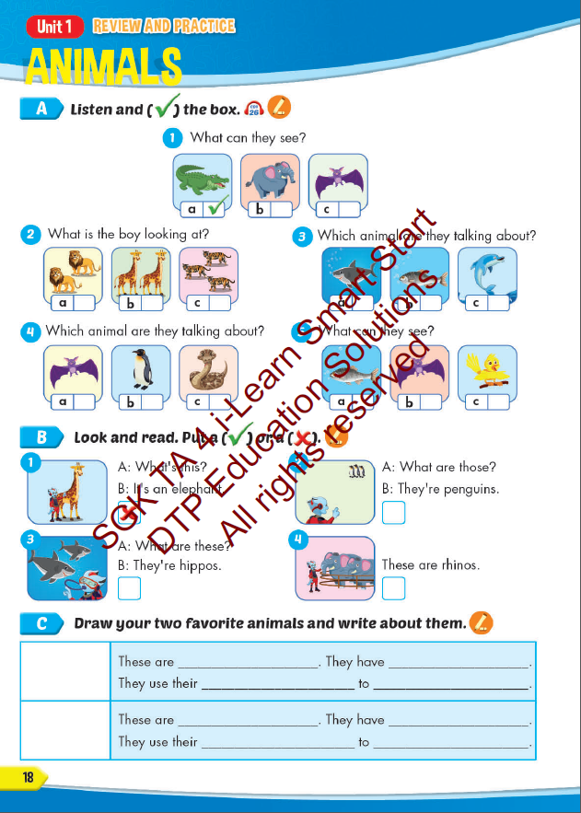
Lesson Outline
Warm-up
Reading
Listening
Consolidation
Wrap-up

Slide 3
Objectives
By the end of this lesson, students will be able to…
Vocabulary: Review: " snake, monkey, horse, camel, hippo, rhino, panda, giraffe, lion, dolphin, tiger, zebra, crocodile, bat, shark, penguin, kangaroo, elephant."
Structure: Review: "This is a monkey. - These are monkeys. That's a snake. - Those are snakes, What's this? It's a panda. What's that? It's a dolphin, What are these? They're penguins. What are those? They're bats."

Slide 4

WARM UP

Slide 5






VOCAB QUIZ

Slide 6






monkey
A
B

Slide 7


rhino
A
B

Slide 8

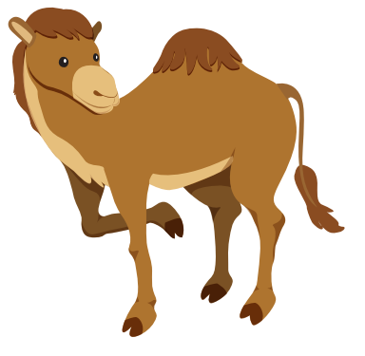
hippo
A
B

Slide 9
camel
B
A

Slide 10
horse
A
B

Slide 11
snake
A
B

Slide 12

It’s time to learn …

Slide 13

Listening

Slide 14


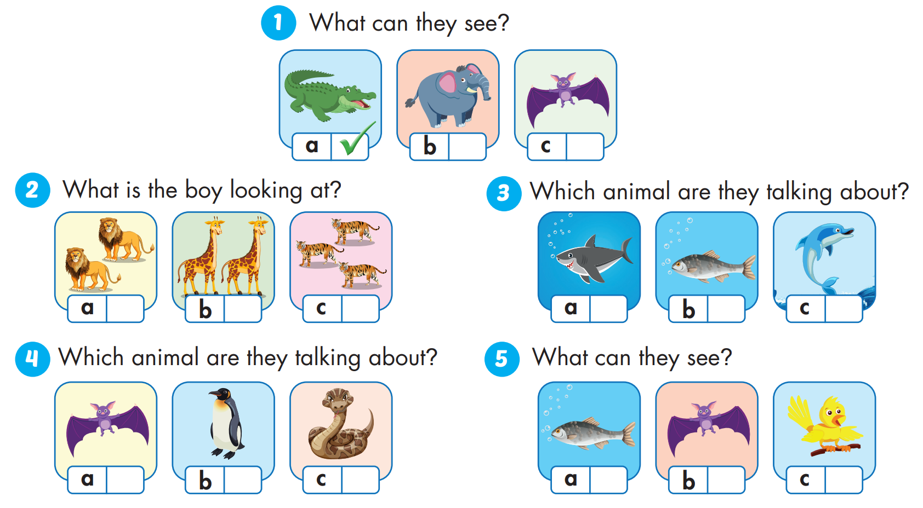


Slide 15

Reading

Slide 16
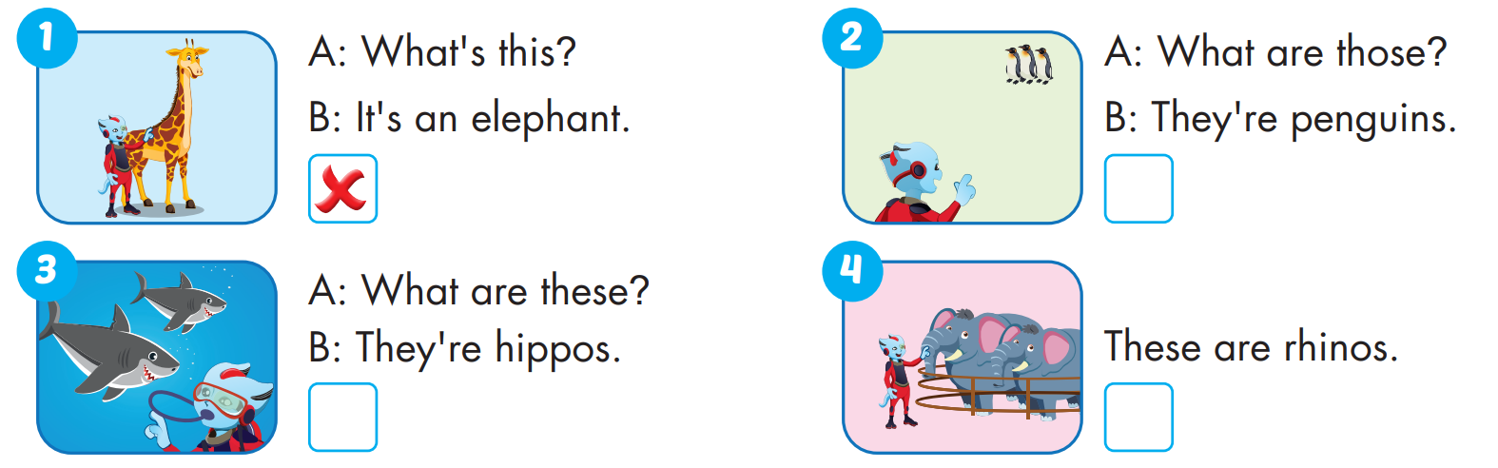


Slide 17
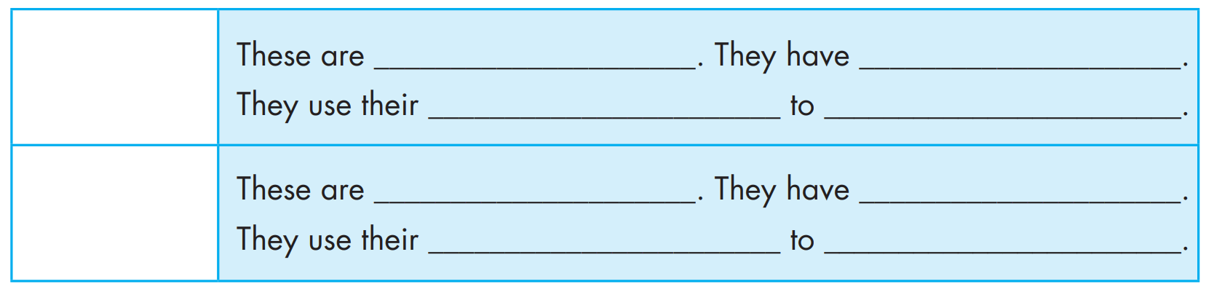

Slide 18

Practice

Slide 19

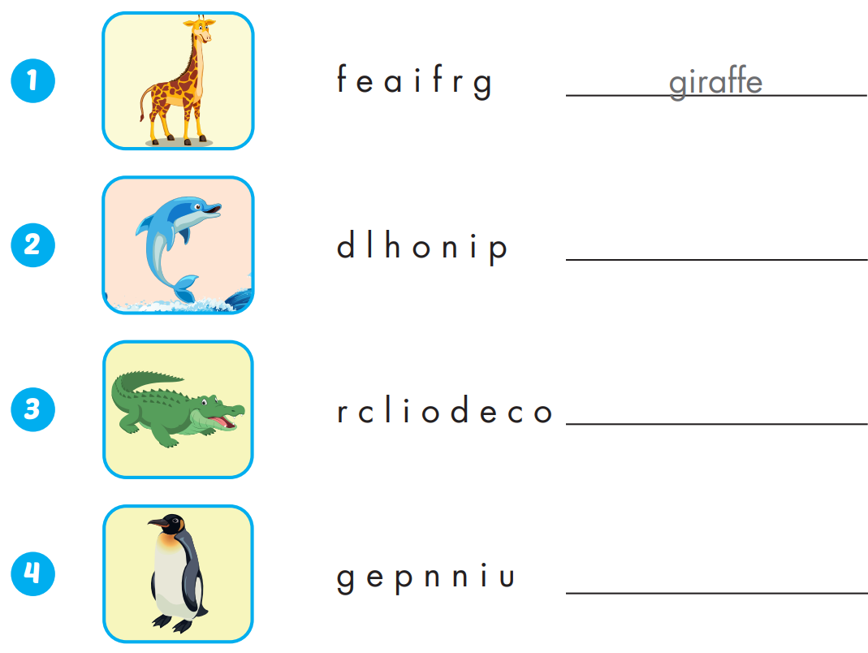
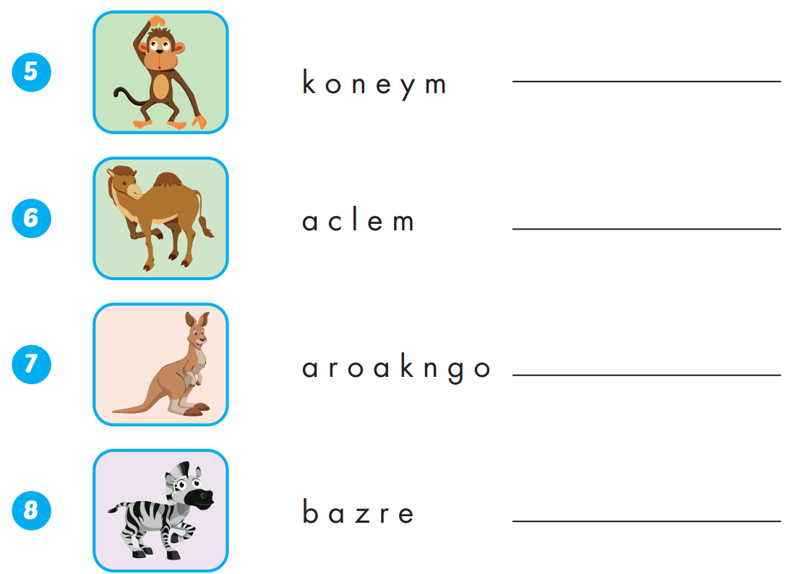
Extra Practice
WB, page 10
monkey
dolphin
camel
crocodile
kangaroo
zebra
penguin

Slide 20

WRAP-UP

Slide 21
Today’s lesson
Vocabularies
Vocabulary: Review: " snake, monkey, horse, camel, hippo, rhino, panda, giraffe, lion, dolphin, tiger, zebra, crocodile, bat, shark, penguin, kangaroo, elephant."
Structures/ Sentence patterns
Review: "This is a monkey.
- These are monkeys.
That's a snake.
- Those are snakes,
What's this? It's a panda.
What's that? It's a dolphin,
What are these? They're penguins.
What are those? They're bats."

Slide 22
Homework
Practice the vocabularies and structure; and make sentences using them.
Do the exercises in Tiếng Anh 4 i-Learn Smart Start WB (page 10)
Do the exercises in Tiếng Anh 4 i-Learn Smart Start Notebook (page 8)
Prepare the next lesson (page 19 SB)
Play the consolidation games in Tiếng Anh 4 i-Learn Smart Start DHA App on www.eduhome.com.vn

Slide 23

Enjoy your day!

