Slide 1
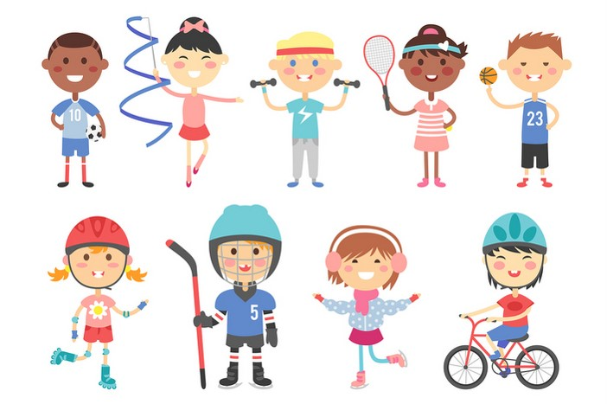
Friday, October 26th 2023
My hobbies
Unit
5
Lesson 1

Slide 2

Warm-up

Slide 3



Let’s sing.
Ears,,
ears,
ears.
Hair,
hair,
hair.
Touch your ears!
Touch your hair!
Touch your ears!
Touch your hair!

Slide 4






Contents
Facebook : Bùi Liễu
0968142780
Look, listen and repeat.
Listen, point and say.
Let’s talk.
Listen and number.
Read and match.
Let’s play.

Slide 5
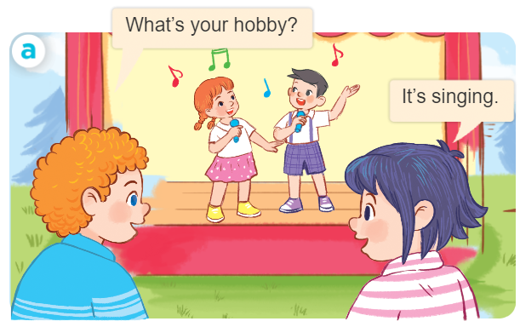
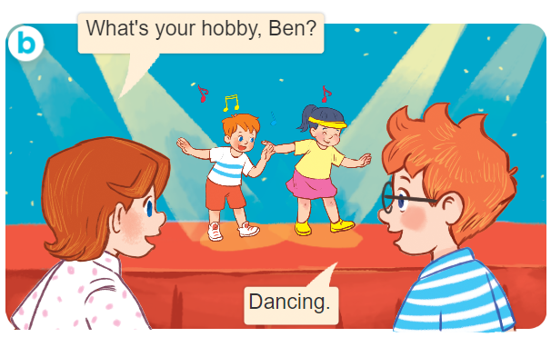
1. Look, listen and repeat.

Slide 6
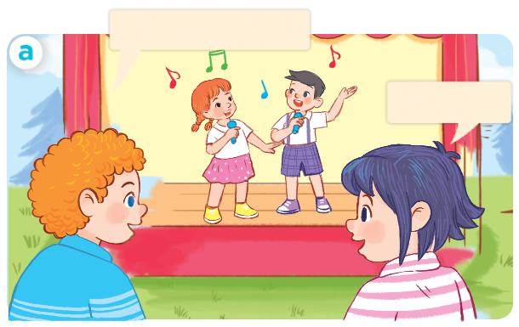
1. Look, listen and repeat.
What’s your hobby?
It’s singing.

Slide 7
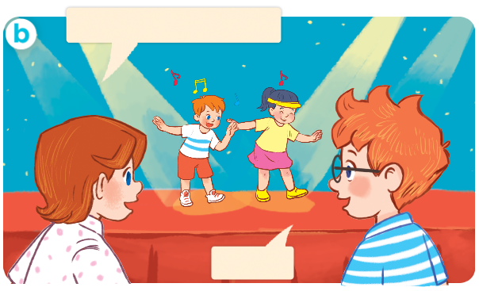
1. Look, listen and repeat.
What’s your hobby, Ben?
Facebook : Bùi Liễu
0968142780
Dancing.

Slide 8
Vocabulary

Slide 9



Vocabulary
hobby
/ˈhɒb.i/
sở thích

Slide 10
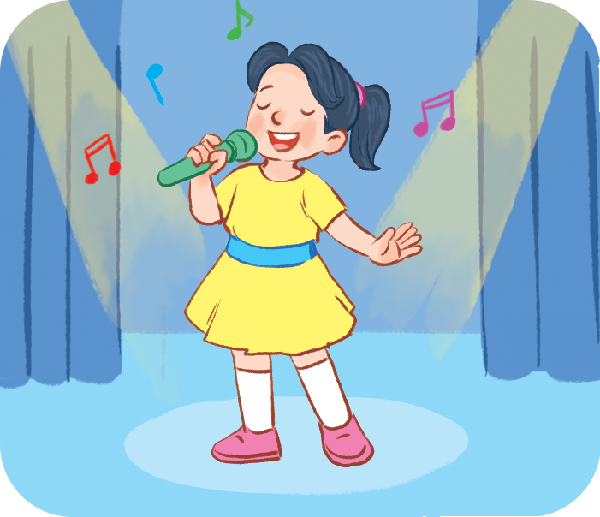
Vocabulary
singing
/ˈsɪŋ.ɪŋ/
hát

Slide 11
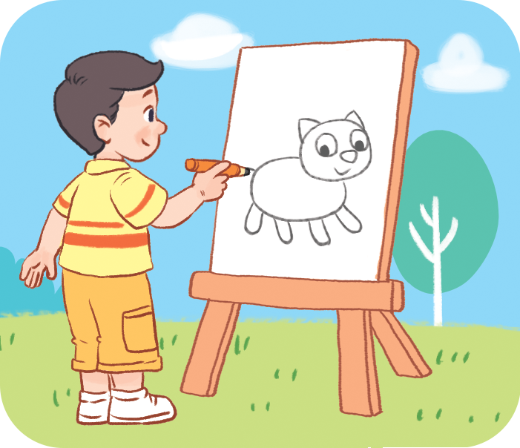
Vocabulary
drawing
/ˈdrɔː.ɪŋ/
vẽ

Slide 12
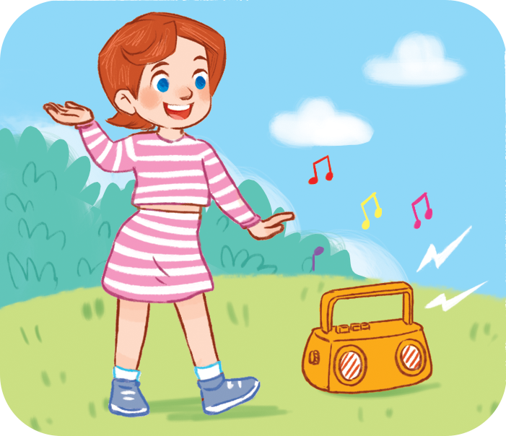
Vocabulary
dancing
/dɑːnsɪŋ/
khiêu vũ

Slide 13

Vocabulary
swimming
/ˈswɪm.ɪŋ/
bơi

Slide 14

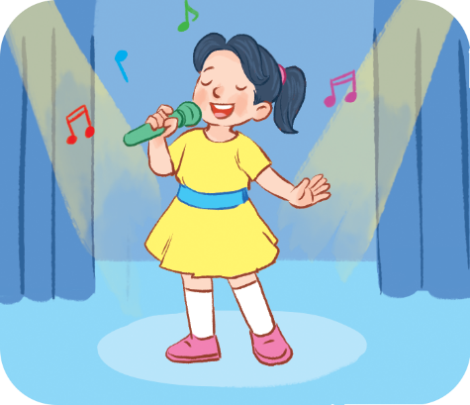
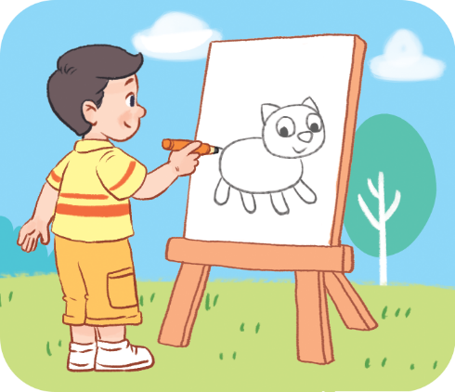
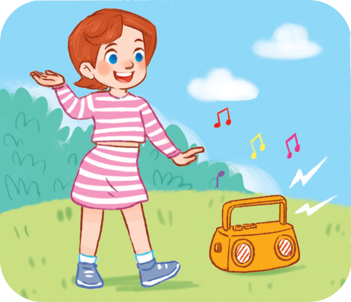

Review
hobby
singing
drawing
dancing
swimming

Slide 15
Vocabulary
hobby: sở thích
singing: hát
drawing: vẽ
dancing: khiêu vũ
swimming: bơi

Slide 16
Structures

Slide 17
Structures
Hỏi và trả lời về sở thích.
- What’s your hobby?
It’s _______.
(Sở thích của bạn là gì?)
What’s = what is
It’s = it is
(Đó là ________)

Slide 18

Let’s play!

Slide 19






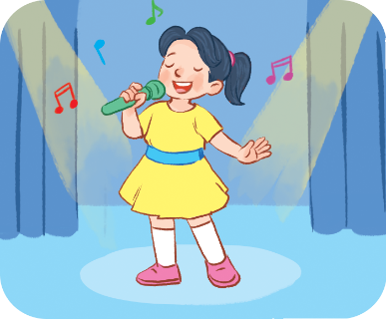
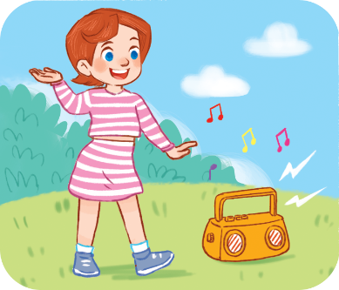

Choose the right answer.
Click on the picture to choose the right answer.
swimming
a
b
c

Slide 20
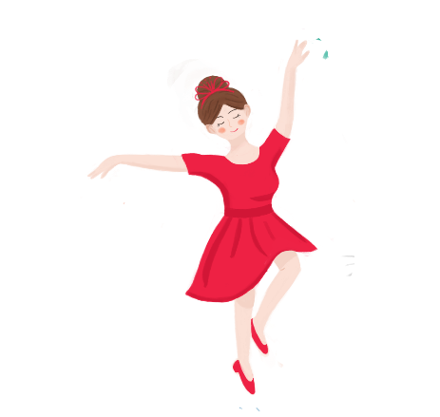


Click on the picture to choose the right answer.
Choose the right answer.
singing
a
b
c

Slide 21

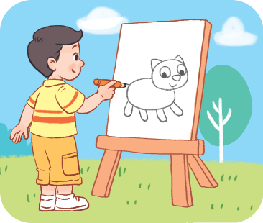
Click on the picture to choose the right answer.
Choose the right answer.
dancing
a
b
c

Slide 22
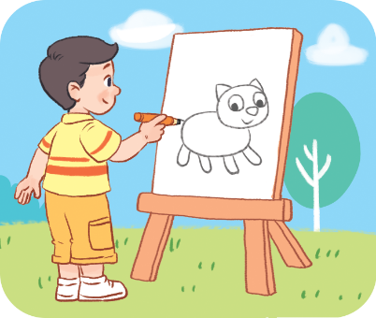
Click on the picture to choose the right answer.
Choose the right answer.
drawing
a
b
c

Slide 23
Choose the right answer.
Click on the picture to choose the right answer.
a
b
c

Slide 24
Click on the picture to choose the right answer.
Choose the right answer.
a
b
c

Slide 25
Click on the picture to choose the right answer.
Choose the right answer.
a
b
c

Slide 26

Choose the right answer.
Click on the picture to choose the right answer.
a
b
c

Slide 27
Thank you!

Slide 28
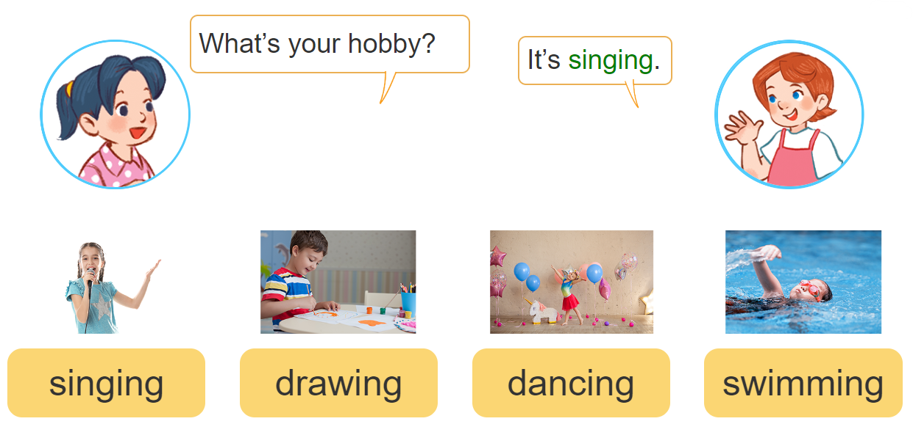
2. Listen, point and say.
a
b
c
d

Slide 29
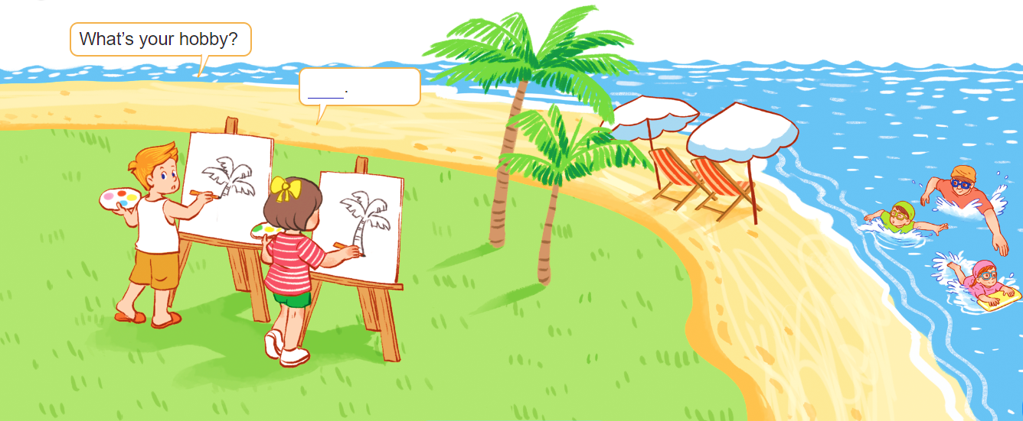
3. Let’s talk.

Slide 30








4. Listen and number.
4
3
2
1
a
b
c
d

Slide 31
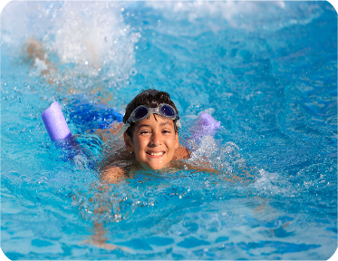


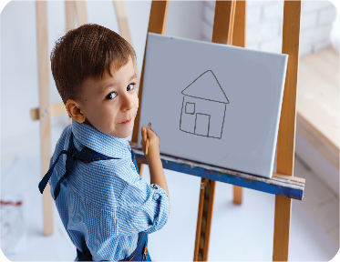
5. Read and match.
What’s your hobby?
a
1. It’s dancing.
b
2. It’s drawing.
c
3. It’s swimming.
4. It’s singing.
d
1 - c
2 - d
3 - a
4 - b

Slide 32
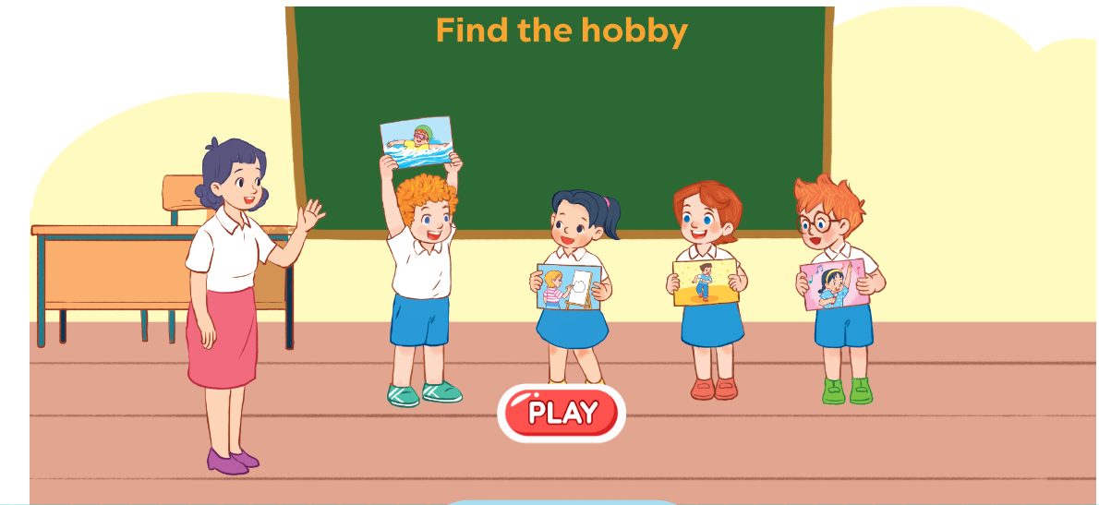
6. Let’s play.

Slide 33
Wrap up

Slide 34


Vocabulary
hobby
singing
drawing
dancing
swimming

Slide 35
Structures
Hỏi và trả lời về sở thích.
- What’s your hobby?
It’s _______.
(Sở thích của bạn là gì?)
What’s = what is
It’s = it is
(Đó là ________)

Slide 36
Homelink
Learn by heart all the new words.
Read again the dialogue in part 1.

Slide 37

Thank you!

