Slide 1


Slide 2
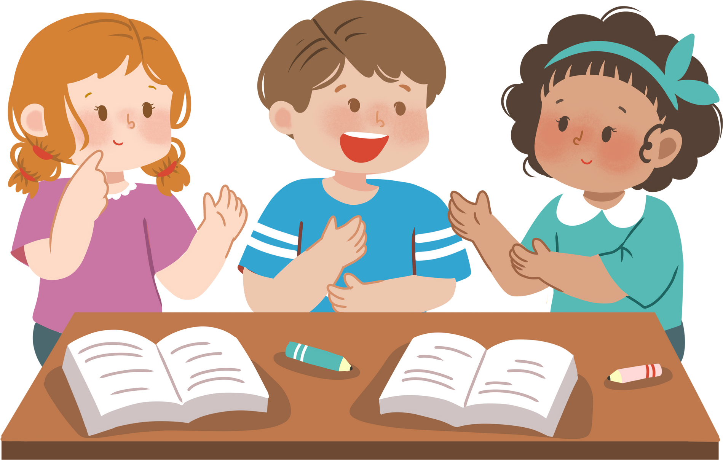
Facebook: Bùi Liễu
0968142780
Monday, February 20th 2024
Review 3

Slide 3
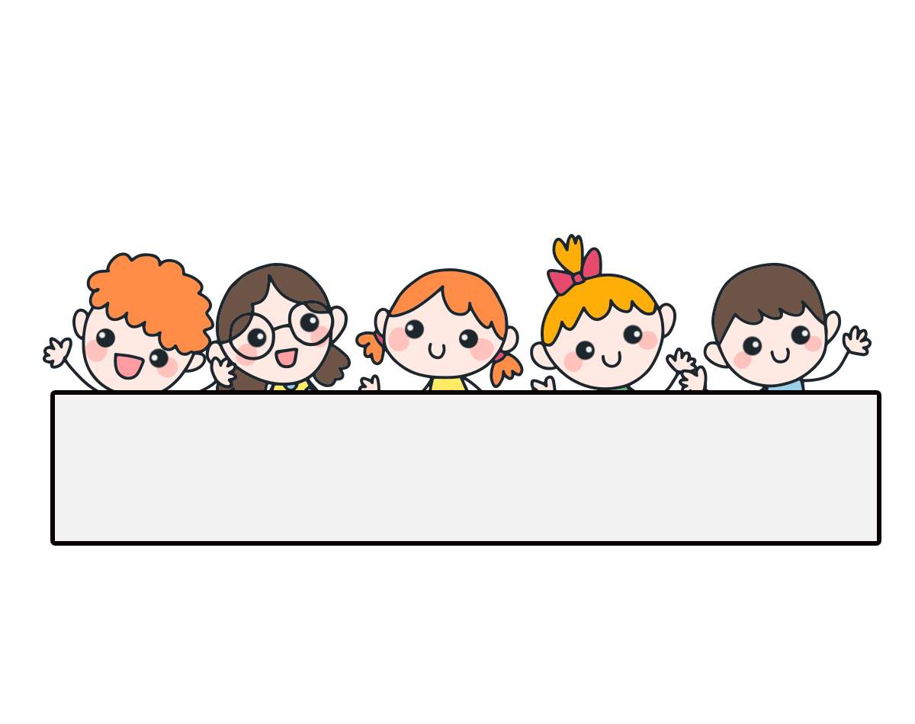
Warm-up

Slide 4


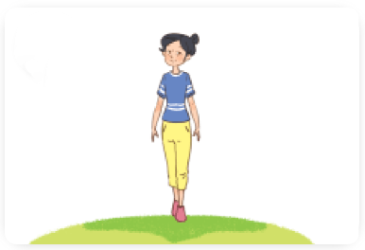
Linh: What does she look like?
Mai: ____________.
A. She’s slim.
B. He’s tall.
C. She’s short.
D. He’s slim.

Slide 5
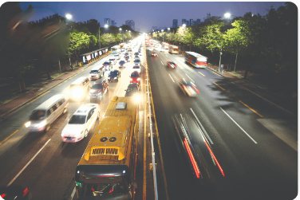
Lucy: What’s the ________ like?
Nam: It’s a _________.
A. village / quiet village
B. road / noisy road
C. city / big city
D. street / busy street

Slide 6
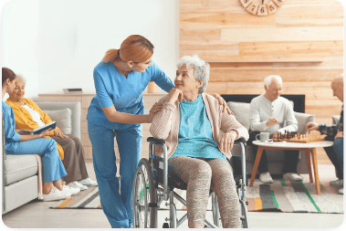
Mary: __________________?
Bill: She works at a nursing home.
A. Where does he work?
B. When do you watch TV?
C. Where does she work?
D. What does he do?

Slide 7
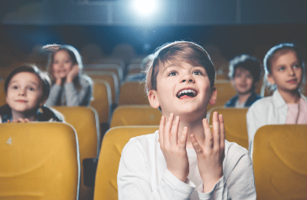
Ben: What does he do on Sundays?
Nam: ____________.
A. She does yoga.
B. She watches films.
C. He cooks meals.
D. He watches films.

Slide 8
Linh: Where do you live?
Mai: I live _____ Tran Hung Dao Street.
A. in
B. at

Slide 9
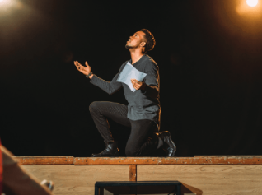
Lucy: What does she do?
Nam: He’s ________.
A. office worker
B. actor
C. nurse
D. nurse

Slide 10
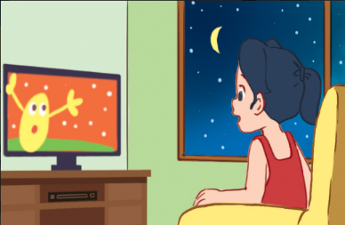
Mary: When do you watch TV?
Bill: I watch TV ________.
A. in the afternoon
B. at noon
C. in the evening
D. in the morning

Slide 11
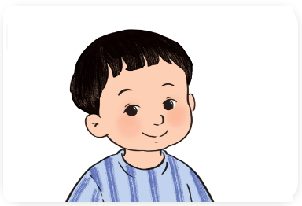
Ben: What does he look like?
Nam: ____________.
A. She has big eyes.
B. He has short hair.
C. She has long hair.
D. He has a round face.

Slide 12
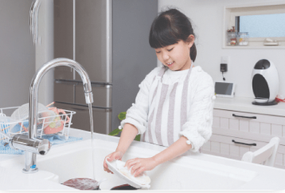
Lucy: What do you do at noon?
Nam: I ___________.
A. help with the cooking
B. wash the dishes
C. wash the clothes
D. clean the floor

Slide 13
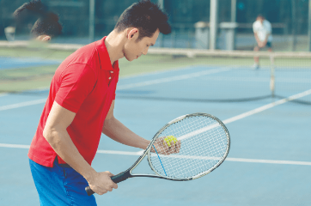
Mary: ______ does he go on Saturdays?
Bill: He goes to the sport centre.
A. How
B. What
C. Where
D. When

Slide 15





Contents
Listen and number.
Ask and answer.
Read and match.
Read and complete.
Let’s write.

Slide 16

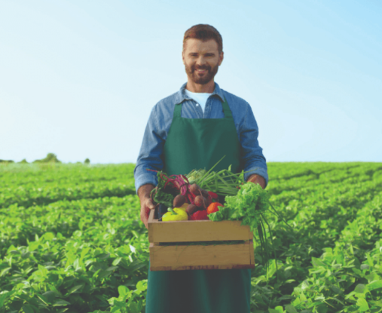
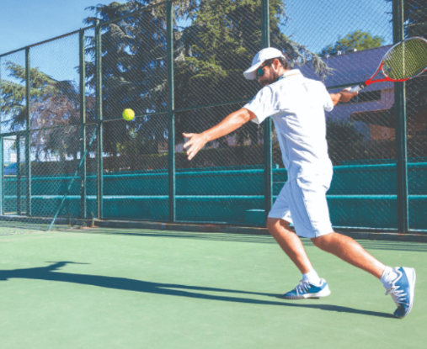
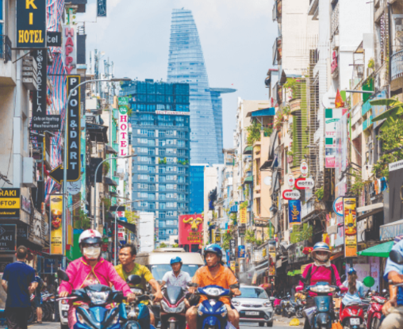
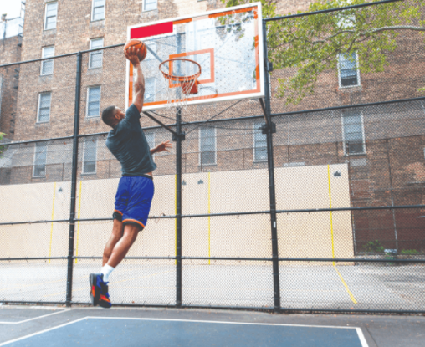



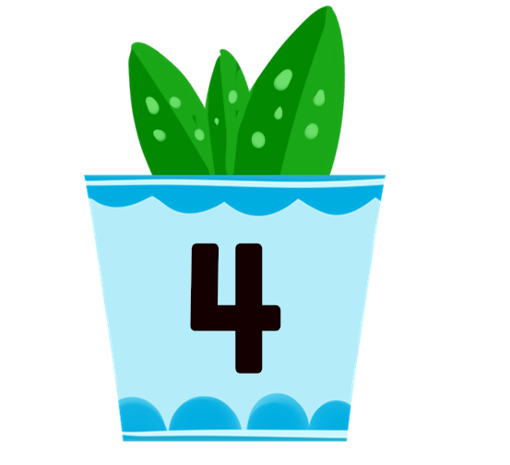
1. Listen and number.
a
b
2
4
c
d
1
3

Slide 17
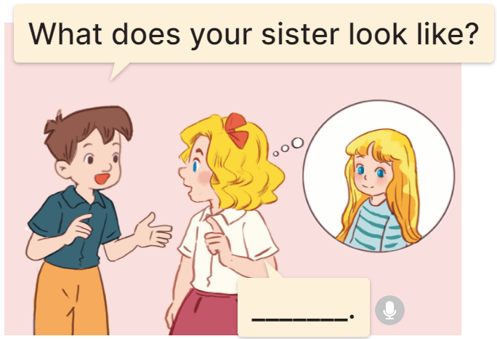
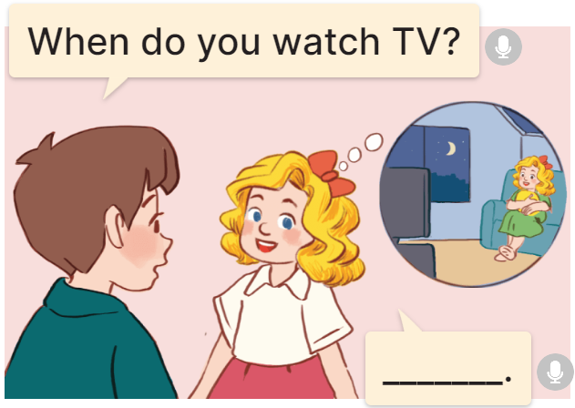
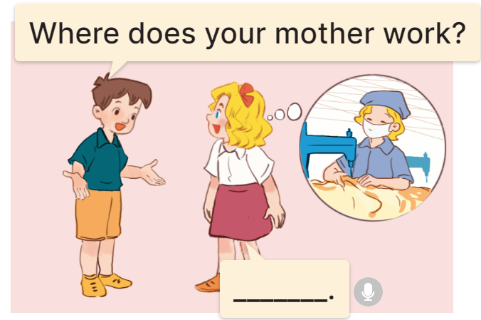
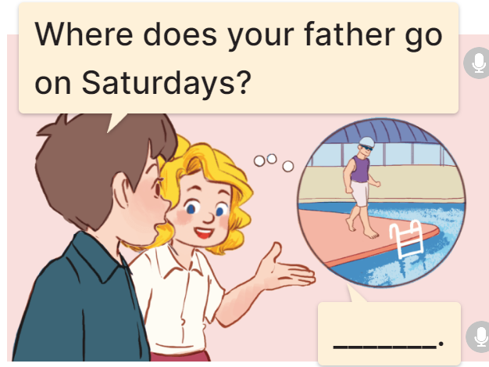
2. Ask and answer.
1.
2.
When do you watch TV?
What does your sister look like?
________________________.
_______________.
I watch TV in the evening
She has long hair
3.
4.
Where does your mother work?
Where does you father go on Saturdays?
______________________.
She works at a factory
____________________________.
He goes to the swimming pool

Slide 18
3. Read and match.
1. Where do you live?
a. She has short hair.
2. What does your sister look like?
b. He works at a nursing home.
3. What do you do in the morning?
c. He cooks meals.
4. What does your brother do at the weekend?
d. I live at 25 Le Lai Street.
5. Where does your father work?
e. I do housework.

Slide 19
4. Read and complete.
factory | pupil | slim | watch | works
There are three people in my family: my father, my mother and me. My father is tall. He works at a (1) ___________. My mother is (2) ________. She (3) _________ at a school. I am a (4) __________. In the morning and afternoon, I study at school. In the evening, I do homework and (5) _________ TV.
factory
slim
works
pupil
watch

Slide 20
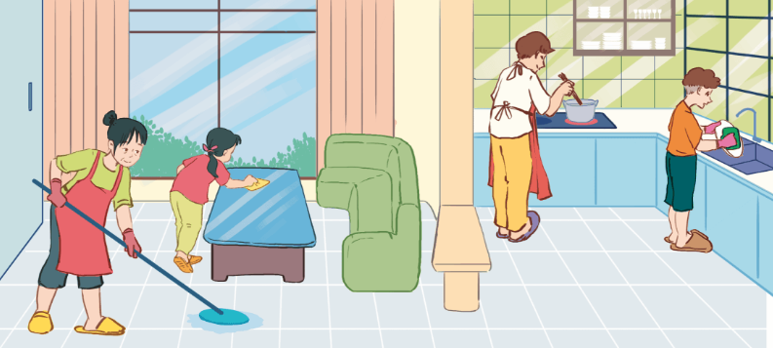
5. Let’s write.
This is my family. On Sundays, we stay at home and do many things. My father ___________. My mother ____________. My brother ________________. I __________________
___________.
cooks meals
clean the floor
washes the dishes
do housework with
my mother

Slide 21
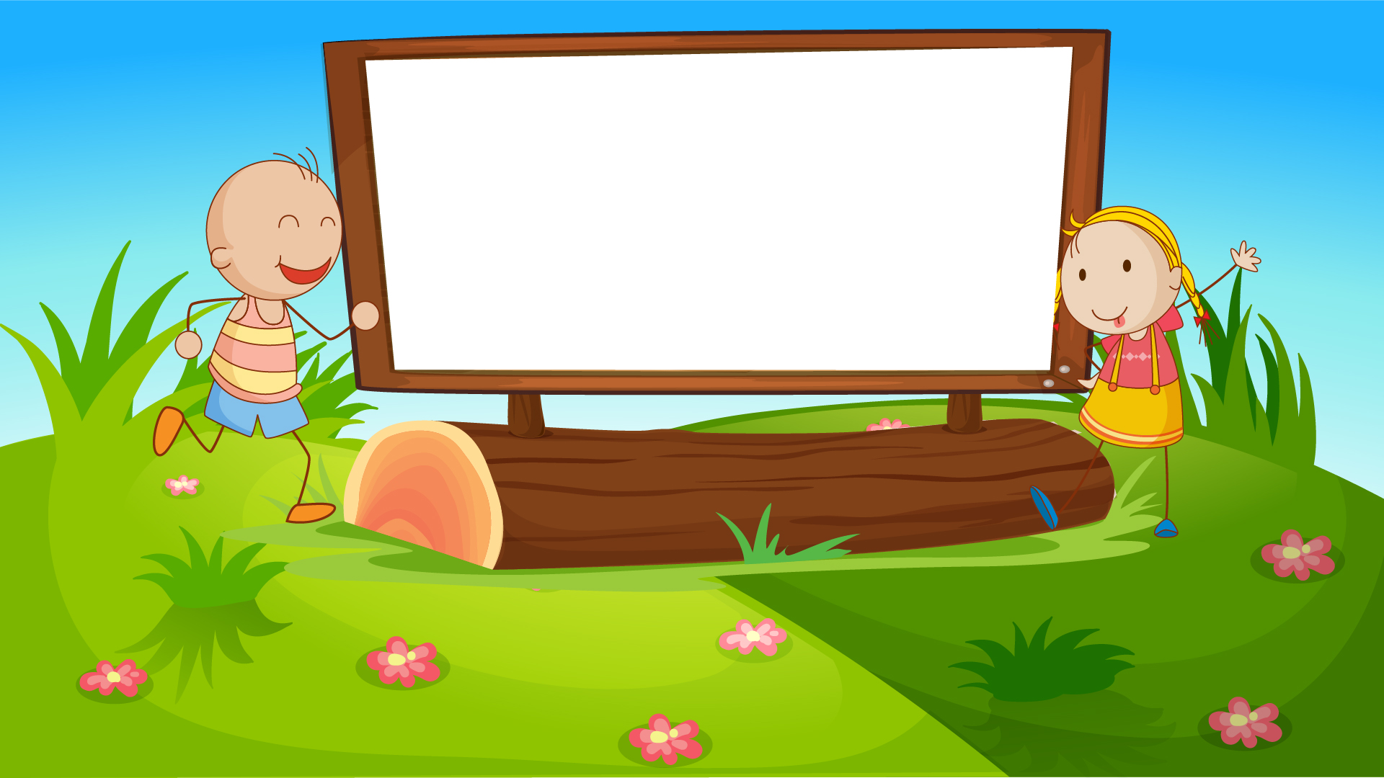
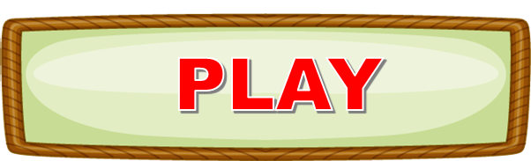

Let’s play!

Slide 22
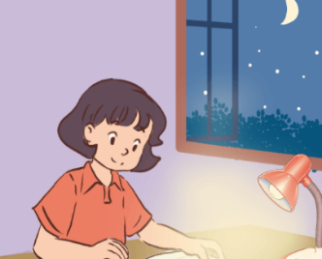

A: ______do you do housework?
B: In the evening.
When
Answer

Slide 23
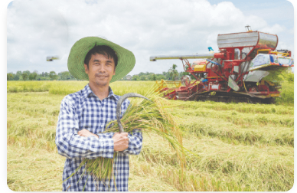
A: Where does he work?
B: _________.
He works on a farm.
Answer

Slide 24
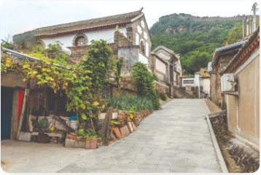
What’s the _____ like?
village
Answer

Slide 25
A: ___________
B: I live at 12 Le Loi Street.
Where do you live?
Answer

Slide 26
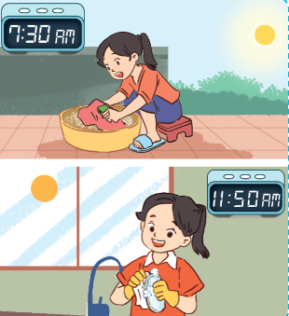
A: What do you do ______?
B: I wash the clothes.
in the morning
Answer

Slide 27
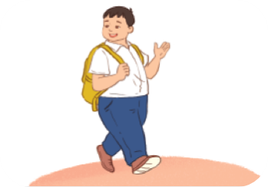
A: What does he ________?
B: He’s ______.
big
Answer

Slide 28
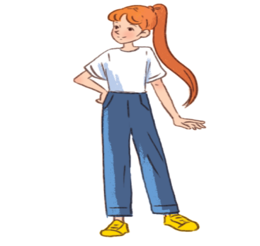
She’s slim. She has _____.
long hair
Answer

Slide 29
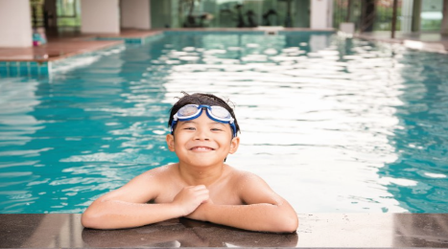
A: Where does he go on Saturdays?
B: He goes to the _______.
swimming pool
Answer

Slide 30
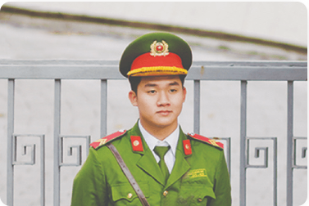
A: What does he do?
B: __________.
He’s a policeman.
Answer

Slide 31
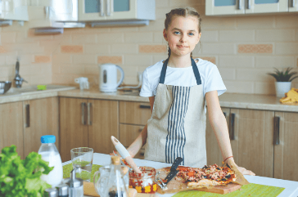
A: What does she do on Sundays?
B: She _______.
cooks meals
Answer

Slide 32
Great!

Slide 33
Homework
……………………………………..
……………………………………...

Slide 34

Thank you!

