Slide 1


Slide 2
REVIEW 3
Lesson 1

Slide 3
Warm-up
Sing a song.
01

Slide 4

Notes:
Animation video: https://www.youtube.com/watch?v=brJK_Ke9Btw&list=PL8_ETpRL2xNay3h-a-vBjWhplE1wXFpSJ&index=31

Slide 5


Unit 11:
My home
Where do you live?
What’s the street like?
Unit 14:
Daily activities

Slide 6
Unit 15:
My family’s weekends
What does your mother do?
Where does she work?
Unit 12:
Jobs

Slide 7
Unit 13:
Appearance
What does she look like?
What does he look like?
Unit 11:
My home

Slide 8
Unit 12:
Jobs
When do you watch TV?
What do you do in the morning?
Unit 14:
Daily activities

Slide 9
Unit 11:
My home
Where does he go on Saturdays?
Unit 15:
My family’s weekends
What does he do on Sundays?

Slide 10

Listen and number
02

Slide 11
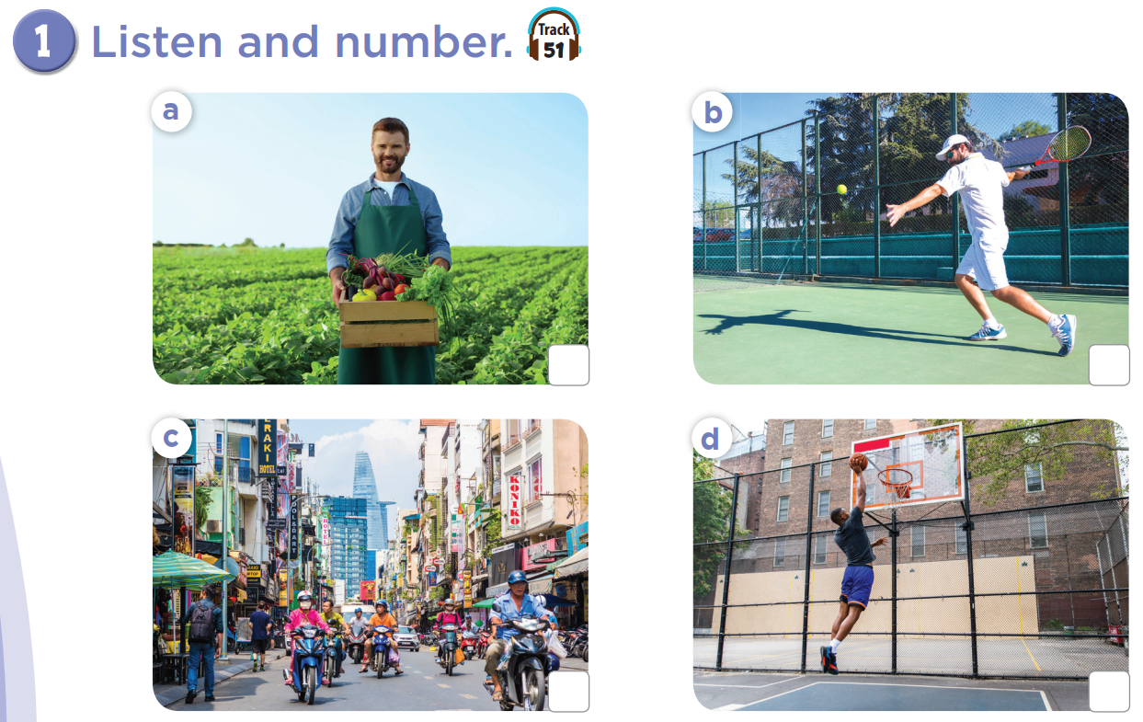


Slide 12

2
4
a farmer
play tennis
busy street
1
tall
3

Slide 13
Ask and answer.
03

Slide 14
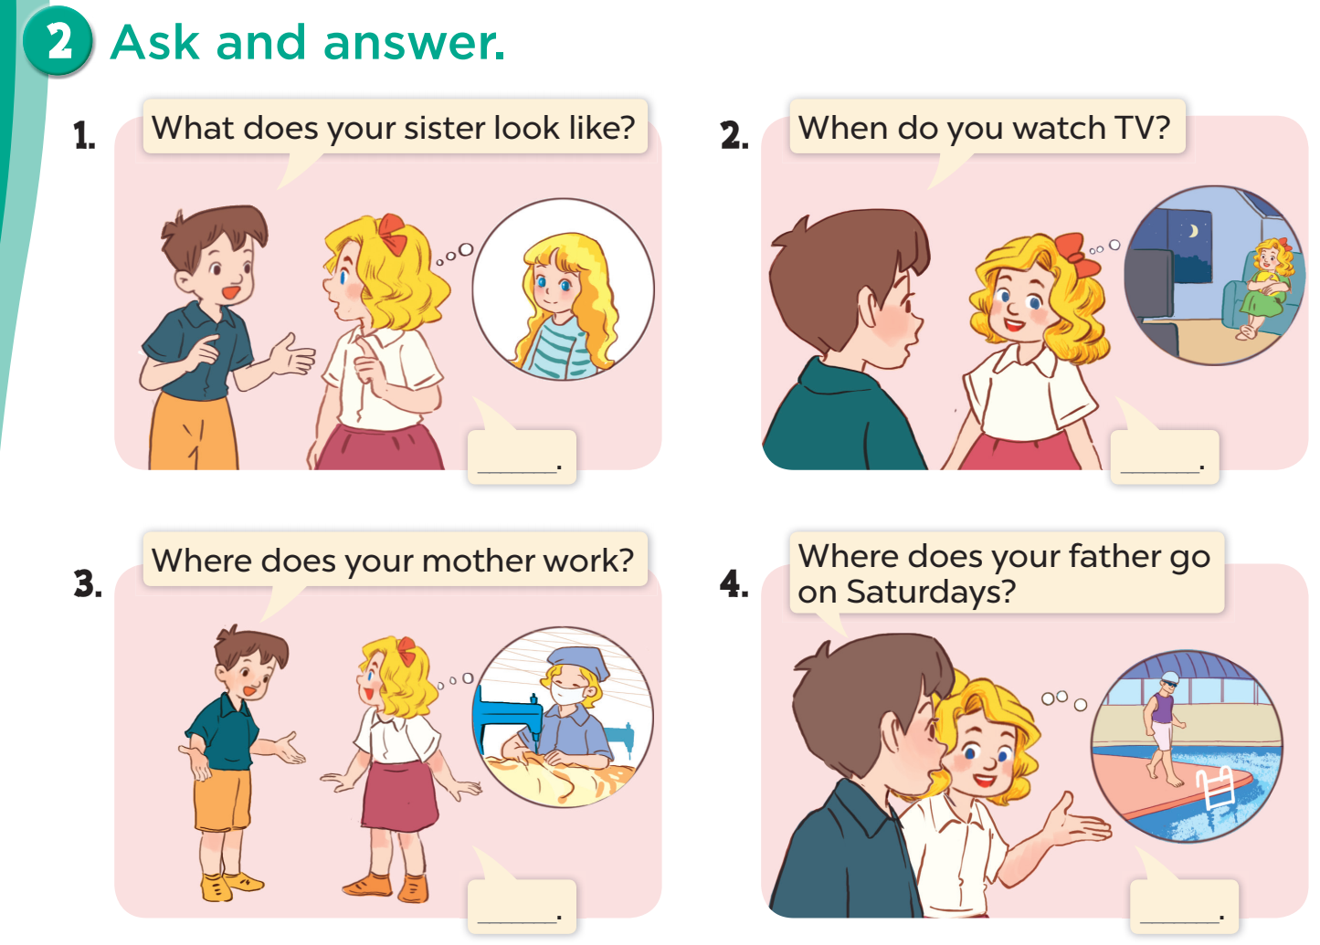

Slide 15
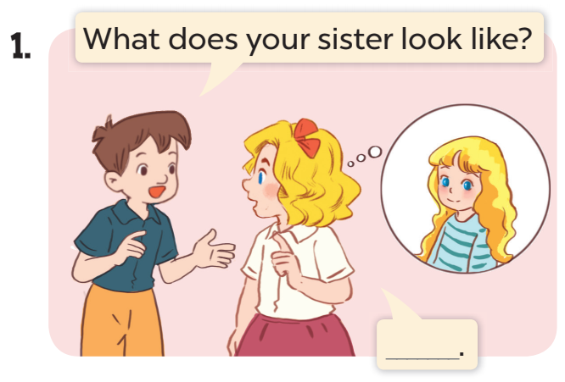
She has long hair.

Slide 16
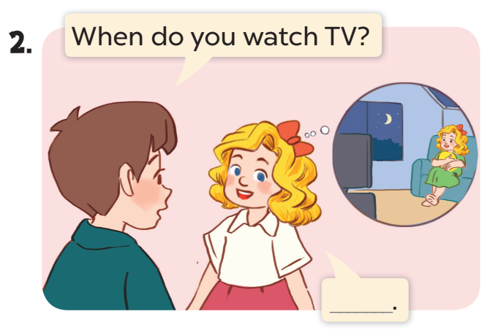
I watch TV in the evening.

Slide 17
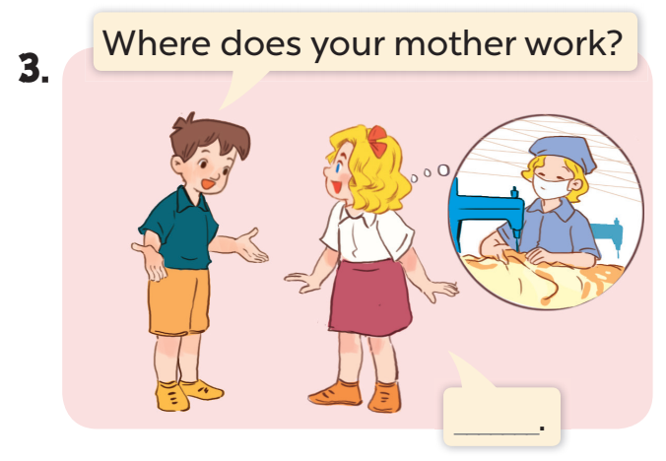
She works at a factory.

Slide 18
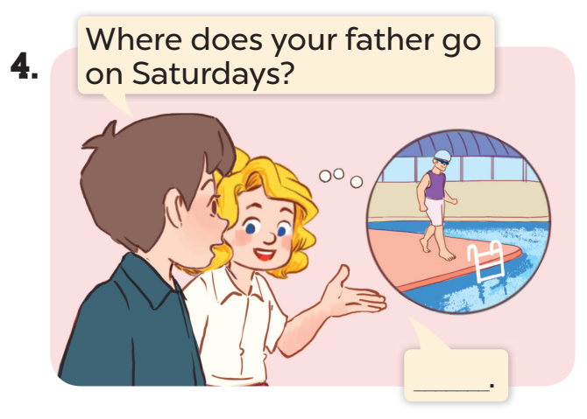
He goes to the swimming pool.

Slide 19
Practice 2’
She has long hair.
I watch TV in the evening.
She works at a factory.
He goes to
the swimming pool.

Slide 20


Fun time

Slide 21
1
When do you watch TV?
2
What do you do in the morning?
3
What does your mother do?
4
What does your father look like?
Where does your sister go on Sundays?
5

Slide 22
Fun corner
Review game
04

Slide 23



Slide 24



WHAT DOES HE DO?
He is .........
a farmer
an office worker
a policeman
A
B
C

Slide 25

WHERE DOES SHE WORK?
She works at a nursing home.

Slide 26


LOOK, CHOOSE THE BEST ANSWER
tall
short
big
A
B
C

Slide 27

WHAT DOES HE LOOK LIKE?
He ...... a round face.
A
is
B
has

Slide 28

WHAT DOES YOUR FATHER LOOK LIKE?
He is big.

Slide 29


CHOOSE THE BEST ANSWER
A
in the morning
B
in the afternoon
C
in the evening

Slide 30


WHEN DO YOU CLEAN THE FLOOR?
I clean the floor in the morning.

Slide 31
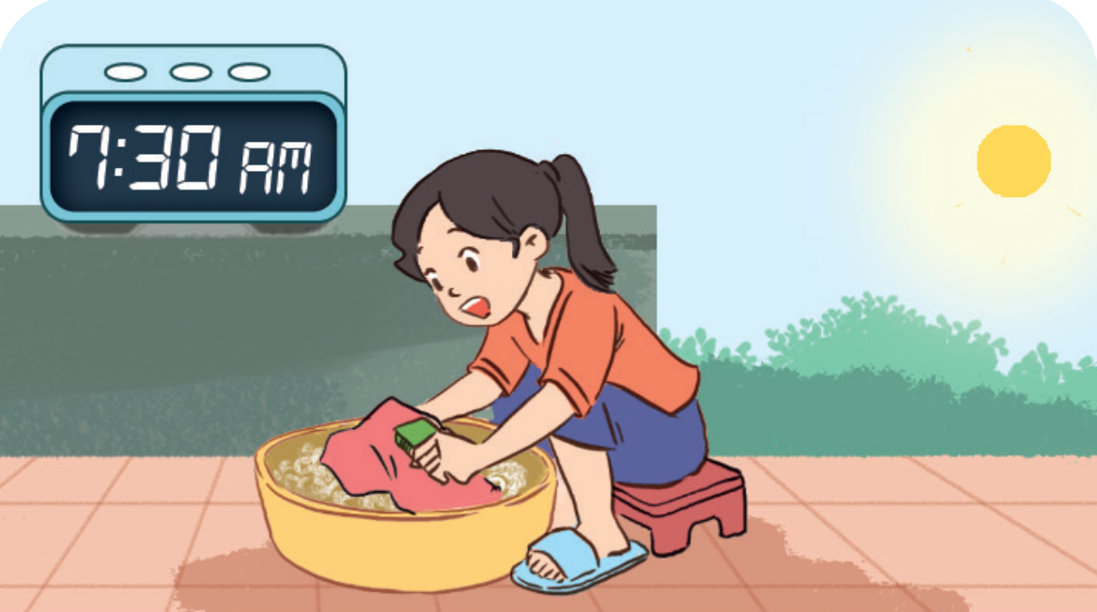
WHAT DO YOU DO IN THE MORNING?
I wash the clothes.

Slide 32


WHERE DOES SHE GO ON SUNDAYS?
She goes to the cinema on Sundays.

Slide 33

WHAT DOES SHE DO ON SATURDAYS?
She does yoga.

Slide 34








THANK YOU
Website: hoclieu.vn
Fanpage: facebook.com/www.tienganhglobalsuccess.vn

