Slide 1


Slide 2
REVIEW 3
Lesson 2

Slide 3
Warm-up
01
Let’s chant

Slide 4


Slide 5


Choose the best answer
live/ you/ Where/ do?
Where you do live?
Where do you live?

Slide 6
Choose the best answer
does/ your/ look like/ sister/ What?
What does your sister look like ?
What does your sister like look ?

Slide 7
Choose the best answer
do/ you/ do/ in the/ What/ morning?
What do you do in the morning ?
What do you in do the morning ?

Slide 8
Choose the best answer
works/ your/ father/ does/ Where?
Does where your father work ?
Where does your father work ?

Slide 9
Read and match.
02

Slide 10
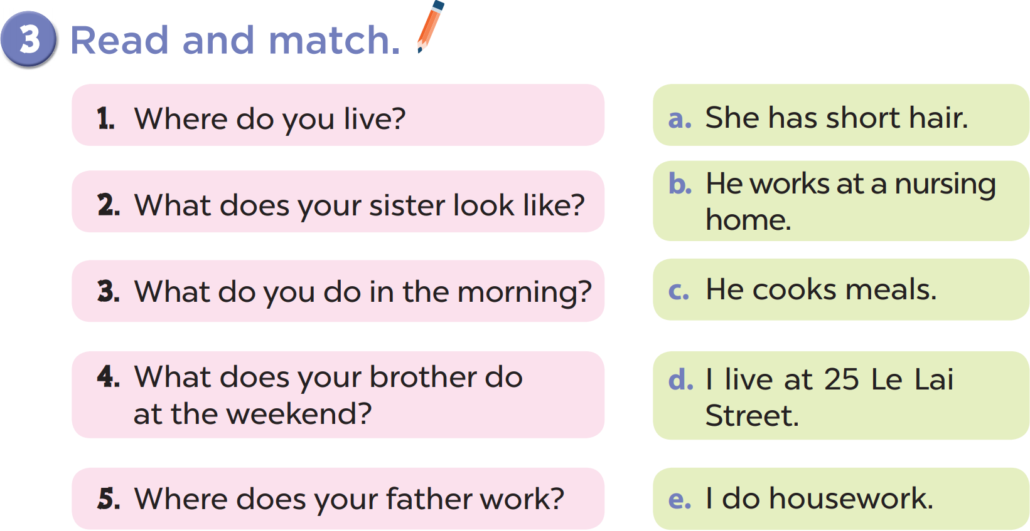

Slide 13
Read and complete.
03

Slide 14
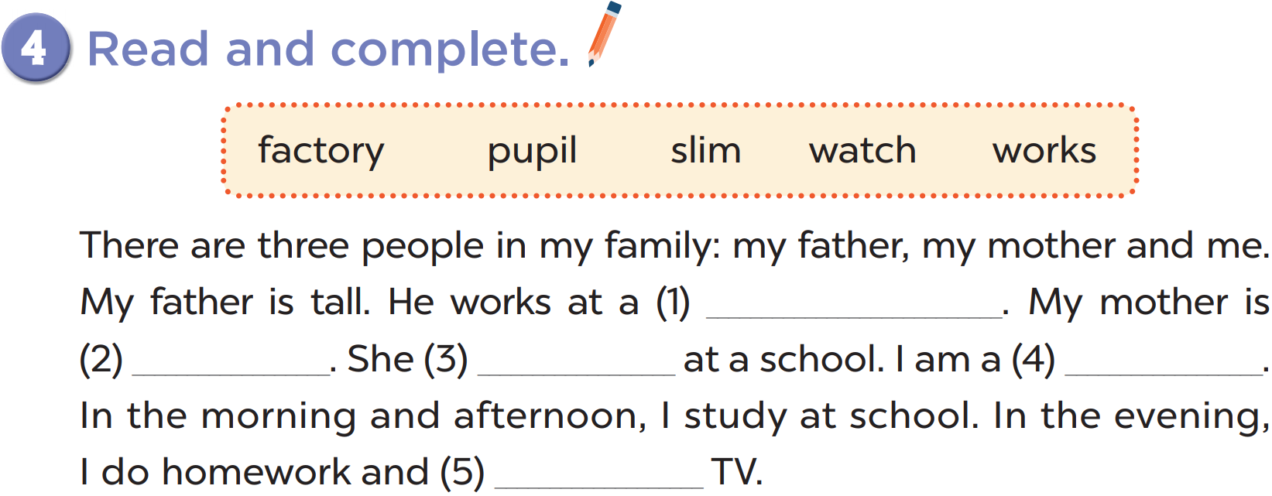

Slide 15
factory
slim
works
pupil
watch

Slide 16
Let’s write.
04

Slide 17
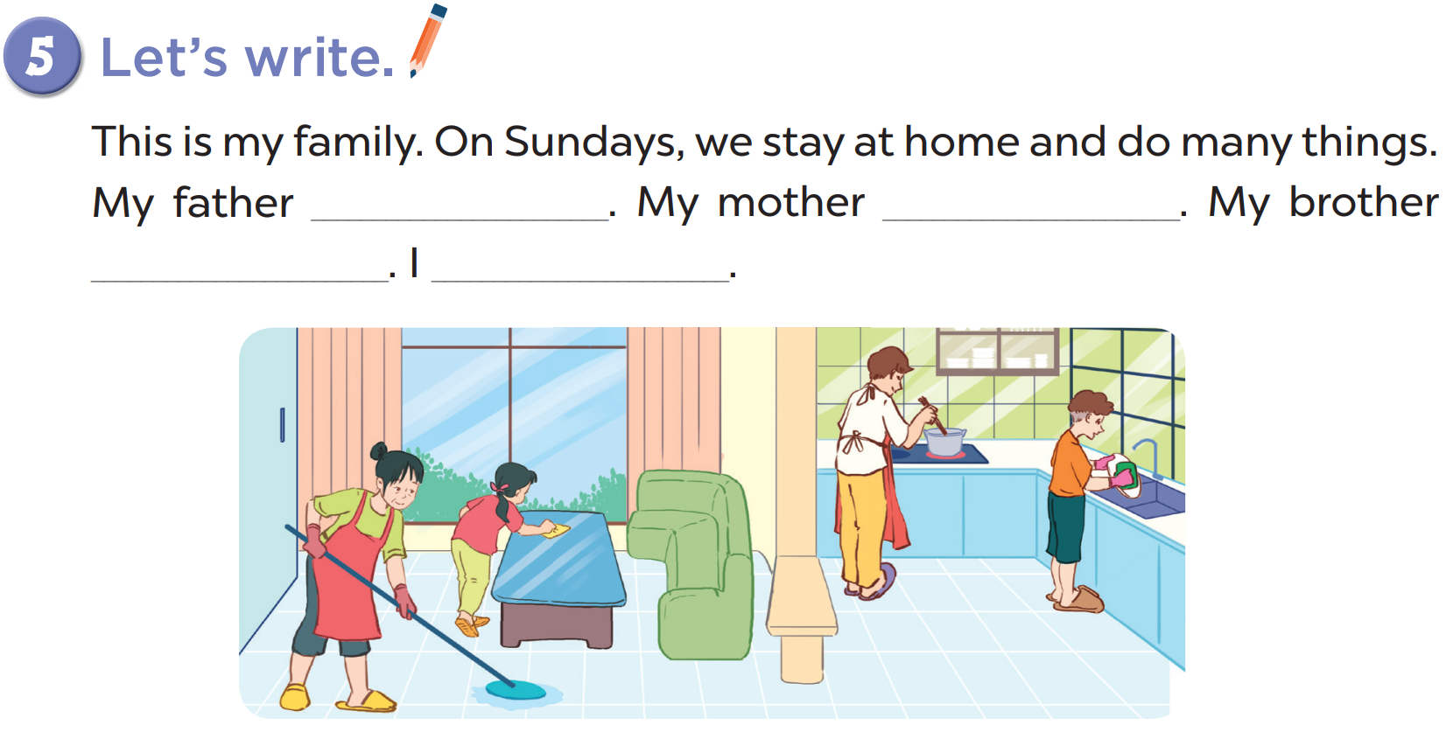

Slide 18
I
cook meals
play badminton
watch films
do yoga
clean the floor
wash the clothes
wash the dishes
my father
cooks meals
plays badminton
watches films
does yoga
cleans the floor
washes the clothes
washes the dishes

Slide 19
Wrap up
05
- Review vocabularies and structures from Unit 11 to 15.
- Prepare new lesson on page 38 and bring enough your books and notebooks.

Slide 20








THANK YOU
Website: hoclieu.vn
Fanpage: facebook.com/www.tienganhglobalsuccess.vn

