Slide 1





Slide 2
Unit 1
My friends
Lesson 1 - Period 1

Slide 3
Table of content
Warm-up
Activity 1
New words
Activity 2
Activity 3
Fun time
01
02
03
05
06
04

Slide 4
01
Warm-up

Slide 5

We live in many different countries in the world.

Slide 6

Can you name any country in the world?

Slide 7
02
Activity 1
Look, listen and repeat.

Slide 8
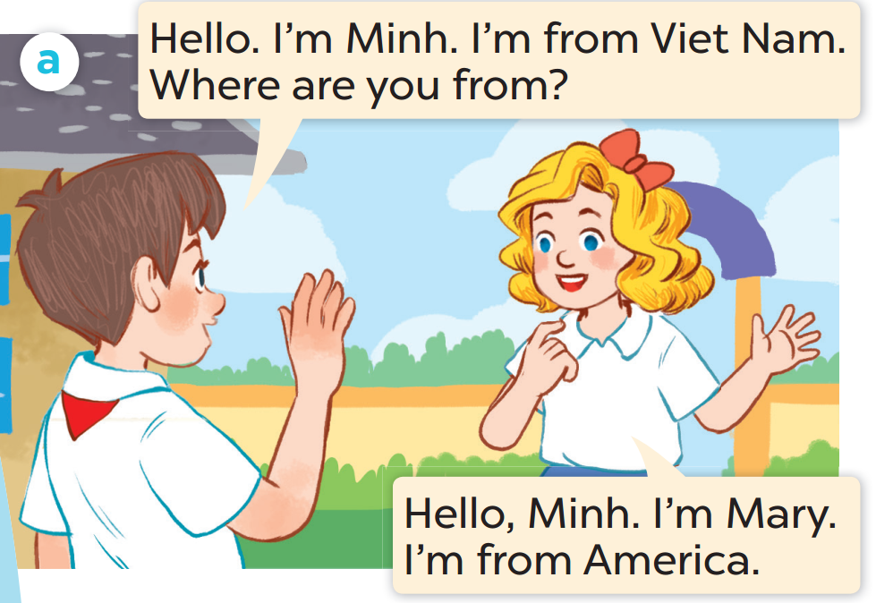
Who is the boy?
Who is the girl?

Slide 9
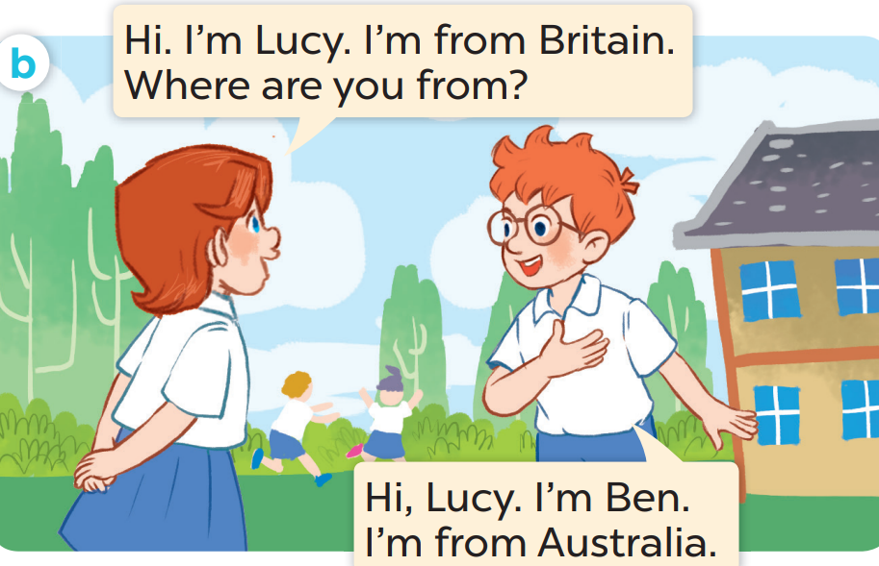
Who is the girl?
Who is the boy?

Slide 10

Listen and repeat.
Notes:
Click on the Speaker Icon to play the audio.

Slide 11
Listen and repeat.
Notes:
Click on the Speaker Icon to play the audio.

Slide 12
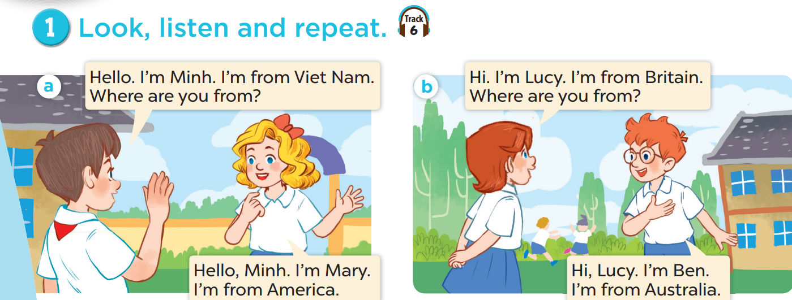
Work in pairs, practise.
Act it out.

Slide 13
03
New words

Slide 14
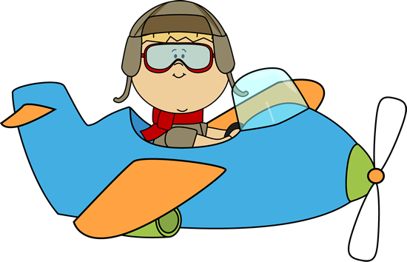
Look, guess, then learn.
Let's visit some countries with me.
Hello. I'm Ben.

Slide 15





Slide 16

Viet Nam

Slide 17









Slide 18

Britain

Slide 19





Slide 20

America

Slide 21

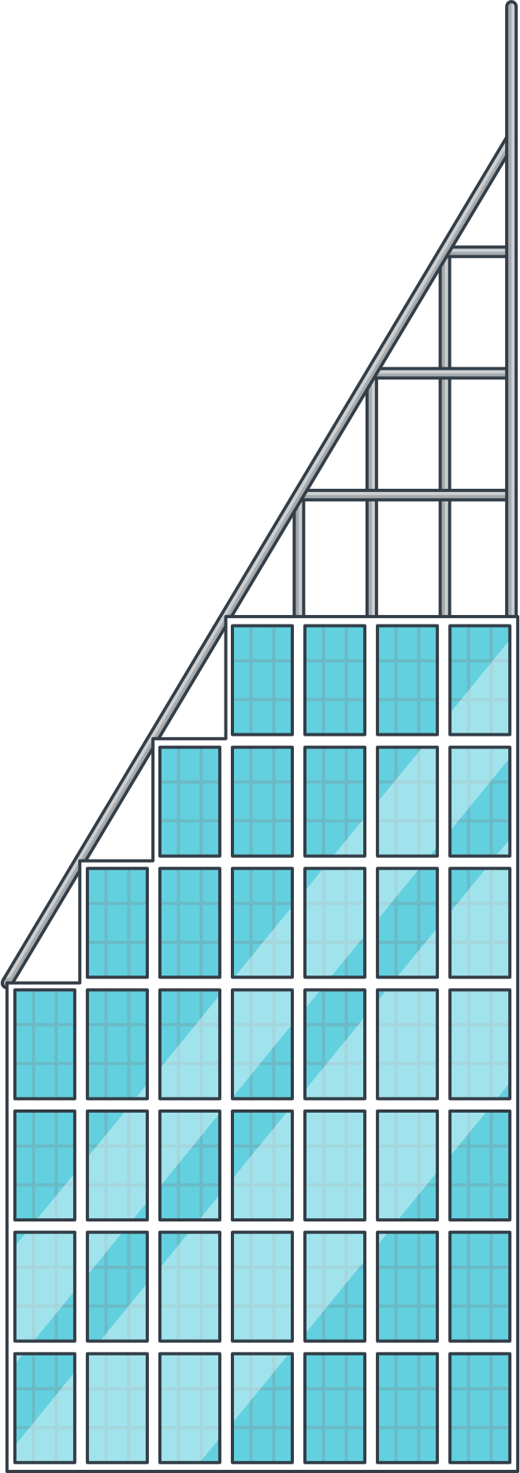







Slide 22

Australia

Slide 23

Review
Viet Nam
America
Britain
Australia

Slide 24
Look and say the name.

Slide 25
Viet Nam

Slide 26
America

Slide 27
Australia

Slide 28

Britain

Slide 29
04
Activity 2
Listen, point and say.

Slide 30
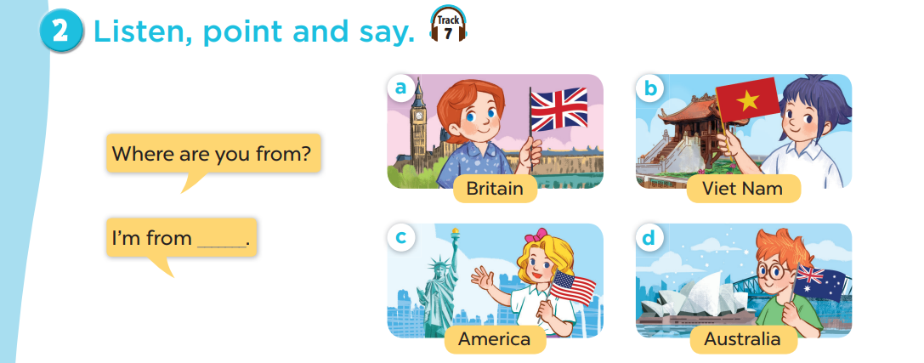
Notes:
Click on the Speaker Icon to play the audio.

Slide 31


Where are you from?
I'm from America.

Slide 32

Where are you from?
I'm from Australia.

Slide 33

Where are you from?
I'm from Viet Nam.

Slide 34
05
Activity 3
Let's talk.

Slide 35
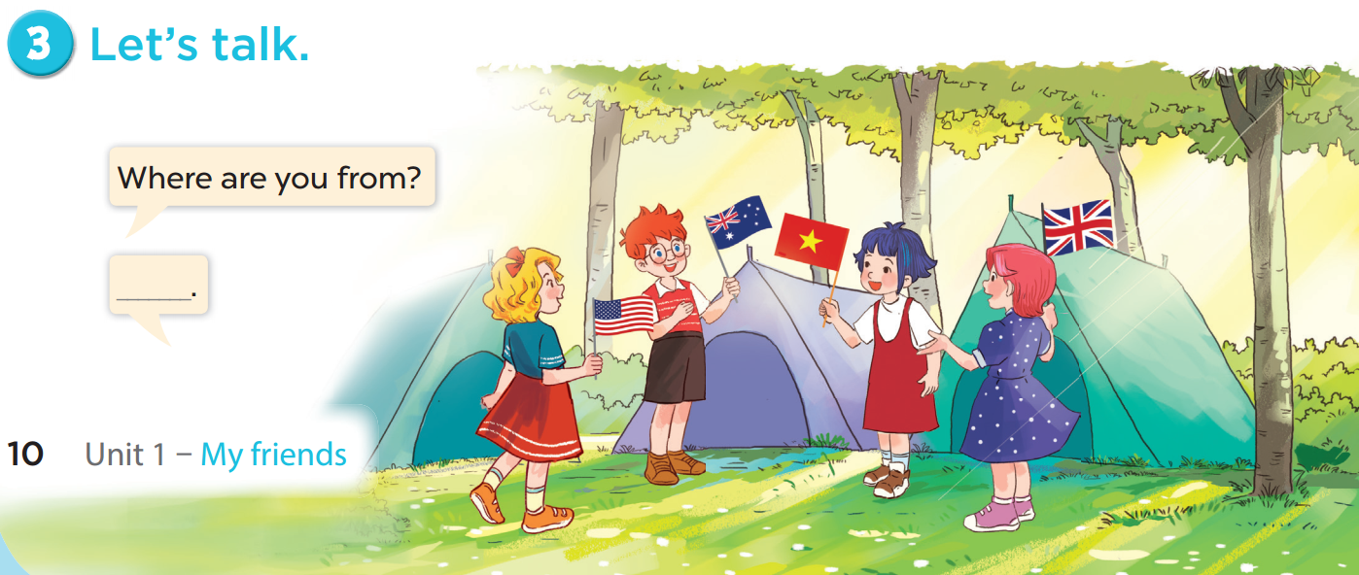

Slide 36
06
Fun time
Choose a number.
Ask, answer and have fun.

Slide 37




1
2
3
= +1 point
4
5
6
= lose 2 points
= rock, paper, scissors
(winner takes 2)
7
8
9

Slide 38








THANK YOU
Website: hoclieu.vn
Fanpage: facebook.com/www.tienganhglobalsuccess.vn
Website: sachmem.vn; hoclieu.vn
Fanpage: www.facebook.com/sachmem.vn

