Slide 1





Slide 2


Time and daily routines
2
Lesson 1 - Period 2

Slide 3
Table of contents
01
Warm-up and review
04
02
03
Let’s play.
05
Fun corner & wrap-up
Listen and tick.
Look, complete and read.

Slide 4
01
Warm-up & review

Slide 5
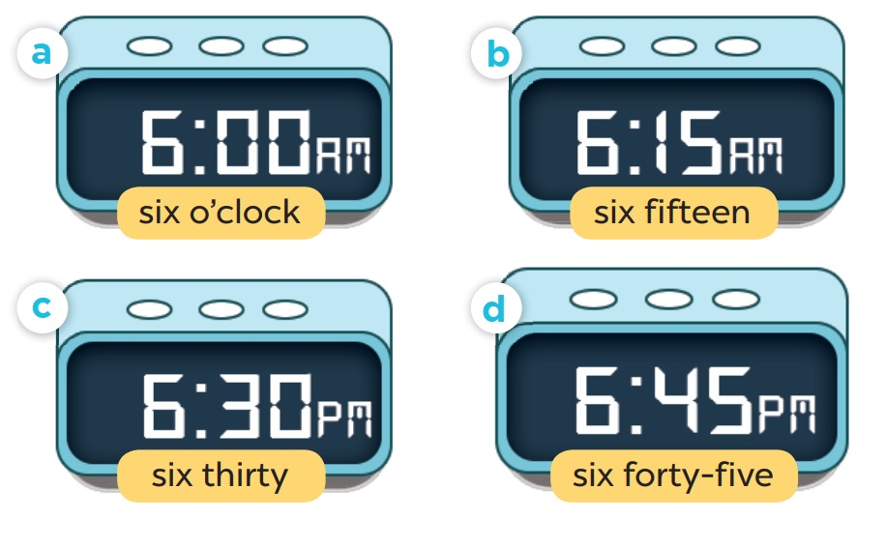
Slap the board

Slide 6
02
Listen and tick.

Slide 7
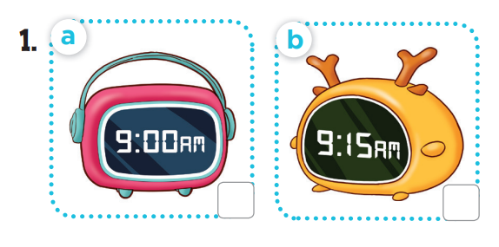
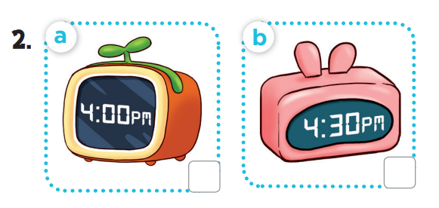

Slide 8
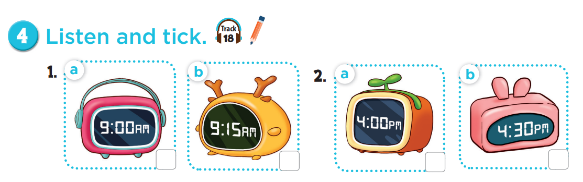



Slide 9
03
Look, complete and read.

Slide 10
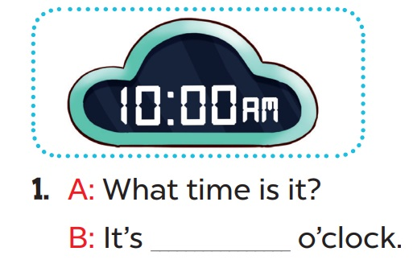
ten

Slide 11
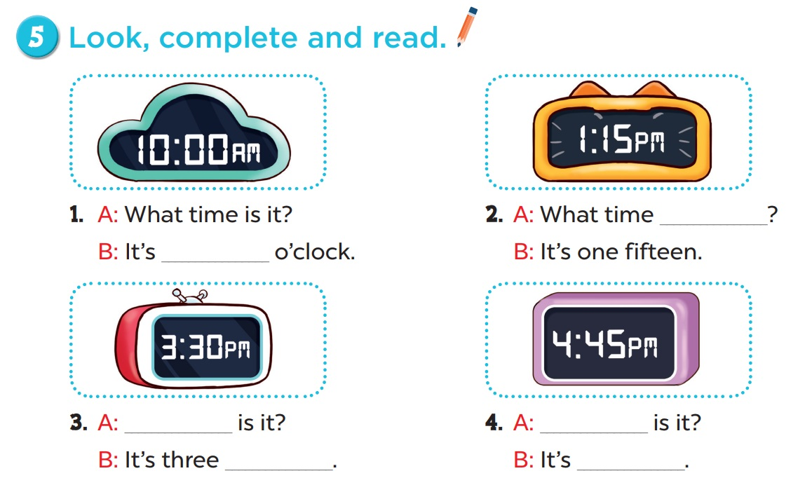
is it
ten
What time
What time
thirty
four forty-five

Slide 12
04
Let’s play.

Slide 13
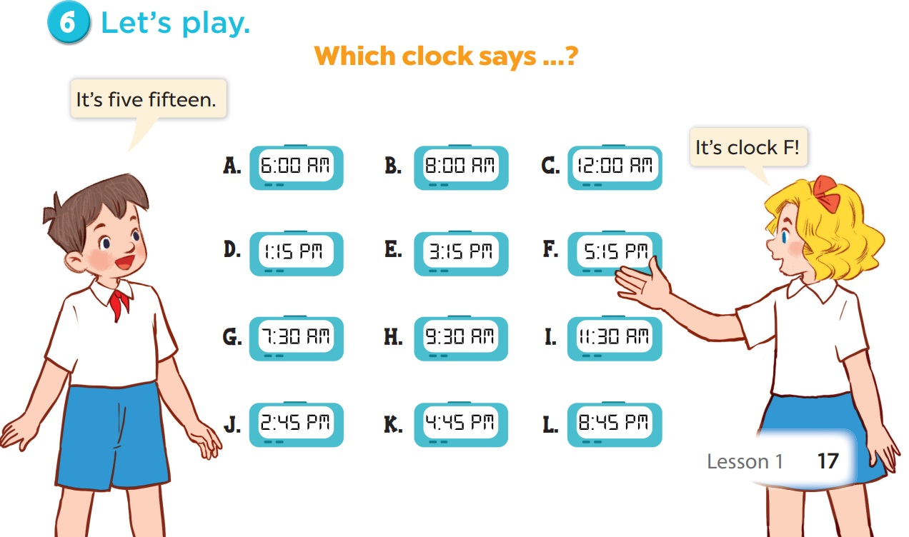

Slide 14
05
Fun corner & wrap-up

Slide 15


What/ is/ time it/ ?
Check
What time is it?

Slide 16
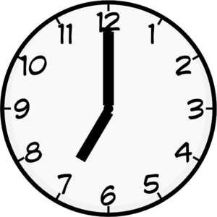
It/ seven/ is/
c’clock/.
Check
It is seven o’clock.

Slide 17

six/ It’s/ o’clock/.
Check
It’s six o’clock.

Slide 18
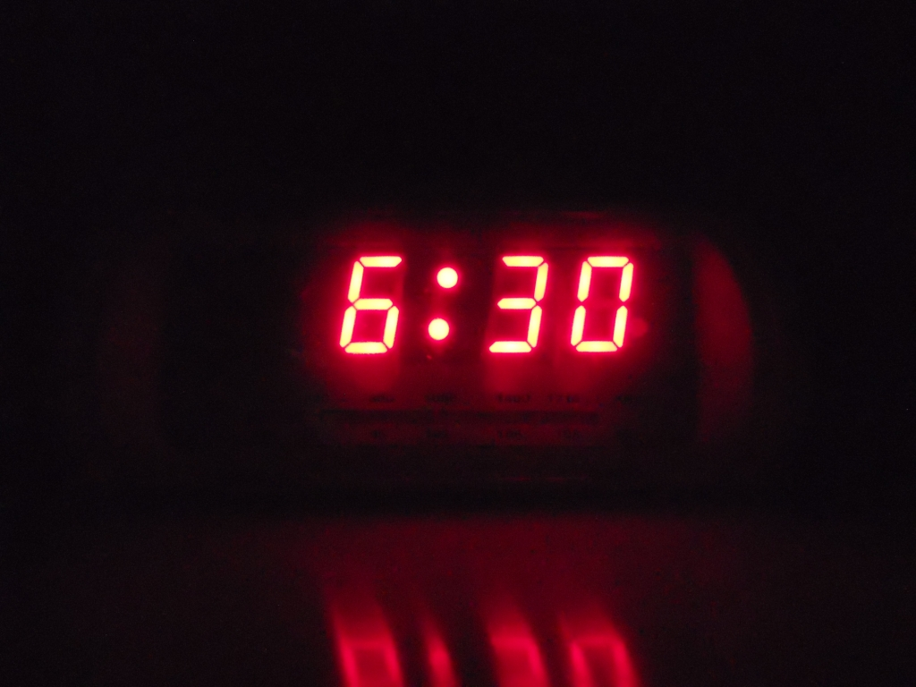
six/ thirty/ It’s/ .
Check
It’s six thirty.

Slide 19

End

Slide 20








THANK YOU
Website: hoclieu.vn
Fanpage: facebook.com/www.tienganhglobalsuccess.vn
Website: sachmem.vn; hoclieu.vn
Fanpage: www.facebook.com/sachmem.vn

