Slide 1


Slide 2

Warm up

Slide 3
Unit 11
What’s the matter with you?
Lesson 1

Slide 4
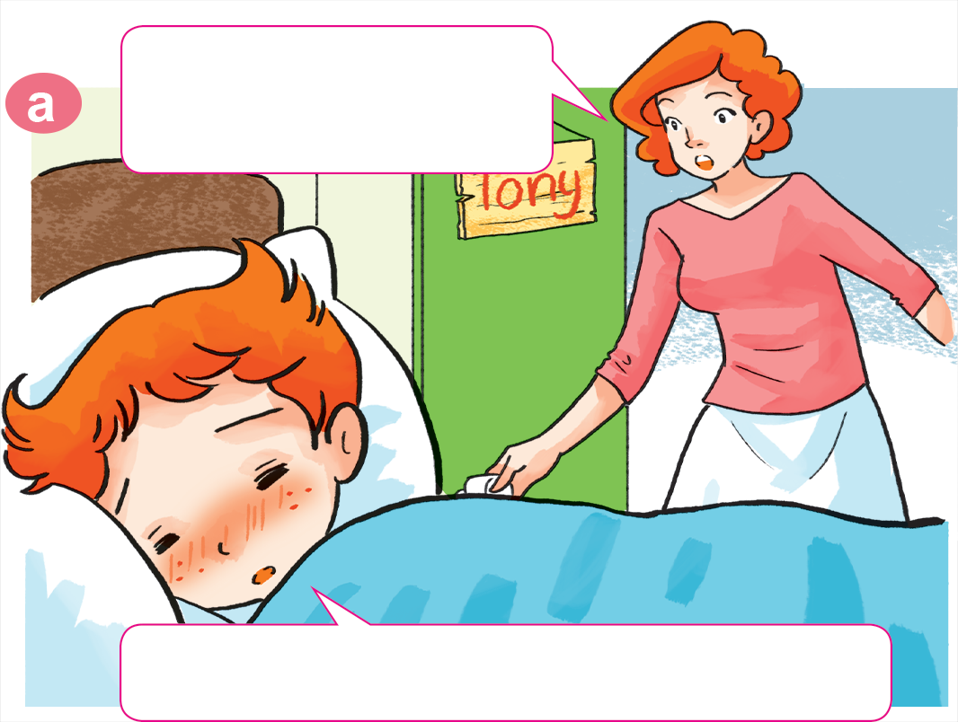

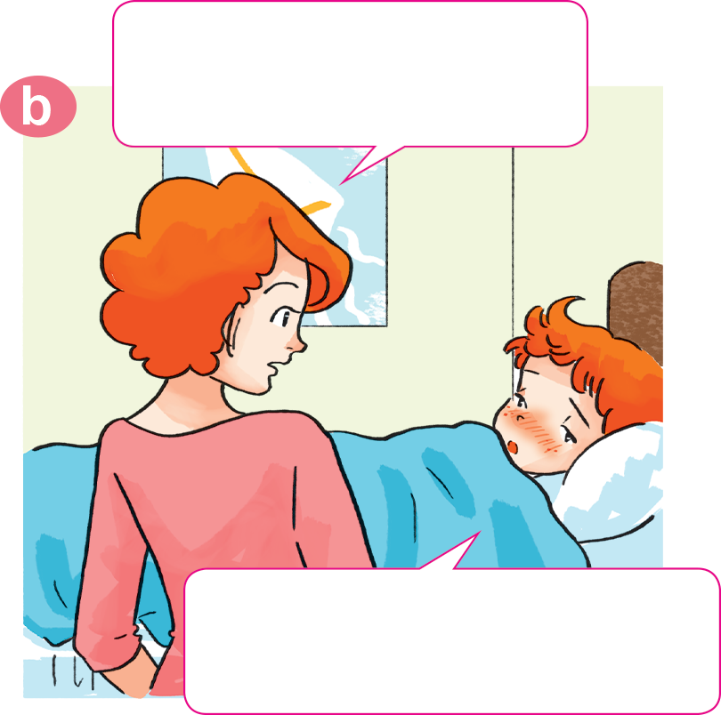
1. Look, listen and repeat.
click on the speaker to hear.
Why not? What's the
matter with you?
Tony, get up!
Breakfast's ready.
I don't feel well.
I have a headache.
Sorry, I can't have breakfast, Mum.

Slide 5
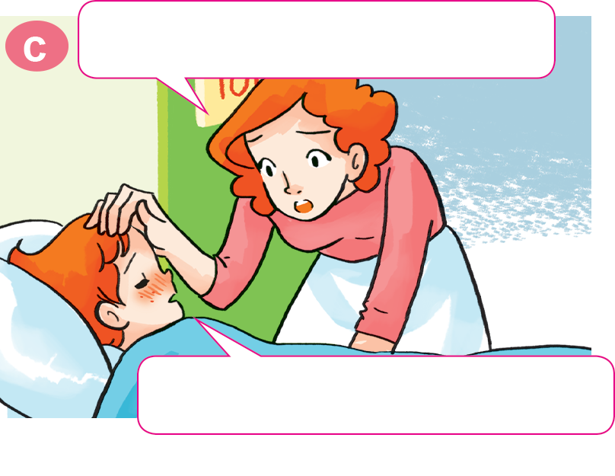
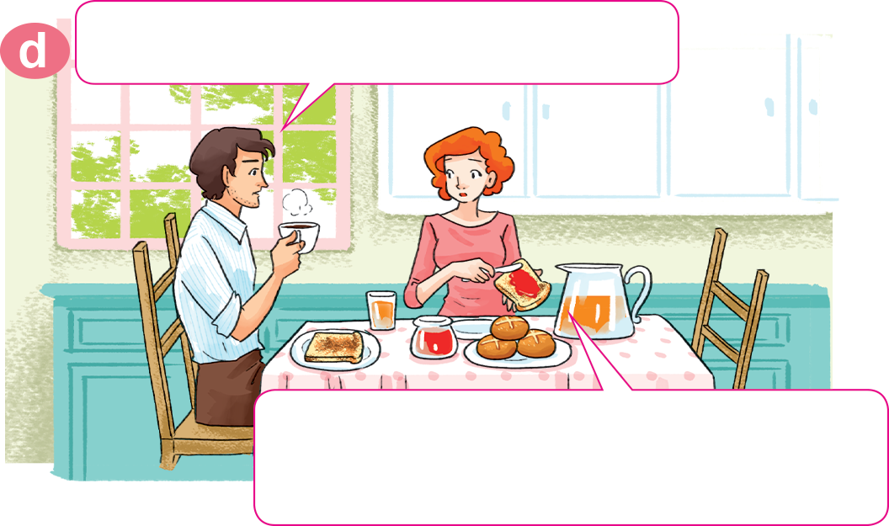
1. Look, listen and repeat.
Oh, you have a fever, too.
What's the matter with Tony?
He has a fever. I'll take him
to the doctor after breakfast.
Yes, Mum. I feel very hot.

Slide 6
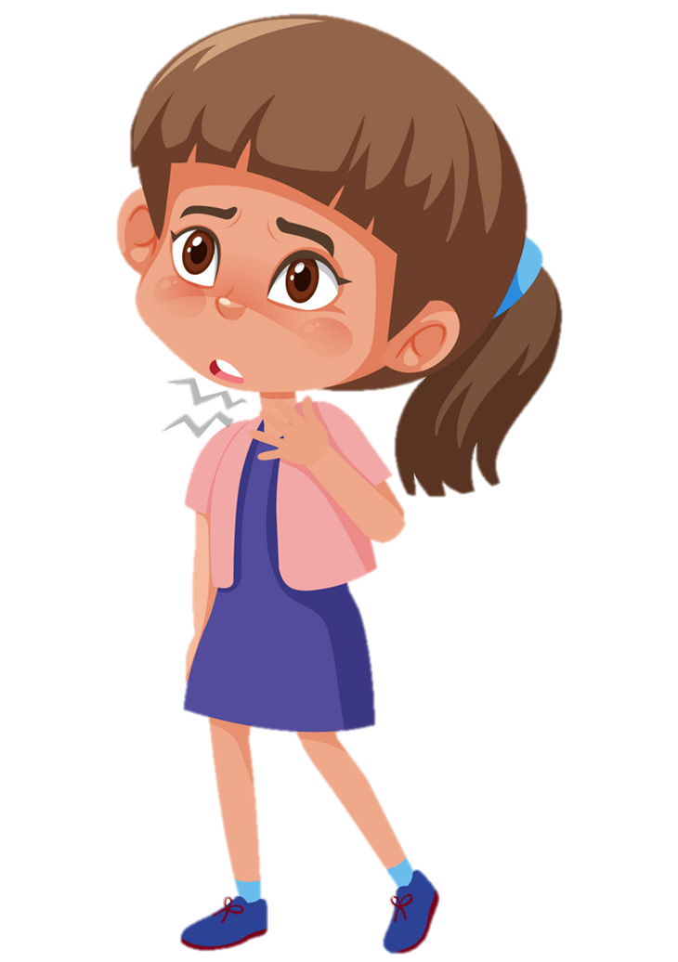
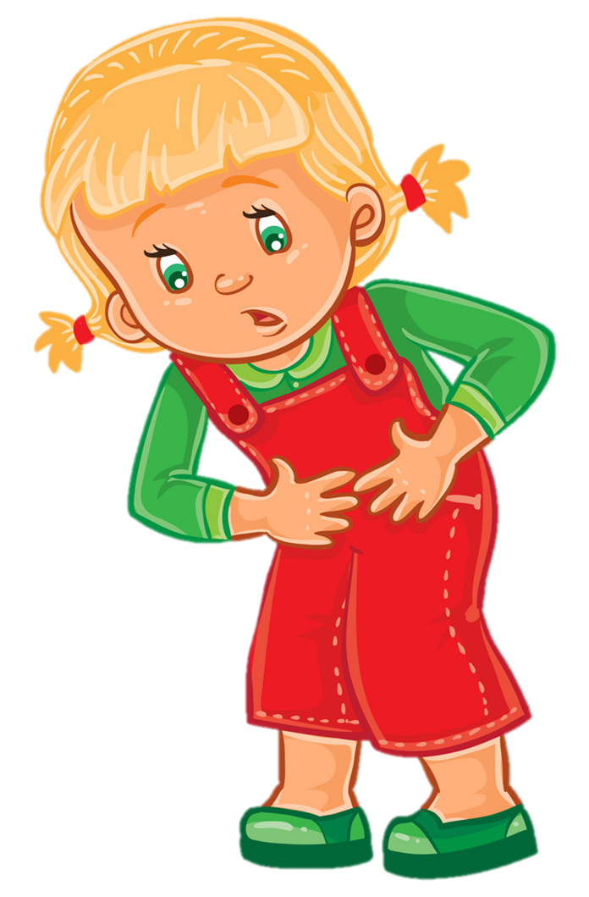
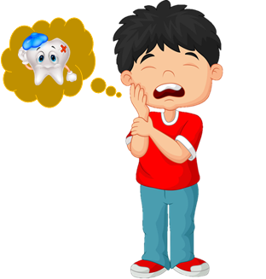
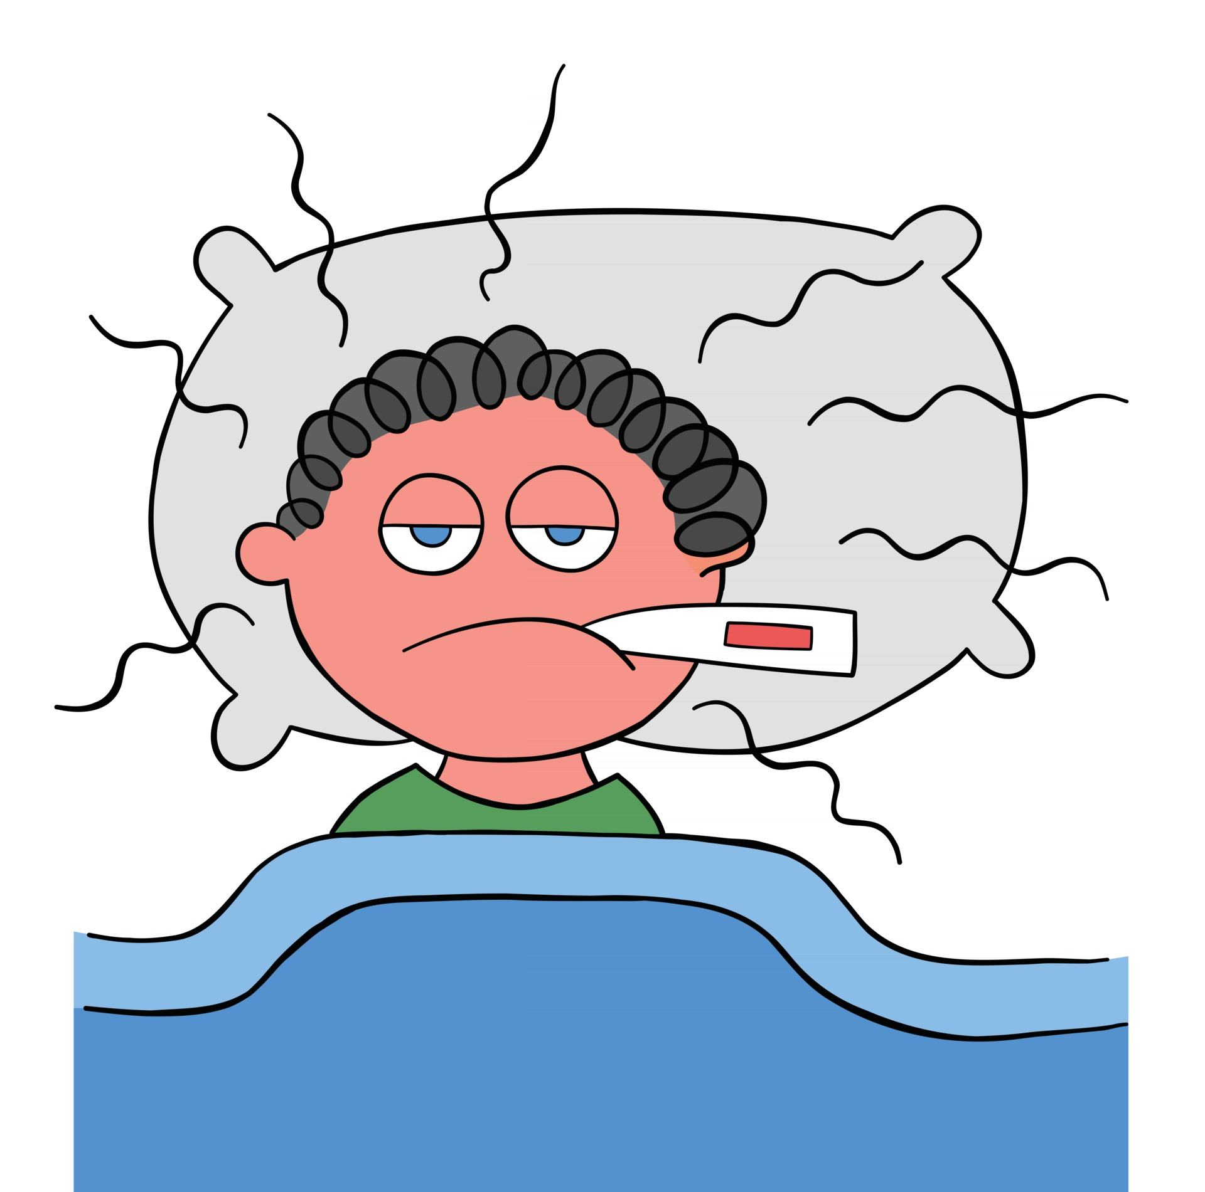
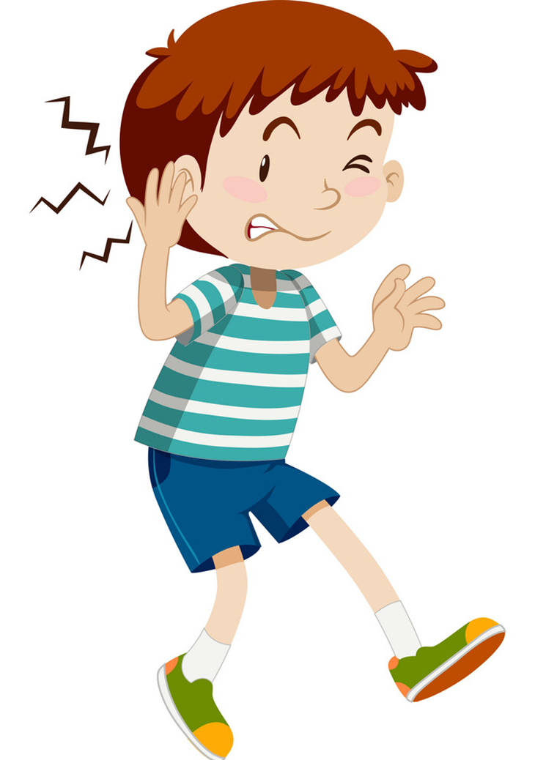
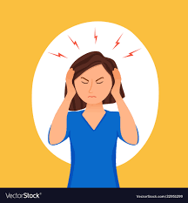
2. Point and say.
a sore throat
a stomach ache
a toothache
a fever
an earache
a headache

Slide 7
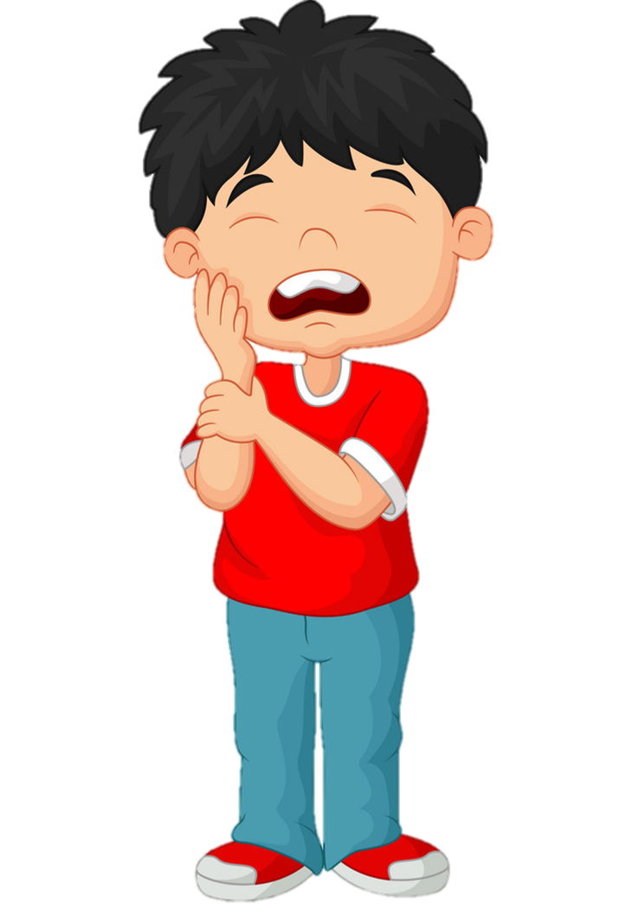
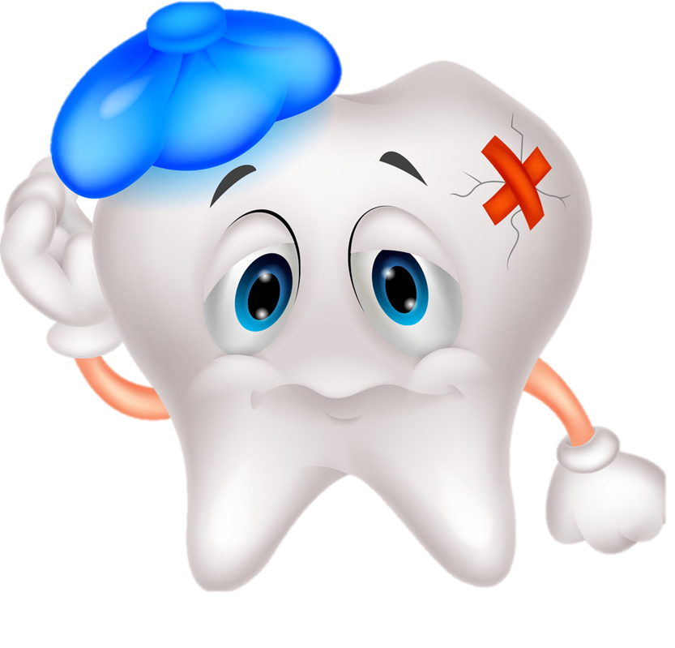

toothache
/ˈtuːθeɪk/
đau răng

Slide 8
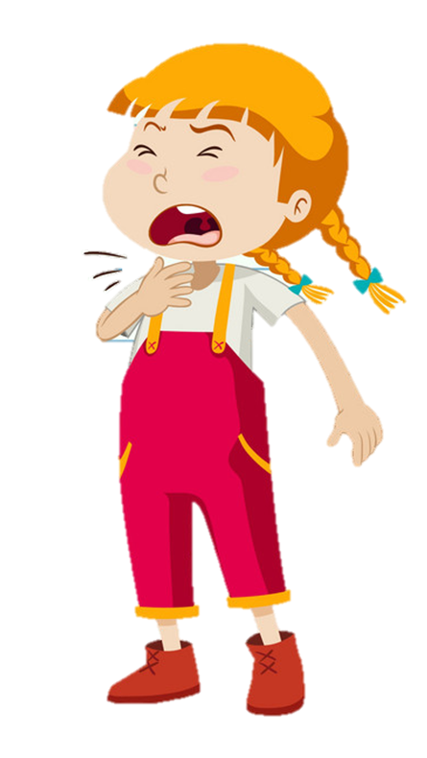
sore throat
/sɔː θrəʊt/
đau họng

Slide 9
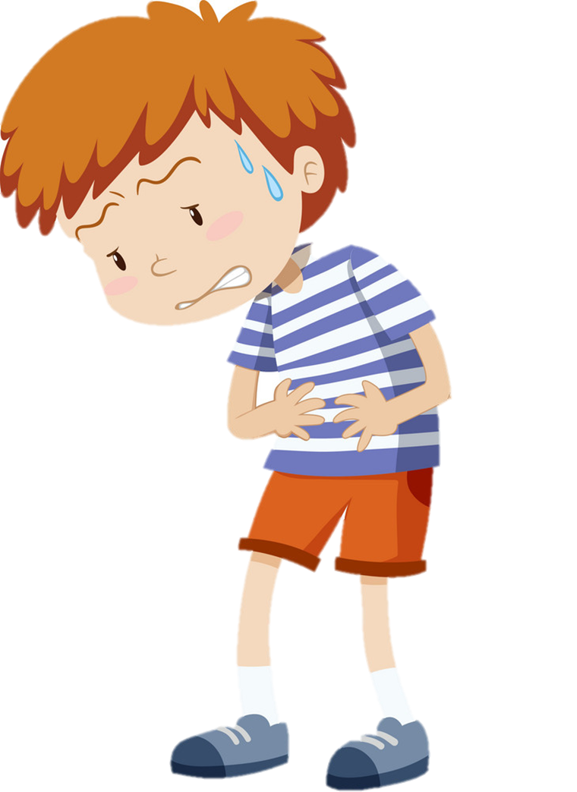
stomach ache
/ˈstʌmək eɪk/
đau bụng

Slide 10
earache
/ˈɪəreɪk/
đau tai

Slide 11
headache
/ˈhedeɪk/
đau đầu

Slide 12
fever
/ˈfiːvər/
sốt

Slide 13
Check Vocabulary
Wordwall.net

Slide 14
Model sentence
What's the matter with you?
toothache
I have a _______________.

Slide 15
Temperature
/ˈtemprətʃər/
Model sentence
sore throat
toothache
What's the matter with you?
I have a/an ______________.
headache
earache
fever
stomach ache
Earache
/ˈɪəreɪk/

Slide 16
2. Point and say.
What's the matter with you?
I have a toothache.
___________________

Slide 17
2. Point and say.
What's the matter with you?
I have an earache.
___________________.

Slide 18
2. Point and say.
What's the matter with you?
I have a sore throat.
___________________.

Slide 19
2. Point and say.
What's the matter with you?
I have a stomach ache.
___________________.

Slide 20
2. Point and say.
What's the matter with you?
I have a headache.
___________________.

Slide 21
2. Point and say.
What's the matter with you?
I have a fever.
___________________.

Slide 22
3. Let’s talk.
Ask and answer questions about health problems.
1. What’s the matter with you?
2. What’s the matter with her?
3. What’s the matter with him?
4. What’s the matter with them?
I have a/an ..................
She has a/an ..................
He has a/an ..................
They have a/an ..................

Slide 23
Extra sentence
What's the matter with her?
What's the matter with him?
She has
a sore throat.
He has
an earache.

Slide 24
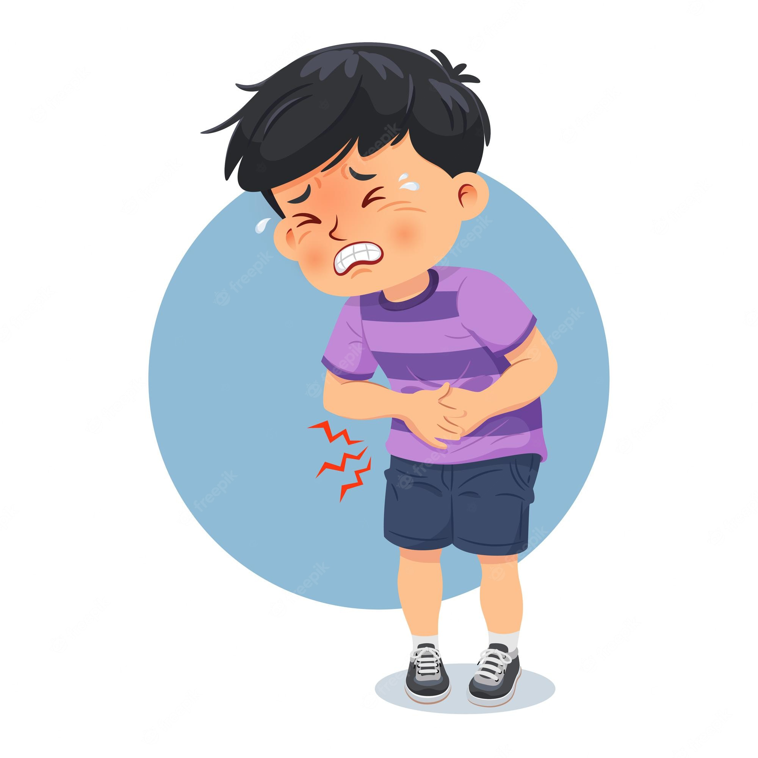
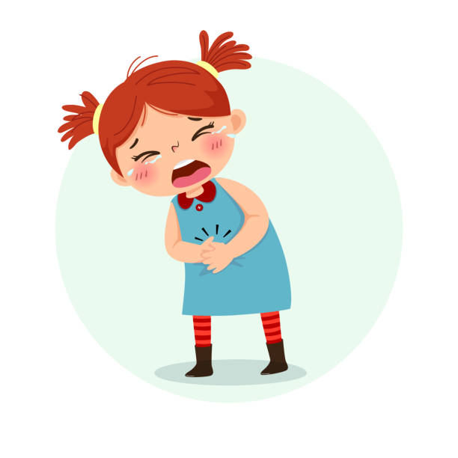
Extra sentence
What's the matter with them?
They have
a stomach ache.

Slide 25


Slide 26
Temperature
/ˈtemprətʃər/
Model sentence
sore throat
toothache
What's the matter with you?
I have a/an ______________.
headache
earache
fever
stomach ache
Earache
/ˈɪəreɪk/

Slide 27


