Slide 1



Unit 1
What’s your address?
Lesson 1

Slide 2
Vocabulary

Slide 3

Vocabulary
address
/əˈdres/
(n) địa chỉ

Slide 4


Vocabulary
lane
/leɪn/
(n) ngõ

Slide 5

Vocabulary
road
/rəʊd/
(n) đường

Slide 6

Vocabulary
street
/striːt/
(n) đường (phố)

Slide 7



Vocabulary
1
tower
2
/ˈtaʊər/
(n) Tòa nhà, tòa tháp
3

Slide 8

Vocabulary
11
10
9
8
floor
7
6
/flɔːr/
5
4
(n) tầng
3
2
1

Slide 9
Vocabulary
flat
/flæt/
(n) Căn hộ

Slide 10

Vocabulary
town
/taʊn/
(n) thị trấn

Slide 11

Vocabulary
village
/ˈvɪlɪdʒ/
(n) làng

Slide 12

Vocabulary
live
/lɪv/
(v) sống/sinh sống

Slide 13



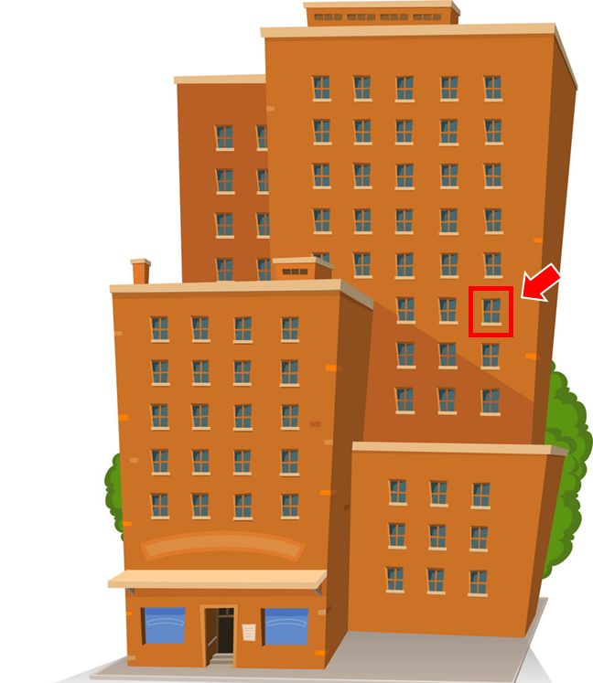
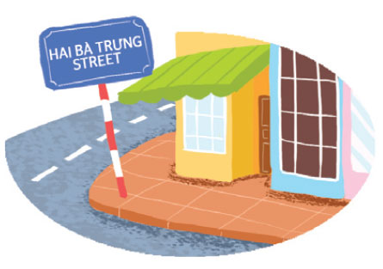

Vocabulary
1
2
3
4
5
village
town
tower
floor
flat
làng
thị trấn
tháp
tầng
Căn hộ
6
7
8
9
10
lane
address
street
road
live
ngõ
địa chỉ
Đường (phố)
Con đường
Sống/sinh sống

Slide 14


START

Slide 15




Look!
Tower
Check
Next

Slide 16

Look!
Address
Check
Next

Slide 17
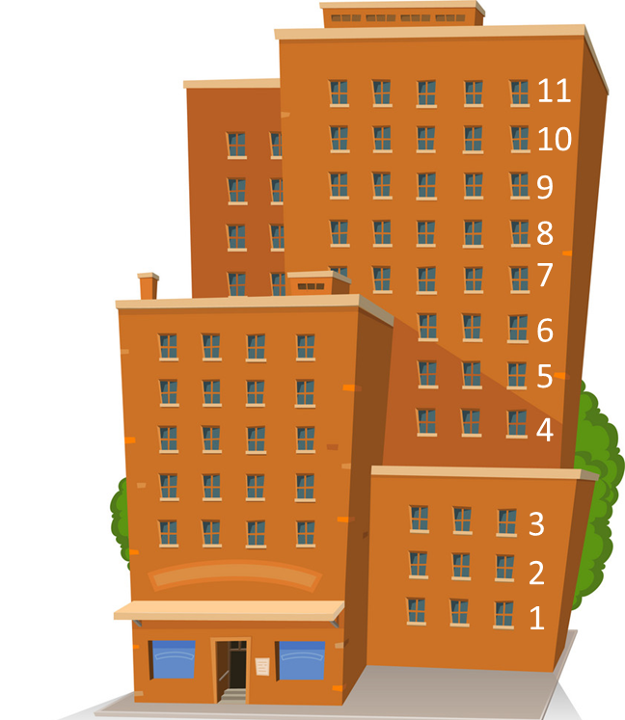
Look!
Floor
Check
Next

Slide 18
Look!
Lane
Check
Next

Slide 19
MsPham
Look!
Road
Check
Next

Slide 20
MsPham
Look!
Street
Check
Next

Slide 21
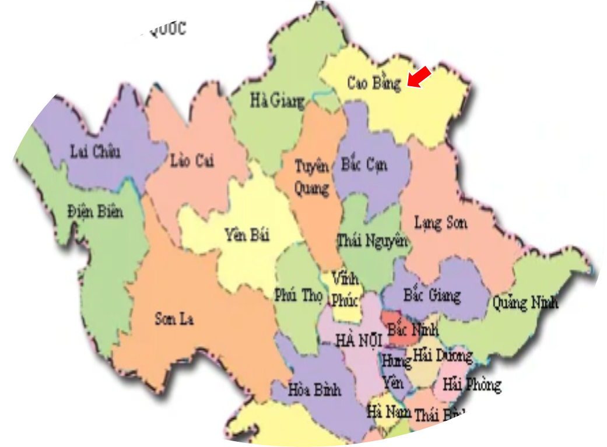
Look!
Province
Check
Next

Slide 22
MsPham
Look!
Village
Check
Next

Slide 23
MsPham
Look!
Flat
Check
Next

Slide 24
MsPham
Look!
Town
Check
Next

Slide 25
Good job!
End

Slide 26
grammar

Slide 27
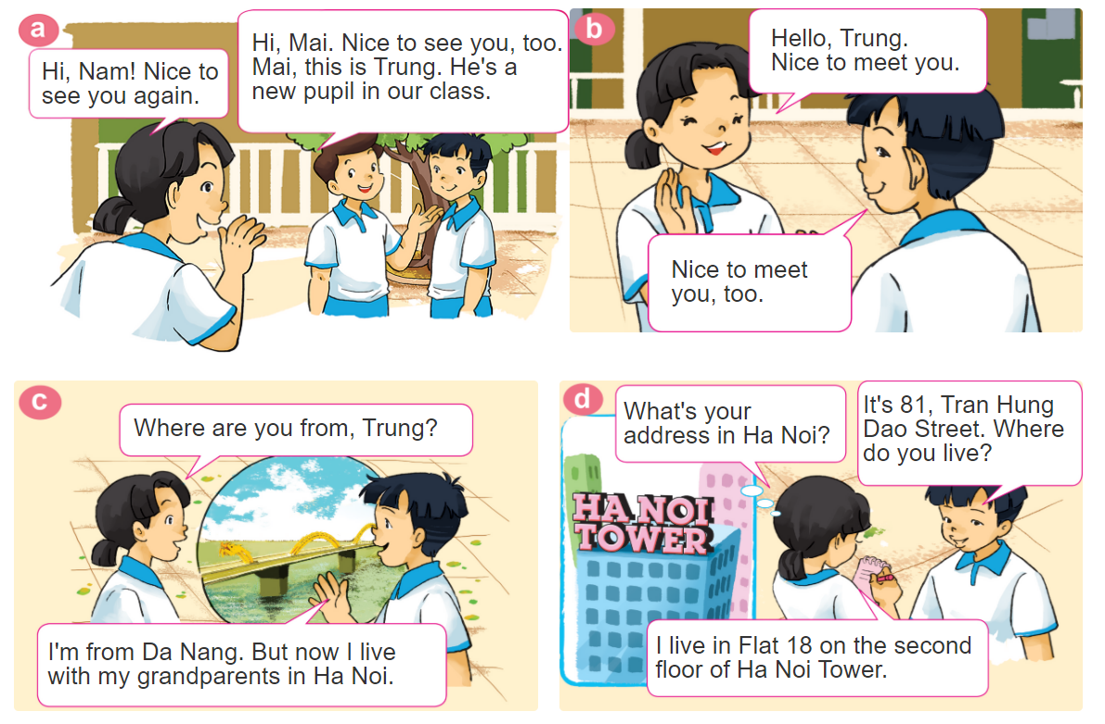

1. Look, listen and repeat.

Slide 28

GRAMMAR
Hỏi - đáp ai đó sống ở đâu:
Where do you live?
(Bạn sống ở đâu?)
I live in/on/at _____________.
+ address
(Tớ sống ở_________)
I live in + (flat/ village/ town / city).
(Mình sống ở + (căn hộ/ làng/ thị xã/ thành phố).
I live on + (road/ street/ the 1st/ 2nd floor).
(Mình sống ở + (tên đường/ phố/ số tầng của chung cư)).
I live at + (number) + (street/ road/ lane).
(Mình sống ở + (số nhà) + (tên phố/ tên đường/ tên ngõ))

Slide 29
GRAMMAR
Hỏi - đáp ai đó sống ở đâu:
Where do you live?
(Bạn sống ở đâu?)
I live in/on/at _____________.
+ address
(Tớ sống ở_________)
Where do you live?
Where do you live?
I live in Quoc Oai Town.
I live at 25 Green Lane.
I live in flat 10.
Where do you live?
I live at 45 Nguyen Trai Road.
I live on Hai Ba Trung Street.
I live on the first floor.

Slide 30
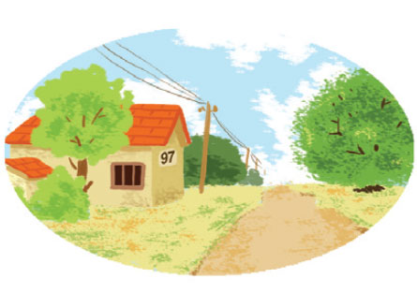

2. Point and say
97, Village Road
It's __________________.
What's your address?
97, Village Road

Slide 31

2. Point and say
75, Hai Ba Trung Street
It's __________________.
What's your address?
75, Hai Ba Trung Street

Slide 32

2. Point and say
flat 8, second floor, City Tower
It's ______________
_____________.
What's your address?
flat 8, second floor,
City Tower

Slide 33
3. Let’s talk
Where are you from?
I’m from _______.
What’s your address?
It’s _______.
Where do you live?
I live in/at/on _______.

Slide 34




Slide 35











It’s flat 8, second floor,
City Tower
Where are you from?
What’s your address?

Slide 36
I’m from Hai Phong.
Where are you from?
What’s your address?

Slide 37
It’s 97, Village Road
What’s your address?
Where do you live?

Slide 38
Where do you live?
I live in Hai Phong.
I’m from Hai Phong.

Slide 39
I live in Flat 18 on the second floor of HaNoi Tower.
Where are you from?
Where do you live?

Slide 40
What’s your address?
It’s 75, Hai Ba Trung Street.
I live at 75, Hai Ba Trung Street.

Slide 41
Where are you from?
It’s in DaNang.
I’m from DaNang.

Slide 42
What’s your address?
____ 105, Hoa Binh Lane.
I live at
It’s

Slide 43
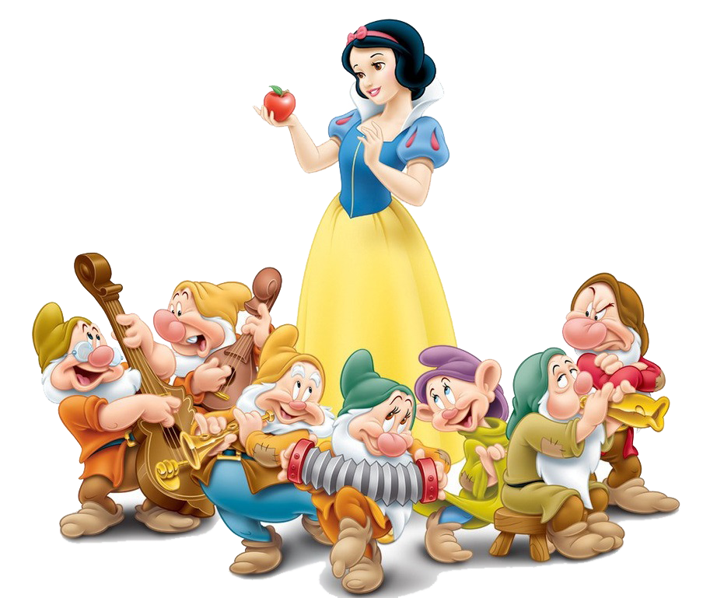
Good job!

Slide 44

https://media3.giphy.com/media/osjgQPWRx3cac/giphy.gif?cid=6c09b9527y6is5tllihm1nhi45jkf8jesdys9p5v2u0745ik&ep=v1_gifs_search&rid=giphy.gif&ct=g

