Slide 1
Unit 11
What’s the matter with you?
Lesson 1

Slide 2
Vocabulary

Slide 3
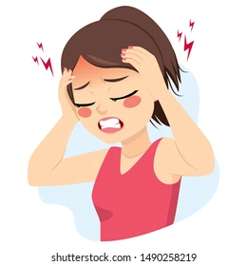
Headache
/ˈhedeɪk/

Slide 4
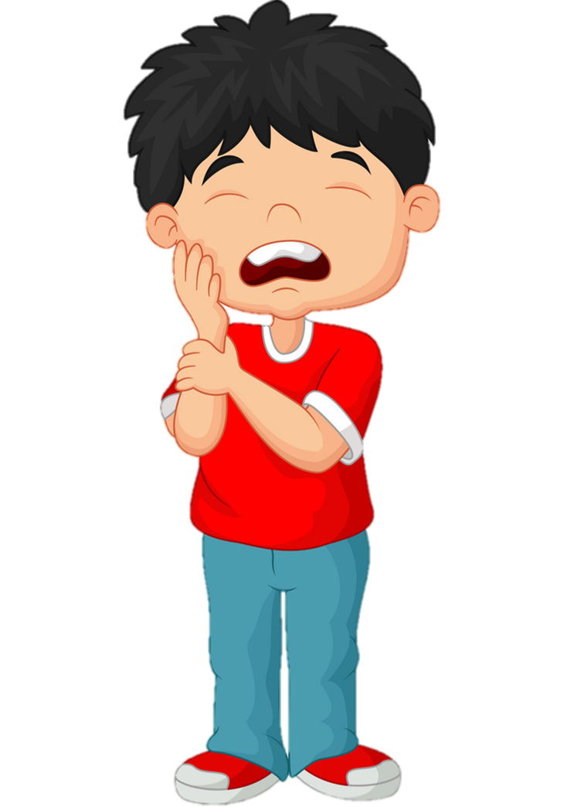

toothache
/ˈtuːθeɪk/

Slide 5

earache
/ˈɪəreɪk/

Slide 6
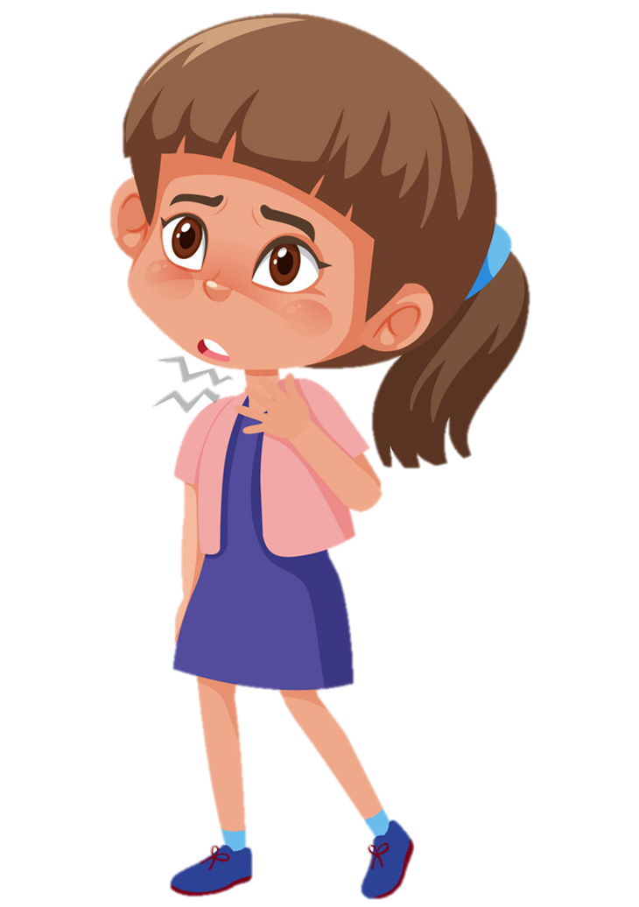
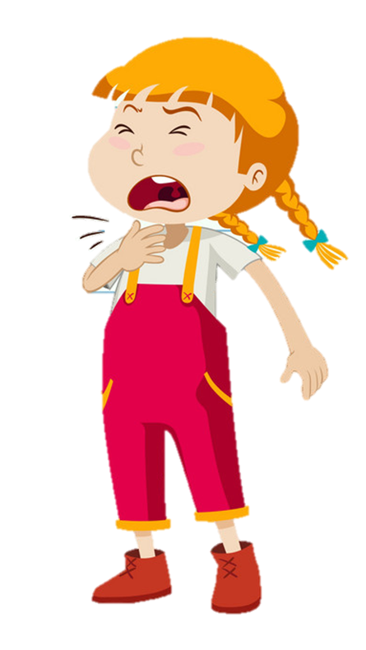
Sore throat
/sɔː θrəʊt/

Slide 7
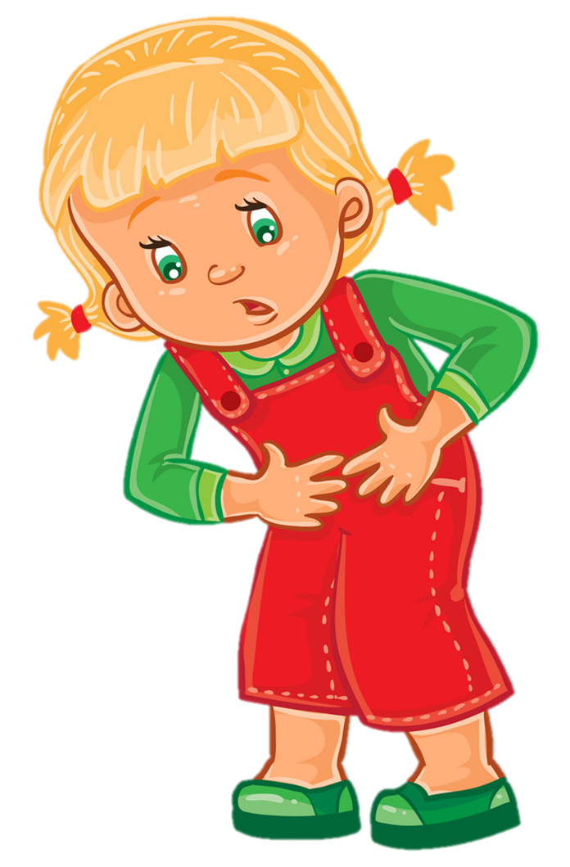
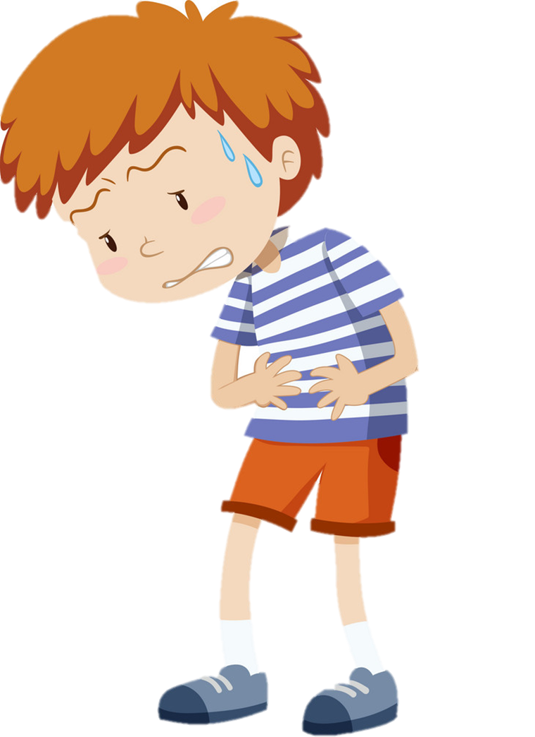
Stomach ache
/ˈstʌmək eɪk/

Slide 8
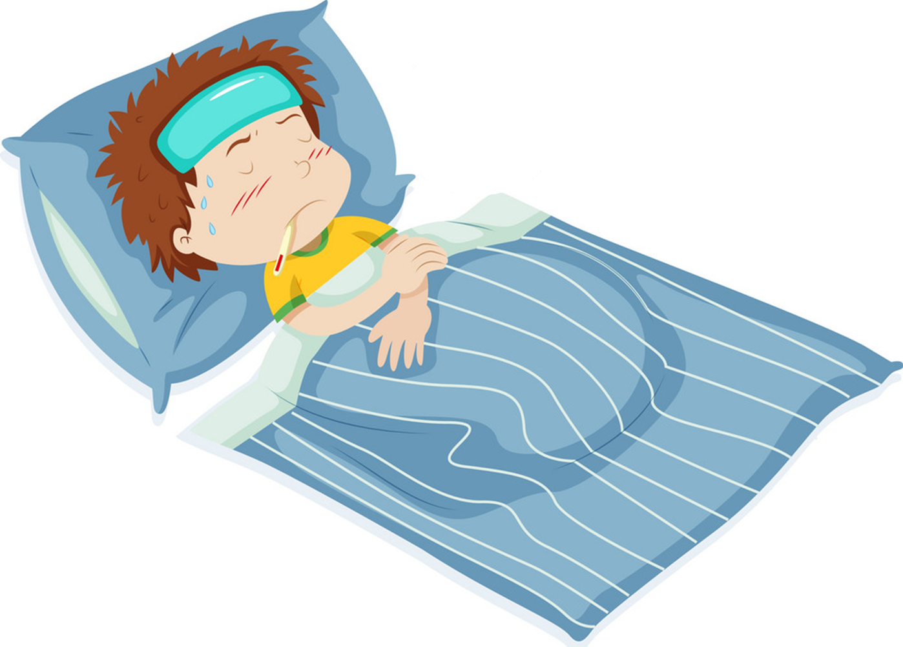
fever
/ˈfiːvər/

Slide 9
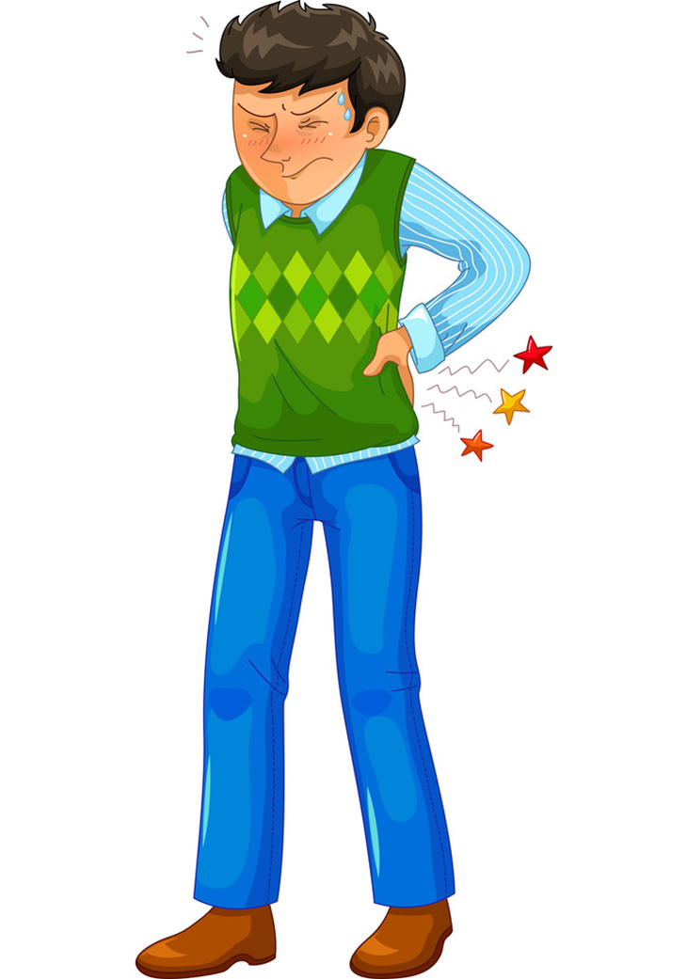
backache
/ˈbækeɪk/

Slide 10
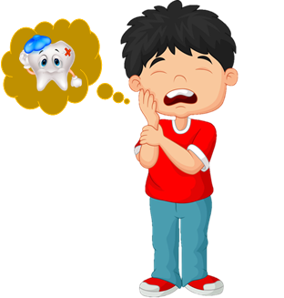
Review
1
2
3
4
headache
Đau đầu
Sore throat
Đau họng
Stomach ache
Đau bụng
Toothache
Đau răng
5
6
7
Earache
Đau tai
Backache
Đau lưng
Fever
sốt

Slide 11


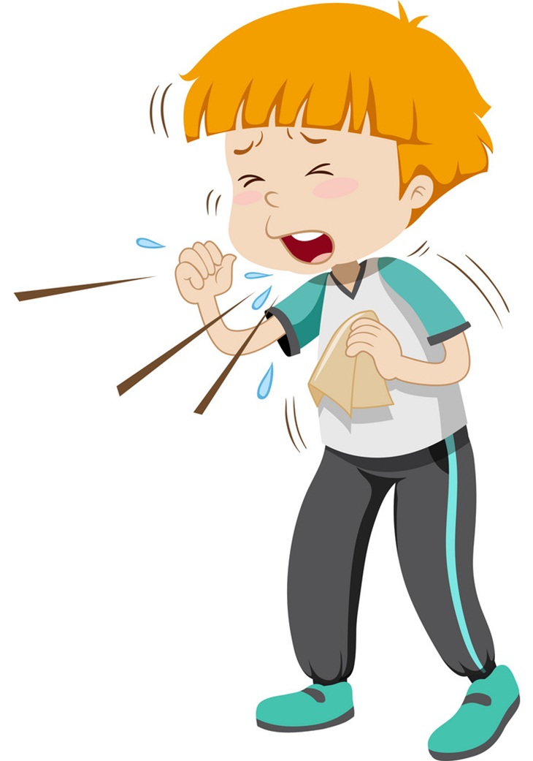
Cough
/kɒf/
Backache
/ˈbækeɪk/
Stomach ache
/ˈstʌmək eɪk/

Slide 12
Earache
/ˈɪəreɪk/
Backache
/ˈbækeɪk/
Stomach ache
/ˈstʌmək eɪk/

Slide 13
fever
/ˈfiːvər/
Sore throat
/sɔː θrəʊt/
Cough
/kɒf/

Slide 14
Toothache
/ˈtuːθeɪk/
headache
/ˈhedeɪk/
Earache
/ˈɪəreɪk/

Slide 15
Sore throat
/sɔː θrəʊt/
Toothache
/ˈtuːθeɪk/
Stomach ache
/ˈstʌmək eɪk/

Slide 16
Toothache
/ˈtuːθeɪk/
Earache
/ˈɪəreɪk/
Sore throat
/sɔː θrəʊt/

Slide 17
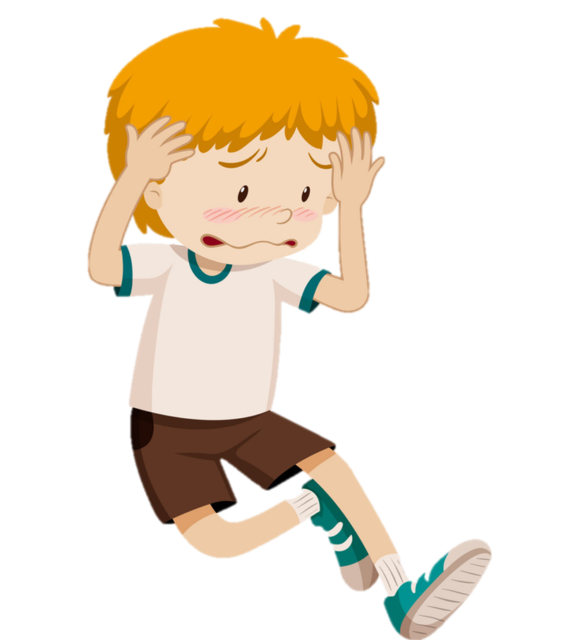
Cough
/kɒf/
Toothache
/ˈtuːθeɪk/
headache
/ˈhedeɪk/

Slide 18
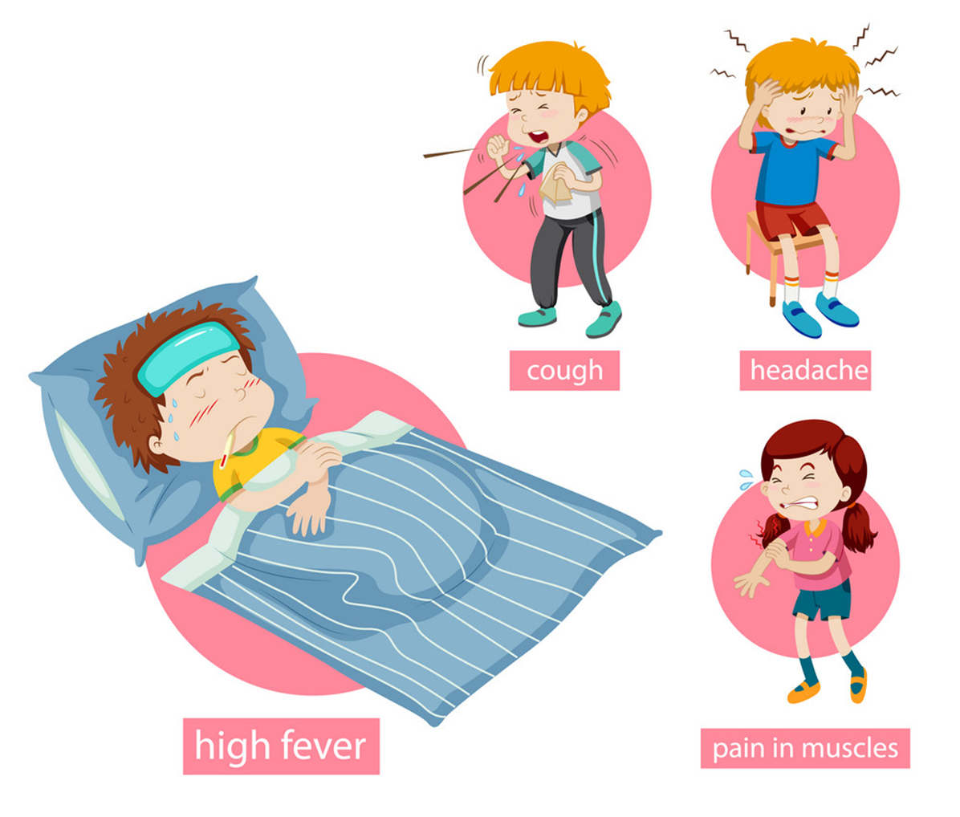
A
B
C
Stomach ache

Slide 19

A
B
C
Fever

Slide 20
A
B
C
Earache

Slide 21
A
B
C
Headache

Slide 22
A
B
C
Toothache

Slide 23
A
B
C
Sore throat

Slide 24
A
B
C
Backache

Slide 25
Grammar

Slide 26
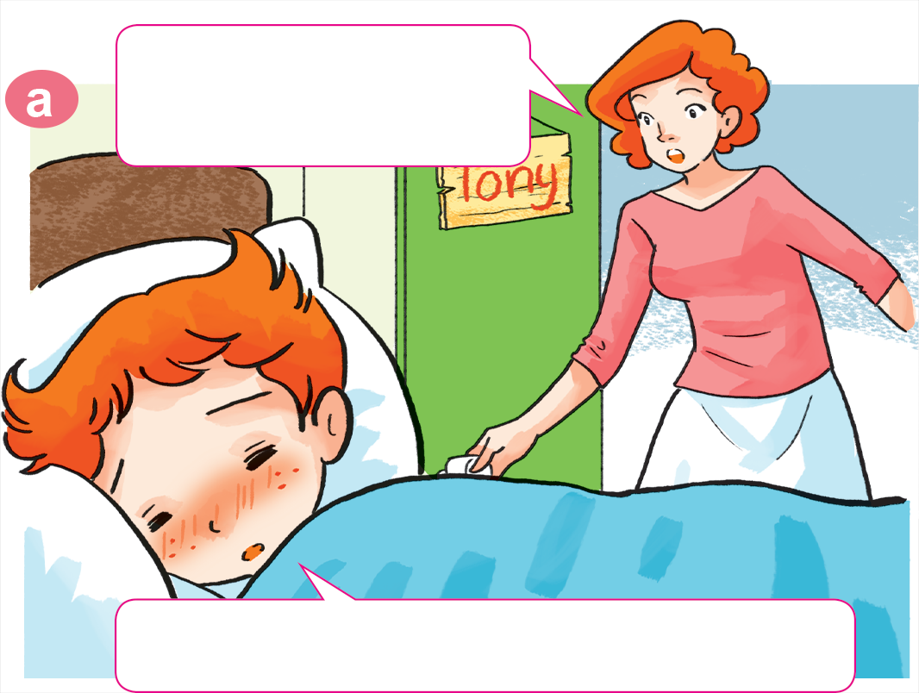

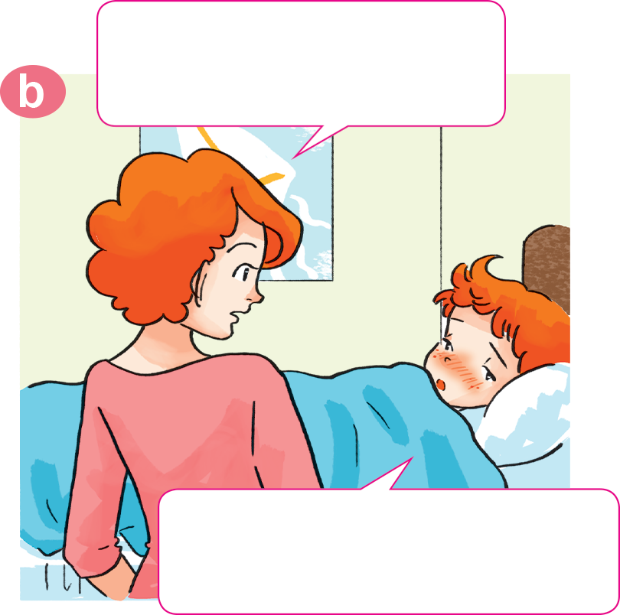
1. Look, listen and repeat.
Why not? What's the
matter with you?
Tony, get up!
Breakfast's ready.
I don't feel well.
I have a headache.
Sorry, I can't have breakfast, Mum.

Slide 27
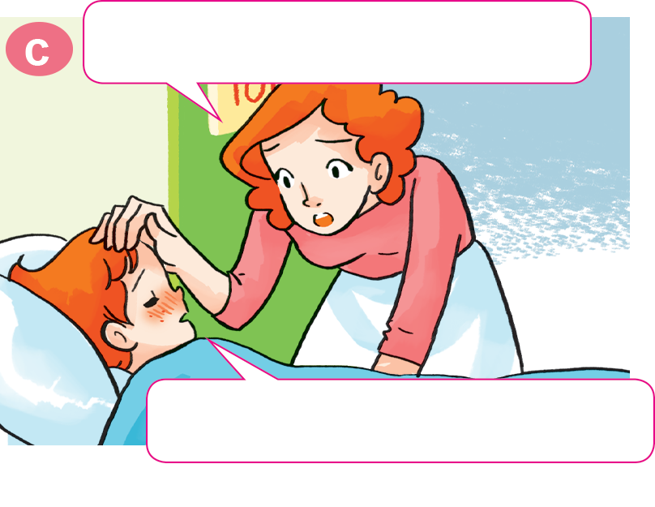
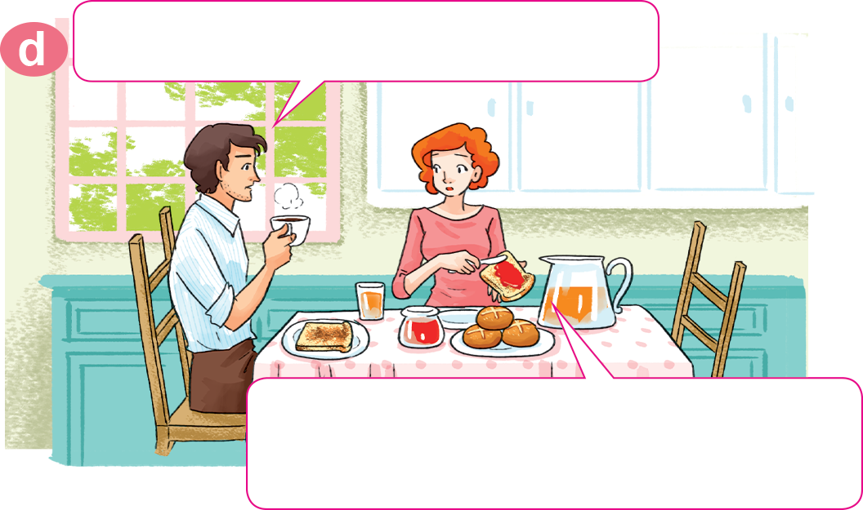
1. Look, listen and repeat.
Oh, you have a fever, too.
What's the matter with Tony?
He has a fever. I'll take him to
the doctor after breakfast.
Yes, Mum. I feel very hot.

Slide 28
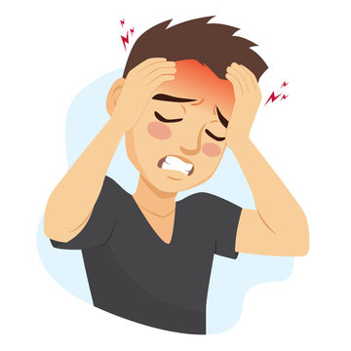

Hỏi và trả lời về vấn đề sức khỏe của bạn.
Hỏi và trả lời về vấn đề sức khỏe của ai đó
What’s the matter with you?
What’s the matter with him/her?
→ I have a/an ___________
→ He/She has a/an ___________
+ vấn đề sức khỏe
+ vấn đề sức khỏe
What’s the matter with you?
What’s the matter with him?
I have a fever
He has a headache.
What’s the matter with you?
What’s the matter with her?
I have an earache
She has a stomach ache.

Slide 29
2. Point and say.
What's the matter with you?
I have a toothache.
___________________

Slide 30
2. Point and say.
What's the matter with you?
I have an earache.
___________________.

Slide 31
2. Point and say.
What's the matter with you?
I have a sore throat.
___________________.

Slide 32
2. Point and say.
What's the matter with you?
I have a stomach ache.
___________________.

Slide 33
Temperature
/ˈtemprətʃər/
Hỏi và trả lời bạn bị làm sao?
toothache
sore throat
headache
What's the matter with you?
I have a/an ______________.
earache
backache
fever
stomach ache
Earache
/ˈɪəreɪk/

Slide 34
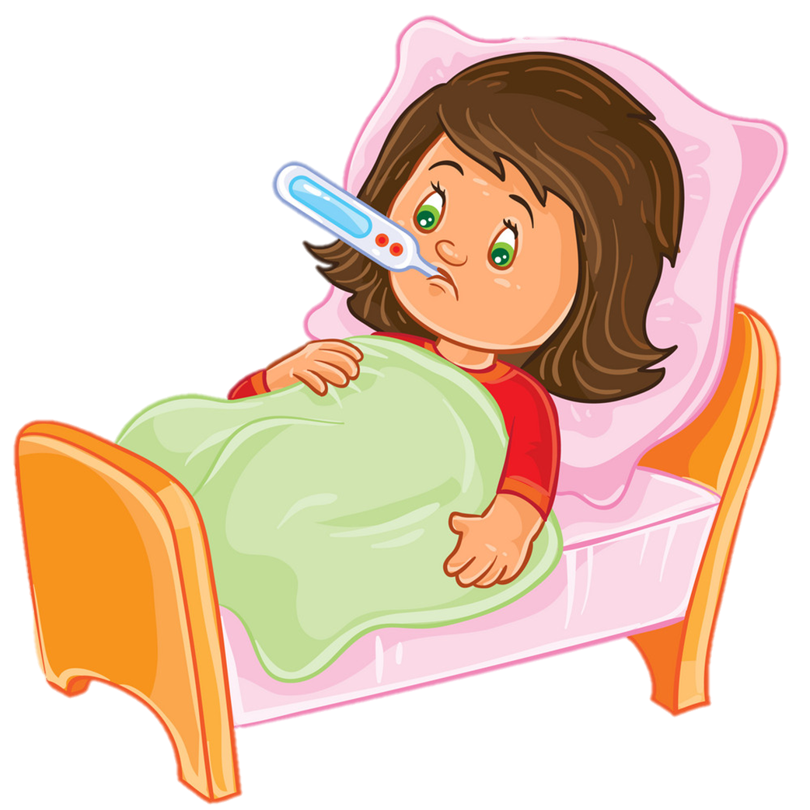
Temperature
/ˈtemprətʃər/
Extra sentence
cough
toothache
headache
sore throat
What's the matter with her/him/them?
She/He has a/an ______________.
They have a/an ____________.
backache
earache
stomach ache
fever
Earache
/ˈɪəreɪk/

Slide 35







Cách chơi:
    Chọn trái táo trên cây để mở câu hỏi
    Trả lời đúng được nhận 1 trái táo vào giỏ
    Click giỏ táo để nhận thêm táo vào giỏ
PLAY
PICKING
APPLES
1
2
3
20
19
18
17
16
15
14
13
12
11
10
9
8
7
6
5
4
3
2
1
0
20
19
18
17
16
15
14
13
12
11
10
9
8
7
6
5
4
3
2
1
0
20
19
18
17
16
15
14
13
12
11
10
9
8
7
6
5
4
3
2
1
0
Notes:
Ms Huyền Phạm - 0936.082.789 – YOUTUBE: MsPham. Facebook: Dạy và học cùng công nghệ.

Slide 36


wall
She have a flu.
What’s the matter with you?
A
I have a flu.
B
He have a flu.
C
Notes:
Ms Huyền Phạm - 0936.082.789 – YOUTUBE: MsPham. Facebook: Dạy và học cùng công nghệ.

Slide 37
What’s the matter with him?
A
What’s the matter with you?
B
What’s the matter with her?
I have a toothache.
C
Notes:
Ms Huyền Phạm - 0936.082.789 – YOUTUBE: MsPham. Facebook: Dạy và học cùng công nghệ.

Slide 38
What’s the matter with him?
A
What’s the matter with you?
B
What’s the matter with her?
He has a headache.
C
Notes:
Ms Huyền Phạm - 0936.082.789 – YOUTUBE: MsPham. Facebook: Dạy và học cùng công nghệ.

Slide 39
I have a sore throat.
What’s the matter with her?
A
He has a
sore throat.
B
She has a
sore throat.
C
Notes:
Ms Huyền Phạm - 0936.082.789 – YOUTUBE: MsPham. Facebook: Dạy và học cùng công nghệ.

Slide 40
I have a fever.
What’s the matter with him?
A
He has a fever.
B
She has a fever.
C
Notes:
Ms Huyền Phạm - 0936.082.789 – YOUTUBE: MsPham. Facebook: Dạy và học cùng công nghệ.

Slide 41
him
A
What’s the matter with___?
He has a backache.
her
B
you
C
Notes:
Ms Huyền Phạm - 0936.082.789 – YOUTUBE: MsPham. Facebook: Dạy và học cùng công nghệ.

Slide 42
you
A
What’s the matter with___?
She has a backache.
he
B
her
C
Notes:
Ms Huyền Phạm - 0936.082.789 – YOUTUBE: MsPham. Facebook: Dạy và học cùng công nghệ.

Slide 43
he
A
What’s the matter with___?
I have a backache.
you
B
she
C
Notes:
Ms Huyền Phạm - 0936.082.789 – YOUTUBE: MsPham. Facebook: Dạy và học cùng công nghệ.

Slide 44
What’s the matter with you?
I ___ a toothache.
have
A
has
B
jo-jo
C
Notes:
Ms Huyền Phạm - 0936.082.789 – YOUTUBE: MsPham. Facebook: Dạy và học cùng công nghệ.

Slide 45
slake
B
What’s the matter with him?
He ___ a headache.
have
A
has
B
Notes:
Ms Huyền Phạm - 0936.082.789 – YOUTUBE: MsPham. Facebook: Dạy và học cùng công nghệ.

Slide 46
He
A
What’s the matter with you?
_____ have a fever.
you
B
I
C
Notes:
Ms Huyền Phạm - 0936.082.789 – YOUTUBE: MsPham. Facebook: Dạy và học cùng công nghệ.

Slide 47
What’s the matter with him?
_____ _____ a fever.
He have
A
He has
B
vall
C
Notes:
Ms Huyền Phạm - 0936.082.789 – YOUTUBE: MsPham. Facebook: Dạy và học cùng công nghệ.

Slide 48
What’s the matter with you?
_____ _____ a stomach ache.
I have
A
I has
B
jo-jo
C
Notes:
Ms Huyền Phạm - 0936.082.789 – YOUTUBE: MsPham. Facebook: Dạy và học cùng công nghệ.

Slide 49
snaek
A
What’s the matter with you?
I have _____ earache.
a
A
an
B
Notes:
Ms Huyền Phạm - 0936.082.789 – YOUTUBE: MsPham. Facebook: Dạy và học cùng công nghệ.

Slide 50
wall
This is a ______.
mall
A
What’s the matter with him?
He has an earache.
True
B
False
C
Notes:
Ms Huyền Phạm - 0936.082.789 – YOUTUBE: MsPham. Facebook: Dạy và học cùng công nghệ.

Slide 51
I can see a _______.
zoo
What’s the matter with her?
She have a sore throat.
True
A
False
B
jo-jo
C
Notes:
Ms Huyền Phạm - 0936.082.789 – YOUTUBE: MsPham. Facebook: Dạy và học cùng công nghệ.

Slide 52

https://media3.giphy.com/media/osjgQPWRx3cac/giphy.gif?cid=6c09b9527y6is5tllihm1nhi45jkf8jesdys9p5v2u0745ik&ep=v1_gifs_search&rid=giphy.gif&ct=g

