Slide 1
Unit 13
WHAT DO YOU DO
IN YOUR FREE TIME?
Lesson 2

Slide 2
Vocabulary

Slide 3
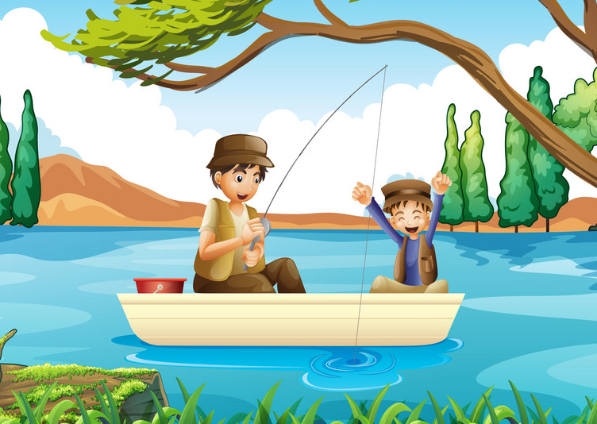

Vocabulary
go fishing
/goʊ ˈfɪʃɪŋ/
Đi câu cá

Slide 4
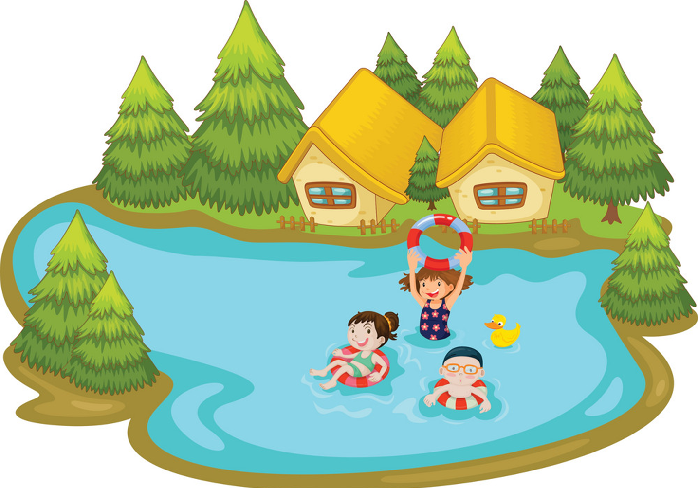
Vocabulary
go swimming
/goʊ ˈswɪmɪŋ/
Đi bơi

Slide 5
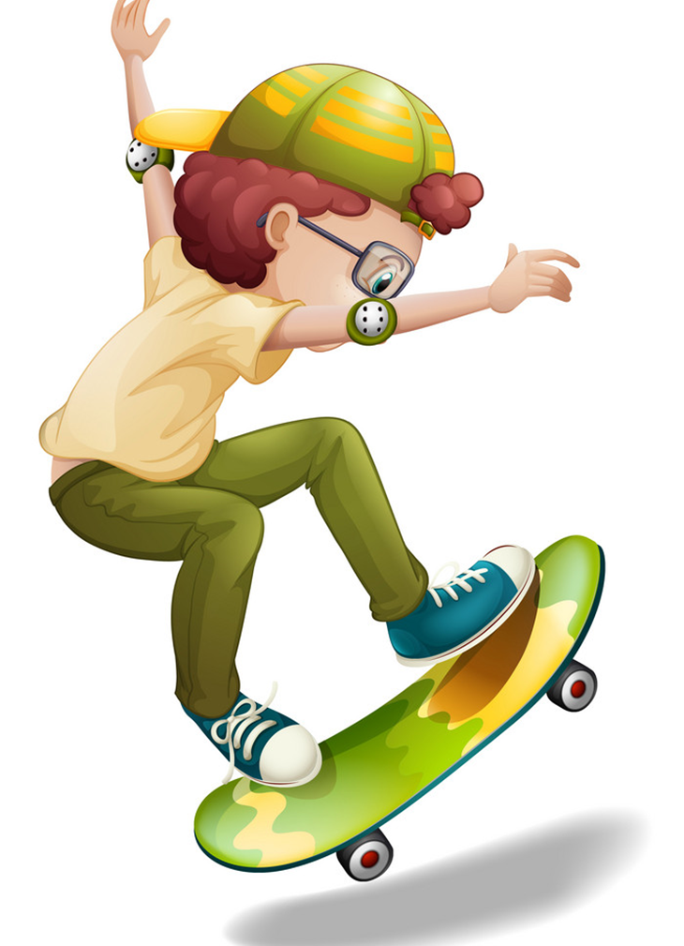
Vocabulary
go skating
/goʊ ˈskeɪtɪŋ /
Trượt ván

Slide 6
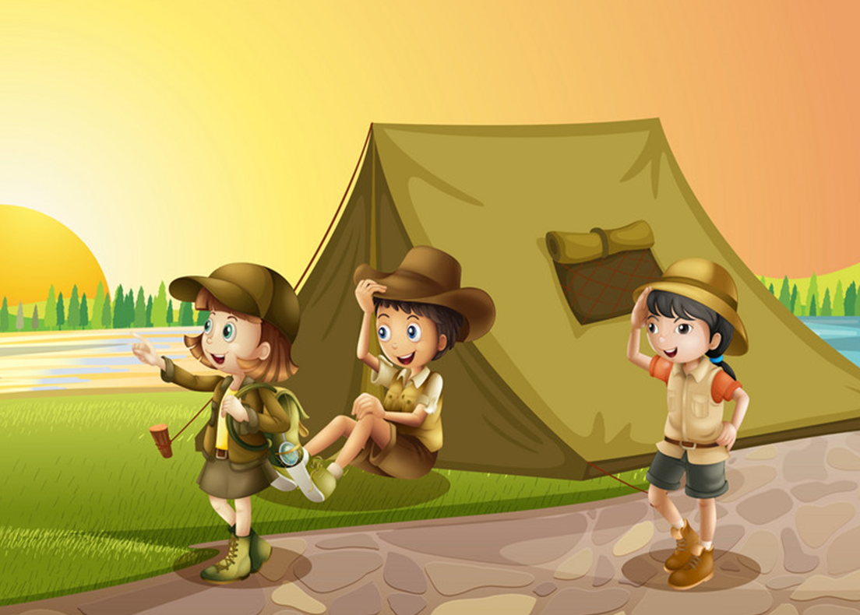
Vocabulary
go camping
/goʊ ˈkæmpɪŋ/
Đi cắm trại

Slide 7
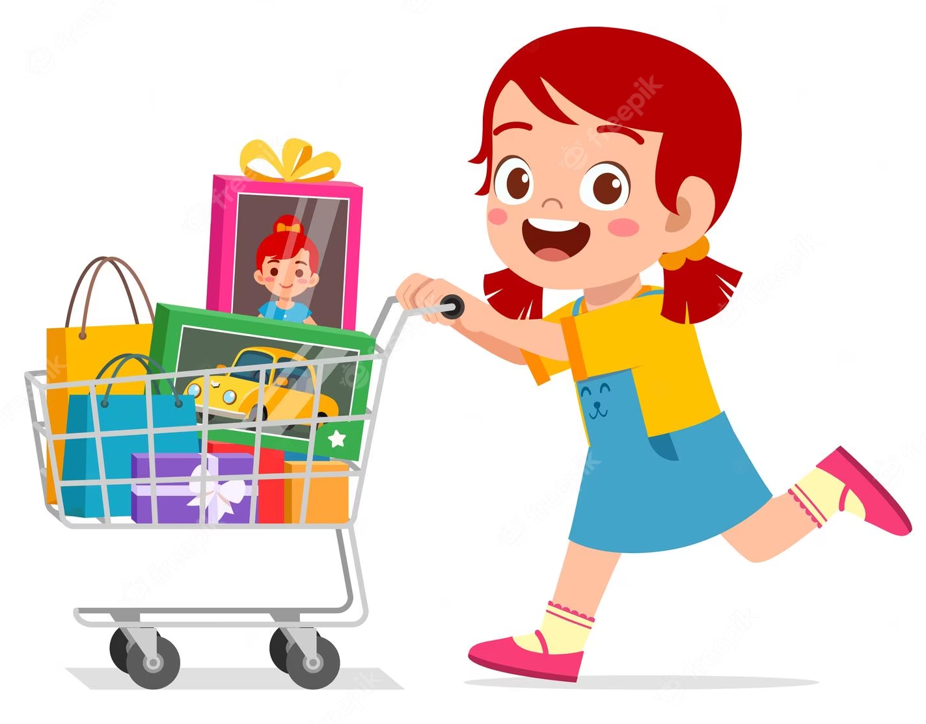
Vocabulary
go shopping
/ goʊ
ˈʃɒpɪŋ /
Đi mua sắm

Slide 8
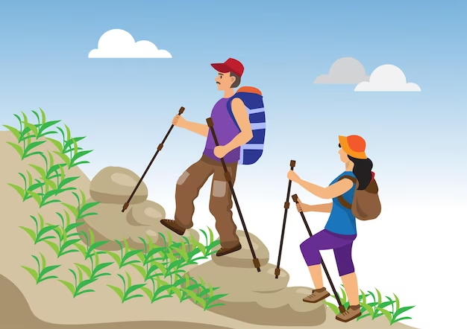
Vocabulary
go hiking
/ goʊ
ŋ
haɪki /
Đi leo núi

Slide 9

Vocabulary
Go fishing
Go swimming
Go camping
Đi câu cá
Đi bơi
Đi cắm trại
Go skating
Go shopping
Go hiking
Đi trượt ván
Đi mua sắm
Đi leo núi

Slide 10
Grammar

Slide 11
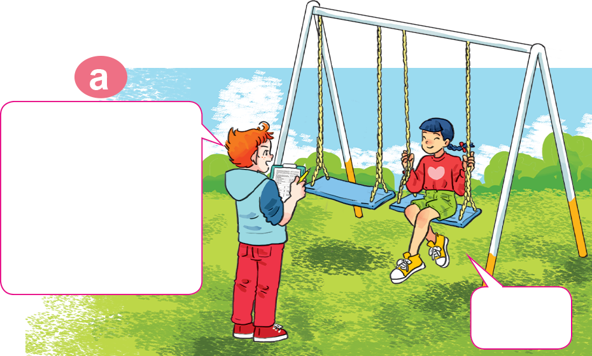
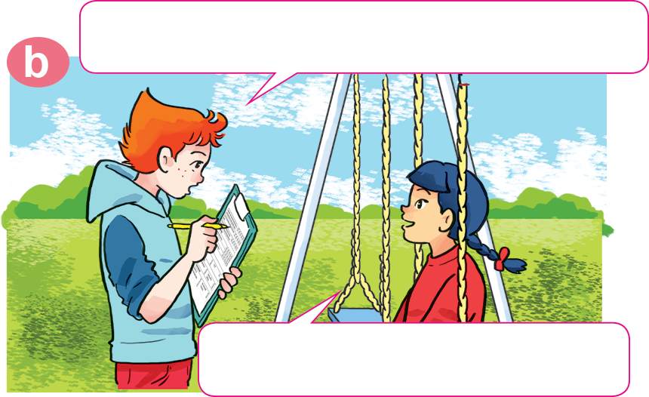
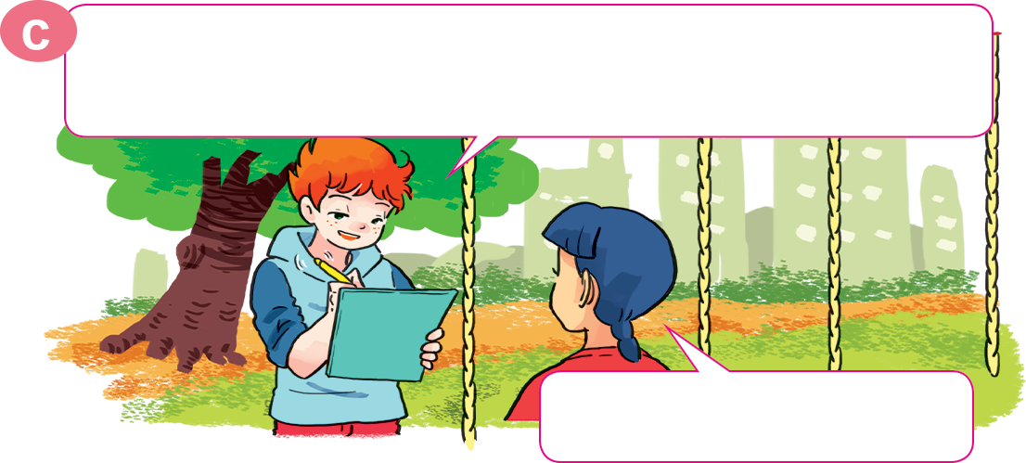
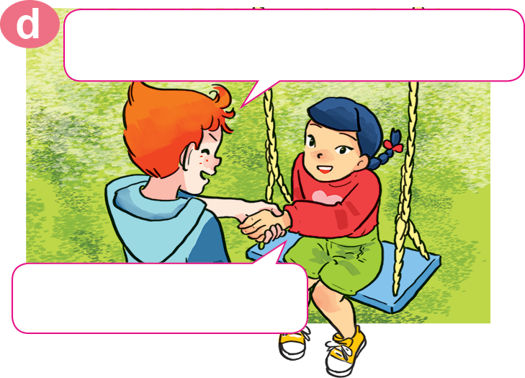
1. Look, listen and repeat
What do you do in your free time?
Hello, Akiko.
May I ask you some questions for my survey?
Sure.
I watch cartoons on TV.
OK, watching cartoons. How about your mother? What does she do in her free time?
OK. Thank you very much.
She goes shopping.
You're welcome.

Slide 12
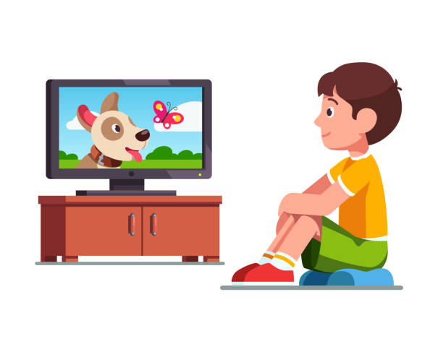

Hỏi và trả lời về các hoạt động trong thời gian rảnh rỗi
What do/does + S + do in + (their/ your/ her/his) + free time?
v(e/es) (động từ thêm s/es)
S(chủ ngữ) +
What does your sister do in her free time?
What does your father do in his free time?
She reads books in her free time.
He watches TV.

Slide 13
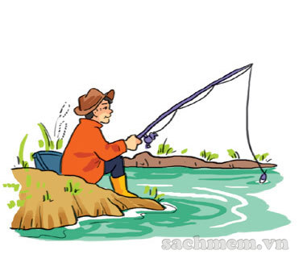
2. Point and say.
father
his
What does your ________ do in ____ free time?
goes fishing
He ______________________.

Slide 14
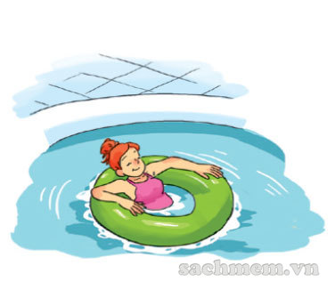
2. Point and say.
her
What does your ________ do in ____ free time?
mother
goes swimming
She ______________________.

Slide 15
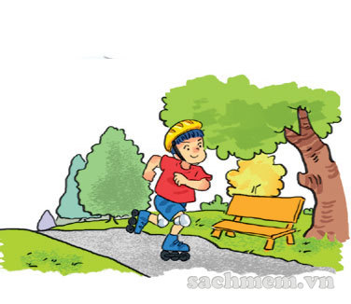
2. Point and say.
brother
his
What does your ________ do in ____ free time?
goes skating
He ______________________.

Slide 16
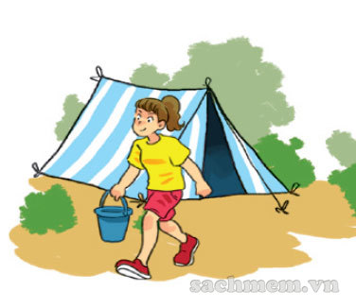
2. Point and say.
sister
her
What does your ________ do in ____ free time?
goes camping
She ______________________.

Slide 17


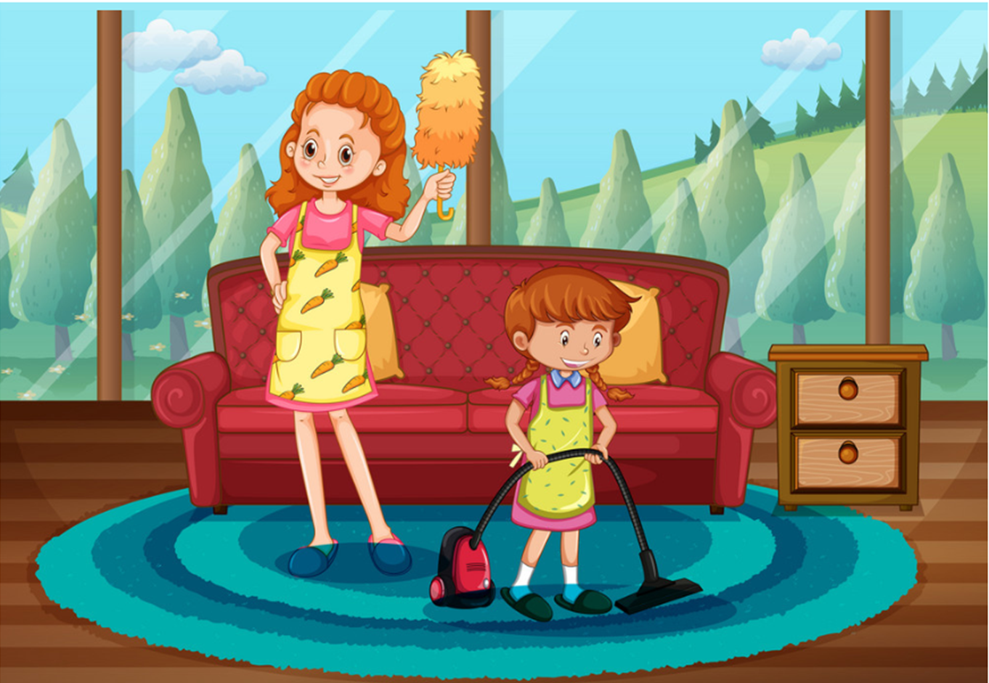

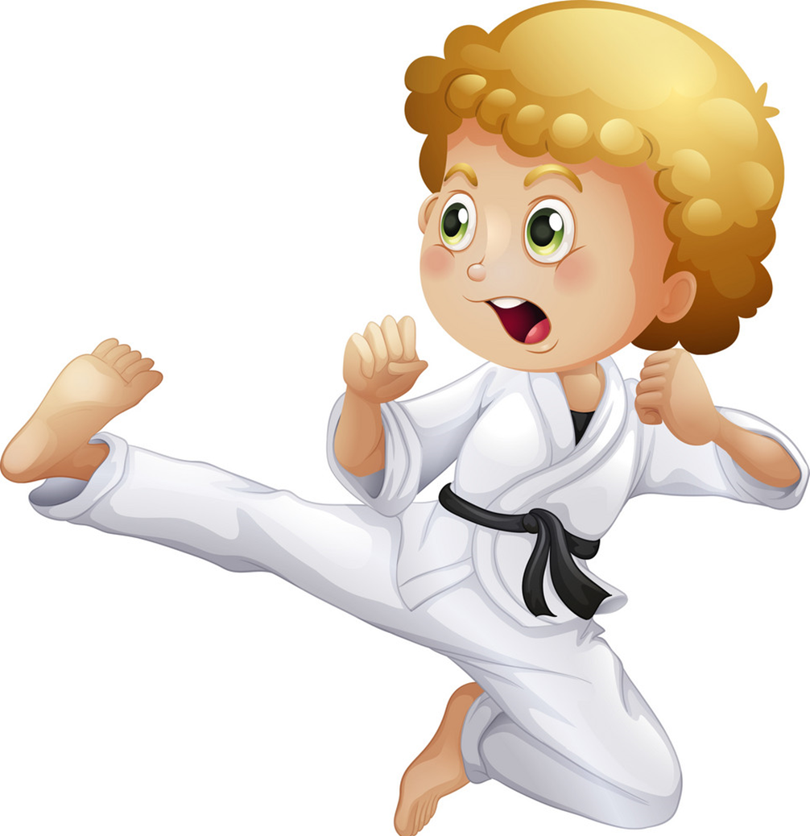
Model sentence
What does your ________ do in ____ free time?
She/he ______________________.
surfs the Internet
go fishing
go swimming
clean the house
go to the cinema
go camping
do karate
go skating

Slide 18
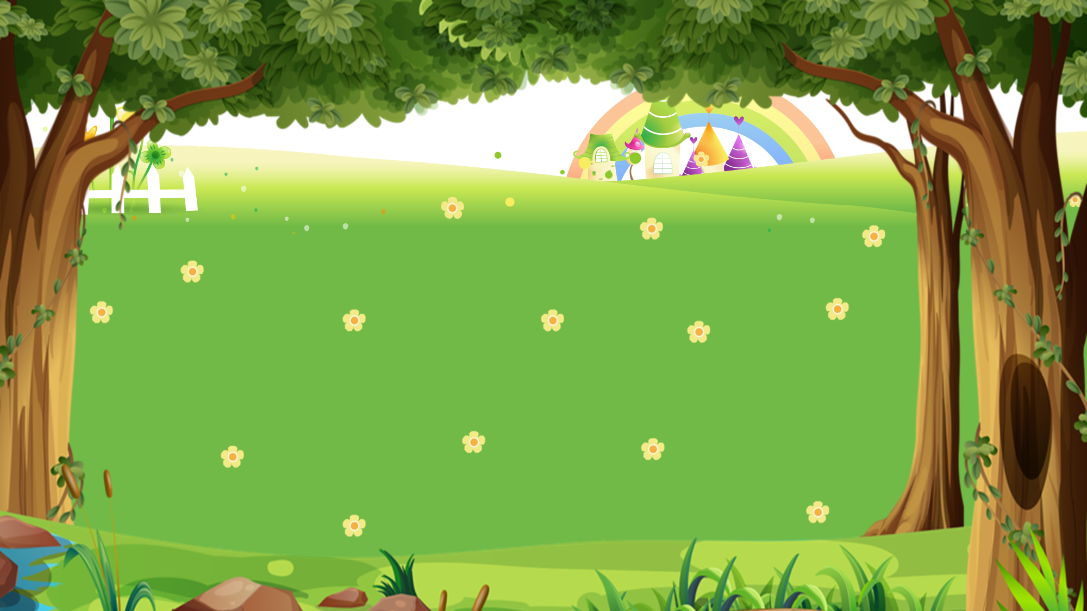

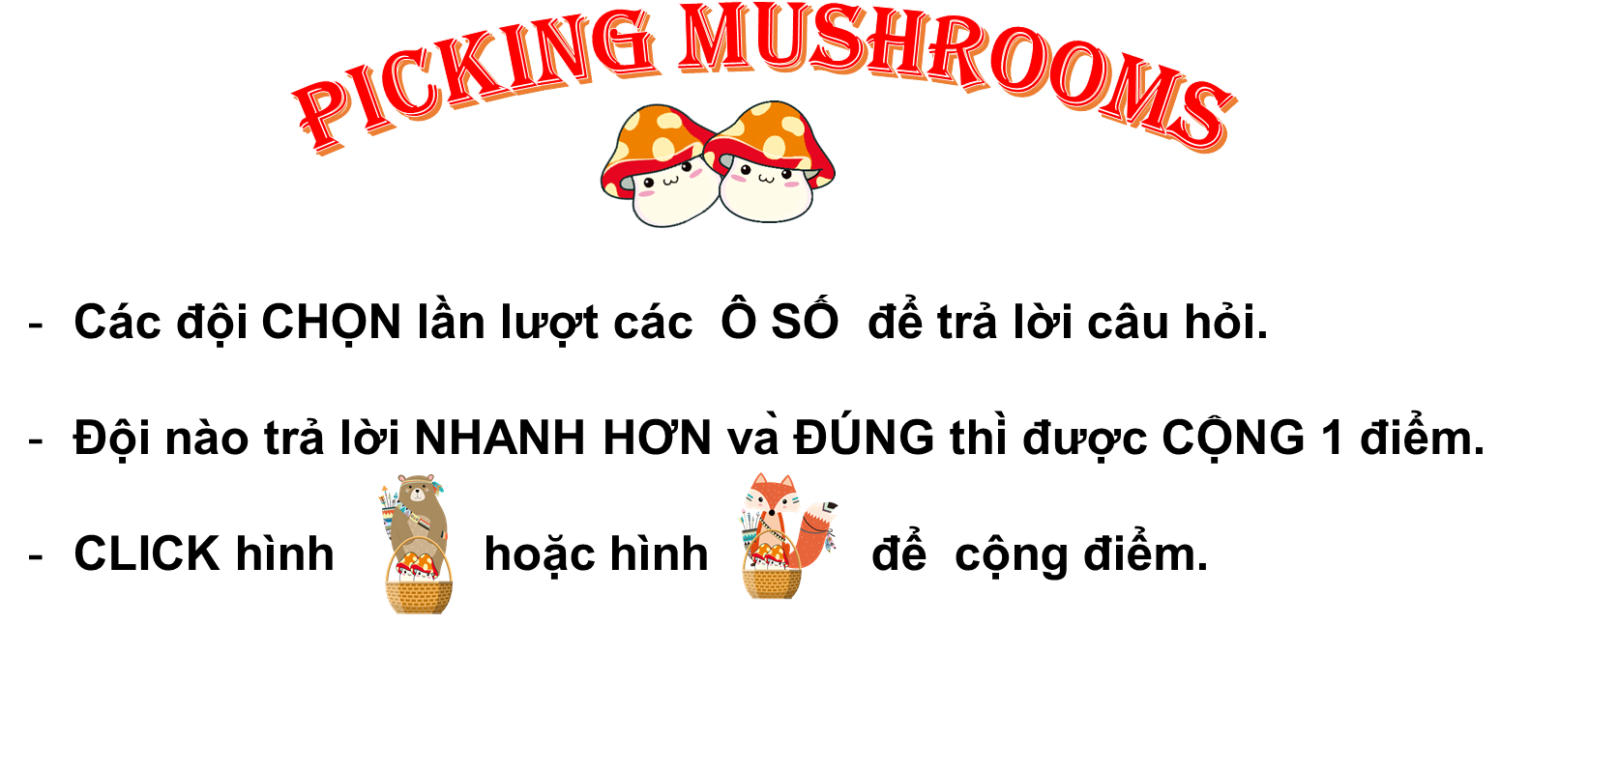






PICKING MUSHROOMS
1
2
3
Các đội CHỌN lần lượt các Ô SỐ để trả lời câu hỏi.
Đội nào trả lời NHANH HƠN và ĐÚNG thì được CỘNG 1 điểm.
CLICK hình hoặc hình để cộng điểm.
4
5
6
7
8
9
10

Slide 19







Time’s up
1
2
3
4
5
6
7
8
9
10
What does _____ do in her free time?
Back
A. she
B. he
C. you
A.

Slide 20
Time’s up
1
2
3
4
5
6
7
8
9
10
What does _____ do
in his free time?
Back
A. you
B. he
C. she
A.

Slide 21
Time’s up
1
2
3
4
5
6
7
8
9
10
What does she do
in _____ free time?
Back
A. your
B. his
C. her
A.

Slide 22
Time’s up
1
2
3
4
5
6
7
8
9
10
What _____ you do
in your free time?
A. Do
Back
B. Does
A.
C. Sai

Slide 23
Time’s up
1
2
3
4
5
6
7
8
9
10
What _____ your father do
in his free time?
B. does
Back
A. do
B. Sai
D. Sai

Slide 24
Time’s up
1
2
3
4
5
6
7
8
9
10
What does your uncle do in his free time?
He ______ camping.
Back
A. goes
B. go
B. Sai
D. Sai

Slide 25
Time’s up
1
2
3
4
5
6
7
8
9
10
What does your mother
do in her free time?
She _______ swimming.
B. goes
Back
A. go
B. Sai
D. Sai

Slide 26


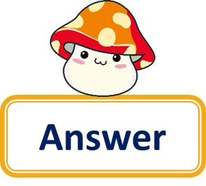

Time’s up
1
2
3
4
5
6
7
8
9
10
Question
What does your teacher do in her free time?
She goes skating.
Back
Answer

Slide 27
Time’s up
1
2
3
4
5
6
7
8
9
10
What does your friend do in his free time?
Question
He does karate.
Back
Answer

Slide 28
Time’s up
1
2
3
4
5
6
7
8
9
10
What do you do
in your free time?
Question
I go fishing.
Back
Answer

Slide 29

https://media3.giphy.com/media/osjgQPWRx3cac/giphy.gif?cid=6c09b9527y6is5tllihm1nhi45jkf8jesdys9p5v2u0745ik&ep=v1_gifs_search&rid=giphy.gif&ct=g

