Slide 1





















Unit 2
My school
Lesson 2 – Task 7,8,9
Notes:
Để nguyên trang bìa như này, chỉ thay đổi tên bài trong quá trình làm. Logo của sách Wonderful World

Slide 2







Warm up
Song: Tooty ta

Slide 3

Notes:
Bài hát khởi động “Tooty Ta”

Slide 4

Presentation
Task 7: Listen and tick

Slide 5

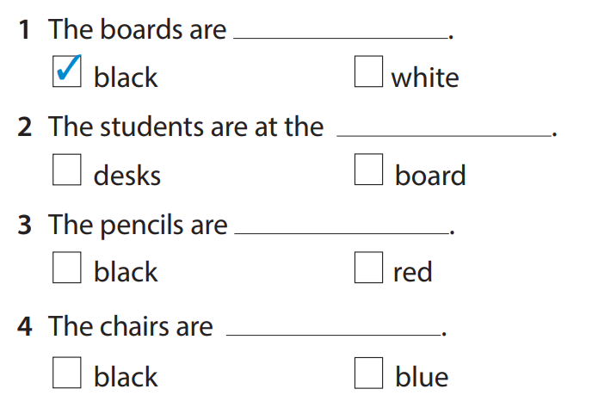
Listen and tick
✓
✓
✓

Slide 6

Practice
Task 8: Look and say

Slide 7









Notes:
(Teacher prepares a wheel with phrases: chairs/ white, students/ cool, teacher/ great, classroom/ nice, desks/ green. Sts can play in teams/whole class. Teacher shows the wheel and spin. Sts as fast as possible make the sentences on pieces of paper. The fastest team/person gets point and a chance to spin for the next round.)
Set game rules
Do a model
Let sts time to spin and play the game
Award the winner of the game

Slide 8


12
1
2
11
10
3
4
9
5
8
7
6

Slide 9
chairs/ white
They’re chairs.
They’re white.
WHEEL
CHECK

Slide 10
12
1
2
11
10
3
4
9
5
8
7
6

Slide 11
students/ cool
We’re students.
We’re cool
WHEEL
CHECK

Slide 12
12
1
2
11
10
3
4
9
5
8
7
6

Slide 13
teacher/ great
He’s/ She’s a teacher.
He’s/ She’s great.
WHEEL
CHECK

Slide 14
12
1
2
11
10
3
4
9
5
8
7
6

Slide 15
classroom/ nice
It’s a classroom.
It’s nice.
WHEEL
CHECK

Slide 16
12
1
2
11
10
3
4
9
5
8
7
6

Slide 17
desks/ green
They’re desks.
They’re green.
WHEEL
CHECK

Slide 18
8 READ AND SAY
1. They’re chairs. They’re white.
2. They’re students. They’re cool.
We’re students. We’re cool.
3. He’s a teacher. He’s great.
She’s a teacher. She’s great.
4. It’s a classroom. It’s nice.
5. They’re desks. They’re green.

Slide 19

Production
Draw, write and say

Slide 20

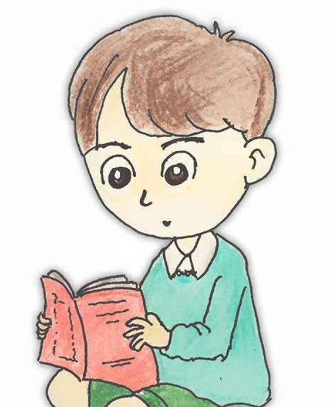
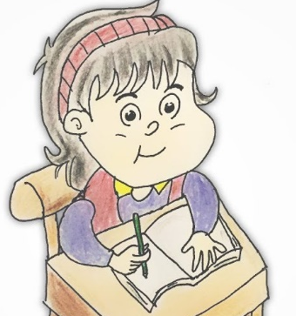
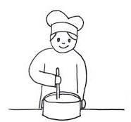

What we can do?

Slide 21
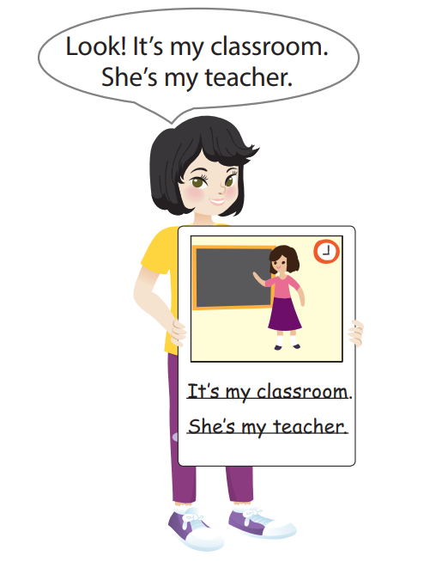
9 Draw, write and say
Look! It’s my classroom.
She’s my teacher.
It’s my classroom.
She’s my teacher.

Slide 22

Assessment
Read and draw

Slide 23
Reorder the words
1.They/ chairs./ are ……………………….………………..
2. It/ a/ is/ clock. ……………………………………………..
3. He/ teacher/ is/ a ……………………………………………..
4. We’re/ nice. students./ are/ We
………………………………………………………….………..
They are chairs.
It is a clock.
He is a teacher.
We are students. We’re nice.
Notes:
HOẠT ĐỘNG TƯƠNG TÁC: 4 CÂU. ĐÁP ÁN LÀ CHỮ MÀU ĐỎ.

Slide 24




Good bye.
See you again!

