Slide 1





















Unit 4
My house
Lesson 2 – Task 4,5,6
Notes:
Để nguyên trang bìa như này, chỉ thay đổi tên bài trong quá trình làm. Logo của sách Wonderful World

Slide 2







Warm up
Hello song

Slide 3


Slide 4
Do a crossword in red?
6
H
1
B
A
T
R
O
O
M
L
I
V
I
N
G
R
O
O
M
2
C
O
M
P
U
T
E
R
3
S
4
T
O
Y
5
B
E
D
Notes:
Click vào số để hiện hình ảnh
Click vào dấu next để chuyển qua phần tiếp theo

Slide 5
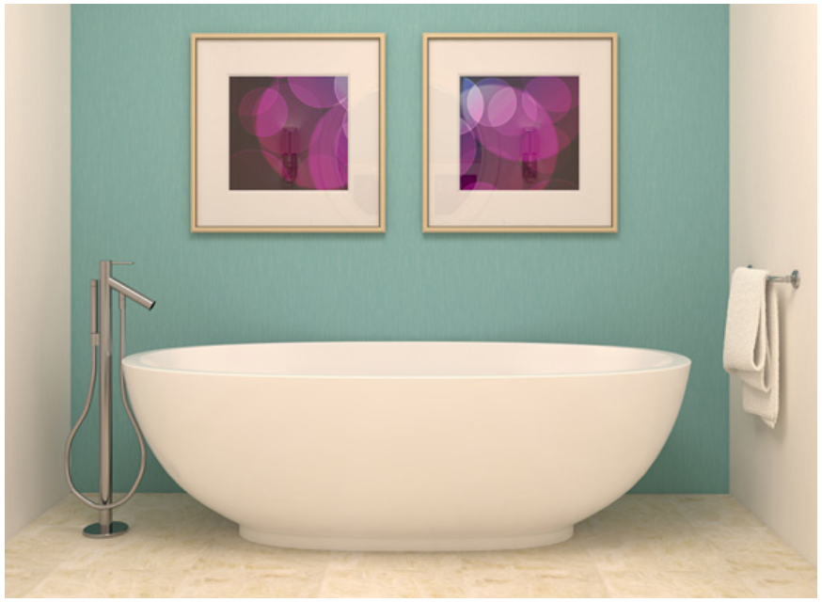

Slide 6
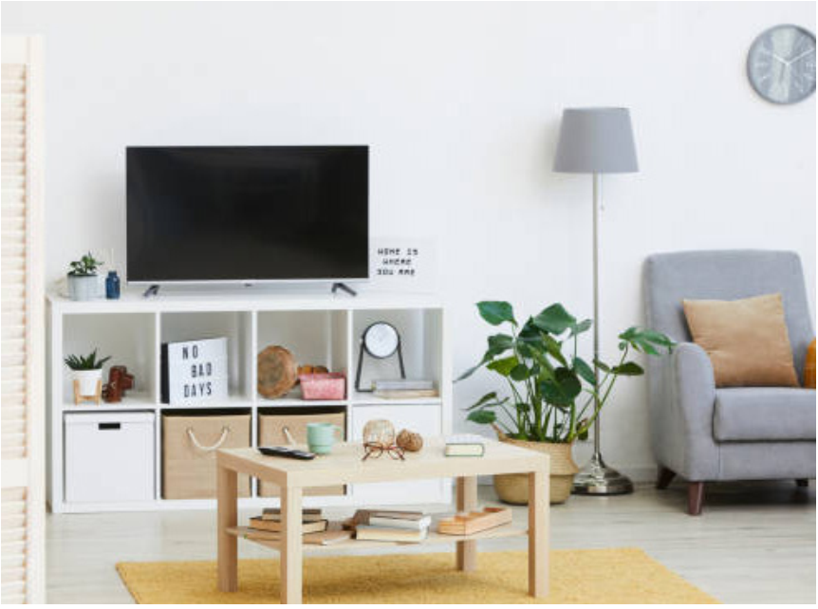

Slide 7
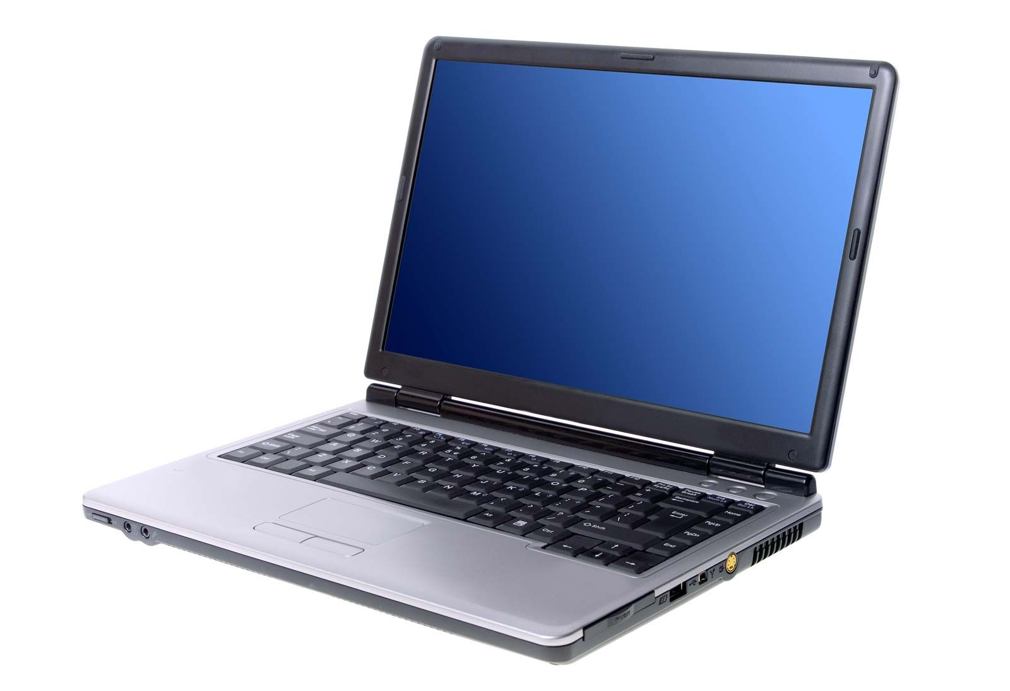

Slide 8
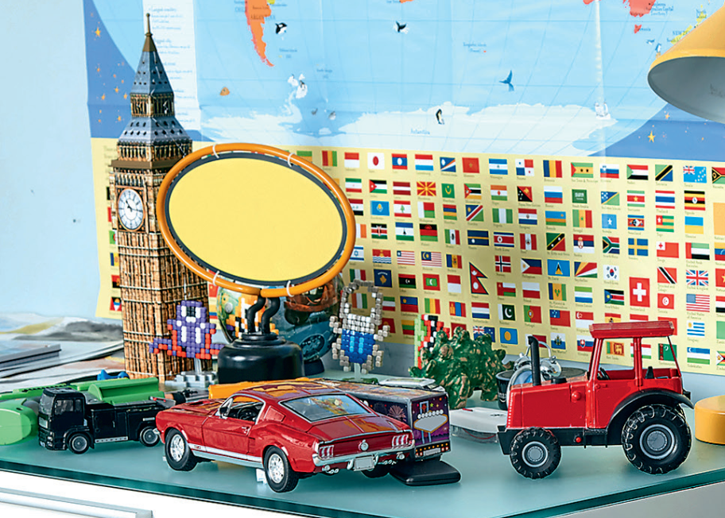

Slide 9
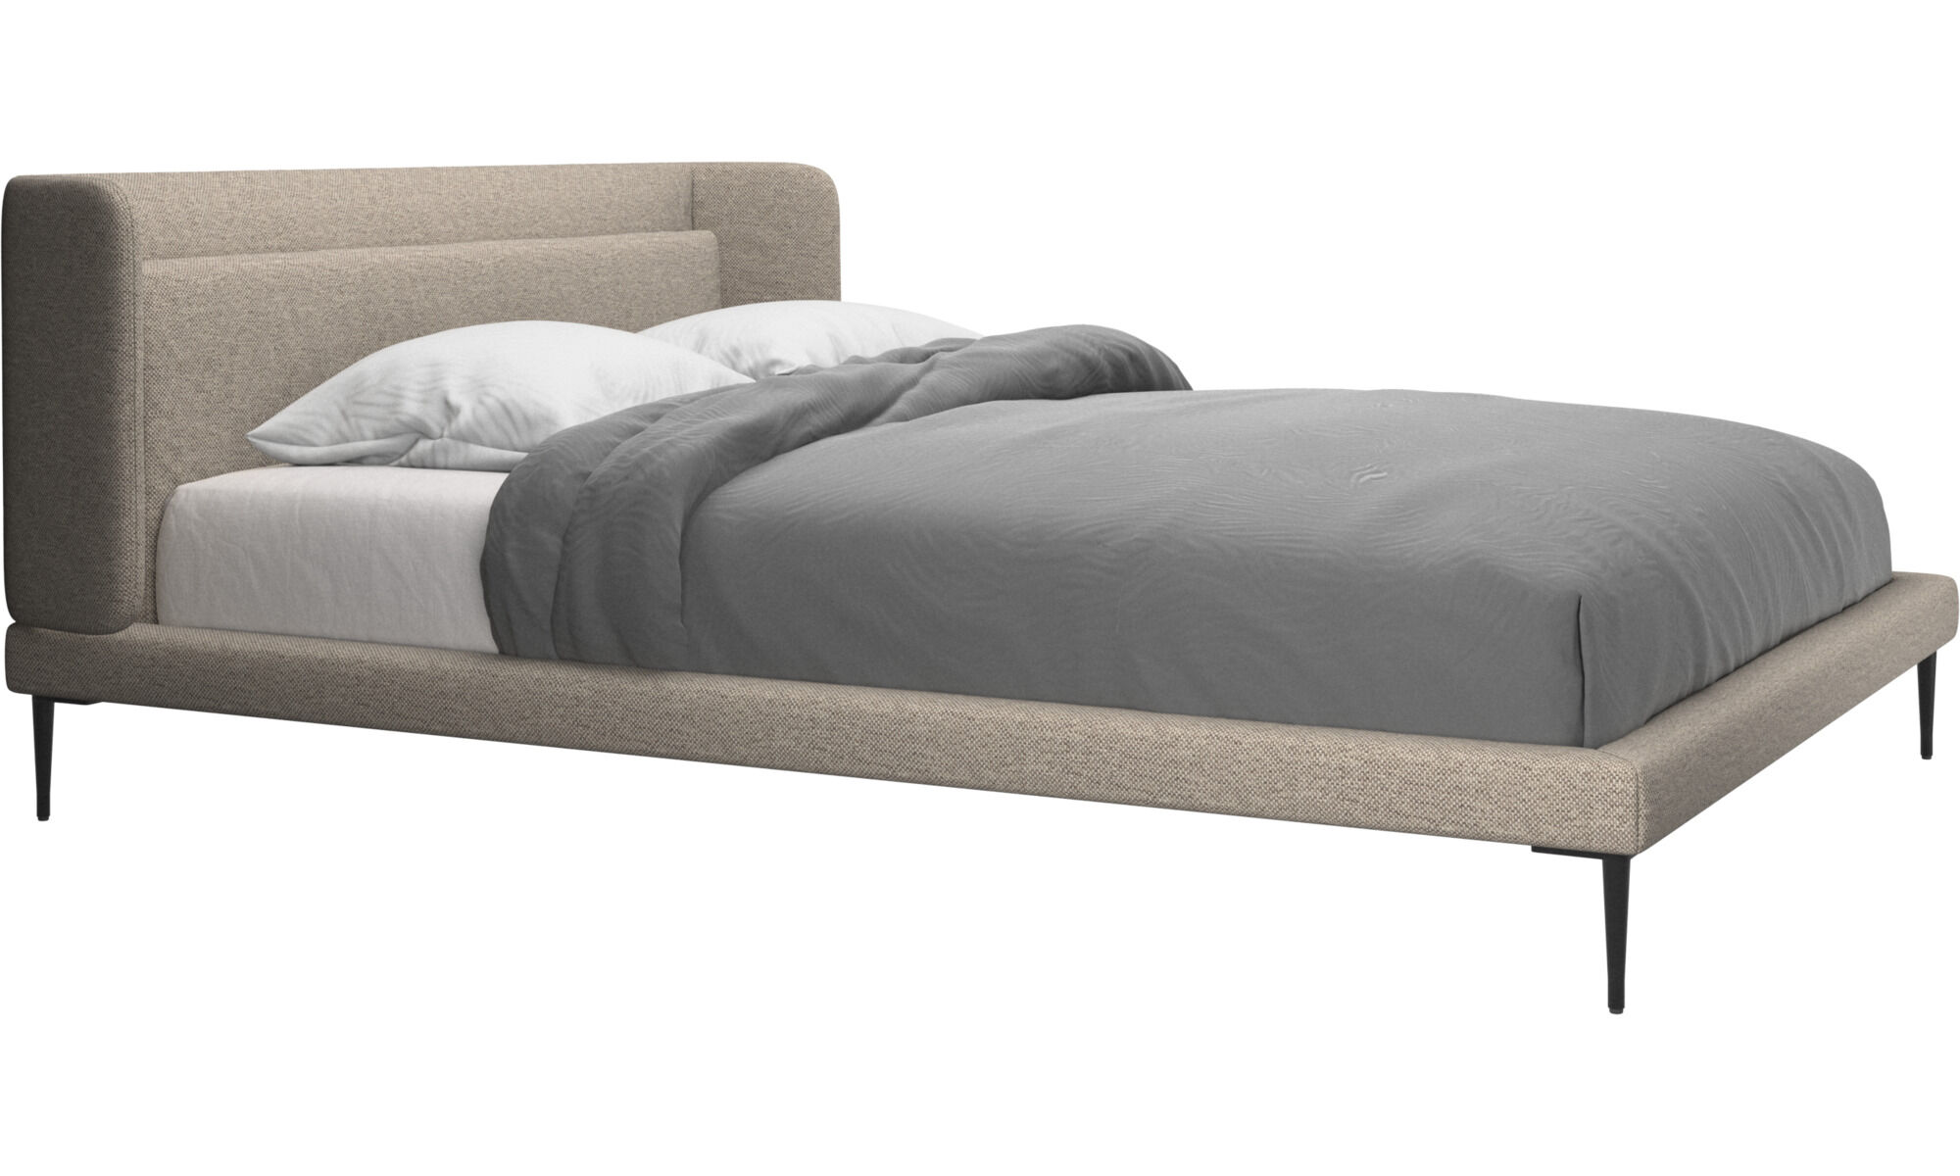

Slide 10

Presentation
Task 4: Listen and repeat

Slide 11

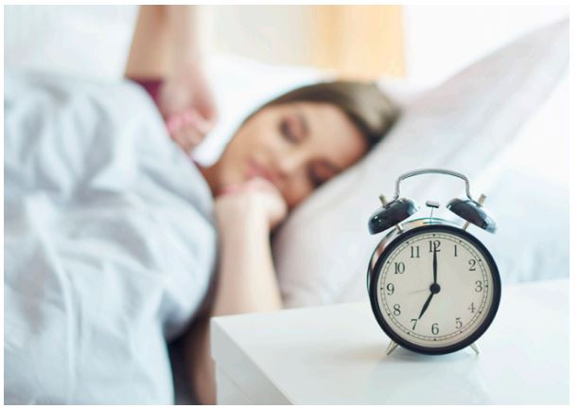
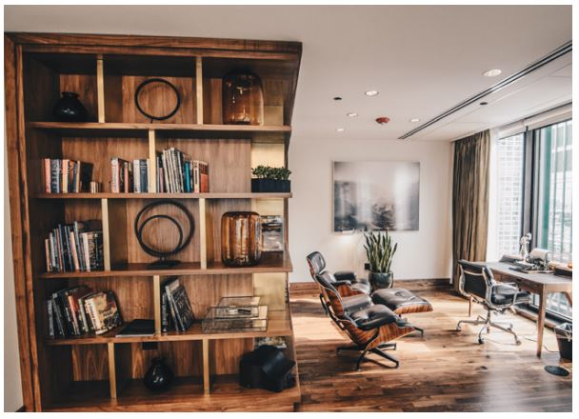

4
Listen and repeat.
1
Is there a clock in the bedroom?
2
Are there books in the living room?
- Yes, there is.
- Yes, there are.
Is there a TV, too?
Are there toys, too?
- No, there isn’t.
There isn’t a TV in the bedroom.
- No, there aren’t.
There aren’t toys in the living room.

Slide 12
WHO’S FASTER?
1
Is there a clock in the bedroom?
2
Are there books in the living room?
- Yes, there is.
- Yes, there are.
Is there a TV, too?
Are there toys, too?
- No, there isn’t.
There isn’t a TV in the bedroom.
- No, there aren’t.
There aren’t toys in the living room.

Slide 13

Practice
Task 5: Look and say

Slide 14
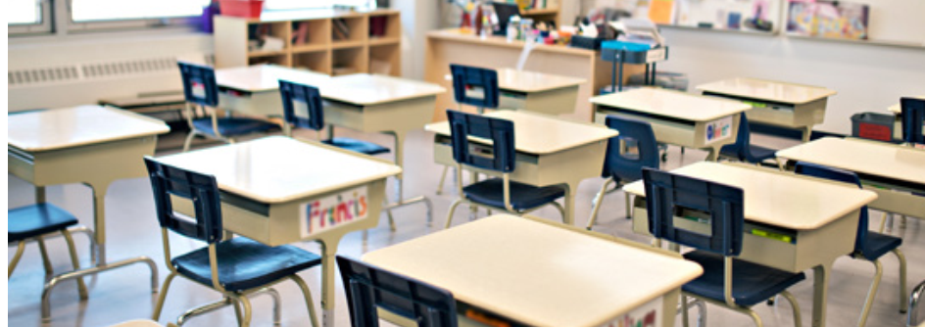
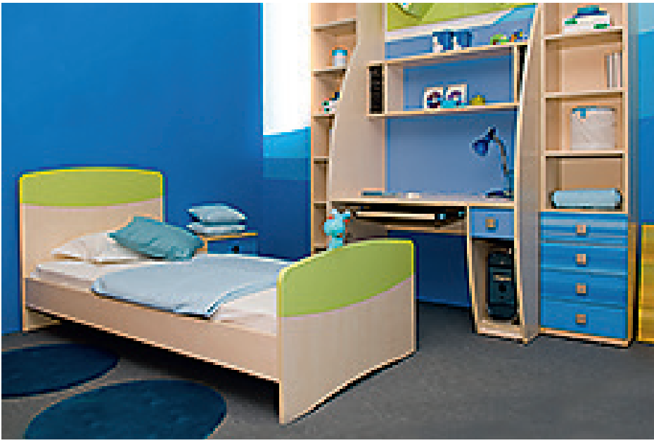
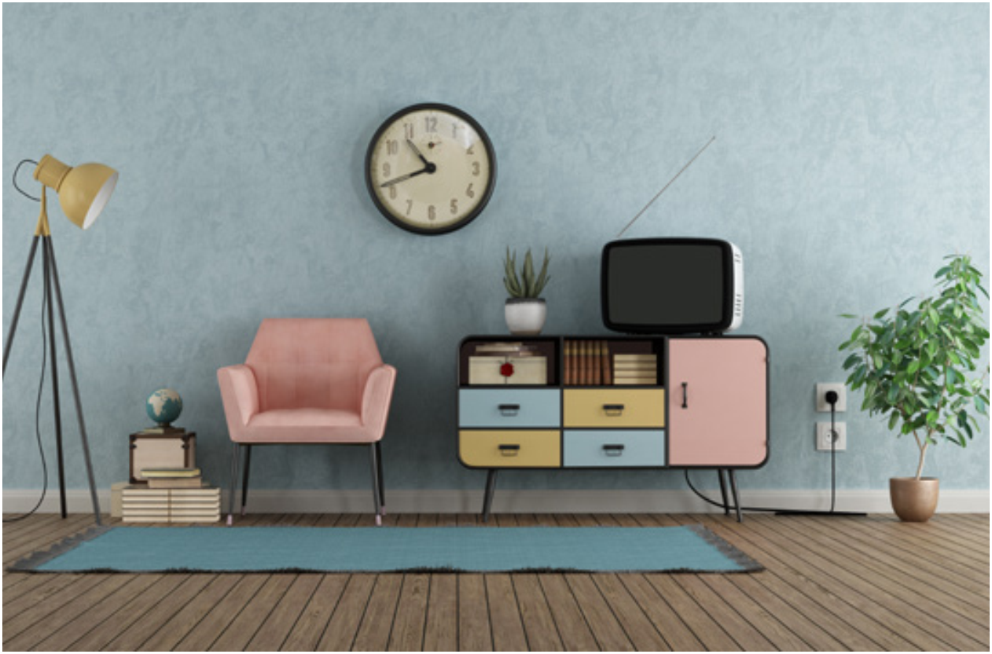
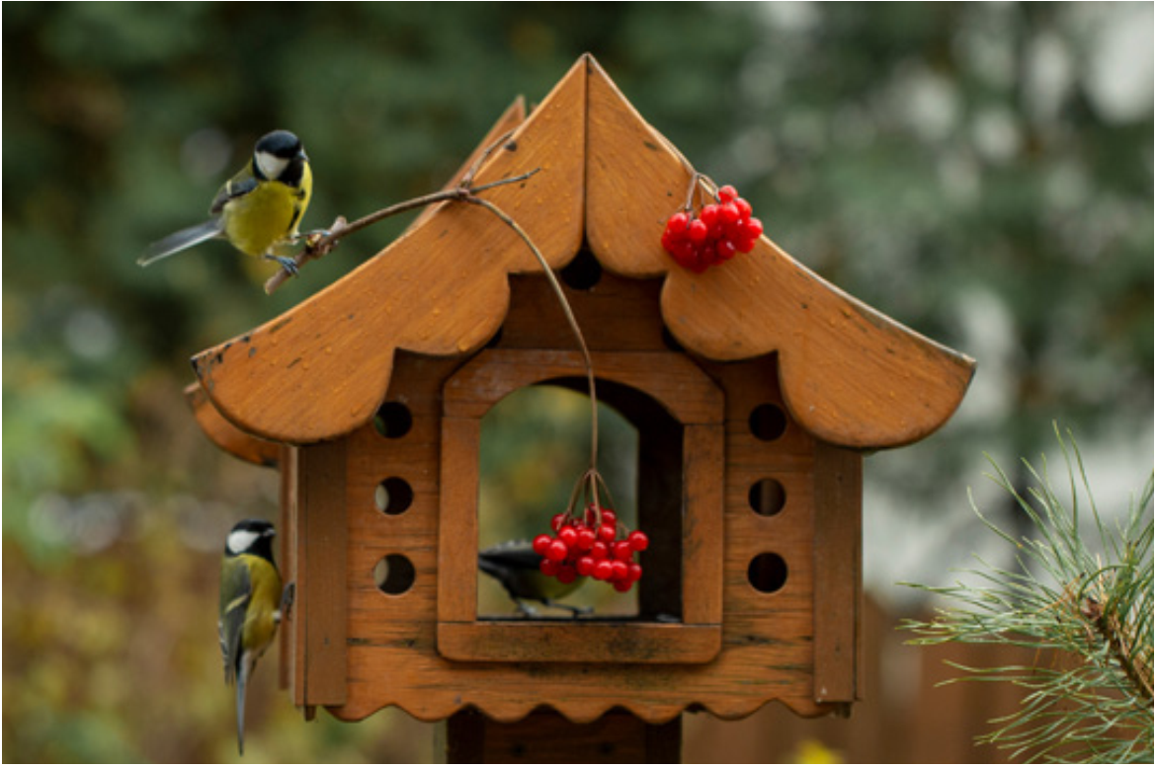
Fastest pens
Notes:
You’re are going to have a house designing contest by drawing a house frame and things in the rooms as required. Before the contest, you have to make a model of the house by making questions, the architect shows clue Yes, there is./ No, there isn’t or Yes, there are/ No, there aren’t. Sts look at the pictures, given words, and the signal tick or cross, write the questions and answer. Draw or write things into the frame
Give the instruction
Set sts to work in 8 groups
Give them boards and markers to write
Ask group to choose a room
Show a picture, words and signals
Groups write the answer
Check with whole class

Slide 15
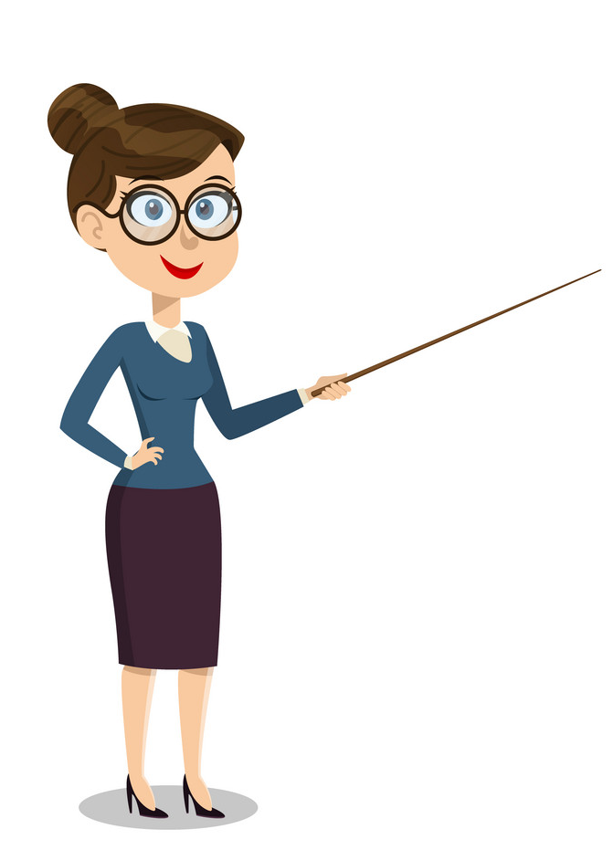


5
Look and say.
Is there a clock in the bedroom?
Yes, there is.
Is there a TV?
No, there isn’t.

Slide 16
Is there a clock in a living room?
Yes, there is.
✓
clock/ living room

Slide 17
Are there birds in the garden?
Yes, there are.
✓
birds/ garden

Slide 18
Is there a computer in the classroom?
No, there isn’t.
✗
computer/ classroom

Slide 19
Are there chairs in the bedroom?
No, there aren’t.
✗
chairs/ bedroom

Slide 20
Are there books in the living room?
Yes, there are.
Are there toys?
No, there aren’t.

Slide 21
Is there a computer in the classroom?
Are there chairs in the bedroom?
No, there aren’t.
No, there isn’t.
Is there a clock in a living room?
Are there birds in
the garden?
Yes, there is.
Yes, there are.

Slide 22
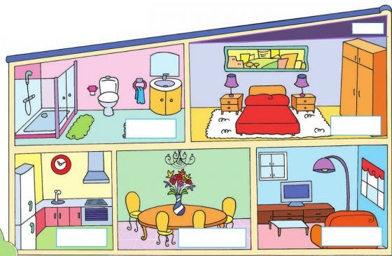
Further practice
There is …
There are …
There isn’t …
There aren’t …

Slide 23

Production
Write about your house. Say

Slide 24
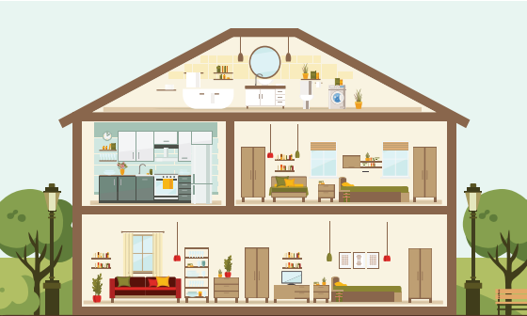
CODING
 | A | B | C | D
0 | There is | toy | bathroom | beds
1 | There is | in | computer | living room
2 | There isn’t | kitchen | the | lamps
3 | There are | lamp | TV | bedroom
4 | There aren’t | a | chairs | garden
0A
4B
3B
1B
2C
0C
There is a lamp in the bathroom.
Ex: 0.
1.
3A
0D
1B
2C
3D
There are beds in the bedroom.
2.
4A
2D
1B
2C
4D
There aren’t lamps in the garden.
3.
1A
4B
0B
1B
2C
1D
There is a toy in the living room.
4.
2A
4B
3C
1B
2C
2B
There isn’t a TV in the kitchen.

Slide 25
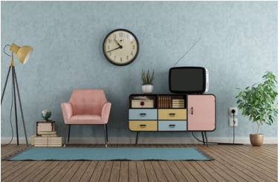
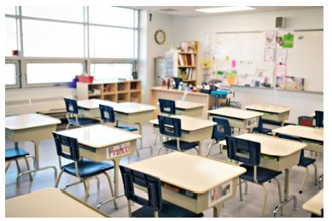
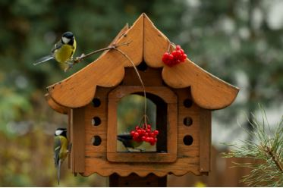
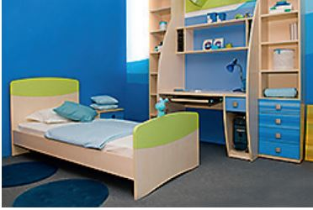
6
Write about your house. Say.
1.There is _____in the_____.
2.There are _____in the____.
clock
computer
3.There isn’t _____in the___.
4.There aren’t ___in the____.
birds
chairs

Slide 26

Assessment

Slide 27
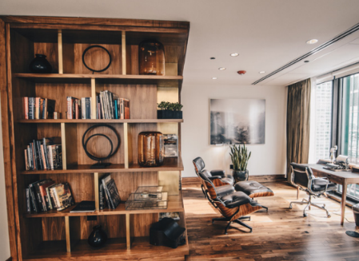
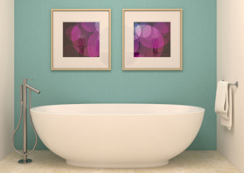
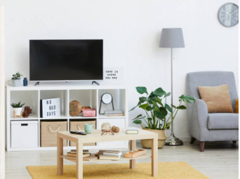
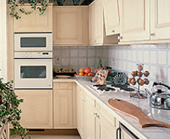
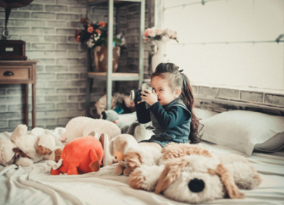
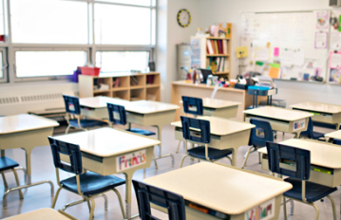
Ex: There is a TV in the living room.
1. There are chairs in the classroom.
Match
each
sentence
with
the
correct
picture.
2. There are books in
the living room.
3. There isn’t a clock in the kitchen.
4. There aren’t beds in the bathroom.
5. There isn’t a laptop in the bedroom.
Notes:
HOẠT ĐỘNG TƯƠNG TÁC

Slide 29




Good bye.
See you again!

