Slide 1





















Unit 4
My house
Lesson 3 – Task 7,8,9
Notes:
Để nguyên trang bìa như này, chỉ thay đổi tên bài trong quá trình làm. Logo của sách Wonderful World

Slide 2







Warm up
Play the brain gym

Slide 3

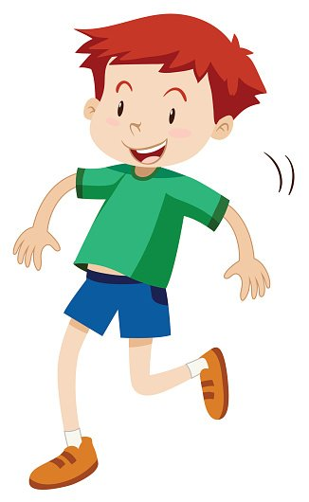
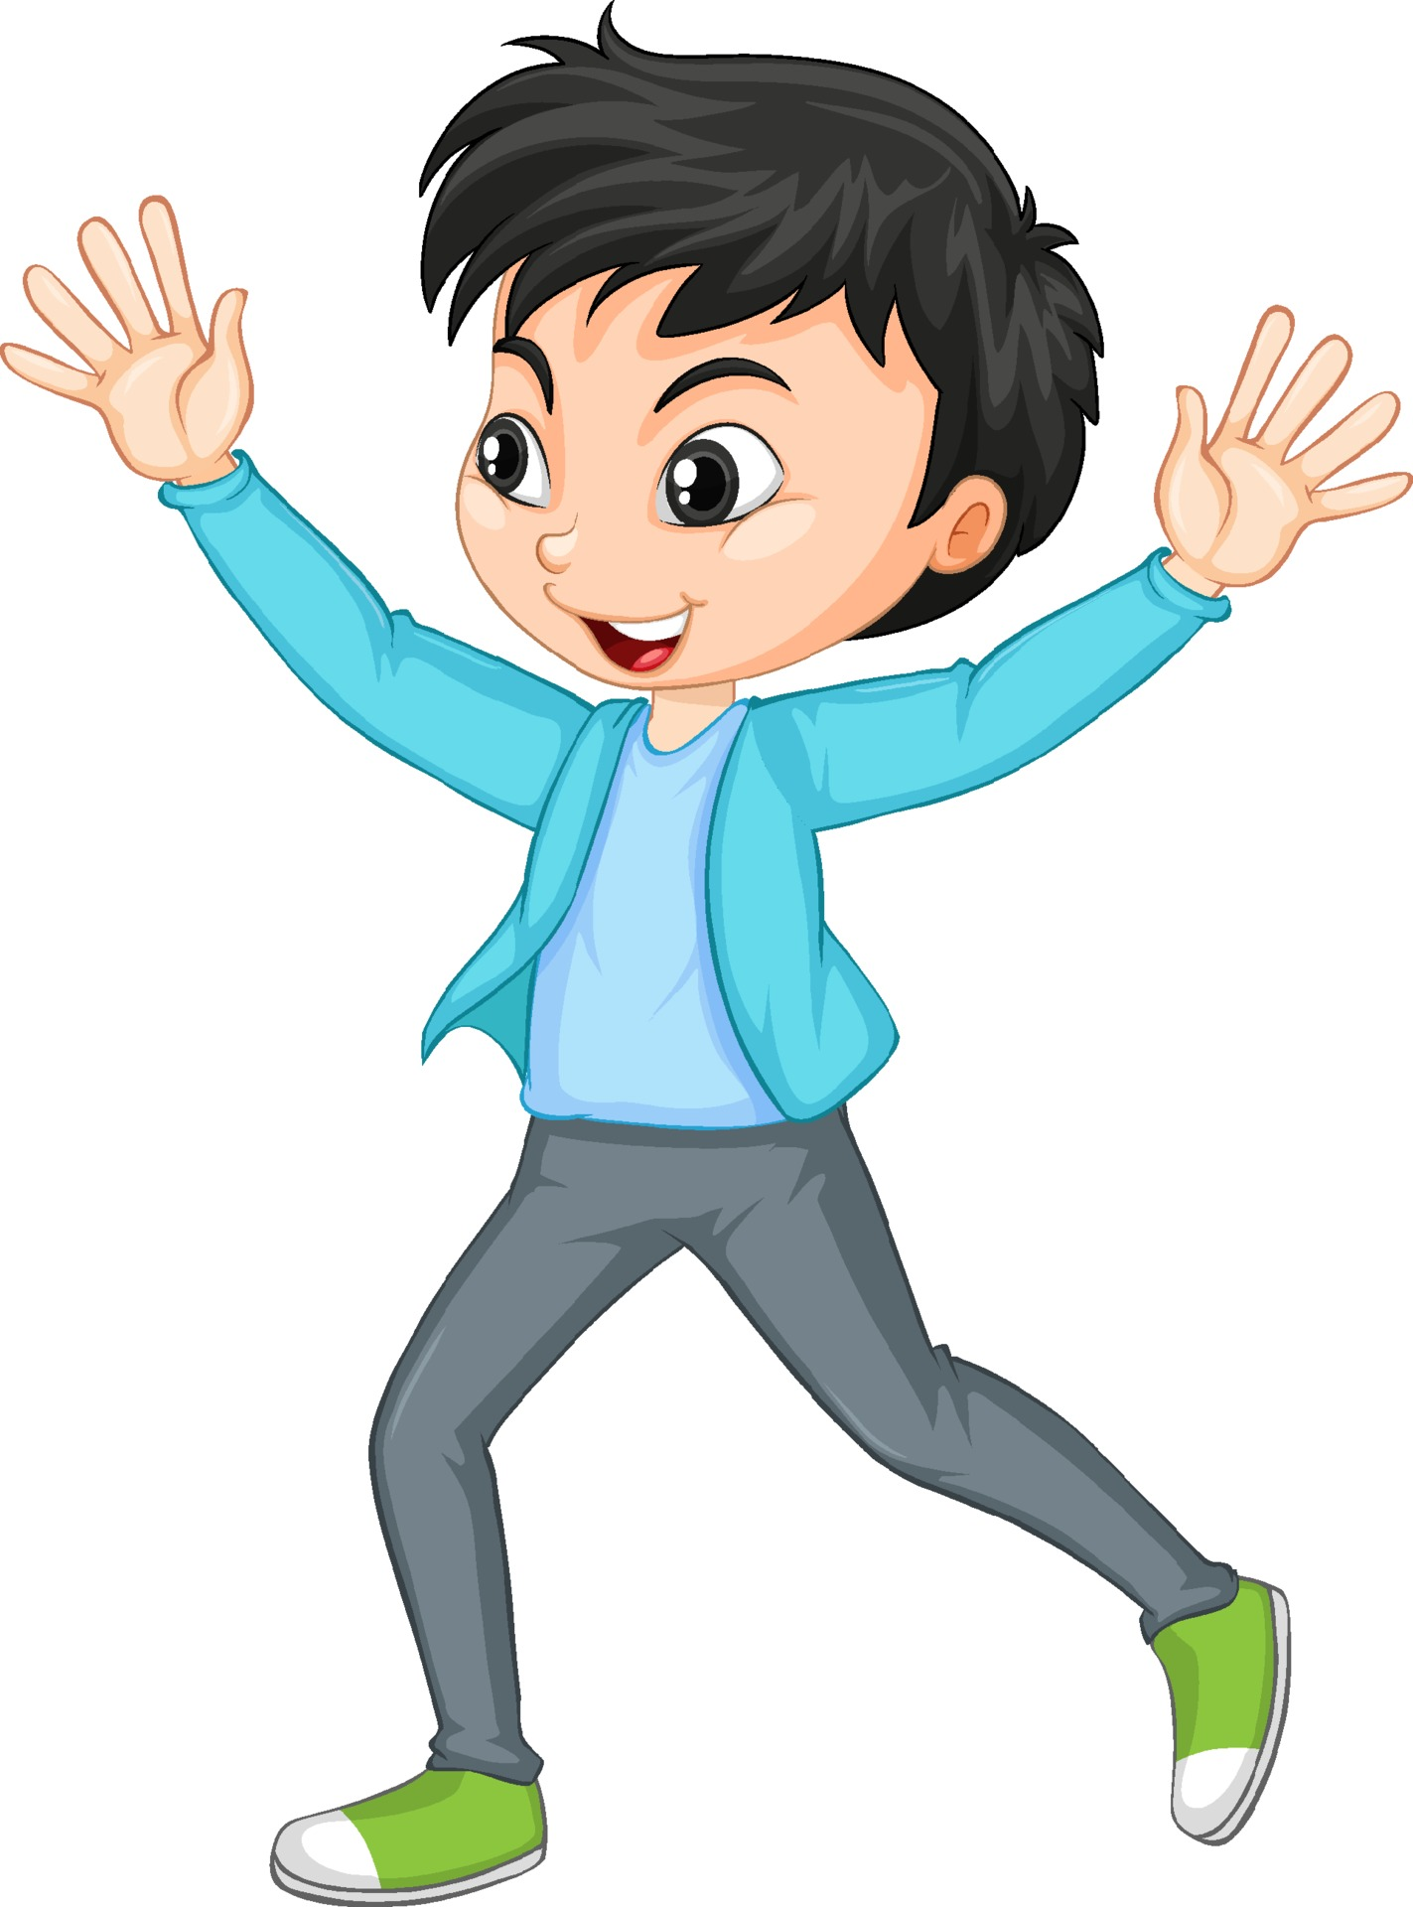
Brain Gym
🖐️🖖🤞🤘👈👉👆👇☝️🤌

Slide 4
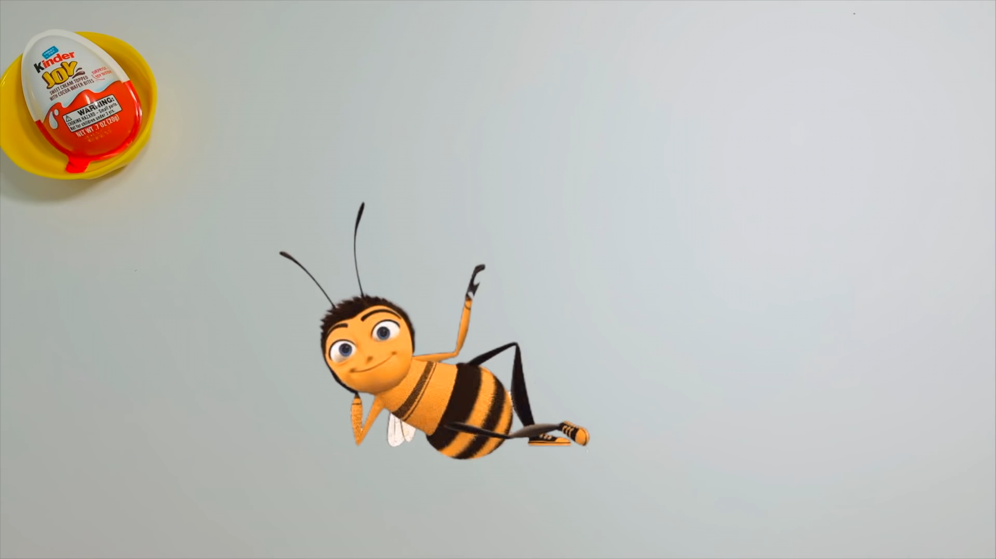
Brain Gym
Notes:
Brain Gym:
Ask sts to look at the video and try to do Brain Gym with their fingers

Slide 5



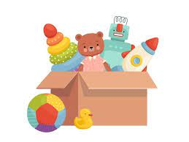
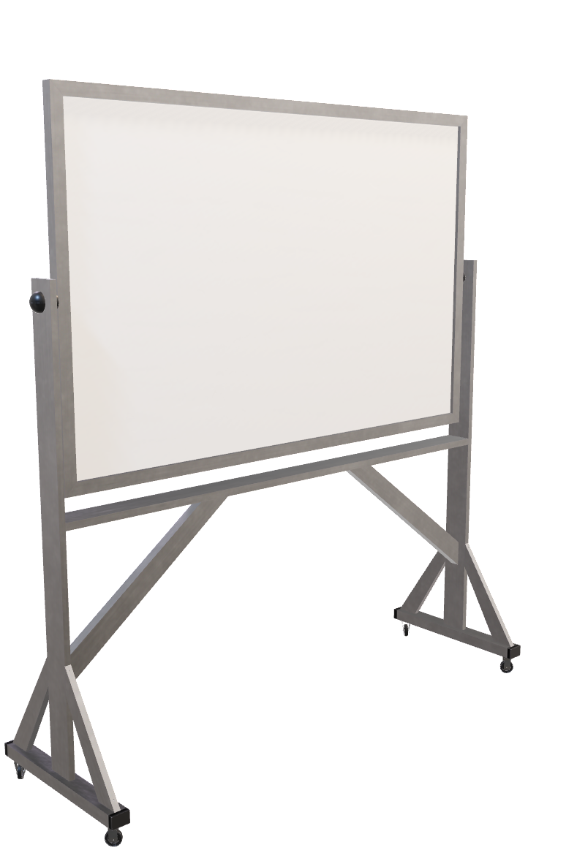
Board race
Group 1
Group 2
Notes:
Board race
- Put 2 flashcards on the board (bedroom, living room)
- Put flashcards (T.V, bed, toys, clock, lamp, computer on chalk rail)
- Have sts work in two groups
- Say a word and sts from each group run as fast as possible to the board, choose the right pictures to stick on the board
- Praise the group with more points and encourage the team with fewer points

Slide 6

Presentation
Task 7: Listen and repeat

Slide 7


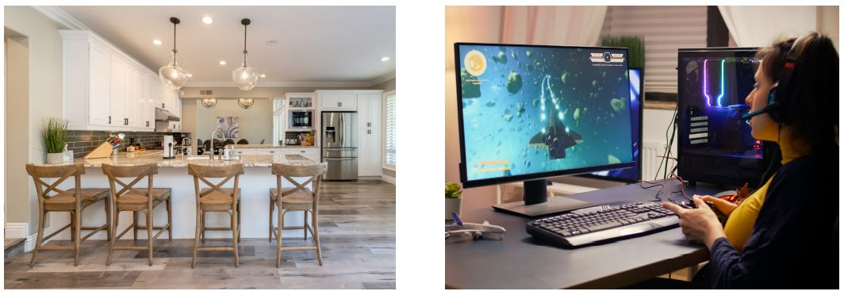
7
Listen and repeat.
chair
game
There are four chairs in the kitchen.
The game is great.

Slide 8
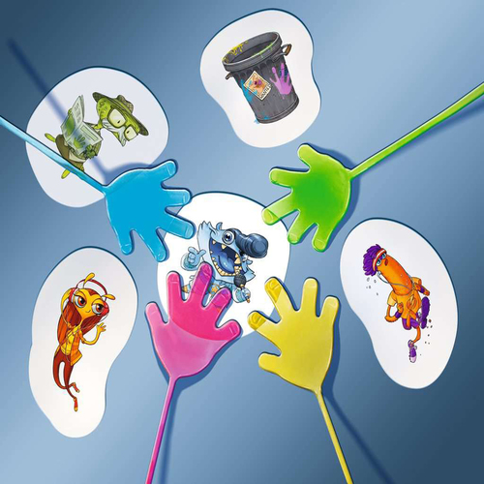
Slap the board👉

Slide 9

Practice
Task 8: Listen and chant

Slide 10
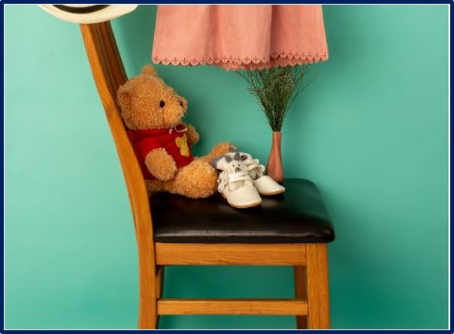
8
Listen and chant.
Game, game, game!
Great, great, great!
The game is great.
Teddy, teddy, teddy bear!
Chair, chair, chair!
The teddy bear is on the chair.

Slide 11
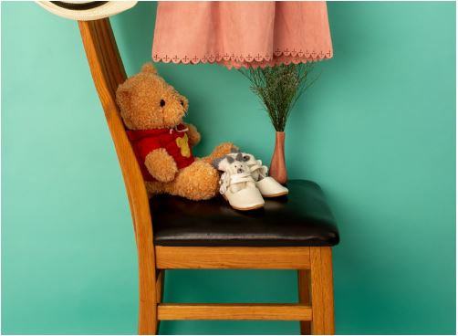
The game is great.
The teddy bear is on the chair.

Slide 12
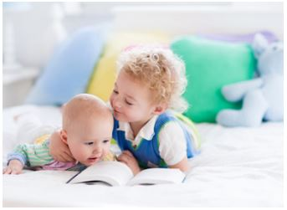
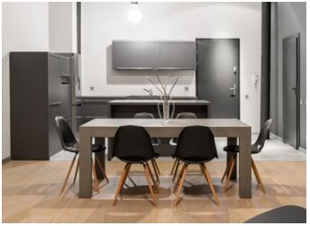
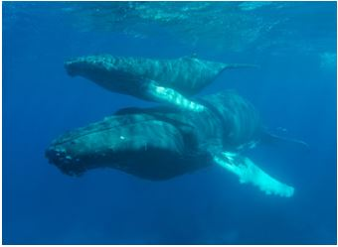
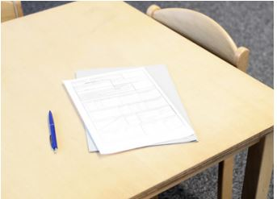
9
Say it.
There are two babies in the bedroom
2. There are six small chairs
in the kitchen.
3. The blue whales are great.
4. There is paper on the desk.

Slide 13

There are two babies
in the kitchen
There are six small chairs
on the desk
The blue whales
in the bedroom
There is paper
are great
Notes:
HOẠT ĐỘNG TƯƠNG TÁC

Slide 14

Production

Slide 15
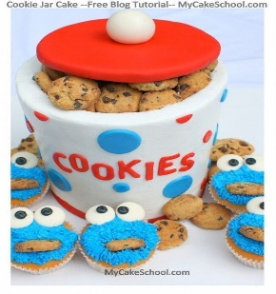
Cookies jar
Notes:
Ask sts to prepare one cookie jar for each group; they can bring some cookies or candies and put them in the jar. For each phonics lesson, they can take it out and use
- Ask sts to work in groups
- Ask them to discuss and find their own word that has the sounds /eɪ/ /eə/ and collect them in a jar.
For each correct word, they can take out one cookie/candy for their own
Groups take turns to say out loud the word’s content sound.
The group having the most words/ cookies wins the game.

Slide 16

Assessment
Choose the correct answer!

Slide 17



Odd one out
a
game
b
chair
c
great
Notes:
HOẠT ĐỘNG TƯƠNG TÁC TỪ SLIDE 20 ĐẾN 23

Slide 18
Odd one out
a
chair
b
game
c
teddy bear

Slide 19
Reorder the words
four/ there/ chairs/ kitchen./ are/ the/ in
a
There are four chairs in the kitchen.
b
There four are chairs in the kitchen.
c
There are in four chair the kitchen.

Slide 20
Reorder the words
great./ The/ is/ game
a
The is game great.
b
The game is great.
c
The great is game.

Slide 21
Listen and write the words in the correct column.
chair / game / bear/ great/ there/ birthday
/eə/ | /ei/
chair
game
bear
great
there
birthday

Slide 22



Slide 23




Good bye.
See you again!

