Slide 1





















Unit 4
My house
Fun time & Project
Notes:
Để nguyên trang bìa như này, chỉ thay đổi tên bài trong quá trình làm. Logo của sách Wonderful World

Slide 2







Activity 1
Fun time

Slide 3

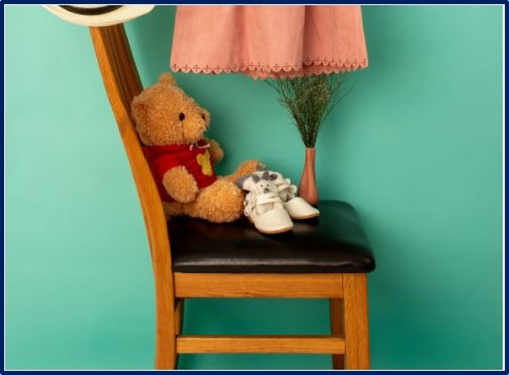
Chant
Game, game, game!
Great, great, great!
The game is great.
Teddy, teddy, teddy bear!
Chair, chair, chair!
The teddy bear is on the chair.

Slide 4



Memory chain

Slide 5


There is …...

Slide 6
There is a car.

Slide 7

There is a
teddy bear.

Slide 8
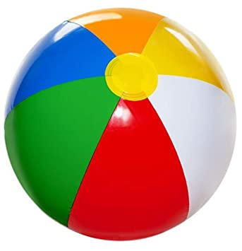
There is
a ball.

Slide 9

Notes:
Game: Find your partner
- Use word cards and put in multiple sets so that all sts have word cards or pictures (half of flashcards are word cards the others are pictures)
- Have ss walk around to look for another ss who have the same flashcards (Words or pictures)

Slide 10


Notes:
- Game: Walk and talk
+ Place a couple of flashcards around the room (eg: T. V- living room
a lamp - bedroom, game – T.V, a clock – living room,
a computer – classroom, a toy – bathroom)
- Have ss go around in pairs. At signal “stop”
S1: face up the cards and ask “What’s this?”
S2: There is a T.V in the living room.

Slide 11

1
Unscramble the letters

Slide 12

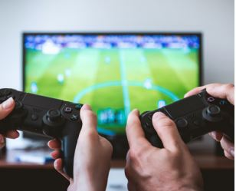
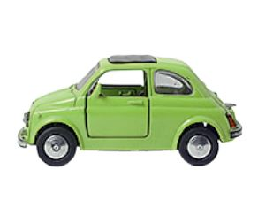
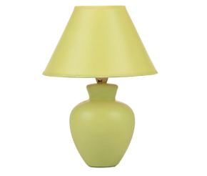
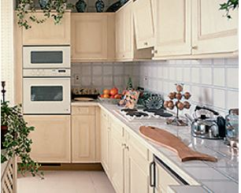

1
Unscramble the letters.
1
labl
2
meag
3
arc
4
malp
5
tchnike
6
ddyet rabe
Notes:
THIẾT KẾ HOẠT ĐỘNG TƯƠNG TÁC. ĐÁP ÁN SLIDE 20

Slide 13
1
labl
ball

Slide 14
2
meag
game

Slide 15
3
arc
car

Slide 16
4
malp
lamp

Slide 17
5
tchnike
kitchen

Slide 18
6
ddyet rabe
teddy bear

Slide 19
1
Unscramble the letters.
1
labl
2
meag
3
arc
ball
game
car
4
malp
5
tchnike
6
ddyet rabe
lamp
kitchen
teddy bear

Slide 20

Activity 2
Project

Slide 21
2
Project: A nice house.
Draw the rooms of a house. Tell the class about them.
Living room
Bedroom
Bathroom
Kitchen

Slide 22

Draw your dream house
SHOW AND TELL

Slide 23



Slide 24




Good bye.
See you again!

