Slide 1
















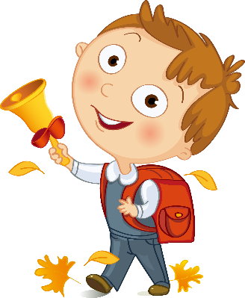



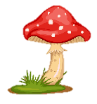
Notes:
Để nguyên trang bìa như này, chỉ thay đổi tên bài trong quá trình làm. Logo của sách Wonderful World

Slide 2
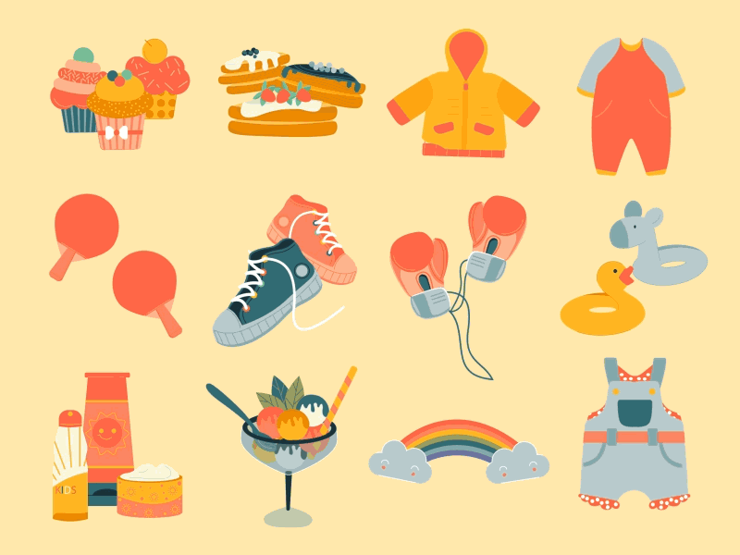



Unit 5
My clothes
Lesson 3 – Task 1,2,3

Slide 3


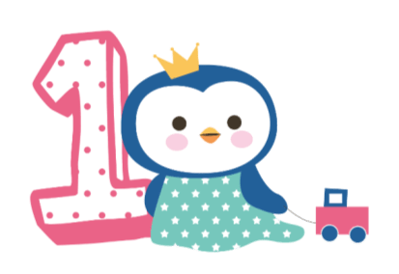



Warm up
Song: Brain gym

Slide 4


Hello everyone!
Brain gym!

Slide 5

Hi! I’m Mr Bean.

Slide 6
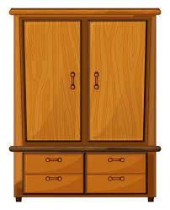
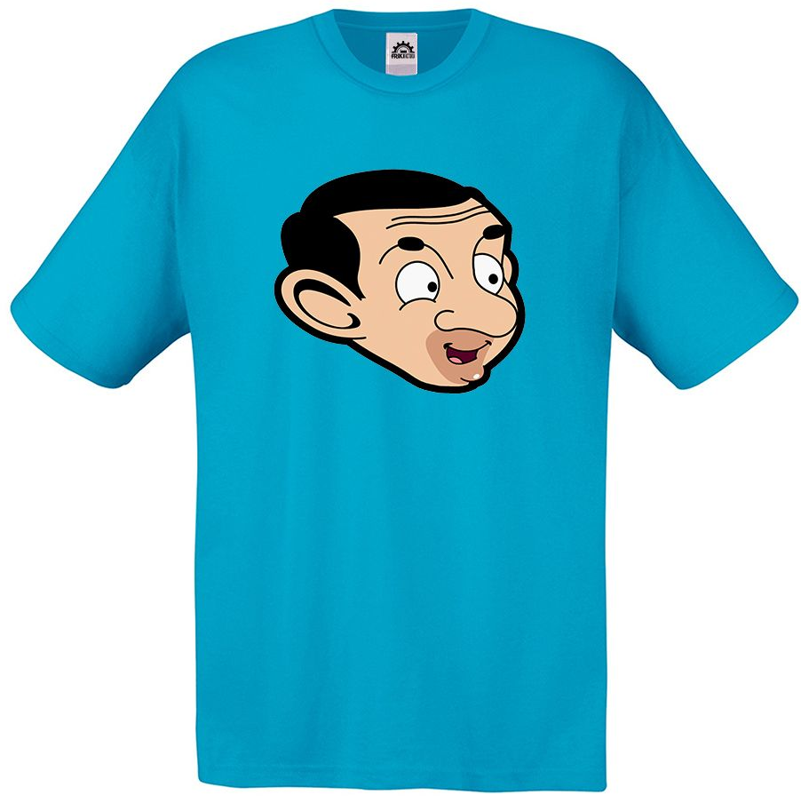

What ‘s in my closet?

Slide 7
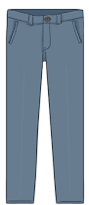
What ‘s in my closet?

Slide 8
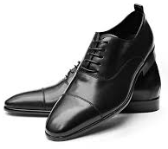
What ‘s in my closet?

Slide 9
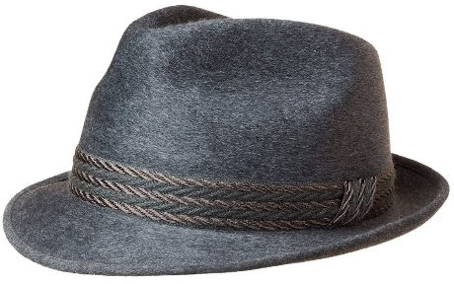
What ‘s in my closet?

Slide 10
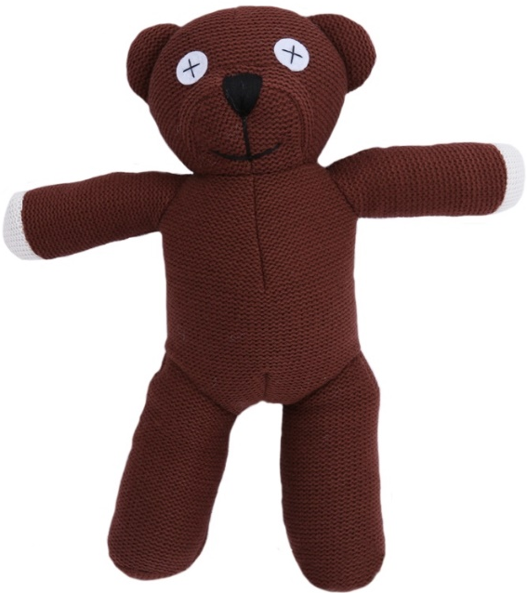
What ‘s in my closet?

Slide 11
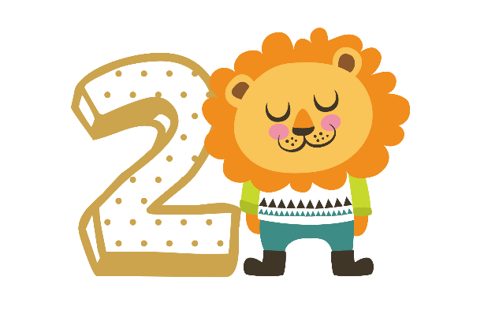
Presentation
Task 1: Listen and point

Slide 12

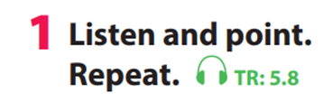

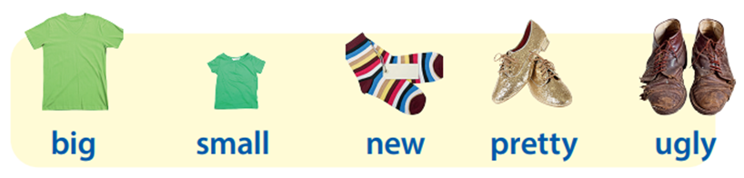

Slide 13
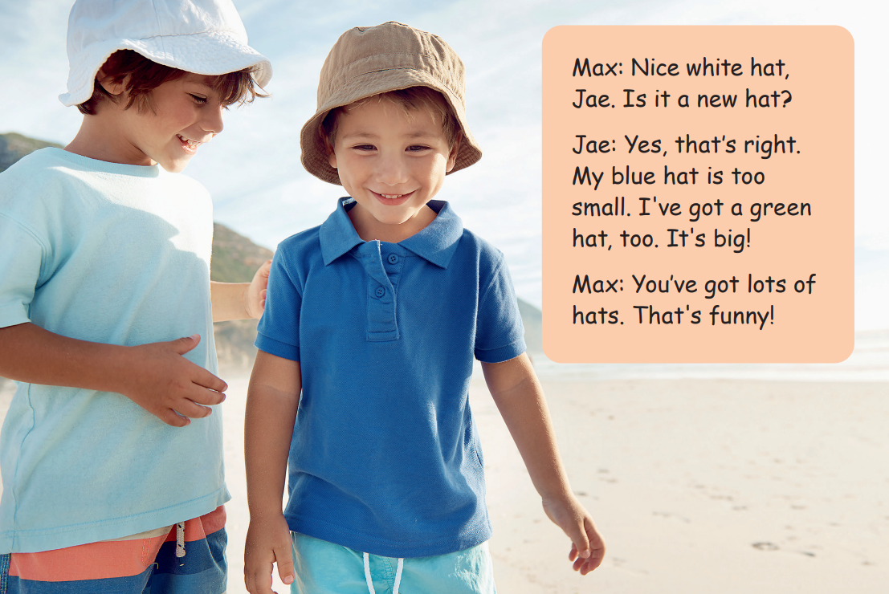
2 Listen and tick.

Slide 14


Jae has got a hat. His hat is
green and .........
a
new
b
small
c
big

Slide 15
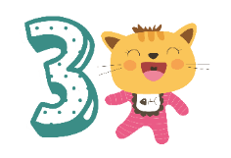
Practice
Task 8: Look and say

Slide 16


3
Practice

Slide 17
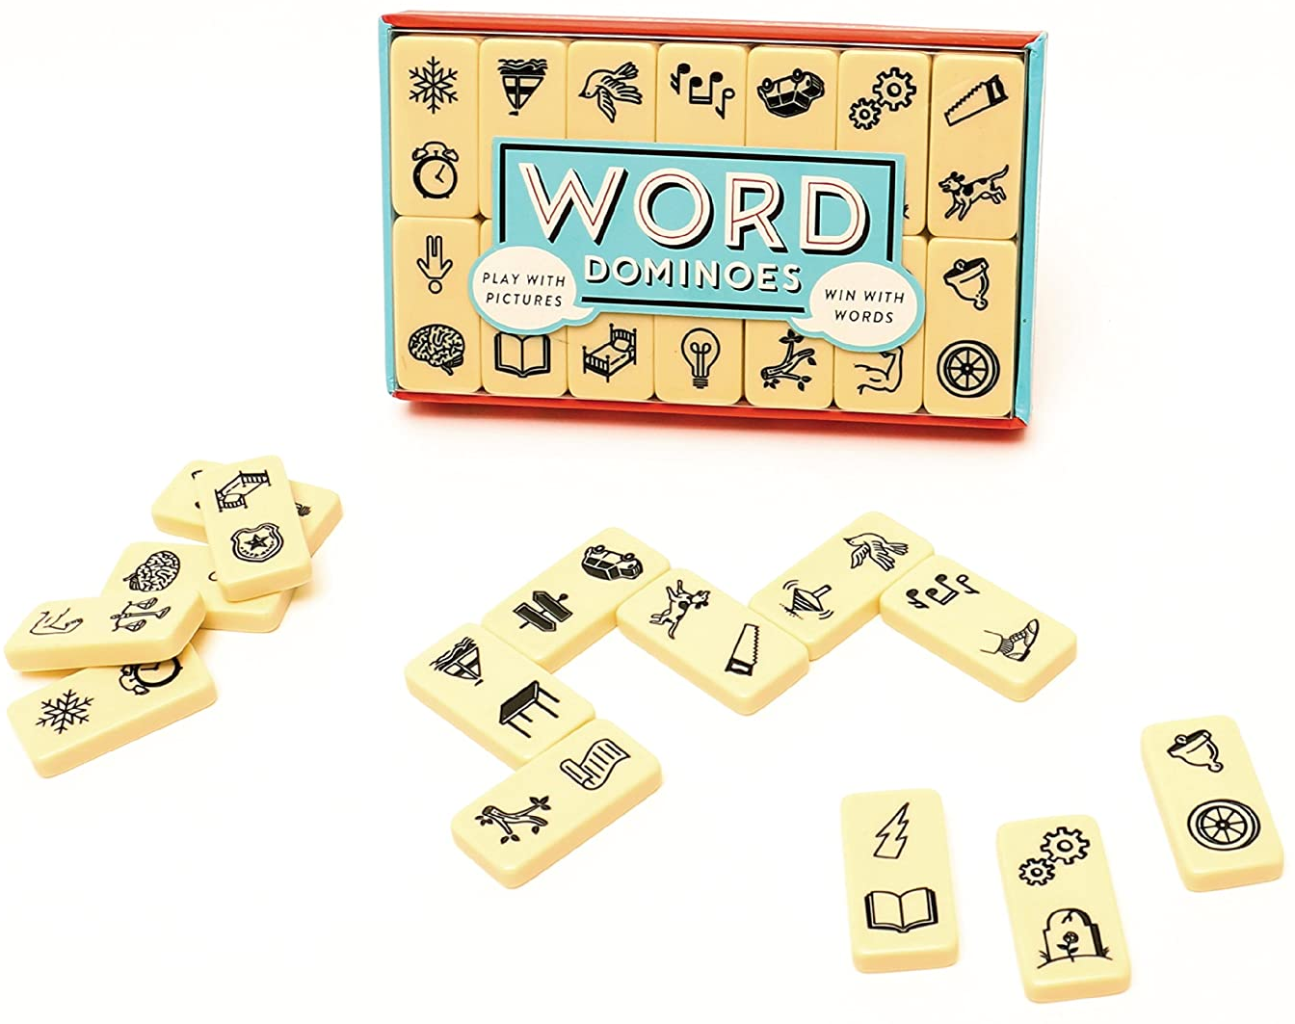
Leisure dominoes
Notes:
Game: Leisure dominoes
- Make a copy of the Leisure dominoes worksheet and cut it into flashcards. Make a copy of the Leisure dominoes worksheet for each small group and stick it onto a card
Brainstorm sts by asking them what they have learned, and focus on the new words of this lesson. Use the flashcards to play a miming game. One student comes to the front of the class. Show them a card and they have to mime the activity for the rest of the class to guess
- Arrange the class in small groups working around table
- Explain the rules. This can be done by example. Shuffle the dominoes and divide them between a group of sts. Place the last dominoes face up in the middle of the table
- The player to the left of the dealer starts. He or she put a dominoes next to the one on the table (either before or after) It must match the word or the picture
- The player on his or her left continues and repeat process. If any player cannot put a domino down, it is the player’s turn
- The first person to play all their dominoes is the winner. The others continue playing. When all the dominoes have been played, they should form a closed circuit. If sts do not have a closed circuit at the end of the game, they should look for the mistake
- Circulate to monitor and check

Slide 18
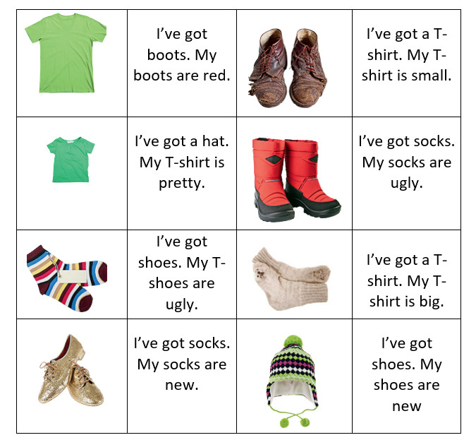
Leisure dominoes
Notes:
Game: Leisure dominoes
- Make a copy of the Leisure dominoes worksheet and cut it into flashcards. Make a copy of the Leisure dominoes worksheet for each small group and stick it onto a card
- Brainstorm sts by asking them what they have learned, and focus on the new words of this lesson. Use the flashcards to play a miming game. One student comes to the front of the class. Show them a card and they have to mime the activity for the rest of the class to guess
- Arrange the class in small groups working around table
- Explain the rules. This can be done by example. Shuffle the dominoes and divide them between a group of sts. Place the last dominoes face up in the middle of the table
- The player to the left of the dealer starts. He or she put a dominoes next to the one on the table (either before or after) It must match the word or the picture
- The player on his or her left continues and repeat process. If any player cannot put a domino down, it is the player’s turn
- The first person to play all their dominoes is the winner. The others continue playing. When all the dominoes have been played, they should form a closed circuit. If sts do not have a closed circuit at the end of the game, they should look for the mistake
- Circulate to monitor and check

Slide 19
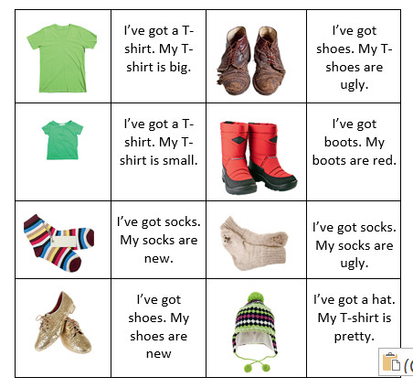
Leisure dominoes

Slide 20

4
Production

Slide 21
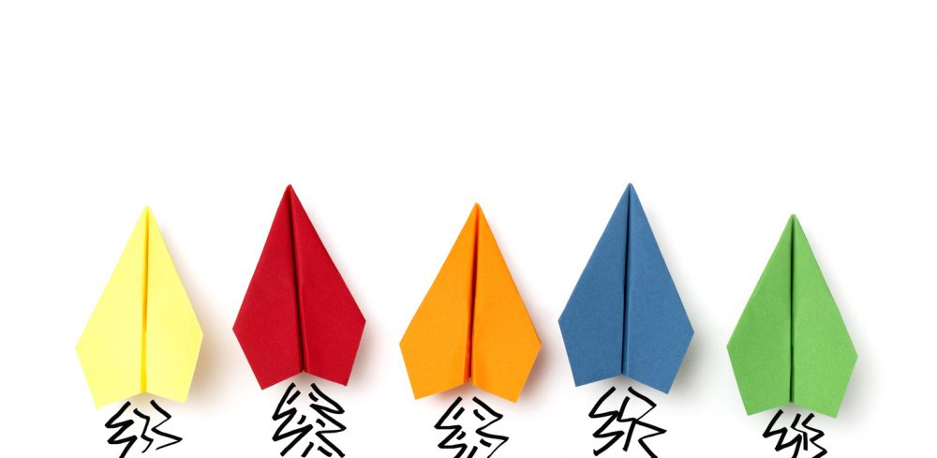
Guessing game
Notes:
Ask Sts to quickly write on their papers someone’s clothes they are wearing. Then sts fold up like a paper airplane. Sts make a circle/ lines/ groups (with their backs to each other). Then throw it to their friends. Whoever receives it will guess the name of the writer who wants to mention

Slide 22
5
Assessment

Slide 23
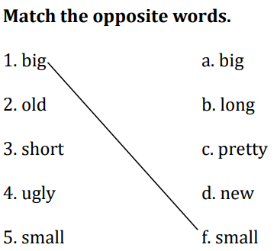
Notes:
HOẠT ĐỘNG TƯƠNG TÁC

Slide 24

Goodbye!

Slide 25




Good bye.
See you again!

