Slide 1




















Notes:
Để nguyên trang bìa như này, chỉ thay đổi tên bài trong quá trình làm. Logo của sách Wonderful World

Slide 2






Unit 6:
Outdoor Activities
Lesson 3 - Period 3 - Task 7 8 9

Slide 3
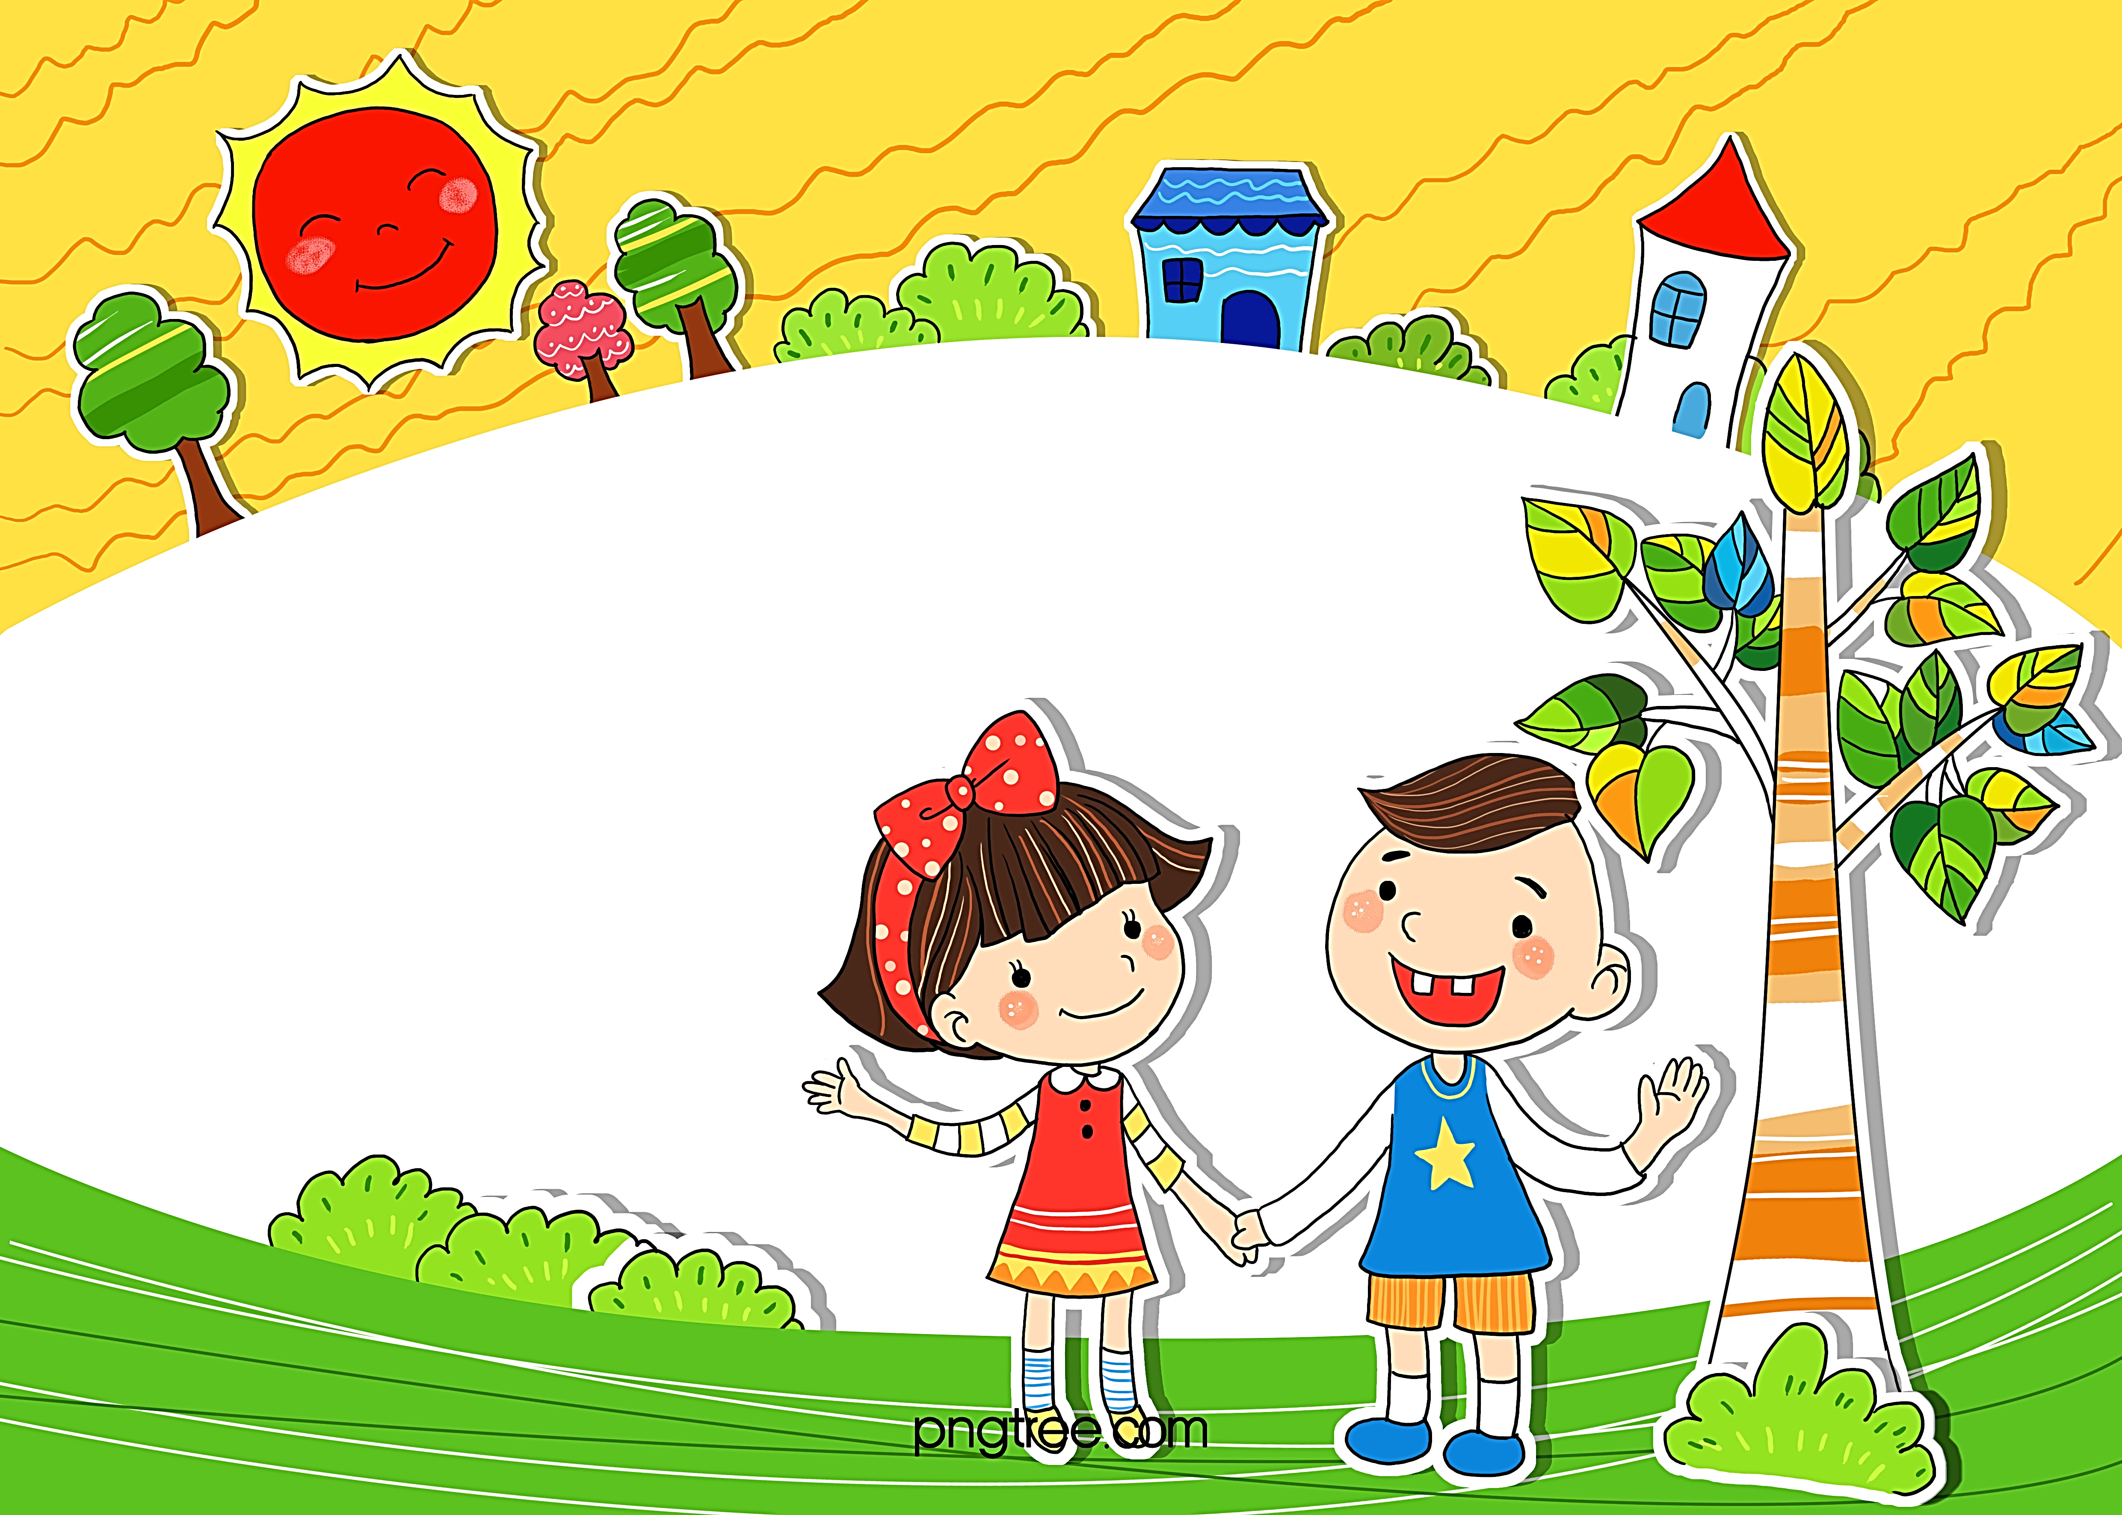
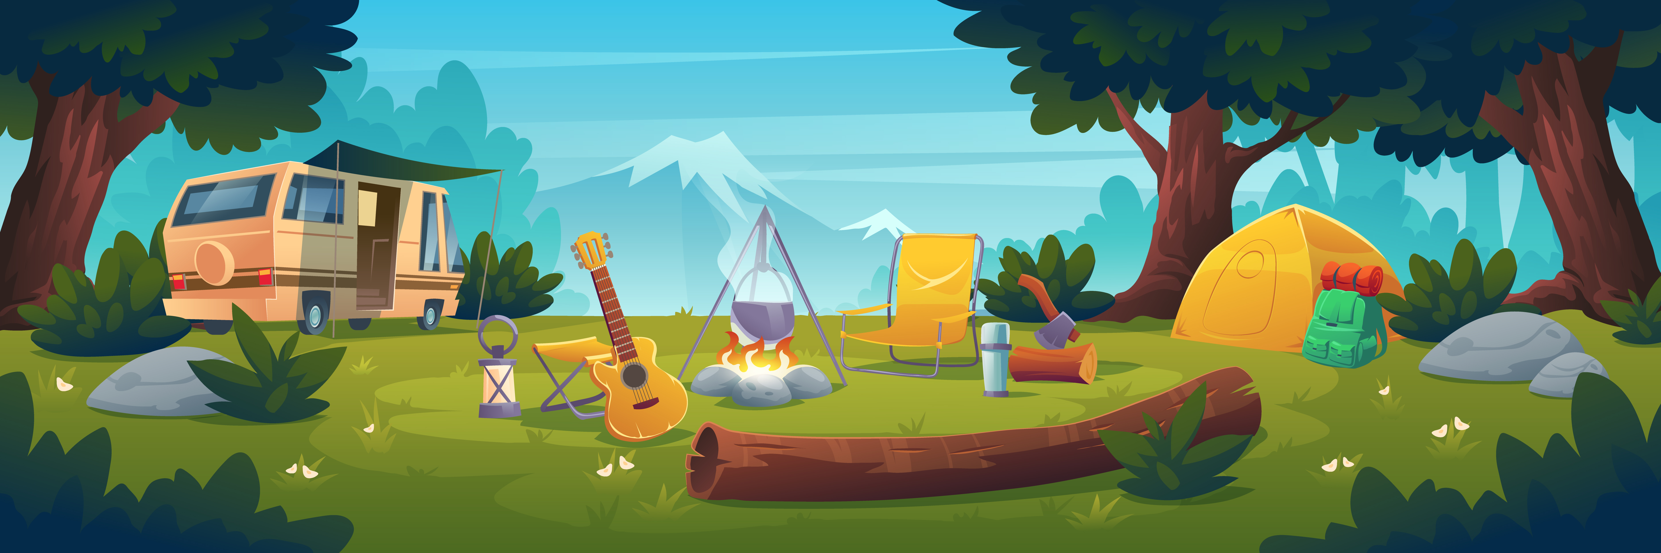
01
WARM-UP

Slide 4


Slide 5
02
PRESENTATION

Slide 6

Let’s Play A Game!

Slide 7

g
go

Slide 8
sk
ski

Slide 9
Slap The Board!
/g/
/sk/

Slide 10
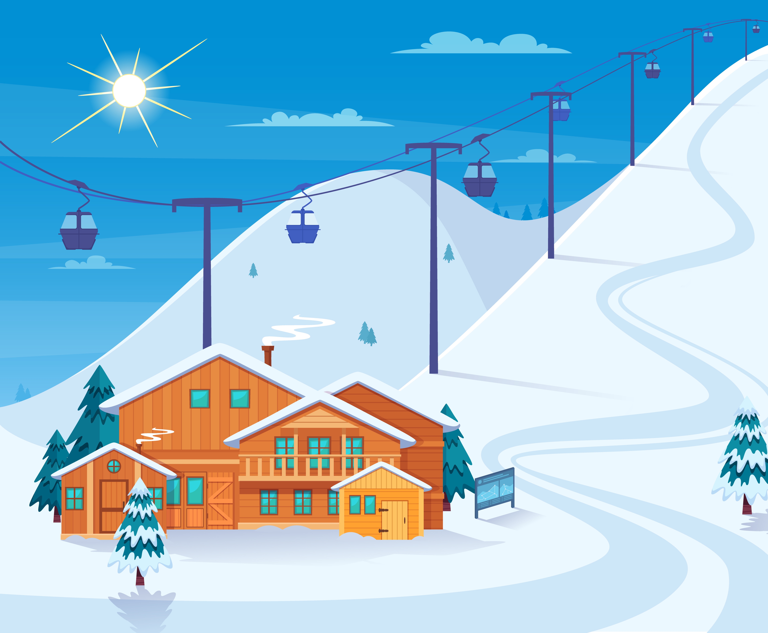
03
PRACTICE

Slide 11



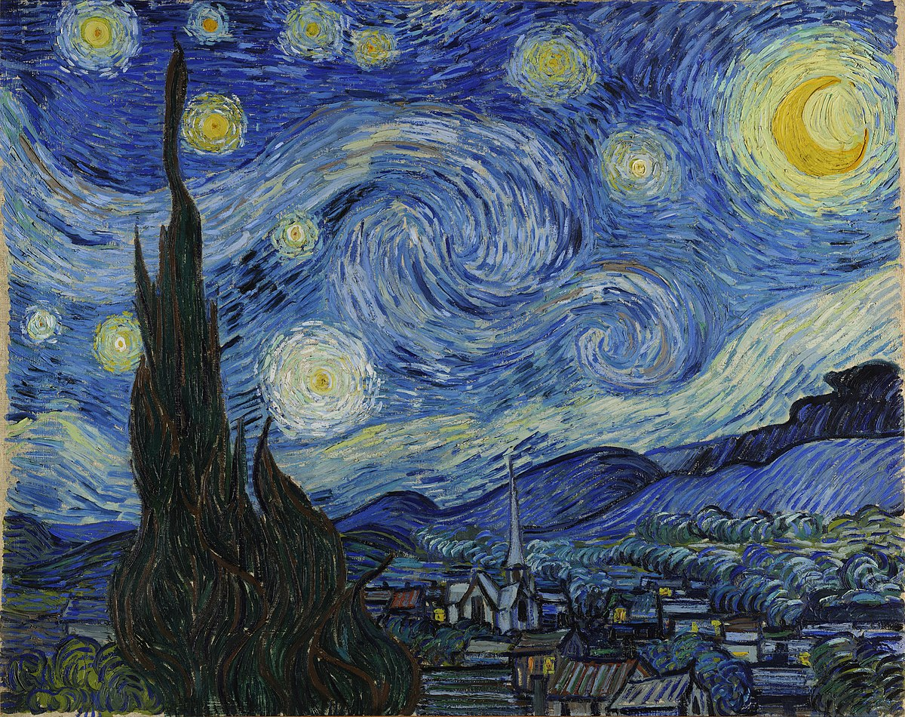
Starry Night Game!

Slide 12
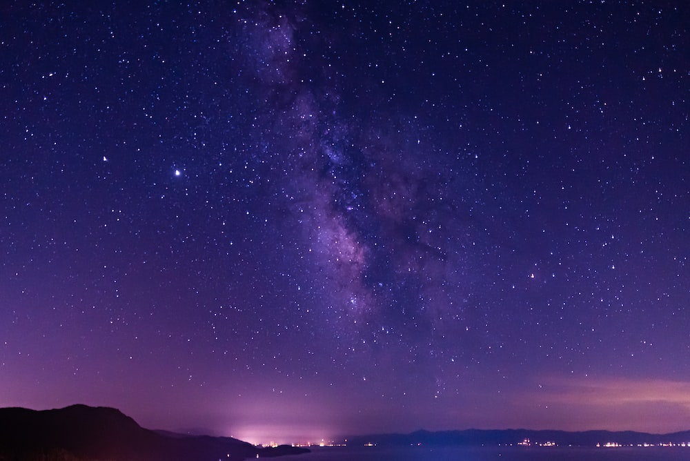

Pick a star!
Next

Slide 13
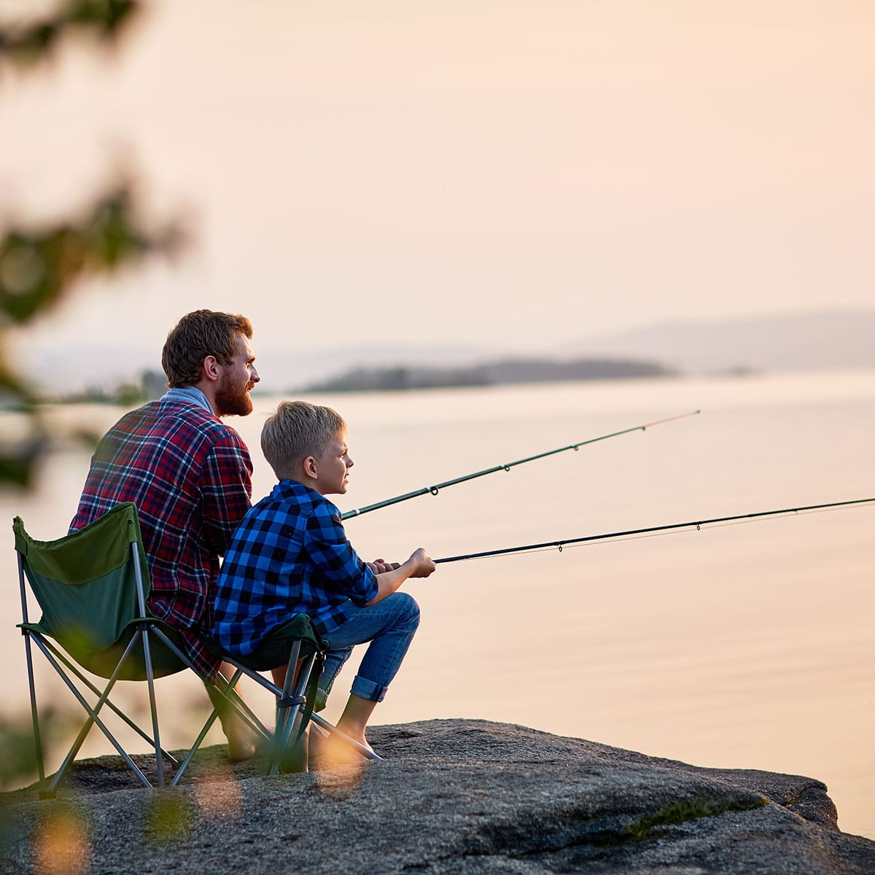
What are they doing?
They are going fishing.

Slide 14
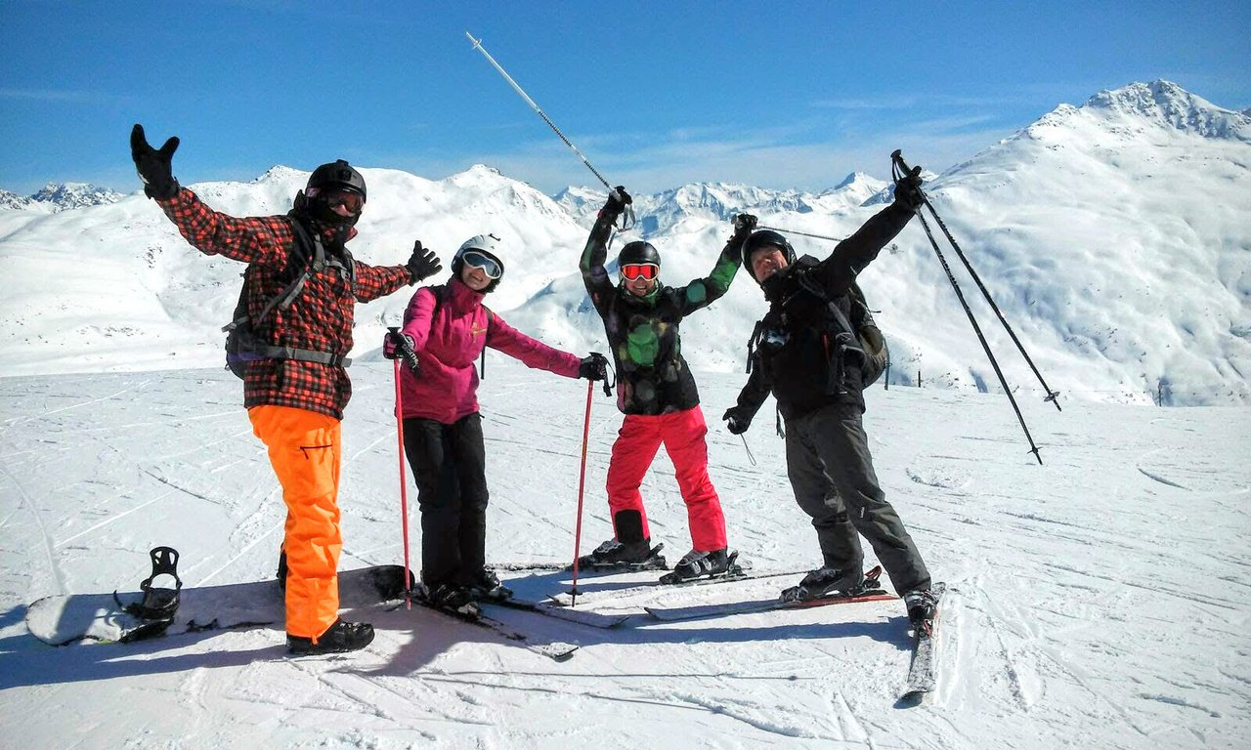
What are they doing?
They are skiing.

Slide 15
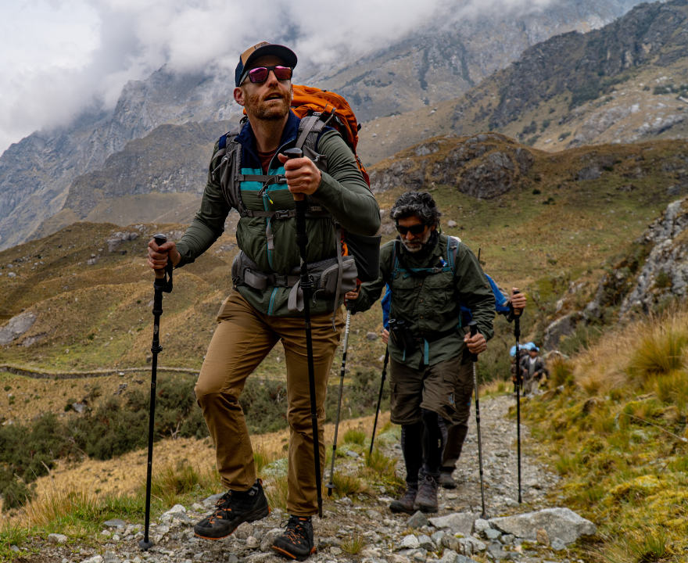
What are they doing?
They are going hiking.

Slide 16
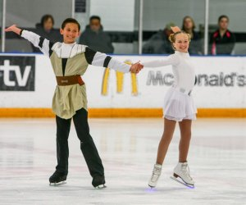
What are they doing?
They are ice-skating.

Slide 17
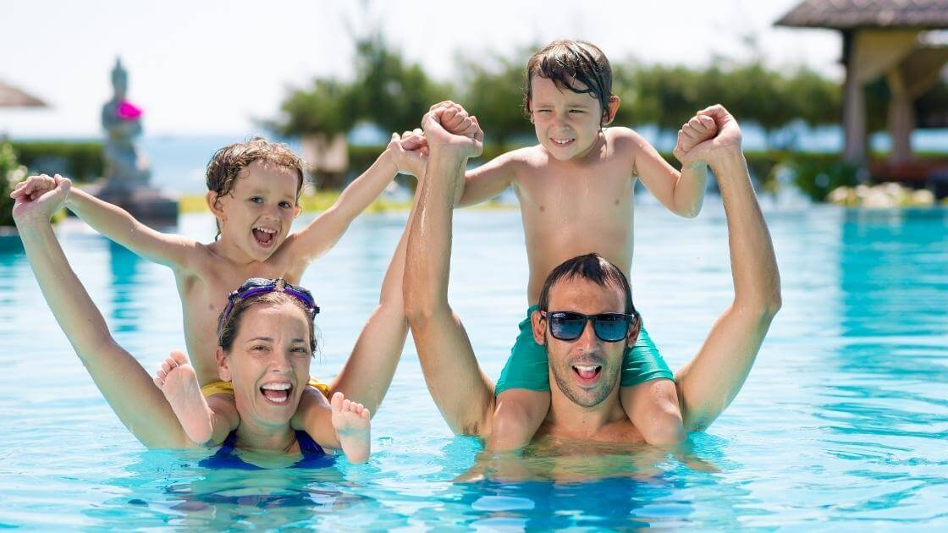
What are they doing?
They are going swimming.

Slide 18
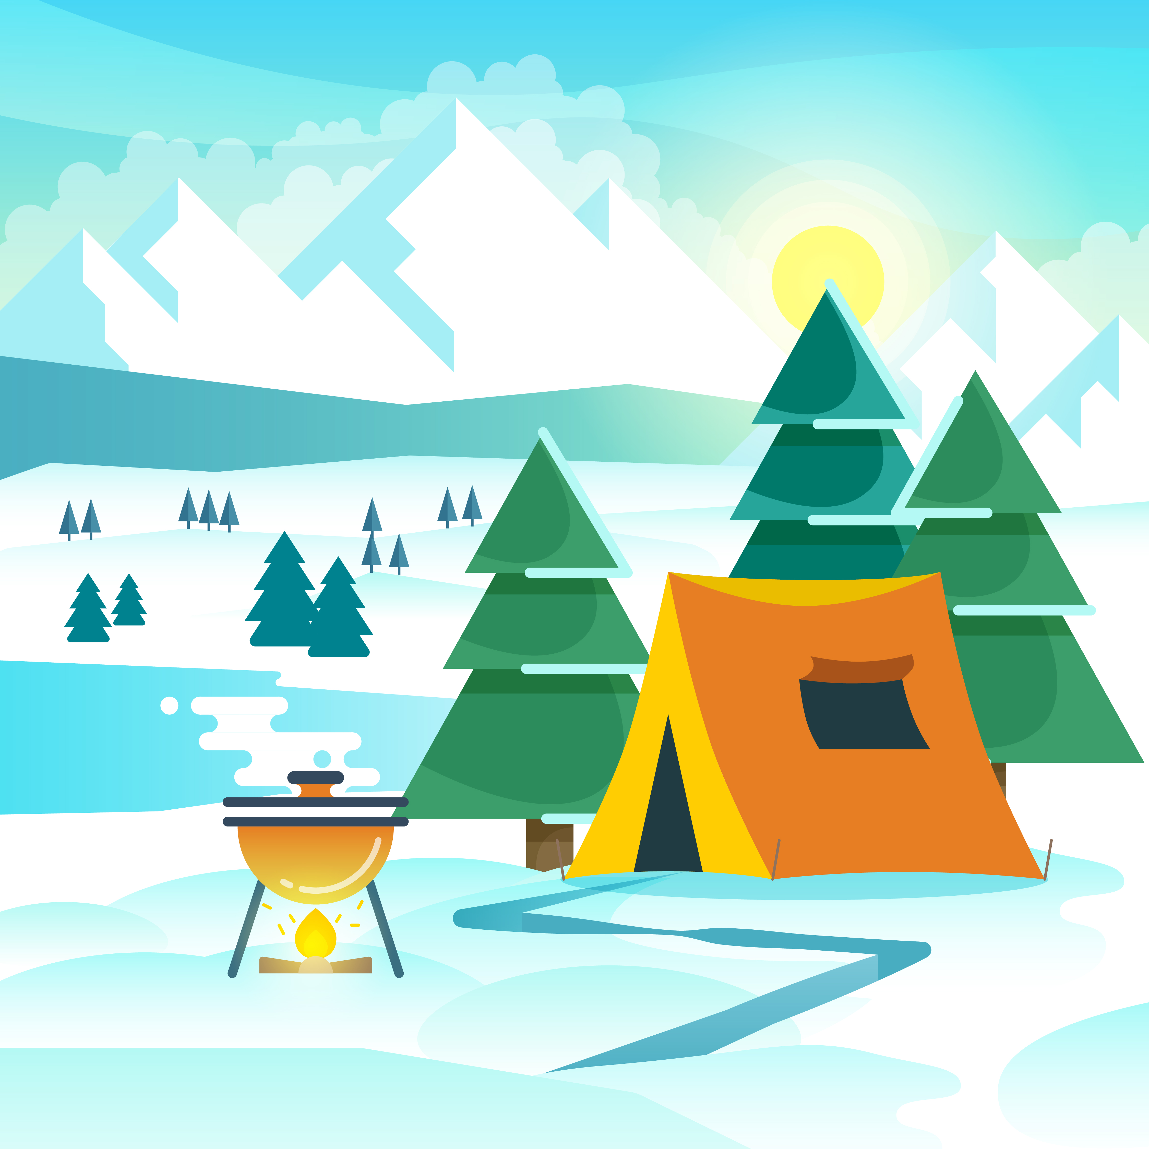
7. Listen and repeat. (Track 6.12)
go
Ski
I cαn go camping.
I can ski, too.

Slide 19
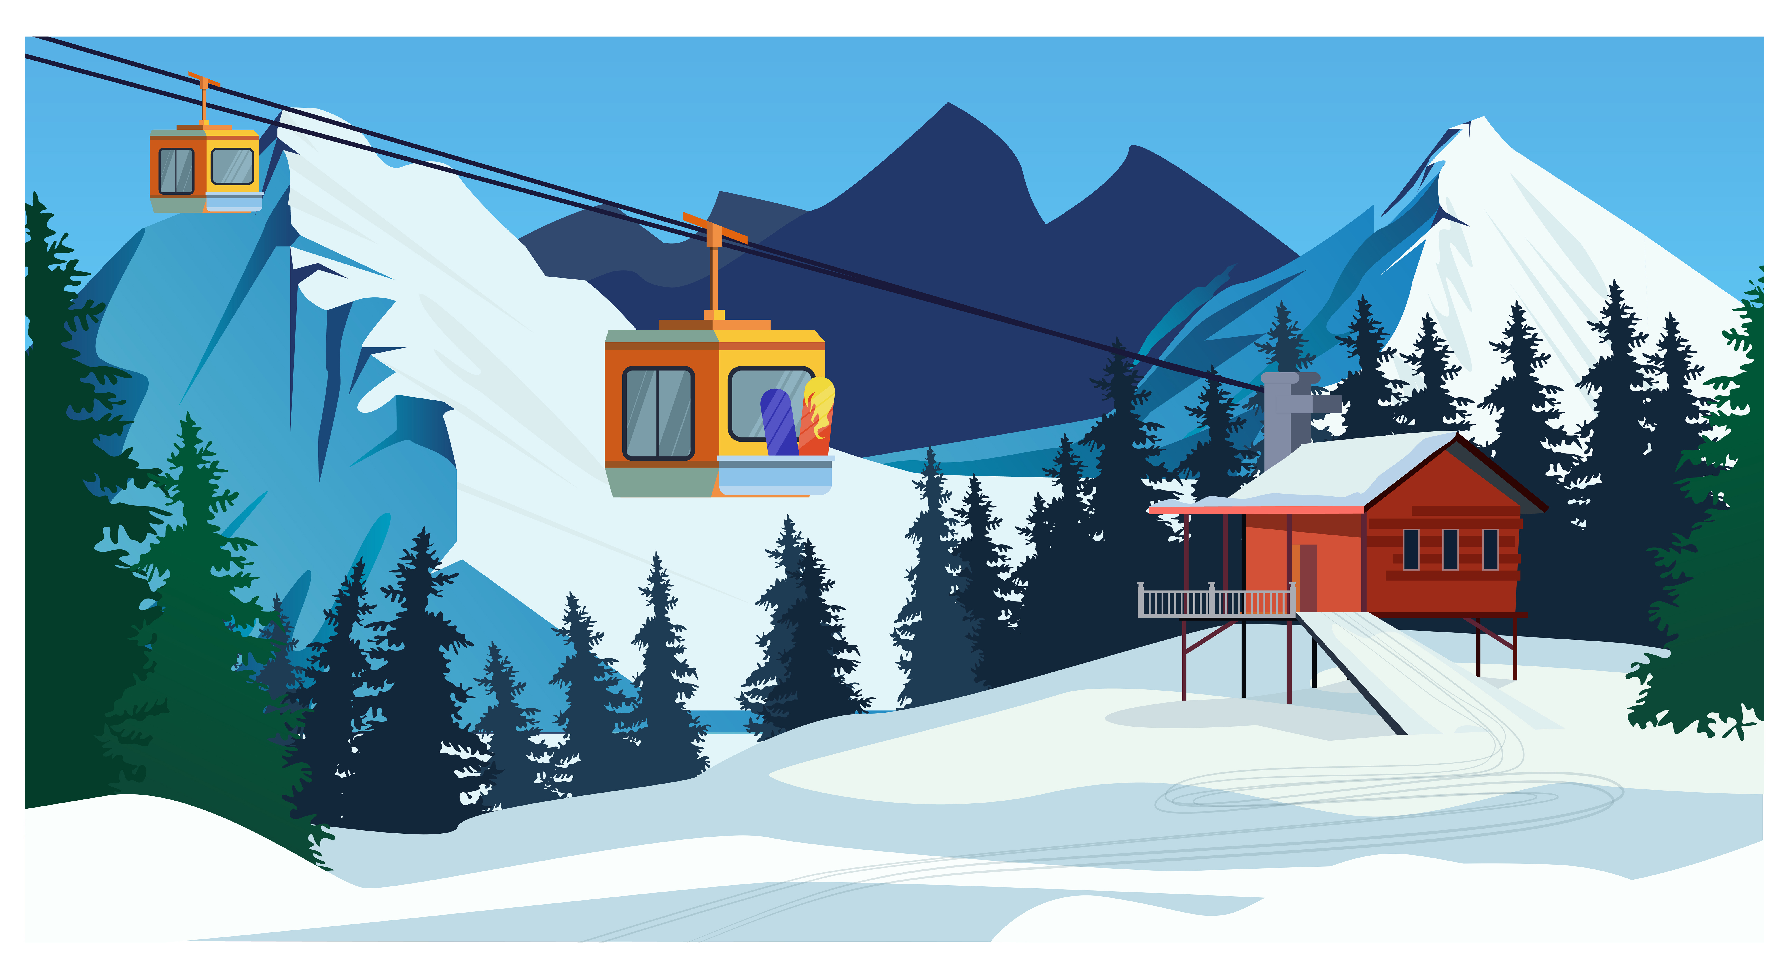
8. Listen and chant. (Track 9.13)
Go, go, go!
I cαn go to the mountαin.
Ski, ski, ski!
I cαn ski on the snow.
Let's go to the mountαin αnd
ski on the snow!

Slide 20
04 PRODUCTION

Slide 21
9. Say it.
1. They're playing α gαme in the garden.
2. She cαn go hiking on the mountαin.

Slide 22
9. Say it.
3. She cαn ski on the mountαin todαy becαuse it's snowy.
4. We cαn ice-skαte on the
mountαin, but we cαn't go fishing.

Slide 23
05
ASSESSMENT

Slide 24



ASSESSMENT
TEAM 1
TEAM 2
TEAM 3
TEAM 4
Vận dụng xuất sắc những kiến thức đã học vào thực hành
Vận dụng tốt những kiến thức đã học vào thực hành
Biết cách vận dụng những kiến thức đã học vào thực hành

Slide 25

Order and write.
1. ride / I / a / forest / bike / in / can / the/ .
I can ride a bike in the forest.
2. He / mountain/ skiing / on / the / is /.
He is skiing on the mountain.
3. board / She / playing / home / at / is / game / .
She is playing board game at home.
4. do / What/ mountain / on / the / you / can /?
What can you do on the mountain?
Notes:
Slide này cho hình nền màu đậm các câu và chữ to lên

Slide 26
UNIT 6: OUTDOOR ACTIVITIES
LESSON 7 8 9
What we learnt today
identify and write g and sk
- identify and pronounce words with initial sounds /g/and /sk/

Slide 27




Thank you & goodbye!

