Slide 1




REVIEW 2A
Grade 1

Slide 2
VOCABULARY & PHONICS

Slide 3
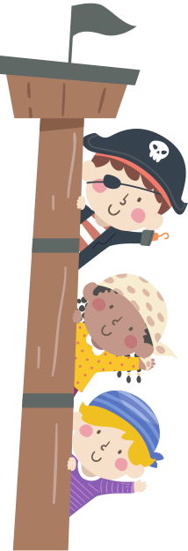
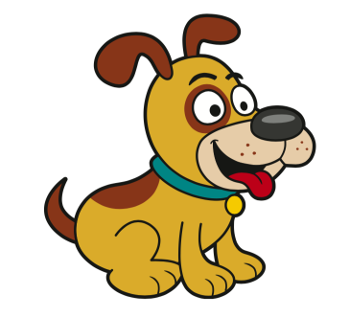
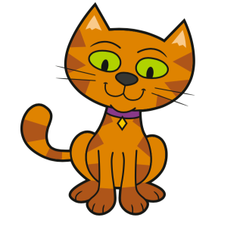
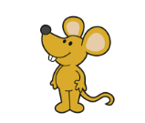

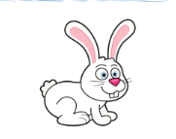
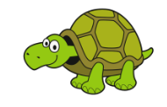
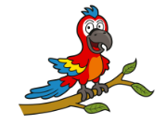
PETS
It’s a _________.

Slide 4

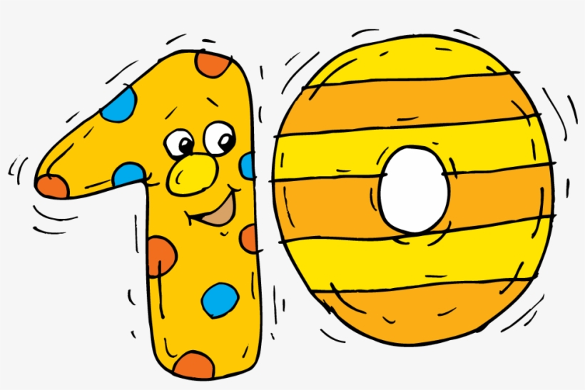



PETS
drum
/D/
/T/
ten
two
doctor

Slide 5

PETS
Big
Small
It’s a big/ small _________.

Slide 6
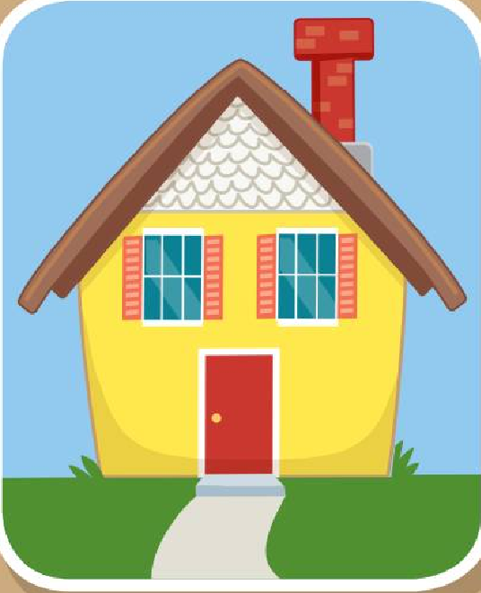
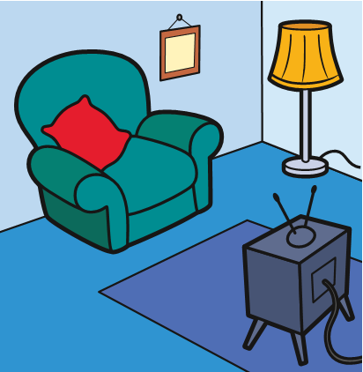
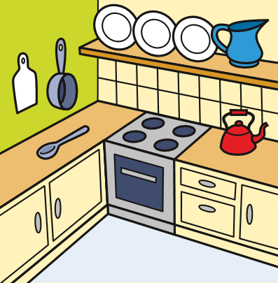
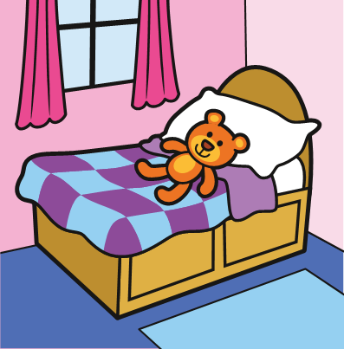
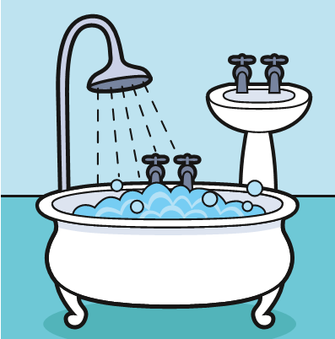
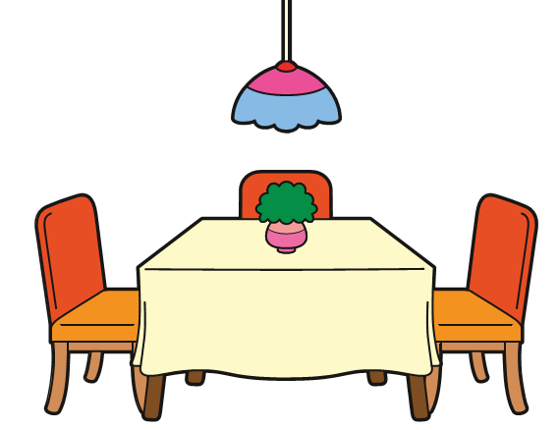
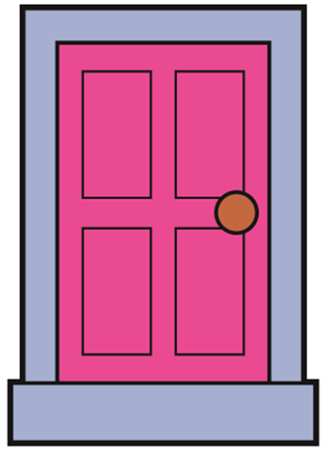

MY HOUSE
This is the _________.

Slide 7
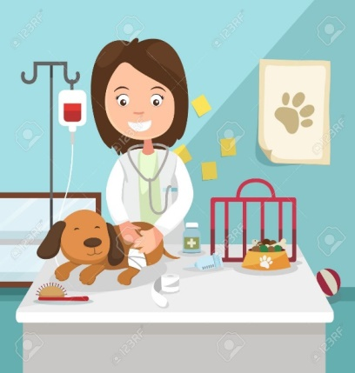


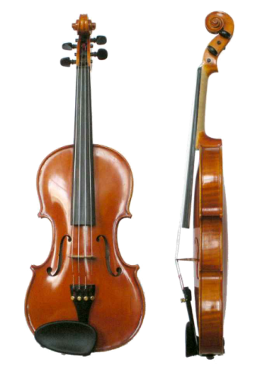
MY HOUSE
wave
/W/
/V/
vet
violin
window

Slide 8
MY HOUSE
Where is my Mum?
- She’s in the _________.

Slide 9
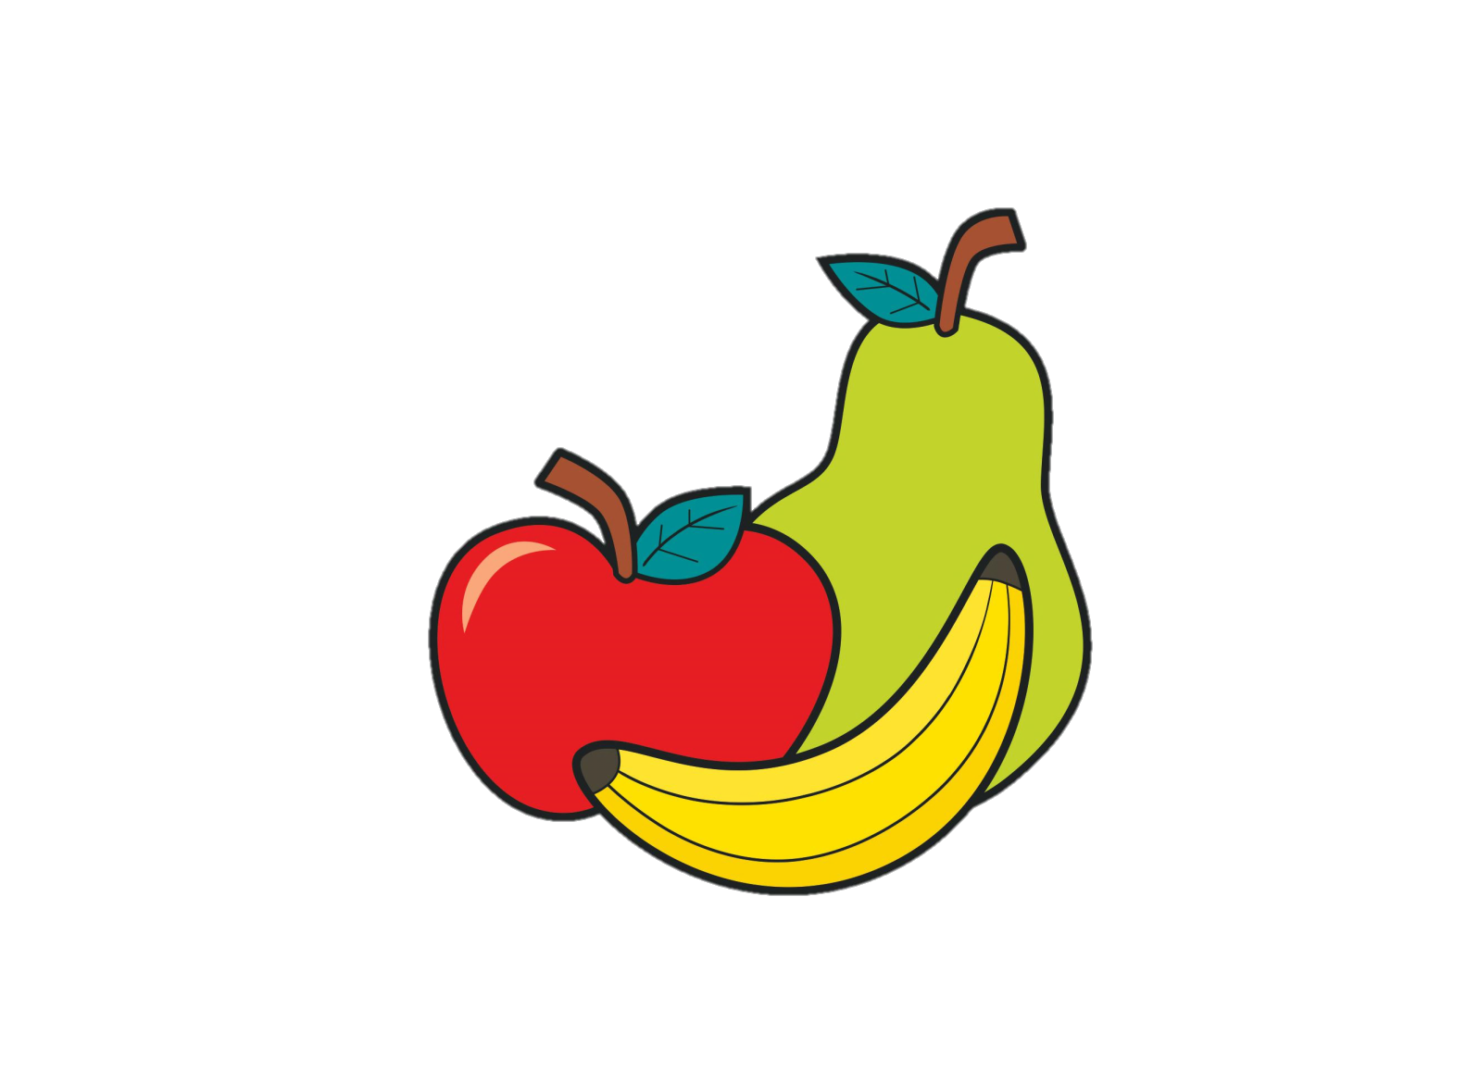


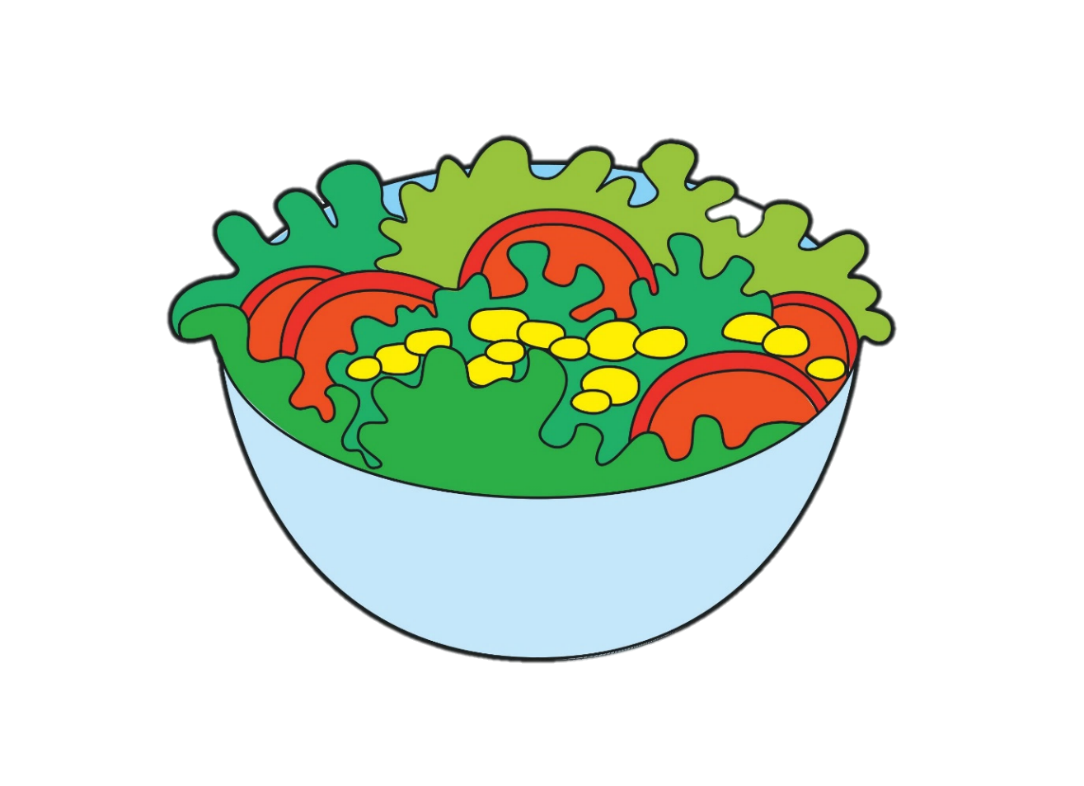
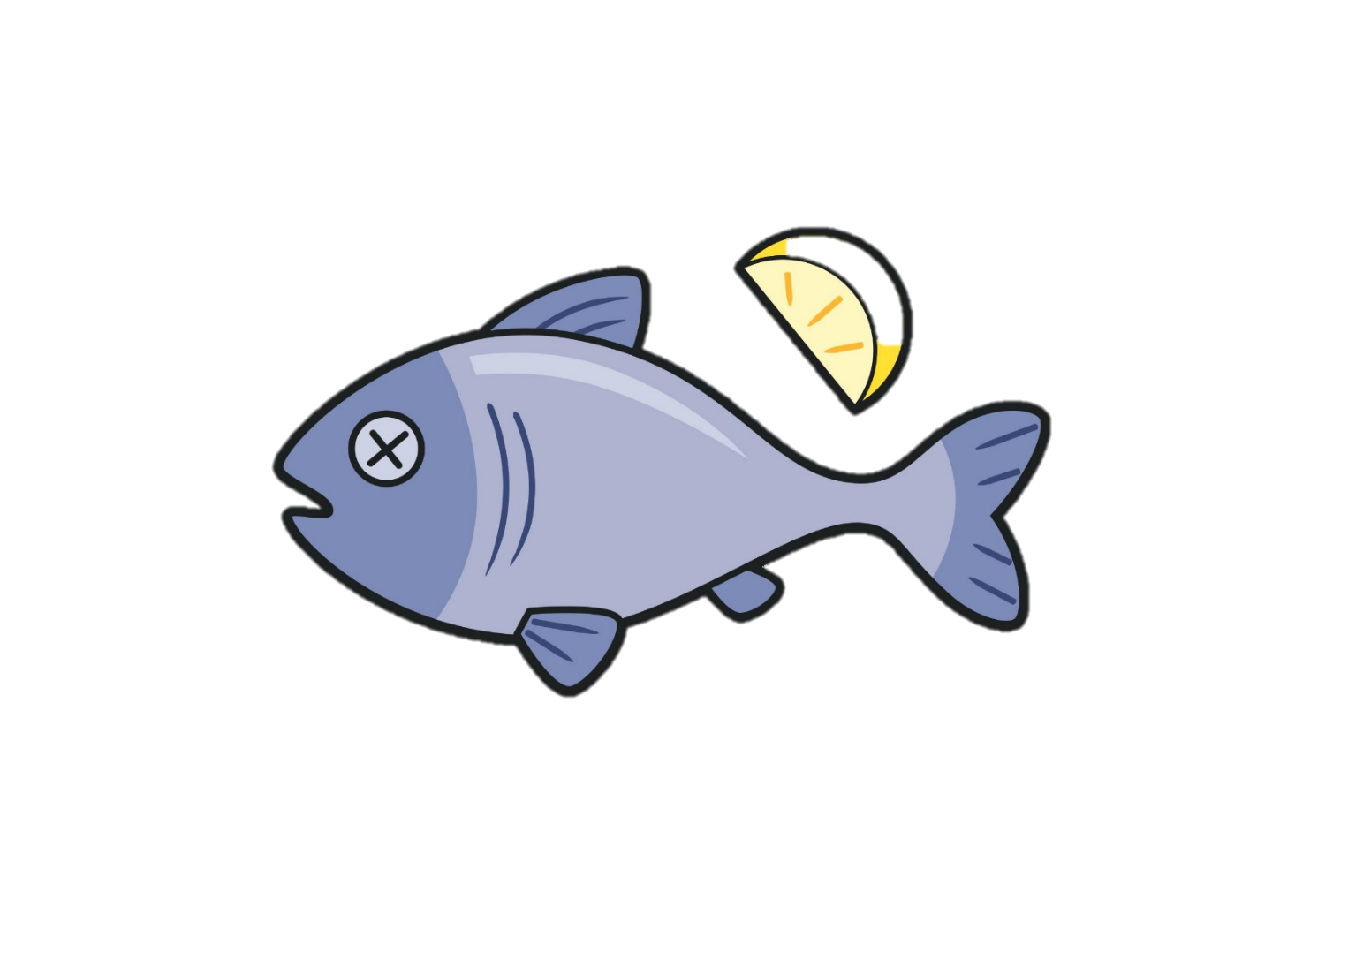
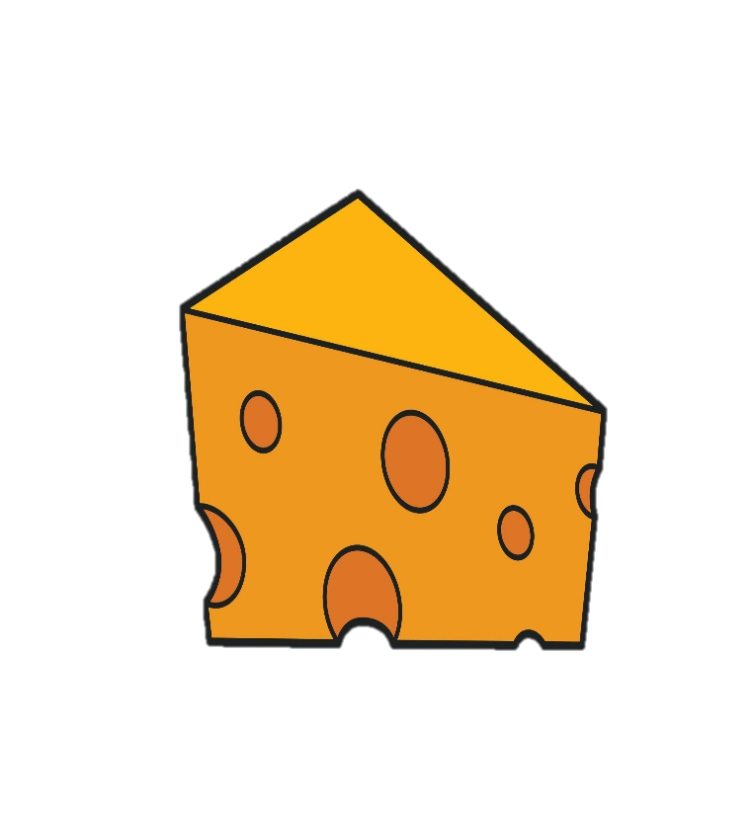
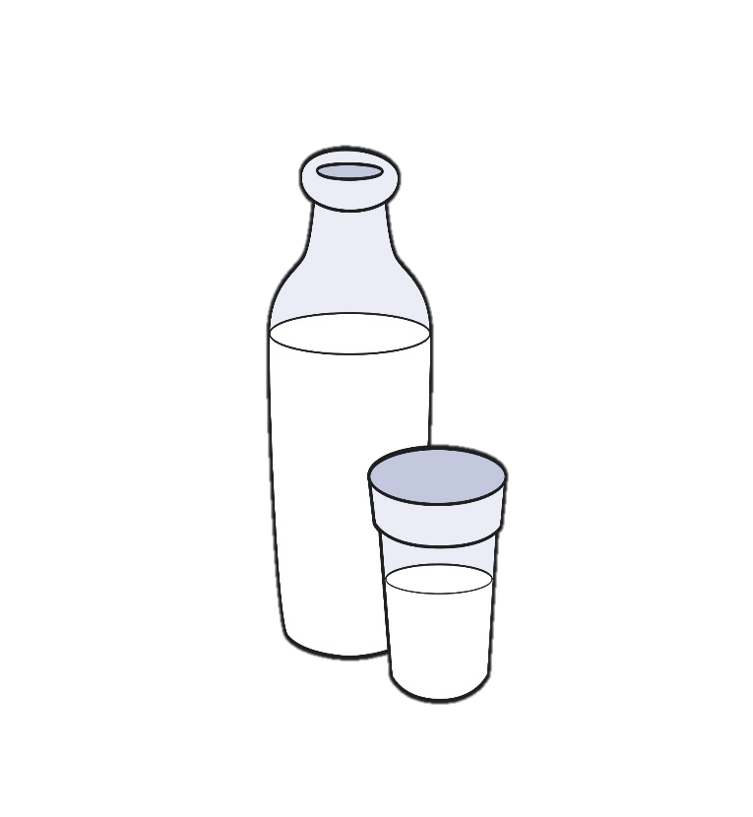
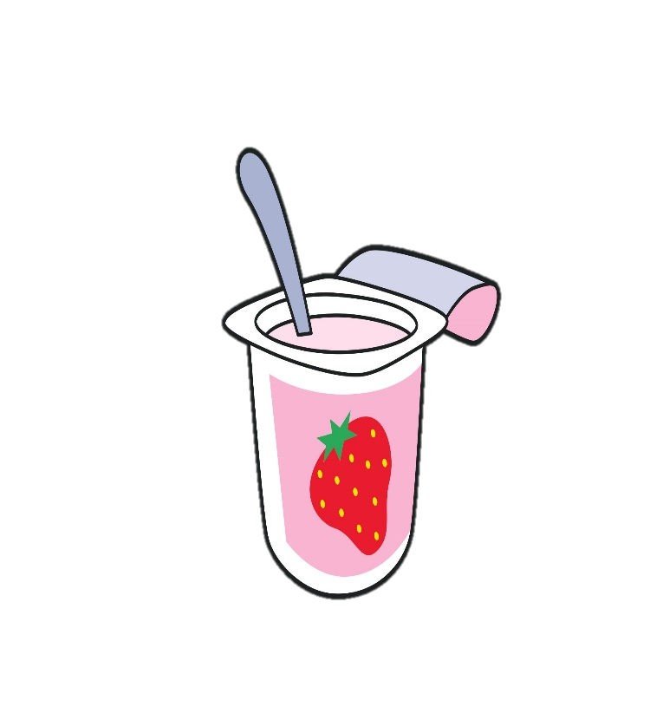
FOOD

Slide 10

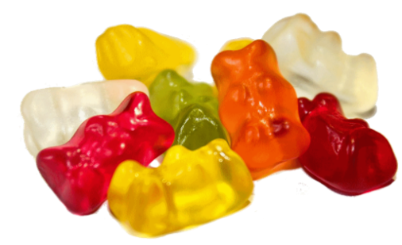
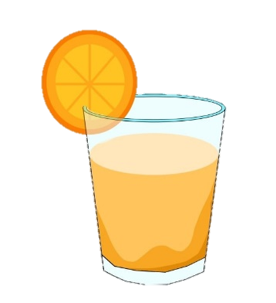
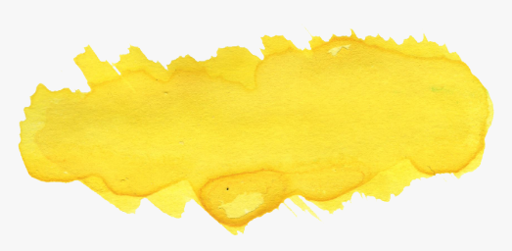
FOOD
jelly
/J/
/Y/
yoghurt
juice
yellow

Slide 11
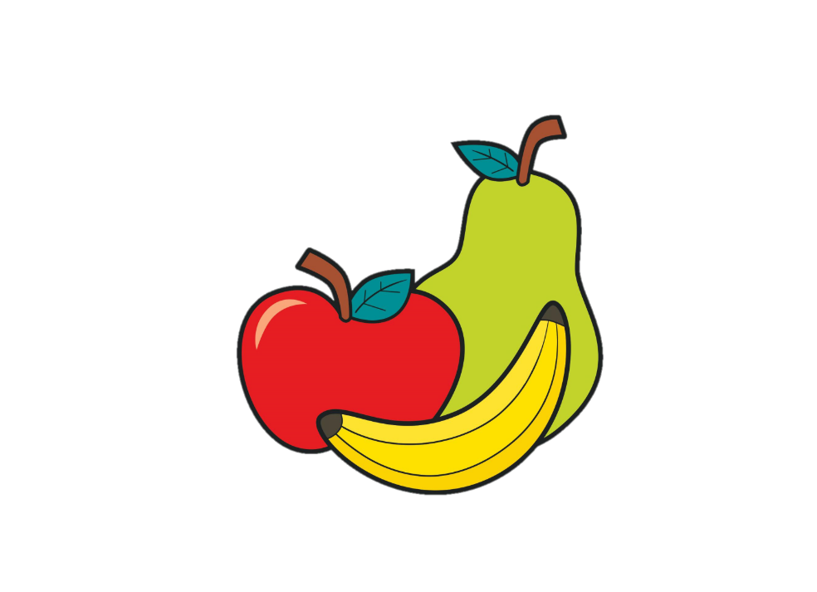



FOOD
I’ve got _____________.

Slide 12
FOOD
I like/ don’t like _____________.

Slide 13



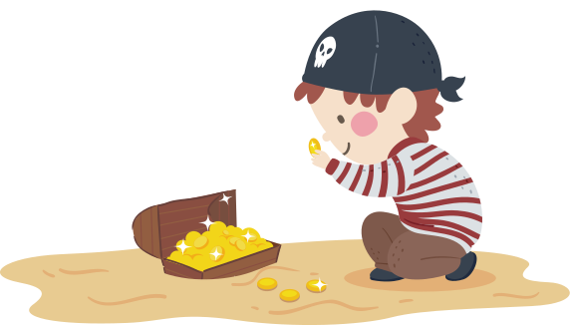

TREASURE HUNT

Slide 14
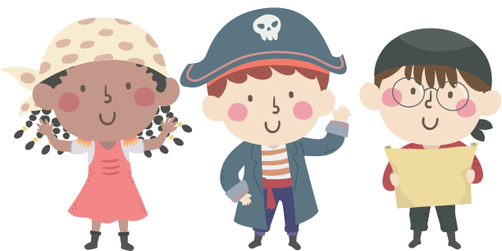
Are you ready?

Slide 15


This is the _________.
A. dining room
B. kitchen
C. living room

Slide 16
It’s a __________.
A. small cat
B. big dog
C. big cat

Slide 17
What sound is this?
A. / j /
B. / v /
C. / ch /

Slide 18
I like __________.
A. milk
B. bread
C. cheese

Slide 19
What sound is it?
A. / d /
B. / t /
C. / w /

Slide 20
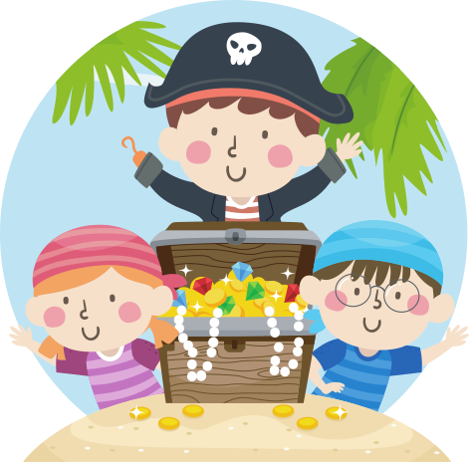
Yay!!

Slide 21
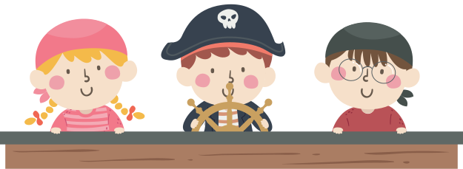
See you again!

