Slide 1

Review
Units 5-8
Page 124

Slide 2
Lesson Outline
Warm-up
Vocabulary
Grammar
Consolidation
Wrap-up

Slide 3
Objectives
By the end of this lesson, students will be able to review the vocabulary items and the sentence structures from Unit 5 to Unit 8.
Vocabulary:
sweater, onion, throw, go swimming, chicken, wardrobe, arm, tennis, pajamas, doll

Slide 4
Objectives
By the end of this lesson, students will be able to review the vocabulary items and the sentence structures from Unit 5 to Unit 8.
Structures:
We eat noodles with chopsticks./ I’m wearing brown boots./ Would you like some fish?

Slide 5

WARM UP

Slide 6
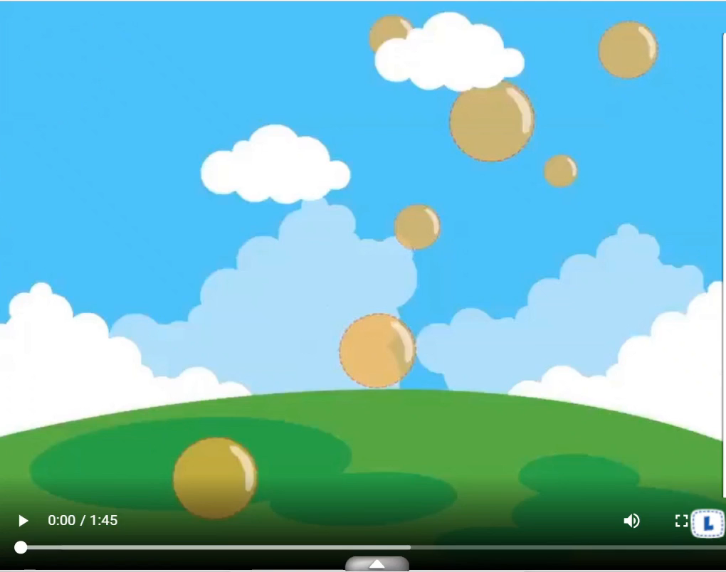

Slide 7
Look and write.
sweatertyhfhsfgchickenqwbnvcwardrobezxsbfriptennisptfgddolllsds
1.________
2.________
3.________
sweater
chicken
wardrobe
4.________
5.________
tennis
doll
KEYS

Slide 8

It’s time to learn …

Slide 9

Vocabulary

Slide 10
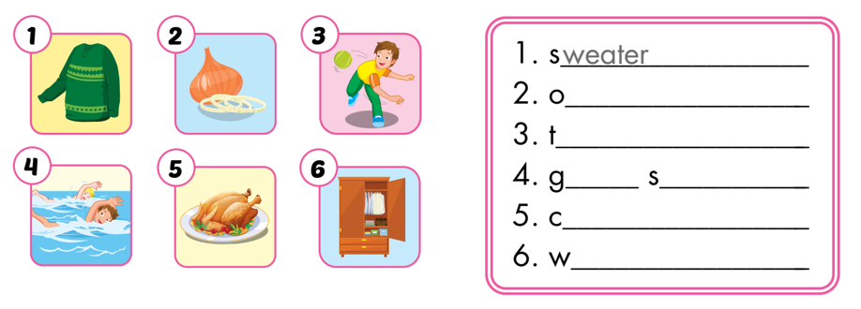
1. Look and write. The first letters are given.
nion
hrowing
o
wimming
hicken
ardrobe

Slide 11
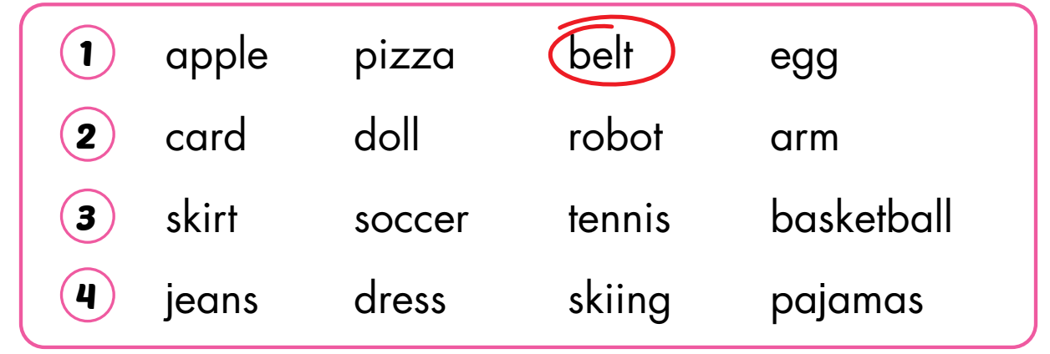
2. Read and circle the odd one out.

Slide 12

Grammar

Slide 13
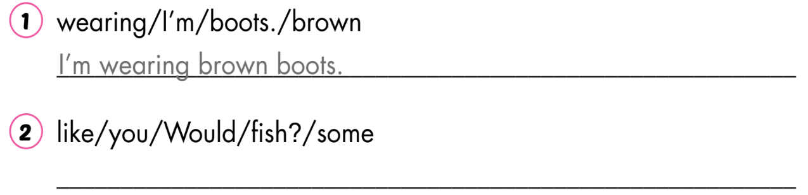
3. Unscramble and write.
Would you like some fish?

Slide 14
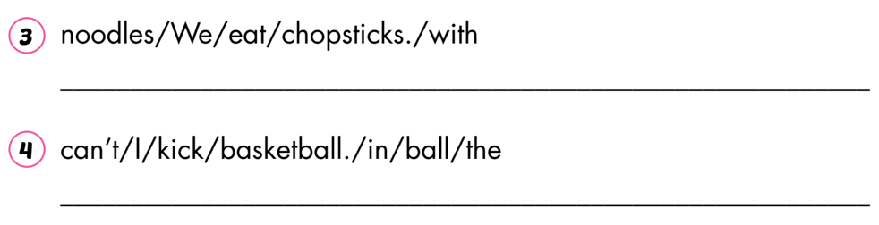
3. Unscramble and write.
We eat noodles with chopsticks.
I can’t kick the ball in basketball.

Slide 15

Extra Practice

Slide 16
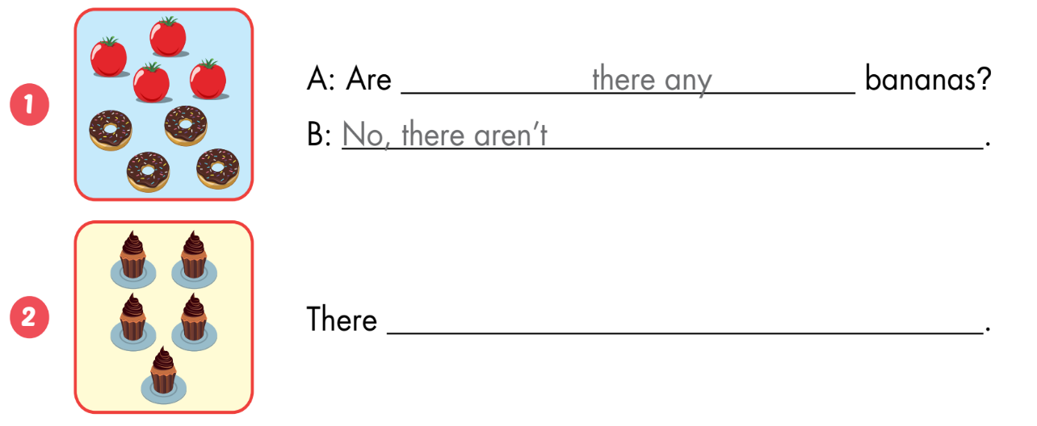
A
Look and write.
are five cupcakes

Slide 17
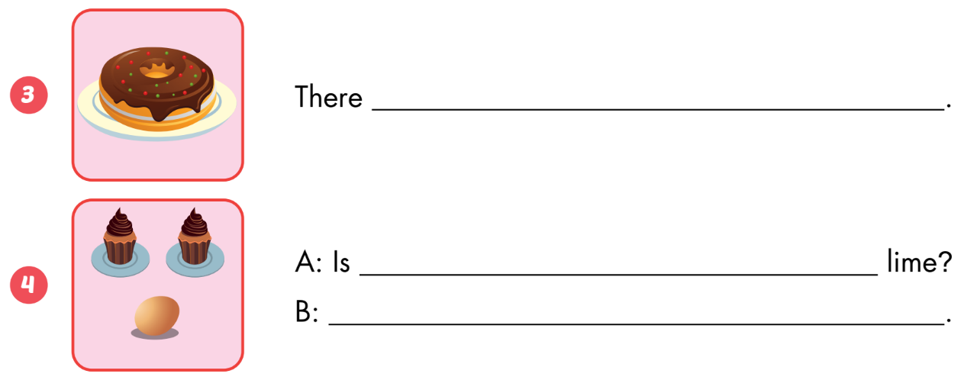
A
Look and write.
is a donut
there a
No, there isn’t

Slide 18
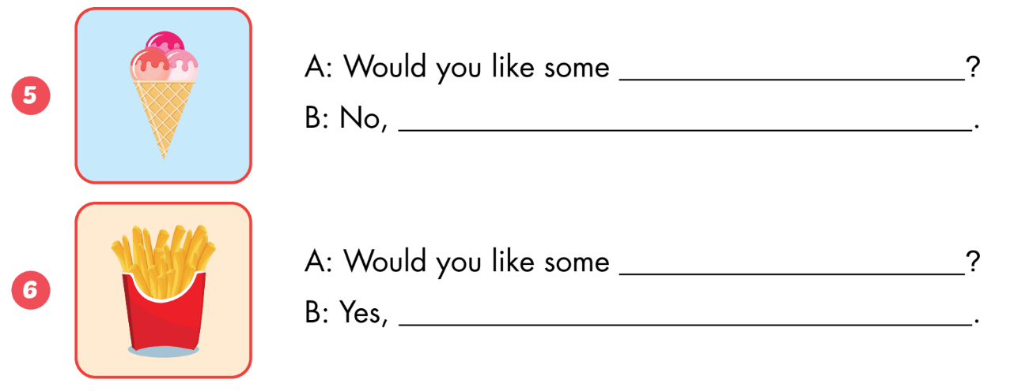
A
Look and write.
ice cream
thank you
fries
please

Slide 19

Consolidation

Slide 20
1
4
6
1
SPIN
2
5
2
5
4
3
3
6
Next Part

Slide 21
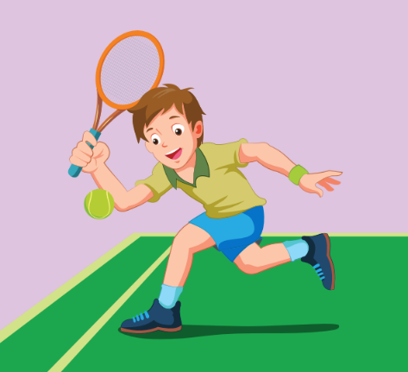
Look and say.
Go back

Slide 22

Look and say.
Go back

Slide 23

Look and say.
Go back

Slide 24

Look and say.
Go back

Slide 25
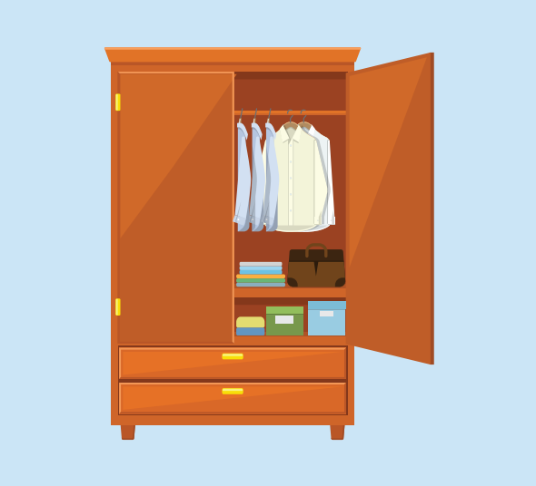
Look and say.
Go back

Slide 26
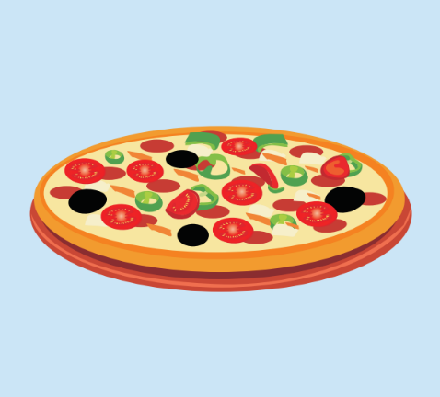
Look and say.
Go back

Slide 27

WRAP-UP

Slide 28
Today’s lesson
Vocabulary:
sweater, onion, throw, go swimming, chicken, wardrobe, arm, tennis, pajamas, doll
Structures:
We eat noodles with chopsticks./ I’m wearing brown boots./ Would you like some fish?

Slide 29
Homework
Practice vocabularies and structure. Make sentences using them.
Practice the vocabulary and structure in Tiếng Anh 3 i-Learn Smart Start Notebook (pages 62 - 63).
Play consolidation games in Tiếng Anh 3 i-Learn Smart Start DHA App on www.eduhome.com.vn
Prepare the next lesson (Page 125)

Slide 30

Enjoy your day!

