Slide 1
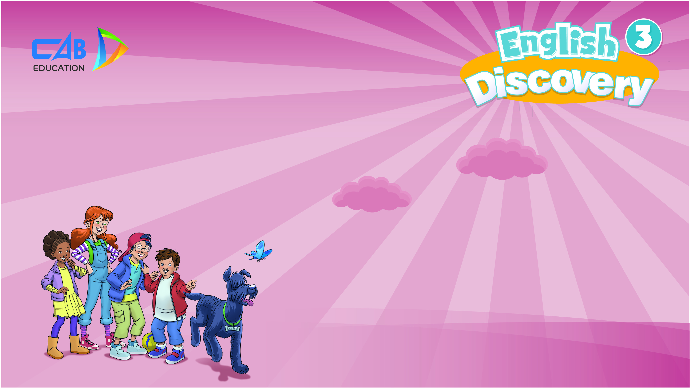
Monday, January 30th, 2023
UNIT 6: HELP THE ANIMALS
Lesson 3 –Vocabulary and Grammar 2

Slide 2
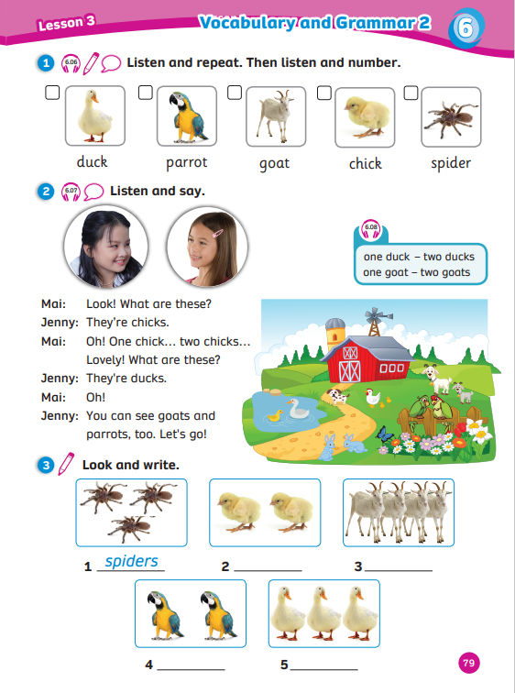
UNIT 6: HELP THE ANIMALS
We’re learning…
five common pets
to ask and answer about common pets
- SB p.79

Slide 3
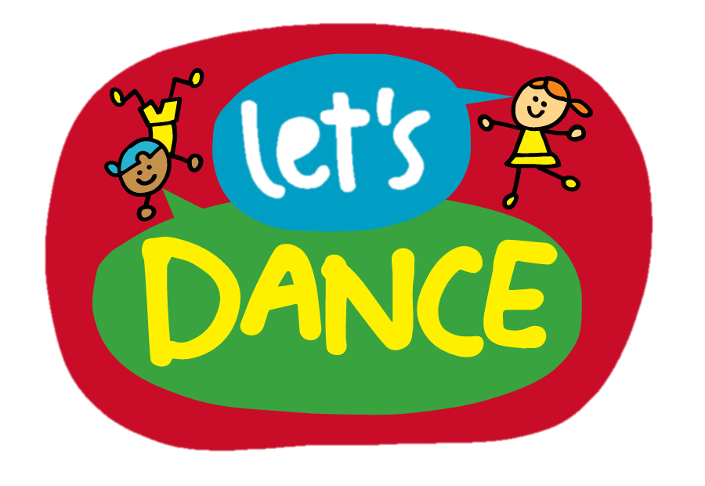

Song: Animal actions
WARM-UP
All students stand up.
Listen to the song.
Dance along.

Slide 4

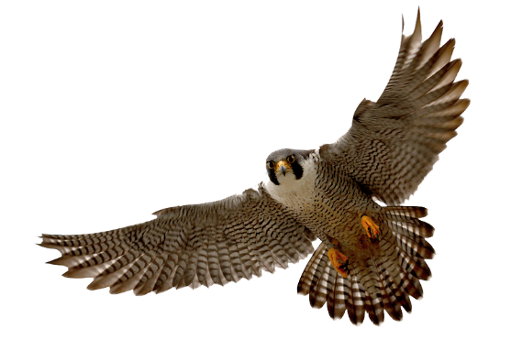
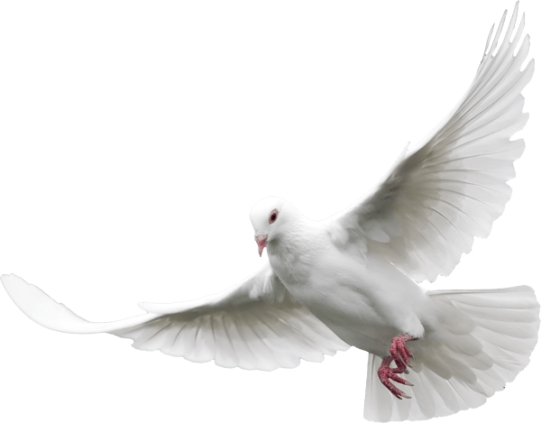
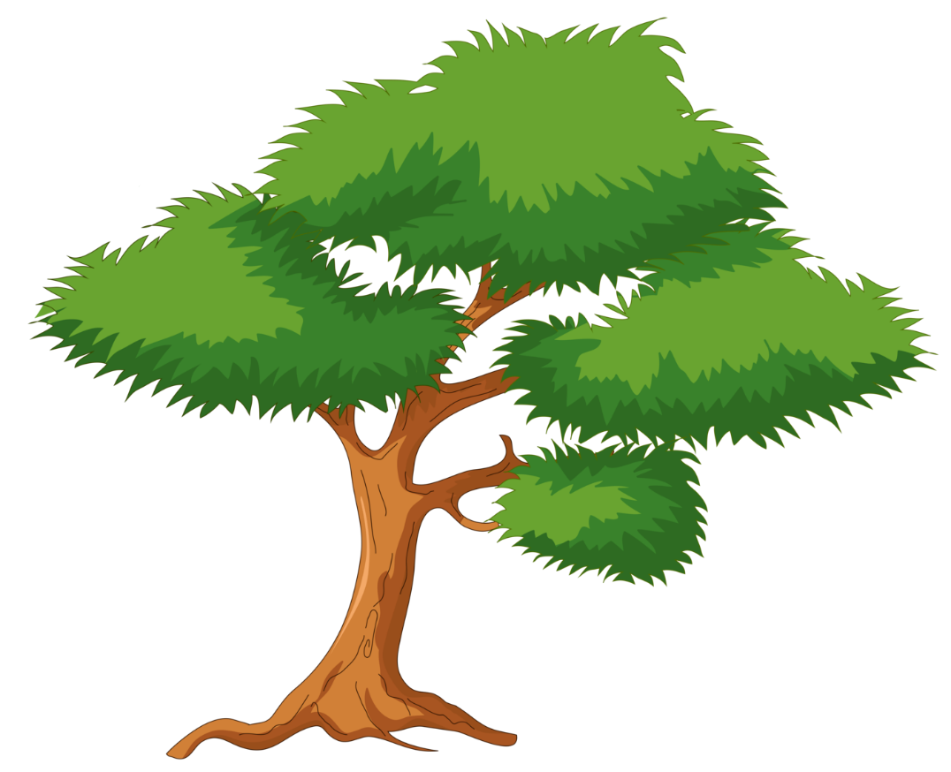
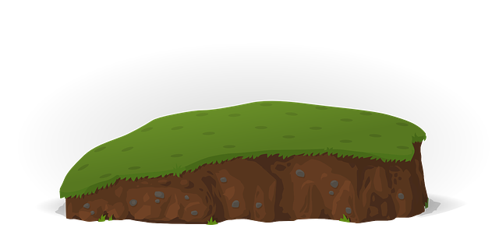
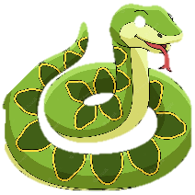
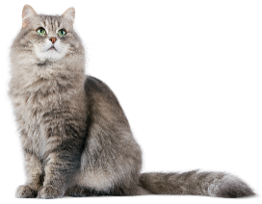
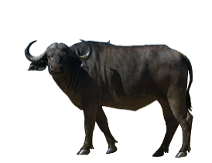
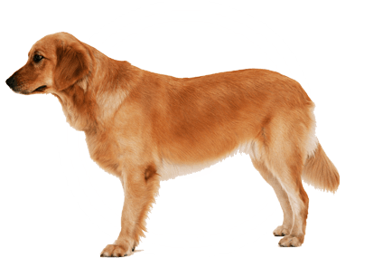
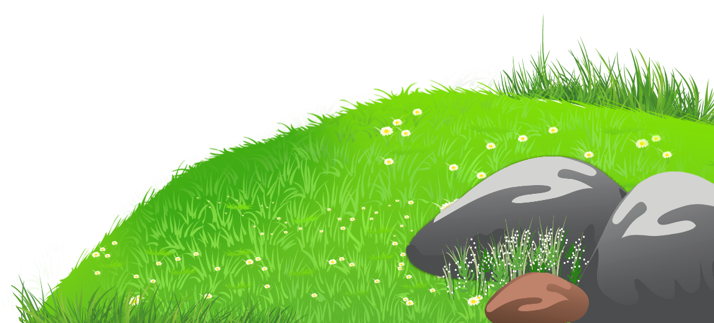
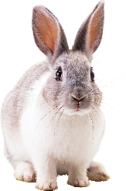
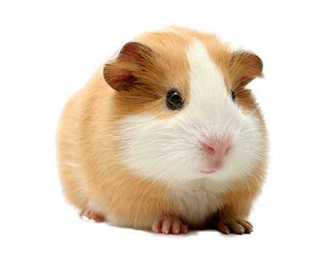
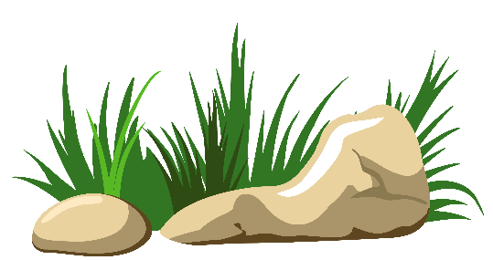
REVIEW ANIMALS

Slide 5
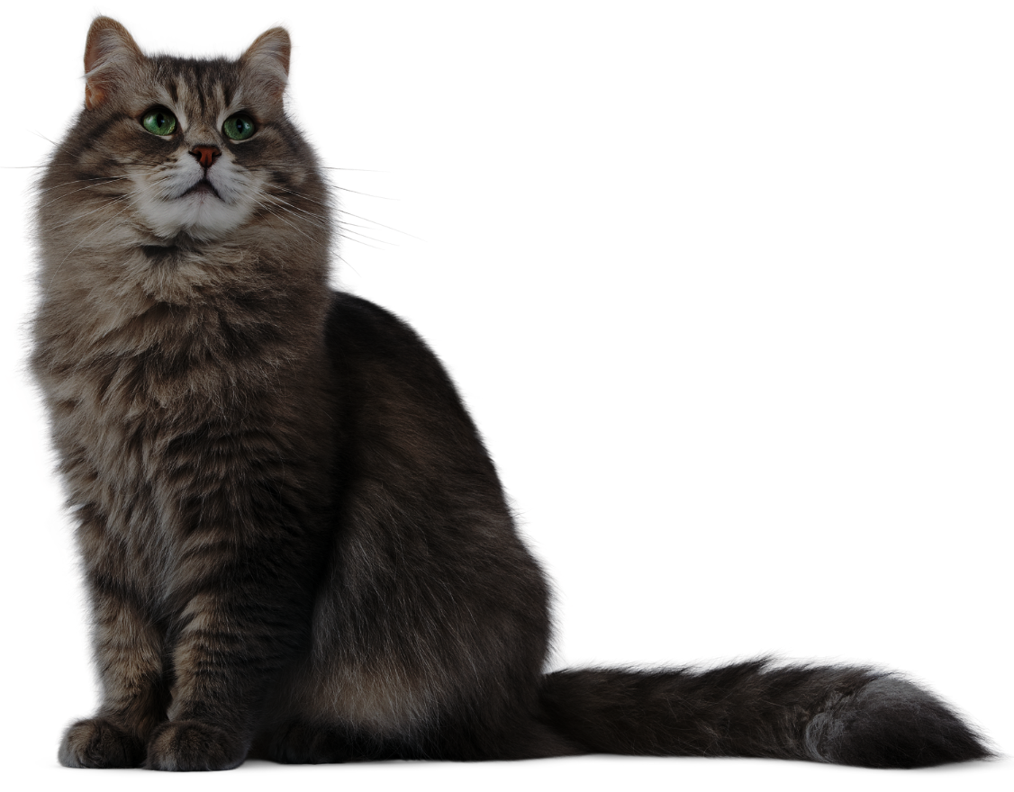

PRE
NEXT
Lion
Tiger
Cat
Rabbit

Slide 6
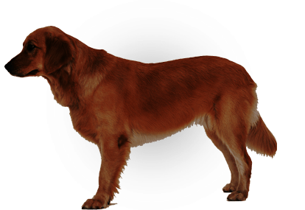
PRE
NEXT
Tiger
Fox
Dog
Zebra

Slide 7
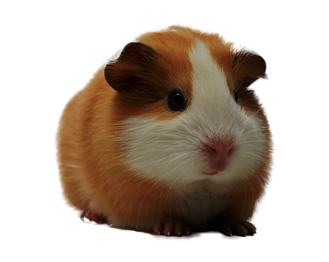
PRE
NEXT
Rabbit
Lion
Guinea pig
Panda

Slide 8
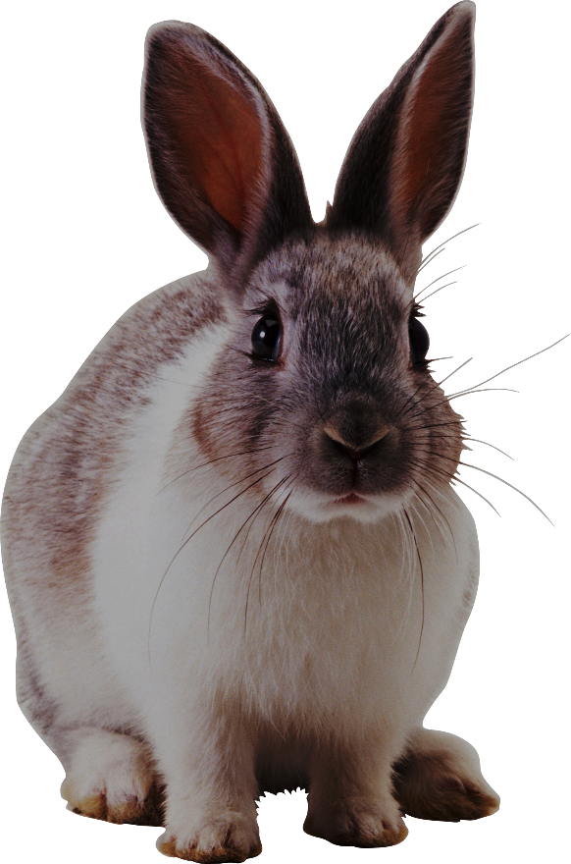

PRE
NEXT
Cat
Rabbit
Dog
Guinea pig

Slide 9
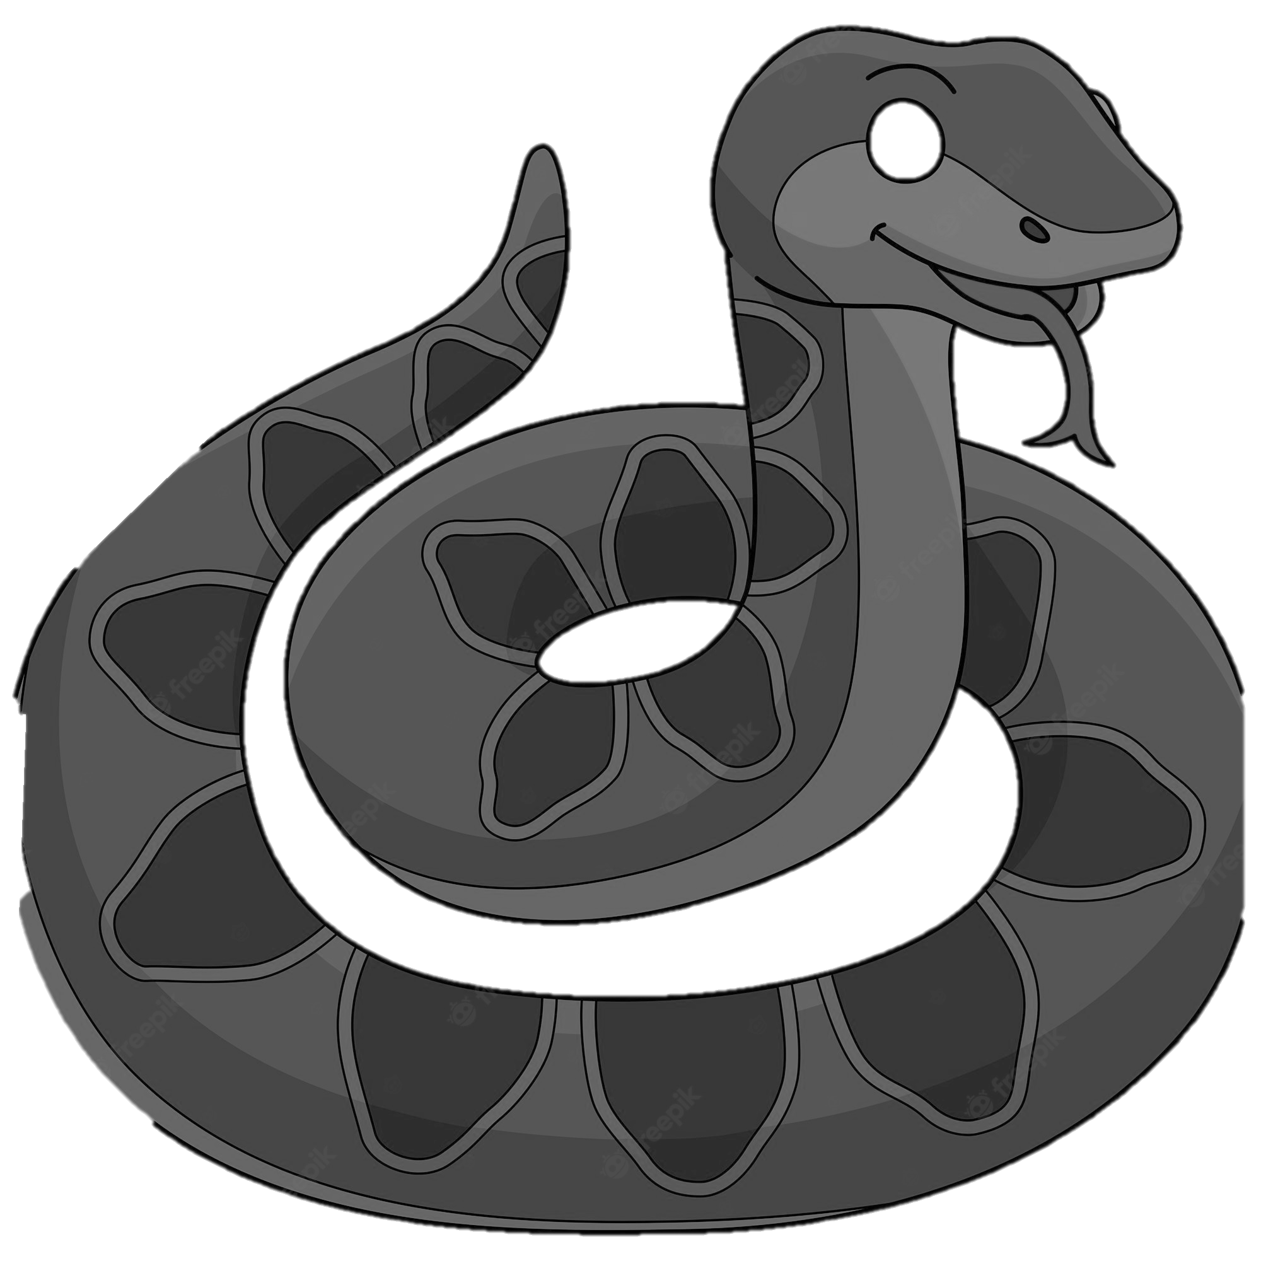
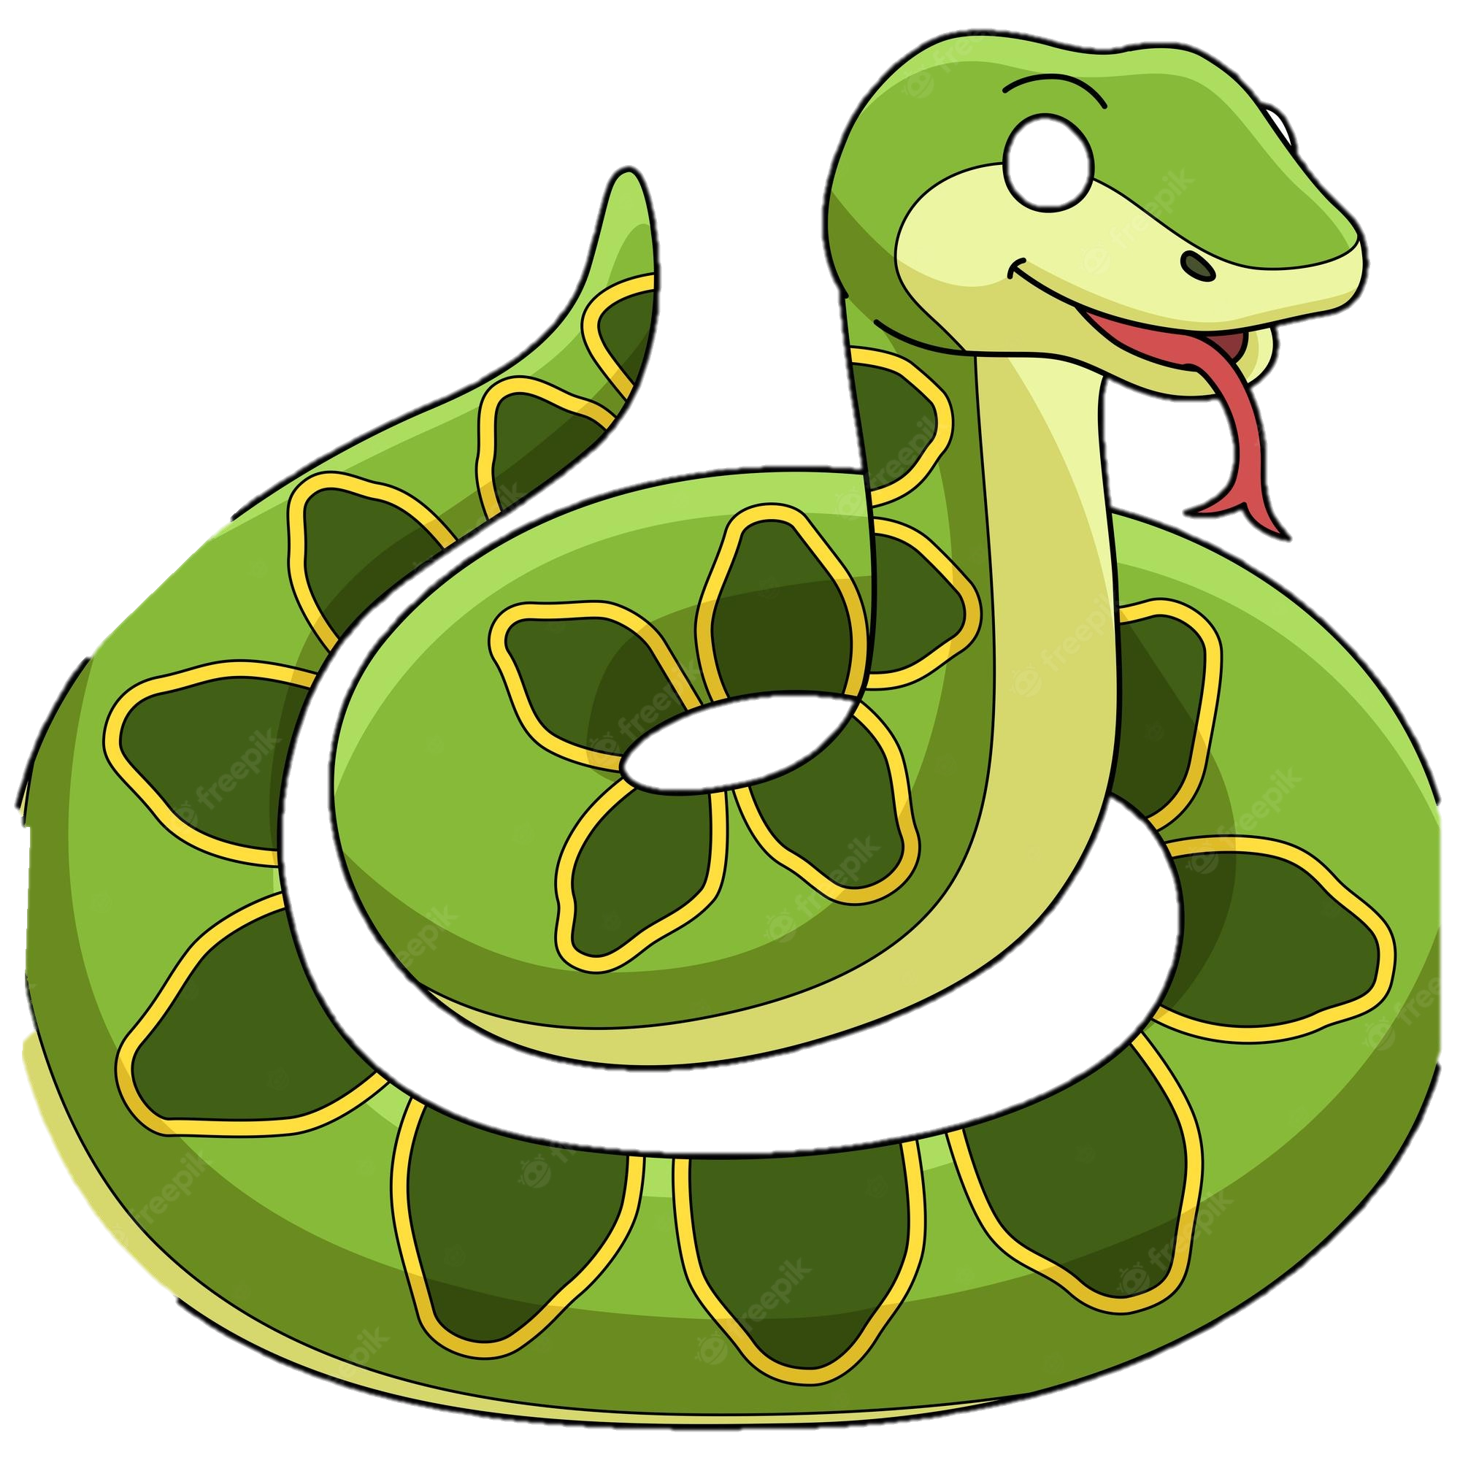
PRE
NEXT
Guinea pig
Snake
Dog
Rabbits

Slide 10
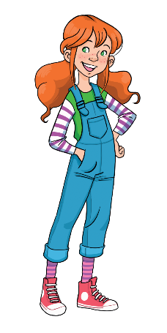
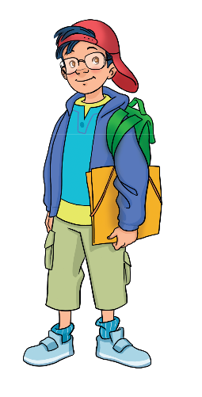
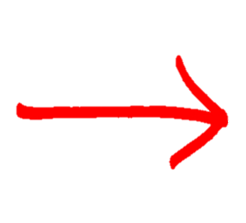
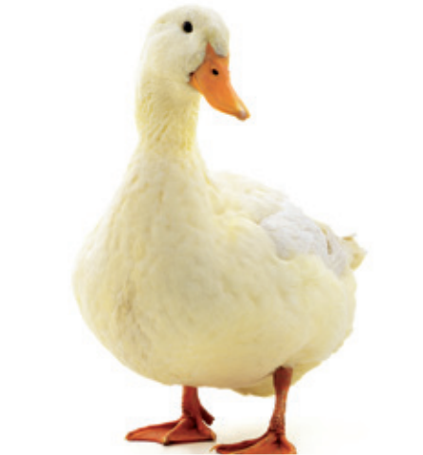

VOCABULARY: Common animals
What’s this?
It’s a …
duck
Let’s spell!
d
u
c
k

Slide 11
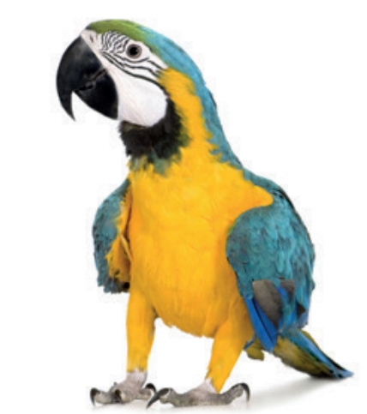
VOCABULARY: Common animals
What’s this?
It’s a …
parrot
Let’s spell!
p
a
r
r
o
t

Slide 12

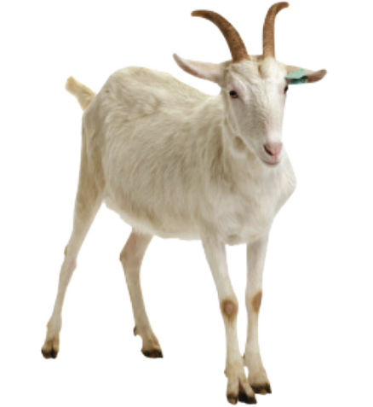
VOCABULARY: Common animals
What’s this?
It’s a …
goat
Let’s spell!
g
o
a
t

Slide 13
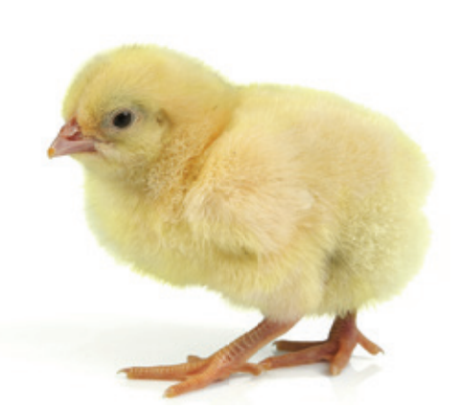
VOCABULARY: Common animals
What’s this?
It’s a …
chick
Let’s spell!
c
h
i
c
k

Slide 14
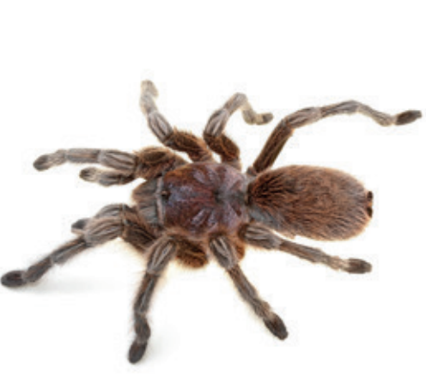
VOCABULARY: Common animals
What’s this?
It’s a …
spider
Let’s spell!
s
p
i
d
e
r

Slide 15
VOCABULARY: Common animals
duck
parrot
goat
chick
spider

Slide 16
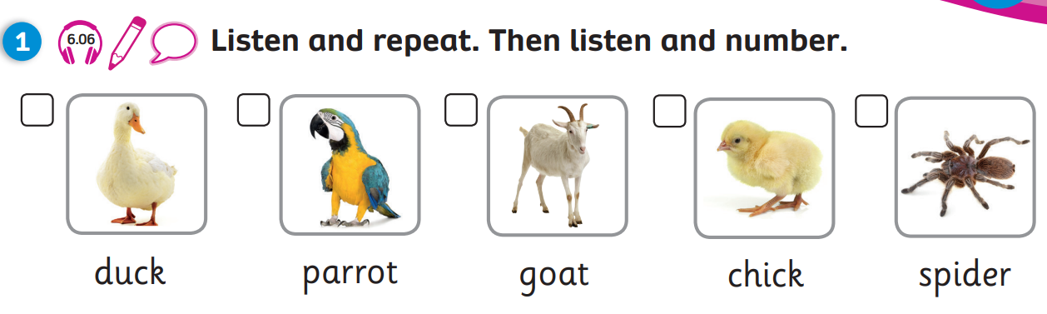
Pupil’s book: page 79

Slide 17
Pupil’s book: page 79
3
2
5
1
4
Notes:
KEY: 1.chick 2.parrot 3.duck 4.spider 5.goat

Slide 18

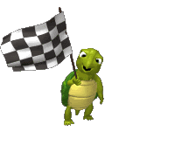
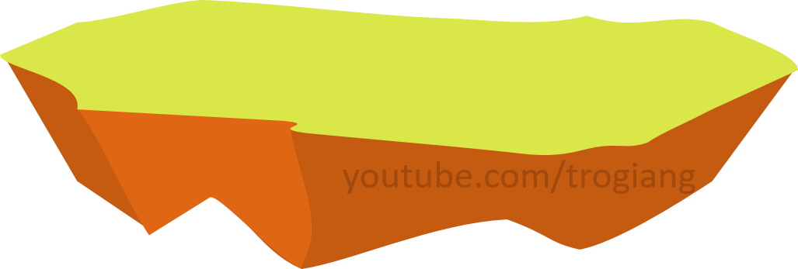

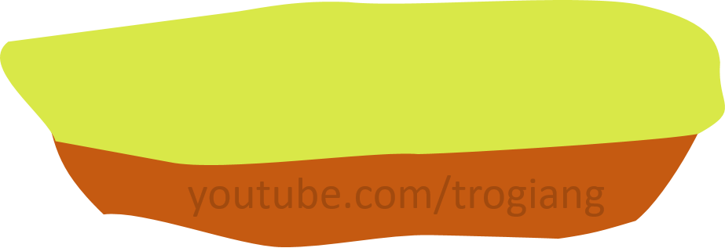
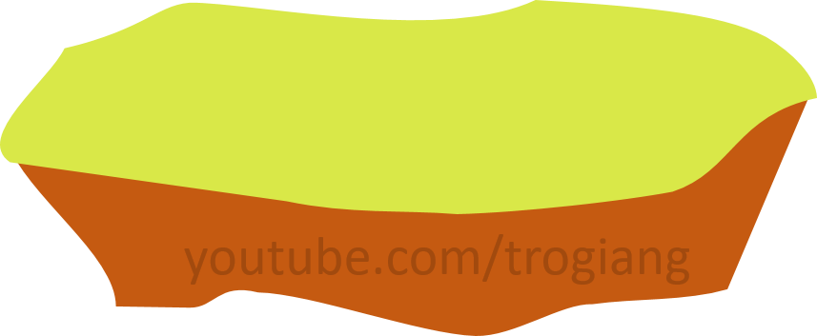
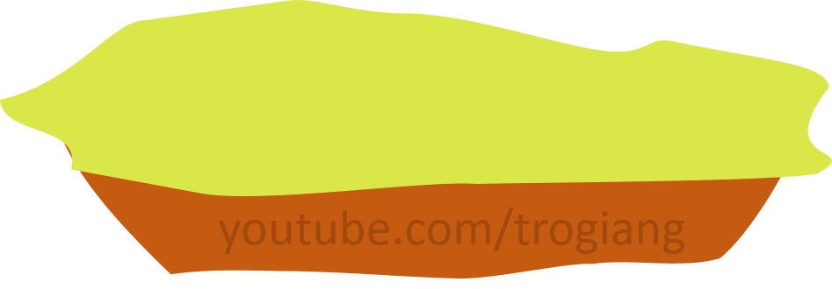
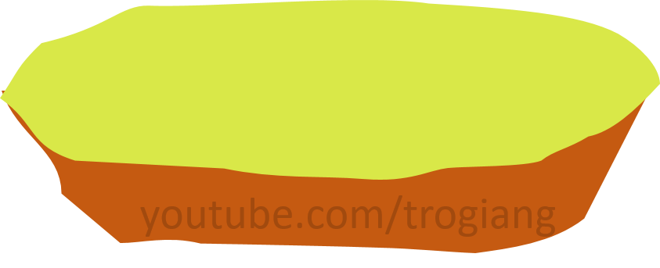
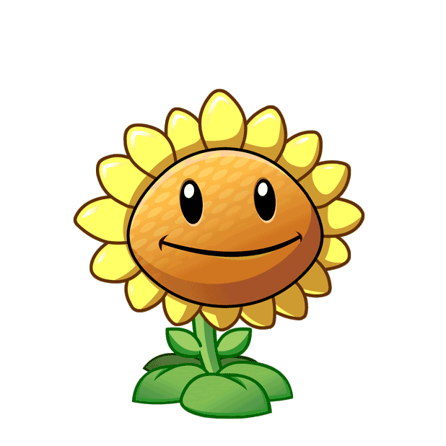
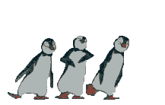
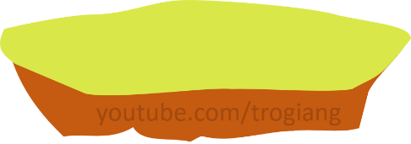
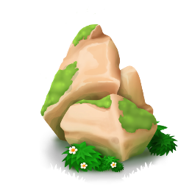
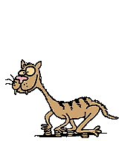
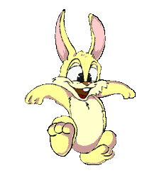
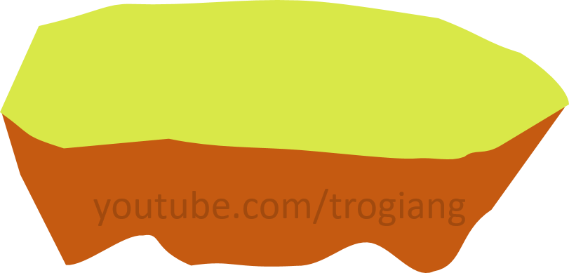
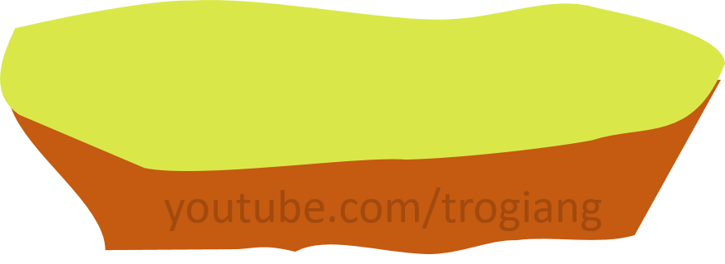

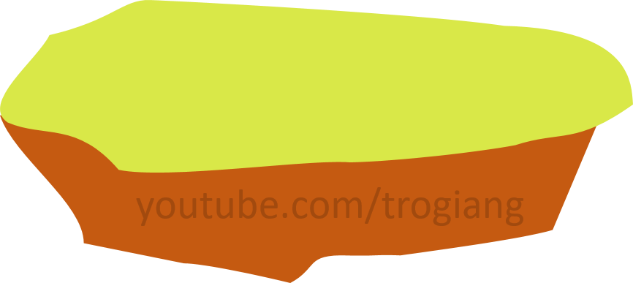
CONGRATULATIONS RABBIT TEAM
CONGRATULATIONS TIGER TEAM
5
5
4
4
3
3
2
2
overtop
1
1
Notes:
Click on the number to see the question. If students answer correctly, click on the rabbit or tiger to go up.
Click on < to go back to the first slide of the game.

Slide 19

RABBIT TEAM
What’s this?
It’s a spider.

Slide 20
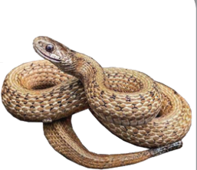
RABBIT TEAM
What’s this?
It’s a snake.

Slide 21
RABBIT TEAM
What’s this?
It’s a chick.

Slide 22
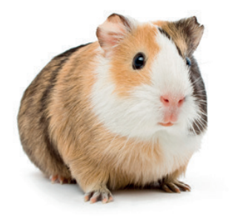
RABBIT TEAM
What’s this?
It’s a guinea pig.

Slide 23
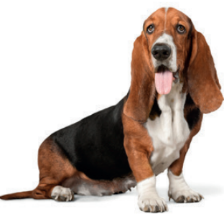
RABBIT TEAM
What’s this?
It’s a dog.

Slide 24
TIGER TEAM
What’s this?
It’s a goat.

Slide 25
TIGER TEAM
What’s this?
It’s a parrot.

Slide 26
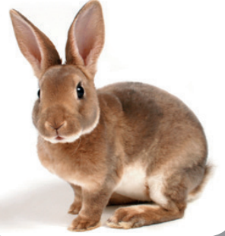
TIGER TEAM
What’s this?
It’s a rabbit.

Slide 27
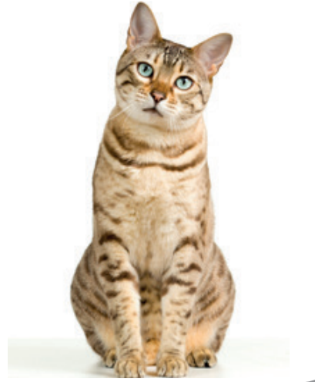
TIGER TEAM
What’s this?
It’s a cat.

Slide 28
TIGER TEAM
What’s this?
It’s a duck.

Slide 29




GRAMMAR: What are these? They’re…
What are these?
They’re chicks .
Notes:
Introduce to Ss that they are going to learn about plural nouns and structure What are these? They’re… “
Show the speech bubbles and have Ss say aloud.
Direct Ss’ attention to the number of the chicks. Ask them the questions:
+ How many chicks?
+ Explain to students that when there are two animals or more, we add “s” at their ending.

Slide 30

GRAMMAR: What are these? They’re…
Work in pairs. Look and count the animals

Slide 31




GRAMMAR: What are these? They’re…

Slide 32


Pupil’s book: page 79
chicks
goats
parrots
ducks

Slide 33



PRODUCTION
Draw your favourite animals
They’re ducks. They’re yellow.
Notes:
Have Ss draw a picture. Then ask them to describe the picture using It’s a…/ They’re ….
This activity is also used for the next lesson.

Slide 34
WRAP-UP
What are these?
They’re chicks .
duck
parrot
goat
Vocabulary
chick
spider
Grammar

Slide 35


UNIT 6: Lesson 3A
We’ve learnt…

