Slide 1

UNIT 6: HELP THE ANIMALS!
Lesson 1A – Vocabulary and Grammar 1

Slide 2
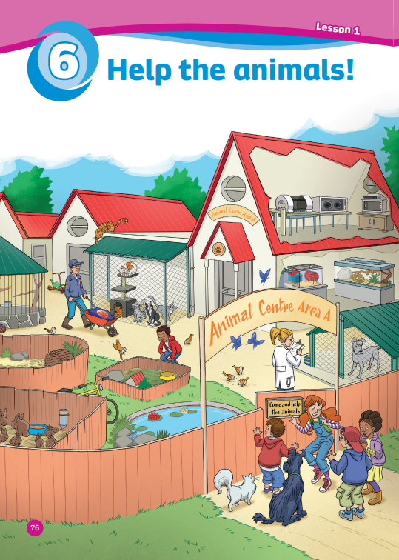
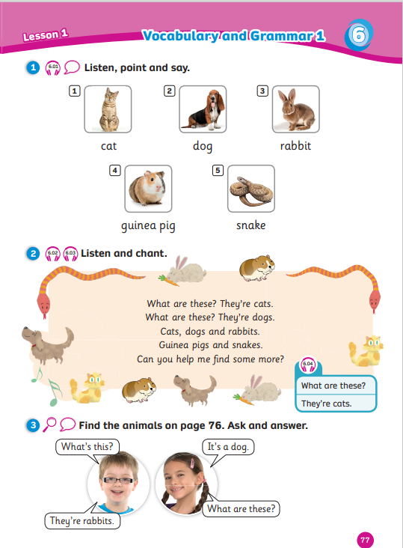
UNIT 6: HELP THE ANIMALS
We’re learning…
- animals
- to ask and answer about animals
- SB p.76-77

Slide 3


Song: The Animal song
WARM-UP
All students stand up.
Listen to the song.
Dance along.

Slide 4
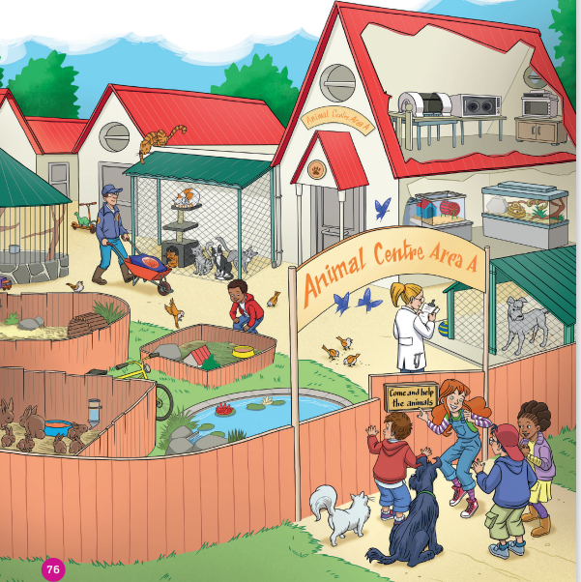
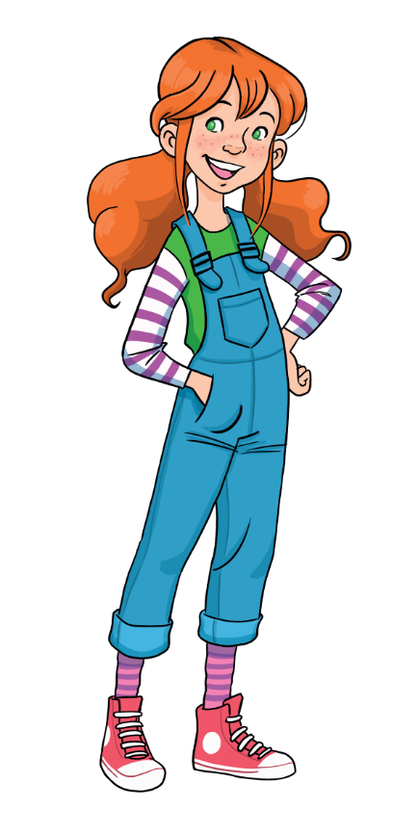
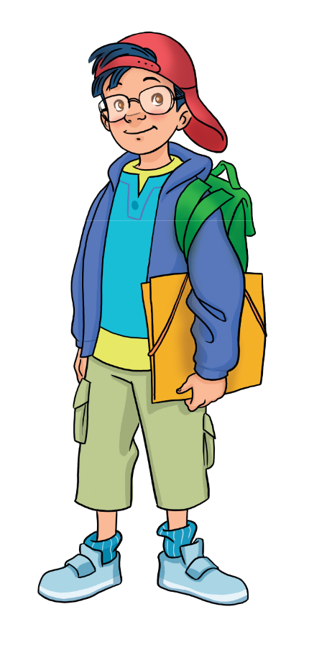
LEAD-IN
Wow! animals!
Name the animals you can see!

Slide 5


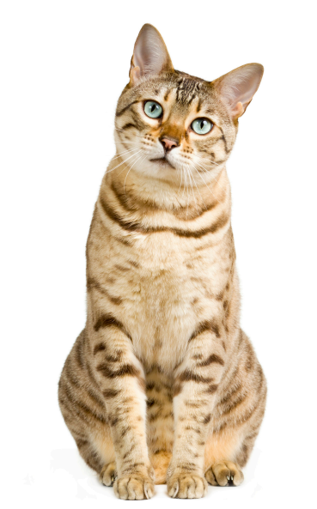

VOCABULARY: ANIMALS
What’s this?
It’s a …
cat
Let’s spell!
c
a
t

Slide 6
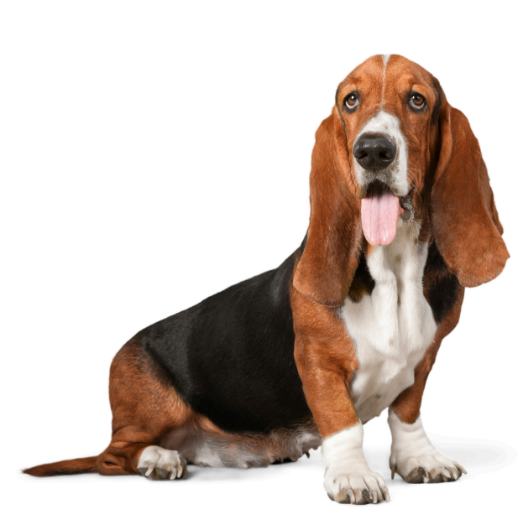
VOCABULARY: ANIMALS
What’s this?
It’s a …
dog
Let’s spell!
d
o
g

Slide 7
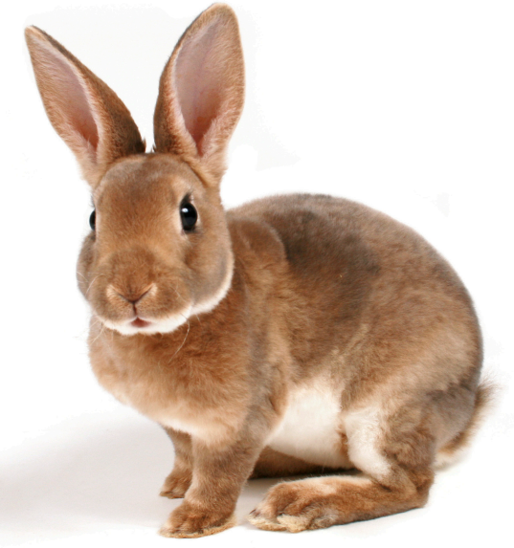
VOCABULARY: ANIMALS
What’s this?
It’s a …
rabbit
Let’s spell!
r
a
b
b
i
t

Slide 8
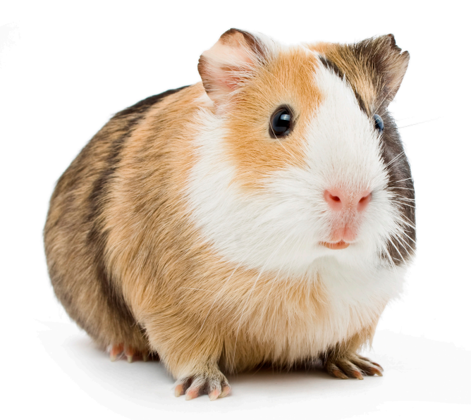
VOCABULARY: ANIMALS
What’s this?
It’s a …
guinea pig
Let’s spell!
g
u
i
n
e
a
p
i
g

Slide 9
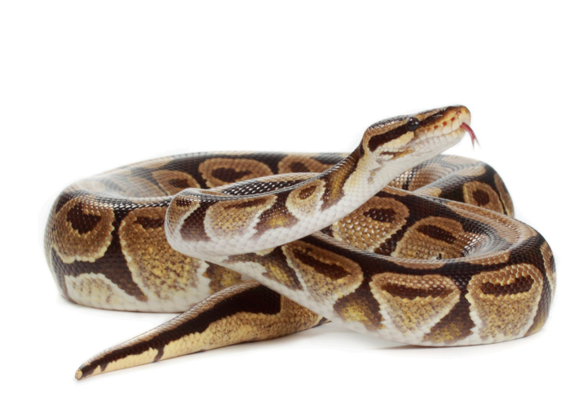
VOCABULARY: ANIMALS
What’s this?
It’s a …
snake
Let’s spell!
s
n
a
k
e

Slide 10


VOCABULARY: ANIMALS
rabbit
dog
guinea pig
animals
cat
snake

Slide 11
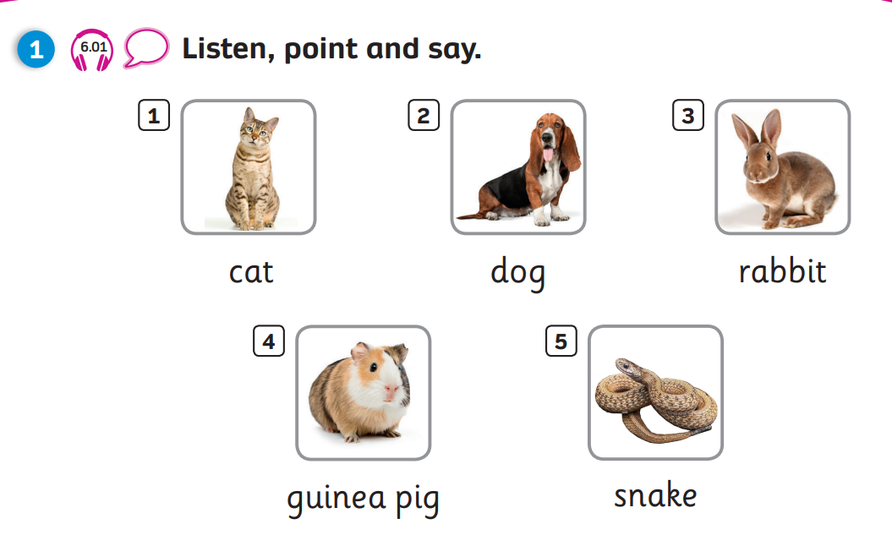

Pupil’s Book (p.77)

Slide 12
Pupil’s Book (p.77)
Work in pair.
Number 1?
It’s a cat.

Slide 13









PRACTICE
Lucky gifts
Choose a gift by saying its colour/shape.
Click on the gift box to see the question.
Answer the question and check.
See your score.
Back to the main page to play more.
Continue

Slide 14


Get back
What’s this?
CHECK
It’s a snake.
1
See your points.

Slide 15
What’s this?
Get back
CHECK
It’s a guinea pig.
2
See your points.

Slide 16
Get back
What’s this?
CHECK
It’s a dog.
4
See your points.

Slide 17
Get back
What’s this?
CHECK
It’s a rabbit.
3
See your points.

Slide 18
LUCKY YOU!
Get back
7

Slide 19
LUCKY YOU!
Get back
4

Slide 20
What’s this?
Get back
CHECK
It’s a cat.
2
See your points.

Slide 21
LUCKY YOU!
Get back
5

Slide 22
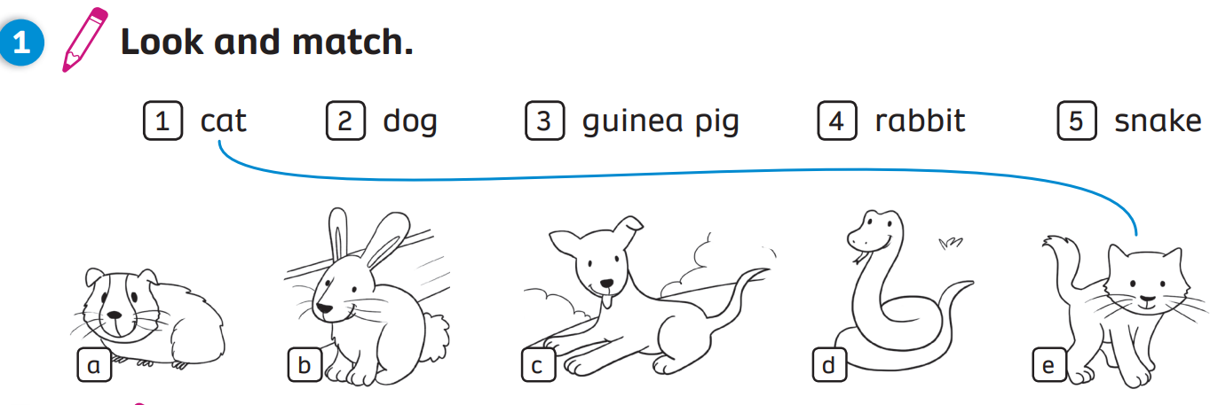
Activity Book (p.60)
Click on “Match” to show the answers

Slide 23
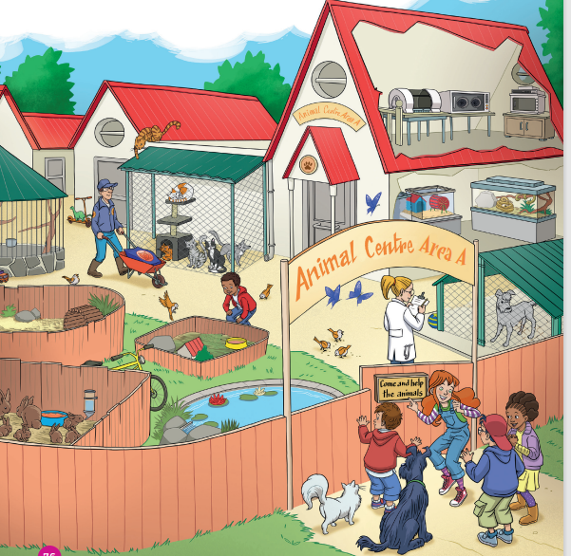

PRODUCTION
Can you see a…?
rabbit
guinea pig
dog
cat
snake
Notes:
Ask Ss to work in pair. Look at page 76 and find the animals in the picture.

Slide 24

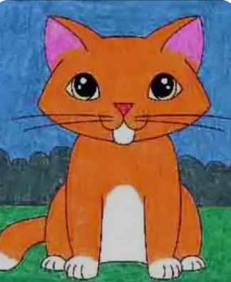

PRODUCTION
Draw an animal
Colour and write.
It’s a ________.
It’s _______________________.
cat
pink, white and orange.
Notes:
Have Ss take out notebook or give them paper.
Ask them to draw an animal, colour then write about it.
Show an example for Ss to follow.
Ask Ss to keep their drawing for the next lesson.

Slide 25




WRAP-UP
What’s this?
-> It’s a…
rabbit
dog
guinea pig
cat
snake

Slide 26
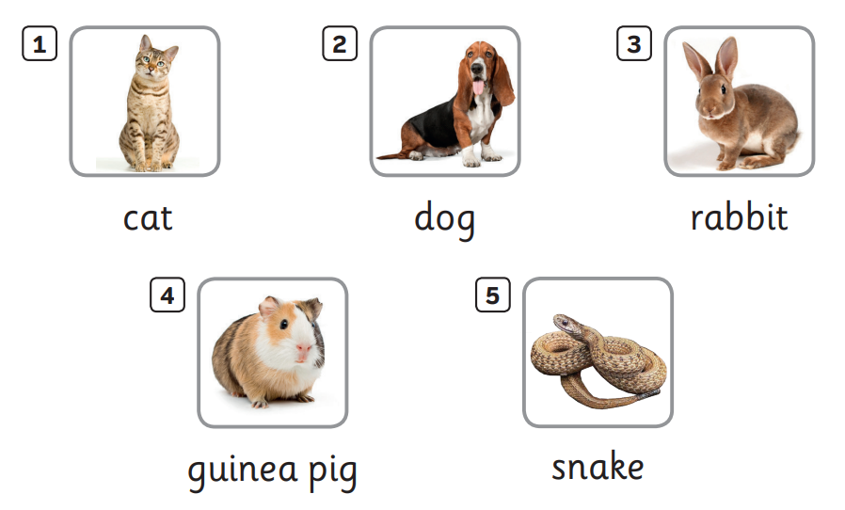

UNIT 6: Lesson 1A
We’ve learnt…

