Slide 1
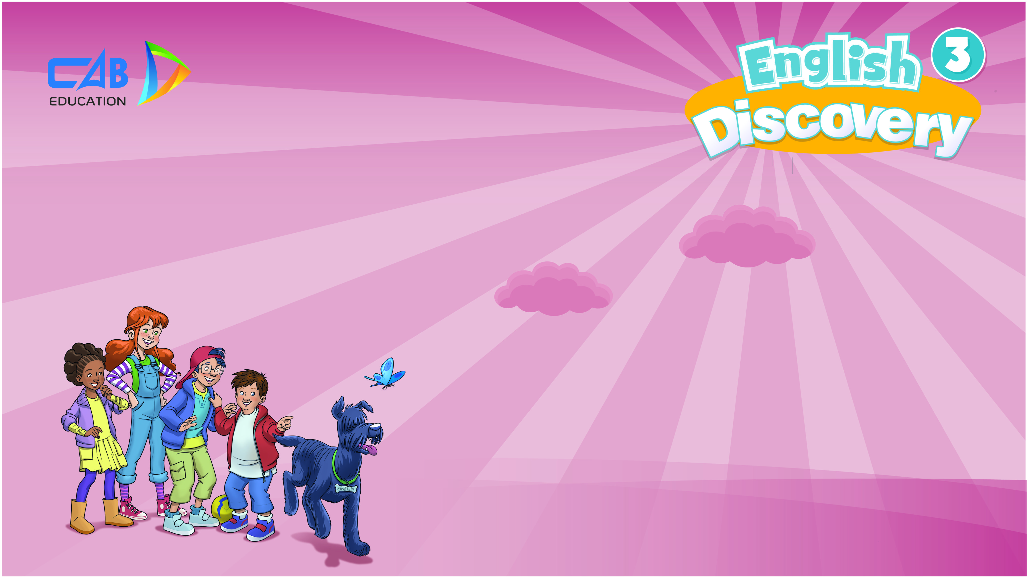
UNIT 6: HELP THE ANIMALS
Lesson 3B –Vocabulary and Grammar 2

Slide 2
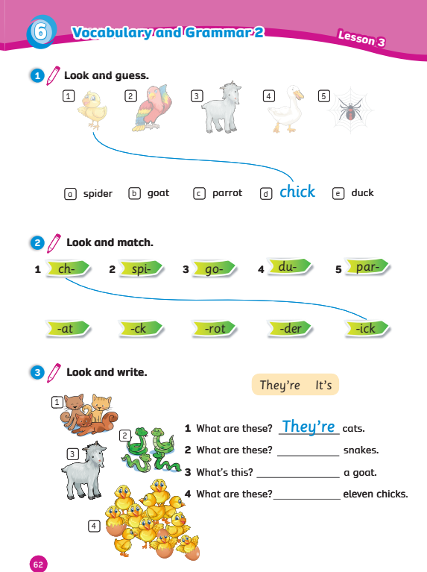
UNIT 6: HELP THE ANIMALS
We’re learning…
five common pets
to ask and answer about common pets
- AB p.62

Slide 3


WARM-UP
Song: Whose tail?
All students stand up.
Listen to the song.
Dance along.

Slide 4

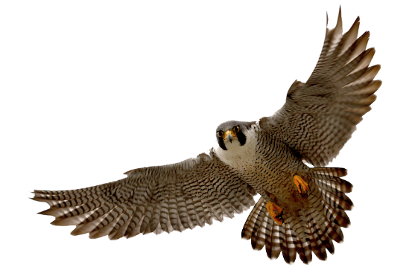
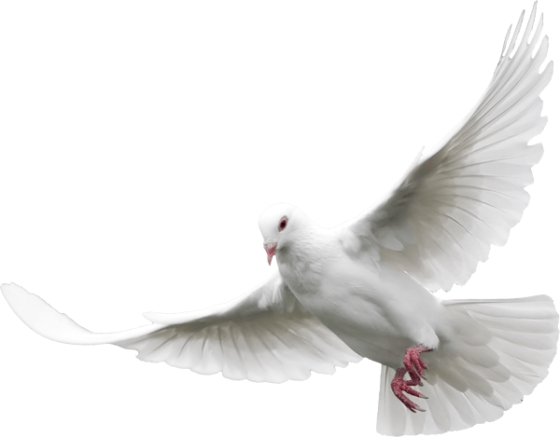
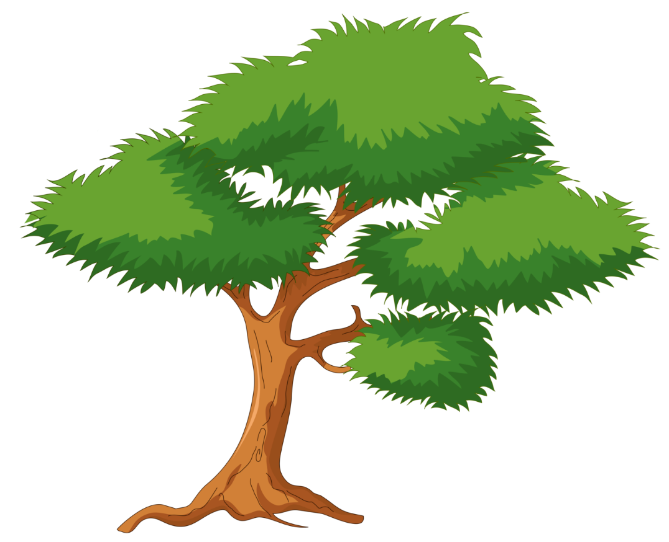
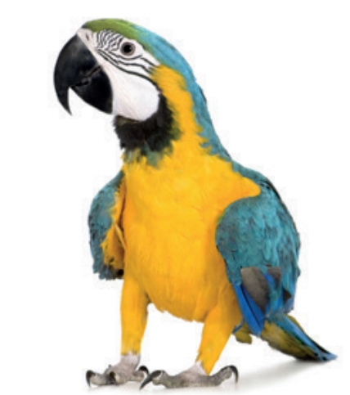
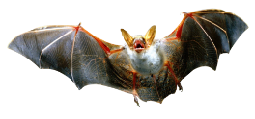
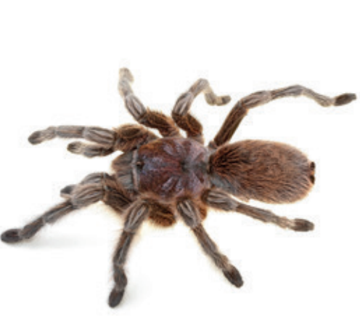
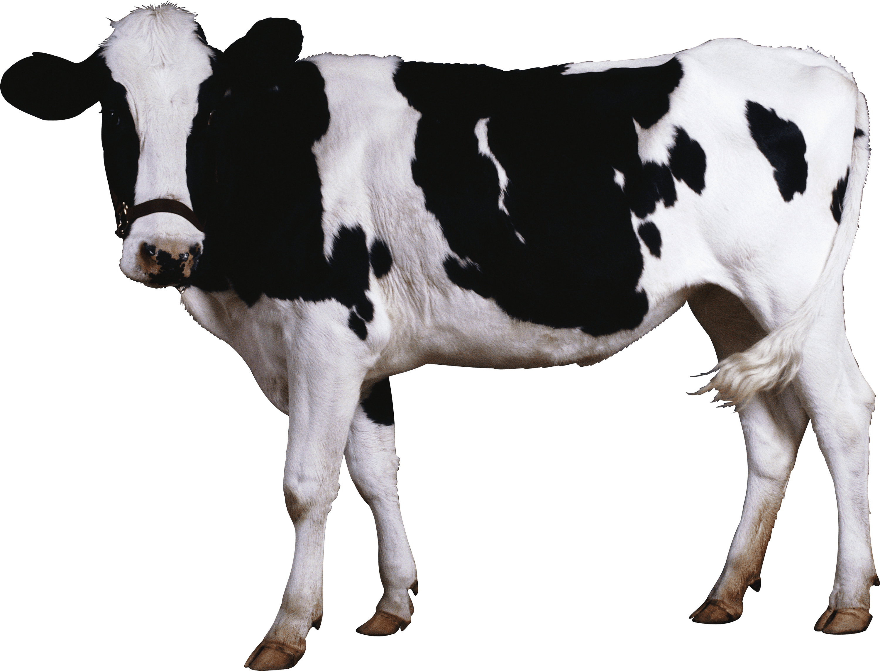
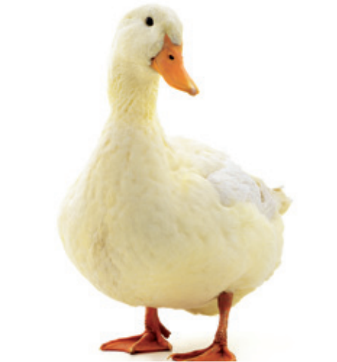
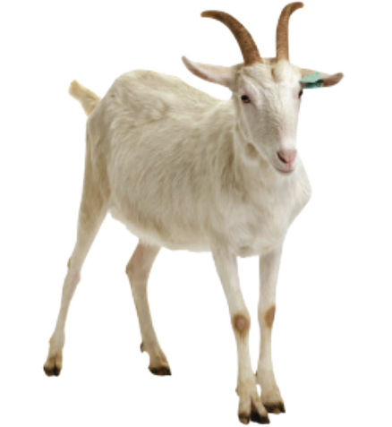
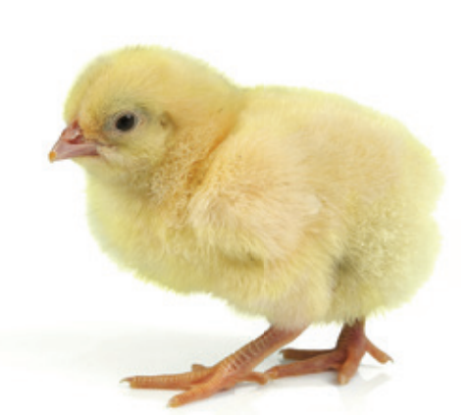
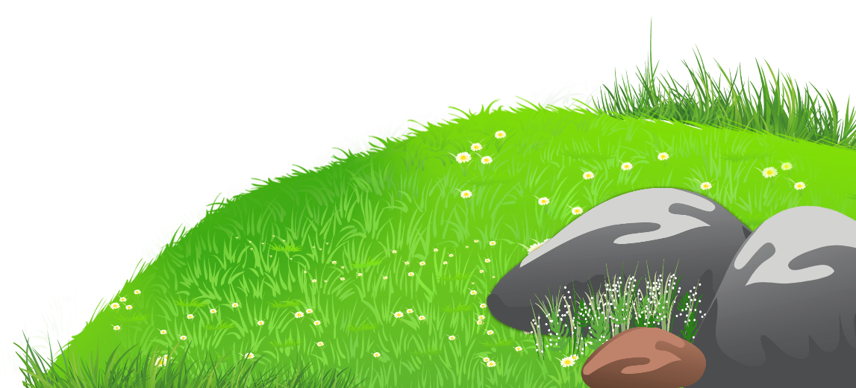
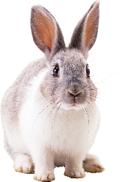
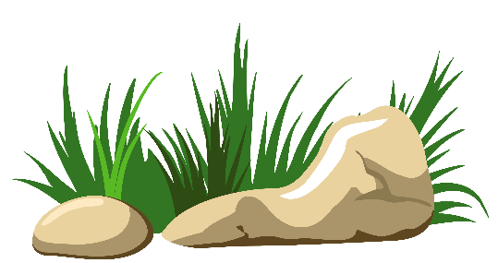
GUESS WHAT?

Slide 5
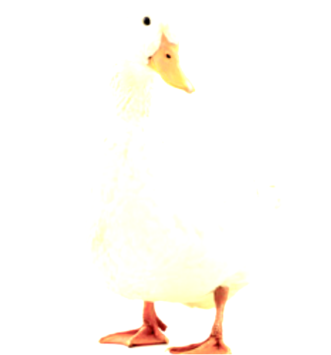
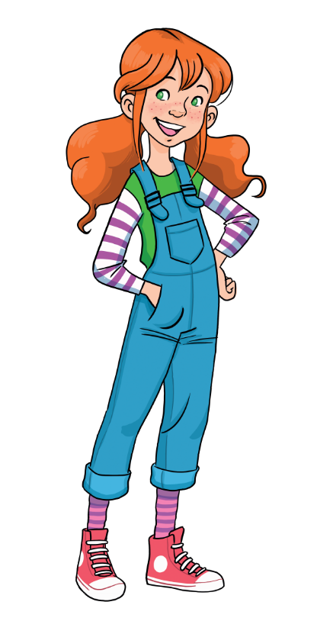
REVIEW: vocabulary
What’s this?
It’s a duck.

Slide 6
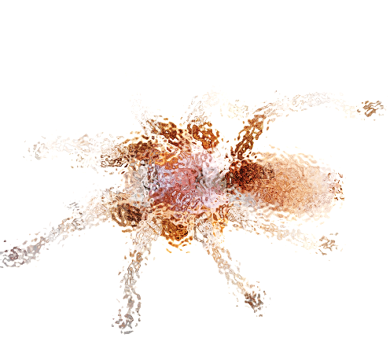
REVIEW: vocabulary
What’s this?
It’s a spider.

Slide 7
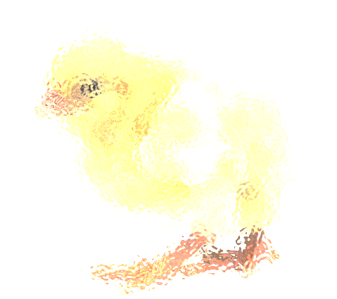
REVIEW: vocabulary
What’s this?
It’s a chick.

Slide 8
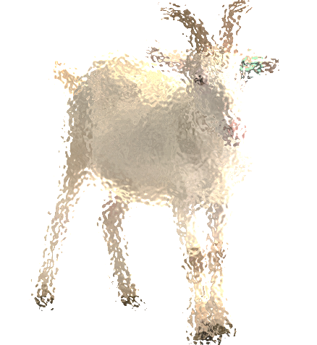
REVIEW: vocabulary
What’s this?
It’s a goat.

Slide 9
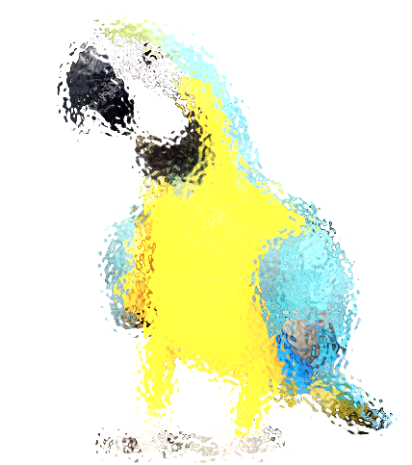
REVIEW: vocabulary
What’s this?
It’s a parrot.

Slide 10
REVIEW: vocabulary
duck
parrot
goat
chick
spider

Slide 11
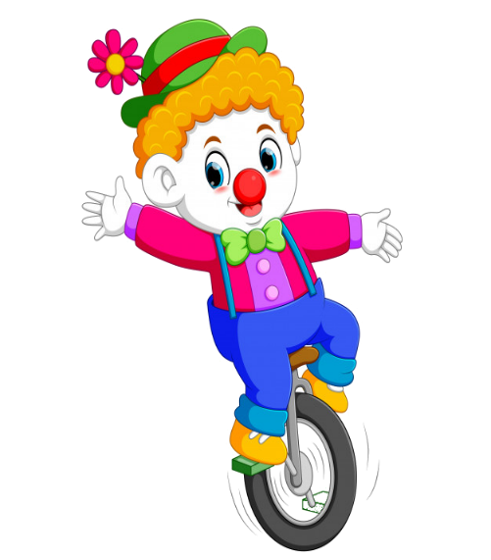
REVIEW: Grammar
What are these?

Slide 12
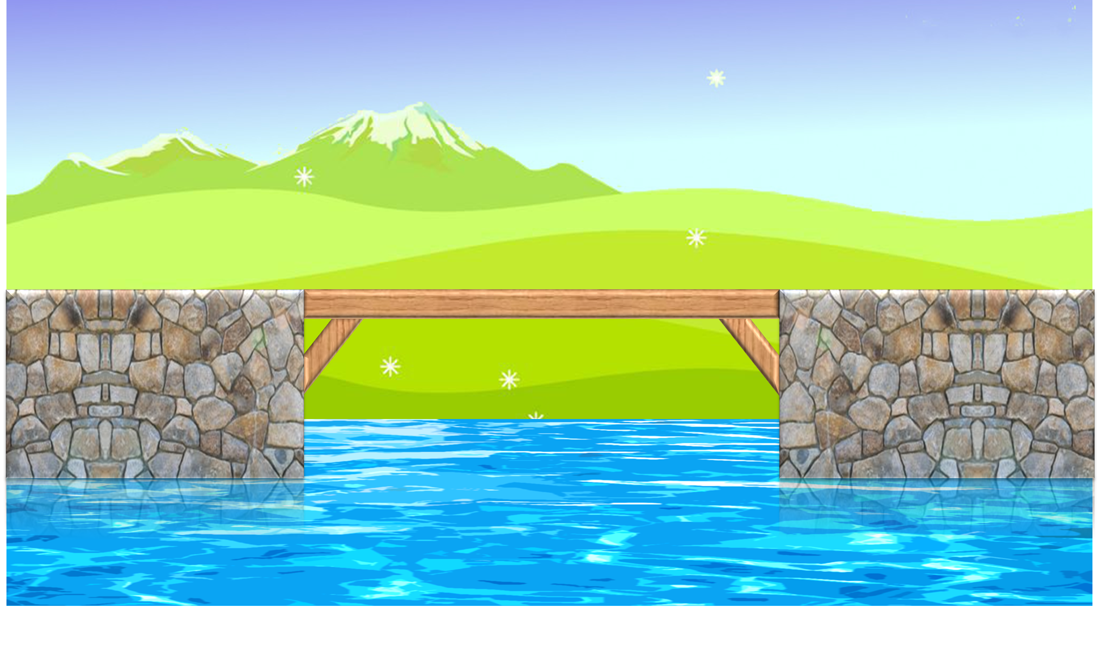


RULES
Students read the sentences.
Say True or False.
1 correct answer = 2 points.

Slide 13

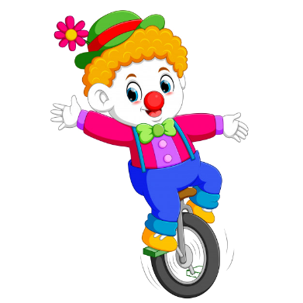
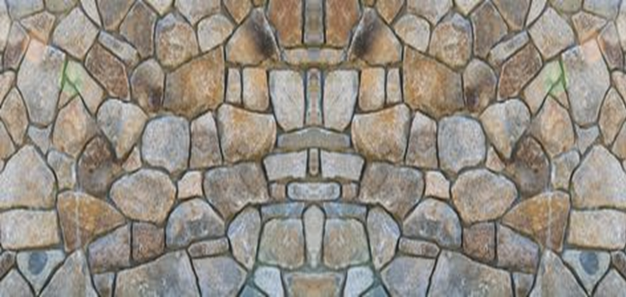




1. What are these?.
They’re spiders.
They’re chicks.

Slide 14
2. What are these? .
They’re snakes.
They’re goats.

Slide 15
3.What are these?
It’s a duck.
They’re ducks.

Slide 16
4. What are these?
They’re parrots.
It’s a parrot.

Slide 17
5. What are these?
They’re ducks.
They’re chicks.

Slide 18
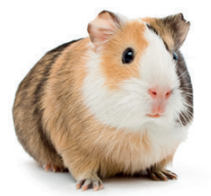


6. What are these?
They’re dogs.
They’re guinea pigs.

Slide 19



Slide 20
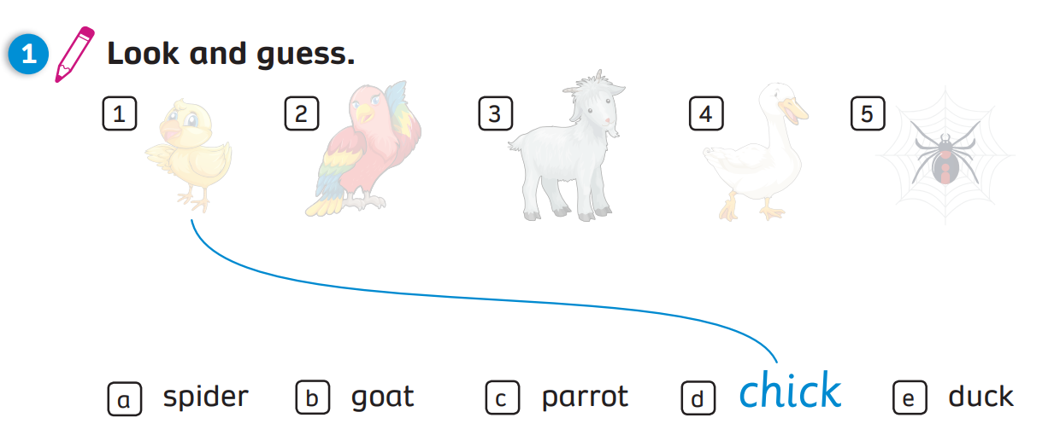
Activity book (p.62)

Slide 21
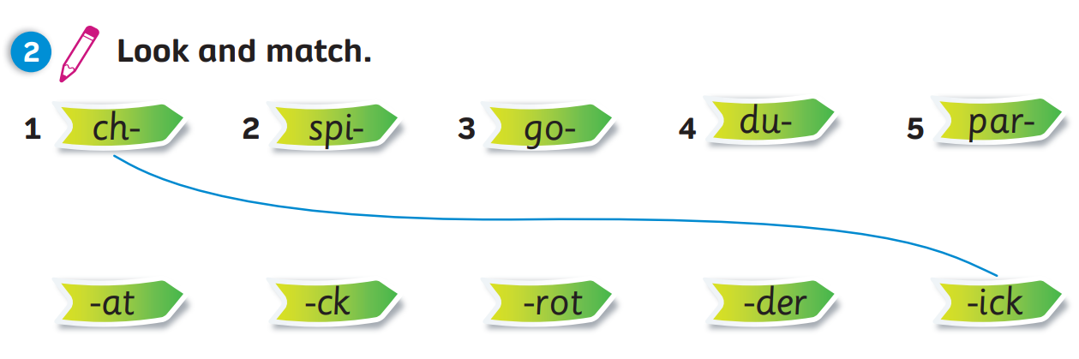
Activity book (p.62)

Slide 22
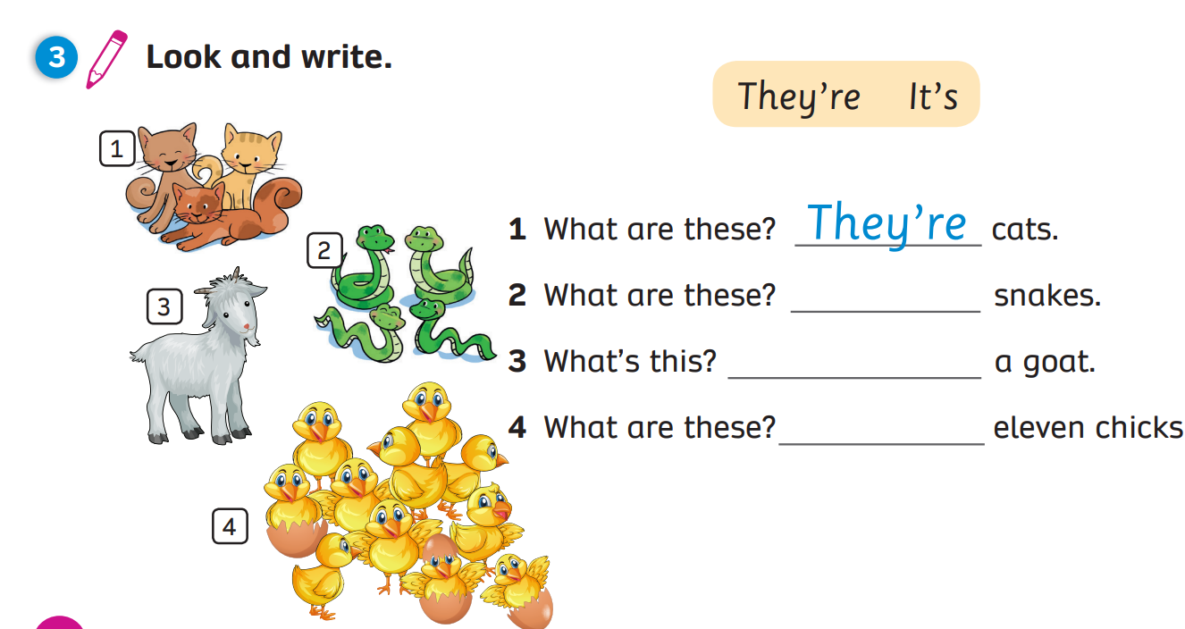
Activity book (p.62)
Answers
They’re
It’s
They’re
Click on “Answers” to show the answers

Slide 23

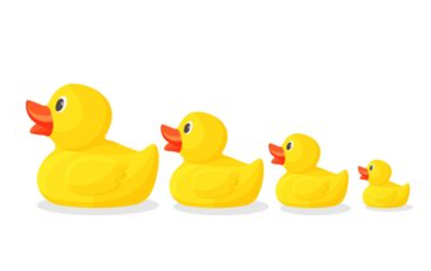
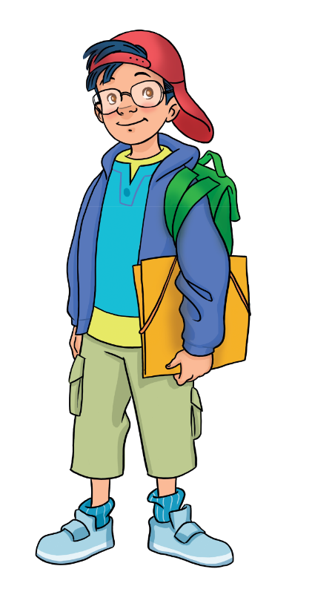
PRODUCTION
Show your drawing in the last lesson.
Move around the class. Talk with 3-5 friends about the toy.
They’re ducks. They’re yellow.
Notes:
Have Ss take out the drawing they have made in previous lesson
Instruct Ss to move around the class and talk with 3 to 5 friends about it using the given structures in the next slide

Slide 24


PRODUCTION: Example
1
2
What are these?
They’re ducks.
4
3
They’re yellow.
What colour are they?
Notes:
Draw Ss’ attention to the 2 questions they have to ask their friends about the drawing
Model by inviting 1 student to come to the front and have the conversation with the teacher

Slide 25
Wrap-up
duck
parrot
goat
chick
spider

Slide 26

UNIT 6: Lesson 3B
We’ve reviewed…
five common pets
to ask and answer about common pets

