Slide 1
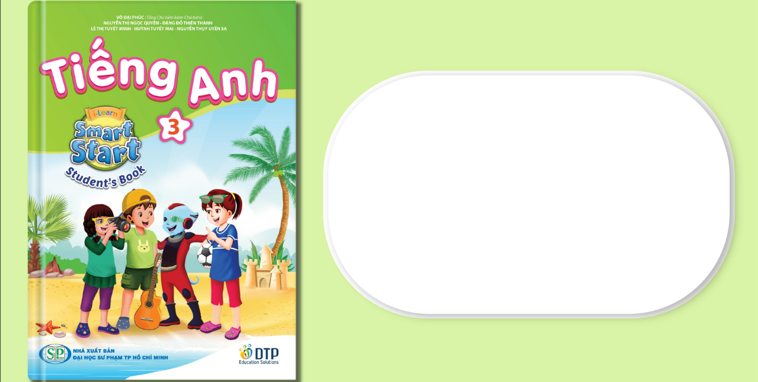
Unit 7: Toys
Review & Practice 1
Page 108

Slide 2
Lesson Outline
Warm-up
Reading
Listening
Consolidation
Wrap-up

Slide 3
Objectives
By the end of this lesson, students will be able to…
Vocabulary: Review vocabularies about toys.
Listening: Listen to people ask and answer about toys.
Reading: Read and tick or cross about toys.

Slide 4

WARM UP

Slide 5









a doll

Slide 6
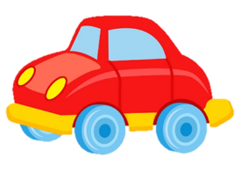

a robot

Slide 7

a yo- yo

Slide 8
a car

Slide 9
a puzzle

Slide 10
a teddy bear

Slide 11



doll
yo-yo
teddy bear

Slide 12
yo-yo
puzzle
kite

Slide 13
car
doll
robot

Slide 14
car
robot
yo-yo

Slide 15
puzzle
robot
doll

Slide 16
yo-yo
teddy bear
doll

Slide 17

It’s time to learn …

Slide 18

Listening

Slide 19

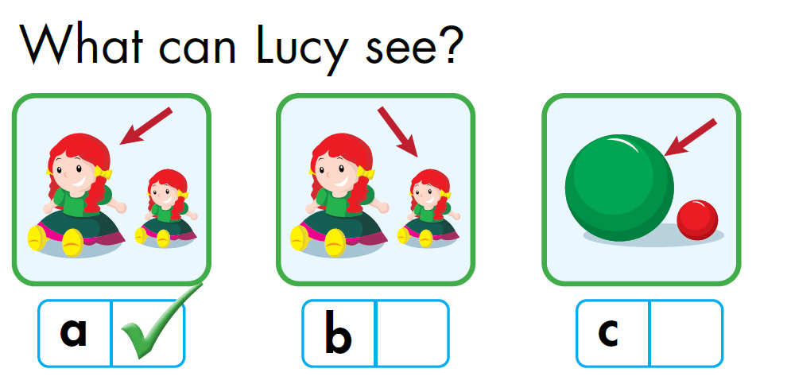

Notes:
Bấm vào: Listen and draw lines để nghe âm thanh

Slide 20
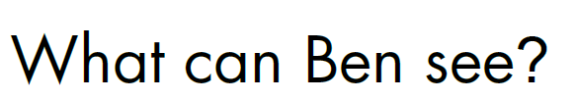
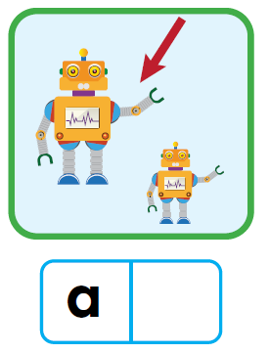
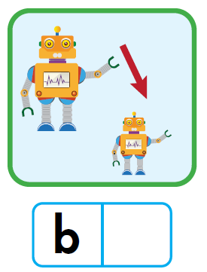
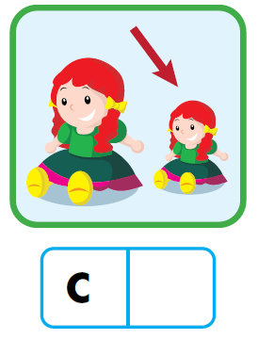


Notes:
Bấm vào: Listen and draw lines để nghe âm thanh

Slide 21

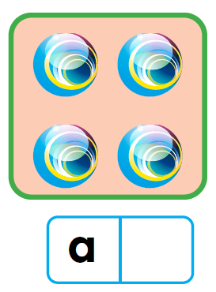
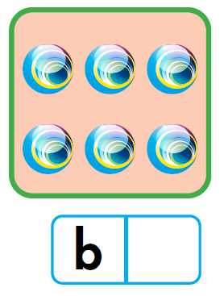
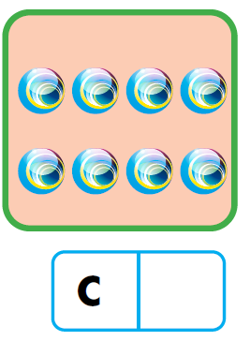

Notes:
Bấm vào: Listen and draw lines để nghe âm thanh

Slide 22

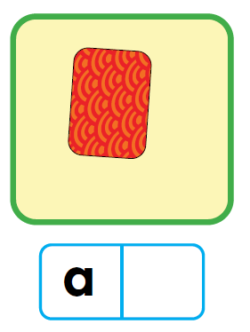
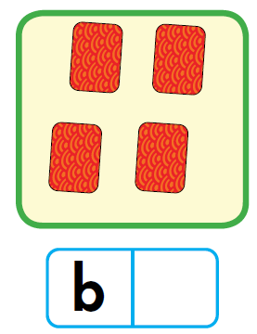
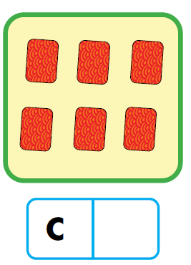
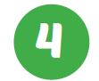
Notes:
Bấm vào: Listen and draw lines để nghe âm thanh

Slide 23

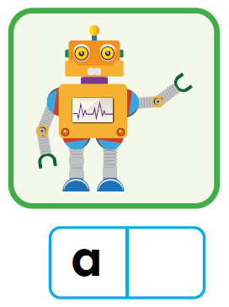
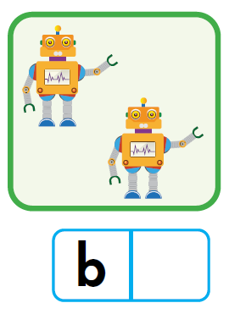
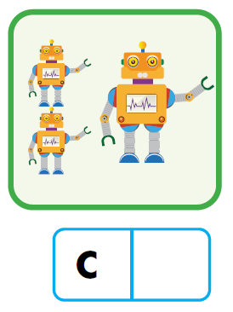

Notes:
Bấm vào: Listen and draw lines để nghe âm thanh

Slide 24

Listen and fill in the blanks:
1. Ben: What can you see, Lucy?
Lucy: __________________.
Ben: A big ball?
Lucy: No, I can see a big doll.
I can see a big doll

Slide 25
Listen and fill in the blanks:
2. Lucy: What can you see, Ben?
Ben: I can see a small robot. I have __________________.
Lucy: Great! I have a small doll at home.
a big robot at home

Slide 26
Listen and fill in the blanks:
3. Nick: I have six marbles. How many marbles do you have, Tom?
Tom: ____________________.
I have eight marbles

Slide 27
Listen and fill in the blanks:
4. Tom: I have four cards. How many cards do you have, Nick?
Nick: I have six cards. __________________.
Tom: Thanks.
I can give you one

Slide 28
Listen and fill in the blanks:
5. Mai: _________________________________?
John: I have two small robots and one big robot.
I have three robots.
Mai: Great. I love robots.
How many robots do you have, John

Slide 29

Post-Listening

Slide 30

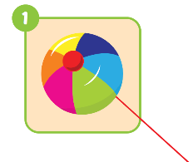
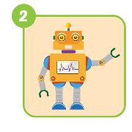
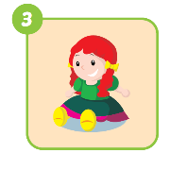
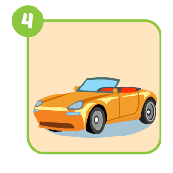
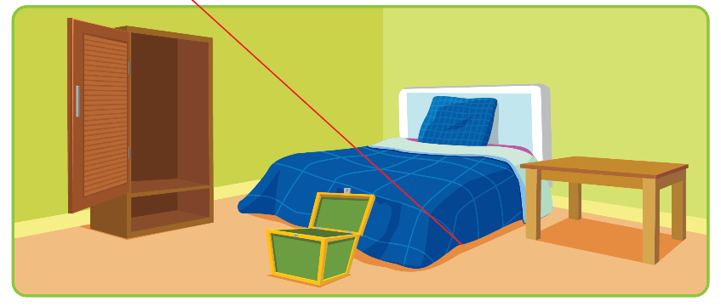
Wordbook, p.77
Click to the number to check the answer.

Slide 31

Reading

Slide 32
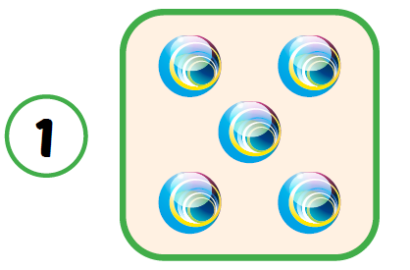


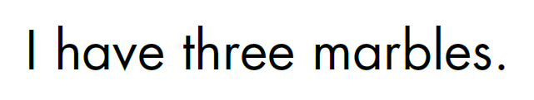

Slide 33
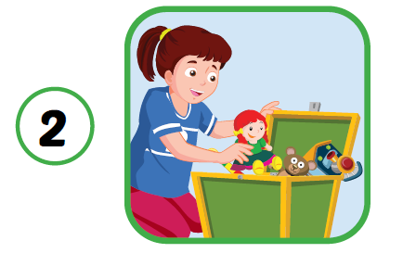

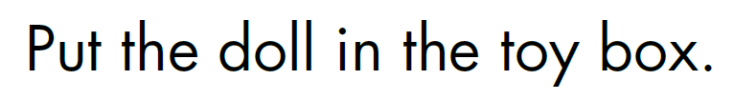

Slide 34
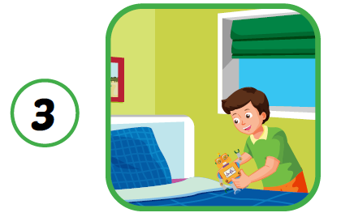
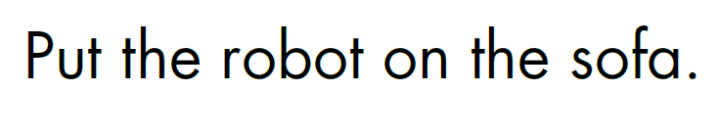

Slide 35
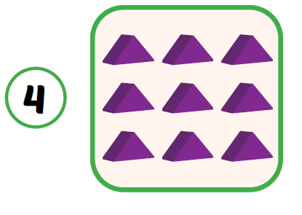
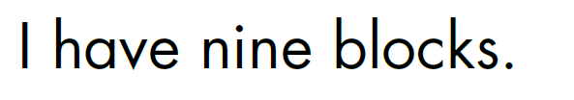

Slide 36

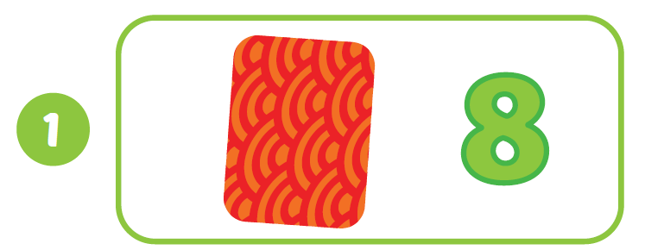
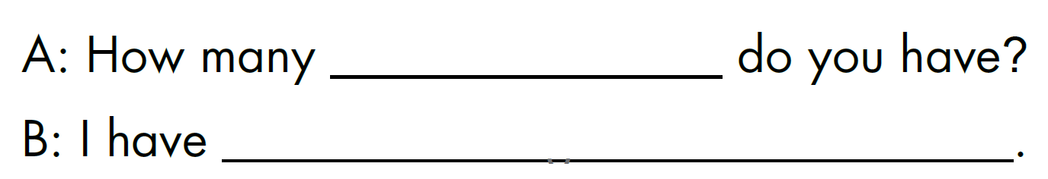
Workbook, p.77
dice
eight dice

Slide 37
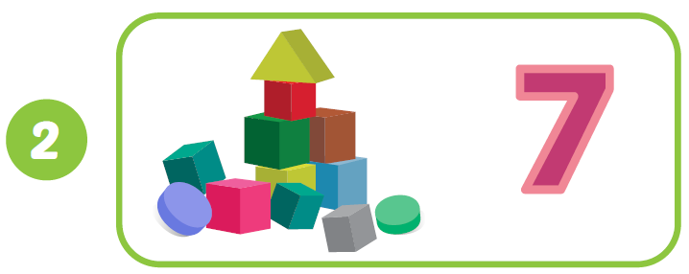
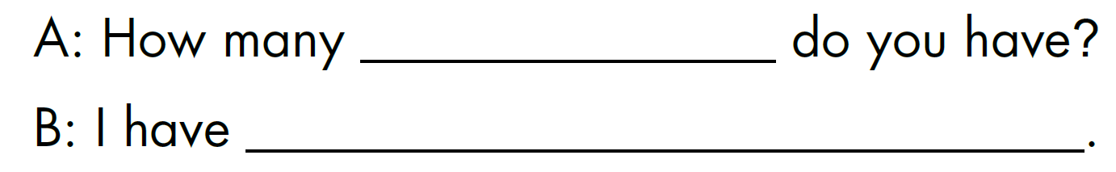
Workbook, p.77
blocks
seven blocks

Slide 38
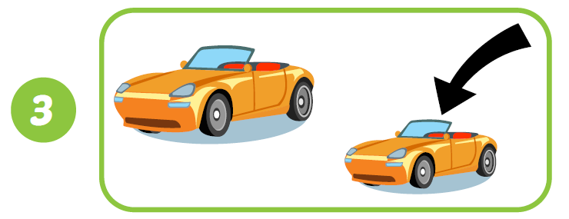
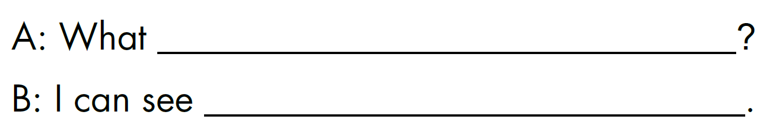
Workbook, p.77
can you see
a small car

Slide 39
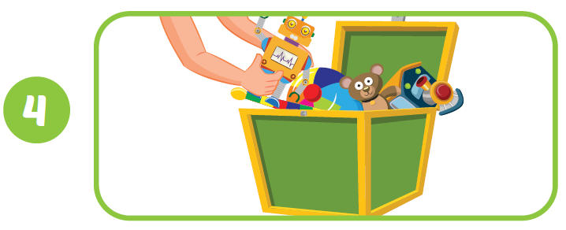
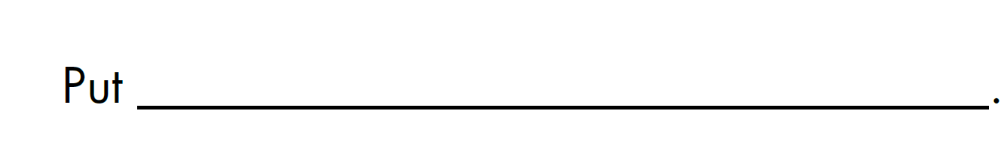
Workbook, p.77
the robot in the toy box

Slide 40

CONSOLIDATION

Slide 41
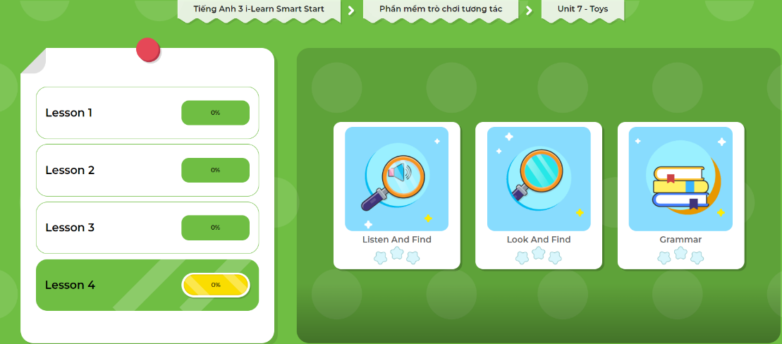
Extra Practice
DHA on Eduhome
LET’S PLAY!
Click here to play the games.

Slide 42

WRAP-UP

Slide 43
Today’s lesson
Vocabulary
Review vocabularies about toys.
Reading
Read and tick or cross about toys.
Listening
Listen to people ask and answer about toys.

Slide 44
Homework
Practice the vocabularies and structure; and make sentences using them.
Do the exercises in Tiếng Anh 3 i-Learn Smart Start WB (page 77)
Do the exercises in Tiếng Anh 3 i-Learn Smart Start Notebook (page 50)
Prepare the next lesson (page 109 SB)
Play the consolidation games in Tiếng Anh 3 i-Learn Smart Start DHA App on www.eduhome.com.vn

Slide 45

Have a nice day!

