Slide 1

Unit 6
DESCRIBING PEOPLE
LESSON 1.1

Slide 2
01
02
WARM UP
VOCABULARY
03
GRAMMAR

Slide 3
01
WARM UP

Slide 4
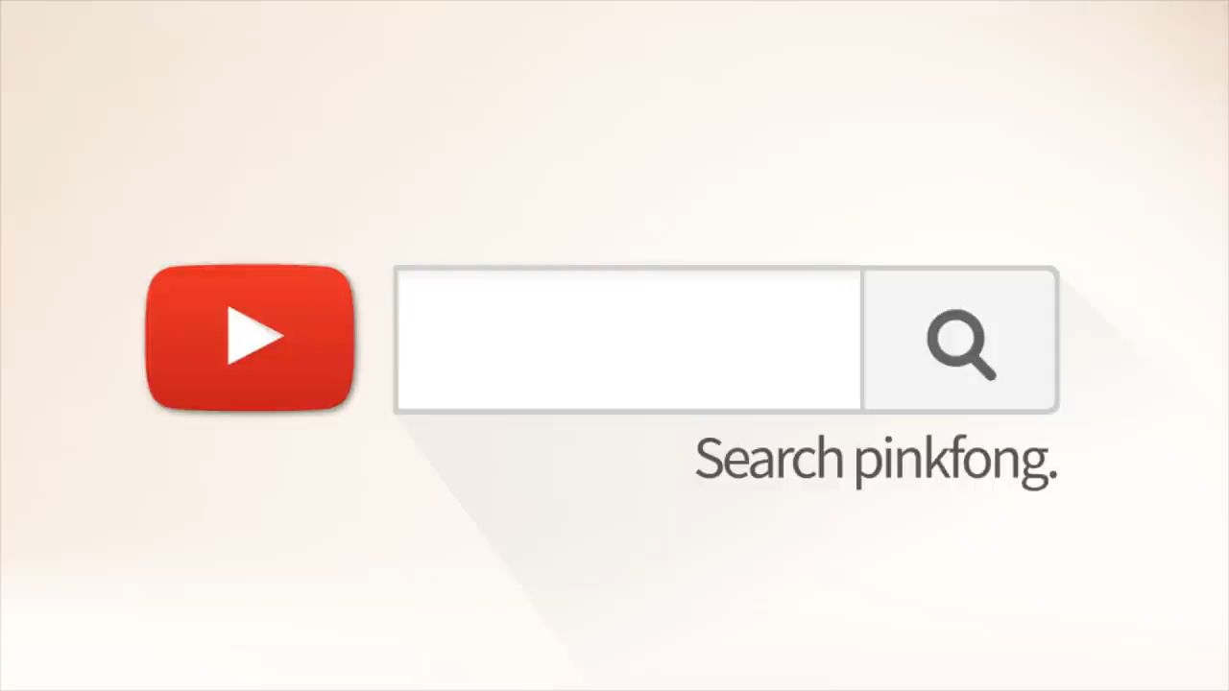

Slide 5
02
VOCABULARY

Slide 6
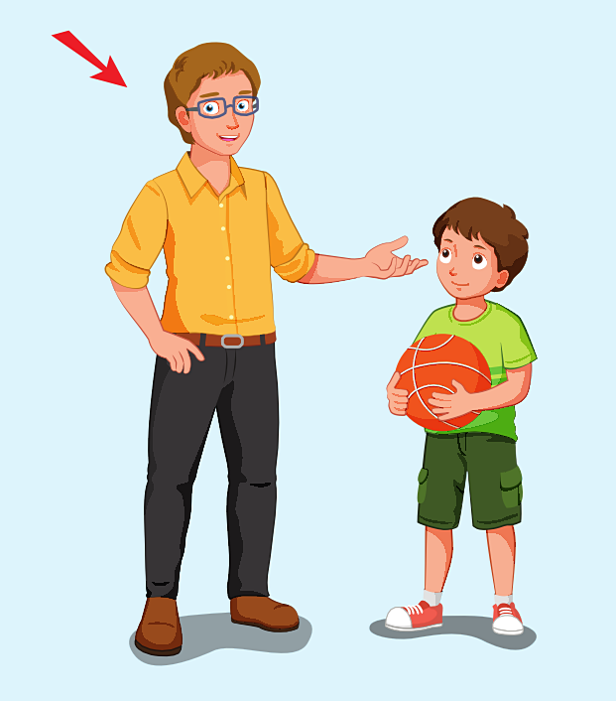

tall

Slide 7
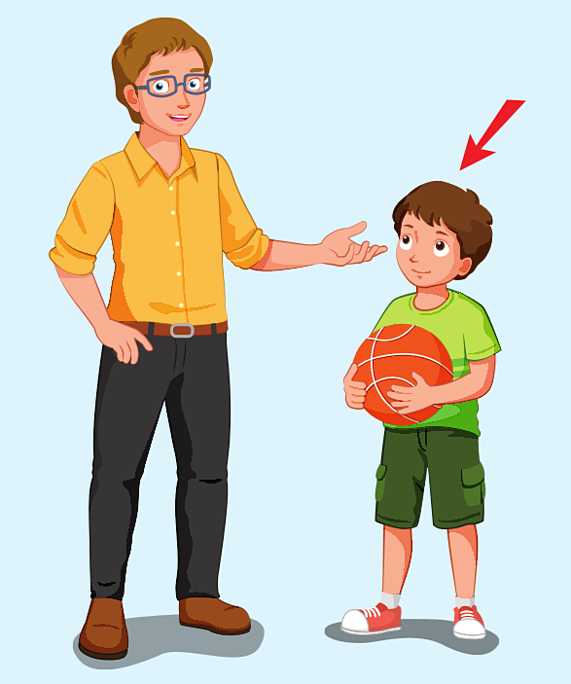
short

Slide 8
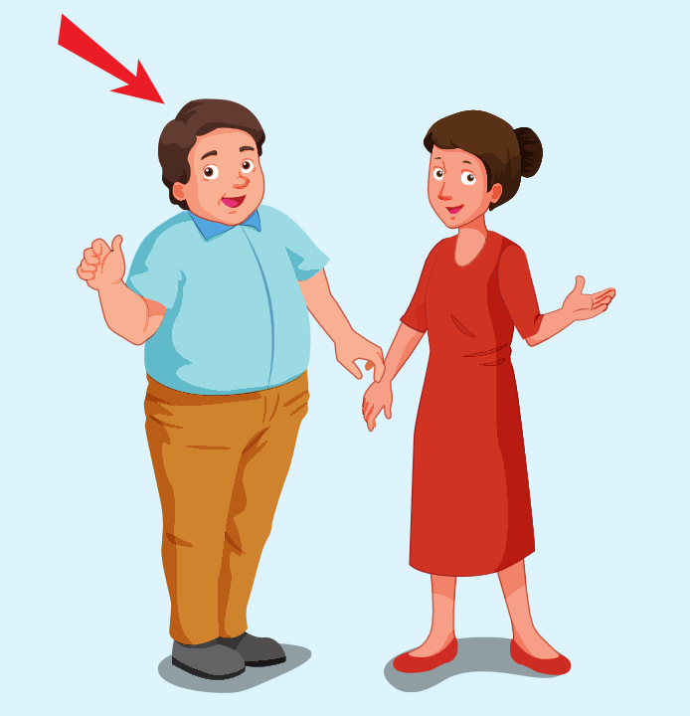
big

Slide 9
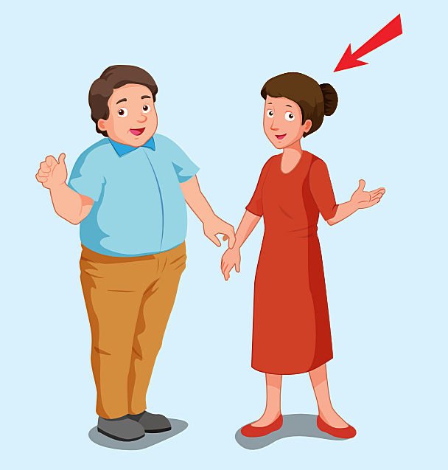
slim

Slide 10
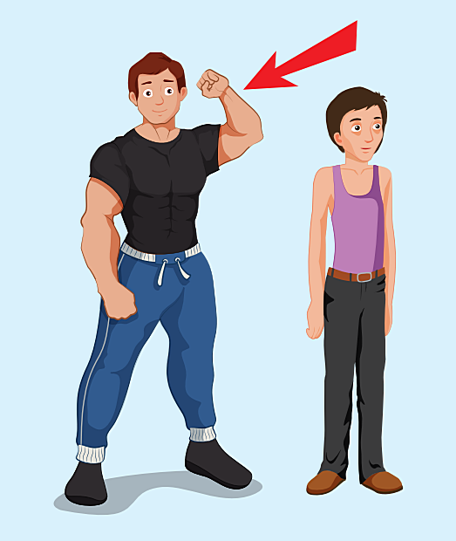
strong

Slide 11
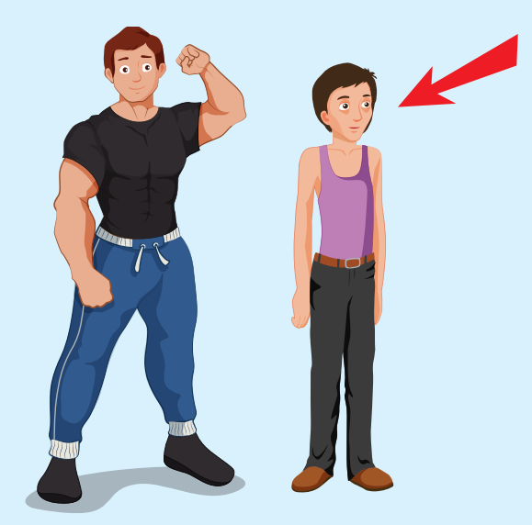
weak

Slide 12

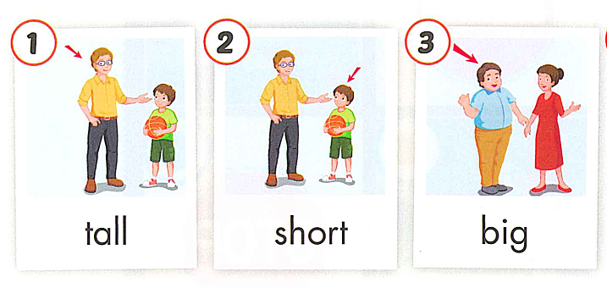
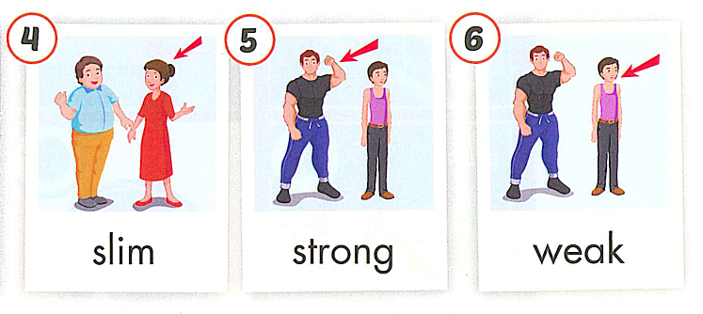

Slide 13
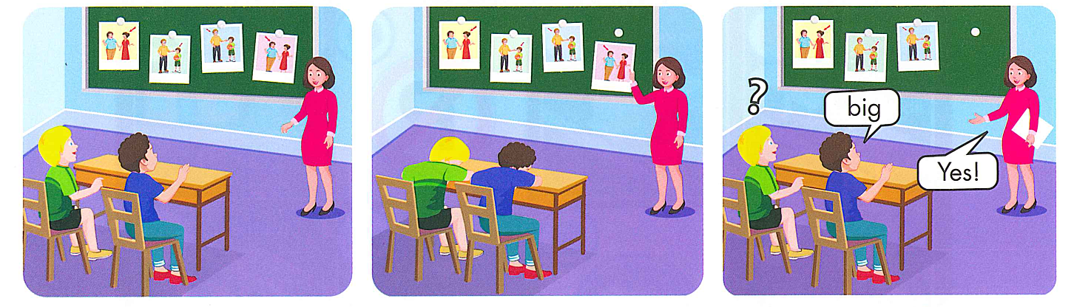

Slide 14
Review vocabulary

Slide 15
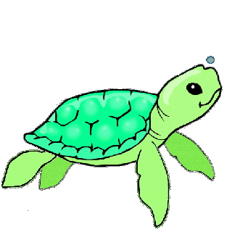

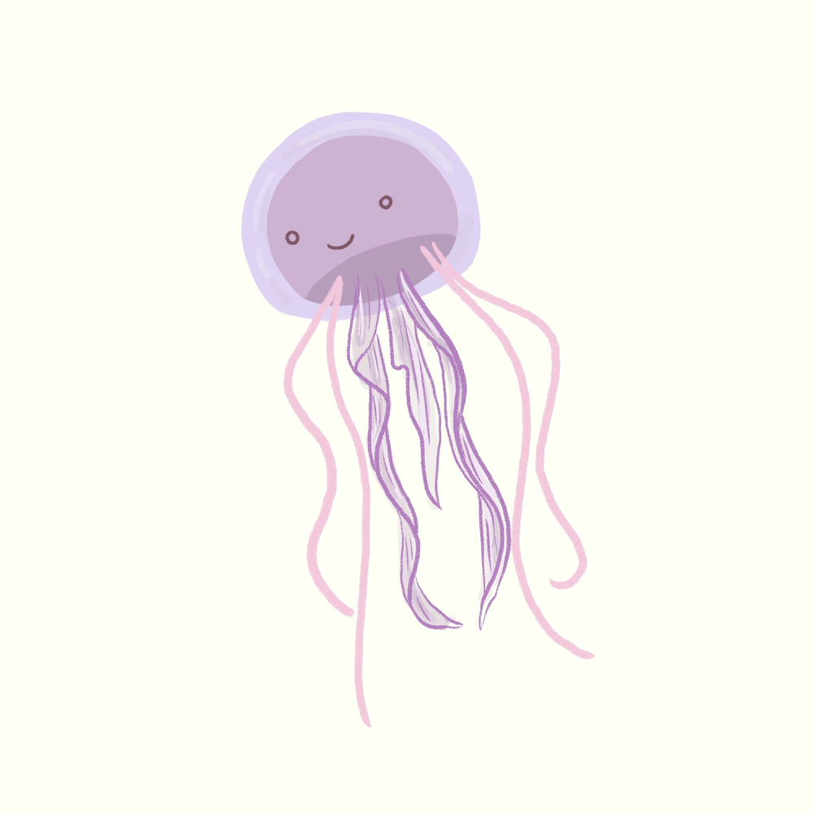
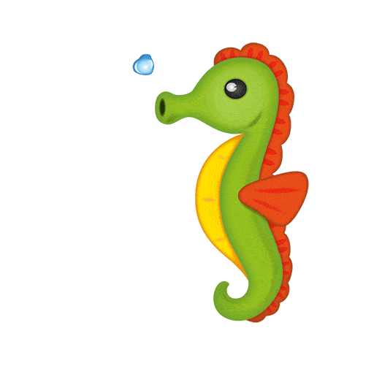

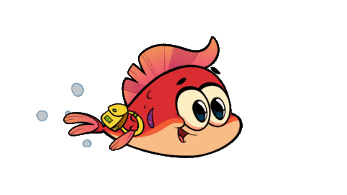


Fish helps friends

Slide 16
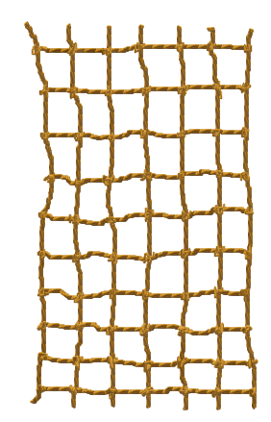
5
2
3
4
6
1

Slide 17


Slide 18

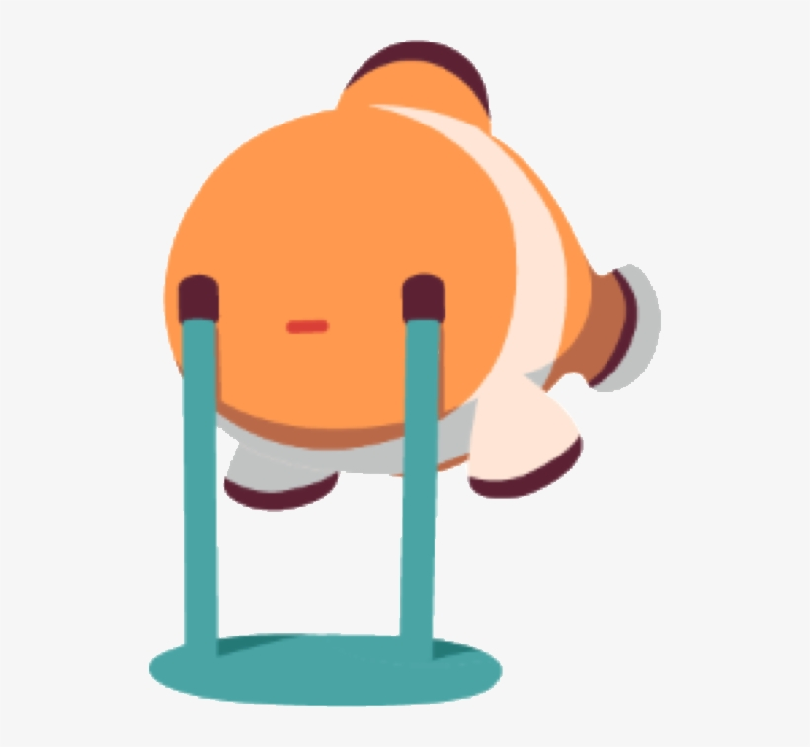




LOOK AND CHOOSE
a. big
c. weak
b. slim
d. strong

Slide 19
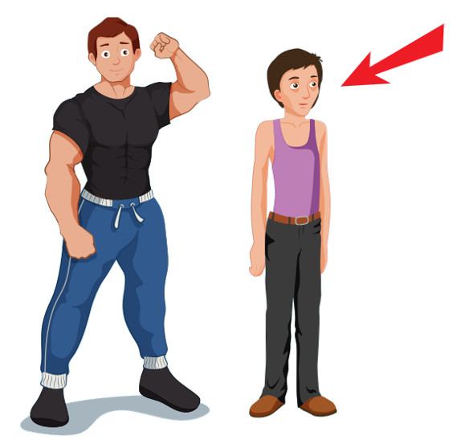
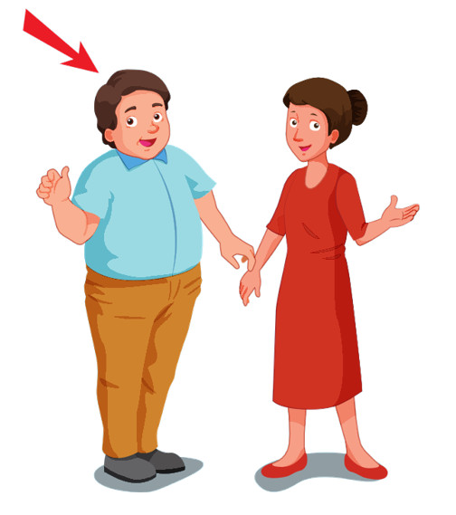
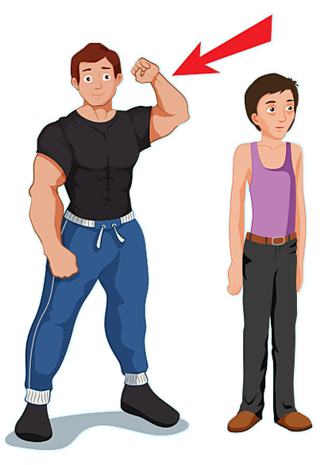
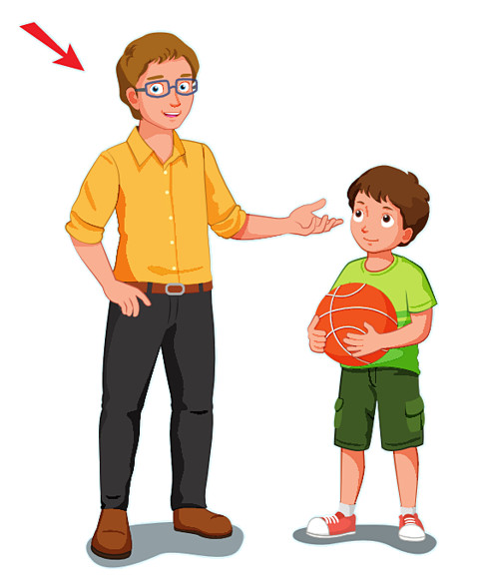
LISTEN AND CHOOSE:
a.
b.
c.
d.

Slide 20
LOOK AND CHOOSE
a. big
c. short
b. strong
d. tall

Slide 21
LISTEN AND CHOOSE:
a. weak
c. strong
b. slim
d. tall

Slide 22
s/h/o/r/t
a. srtho
c. short
b. shotr
d. horts

Slide 23
b__g
a. y
c. i
b. a
d. u

Slide 24

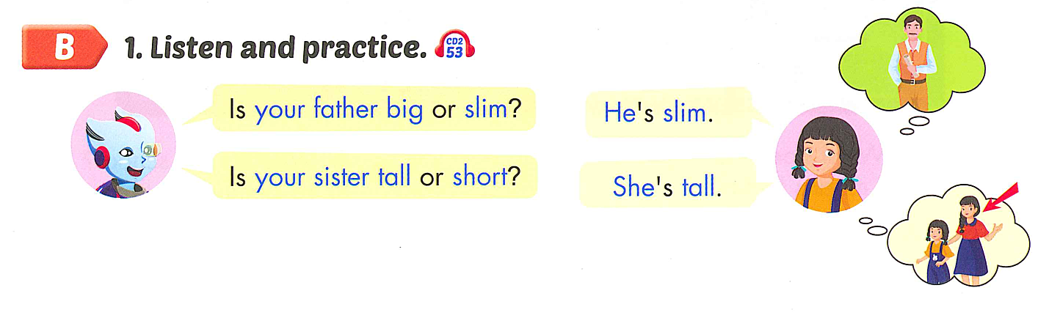


Slide 25
Is + Subject +Adj 1 + or +Adj 2 ?
Subject + be +Adj.

Slide 26
Review grammar

Slide 27
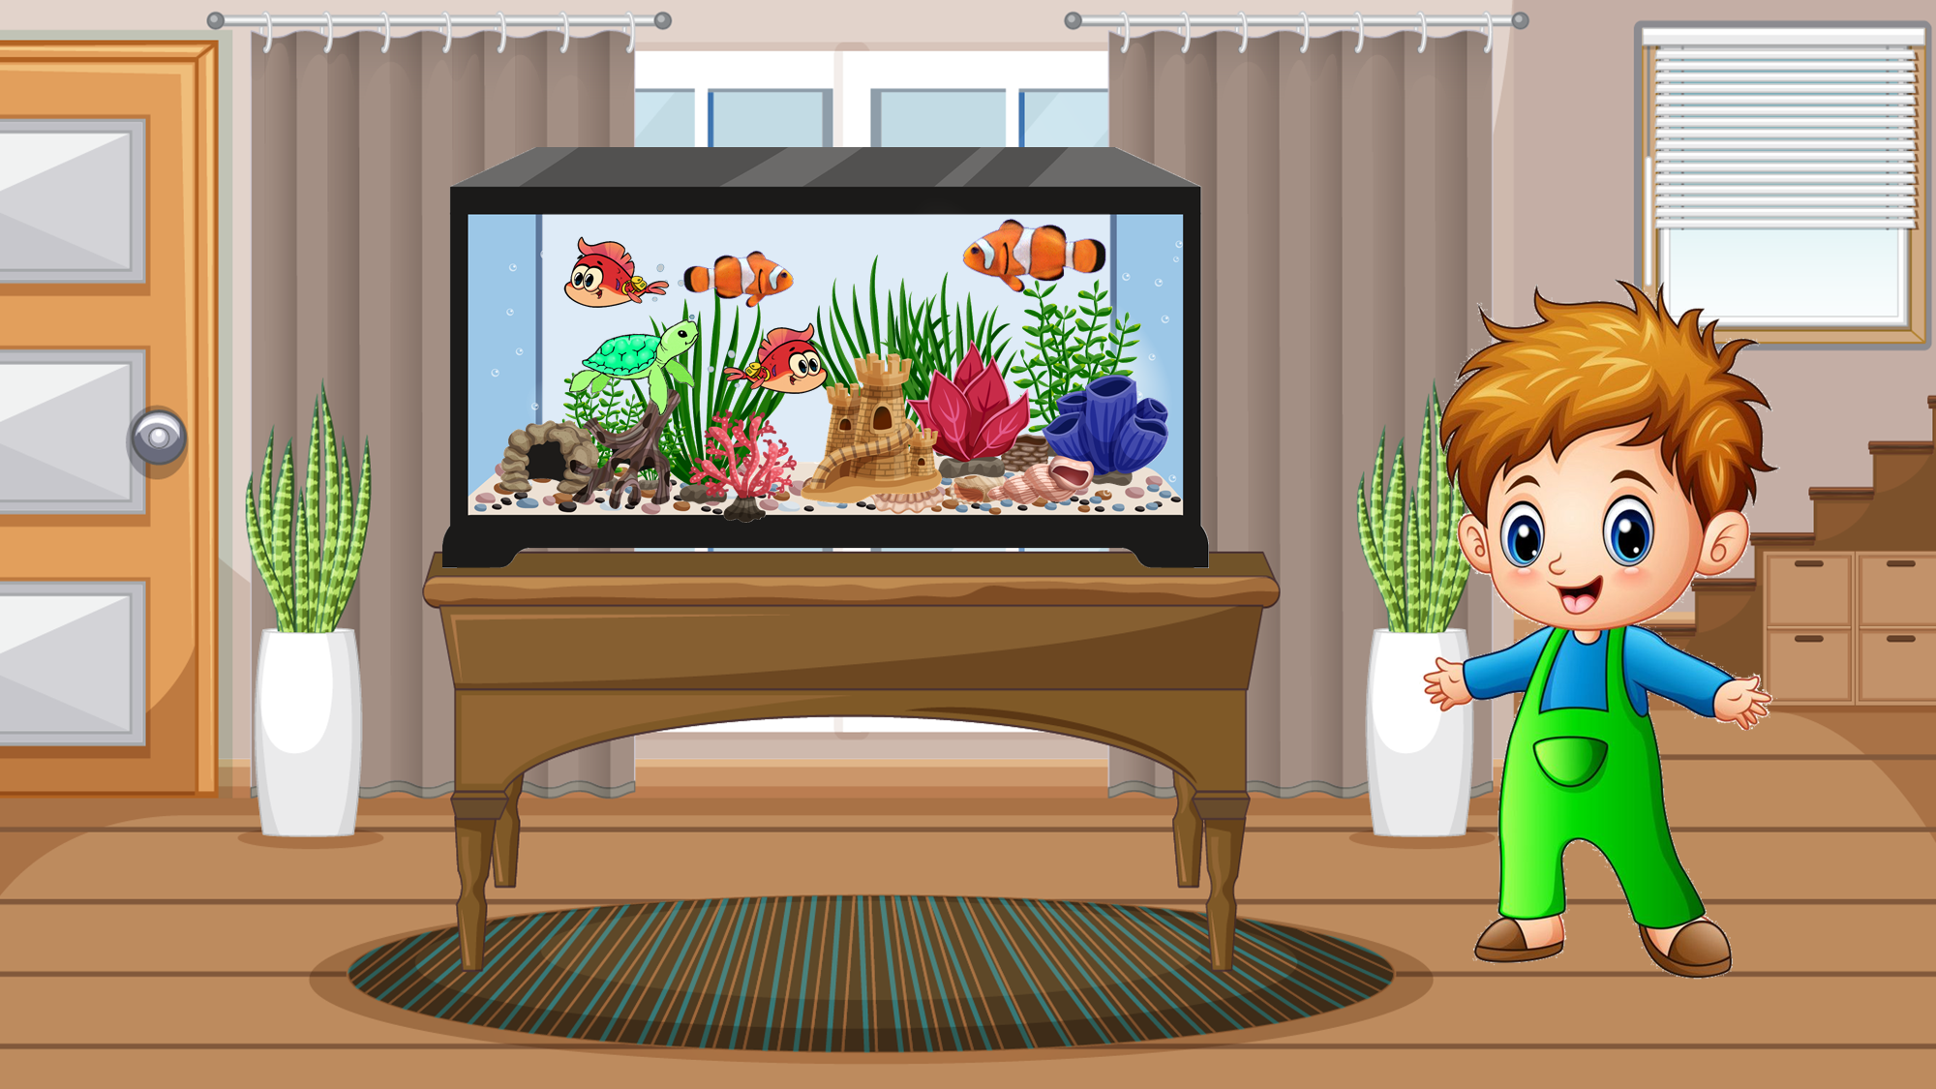

MY AQUARIUM

Slide 28
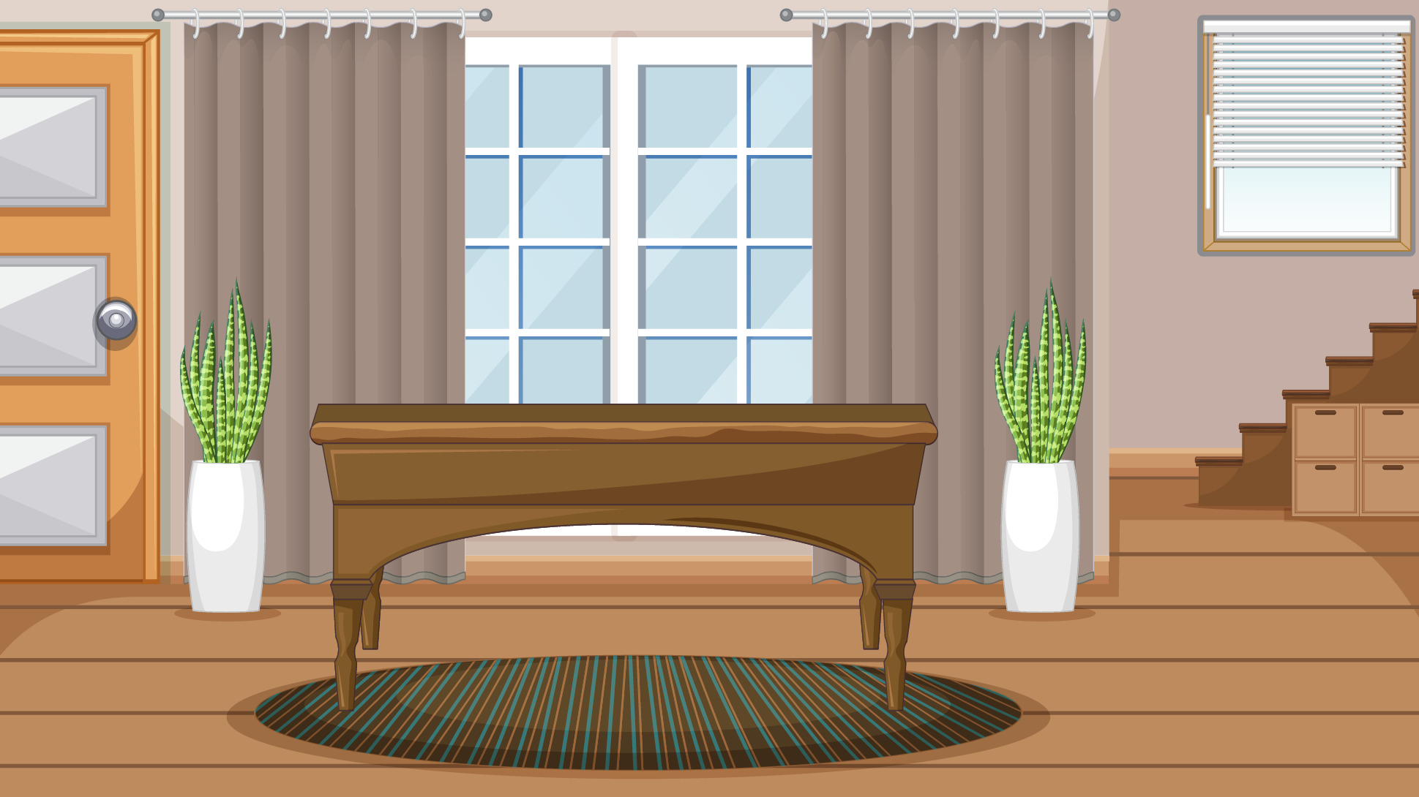








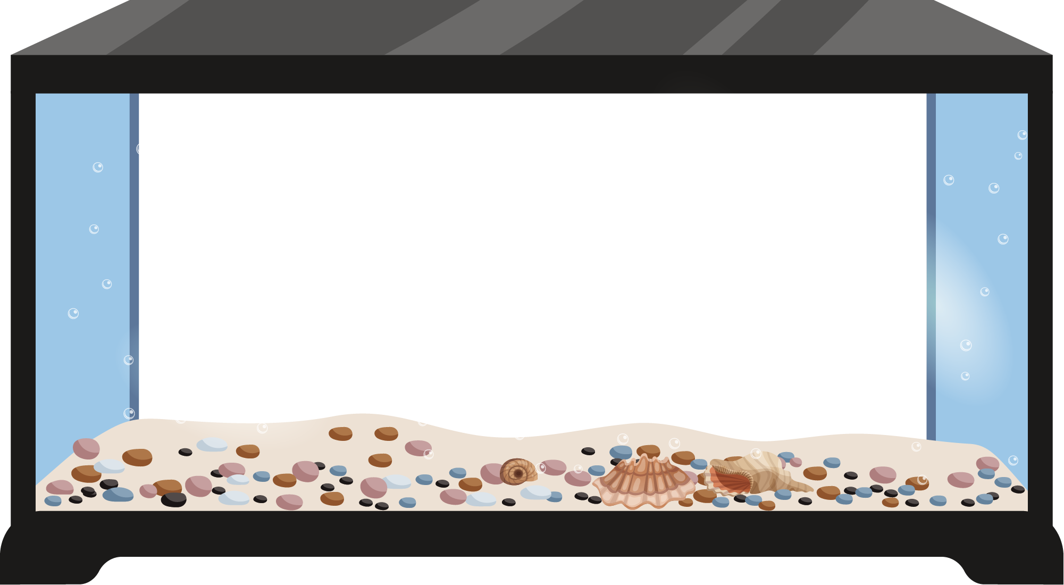
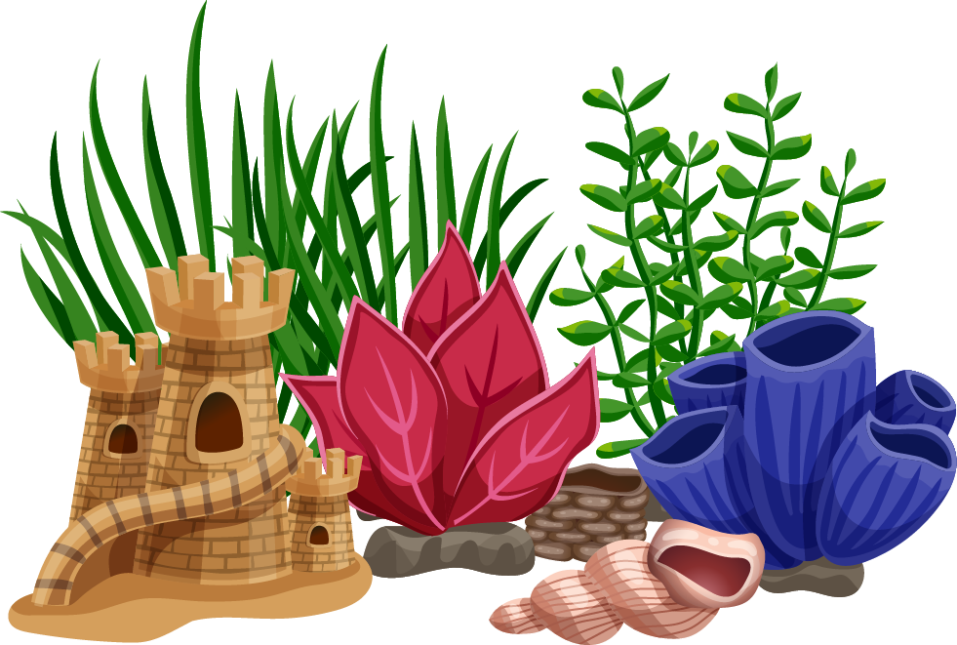
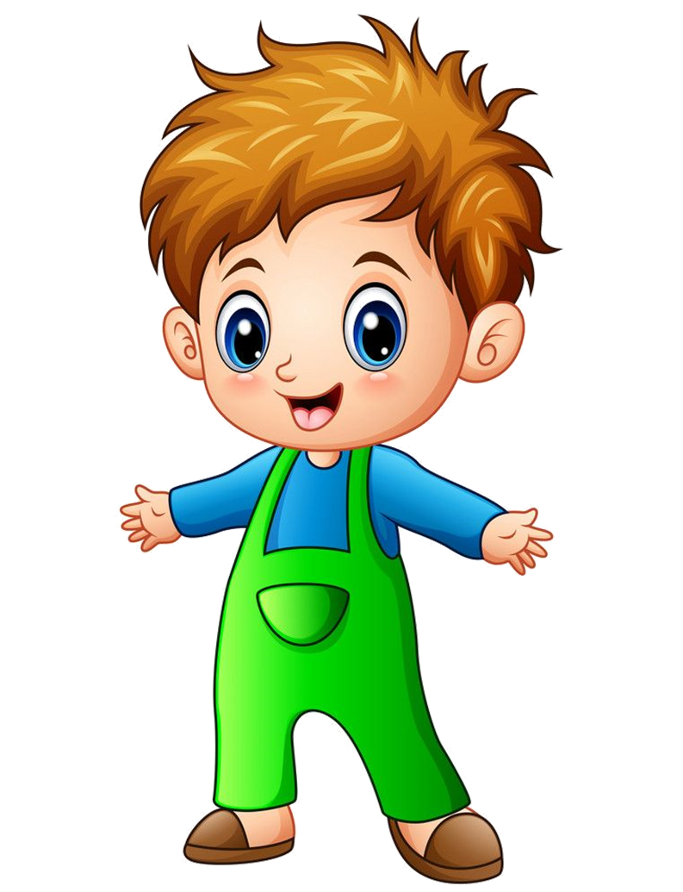
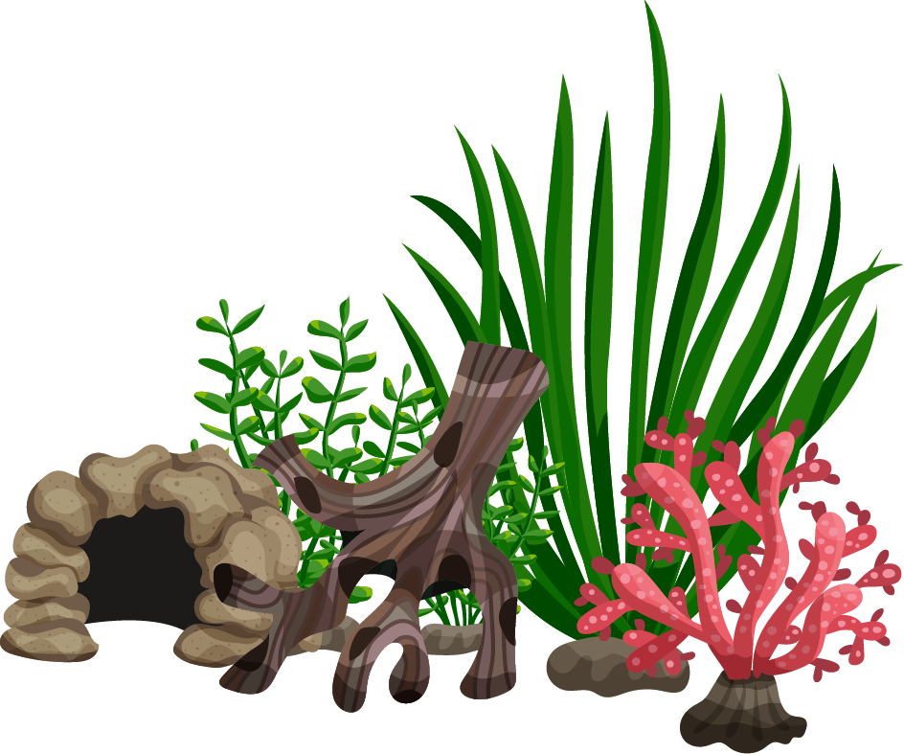
NEXT

Slide 29
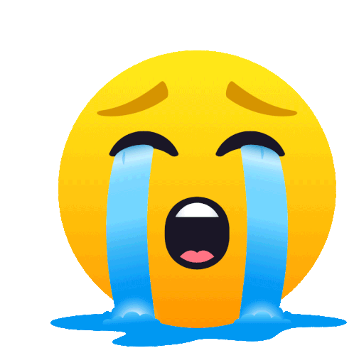



Is your brother tall __short?
He’s tall.
a. and
c. because
b. or
d. so

Slide 30
Is/sister/or/tall/ your/short?
She’s tall
a. Is your sister tall or short ?
c. Is sister your tall or short ?
b. Is tall your sister or short ?
d. Is tall or short your sister ?

Slide 31
Is your brother__ or__ ?
a. strong-big
c. strong-weak
b. weak-short
d. tall-slim

Slide 32
Is your brother__ or slim?
He’s slim
a. big
c. strong
b. short
d. weak

Slide 33
______
She’s short.
a. Is your sister tall or short ?
c. Is your aunt strong or short ?
b. Is your mum tall or weak?
d. Is your teacher strong or weak ?

Slide 34
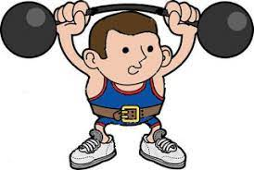
Is your friend strong or weak?
a. Yes, I do.
c. He’s tall.
b. He’s strong.
d. He’s big.

Slide 35
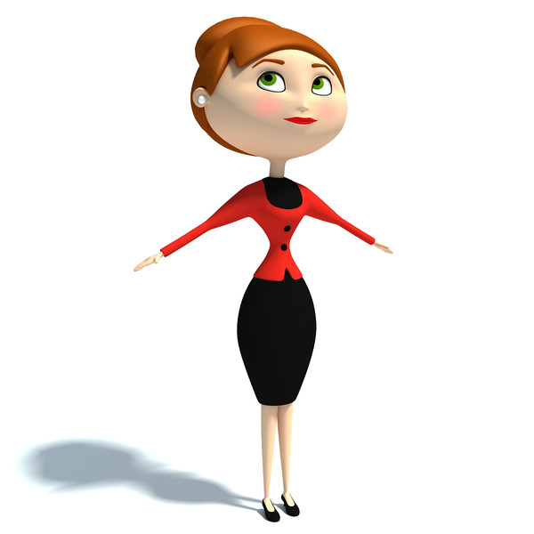
Is your sister big or slim?
a. She’s weak.
c. She’s tall.
b. She’s slim.
d. She’ short.

Slide 36
Is your uncle ___ or ___?
a. weak-strong
c. weak-slim
b. big-slim
d. tall-short

Slide 37
practice

Slide 38



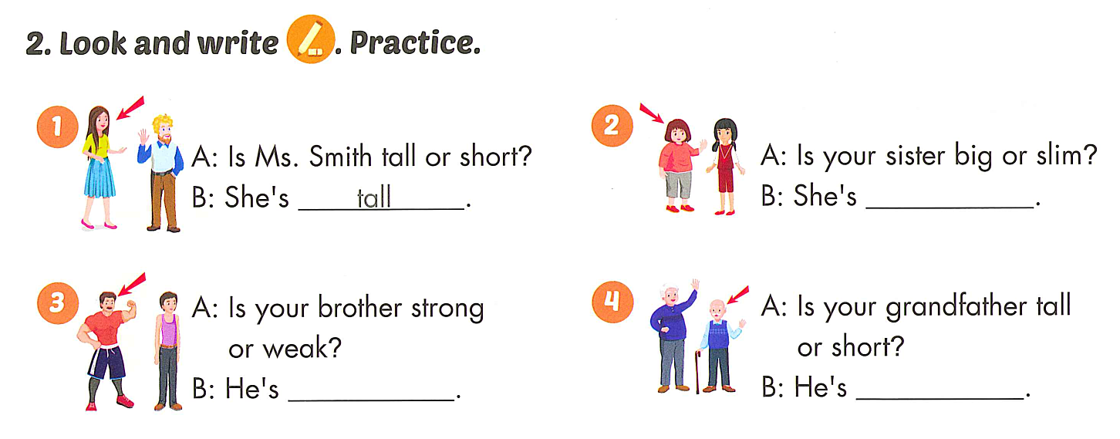
big
strong
short

Slide 39
Good bye

