Slide 1









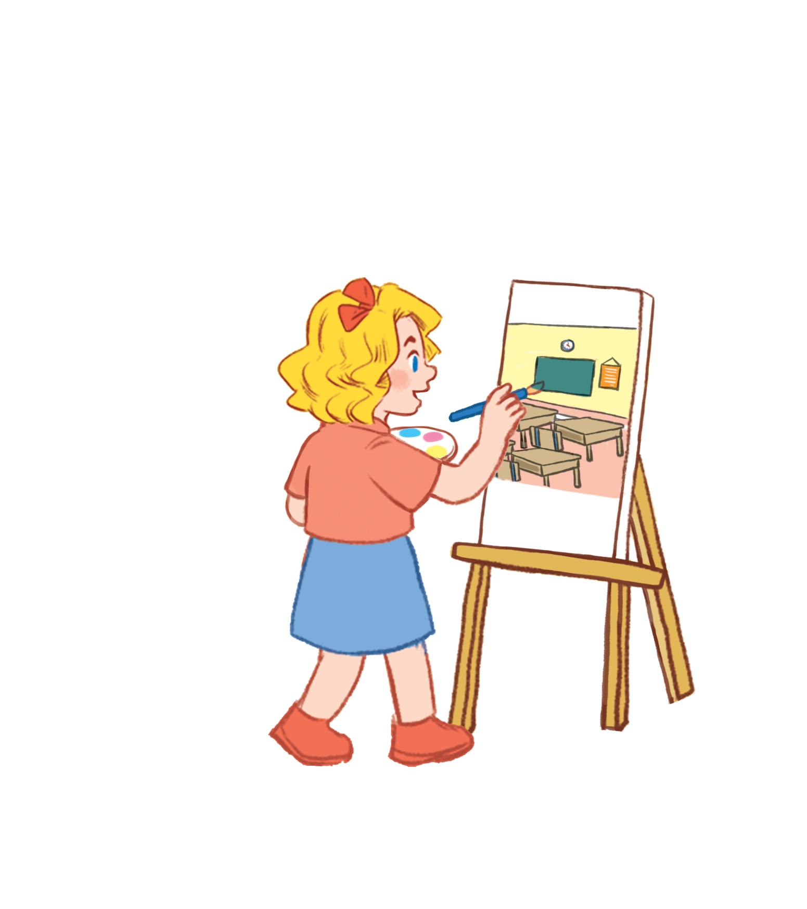

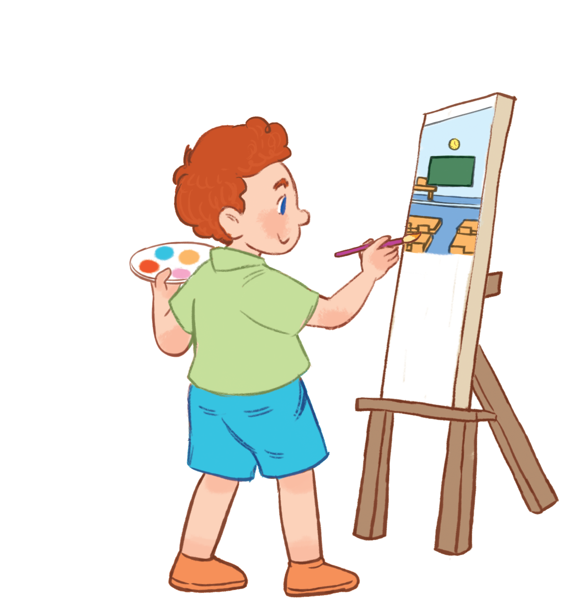


Unit 5
My hobbies
Lesson 1

Slide 2


Warm - up
Play

Slide 3


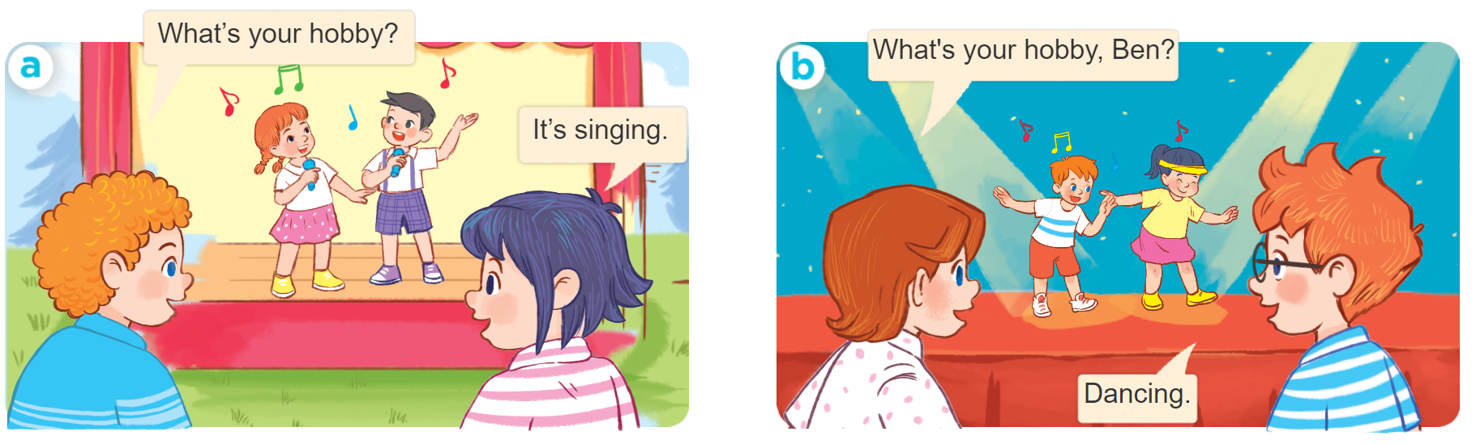
1
Look, listen and repeat.
MsPham-0936082789

Slide 4

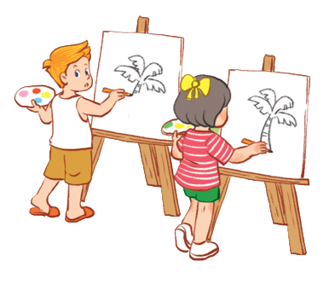

Vocabulary
dancing
/ˈdɑːnsɪŋ/
: Nhảy, múa
singing
/ˈsɪŋɪŋ/
: hát
drawing
/ˈdrɔːɪŋ/
: Vẽ
swimming
ˈswɪmɪŋ/
: Bơi
hobby
/ˈhɒbi/
: Sở thích
MsPham-0936082789

Slide 5


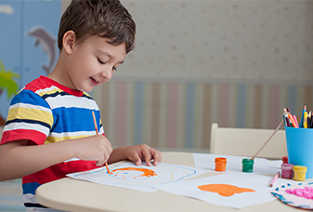
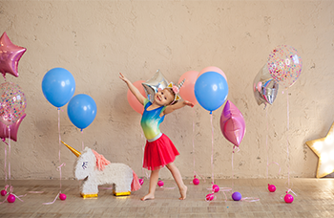

2
Listen, point and say.
What’s your hobby?
It’s _______.
MsPham-0936082789
singing
drawing
dancing
swimming

Slide 6

Structures
Hỏi và trả lời về sở thích:
What’s your hobby?
(Sở thích của bạn là gì)
MsPham-0936082789
It’s ______
(Đó là ______)

Slide 7
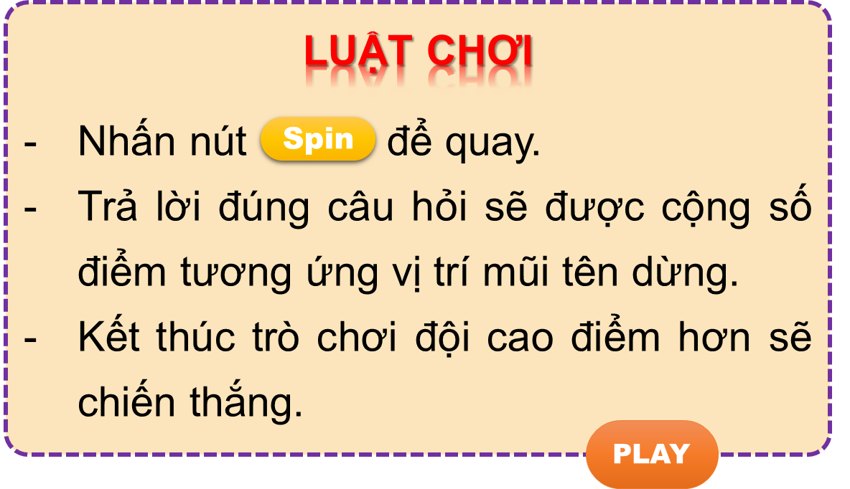


Vòng quay kì diệu
50
10
20
30
10
20
30
40
Spin
PLAY
LUẬT CHƠI
Nhấn nút để quay.
Trả lời đúng câu hỏi sẽ được cộng số điểm tương ứng vị trí mũi tên dừng.
Kết thúc trò chơi đội cao điểm hơn sẽ chiến thắng.
Spin
Notes:
Ms Huyền Phạm - 0936.082.789

Slide 8
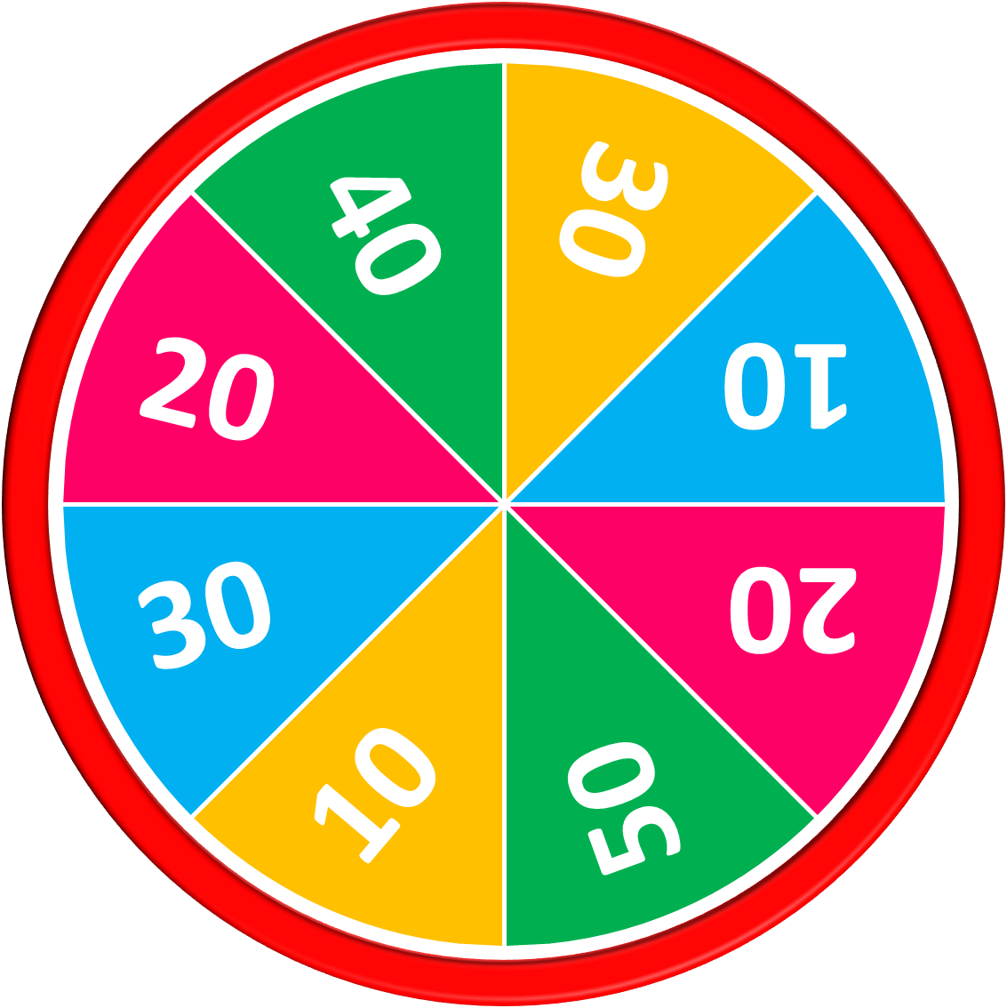
What’s your hobby?
50
10
20
30
10
20
30
40
It’s swimming.
Answer
Stop
Spin
Notes:
Ms Huyền Phạm - 0936.082.789

Slide 9
  What’s your hobby?
50
10
20
30
10
20
30
40
It’s dancing.
Answer
Stop
Spin
Notes:
Ms Huyền Phạm - 0936.082.789

Slide 10
  What’s your hobby?
50
10
20
30
10
20
30
40
It’s drawing.
Answer
Stop
Spin
Notes:
Ms Huyền Phạm - 0936.082.789

Slide 11
What’s your hobby?
50
10
20
30
10
20
30
40
It’s singing.
Answer
Stop
Spin
Notes:
Ms Huyền Phạm - 0936.082.789

Slide 12
_____ your hobby?
It’s drawing.
50
10
20
30
10
20
30
40
What’s
Answer
Stop
Spin
Notes:
Ms Huyền Phạm - 0936.082.789

Slide 13
What’s your _____?
It’s dancing.
50
10
20
30
10
20
30
40
hobby
Answer
Stop
Spin
Notes:
Ms Huyền Phạm - 0936.082.789

Slide 14
What’s your hobby?
_____ drawing.
50
10
20
30
10
20
30
40
It’s
Answer
Stop
Spin
Notes:
Ms Huyền Phạm - 0936.082.789

Slide 15
What’s _____ hobby?
It’s singing.
50
10
20
30
10
20
30
40
a red pencil
Answer
Stop
Spin
Notes:
Ms Huyền Phạm - 0936.082.789

Slide 16



50
10
20
30
10
20
30
40
EXIT
Notes:
Ms Huyền Phạm - 0936.082.789

Slide 17
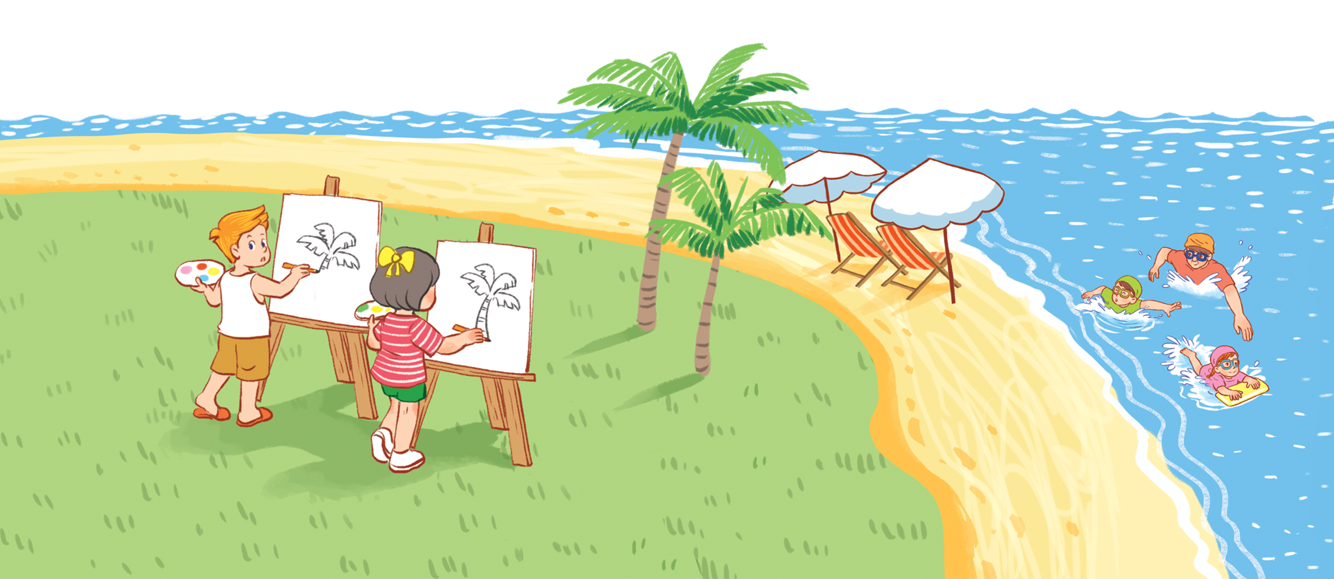

3
Let’s talk.
What’s your hobby?
It’s drawing.
MsPham-0936082789

Slide 18
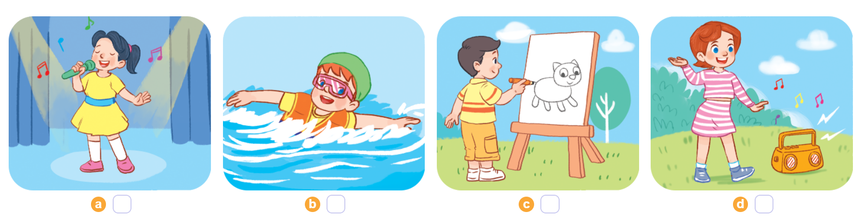
4
Listen and number.
MsPham
0936082789
a
4
b
3
c
2
d
1
1
2
3
4

Slide 19




5
Read and match.
What’s your hobby?
1
It’s dancing.
a
2
It’s drawing.
b
MsPham-0936082789
3
It’s swimming.
c
4
It’s singing.
d

Slide 20











Ms Huyền Phạm
0936.082.789
Ms Huyền Phạm
0936.082.789
Ms Huyền Phạm
0936.082.789
Ms Huyền Phạm - 0936.082.789 – YOUTUBE: MsPham. Facebook: Dạy và học cùng công nghệ.
Ms Huyền Phạm
0936.082.789
Notes:
Ms Huyền Phạm - 0936.082.789 – YOUTUBE: MsPham. Facebook: Dạy và học cùng công nghệ.

Slide 21






What’s your hobby?
It’s ____.
Next
The sing
singging
sing
singing
Notes:
Ms Huyền Phạm - 0936.082.789 – YOUTUBE: MsPham. Facebook: Dạy và học cùng công nghệ.

Slide 22
What’s your hobby?
It’s ____.
Next
simming
swiming
swimming
wimming
Notes:
Ms Huyền Phạm - 0936.082.789 – YOUTUBE: MsPham. Facebook: Dạy và học cùng công nghệ.

Slide 23
What’s your hobby?
It’s ____.
Next
drawwing
drawing
drowing
dawing
Notes:
Ms Huyền Phạm - 0936.082.789 – YOUTUBE: MsPham. Facebook: Dạy và học cùng công nghệ.

Slide 24
What’s your hobby?
It’s ____.
Next
dancing
danceing
dancig
dencing
Notes:
Ms Huyền Phạm - 0936.082.789 – YOUTUBE: MsPham. Facebook: Dạy và học cùng công nghệ.

Slide 25
What’s your hobby?
Next
Fine. Thank you.
It’s drawing.
Hello.
Goodbye.
Notes:
Ms Huyền Phạm - 0936.082.789 – YOUTUBE: MsPham. Facebook: Dạy và học cùng công nghệ.

Slide 26
___________?
It’s swimming.
Next
How are you
What’s your name
What’s your hobby
How old are you
Notes:
Ms Huyền Phạm - 0936.082.789 – YOUTUBE: MsPham. Facebook: Dạy và học cùng công nghệ.

Slide 27
What’s your hobby?
Next
It’s singing.
I’m singing.
It singing.
Dancing.
Notes:
Ms Huyền Phạm - 0936.082.789 – YOUTUBE: MsPham. Facebook: Dạy và học cùng công nghệ.

Slide 28








Notes:
Ms Huyền Phạm - 0936.082.789 – YOUTUBE: MsPham. Facebook: Dạy và học cùng công nghệ.

Slide 29
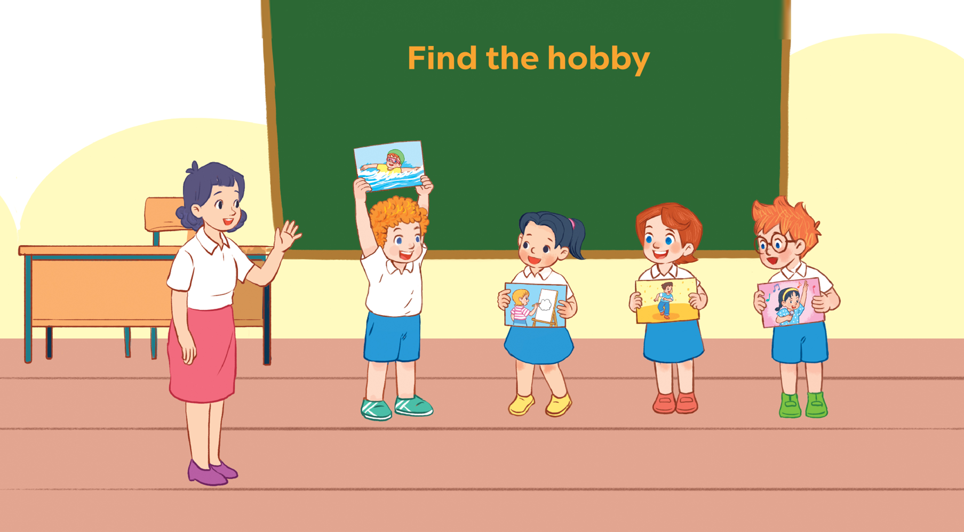
6
Let’s play.
MsPham-0936082789

Slide 30





Thank you
MsPham-0936082789
For enjoying!

