Slide 1
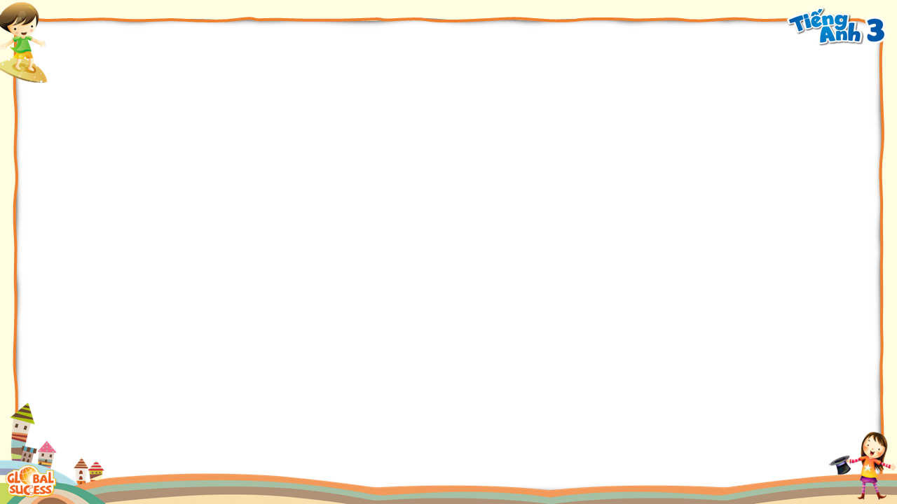



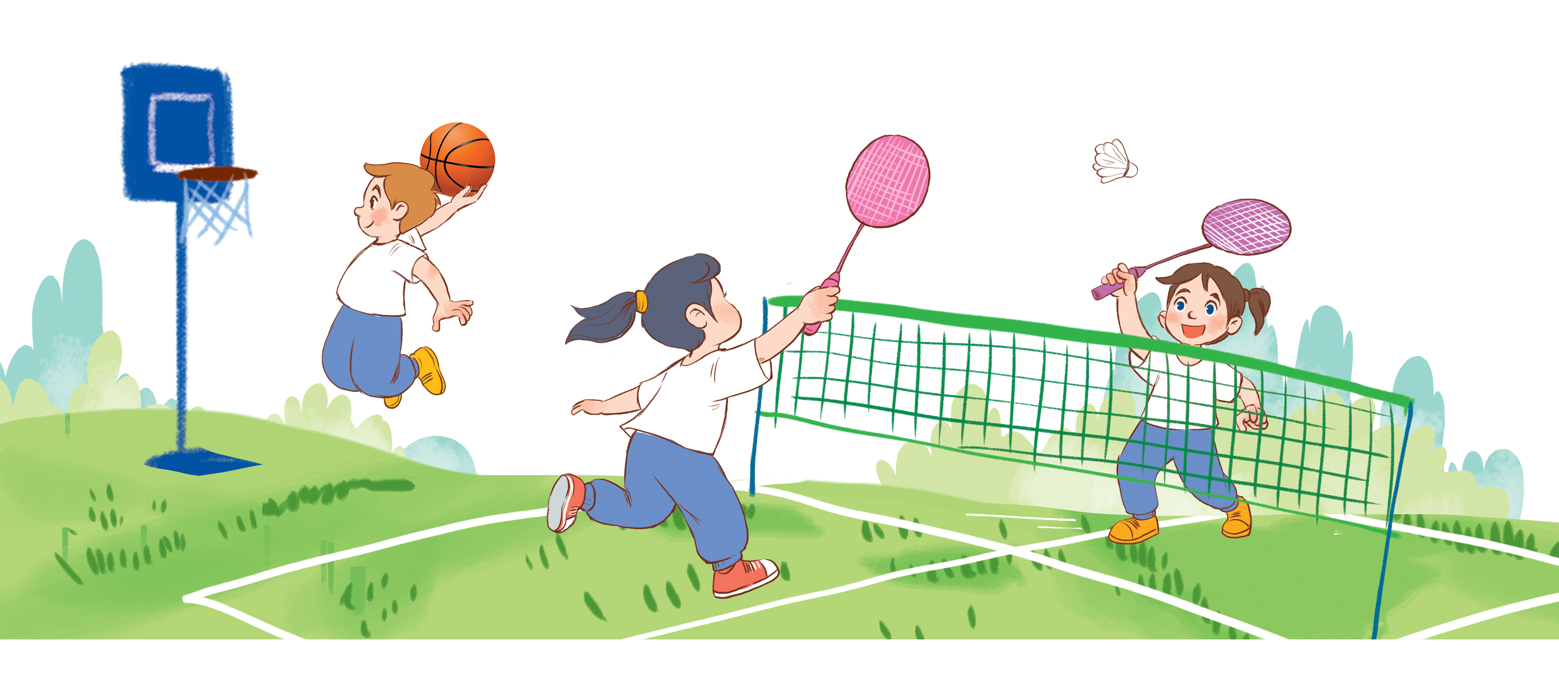
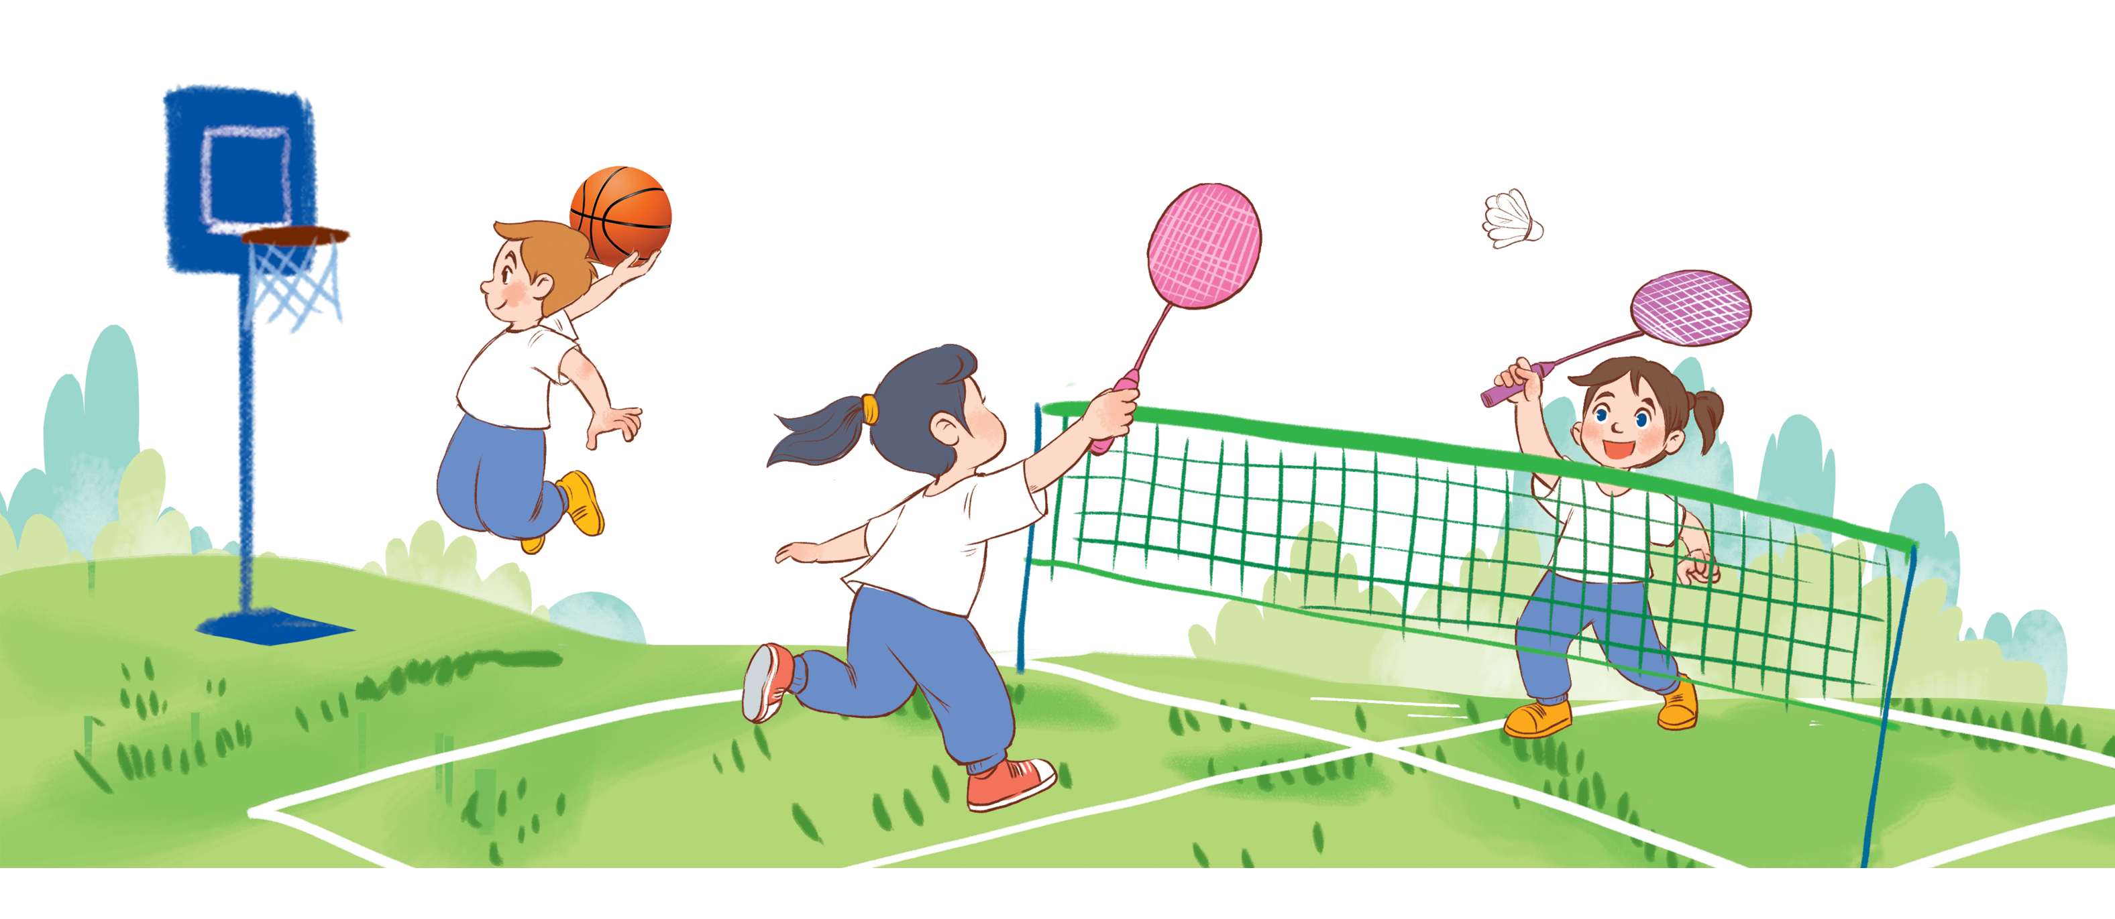

Unit 10
Break time
activities
Lesson 1

Slide 2


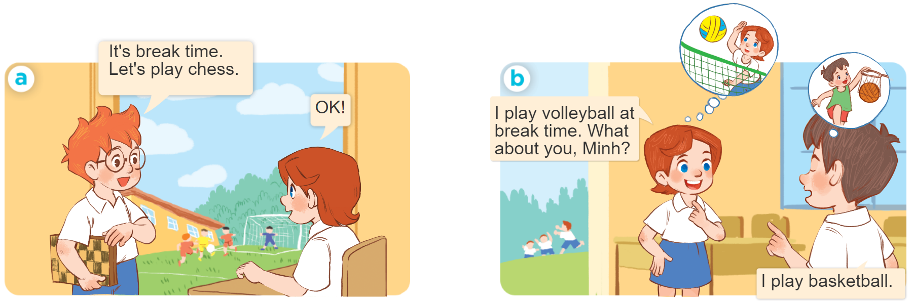
1
Look, listen and repeat.
MsPham-0936082789

Slide 3
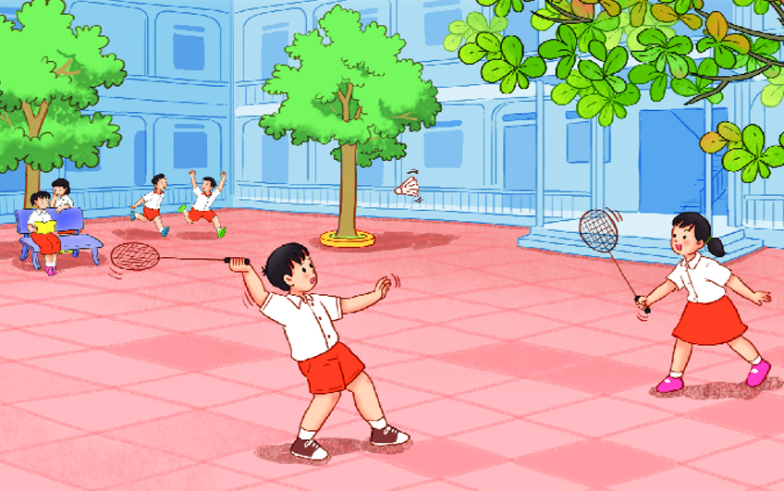
MsPham-0936082789
Vocabulary
MsPham-0936082789
break time
: Giờ giải lao, giờ ra chơi
/ˈbreɪk taɪm/

Slide 4
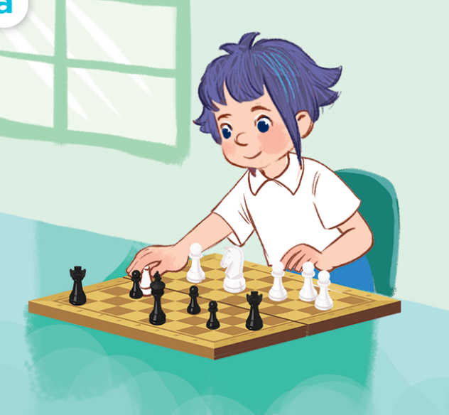
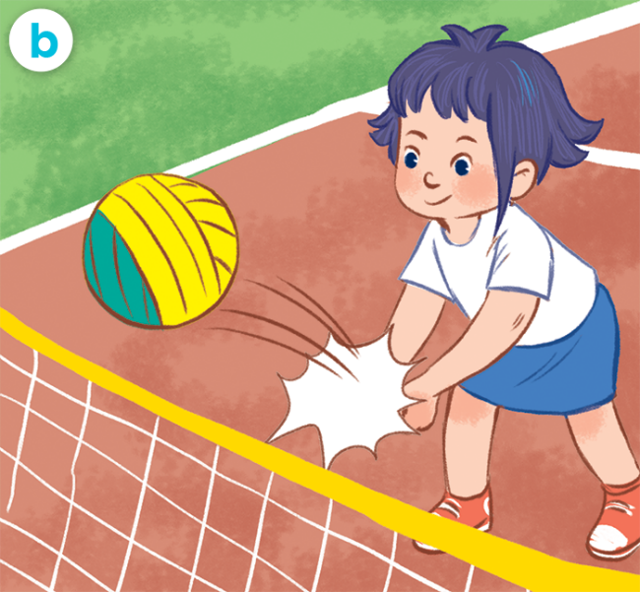
Vocabulary
MsPham-0936082789
play chess
: Chơi cờ
play volleyball
: Chơi bóng chuyền

Slide 5
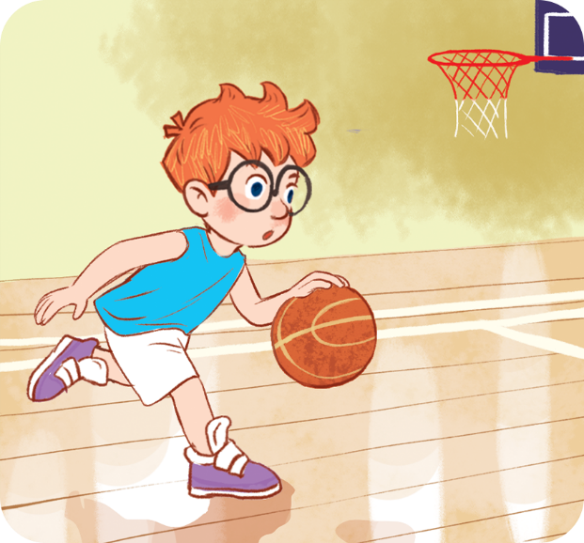
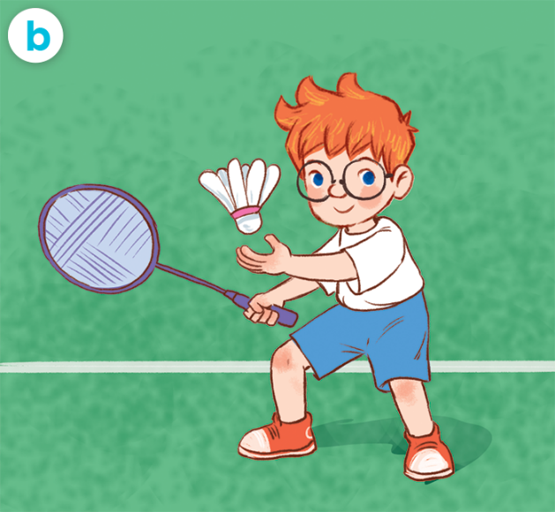
Vocabulary
MsPham-0936082789
play basketball
: Chơi bóng rổ
play badminton
: Chơi cầu lông

Slide 6
1
Look, listen and repeat.
MsPham-0936082789

Slide 7

Structures
MsPham-0936082789
Cách nói mình làm gì đó vào giờ ra chơi:
I _____ at break time
(Tớ _______ vào giờ ra chơi)

Slide 8
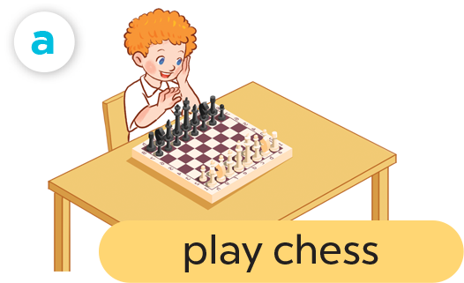
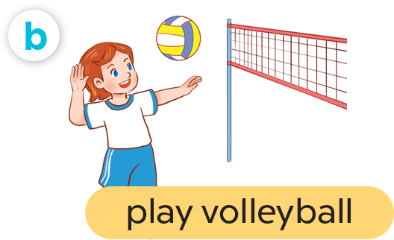
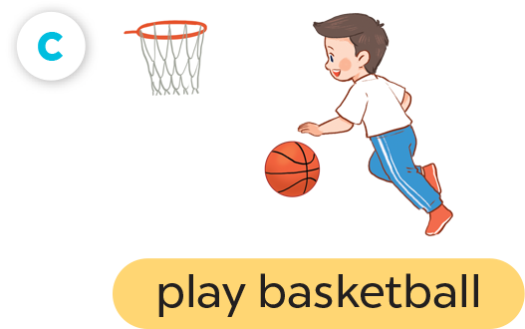
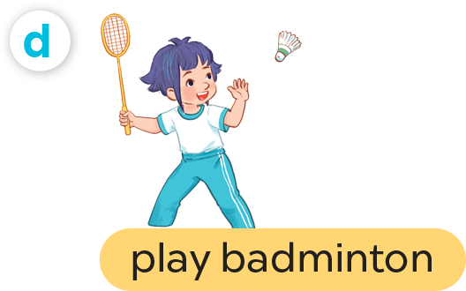
2
Listen, point and say.
I _____ at break time
MsPham-0936082789

Slide 9
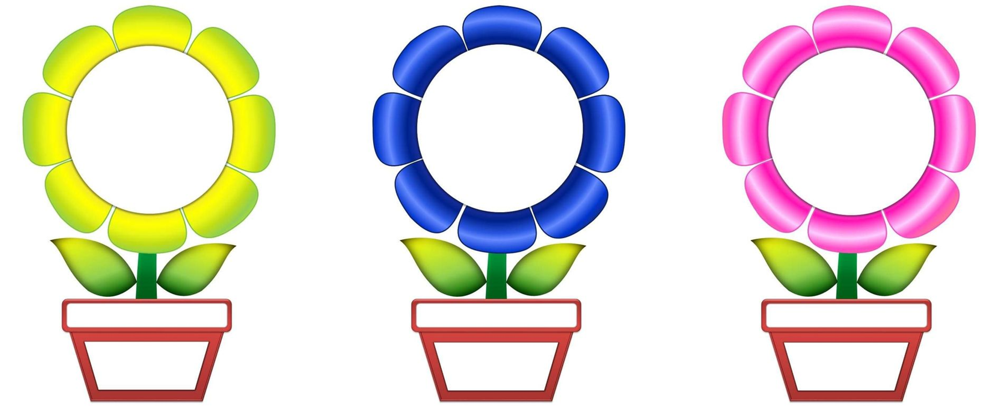

Ong thông thái
A
B
C
PLAY

Slide 10

I play basketball
at break time.
A
B
C
take a boat

Slide 11
I play chess
at break time.
A
B
C
go by plane

Slide 12
I play volleyball
at break time.
A
B
C
take a boat

Slide 13
I play badminton
at break time.
A
B
C
take a coach

Slide 14
I _____
at break time.
play
basketball
play
badminton
play
volleyball
A
B
C
go by plane

Slide 15
I _____
at break time.
play
badminton
play
chess
play
volleyball
A
B
C
take a boat

Slide 16
I _____
at break time.
play
chess
play
basketball
play
volleyball
A
B
C
go by plane

Slide 17
I _____
at break time.
play
volleyball
play
badminton
play
chess
A
B
C
take a coach

Slide 18
Good job!
A
B
C

Slide 19

3
Let’s talk.
I _____ at break time
MsPham-0936082789

Slide 20
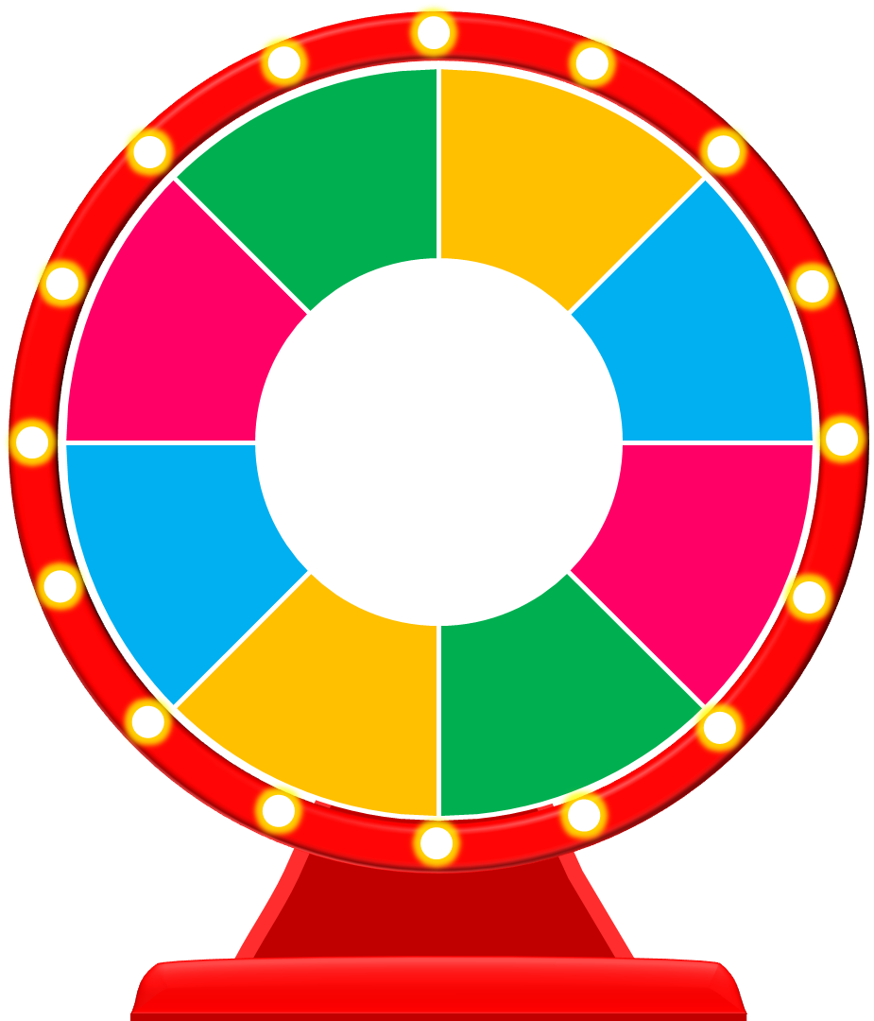
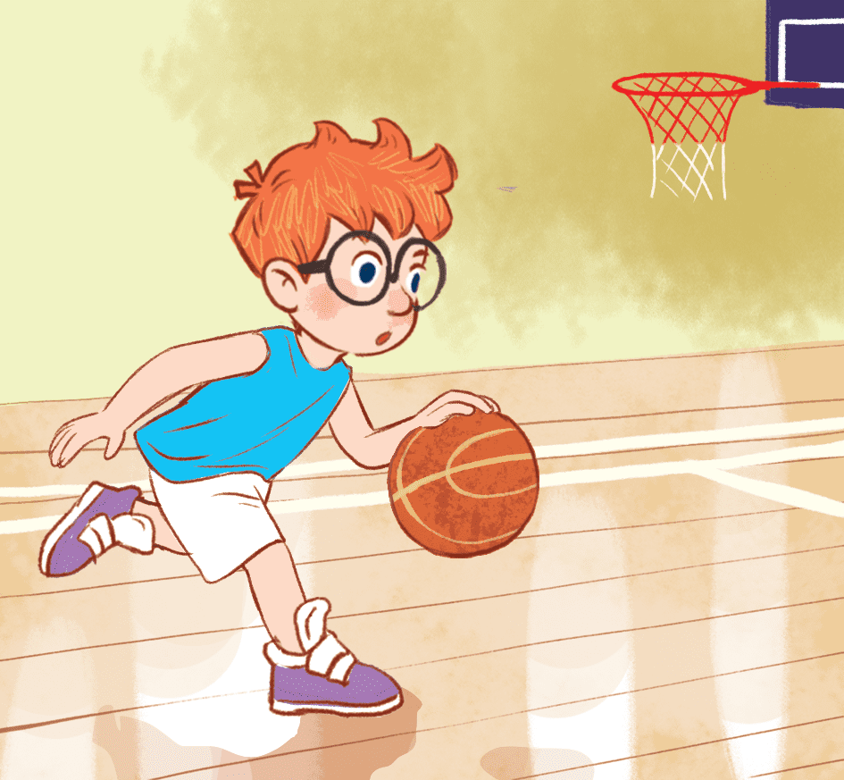
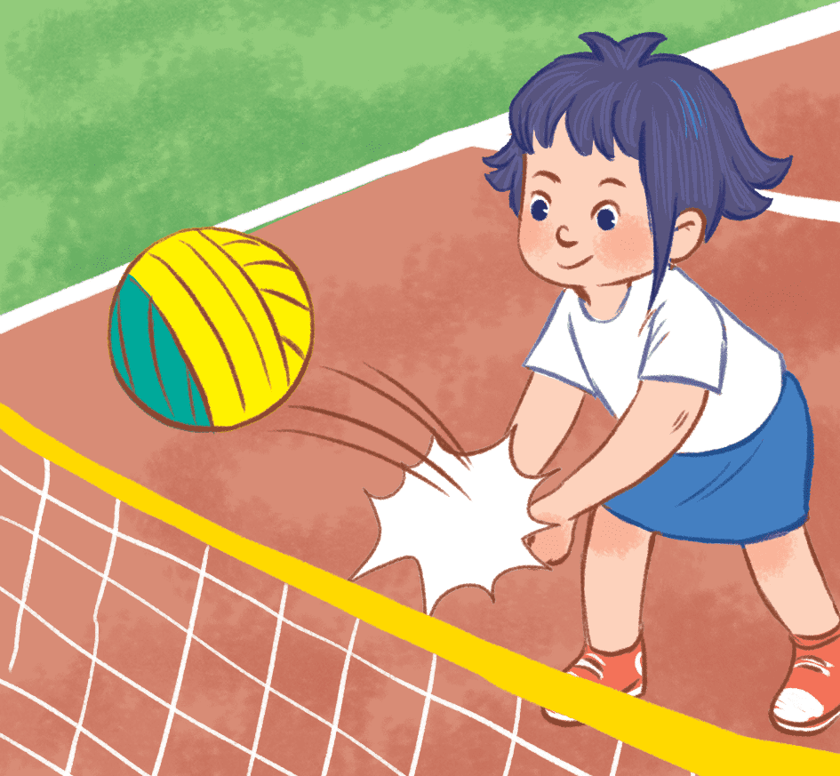

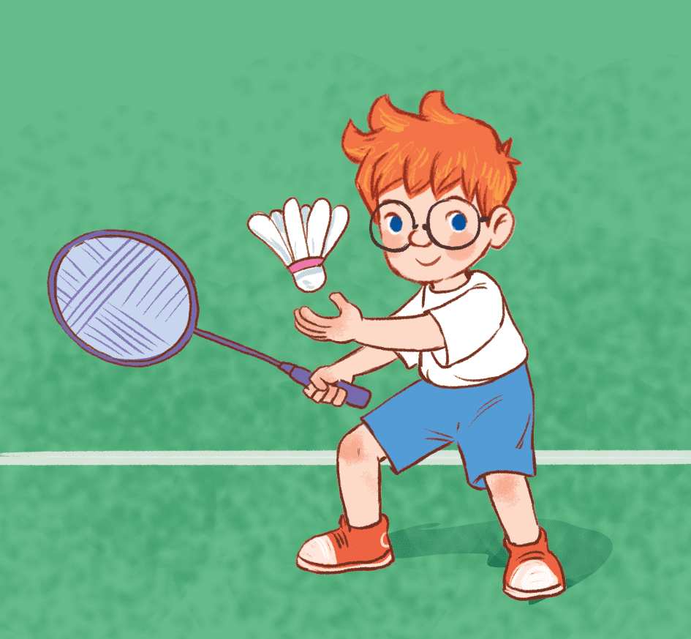
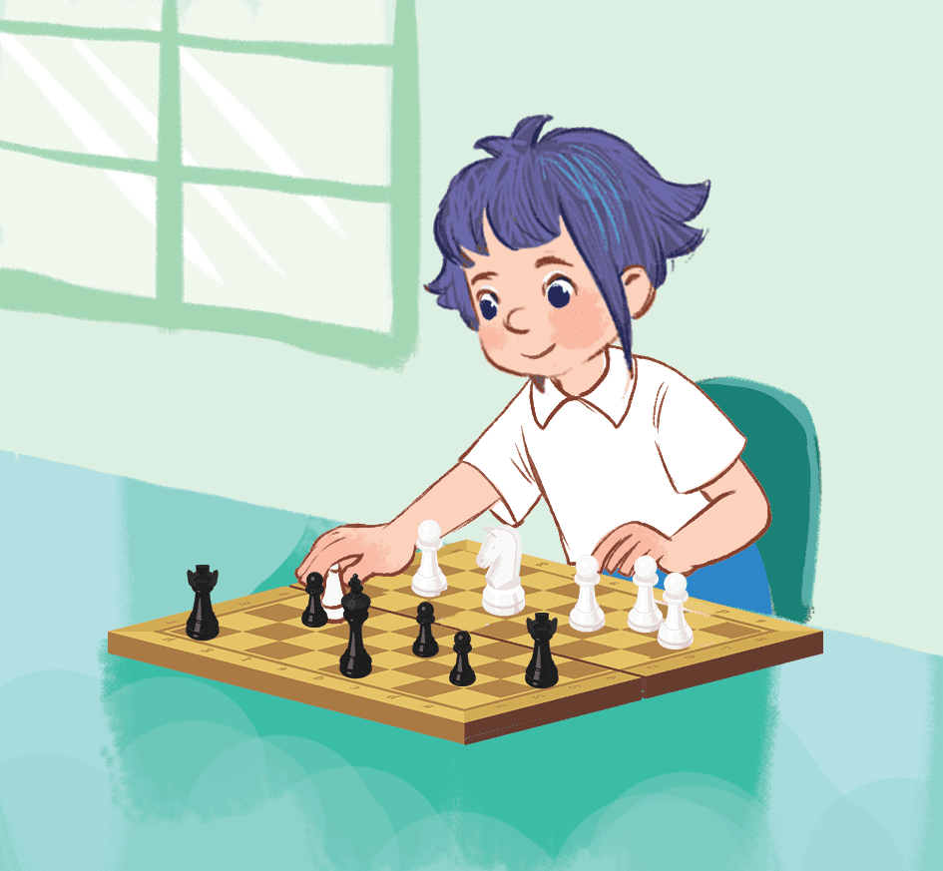
10
10
play badminton
play chess
play basketball
play volleyball
I ____________
at break time.
Lucky wheel
50
50
10
50
50
10
Start
Stop
Spin
Click hình bức tranh để hiện đáp án
Notes:
Click hình bức tranh để hiện đáp án
Ms Huyền Phạm - 0936.082.789

Slide 21



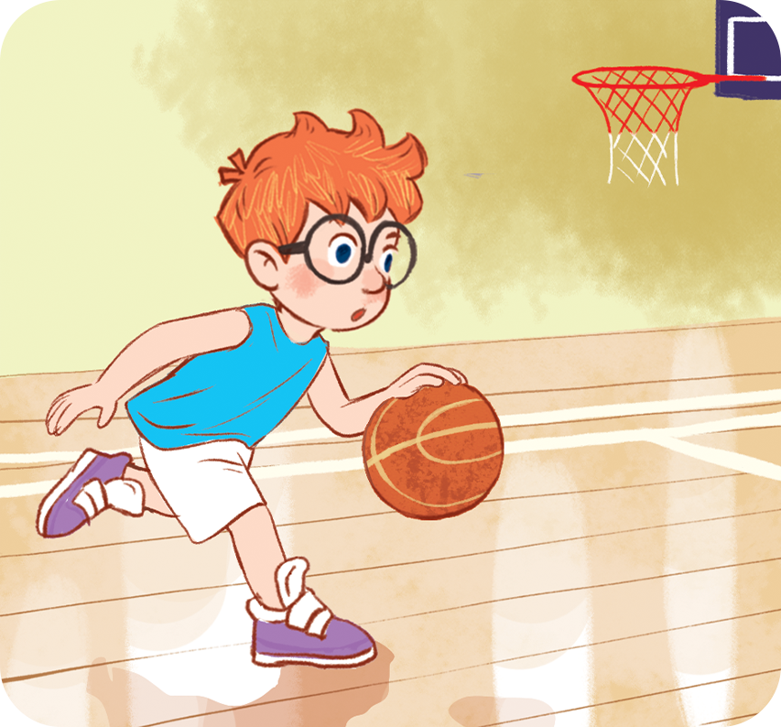
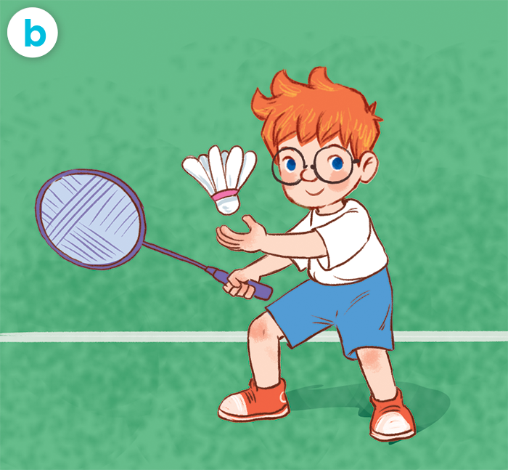
4
Listen and tick.
1
MsPham
0936082789
a
2

Slide 22
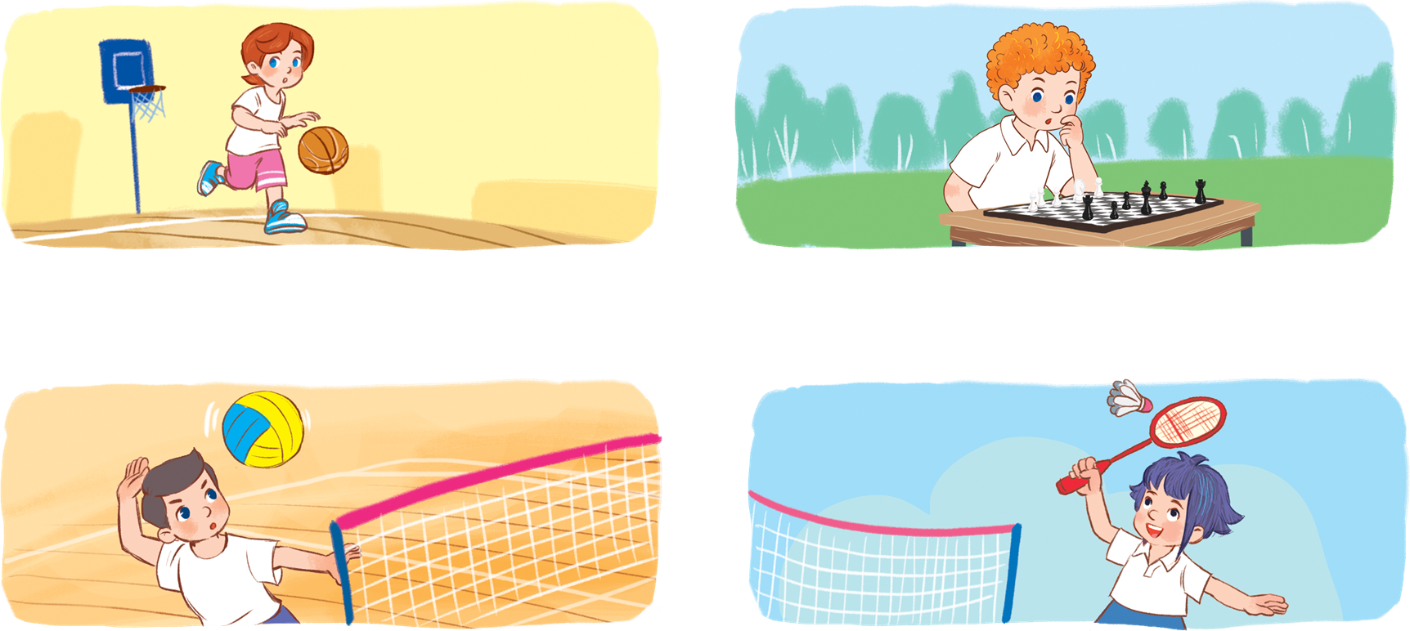
5
Look, complete and read.
MsPham-0936082789
1
2
_________
_________
I play basketball at break time.
I play chess at break time.
3
4
I play volleyball at break time.
_________
I play badminton at break time.
_________

Slide 23
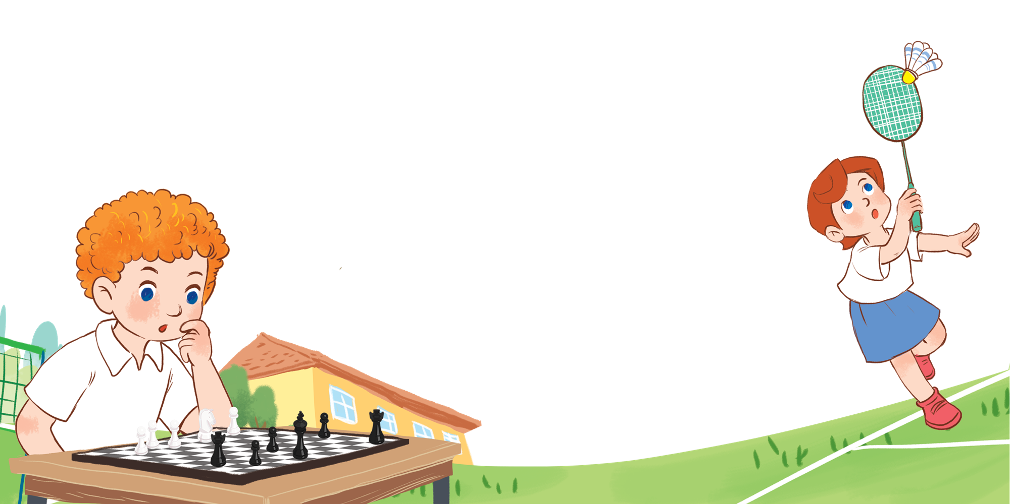
6
Let’s sing.
It’s break time.
Break time, break time.
It’s break time.
Chess, chess, chess.
I play chess at break time.
Break time, break time.
It’s break time.
Badminton, badminton, badminton.
I play badminton at break time.
MsPham-0936082789

Slide 24
MsPham-0936082789
Thank you
For enjoying!

