Slide 1

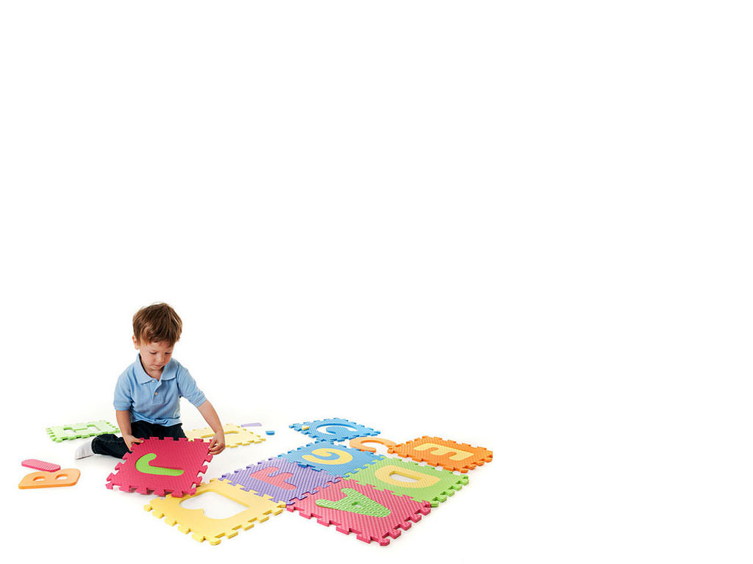
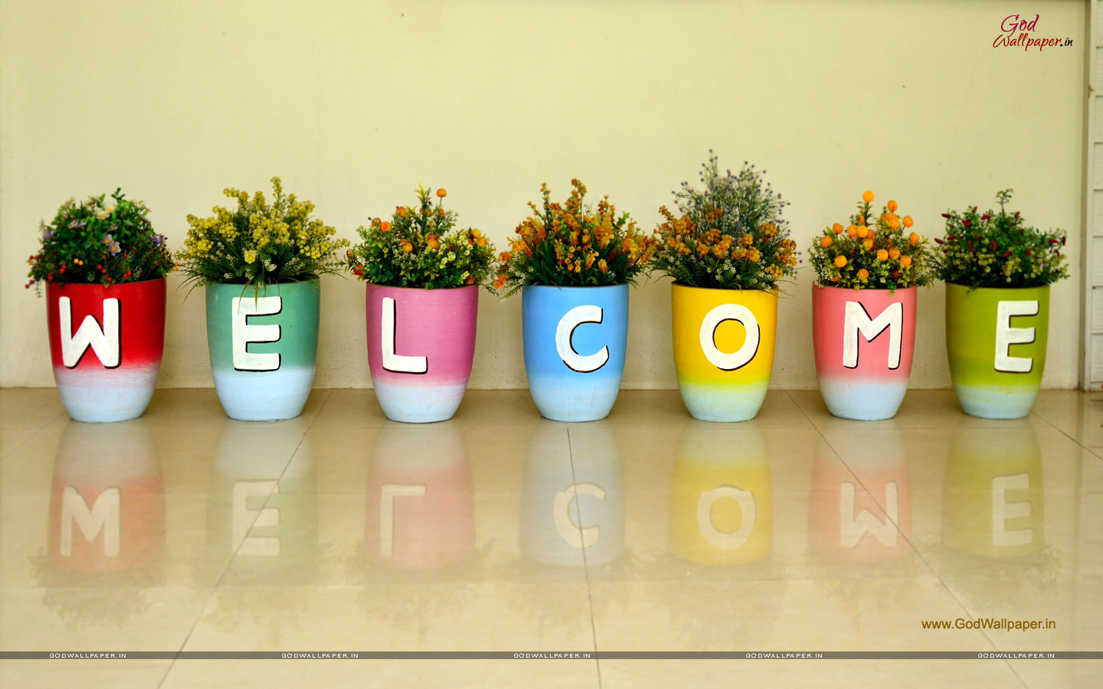



* English - Grade 1*
2019 - 2020

Slide 2

Part 1

Slide 3
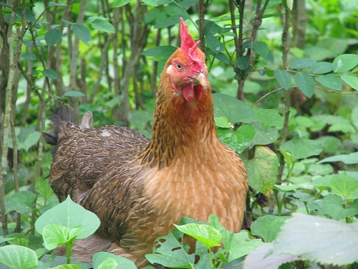
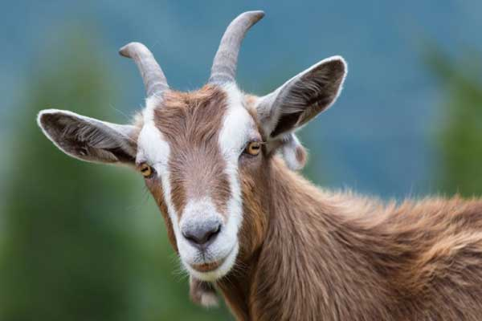
LET’S REVIEW: ÔN TẬP
Hen: gà mái | Goat: con dê

Slide 4
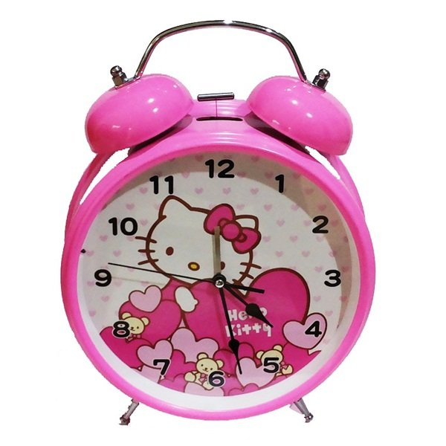
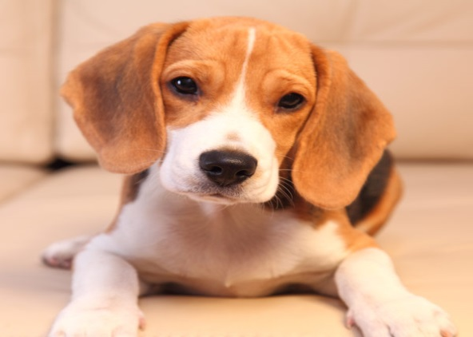
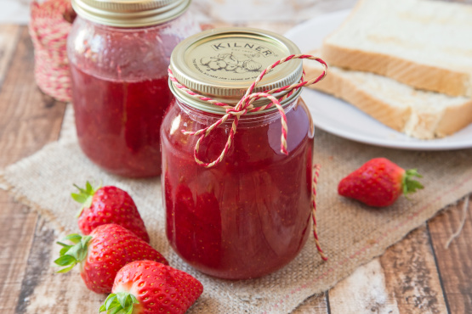
LET’S REVIEW: ÔN TẬP
Clock: đồng hồ | Dog: con chó | Jam: mứt

Slide 5
LET’S REVIEW: ÔN TẬP
Hen: gà mái | Goat: con dê
Clock: đồng hồ | Dog: con chó
Jam: mứt

Slide 6

n e h
h e n
h n e
B. h e n
15
5
12
14
11
8
13
2
3
1
4
6
7
9
10
TIME’S UP
START
1

Slide 7
_ o a t
t
d
g
15
5
12
14
11
8
13
2
3
1
4
6
7
9
10
TIME’S UP
C. g
START
2

Slide 8
I am a __
clock
carrot
cat
A. clock
15
5
12
14
11
8
13
2
3
1
4
6
7
9
10
TIME’S UP
START
3

Slide 9


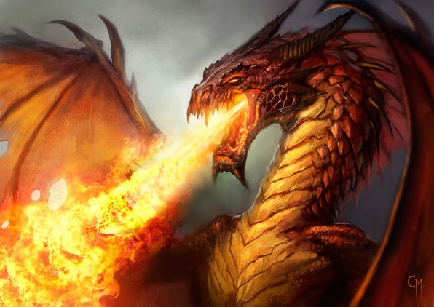
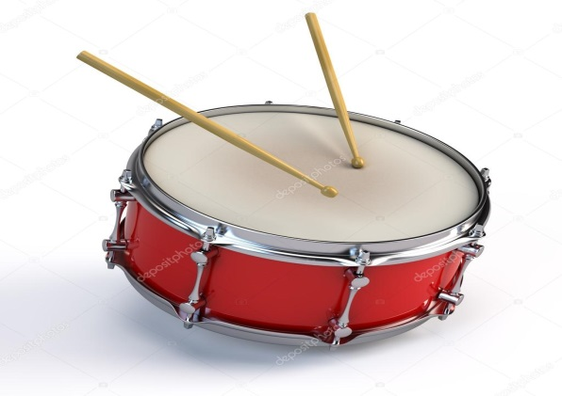
It is a _____ !
B.
C.
15
5
12
14
11
8
13
2
3
1
4
6
7
9
10
TIME’S UP
START
B.
4

Slide 10
a j m
j m a
j a m
C. j a m
15
5
12
14
11
8
13
2
3
1
4
6
7
9
10
TIME’S UP
START
5

Slide 11
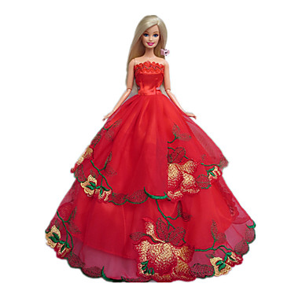
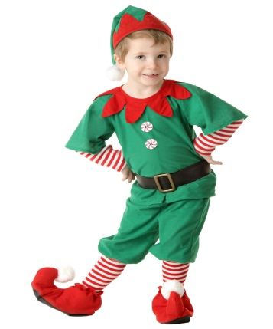
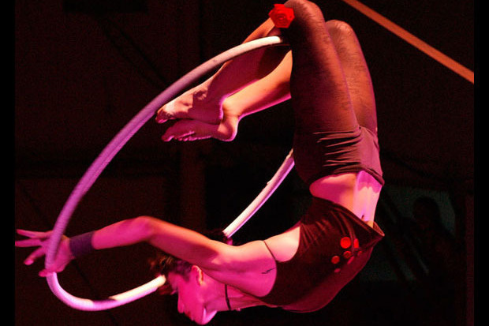
acrobat
B.
C.
15
5
12
14
11
8
13
2
3
1
4
6
7
9
10
TIME’S UP
START
C.
6

Slide 12
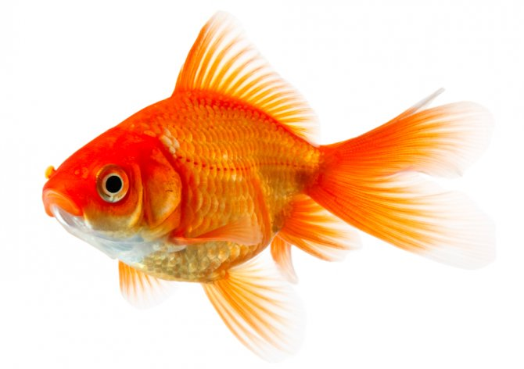
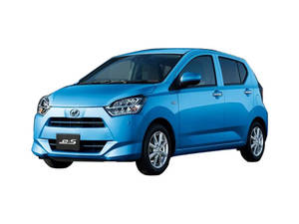


A. car
car
clock
carrot
15
5
12
14
11
8
13
2
3
1
4
6
7
9
10
TIME’S UP
START
7

Slide 13
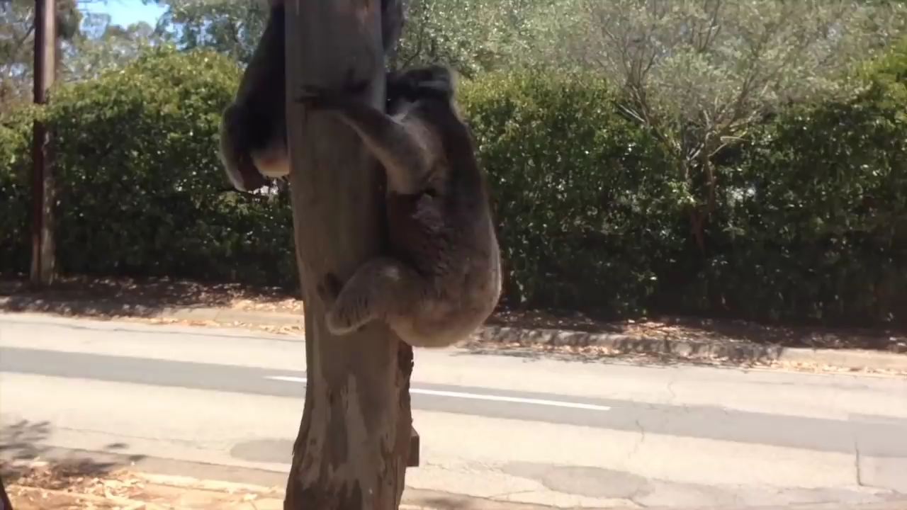
15
5
12
14
11
8
13
2
3
1
4
6
7
9
10
TIME’S UP
START
k _ al_
o e
o a
o n
B. o a
8

Slide 14
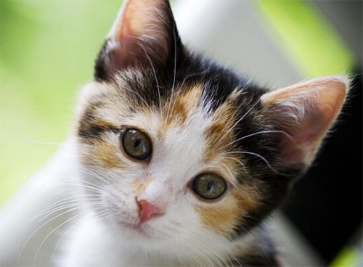
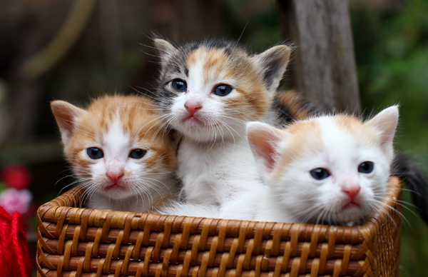


four
one
three
A. four
15
5
12
14
11
8
13
2
3
1
4
6
7
9
10
TIME’S UP
START
9

Slide 15
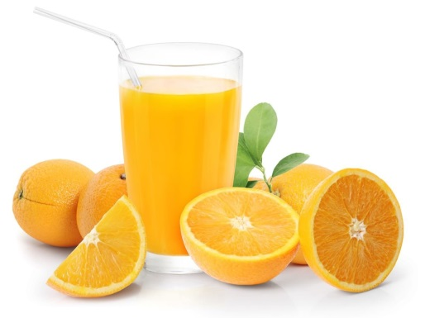
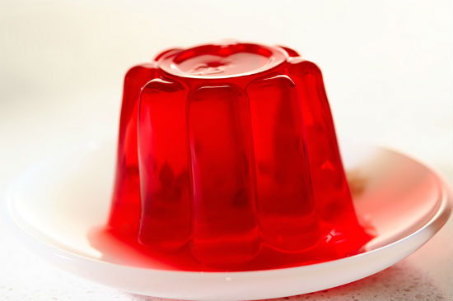
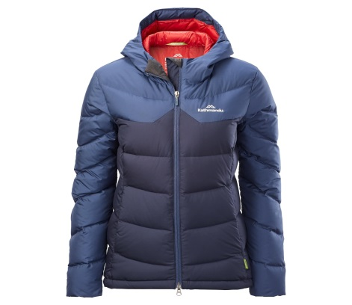
15
5
12
14
11
8
13
2
3
1
4
6
7
9
10
TIME’S UP
START
K k
M m
J j
C. J j
10

Slide 16
LET’S REVIEW: ÔN TẬP
Jam: mứt | Jacket: áo khoác
Juice: nước trái cây | Dog: con chó
Jelly: thạch | Car: ô tô
Koala: gấu túi

Slide 17
Part 2

Slide 18
t a c
c a t
t c a
B. c a t
15
5
12
14
11
8
13
2
3
1
4
6
7
9
10
TIME’S UP
START
1

Slide 19
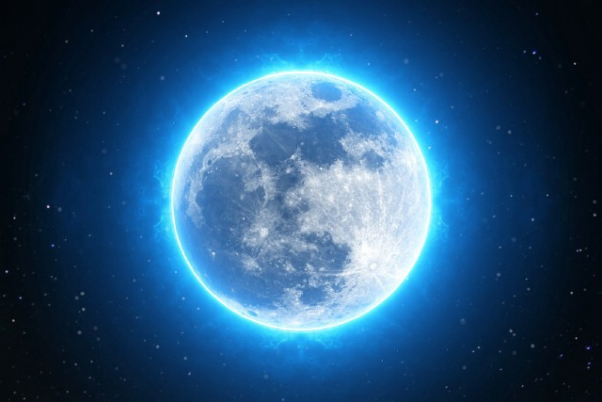
m _ on
o
u
e
15
5
12
14
11
8
13
2
3
1
4
6
7
9
10
A. o
TIME’S UP
START
2

Slide 20
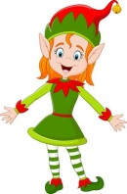

A. hat
hat
elf
elbow
15
5
12
14
11
8
13
2
3
1
4
6
7
9
10
TIME’S UP
START
3

Slide 21
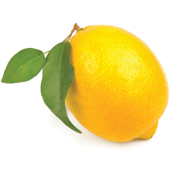
Look! a __
mouse
lemon
hippo
15
5
12
14
11
8
13
2
3
1
4
6
7
9
10
TIME’S UP
B. lemon
START
4

Slide 22
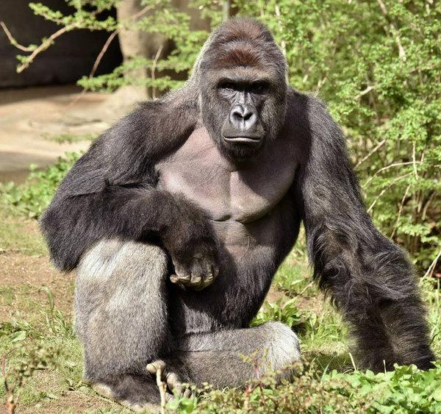
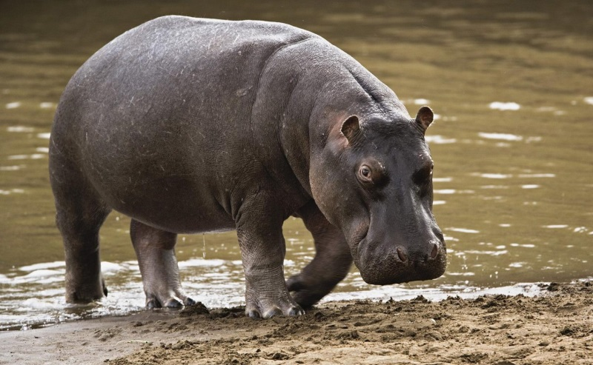
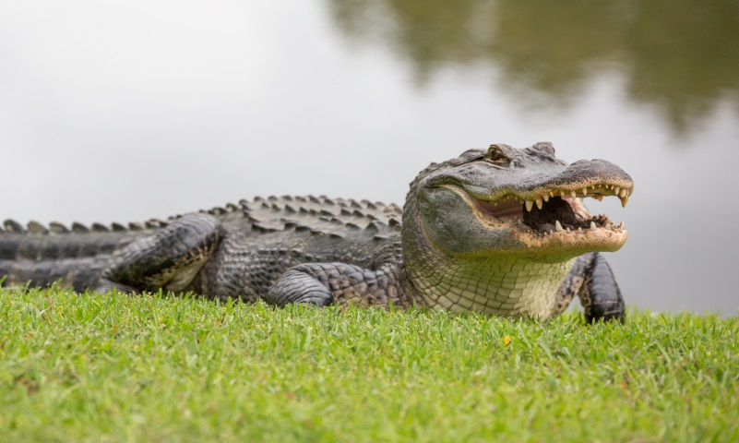
B.
C.
15
5
12
14
11
8
13
2
3
1
4
6
7
9
10
TIME’S UP
A.
START
5

Slide 23




15
5
12
14
11
8
13
2
3
1
4
6
7
9
10
TIME’S UP
START
K k
M m
Dd
C. Dd
6

Slide 24
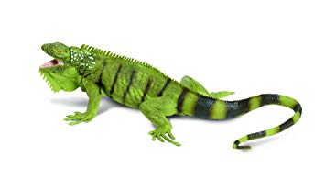
four
five
three
15
5
12
14
11
8
13
2
3
1
4
6
7
9
10
TIME’S UP
B. five
START
7

Slide 25
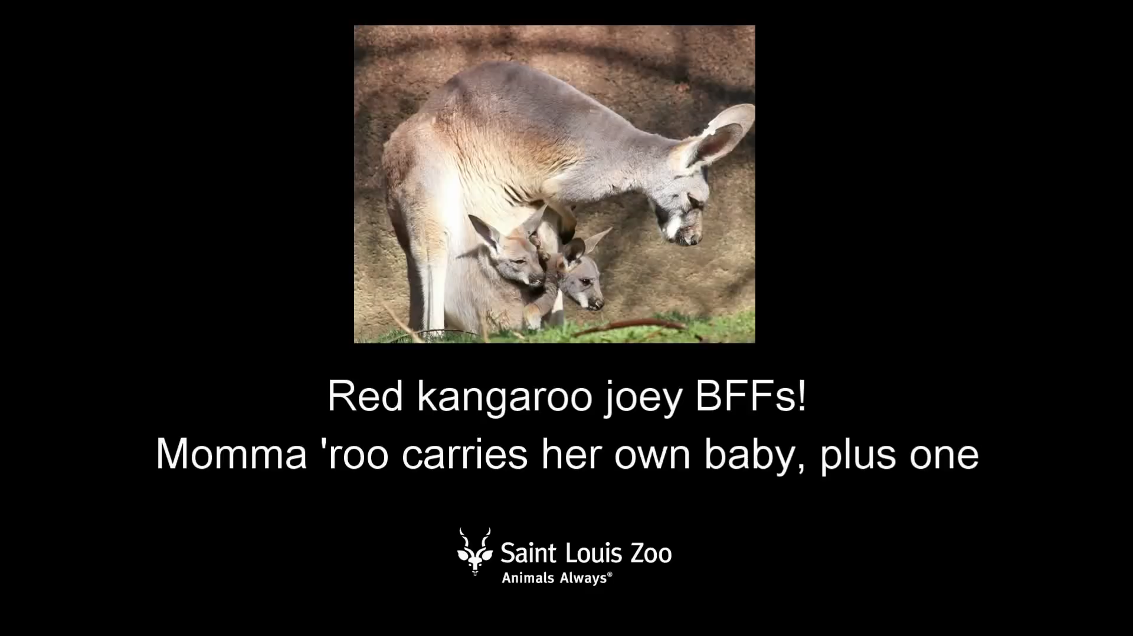
15
5
12
14
11
8
13
2
3
1
4
6
7
9
10
TIME’S UP
START
k _ ngar_o
a e
a u
a o
C. a o
8

Slide 26
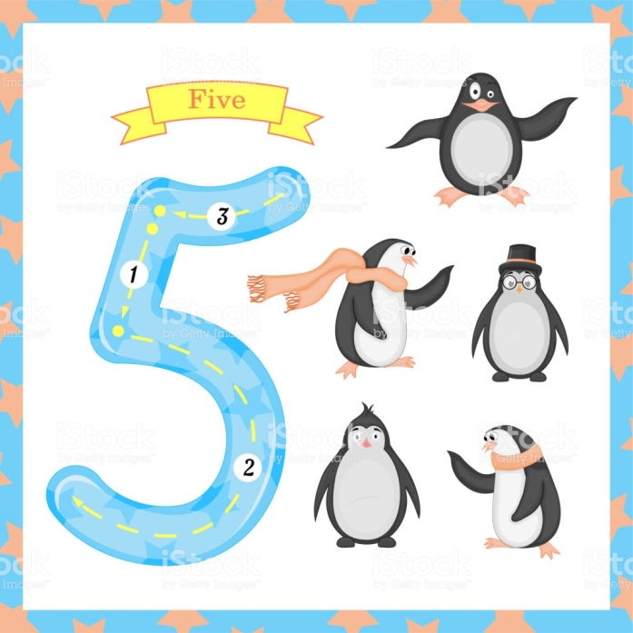

eight
one
three
A. eight
15
5
12
14
11
8
13
2
3
1
4
6
7
9
10
TIME’S UP
START
9

Slide 27
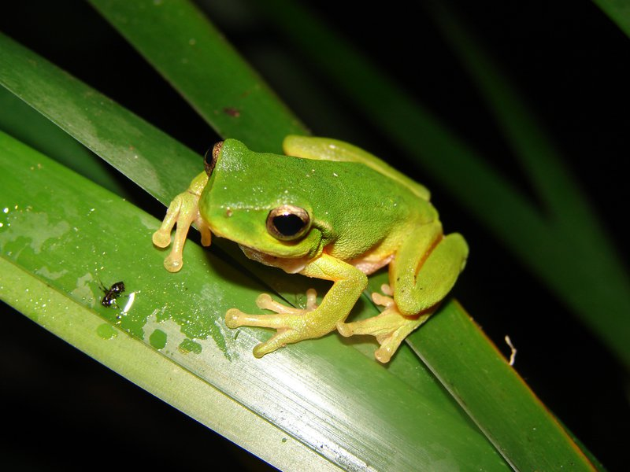
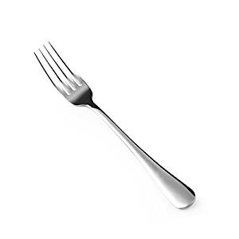
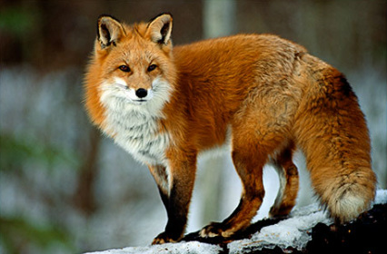
15
5
12
14
11
8
13
2
3
1
4
6
7
9
10
TIME’S UP
START
G g
C c
F f
C. F f
10

Slide 28
Friday, April 3rd 2020.
Unit 13: At the school canteen
(page: 50)
Review

Slide 29
Part 3

Slide 30
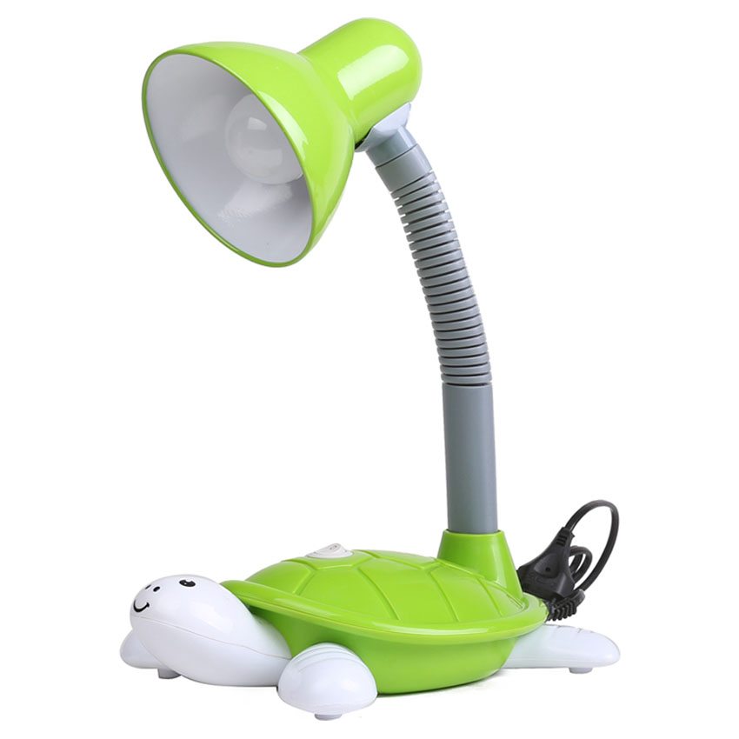
L a _ p
n
g
m
15
5
12
14
11
8
13
2
3
1
4
6
7
9
10
TIME’S UP
C. m
START
1

Slide 31
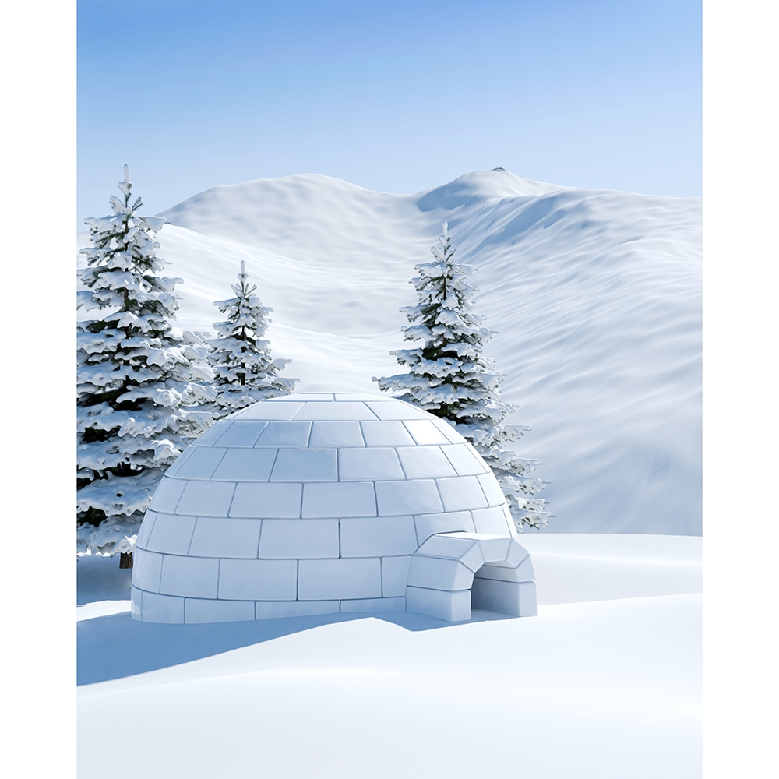
ink
igloo
iguana
B. igloo
15
5
12
14
11
8
13
2
3
1
4
6
7
9
10
TIME’S UP
START
2

Slide 32
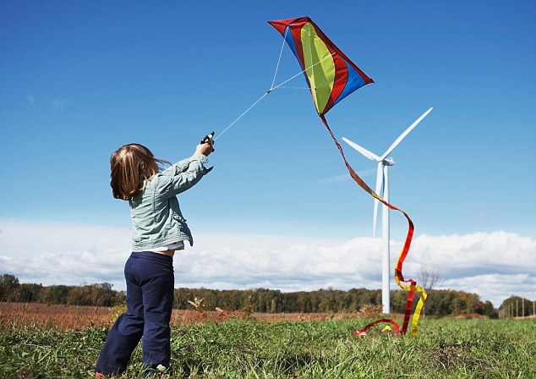
15
5
12
14
11
8
13
2
3
1
4
6
7
9
10
TIME’S UP
START
Fly the__
kite
kiet
keti
A. kite
3

Slide 33

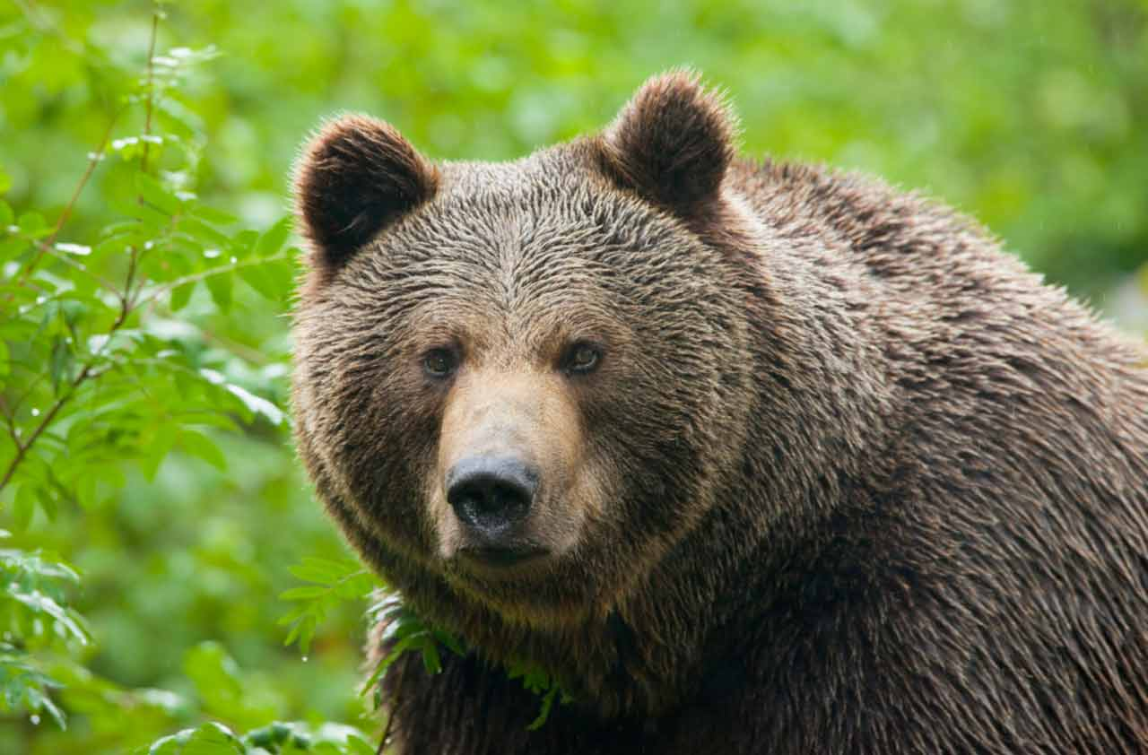
B.
C.
15
5
12
14
11
8
13
2
3
1
4
6
7
9
10
TIME’S UP
START
B.
4

Slide 34
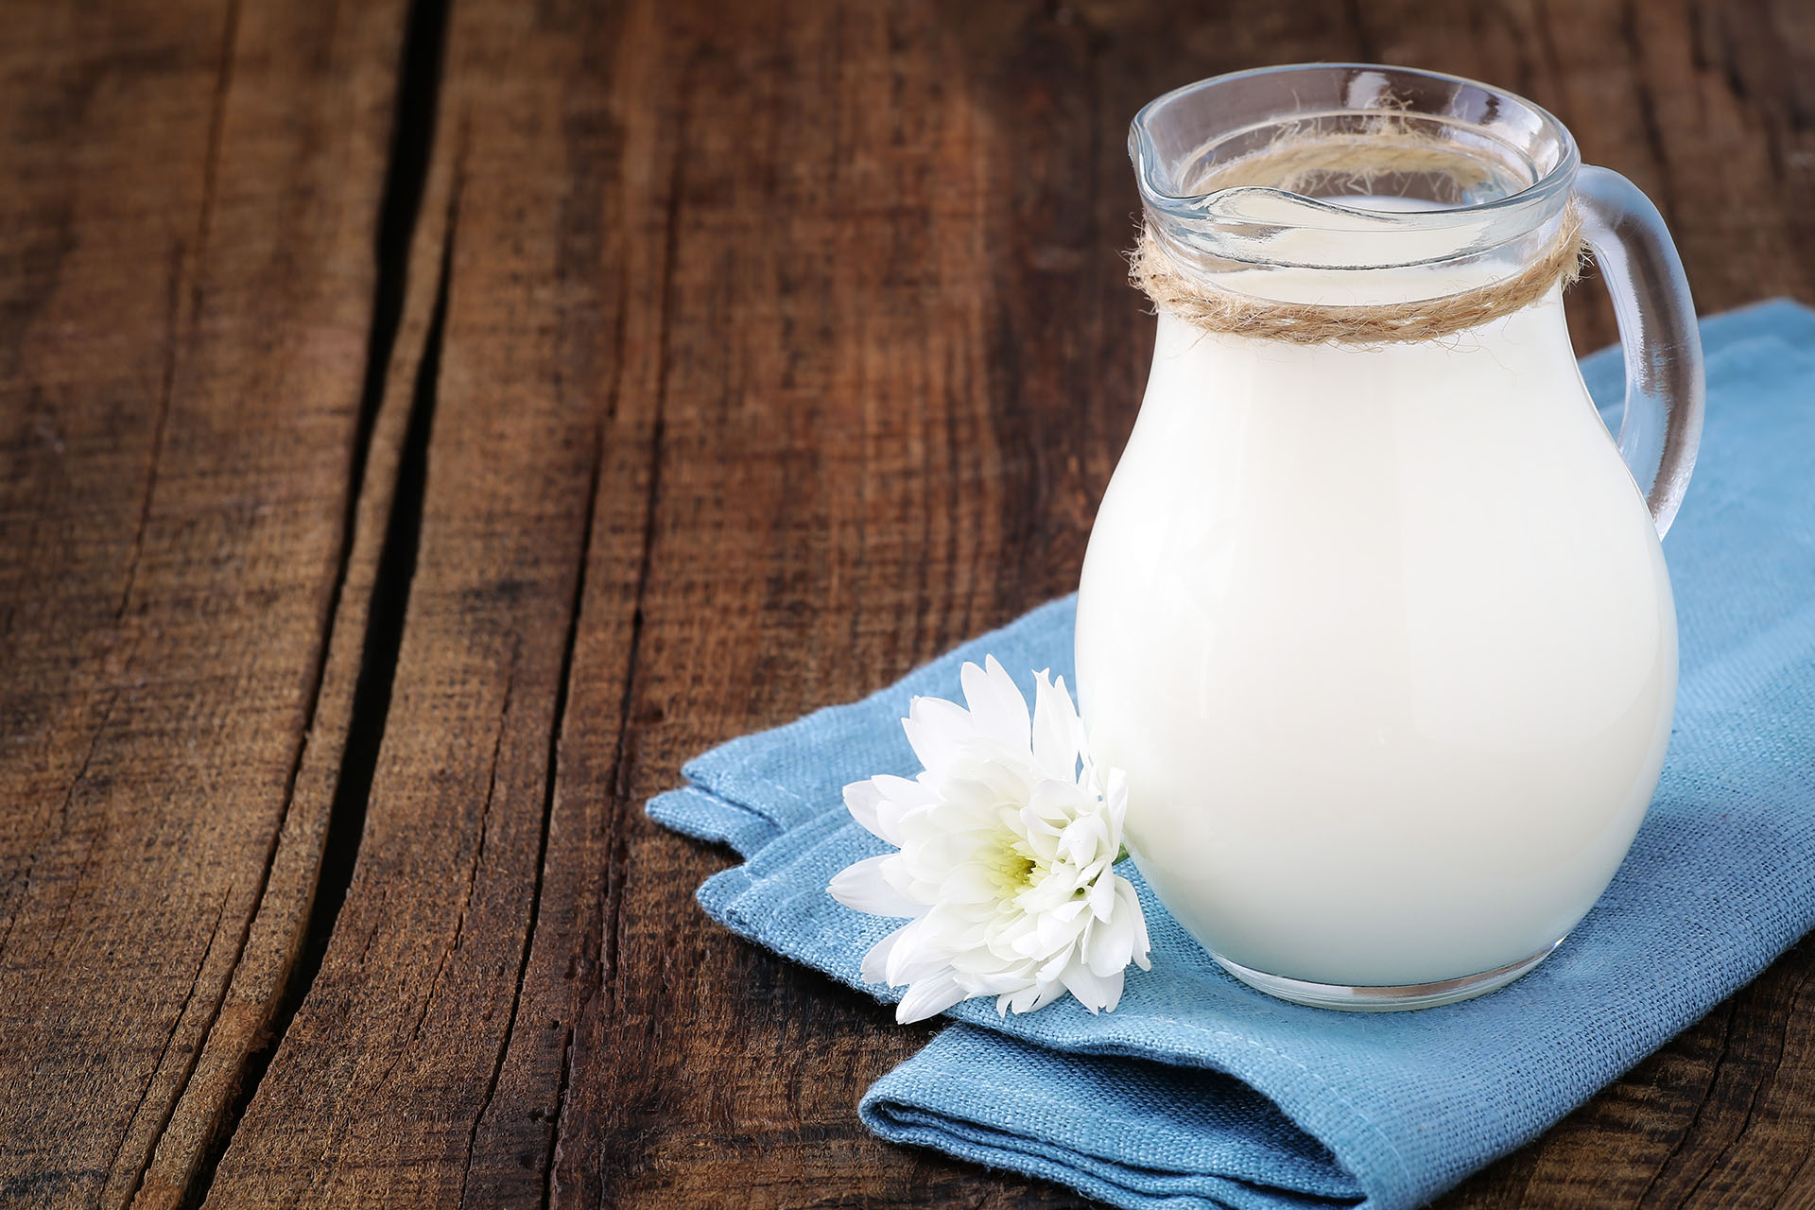
mlki
klmi
milk
15
5
12
14
11
8
13
2
3
1
4
6
7
9
10
TIME’S UP
C. milk
START
5

Slide 35
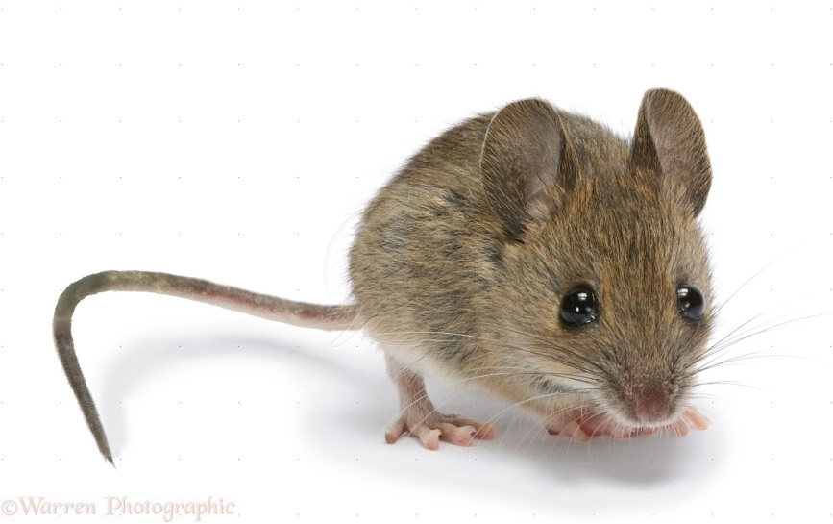
15
5
12
14
11
8
13
2
3
1
4
6
7
9
10
TIME’S UP
Can you see the ____ ?
lollipop
B. mouse
C. insect
START
B. mouse
6

Slide 36
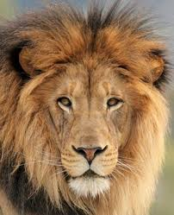

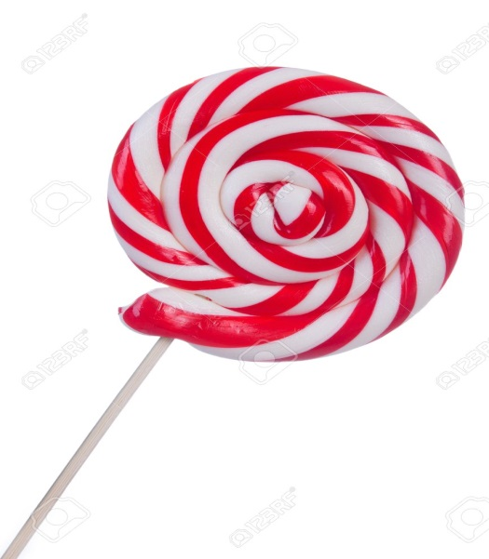
15
5
12
14
11
8
13
2
3
1
4
6
7
9
10
TIME’S UP
START
Jj
Aa
Ll
C. Ll
7

Slide 37
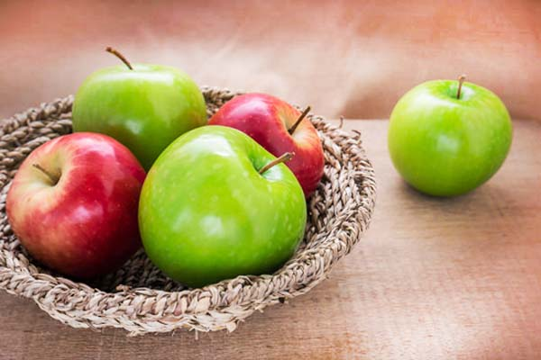
A. five B. one C. three
A. five
15
5
12
14
11
8
13
2
3
1
4
6
7
9
10
TIME’S UP
START
8

Slide 38
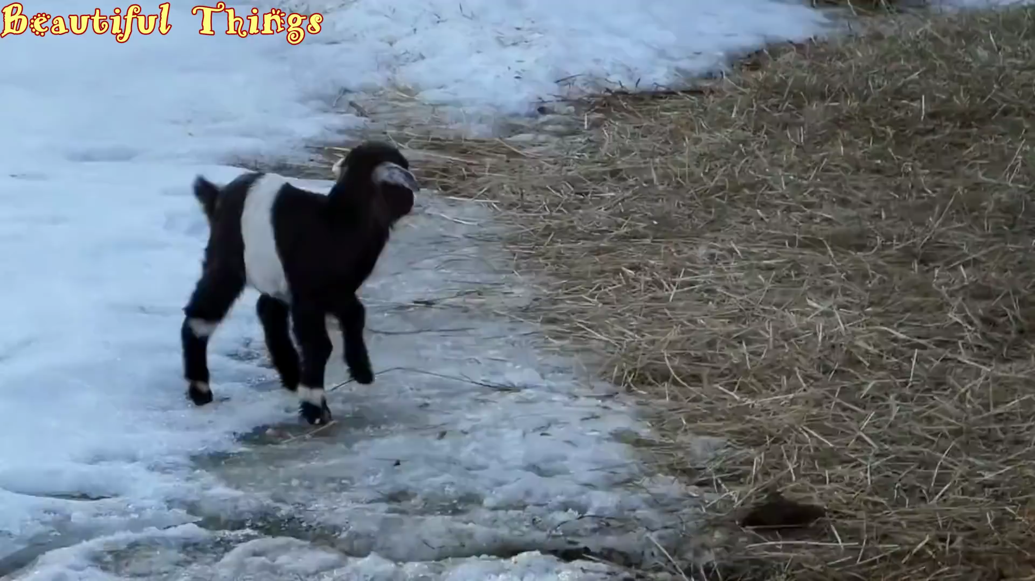
15
5
12
14
11
8
13
2
3
1
4
6
7
9
10
TIME’S UP
START
_ oa _
g t
g m
g h
A. g t
9

Slide 39
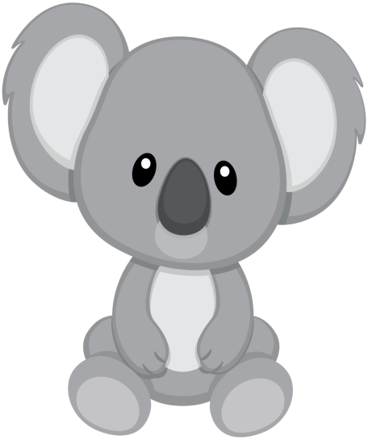
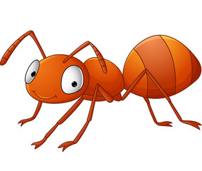
ball
glass
ant
15
5
12
14
11
8
13
2
3
1
4
6
7
9
10
TIME’S UP
C. ant
START
10

Slide 40
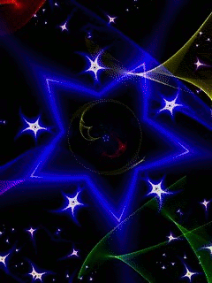


Slide 41
