Slide 1

Welcome!
Unit 20. What are you going to do this summer?

Slide 2
NEW WORDS
Go on a boat cruise: đi du thuyền
Hotel: khách sạn
Next: tiếp sau
Prepare: chuẩn bị
Sandcastle: lâu đài cát
Sea: biển
Seafood: hải sản
Summer: mùa hè
Summer holidays: kỳ nghỉ hè

Slide 3
Lesson 1:

Slide 4
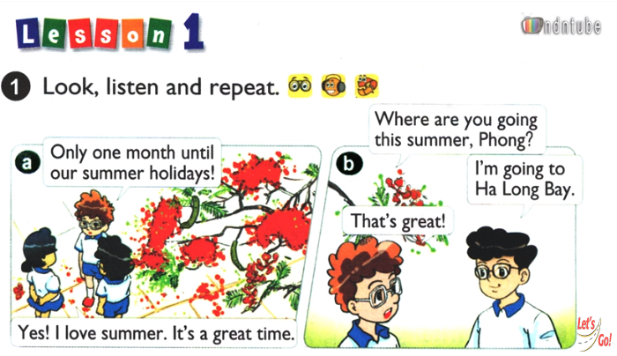

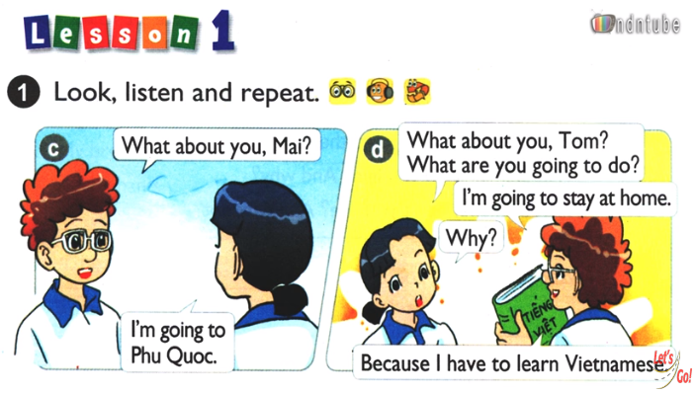

Slide 5
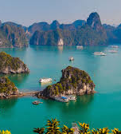
Model centences:
Where are you going this summer?
Im’m going to PHU QUOC.

Slide 6
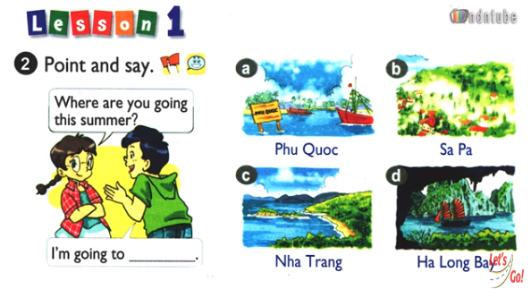

Slide 7
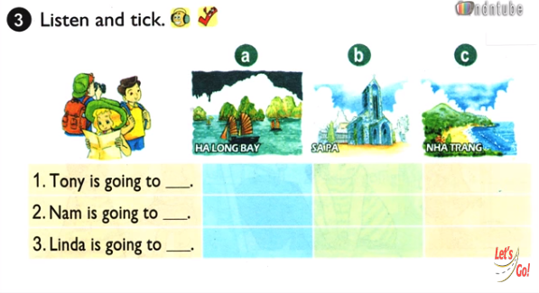
V
V
V

Slide 8
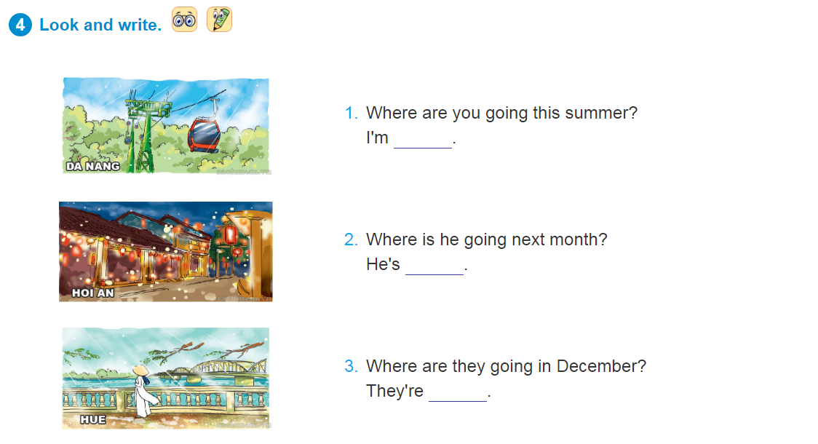

Slide 9
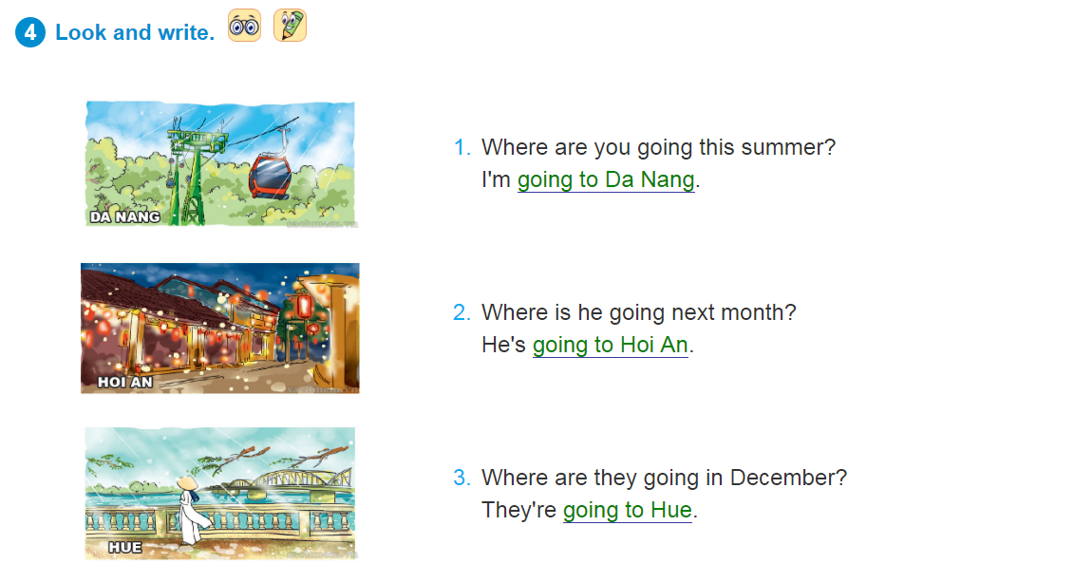

Slide 10
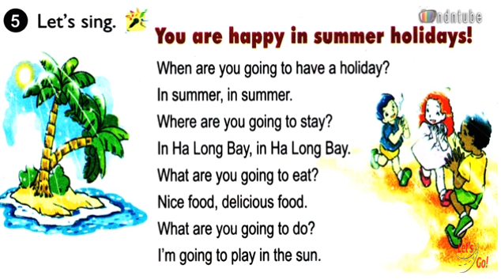

Slide 11
Lesson 2:

Slide 12
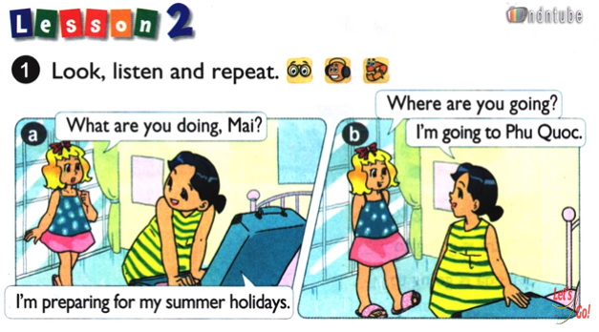
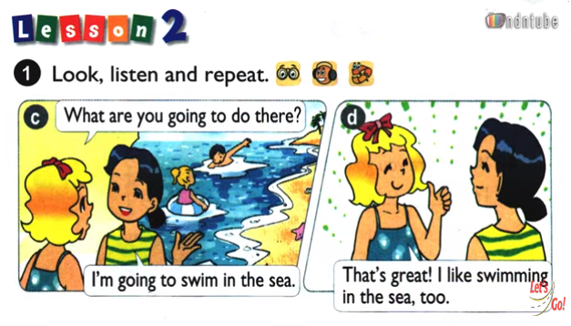

Slide 13
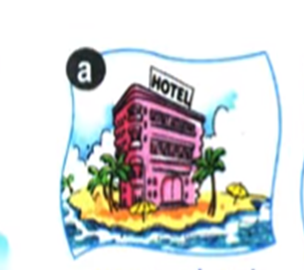
Model centences:
what are you going to do?
Im’m going to stay in a hotel.

Slide 14
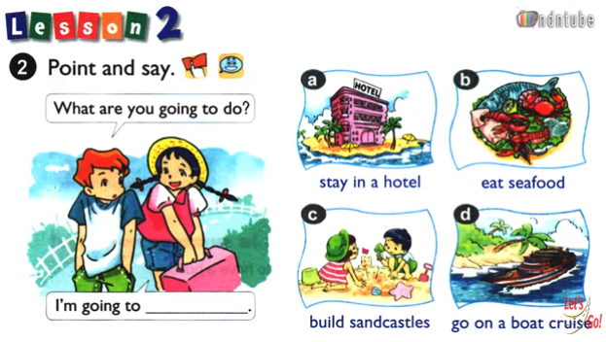

Slide 15
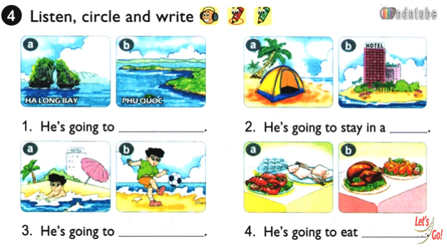
Ha Long Bay
hotel
swim in the sea
seafood

Slide 16
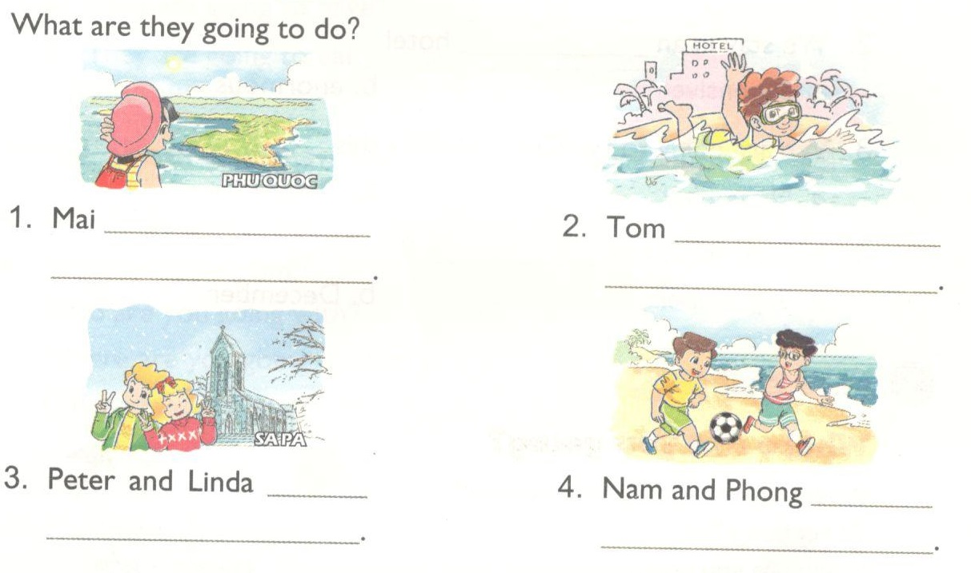
Are going to PHU QUOC
Are going to swim in the sea
Are going to SAPA
Are going to play football

Slide 17
Lesson 3:

Slide 18
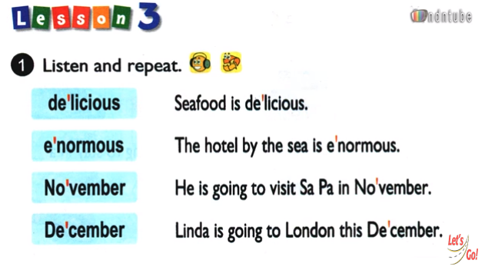

Slide 19
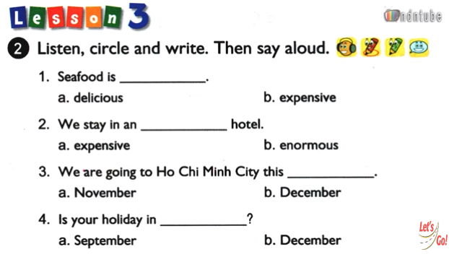

Slide 20
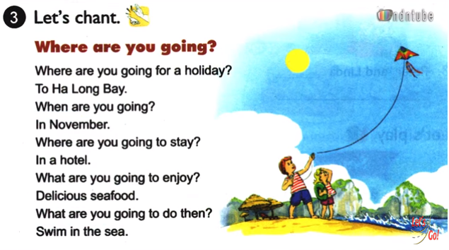

Slide 21
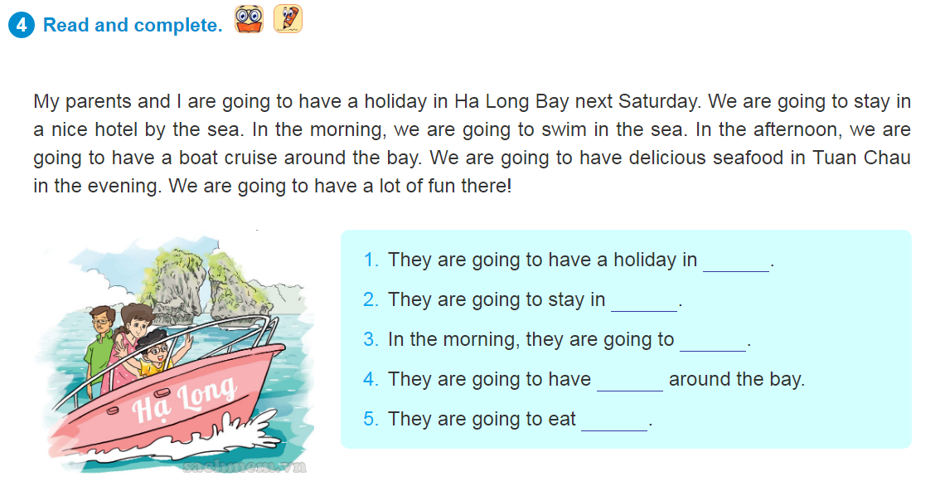

Slide 22
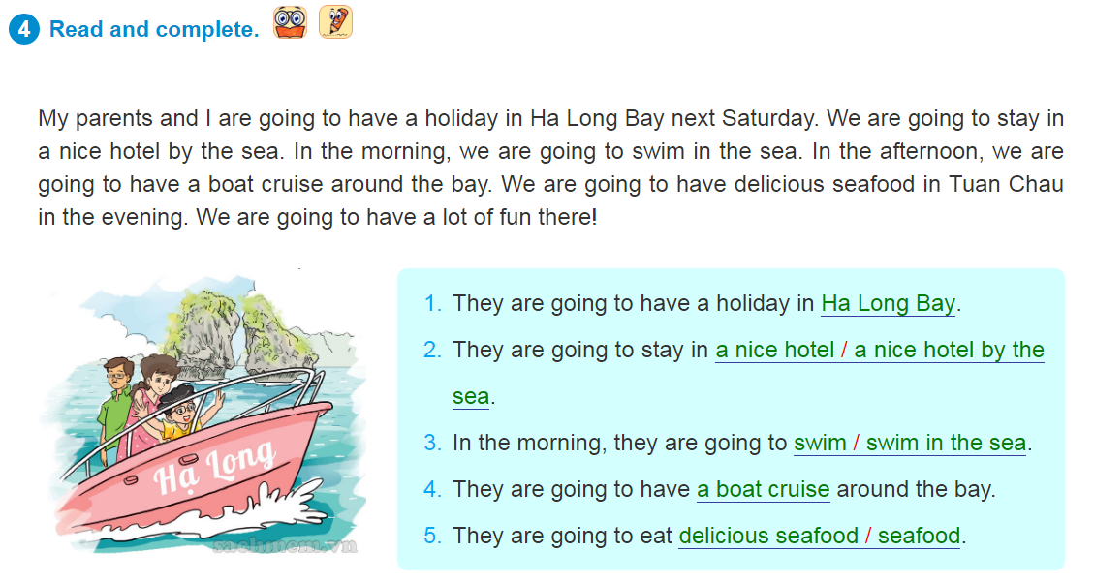

Slide 23
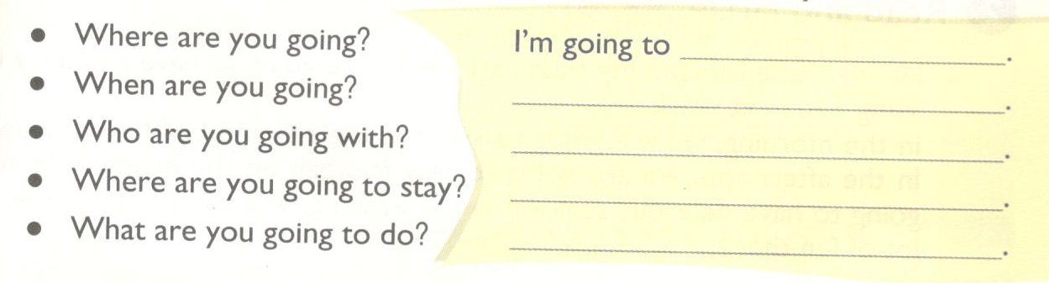


Eg:
Where are you going? I‘m’m going to PHU QUOC.
When are you going? Im’m going on the first of may.
Who are going with? Im’m going with my parents.
Where are you going to stay? Im’m going to stay in a hotel.
What are you going to do? Im’m going to swim in the sea,eat seafood and play volleyball.

Slide 24
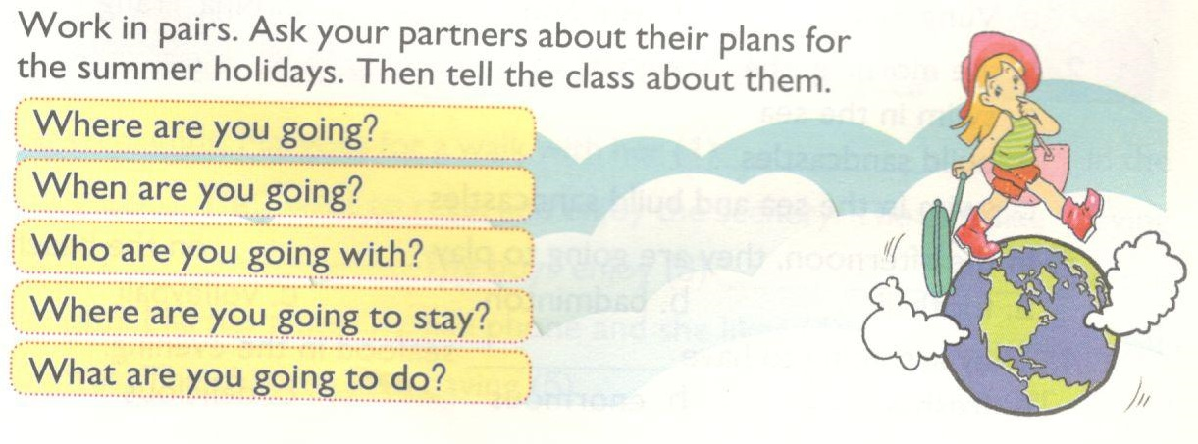

Slide 25

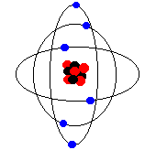
Bye bye!
SEE YOU AGAIN!

