Slide 1
Unit 2: I always get up early. How about you?
Lesson 1 (1, 2, 3)

Slide 2
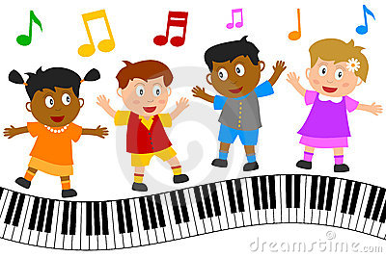
Let’s sing a song and dance

Slide 3
“Hello Song”

Slide 4
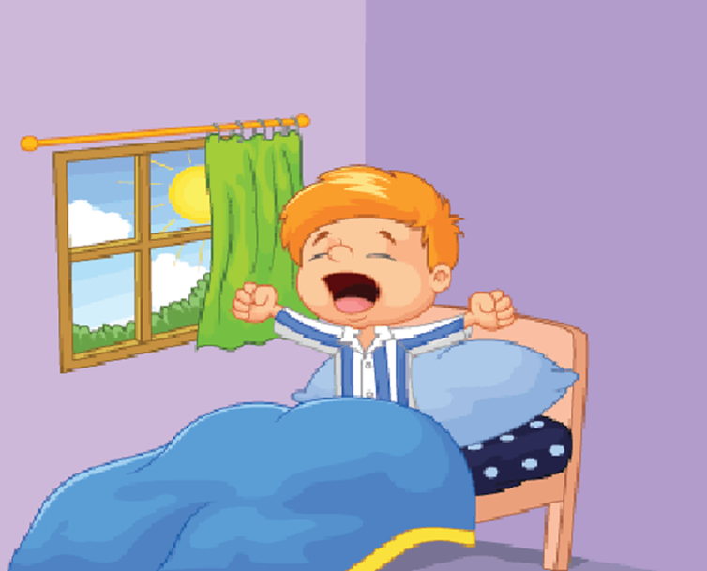
Unit 2: I always get up early. How about you?
Lesson 1: (1,2,3)

Slide 5
OBJECTIVES
Knowledge: students will be able to ask and answer questions about someone’s daily routine.
Skills: Listening – Speaking.
Vocabulary: always, usually, often, sometimes…
Grammar: What do you do…?
I always/ usually/ often….

Slide 6
New words

Slide 7
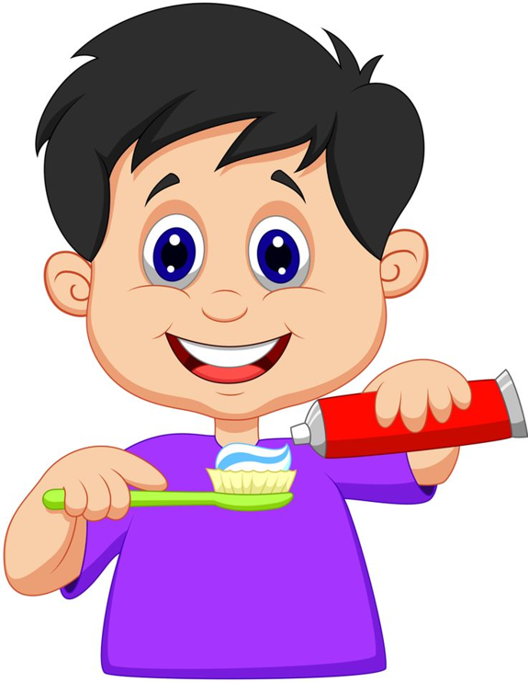
Brush teeth

Slide 8
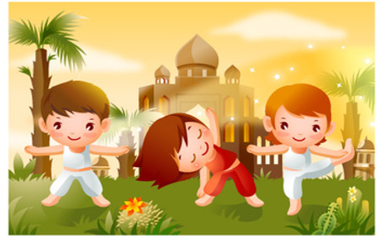
Do morning excercise

Slide 9
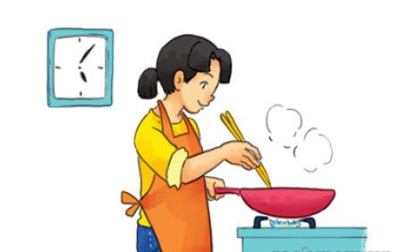
Cook dinner

Slide 10
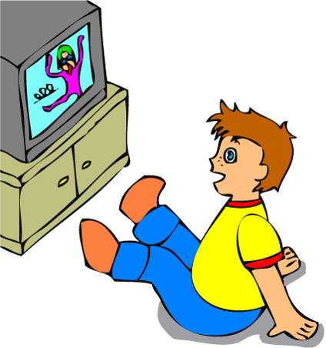
Watch TV

Slide 11
Get up

Slide 12
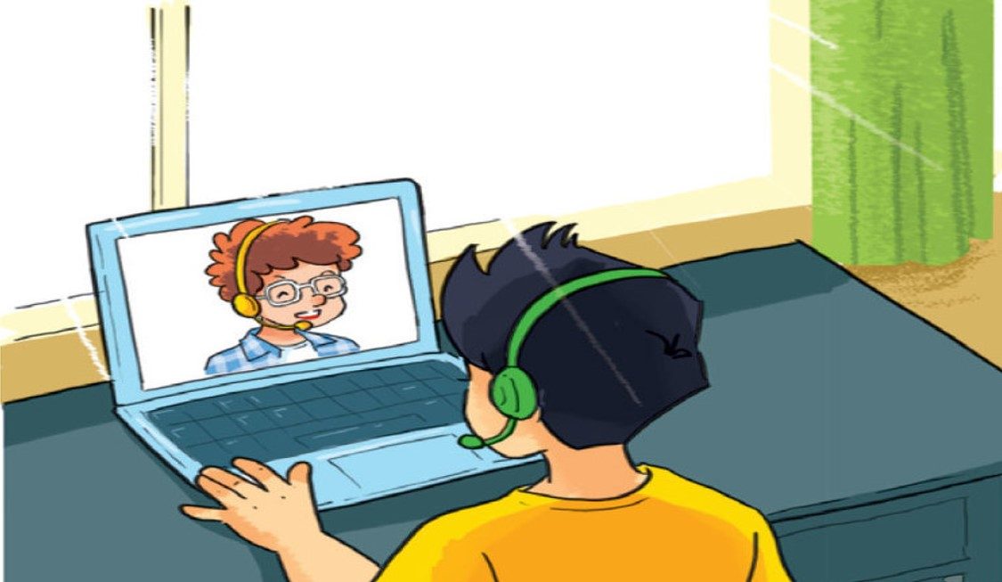
Talk with friends online

Slide 13
Let’s play
a matching game

Slide 14
Match the English words in column 1 with their meanings in column 2
Column 1
Column 2
D
1. Get up
A.
Xem tivi
C
2. Do morning excercise
B.
Nói chuyện trên mạng với bạn bè
A
3. Watch TV
C.
Tập thể dục buổi sáng
B
4. Talk with friends online
D.
Thức dậy
F
5. Cook dinner
E.
Đánh răng
E
6. Brush teeth
F.
Nấu bữa tối
Correct - Click anywhere or press Control Y to continue
Incorrect - Click anywhere or press Control Y to continue
You answered this correctly!
Submit
Clear
Your answer:
You must answer the question before continuing
You did not answer this question completely
The correct answer is:

Slide 15
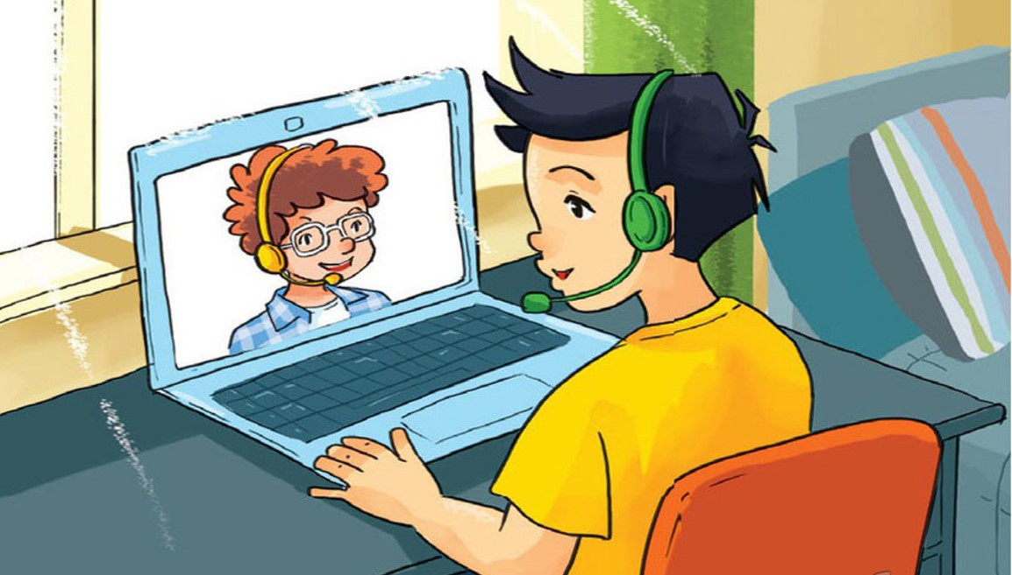
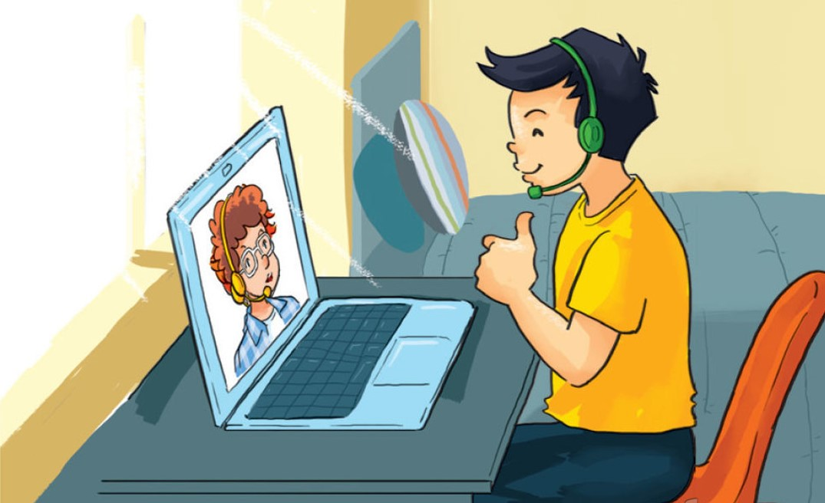
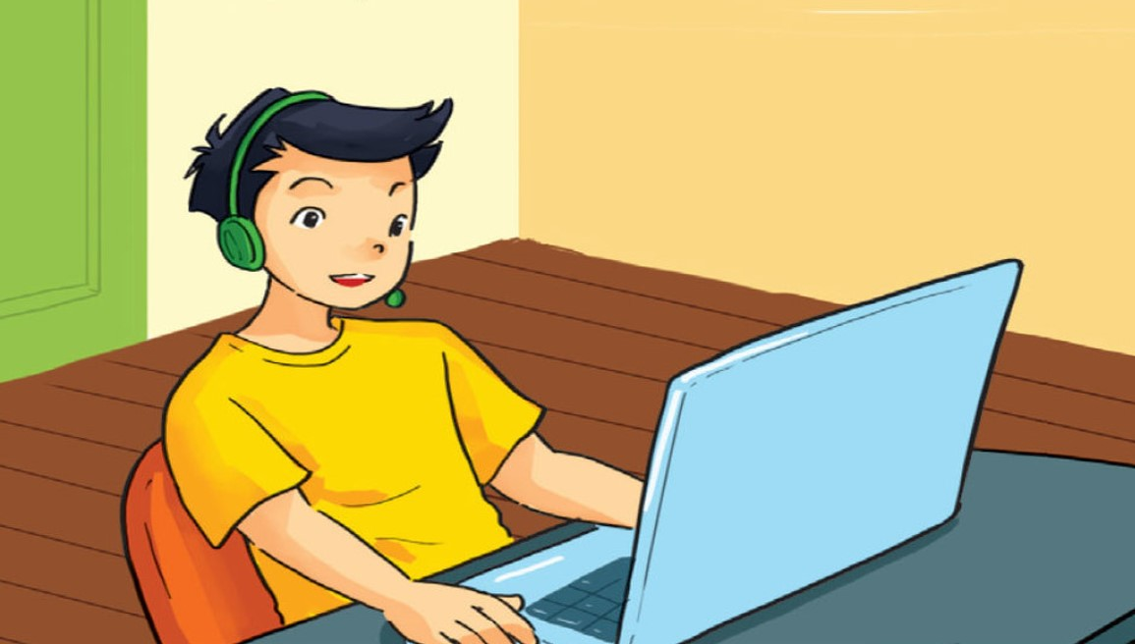
1. Look, listen and repeat

Slide 16
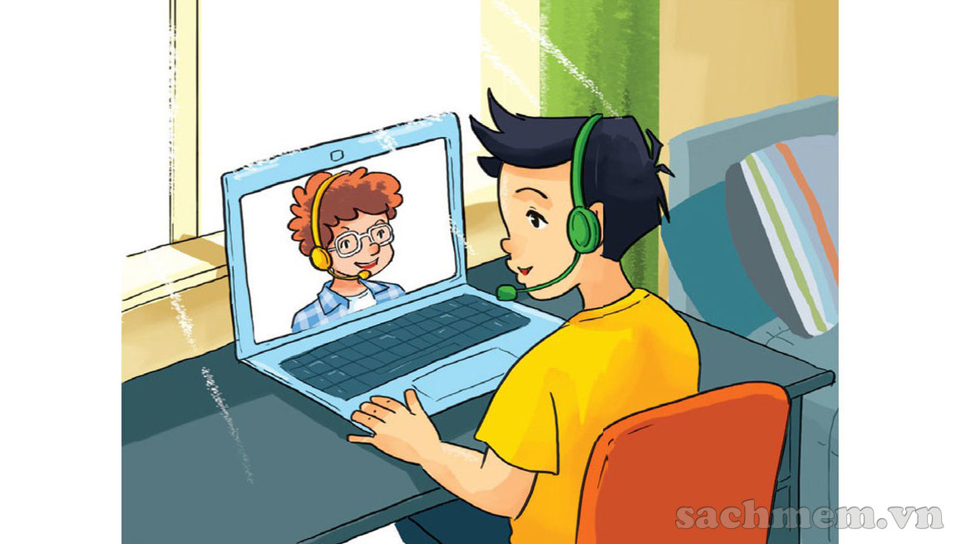

Hi, Quan! You’re up early.
Hi, Tom! Yes, I always get up early. How about you?

Slide 17
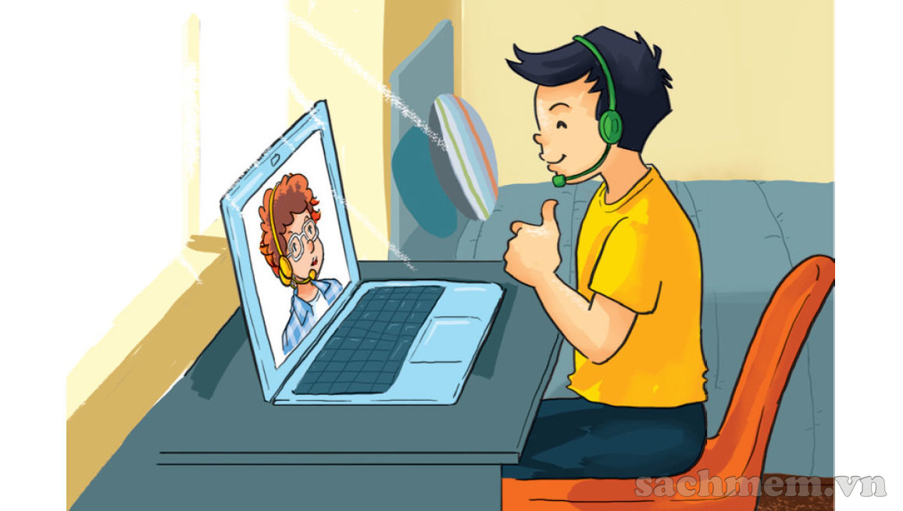
Me too. I get up early and I always have a big breakfast before I go to school.
Good idea!

Slide 18
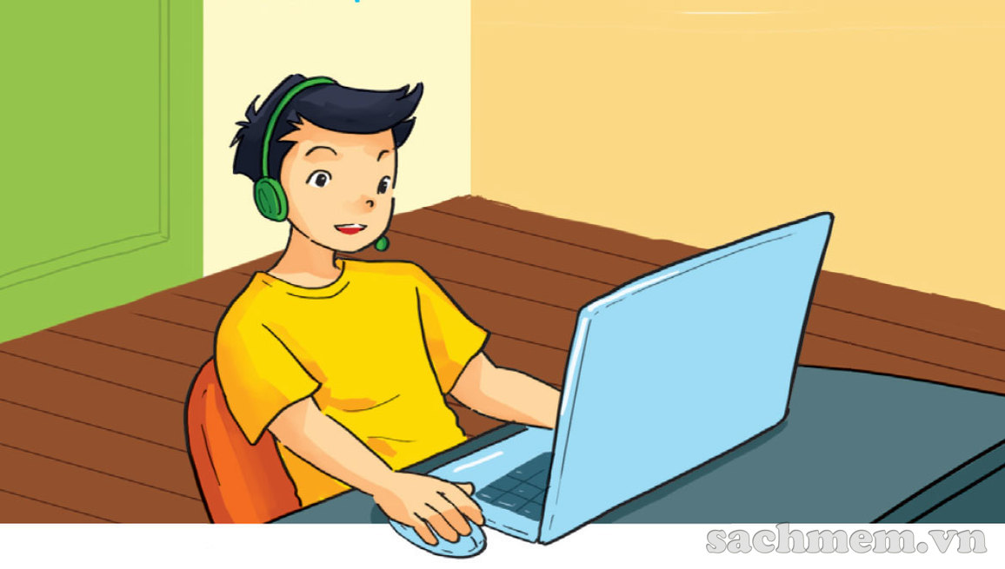
What do you do in the afternoon?
After school? I usually do my homework.

Slide 19
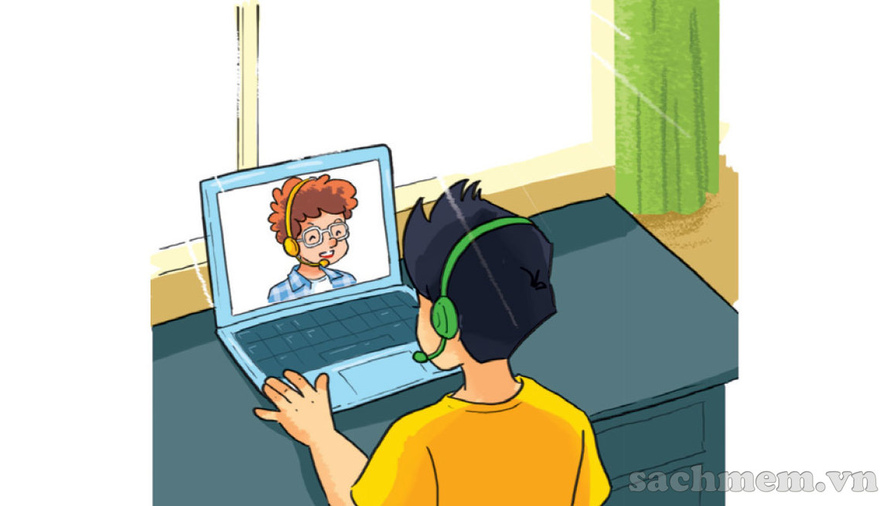
So do I. And I often talk with friends online.
I can see that, haha!

Slide 20
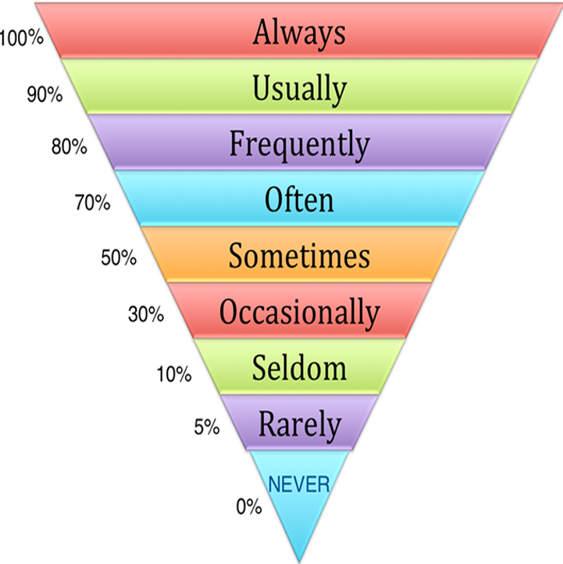
Adverbs of frequency
Luôn luôn
Thường xuyên
Thường xuyên
Thường xuyên
Thỉnh thoảng
Thi thoảng
Ít khi
Hiếm khi
Không bao giờ

Slide 21
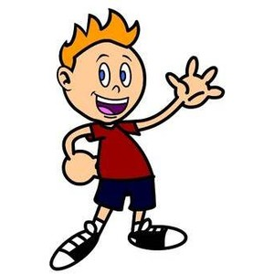

Grammar:
What do you do……….?
I always/ usually/ often/ sometimes......

Slide 22


Example 1:
What do you do in the morning?
I often read books.

Slide 23
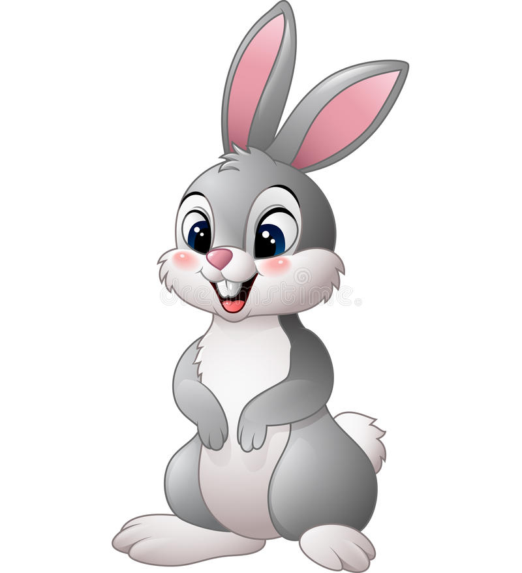
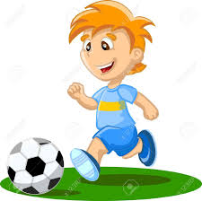
Example 2:
What do you do in the afternoon?
I usually play football.

Slide 24
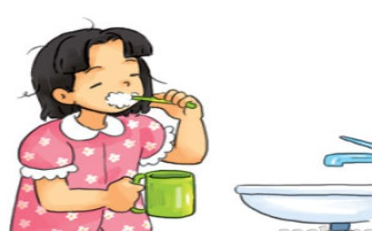
2. Point and say
morning/ always brush my teeth

Slide 25
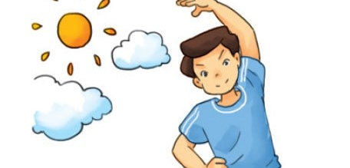
morning/ usually do morning exercise

Slide 26
afternoon/ often cook dinner

Slide 27
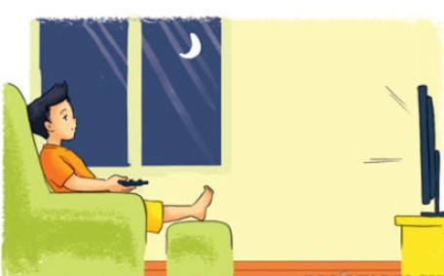
evening/ sometimes watch TV

Slide 28
Let’s talk
3
What do you do in the morning/ afternoon/ evening?
I always/ usually/ often/ sometimes……………

Slide 29
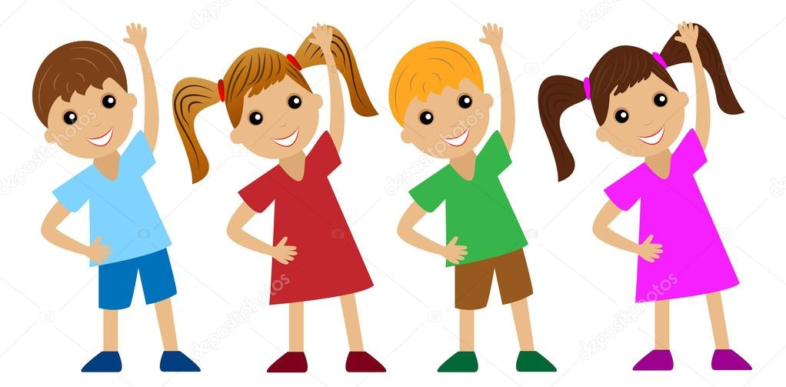
What do you do in the morning?
A)
I often do morning excercise.
B)
I often brush my teeth.
C)
I often cook dinner.
Correct - Click anywhere or press Control Y to continue
Incorrect - Click anywhere or press Control Y to continue
You answered this correctly!
Submit
Clear
Your answer:
You did not answer this question completely
You must answer the question before continuing
The correct answer is:

Slide 30
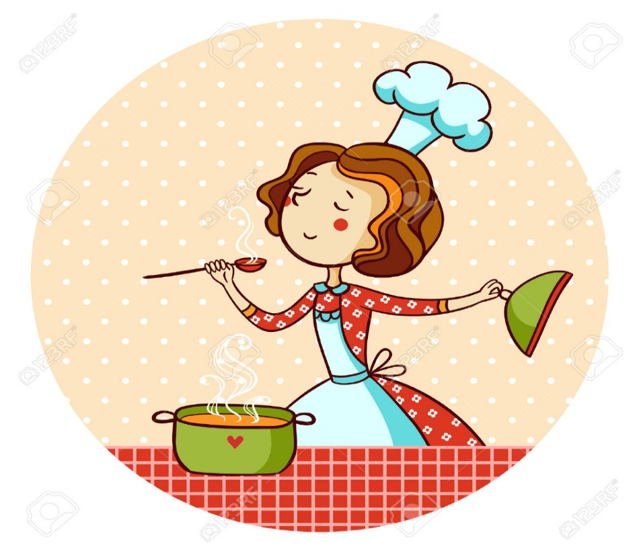
What do you do in the afternoon?
A)
I usually watch TV.
B)
I usually talk with friends online.
C)
I usually cook dinner.
Correct - Click anywhere or press Control Y to continue
Incorrect - Click anywhere or press Control Y to continue
Your answer:
You answered this correctly!
You did not answer this question completely
The correct answer is:
You must answer the question before continuing
Submit
Clear

Slide 31
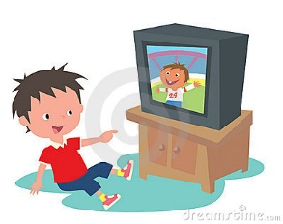
What do you do in the evening?
A)
I always brush my teeth.
B)
I always watch TV.
C)
I always talk with friends online.
Correct - Click anywhere or press Control Y to continue
Incorrect - Click anywhere or press Control Y to continue
Your answer:
You answered this correctly!
You did not answer this question completely
The correct answer is:
You must answer the question before continuing
Submit
Clear

Slide 32

Let’s sing a song

Slide 33
Morning routines song

Slide 34


Slide 35
Tài liệu tham khảo
1, Nguồn tư liệu tham khảo
Google, Youtube
Sách giáo khoa và sách giáo viên Tiếng Anh 5 của BGD&ĐT
2, Các phần mềm sử dụng
Microsoft Powerpoint, Adobe Presenter 10.0
Chương trình ghi âm Adobe Audition
Chương trình cắt ghép video Camtasia 8.6

