Slide 1







Good morning!

Slide 2

WARM UP

Slide 3
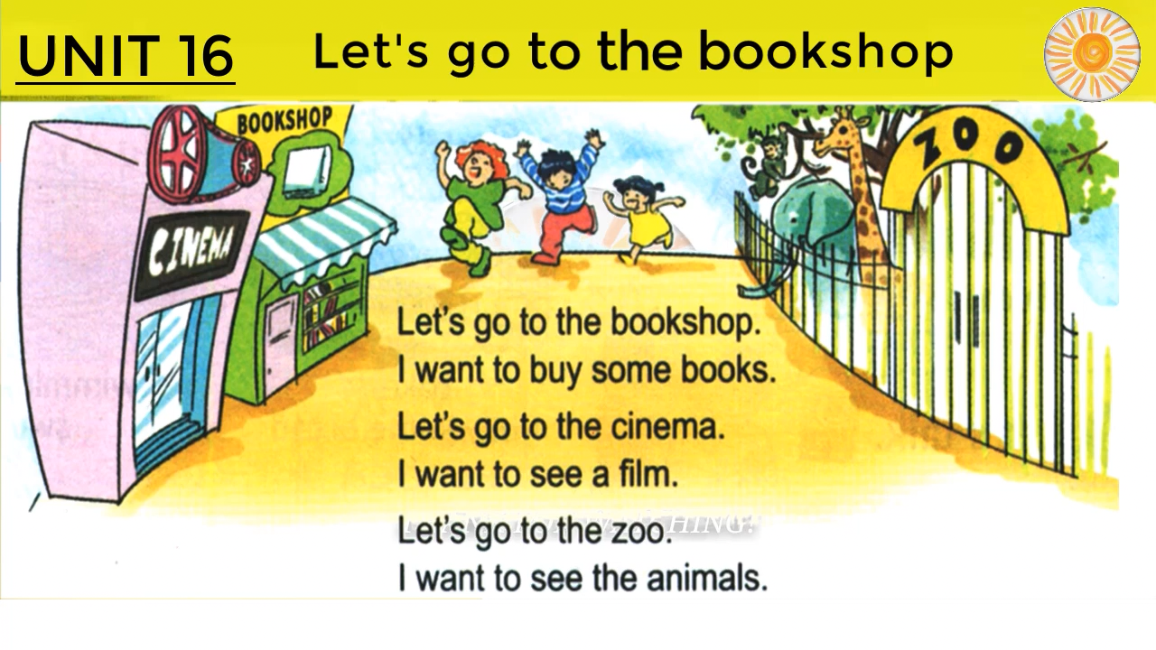

Slide 4

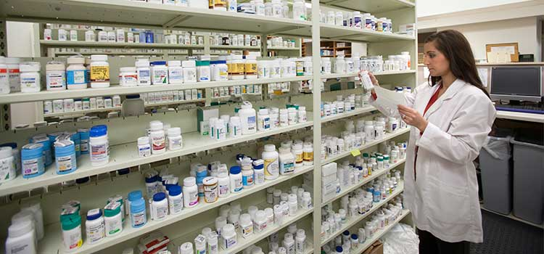
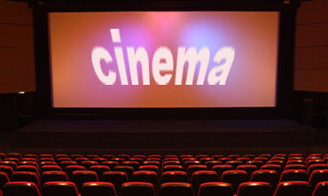
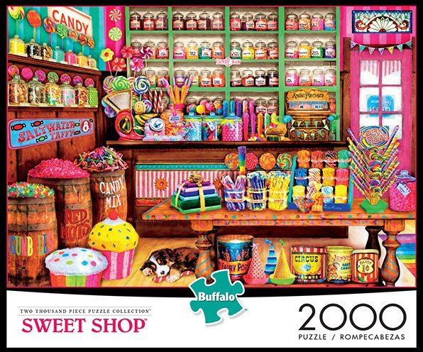
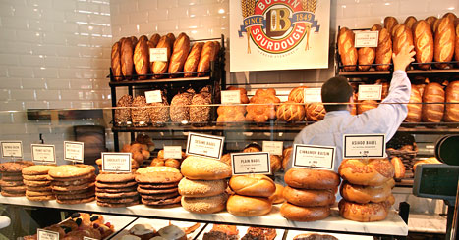
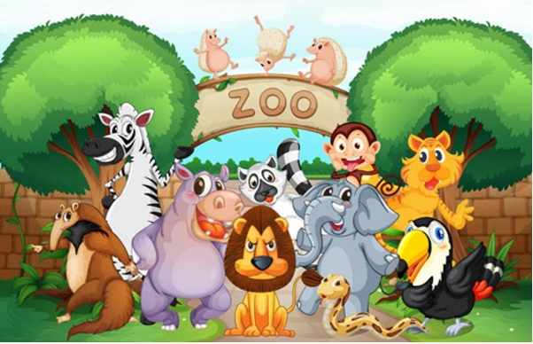
WARM UP!

Slide 5
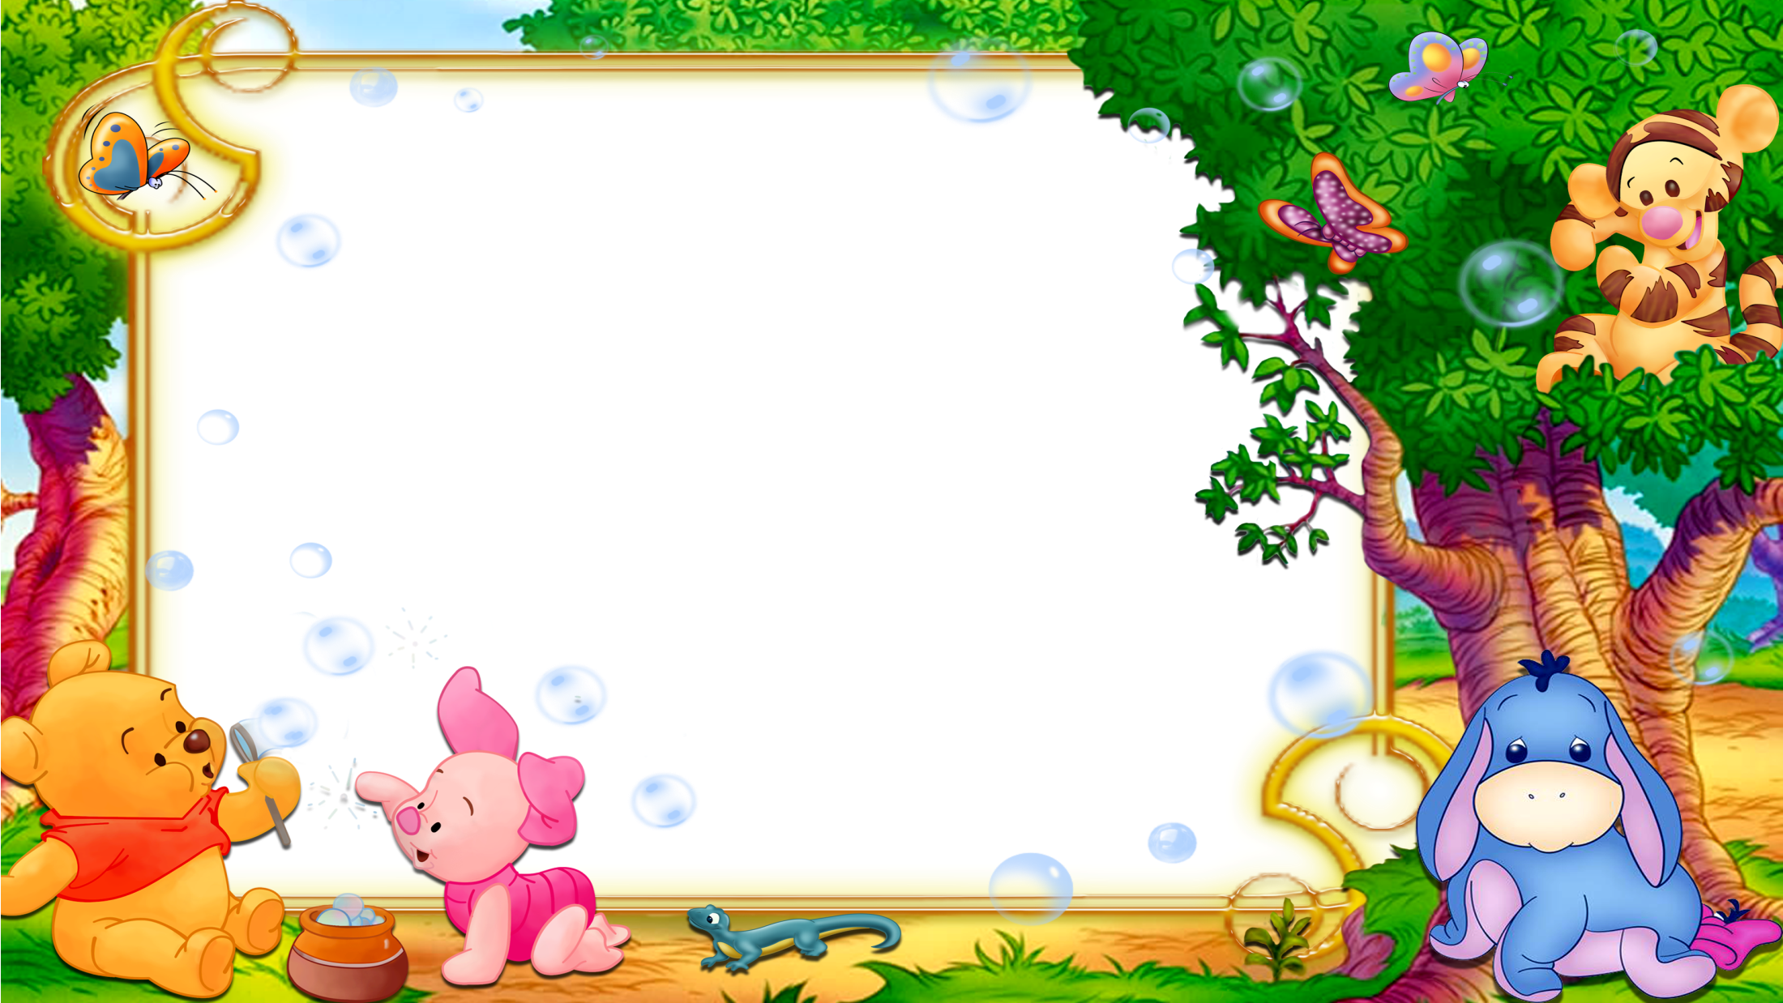
Thursday, March 21st 2019
UNIT 16. LET’S GO TO THE BOOKSHOP.
LESSON 2: Part 4, 5, 6

Slide 6

4. Listen and circle.
1.Mai wants to go to the ______.
a. zoo b. sweet shop c. bookshop
2.Tony wants to go to the ______.
a. bakery b. pharmacy c. cinema
3.Phong wants to buy some ______.
a. books b. pens c. rulers
4.Tom wants to buy some ______.
a. sweets b. chocolate c. bread
1
2
3
4
Work in groups and talk:
How many people are there?
Who are they?
Can you guess where they want to go to? Or what they want to do?`

Slide 7


Slide 8












Slide 9
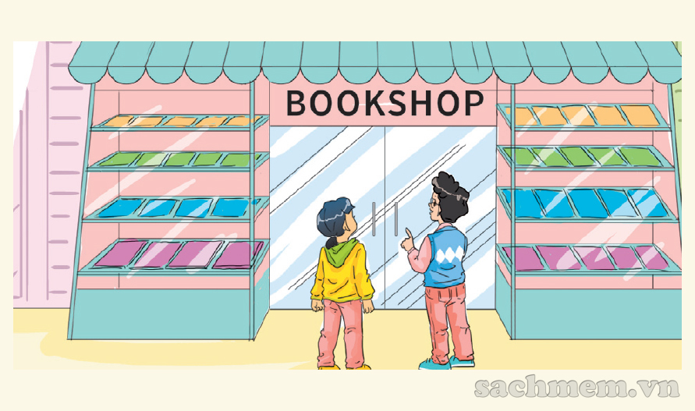


Let’s go to the sweet shop.
I want to buy some ….
medicine
cakes and sweets
pens

Slide 10
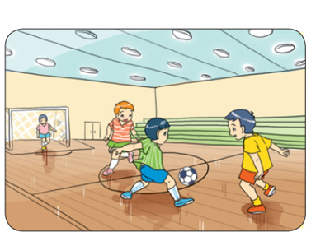

Why do you want to go to the ... ?
Because I want to play football.
pharmacy
bakery
gym

Slide 11
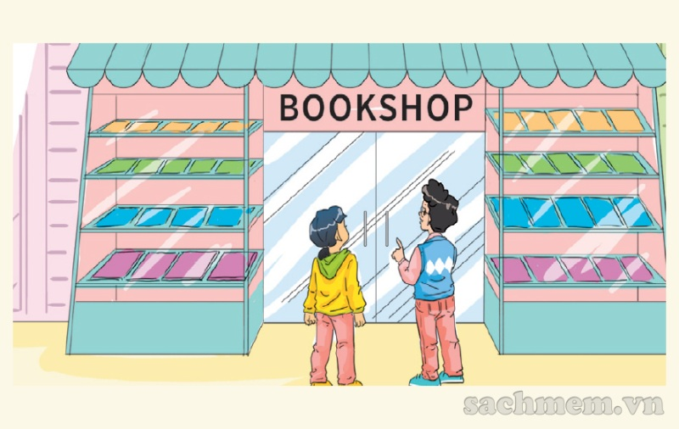
Why do you ... to go to the bookshop?
I … to buy some books.
want - wants
want – want
want - ..x..

Slide 12
Unit 16 : Let’s go to the bookshop. - lesson 2 (4,5,6)
5. Look and write:
* Why do you want to go to the supermarket?
Because I want to buy some cakes and sweets.
* Why does he want to go to the supermarket?
Because he wants to buy some cakes and sweets.

Slide 13

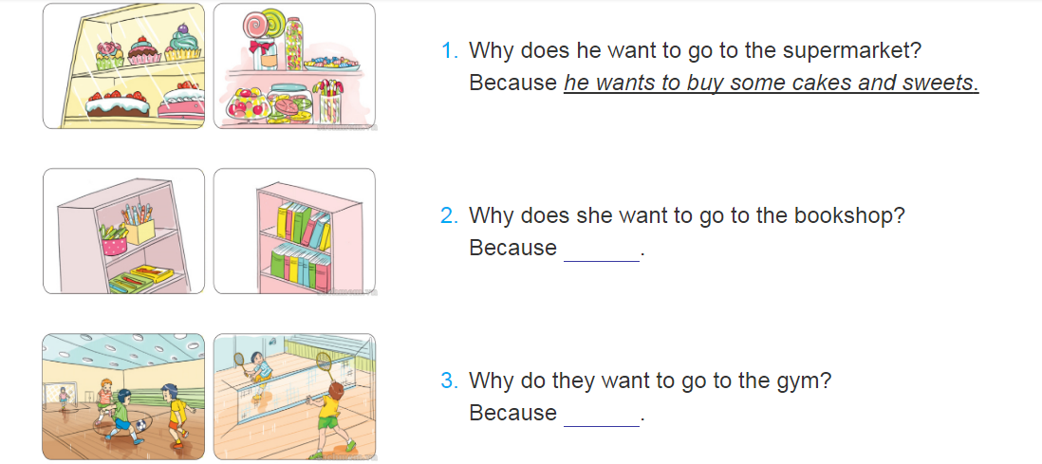

Slide 14
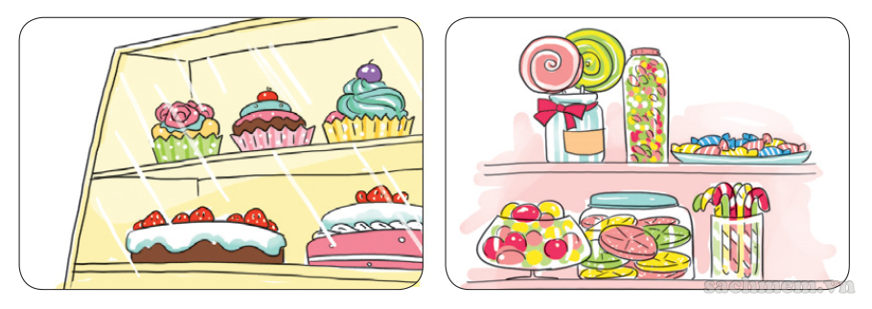
LOOK & WRITE
1
A: Why does he want to go to the supermarket?
B: Because
he wants to buy some cakes and sweets.

Slide 15
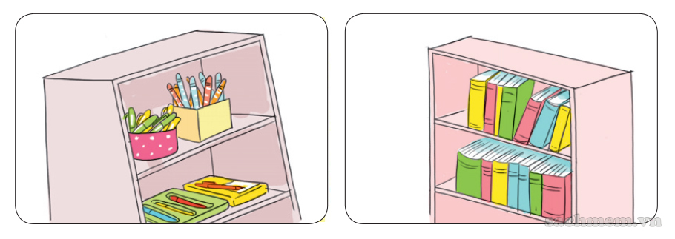
LOOK & WRITE
2
A: Why does she want to go to the bookshop?
B: Because
she wants to buy some pens and books.

Slide 16
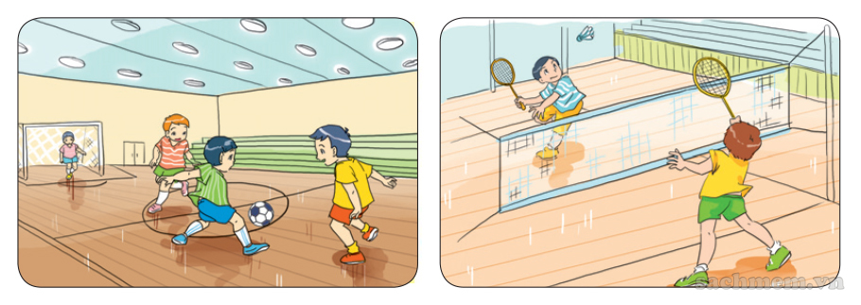
LOOK & WRITE
3
A: Why do they want to go to the gym?
B: Because
they want to play football and badminton .

Slide 17


Slide 18


Slide 19
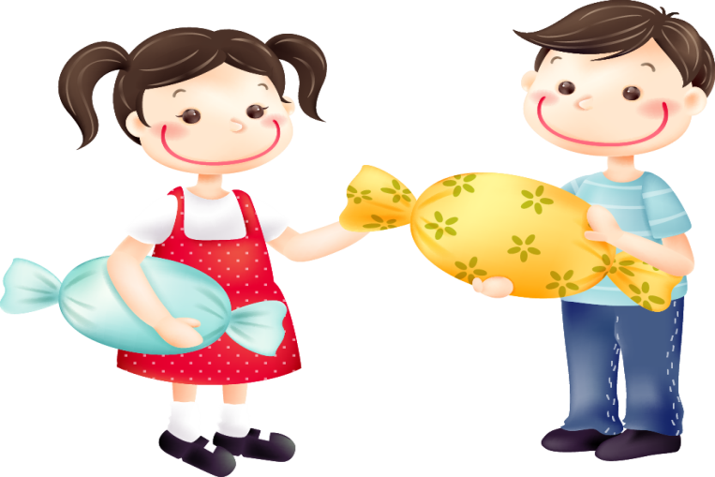

Slide 20

Homework
- Practice sentence
- Do homework 1, 2 (p.65)
- Prepare lesson 3 (1,2,3)

Slide 21

Goodbye!
Thank you for your attention!

