Slide 1

Unit 2
WHAT I CAN DO
LESSON 1.3 - PAGE 22

Slide 2
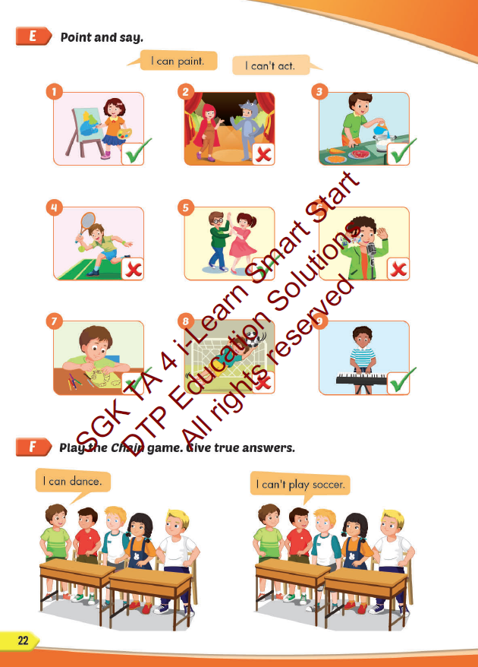
Lesson Outline
Warm-up
Practice
Speaking
Consolidation
Wrap-up

Slide 3
Objectives
By the end of this lesson, students will be able totalk about things they can or can't do correctly.
Vocabulary: dance, sing, draw, cook, play tennis, play soccer, ...
Structure: I can dance. I can't sing.

Slide 4

WARM UP

Slide 5



Slide 6
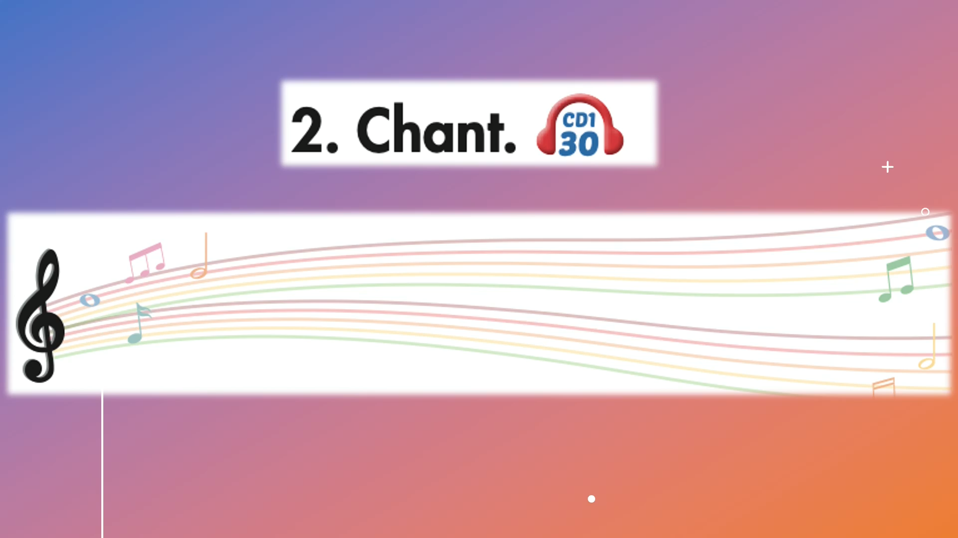

Slide 7

It’s time to learn …

Slide 8

WORD QUIZ
Click on the right word

Slide 9

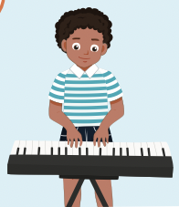


Click on the right word
sing
dance
Play the keyboard

Slide 10
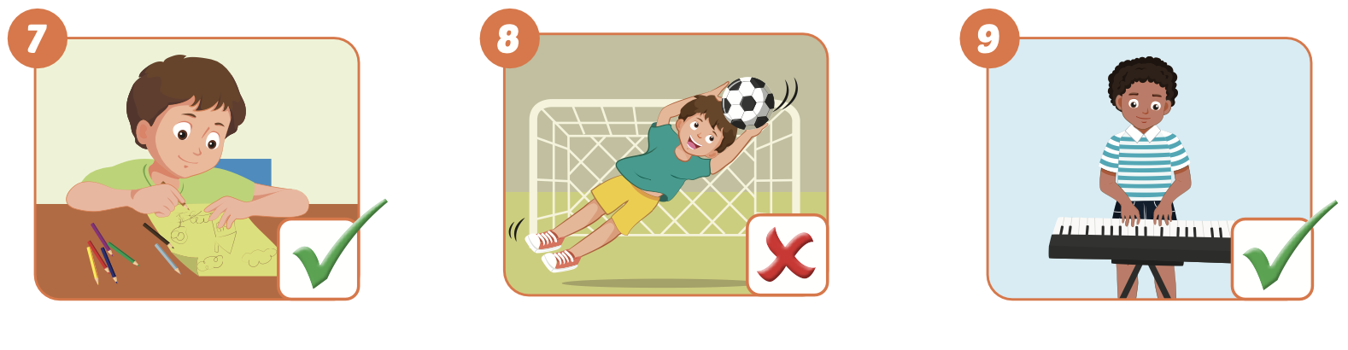
Click on the right word
play soccer
dance
play tennis

Slide 11
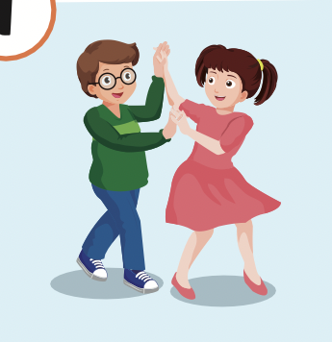
Click on the right word
sing
dance
draw

Slide 12
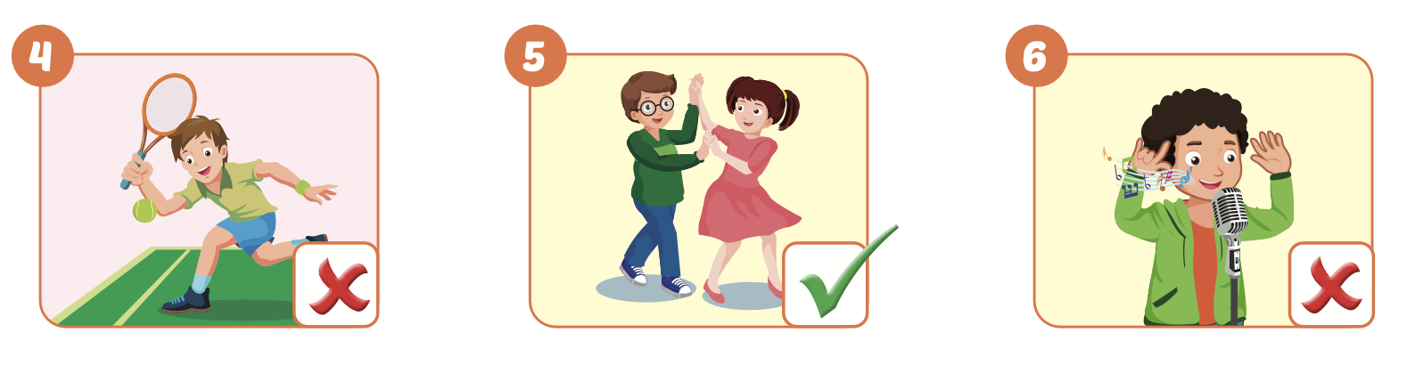
Click on the right word
draw
play soccer
play tennis

Slide 13

Practice

Slide 14

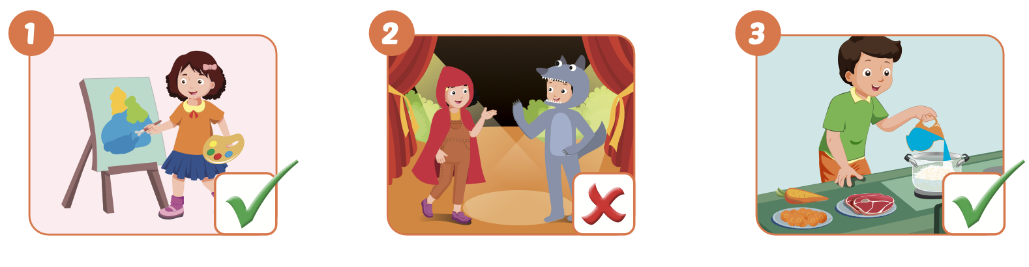


Slide 16
I can cook.

Slide 17
I can play tennis.

Slide 18
I can dance.

Slide 19
I can’t sing.

Slide 20
I can draw.

Slide 21
I can’t play soccer.

Slide 22
I can play the keyboard.

Slide 23

Production

Slide 24
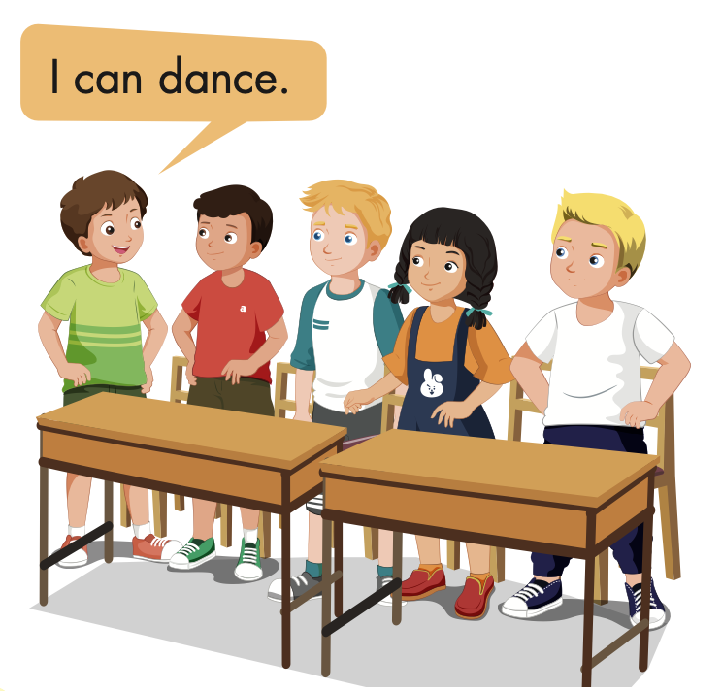
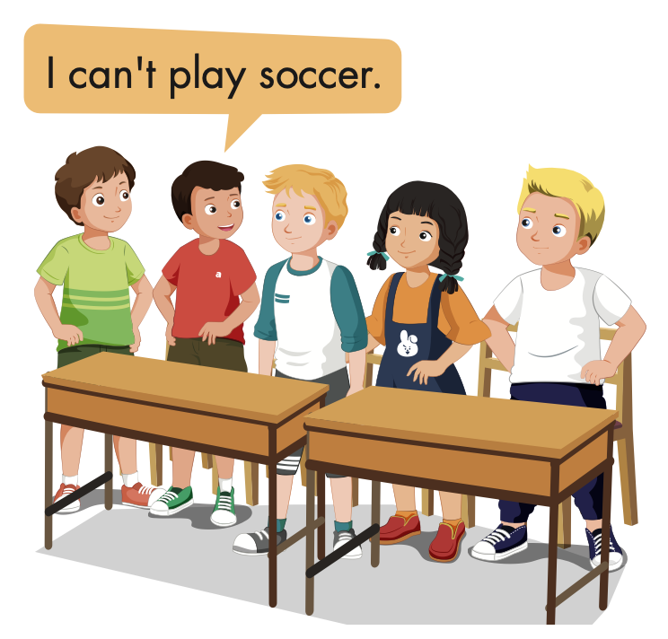

Slide 25

UNSCRAMBLE THE WORDS

Slide 26

can’t / I / the / keyboard / play/.
I can’t play the keyboard.

Slide 27
dance / I / can/ .
I can dance.

Slide 28
Soccer / play / I / can’t /.
I can’t play soccer.

Slide 29
I/ paint/ can/.
I can paint.

Slide 30

CONSOLIDATION

Slide 31


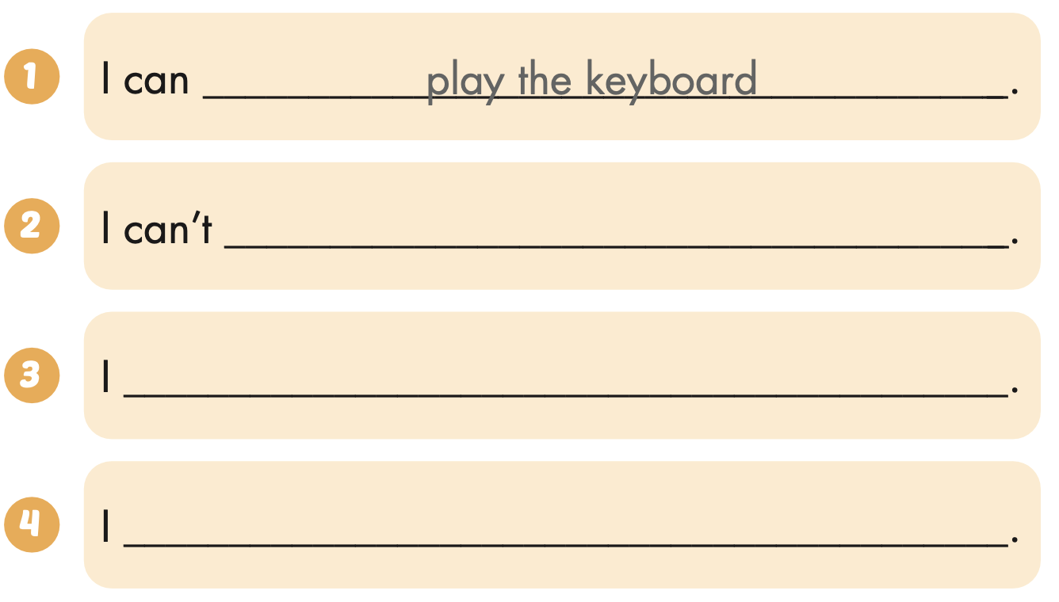
Extra Practice
WB, page 13
paint
can act
can’t sing

Slide 32

WRAP-UP

Slide 33
Today’s lesson
Vocabularies
dance, sing, draw, cook, play tennis, play soccer, ...
Structures/ Sentence patterns
I can dance.
I can't sing.

Slide 34
Homework
Practice the vocabularies and structure; and make sentences using them.
Do the exercises in Tiếng Anh 4 i-Learn Smart Start WB (page 13)
Do the exercises in Tiếng Anh 4 i-Learn Smart Start Notebook (page 10)
Prepare the next lesson (page 23 SB)
Play the consolidation games in Tiếng Anh 4 i-Learn Smart Start DHA App on www.eduhome.com.vn

Slide 35

Enjoy your day!

