Slide 1

Unit 3: MY FRIENDS AND I
Culture – Lesson 1
Page 43

Slide 2
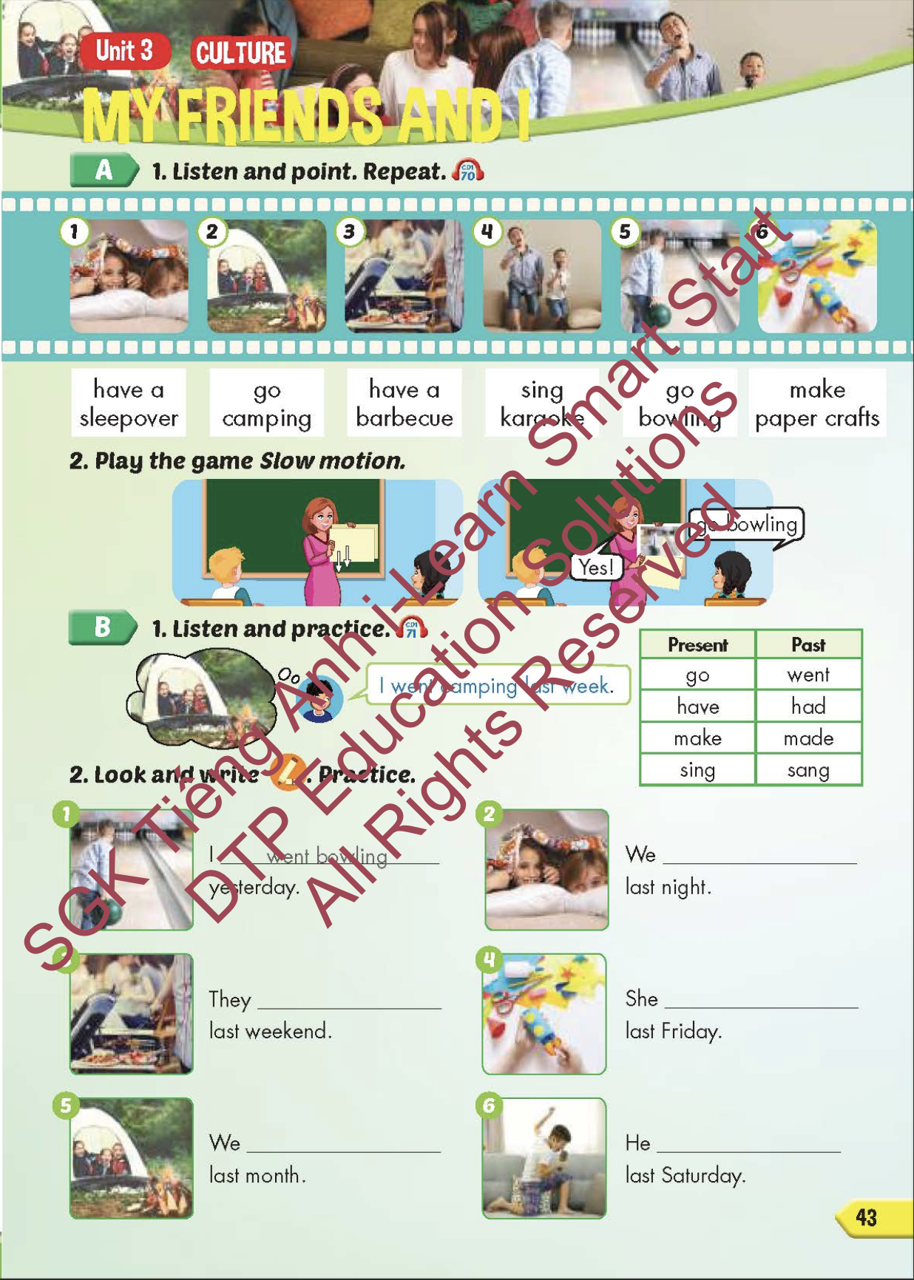
Lesson Outline
Warm-up
Vocabulary
Structure
Consolidation
Wrap-up

Slide 3
Objectives
By the end of this lesson, students will be able to familiarize themselves with aspects of Vietnamese culture. Then students will be able to talk about what they and their friends did in the past and when.
Vocabulary: have a sleepover, go camping, have a barbecue, sing karaoke, go bowling, make paper crafts.
Structure: I went camping last week.

Slide 4
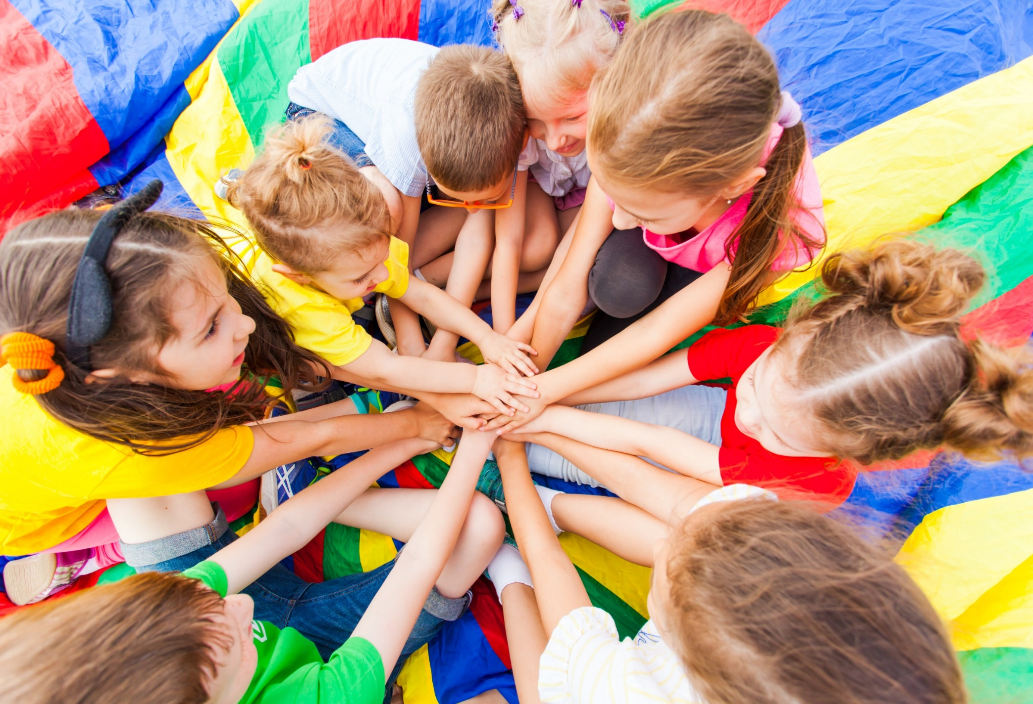
WARM-UP

Slide 5

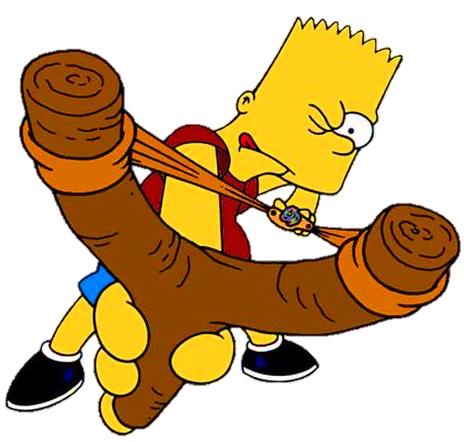



Slide 6
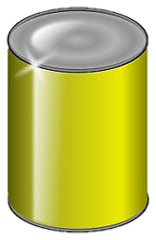



planted
I __________ some flowers yesterday.
planted
painted
played
NEXT
Click on the right can

Slide 7
They __________ soccer last weekend.
played
stayed
painted
played
NEXT
Click on the right can

Slide 8
painted
She __________ a picture last Sunday.
stayed
painted
baked
Click on the right can
NEXT

Slide 9
stayed
We __________ at home last night.
stayed
visited
baked
NEXT
Click on the right can

Slide 10

It’s time to learn …

Slide 11

New words
have a sleepover,
go camping,
have a barbecue,
sing karaoke,
go bowling,
make paper crafts.

Slide 12

Presentation

Slide 13

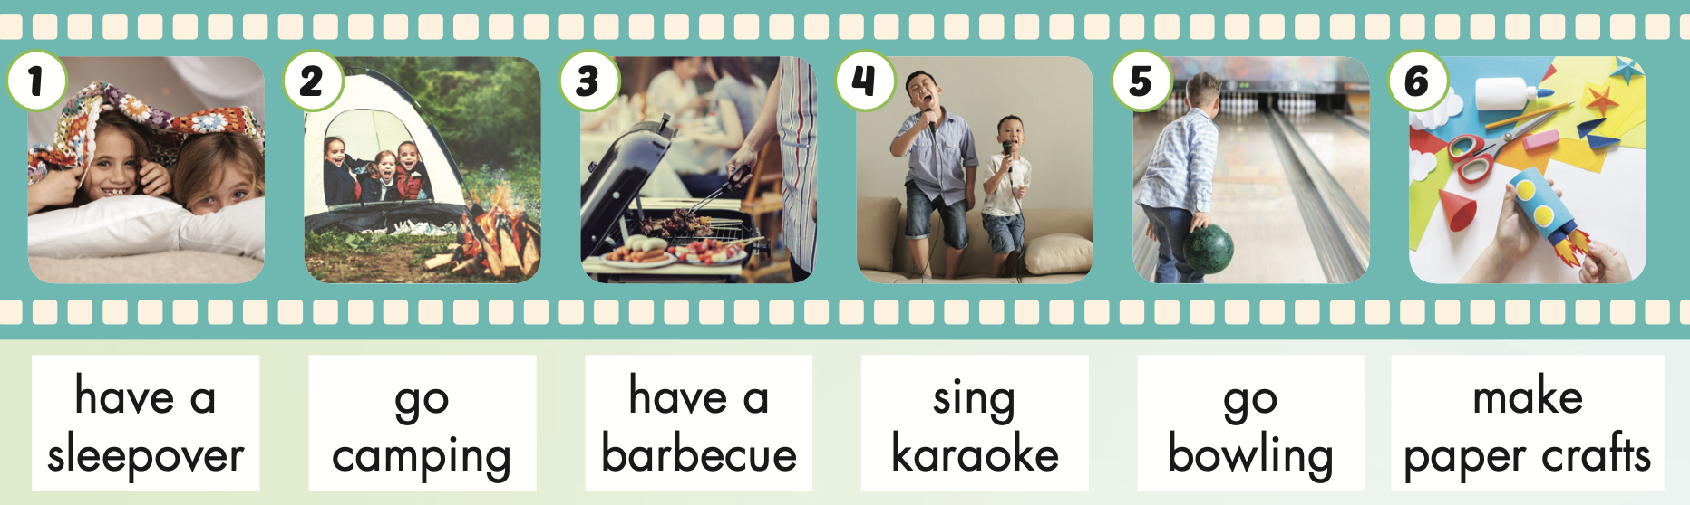
Notes:
Click vào hình A. 1. Listen and point. Repeat để cho cả audio full chạy

Slide 14

have a sleepover
/hæv ə ˈsliːpoʊvər/
tổ chức tiệc ngủ (ở nhà bạn)

Slide 15
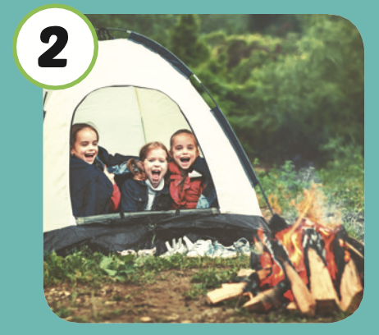
go camping
/ɡoʊ ˈkæmpɪŋ/
đi cắm trại

Slide 16
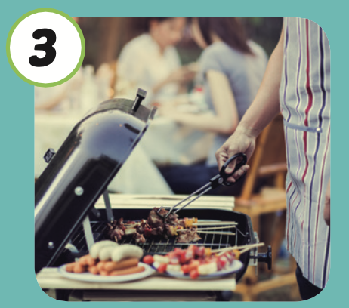
have a barbecue
/ hæv ə ˈbɑːrbəkjuː /
tổ chức tiệc nướng ngoài trời

Slide 17
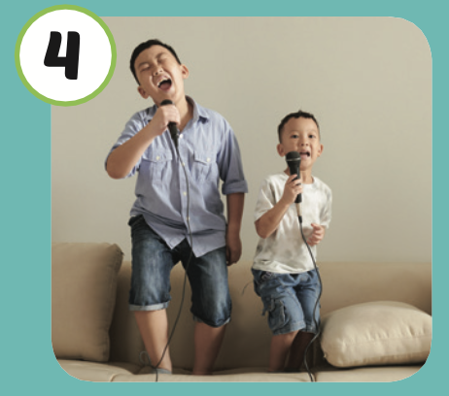
sing karaoke
/ sɪŋ ˌkæriˈoʊki /
hát karaoke

Slide 18
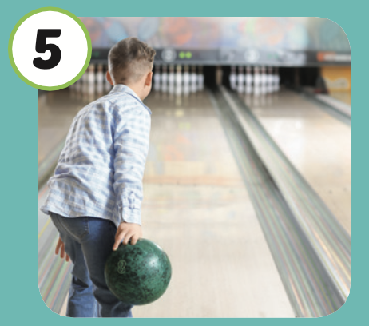
go bowling
/ɡoʊ ˈboʊlɪŋ /
chơi bowling

Slide 19

make paper crafts
/ meɪk ˈpeɪpər kræfts/
làm đồ thủ công giấy

Slide 20
Practice

Slide 21
Listen and choose.
Then say.

Slide 22

Listen and choose
A
B
C

Slide 23
Listen and choose
A
B
C

Slide 24
Listen and choose
A
B
C

Slide 25
Listen and choose
A
B
C

Slide 26
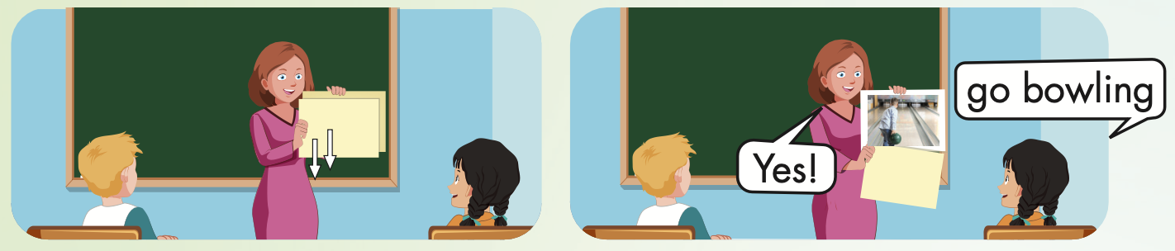

Slide 27
Structure
I went camping last week.

Slide 28
Presentation

Slide 29

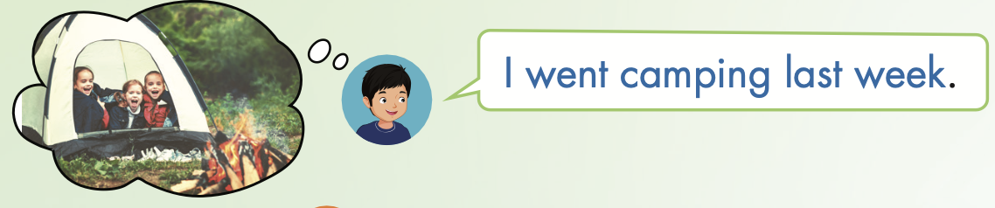
Structure

Slide 30
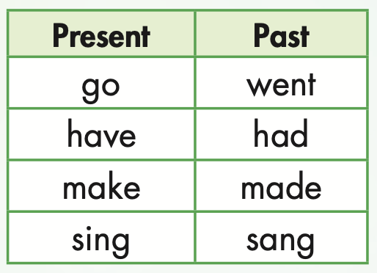

Slide 31
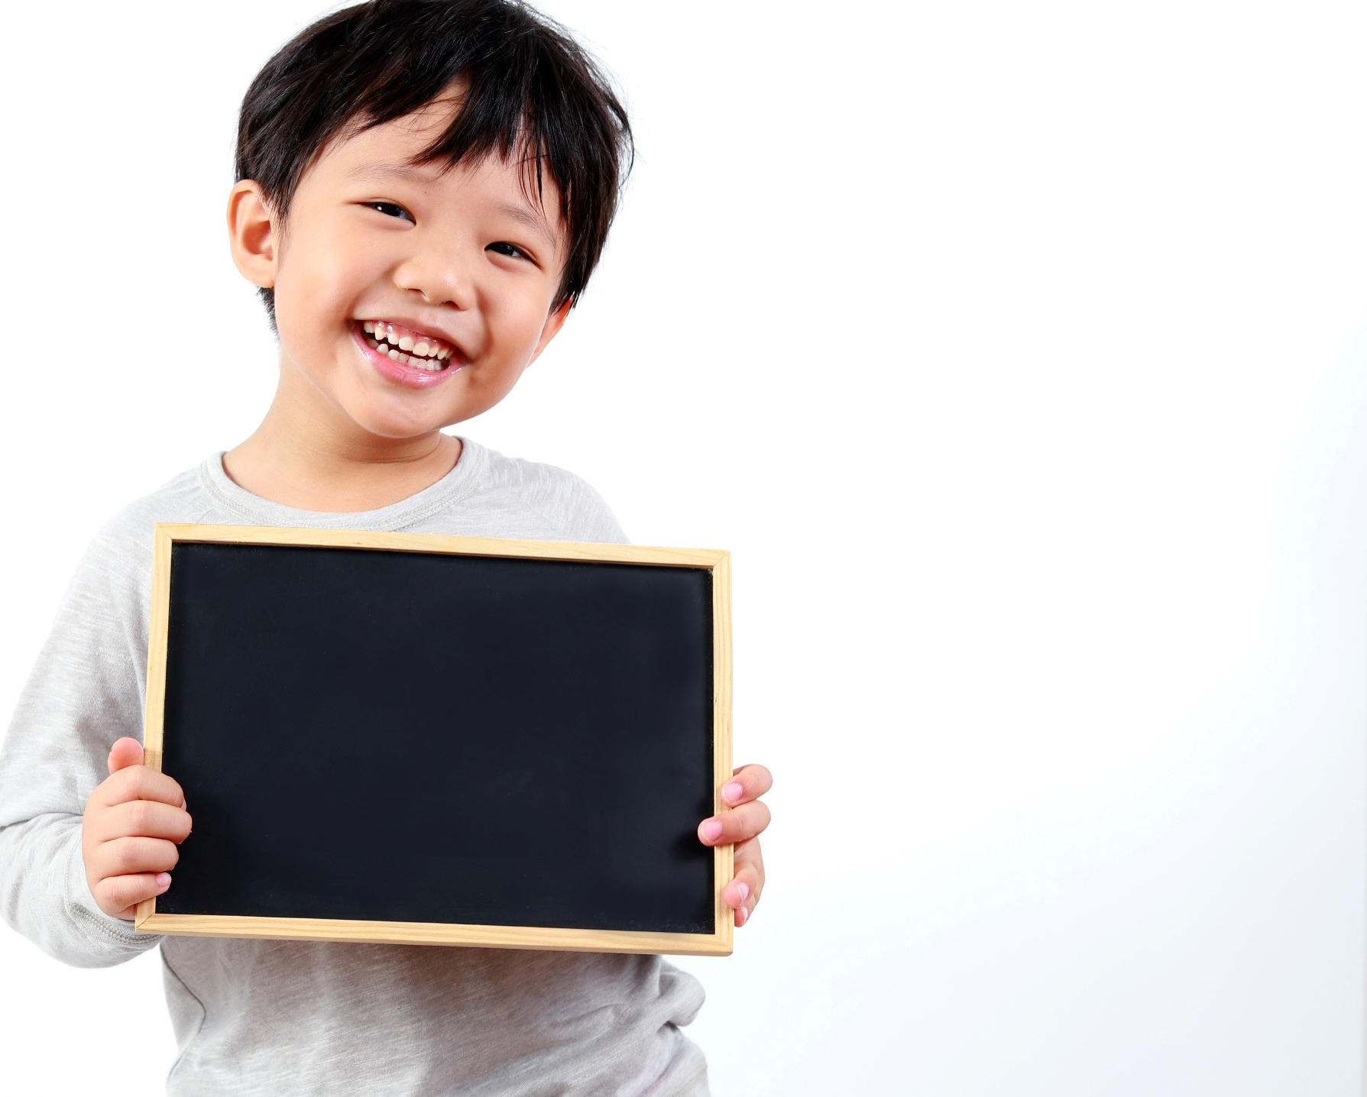
Practice

Slide 32

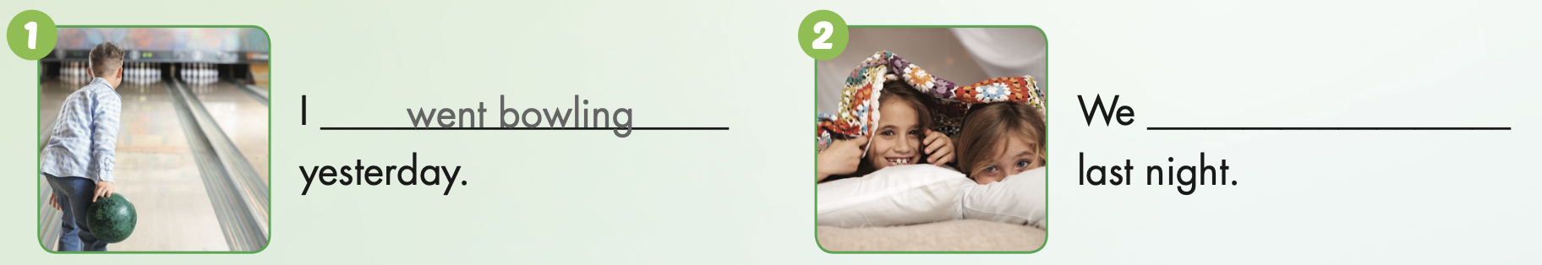
had a sleepover

Slide 33
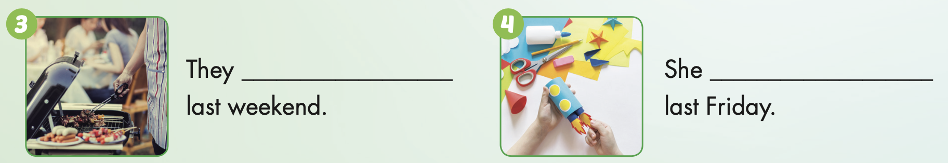
had a barbecue

Slide 34
made paper crafts

Slide 35
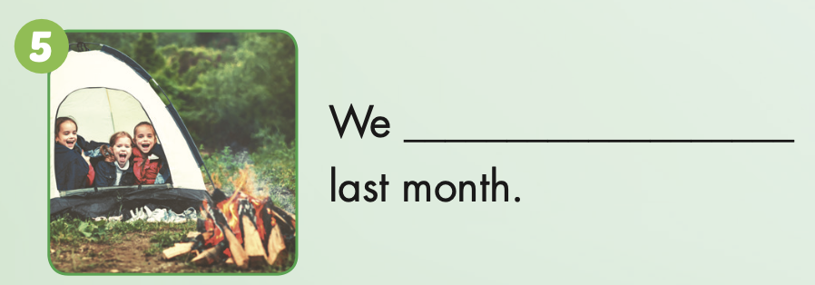
went camping

Slide 36
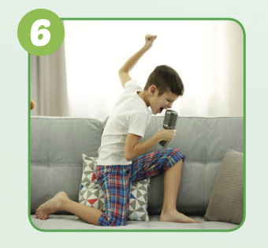
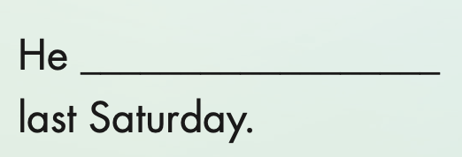
sang karaoke

Slide 37

Production

Slide 38

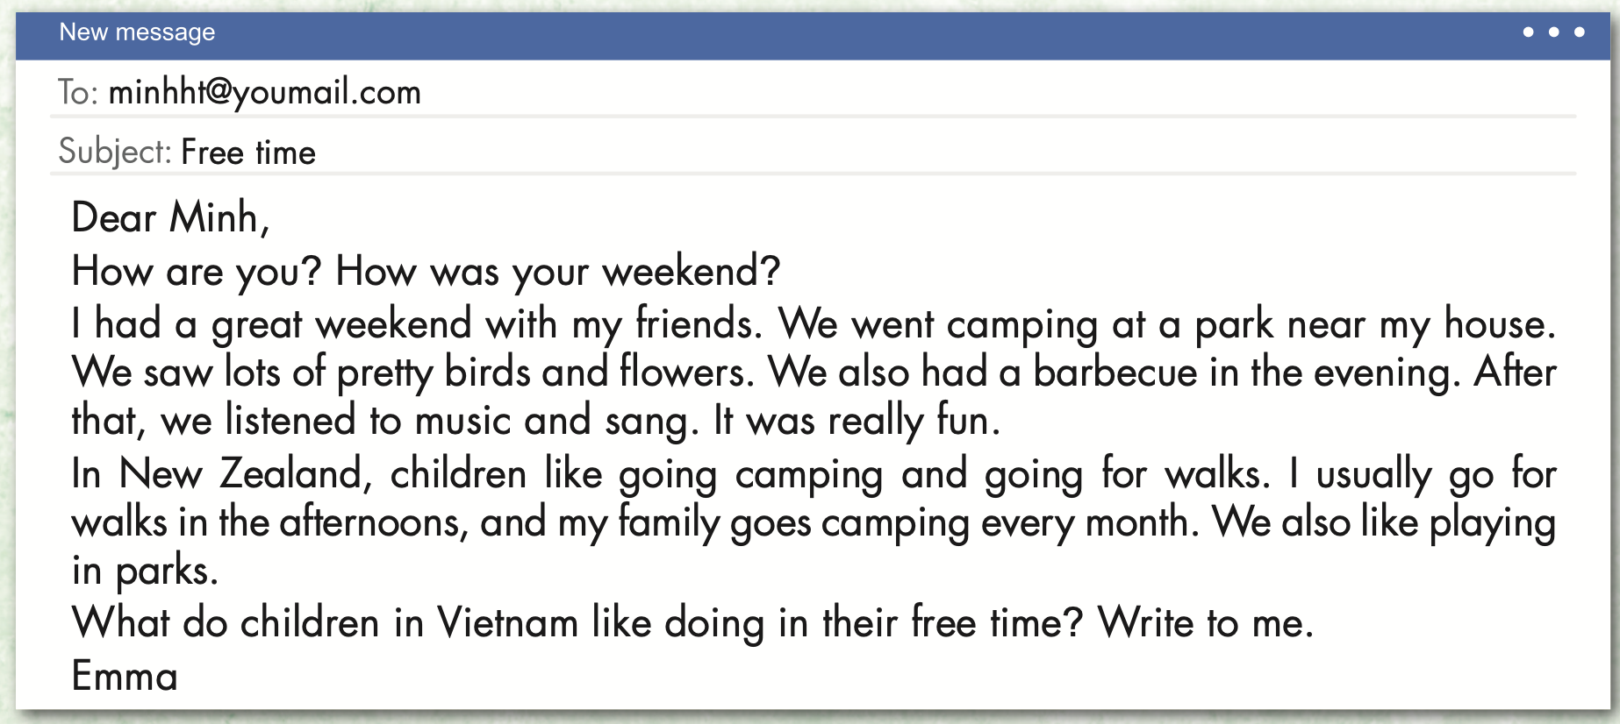
Extra Practice
WB, page 28

Slide 39
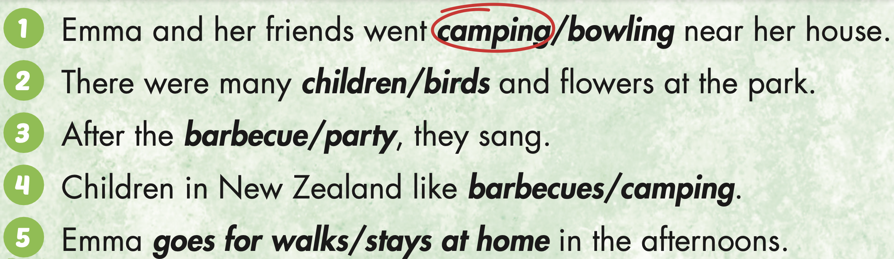
Extra Practice
WB, page 28

Slide 40

CONSOLIDATION

Slide 41
Memory game

Slide 42
- The first student chooses 2 numbers.
If the pictures match (a verb in present tense and its past tense), the student wins a point.

Slide 43
Memory
Sing
Watch
Had
planted
stayed
played
1
2
3
4
5
6
Hide All
Show All
Go
8
11
12
plant
stay
Watched
play
paint
7
9
10
Went
14
15
17
13
were
Have
Walk
Sang
make
16
18
Walked
20
22
23
was
made
19
21
are
is
painted
24

Slide 44

WRAP-UP

Slide 45
Today’s lesson
Vocabularies
have a sleepover,
go camping,
have a barbecue,
sing karaoke,
go bowling,
make paper crafts.
Structures/ Sentence patterns
I went camping last week.

Slide 46
Homework
Practice the vocabularies and structure, and make sentences using them.
Do the exercises in Tiếng Anh 5 i-Learn Smart Start WB (page 28).
Do the exercises in Tiếng Anh 5 i-Learn Smart Start Notebook.
Prepare the next lesson (page 44 SB).
Play the consolidation games in Tiếng Anh 5 i-Learn Smart Start DHA App on www.eduhome.com.vn

Slide 47
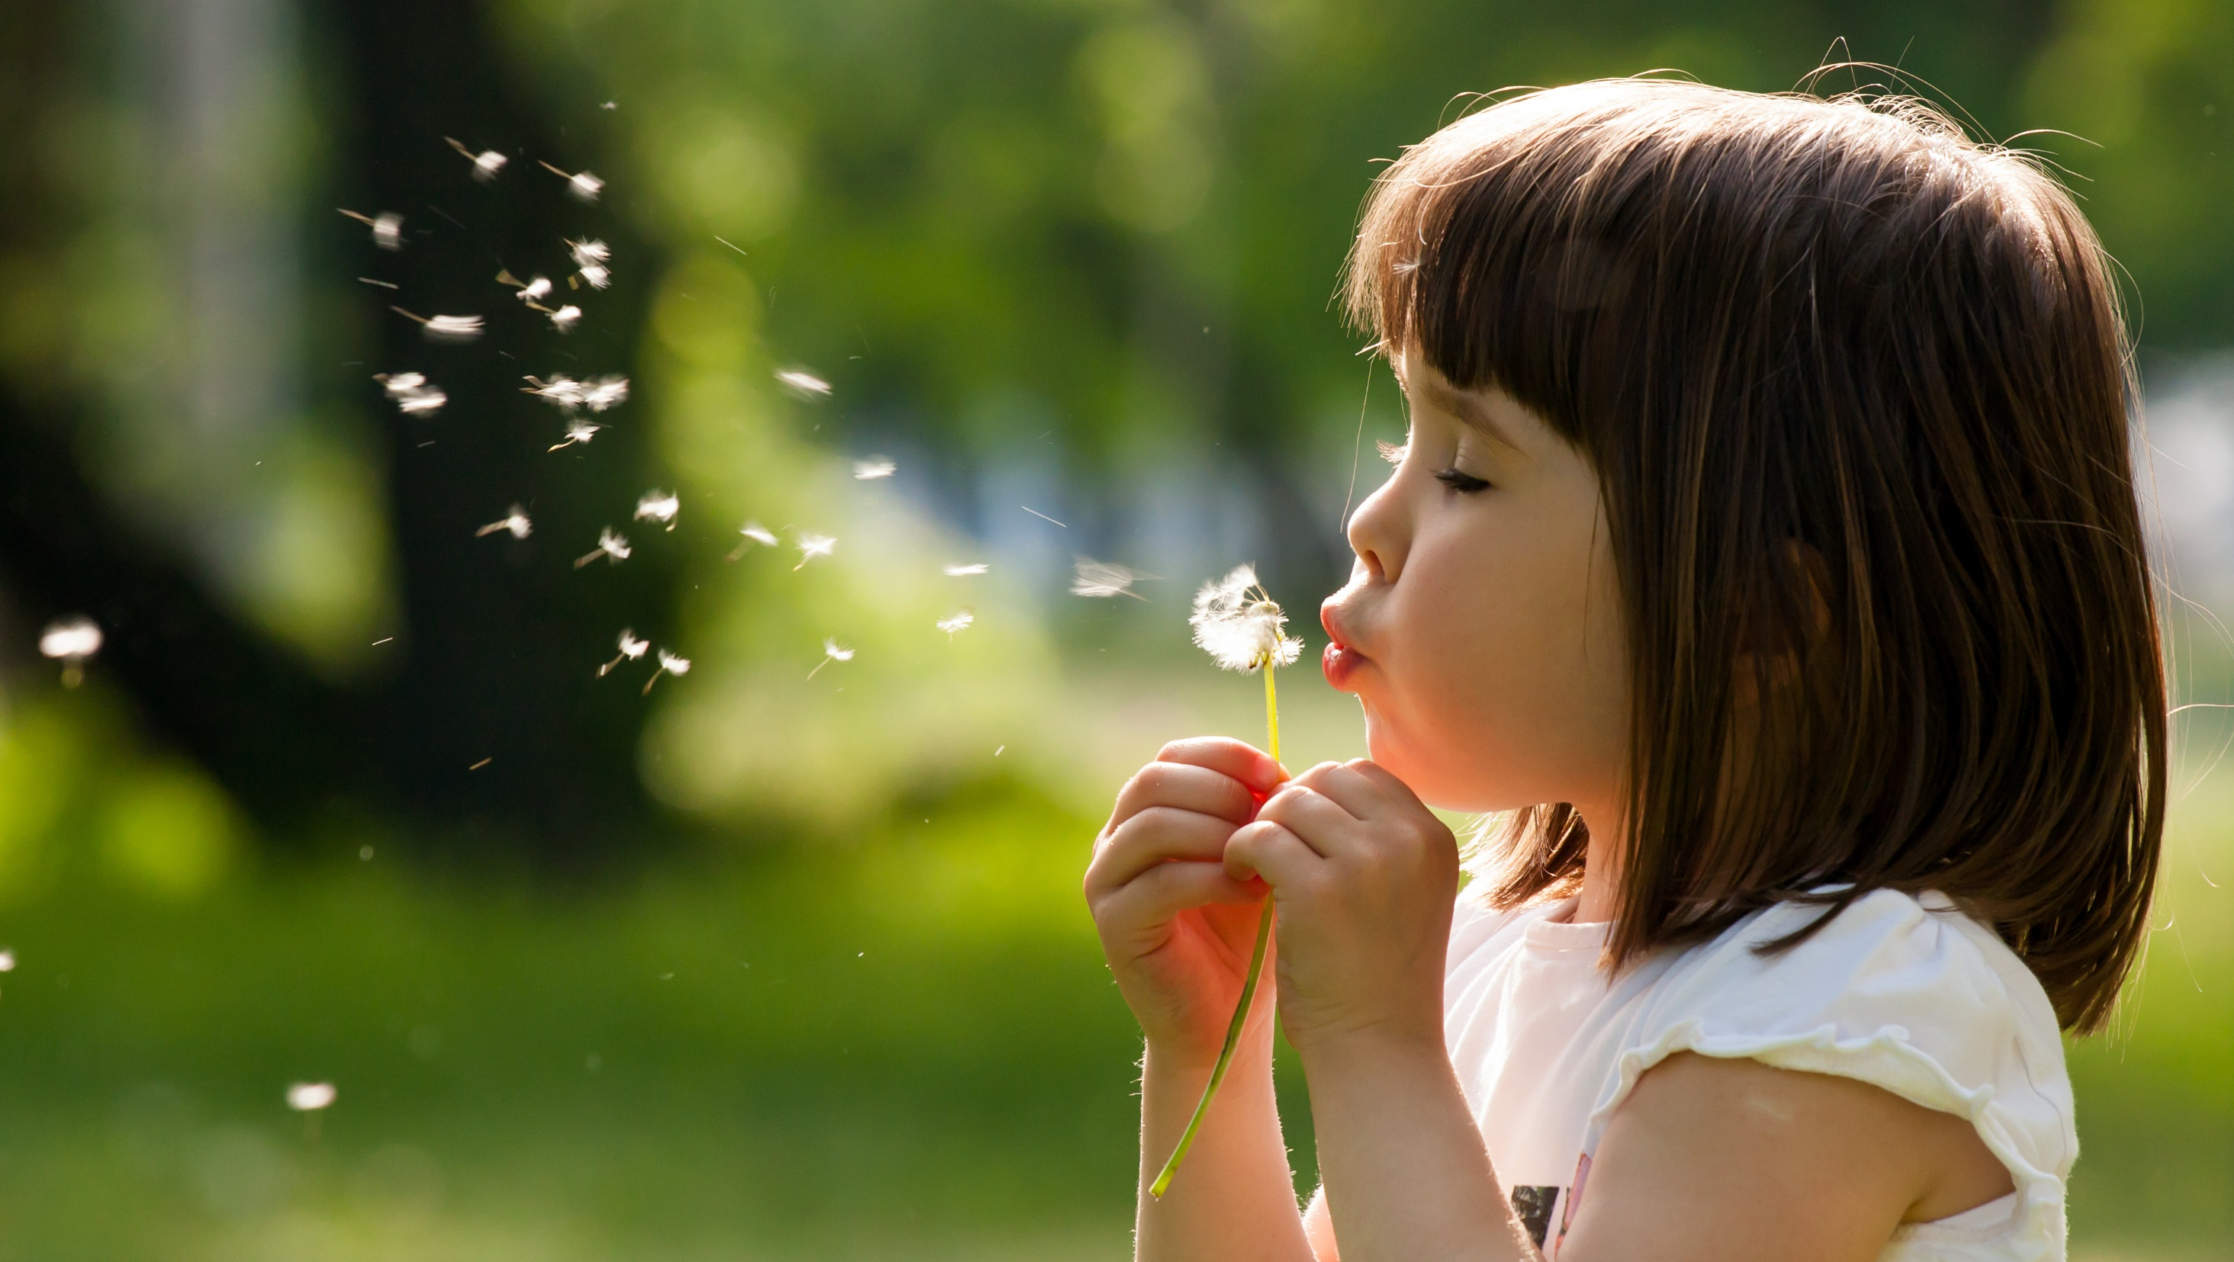
Enjoy your day!

Slide 48

Lesson 3
Stay positive and have a nice day!

