Slide 1
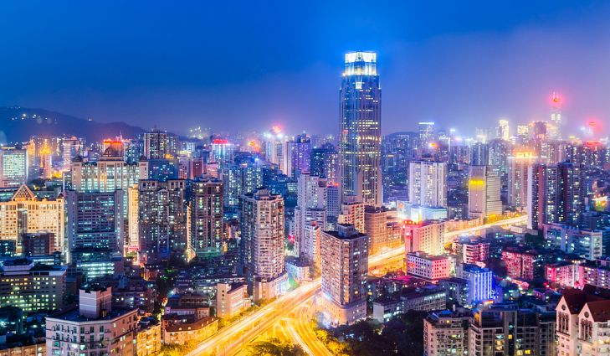
city

Slide 2
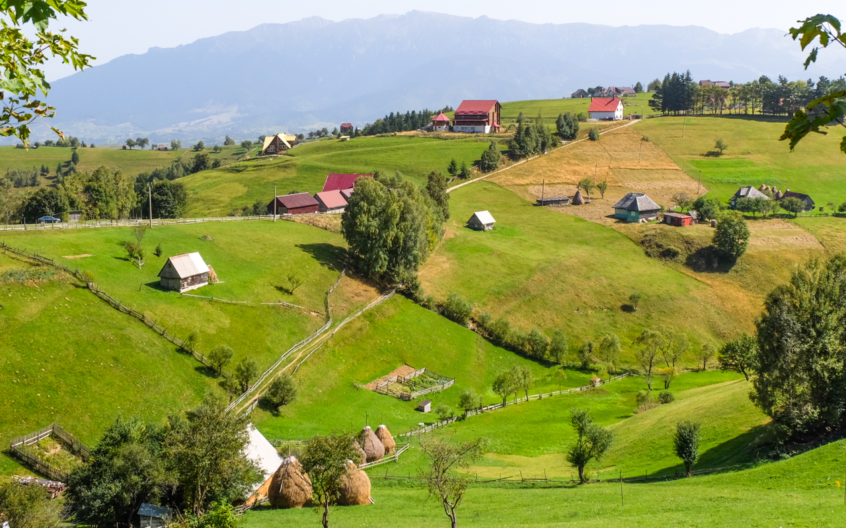
village

Slide 3
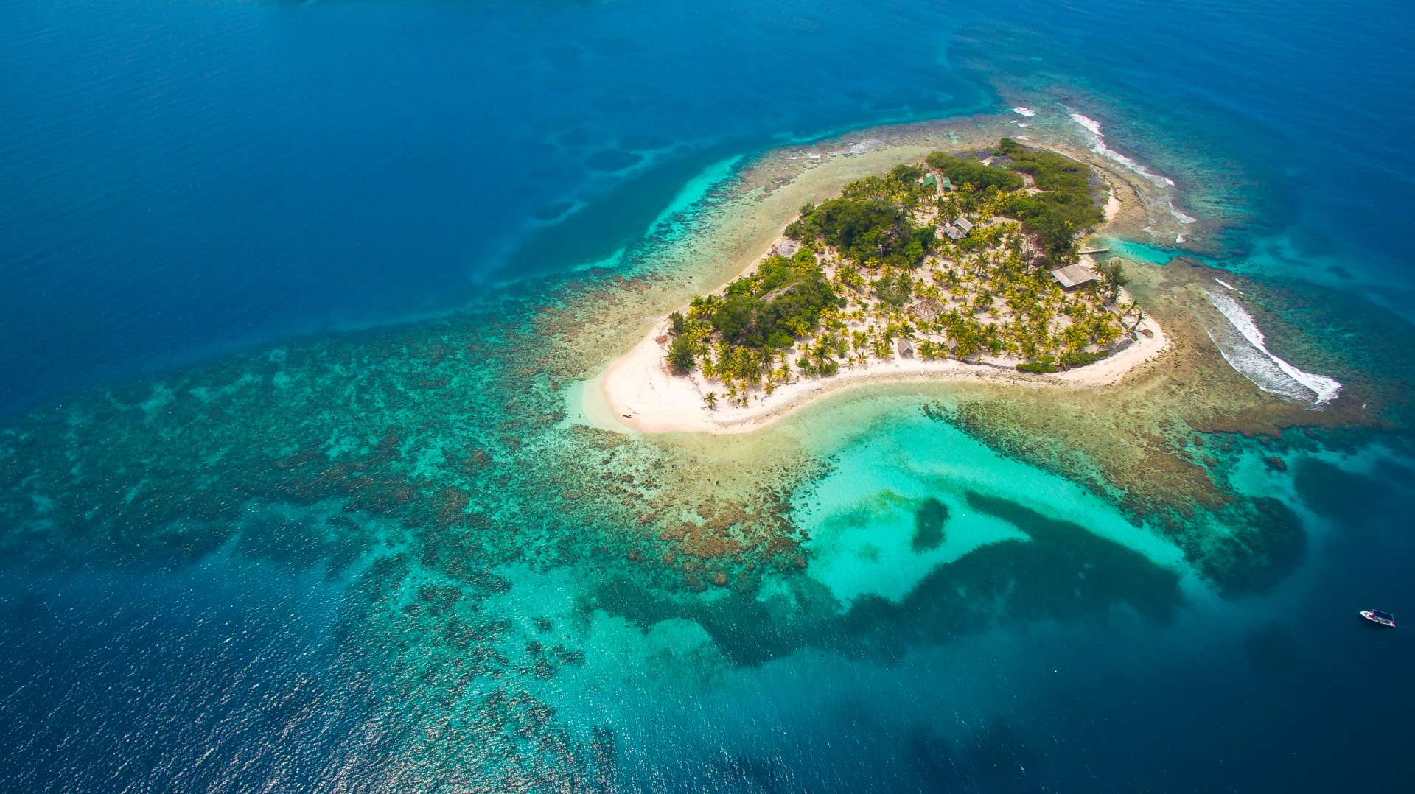
island

Slide 4
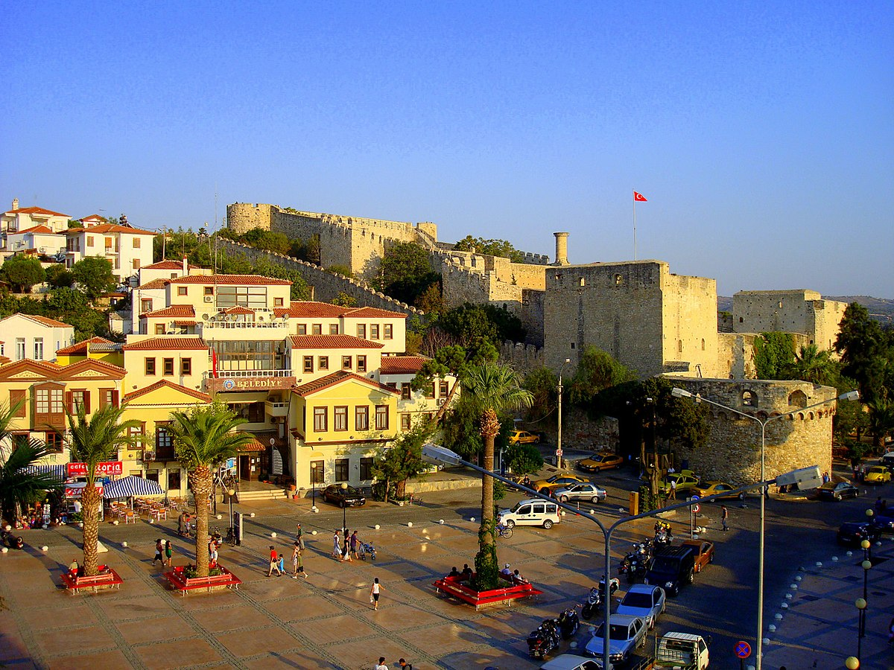
town

Slide 5
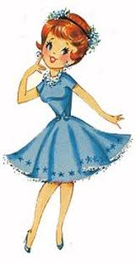
pretty

Slide 6

quiet

Slide 7
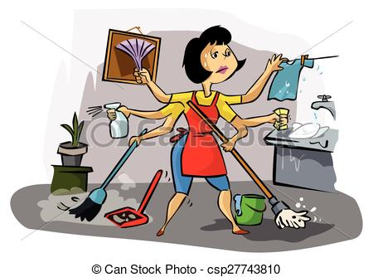
busy

Slide 8
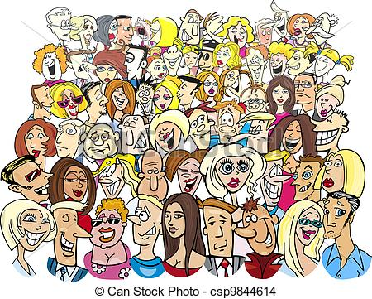
crowded

Slide 9
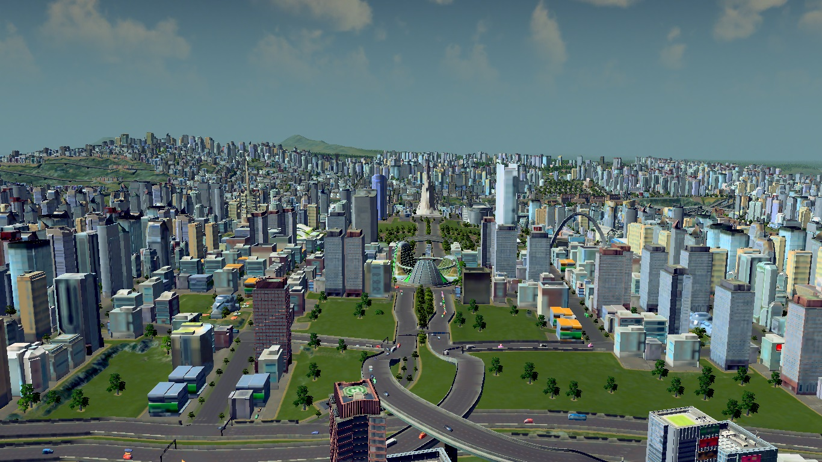
large

Slide 10
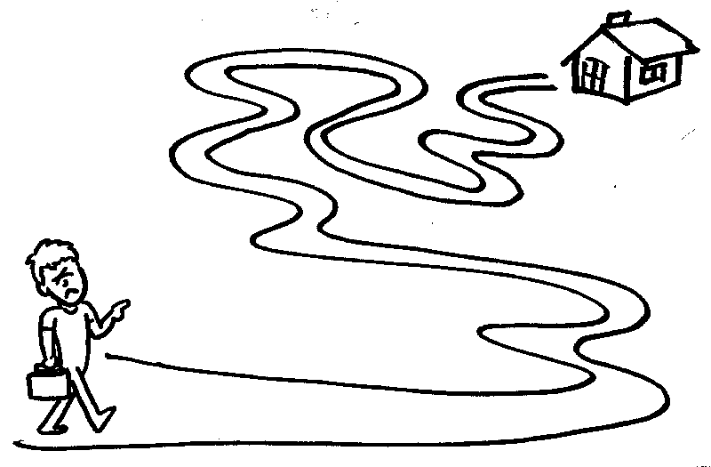
far

Slide 11
What’s the ____like?
It’s ____
city/big and busy

Slide 12
What’s the ____like?
It’s ____
village/far and quiet

Slide 13
What’s the ____like?
It’s ____
town/large and crowded

Slide 14
What’s the ____like?
It’s ____
island/small and pretty

Slide 15
What’s the ____like?
It’s ____
village/pretty and quite

Slide 16
What’s the ____like?
It’s ____
city/large and busy

Slide 17
What’s the ____like?
It’s ____
city/crowded and busy

Slide 18
What’s the ____like?
It’s ____
town/pretty and busy

Slide 19
What’s the ____like?
It’s ____
city/small and busy

Slide 20
What’s the ____like?
It’s ____
town/big and crowded

Slide 21
What’s the ____like?
It’s ____
city/big and busy

Slide 22
What’s the ____like?
It’s ____
town/small and busy

