Slide 1


Slide 2


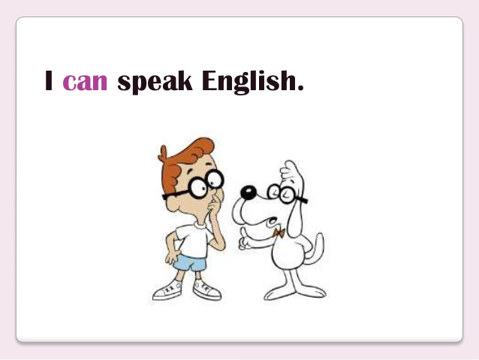

Slide 3

Monday, September 26th 2017 .
Unit 3 : Where did you go on holiday ?
Lesson 1 :

Slide 4
I/ New words :
-Holiday: ngày nghỉ, ngày lễ
Summer holiday : ngày nghỉ hè
Hoi An Ancient Town :Phố cổ Hội An
Hue Imperial City : Hoàng thành Huế
Phú Quốc Island : Đảo Phú Quốc
Do: làm – did :đã làm
go: đi – went :đã đi

Slide 5
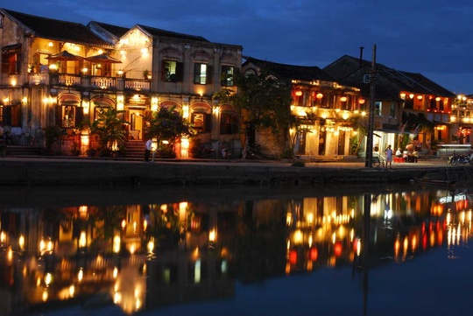
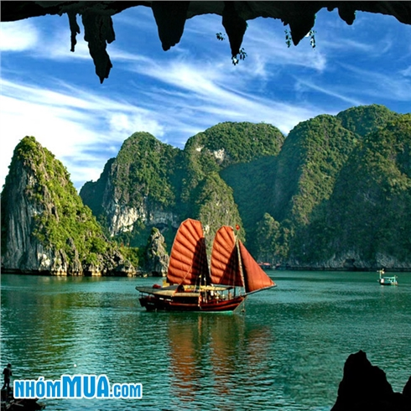
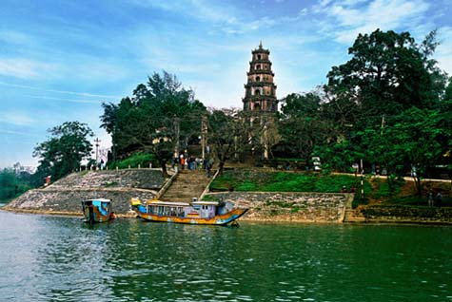
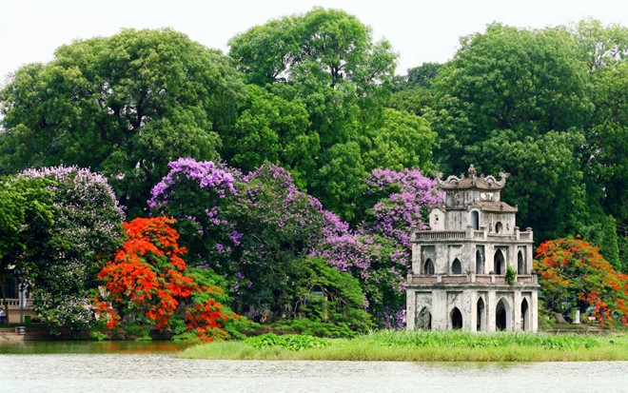
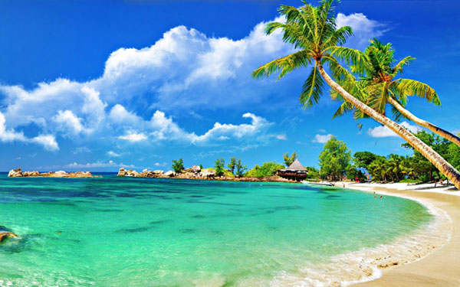
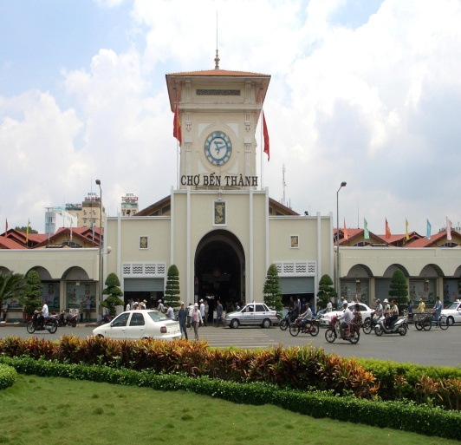
Hoi An Ancient Town
Ha Long Bay
Hue Imperial City
Game : guessing
Phu Quoc Island
Ben Thanh Market
Hoan Kiem Lake

Slide 6
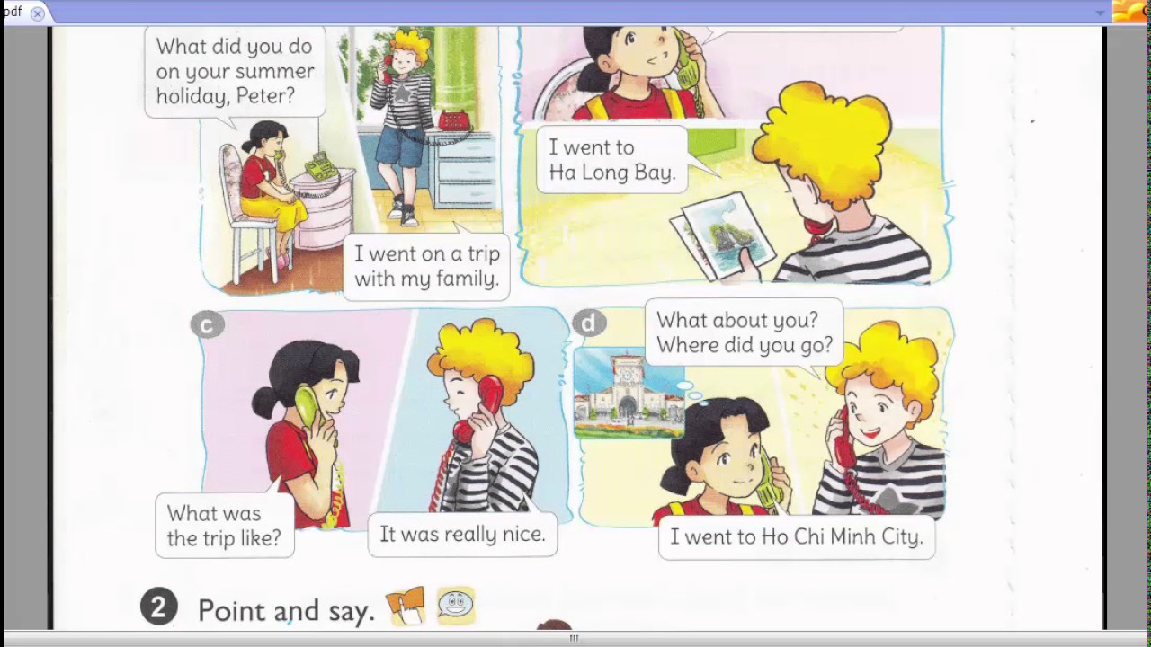

Where did you go

Slide 7
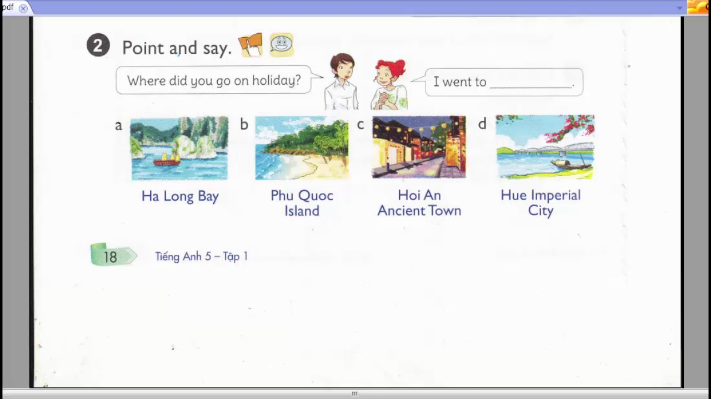
Ha Long Bay

Slide 8
3/ Let’s tall .
Ask and answer question about your holidays .
Where were you on holiday ?
I was …...……
Where did you go ?
I went to ……..
What were the trip like ?
It was ……

Slide 9
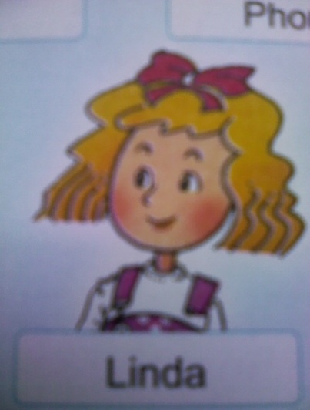
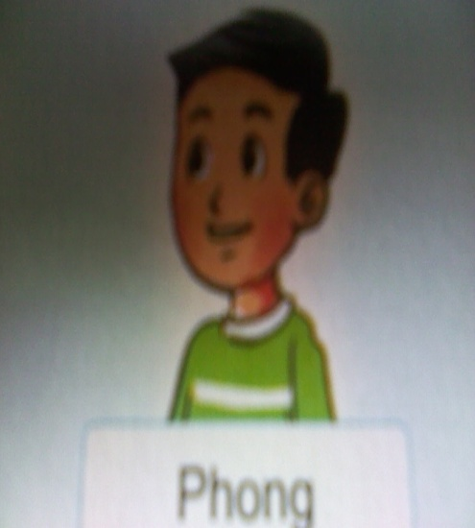
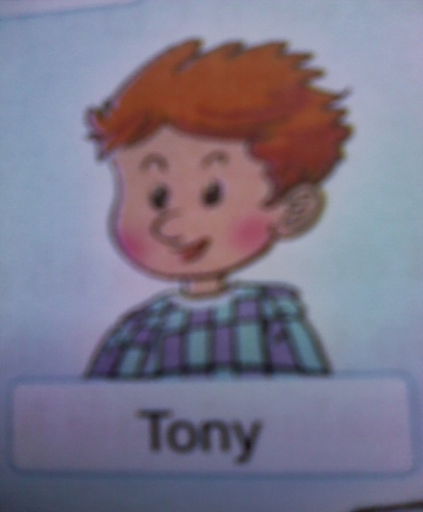
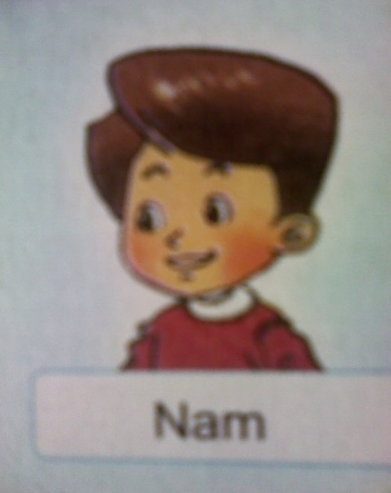

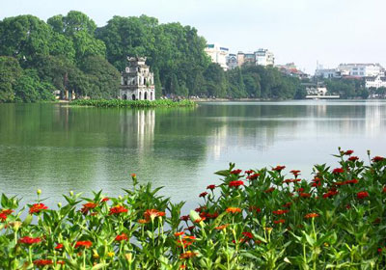
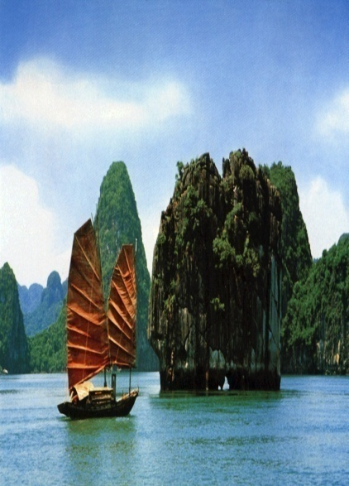
4/ Listen and match :
1. 2. 3. 4.
Quan
A ) B) C ) D )

Slide 10
5/ Read and match :
1. Where were you last summer ?
2. Where did you go ?
3. What did you do ?
4. What was the trip like ?
5. What’s that?
a. I took a boat trip .
b. It’s a photo of my trip.
c.I was at the seaside .
d. I went to Phu Quoc Island .
e. It was great

