Slide 1
Unit 5
CAN YOU SWIM?
Lesson 2

Slide 2
VOCABULARY

Slide 3
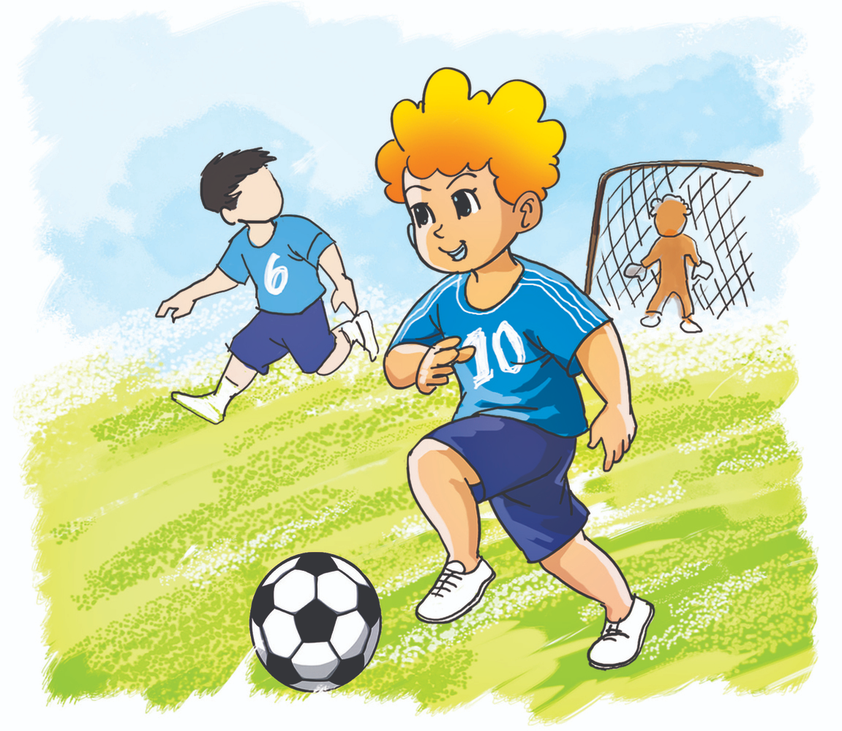
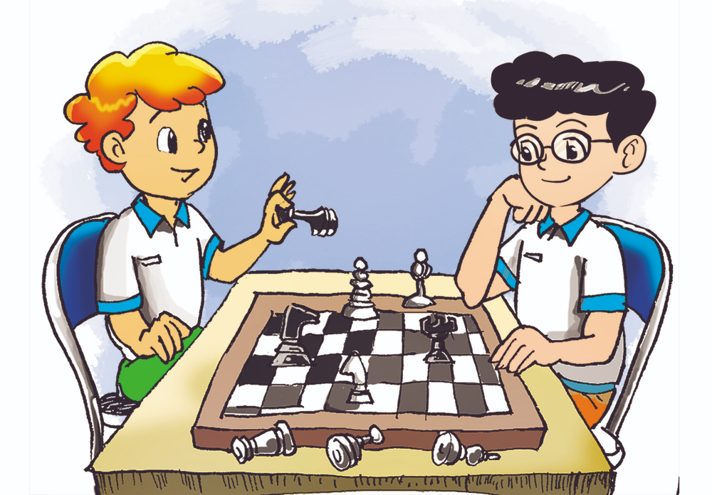
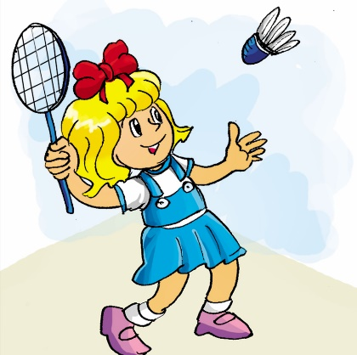
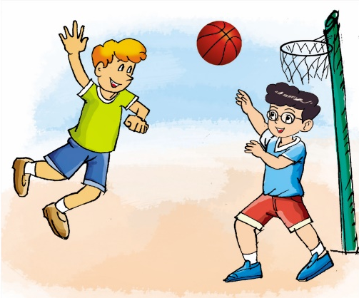
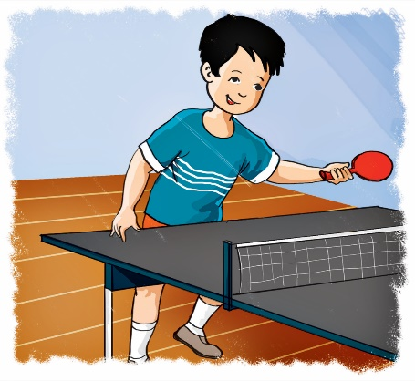
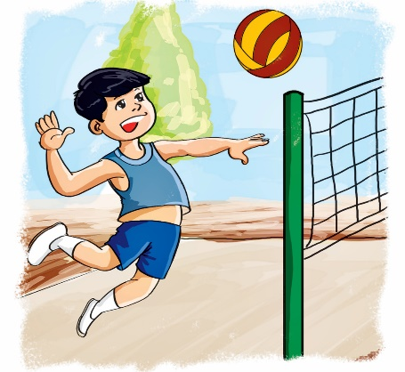
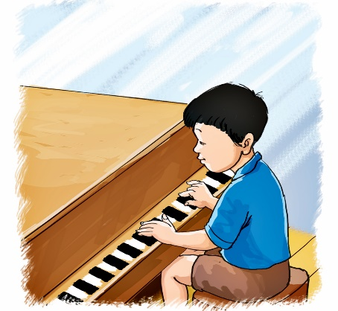
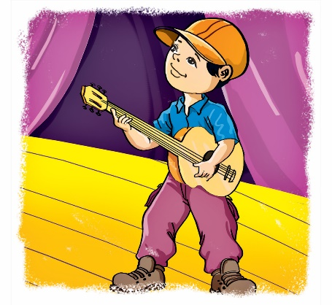
Vocabulary
play
football
play
badminton
play
basketball
play chess
play
table tennis
play
volleyball
play
the piano
play
the guitar

Slide 4
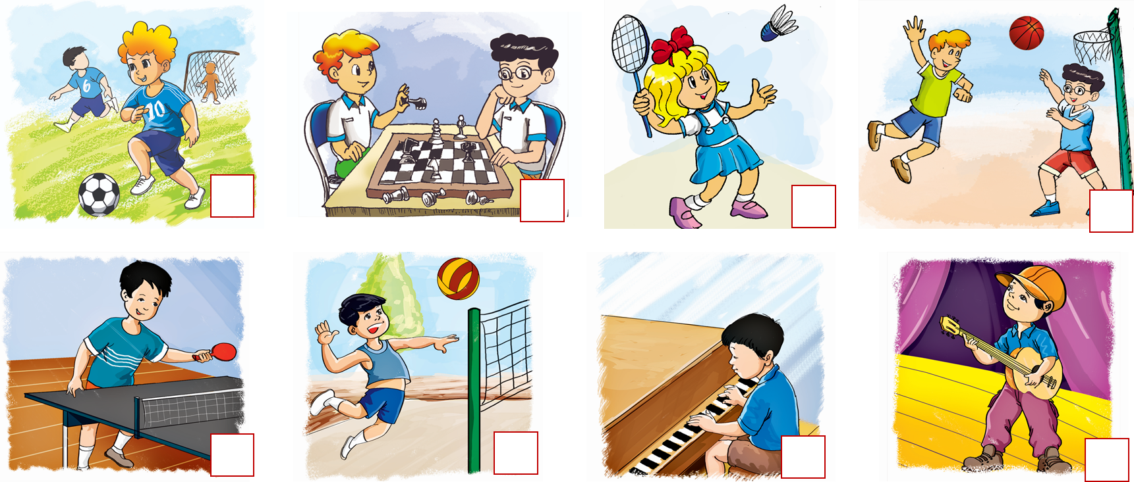

Look and tick the correct picture:
play chess

Slide 5
Look and tick the correct picture:
play the piano

Slide 6
Look and tick the correct picture:
play basketball

Slide 7
Look and tick the correct picture:
play badminton

Slide 8
Look and tick the correct picture:
play football
play
football
play
badminton
play
basketball
play chess
play
table tennis
play
volleyball
play
the piano
play
the guitar

Slide 9
Look and tick the correct picture:
play volleyball

Slide 10
Look and tick the correct picture:
play the guitar

Slide 11
Look and tick the correct picture:
play table tennis

Slide 12
GRAMMAR

Slide 13
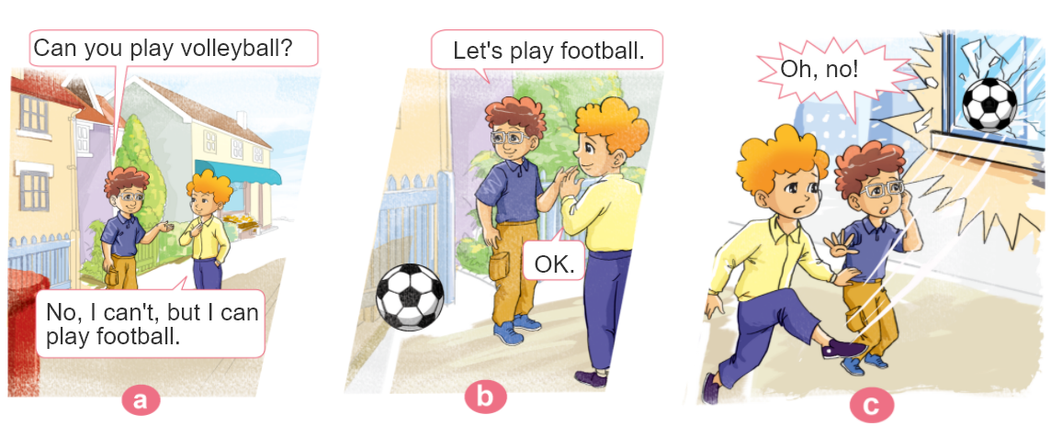

1. Look, listen and repeat.

Slide 14




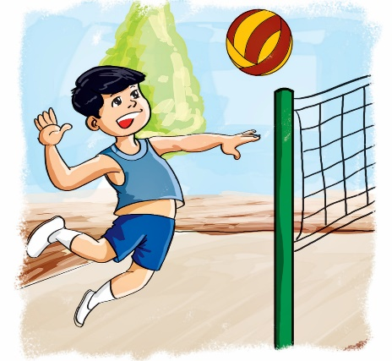



2. Point and say
Can you ________?
play table tennis
play the guitar
Yes, I can.
play volleyball
No, I can’t.
play the piano
Yes, I can.
No, I can’t.

Slide 15
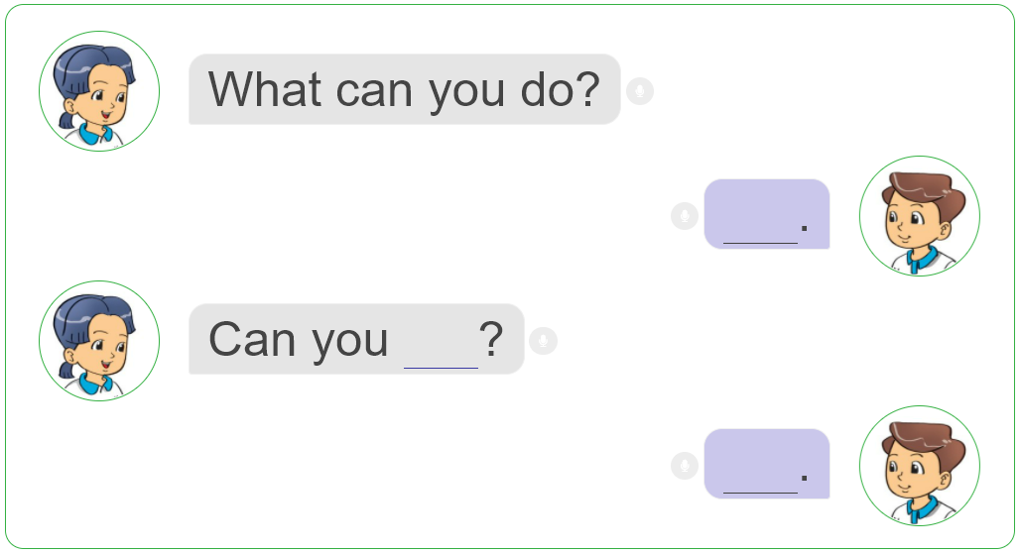
3. Let’s talk
I can ____________.
Yes, I do.
No, I don’t.

Slide 16
Structures:
Hỏi – đáp ai đó có thể làm gì hay không
Can you ________?
+ V
Bạn có thể _____ không?
Yes, I can.
(Tớ có)
No, I can’t.
(Không, tớ không thể)
Thay you bằng She /he / they để hỏi:
Cô ấy/anh ấy/họ có thể làm gì hay không.

Slide 17
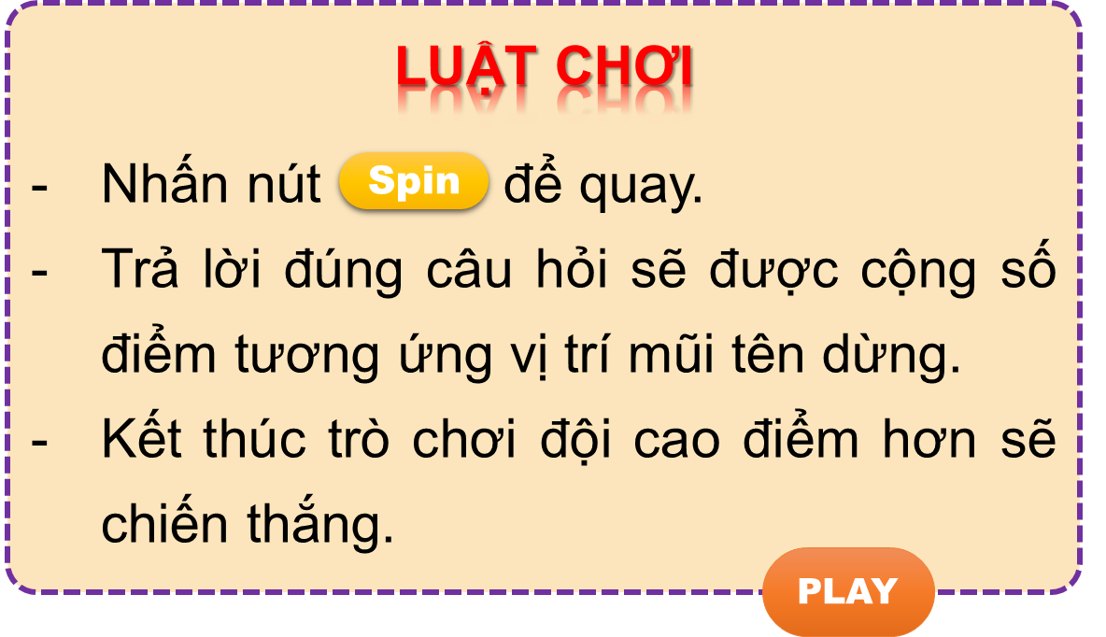

Vòng quay kì diệu
50
10
20
30
10
20
30
40
Spin
PLAY
LUẬT CHƠI
Nhấn nút để quay.
Trả lời đúng câu hỏi sẽ được cộng số điểm tương ứng vị trí mũi tên dừng.
Kết thúc trò chơi đội cao điểm hơn sẽ chiến thắng.
Spin
Notes:
Ms Huyền Phạm - 0936.082.789 – YOUTUBE: MsPham. Facebook: Dạy và học cùng công nghệ.

Slide 18
Can they play basketball?
50
10
20
30
10
20
30
40
Yes, they can.
Xem đáp án
Spin
Notes:
Ms Huyền Phạm - 0936.082.789 – YOUTUBE: MsPham. Facebook: Dạy và học cùng công nghệ.

Slide 19
Can you play the guitar?
50
10
20
30
10
20
30
04
No, I can’t.
Xem đáp án
Spin
Notes:
Ms Huyền Phạm - 0936.082.789 – YOUTUBE: MsPham. Facebook: Dạy và học cùng công nghệ.

Slide 20
50
Can you play volleyball?
10
20
30
10
20
30
04
No, I can’t.
Xem đáp án
Spin
Notes:
Ms Huyền Phạm - 0936.082.789 – YOUTUBE: MsPham. Facebook: Dạy và học cùng công nghệ.

Slide 21

50
Can he play table tennis?
10
20
30
10
20
30
40
Yes, he can.
Xem đáp án
Spin
Notes:
Ms Huyền Phạm - 0936.082.789 – YOUTUBE: MsPham. Facebook: Dạy và học cùng công nghệ.

Slide 22
Can he play the piano?
50
10
20
30
10
20
30
40
No, he can’t.
Xem đáp án
Spin
Notes:
Ms Huyền Phạm - 0936.082.789 – YOUTUBE: MsPham. Facebook: Dạy và học cùng công nghệ.

Slide 23
50
Can she play tennis?
10
20
30
10
20
30
40
Yes, she can.
Xem đáp án
Spin
Notes:
Ms Huyền Phạm - 0936.082.789 – YOUTUBE: MsPham. Facebook: Dạy và học cùng công nghệ.

Slide 24
50
10
Can they play chess?
20
30
10
20
30
40
No, they can’t.
Xem đáp án
Spin
Notes:
Ms Huyền Phạm - 0936.082.789 – YOUTUBE: MsPham. Facebook: Dạy và học cùng công nghệ.

Slide 25



50
10
20
30
10
20
30
40
EXIT
Notes:
Ms Huyền Phạm - 0936.082.789 – YOUTUBE: MsPham. Facebook: Dạy và học cùng công nghệ.

Slide 26
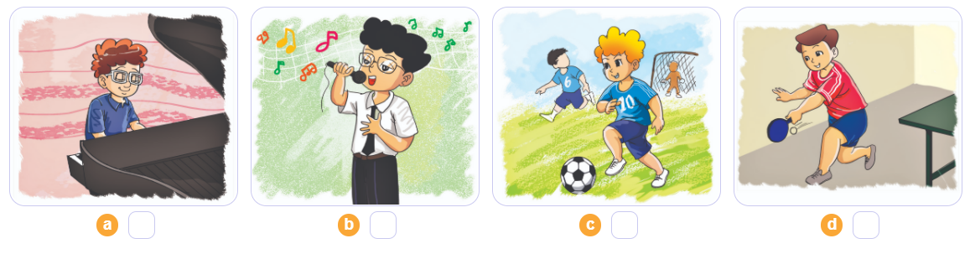
4. Listen and number.
2
4
3
1
1
2
3
4

Slide 27
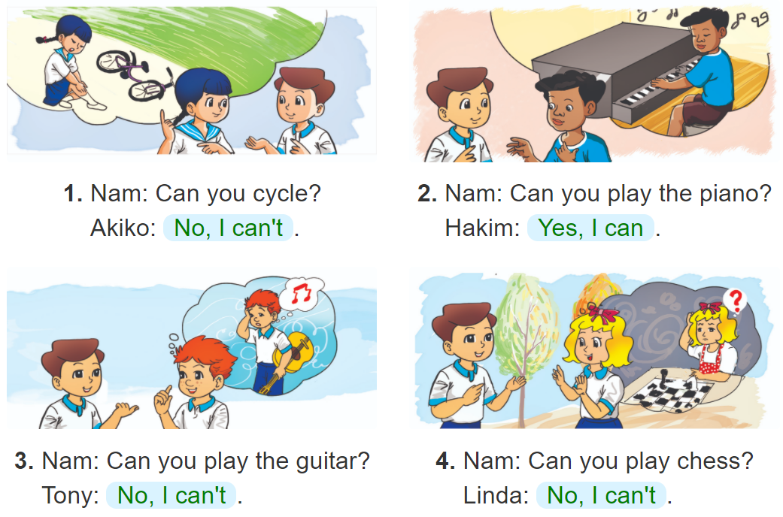
5. Read and write.
__________.
__________.
__________.
__________.

Slide 28
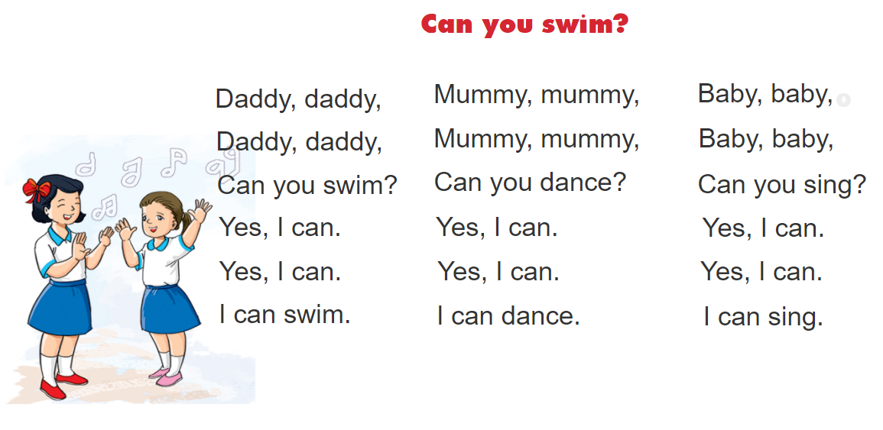


6. Let’s sing.

