Slide 1
Check the last words

Slide 2
Friday, 27th January 2023
Unit 11: What’s the matter with you?
Lesson 2

Slide 3
New words

Slide 4
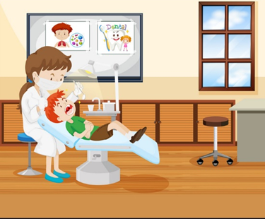

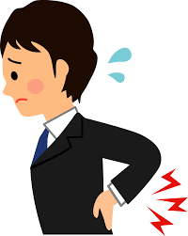
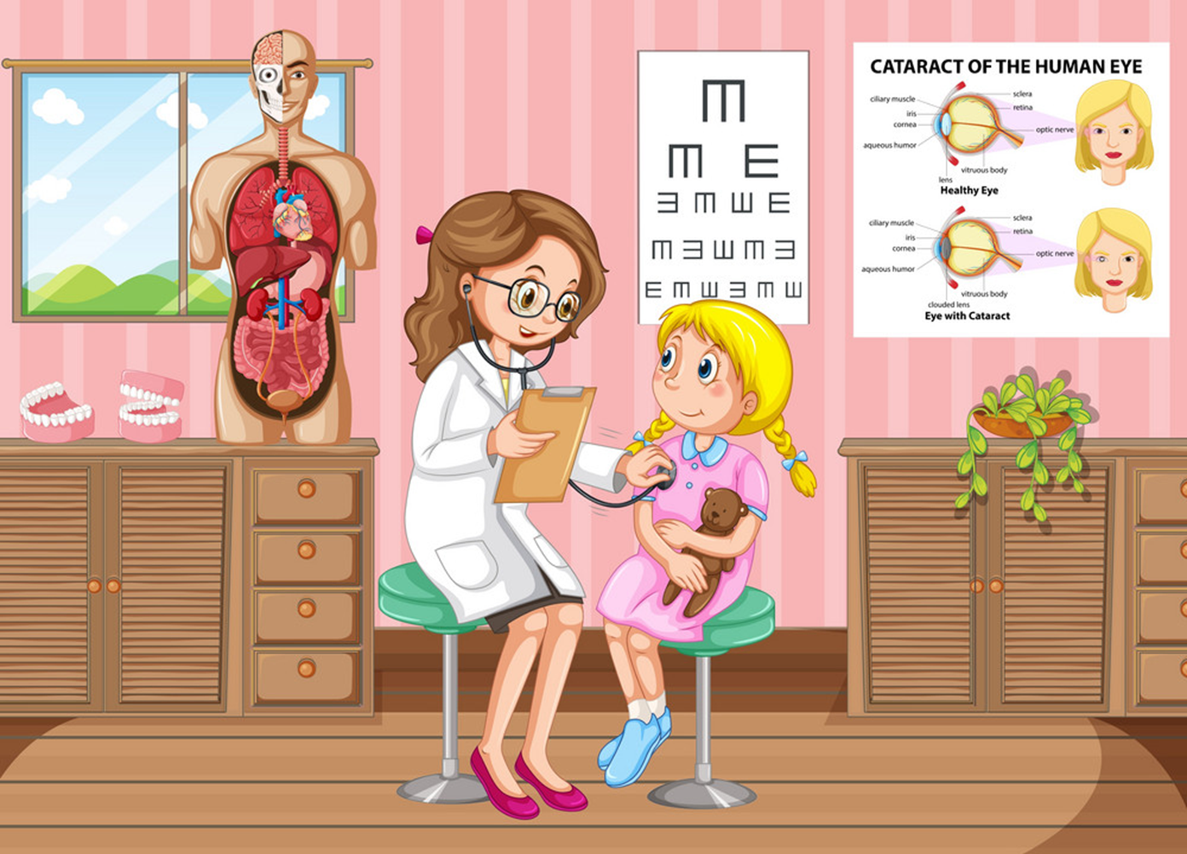
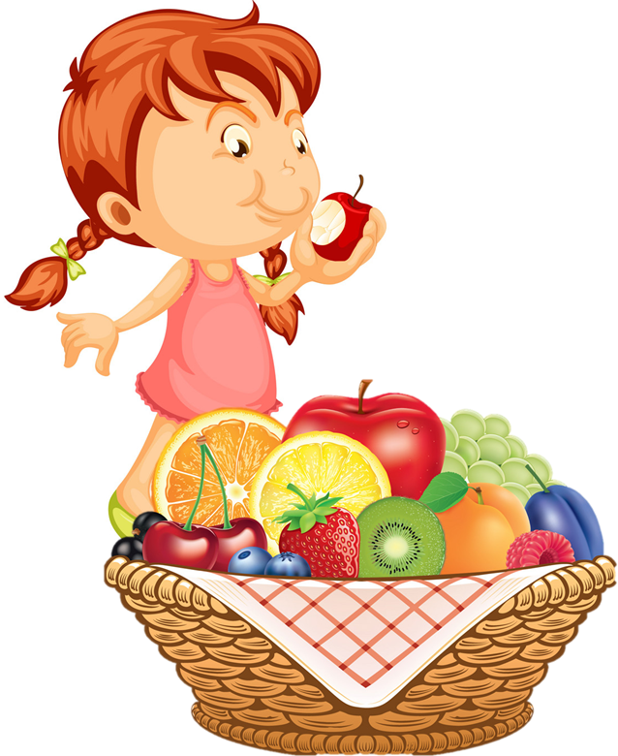
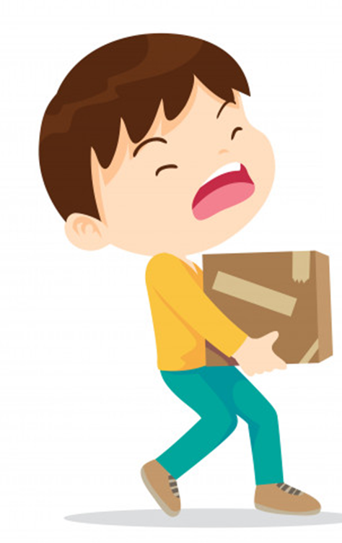
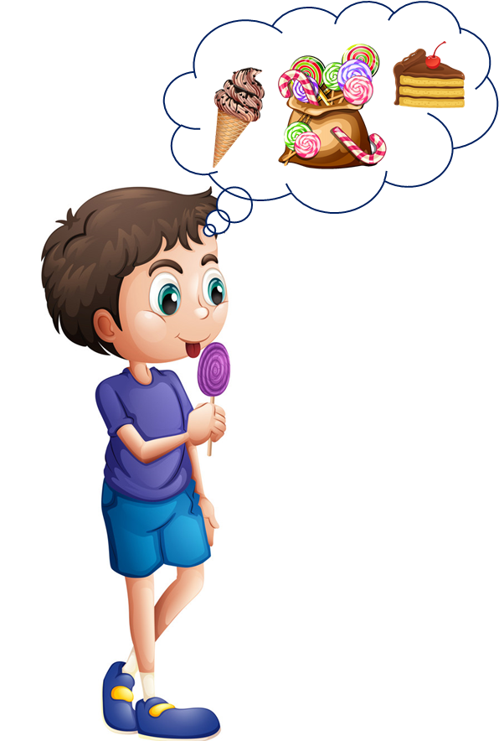
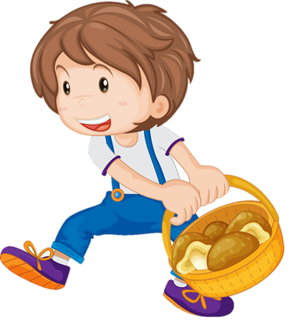
1, a backache
2, go to the doctor
3, go to the dentist
4, take a rest
5, eat a lot of fruit
6, carry heavy things
7, eat a lot of sweets

Slide 5
I.New words
1, a backache: đau lưng
2, go to the doctor: đi gặp bác sĩ
3, go to the dentist: đi gặp bác sĩ nha khoa
4, take a rest: nghỉ ngơi
5, eat a lot of fruit: ăn nhiều hoa quả
6, carry heavy things: mang vác những vật nặng
7, eat a lot of sweets: ăn nhiều đồ ngọt

Slide 6
Model sentences

Slide 7
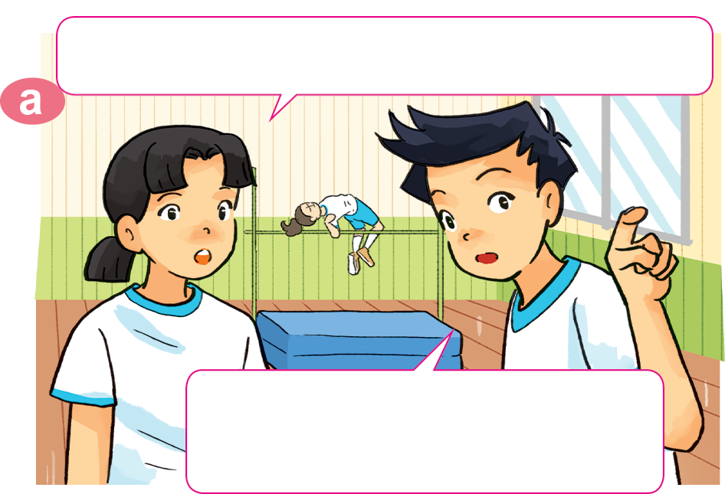
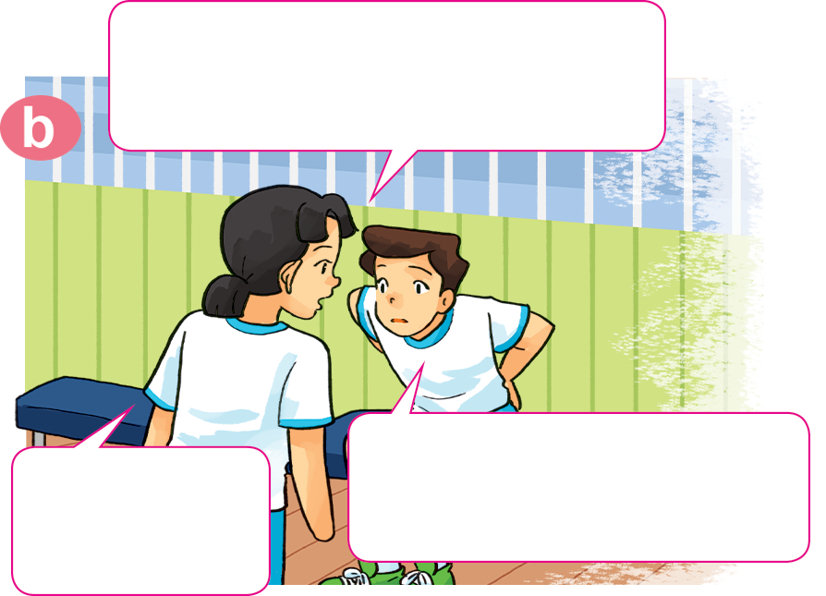

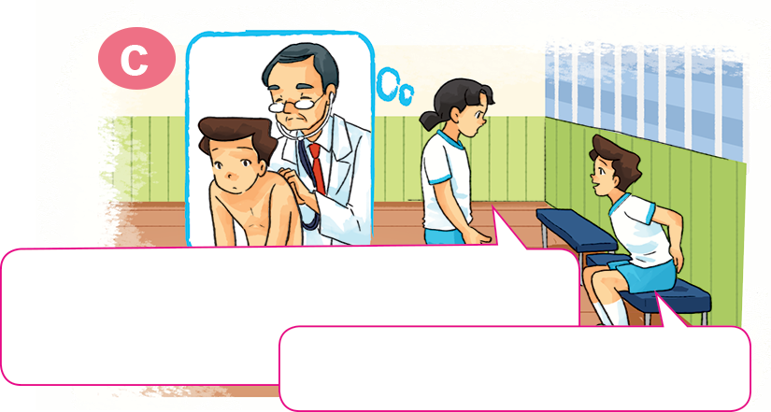
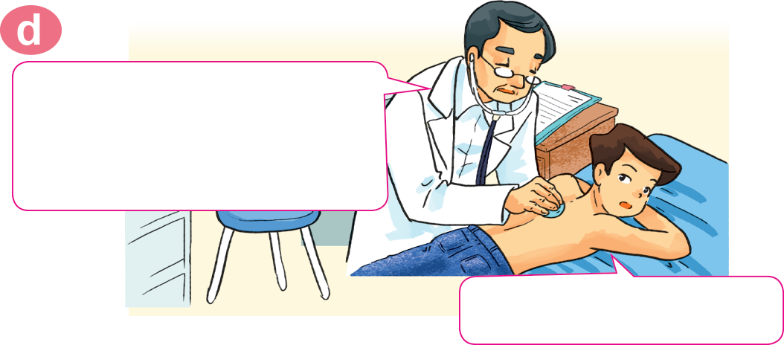
1. Look, listen and repeat.
Where's Nam? I can't see him here.
Hi, Nam. Why aren't you
practising karate?
I don't feel well.
I have a backache.
He's sitting over there,
in the corner of the gym.
Sorry to
hear that.
You should take a rest and shouldn't play
sports for a few days.
You should go to the doctor
now, Nam.
OK, I will. Thanks, Mai.
Thank you, doctor.

Slide 8
II. Model sentences
1, You should go to the doctor.
Yes, I will. Thanks.
2, You shouldn’t play sports for a few days.
OK, I won’t. Thanks.

Slide 9
2. Point and say.
go to the doctor
go to the dentist
You should ____________.
You should ________________.
Yes, I will. Thanks.
Yes, I will. Thanks.

Slide 10

2. Point and say.
take a rest
eat a lot of fruit
You should ______________.
You should ______________.
Yes, I will. Thanks.
Yes, I will. Thanks.

Slide 11
2. Point and say.
carry heavy things
eat a lot of sweets
You shouldn’t ______________.
You shouldn’t ________________.
Ok, I won’t. Thanks.
Ok, I won’t. Thanks.

Slide 12

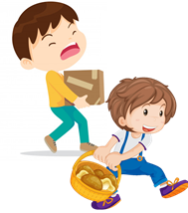
Temperature
/ˈtemprətʃər/
You should/shouldn’t _____________.
Yes, I will. Thanks.
OK, I won't. Thanks
go to the
doctor
take a rest
carry
heavy things
eat a lot of
sweets
go to the
dentist
eat a lot
of fruit
Earache
/ˈɪəreɪk/

Slide 13




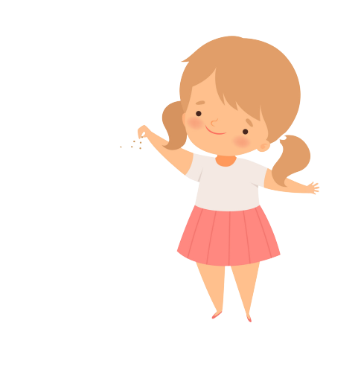

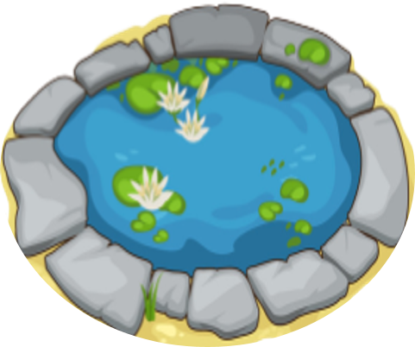
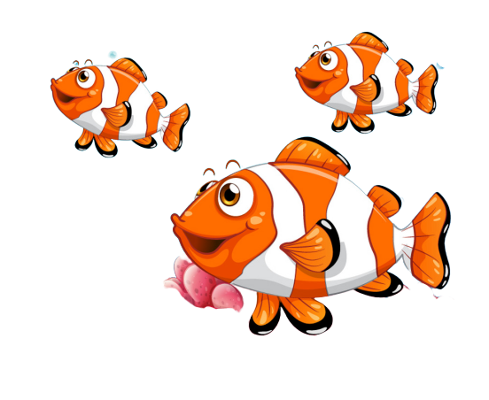
Bống bống bang bang
Mỗi câu trả lời đúng là
CÂU THẦN CHÚ giúp cá Vàng
ngoi lên mặt nước nhận thức ăn.
Nào chúng mình cùng giúp
bạn nhỏ cho cá Vàng ăn nhé!
START

Slide 14

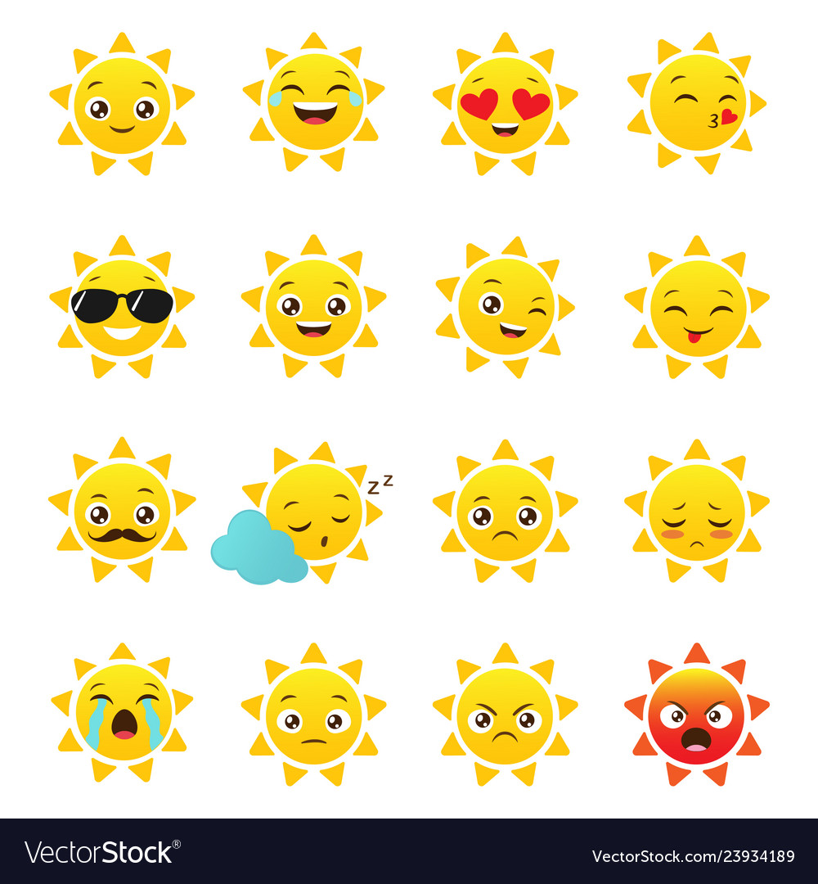
I have a toothache.
You _____ go to the dentist.
Next
Should
Shouldn’t
Sai
Notes:
YOUTUBE: MsPham.
Facebook: Dạy và học cùng công nghệ.

Slide 15
I have a backacke.
You _____ carry heavy things.
Next
Should
Shouldn’t
Sai

Slide 16
I have a toothache.
You _____ eat a lot of sweet.
Next
Should
Shouldn’t
Sai

Slide 17
I have a stomch ache.
You _____ go to the doctor.
Next
Should
Shouldn’t
Sai
Notes:
YOUTUBE: MsPham.
Facebook: Dạy và học cùng công nghệ.

Slide 18
I have a stomach ache.
You _____ eat a lot of sweet.
Next
Should
Shouldn’t
Sai

Slide 19
I have a fever.
You _____ go to school.
Next
Should
Shouldn’t
Sai
Notes:
YOUTUBE: MsPham.
Facebook: Dạy và học cùng công nghệ.

Slide 20
I have a flu.
You _____ take a rest.
Next
Should
Shouldn’t
Sai
Notes:
YOUTUBE: MsPham.
Facebook: Dạy và học cùng công nghệ.

Slide 21
Next
I have a flu.
You should
go to school
You should
take a rest
You should
go to the dentist
Notes:
YOUTUBE: MsPham.
Facebook: Dạy và học cùng công nghệ.

Slide 22
Next
I have a sore throat.
You should carry heavy things.
You shouldn’t
take a rest
You should
take a rest
Notes:
YOUTUBE: MsPham.
Facebook: Dạy và học cùng công nghệ.

Slide 23
Next
I have a backache.
You shouldn’t
carry heavy things.
You should
carry heavy things.
You shouldn’t
take a rest
Notes:
YOUTUBE: MsPham.
Facebook: Dạy và học cùng công nghệ.

Slide 24
Next
I have a toothache.
You shouldn’t
eat a lot of fruit.
You shouldn’t eat
a lot of sweet.
You should eat
a lot of sweet.
Notes:
YOUTUBE: MsPham.
Facebook: Dạy và học cùng công nghệ.

Slide 25
Next
You should
eat a lot of fruit.
I have an apple.
I have a pen.
I have a flu.
Notes:
YOUTUBE: MsPham.
Facebook: Dạy và học cùng công nghệ.

Slide 26
THANK YOU!
Next
Notes:
YOUTUBE: MsPham.
Facebook: Dạy và học cùng công nghệ.

Slide 27
III.Homework
1, Learn by heart the new words and the model sentences.
2, Do exercise in the workbook.
3, Prepare the next lesson.

