Slide 1

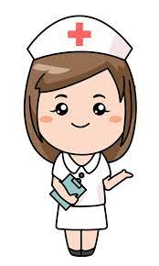
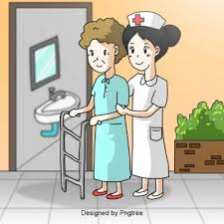
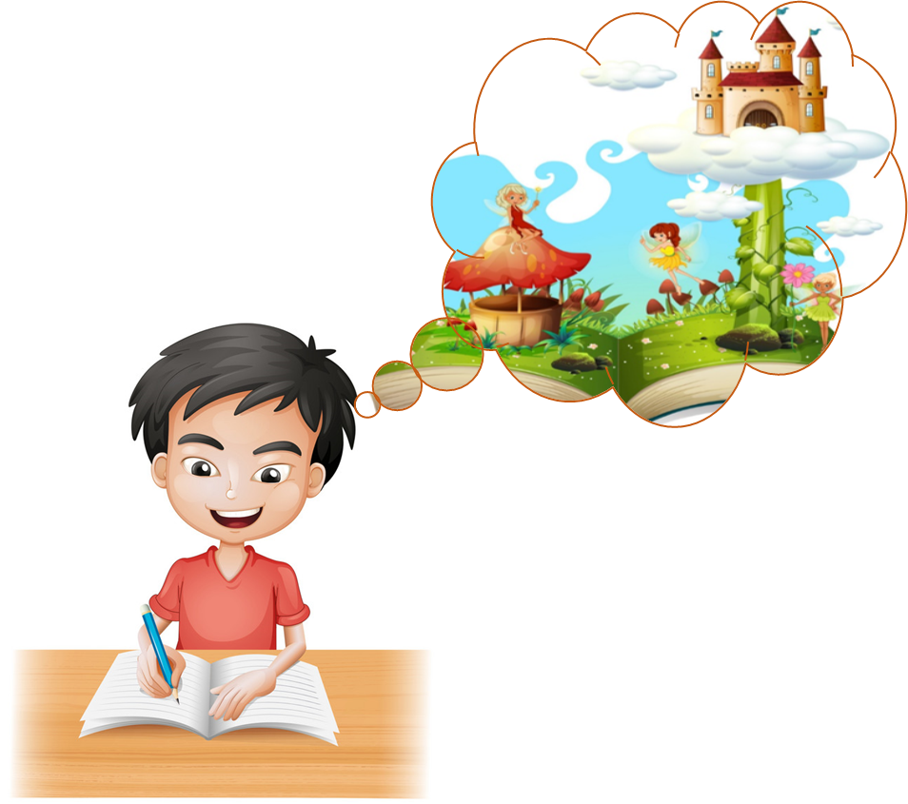
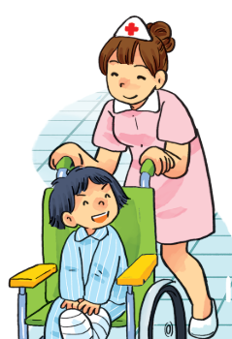

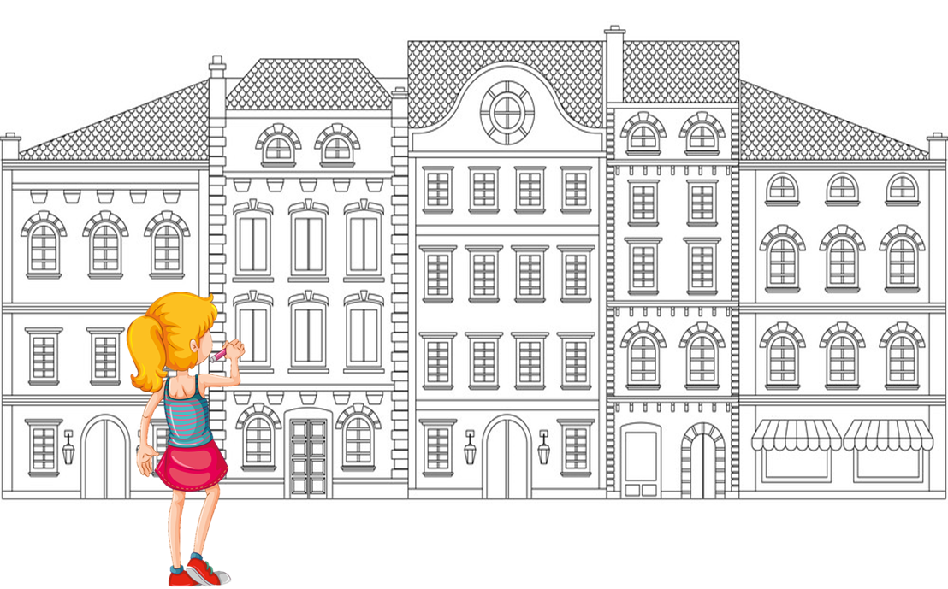
CHECK THE LAST WORDS
1, nurse
2, look after patients
3, write stories for children
4, fly a plane
5, design buildings

Slide 2
Tuesday, 14th March 2023
Unit 15 What would you like to be in the future?
LESSON 3

Slide 3

1. Listen and repeat
1, What would you like to be in the future? ↷ I'd like to be a nurse. ↷
2, Why would you like to be a nurse? ↷ Because I'd like to look after patients. ↷

Slide 4
2. Listen and mark the sentence intonation (↷)
A: What would he like to be in the future?
B: He'd like to be a teacher.
A: Where would he like to work?
B: He'd like to work in a school.
A: Why would he like to be a teacher?
B: Because he'd like to teach young children.
1
↷
↷
↷
2
↷
↷
3
↷

Slide 5
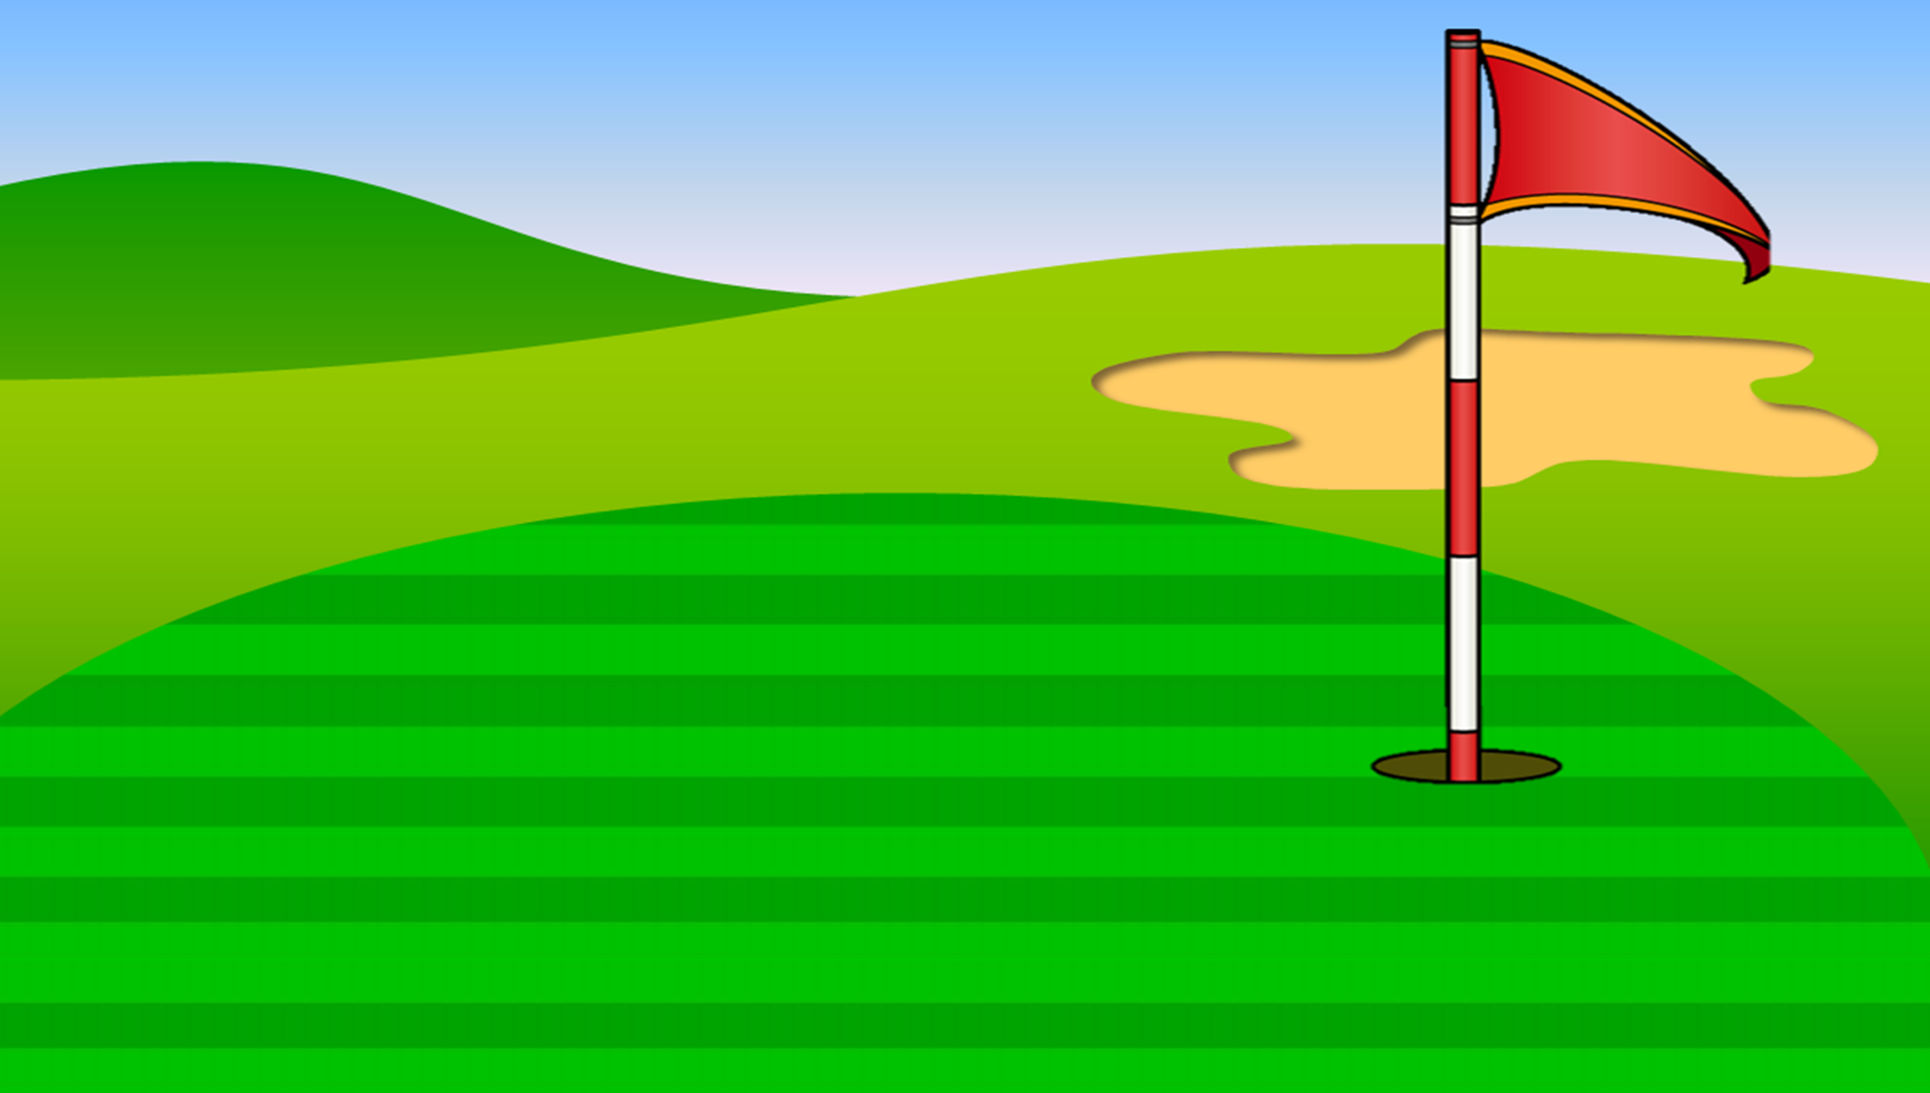
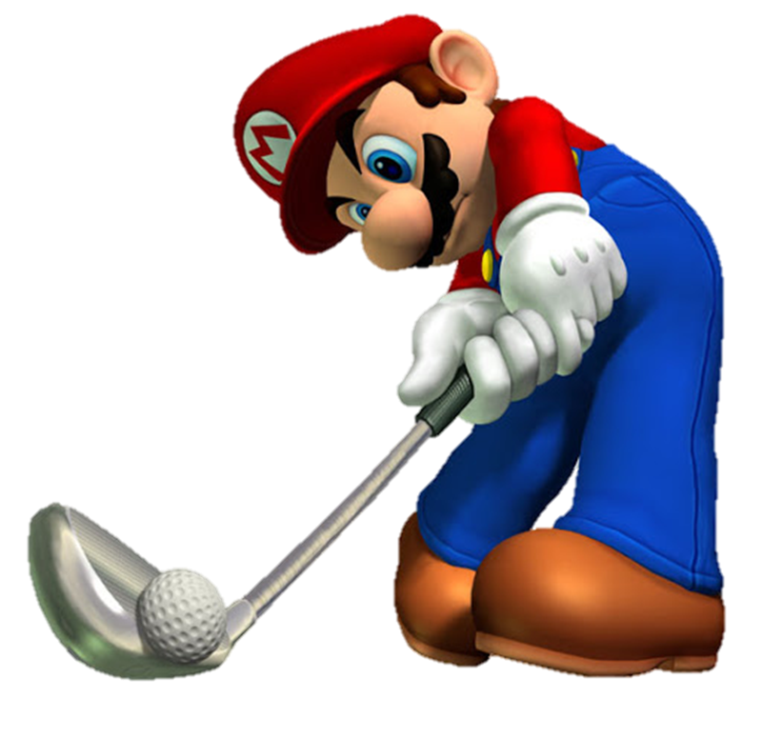
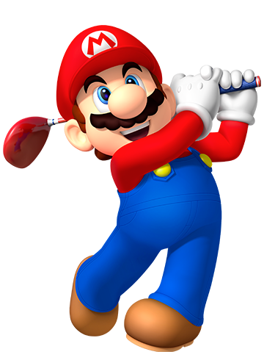
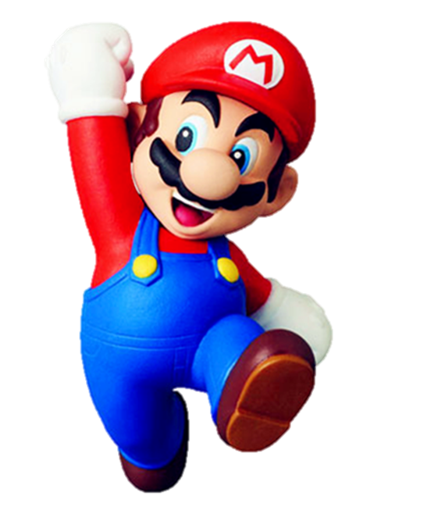


Mario
PLAYING GOLF

Slide 6


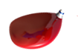


___ would you like to be in the future?
- I'd like to be a nurse.
Why
What
Where

Slide 7
What would you like to be in the future?
- ____ to be a teacher.
I'd like
I'd
I like

Slide 8
What would you like to be in the future?
- I’d like to be ___ architect.
a
an
the

Slide 9
What _____ you like to be in the future?
- I’d like to be a pilot.
would
should
do

Slide 10
What would he like to be in the future?
- ___ like to be a writer.
He’d
She’d
I’d

Slide 11
What would _____ like to be in the future?
- She’d like to be a doctor.
your sister
your brother
you

Slide 12
Why would you like to be a nurse?
- ________ I'd like to look after patients.
And
Because
But

Slide 13
______ would you like to be a writer?
- Because I'd like to write stories for children.
What
Why
How

Slide 14
Why __________ to be a pilot?
- Because I'd like to fly a plane.
would you like
do you like
are you like

Slide 15
Why would you like to be an architect?
- Because I'd like to _______.
design building
fly a plane
draw picture

Slide 16
WELLDONE!

Slide 17
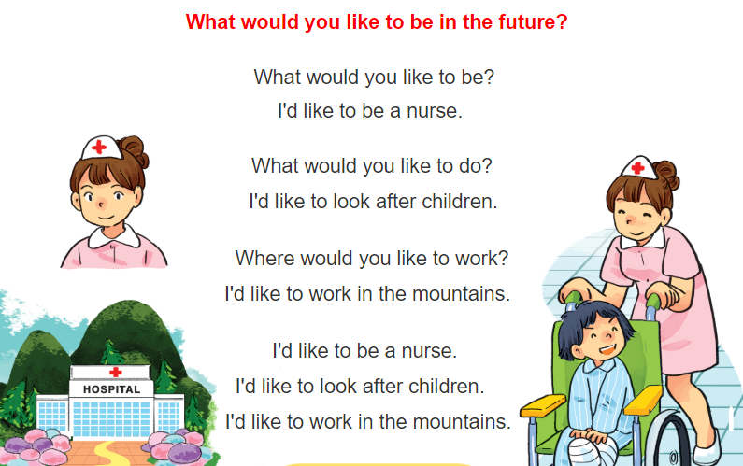


3. Let’s chant

Slide 18
4. Read and tick True (T) or False (F).
My name is David. I'd like to be an astronaut in the future. I'd like to fly in space and work with other people in a spaceship. It's important work and very exciting. I'd like to get out of the spaceship and walk in space. I'd also like to visit other planets. I'm studying hard at school. I hope my dream will come true one day.
 | T | F
1. David would like to be an astronaut.
2. He would like to work with other people.
3. He would like to travel around the world.
4. He would like to walk in space.
5. He would like to visit other planets.
✓
✓
✓
✓
✓

Slide 19
5. Write about what you would like to be and do in the future.
My name is _______________.
I'm studying at _______________.
I'd like to be _______________ in the future.
I'd like to _______________.
In my free time, I'd like _______________.

Slide 20
Homework
1, Practice reading part 1.
2, Do exercise in the student book and the workbook.

