Slide 1




Unit 13
MY HOUSE
LESSON 2.1

Slide 2
01
WARM UP

Slide 3


Slide 4
02
NEW WORDS

Slide 5
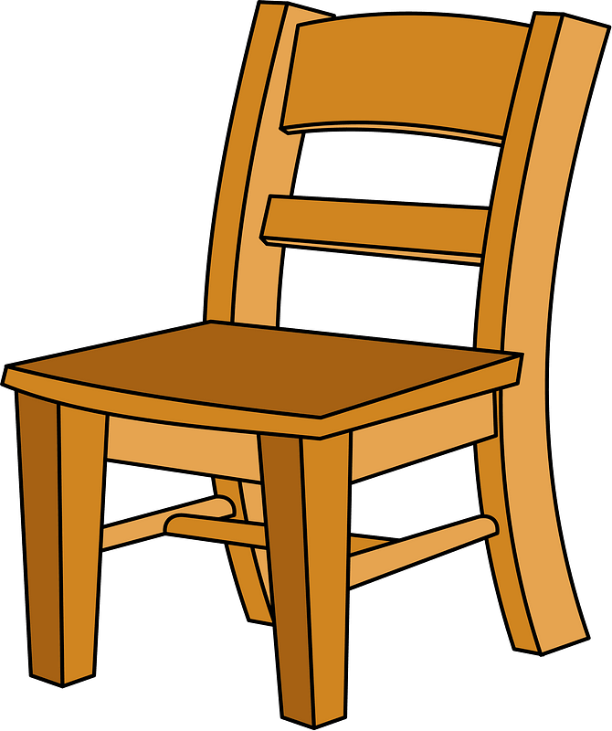

chair

Slide 6
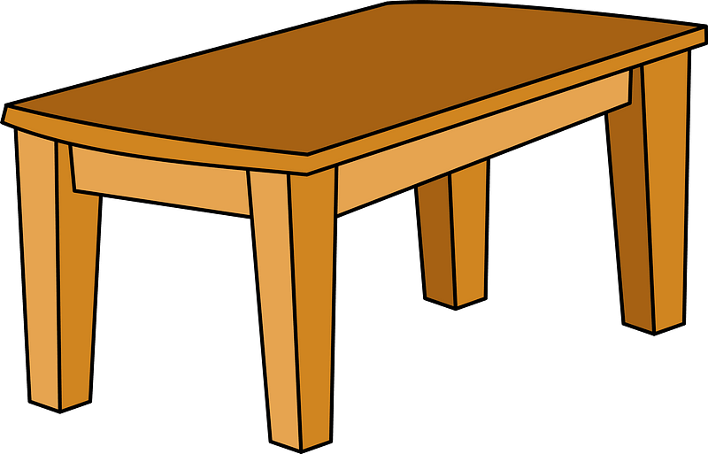
table

Slide 7

lamp

Slide 8
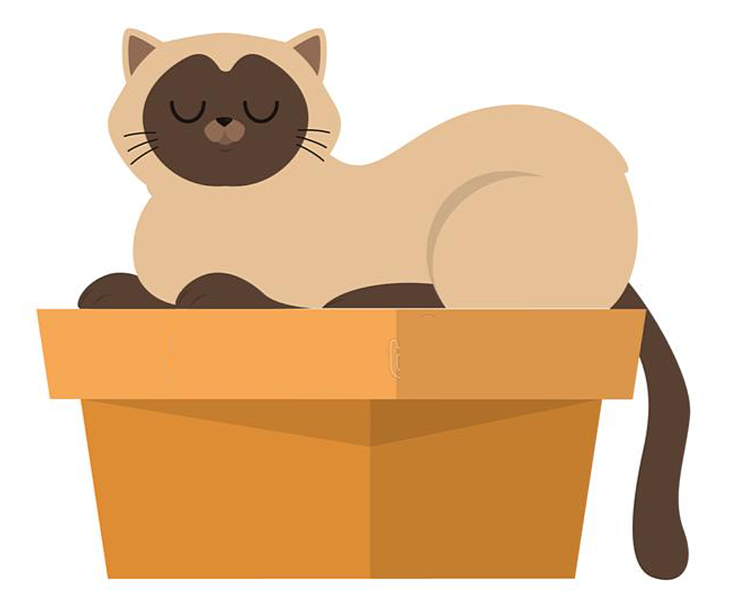
on

Slide 9

in

Slide 10

Quiz

Slide 11
Look and choose
A. table
C. chair
Well done!
B. house

Slide 12
FIND THE MISSING LETTER
l_m_
S-U
A-P
U-B
Well done!

Slide 13
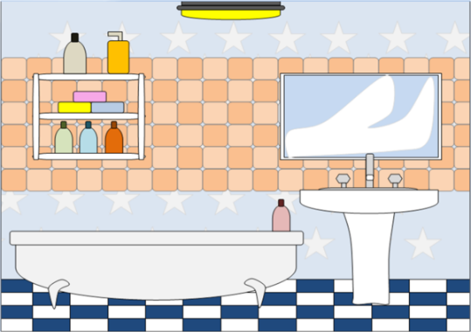

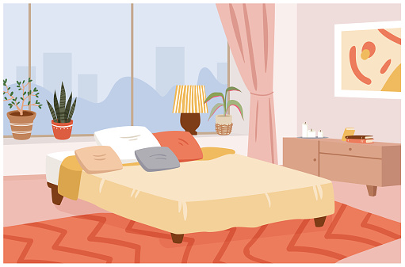
LOOK AND CHOOSE
bedroom
Well done!

Slide 14
Listen and choose
Where're the chairs?
Where's the kitchen?
Well done!
Where's the table?

Slide 15
LISTEN AND CHOOSE
in the bedroom
A
B
C
Well done!

Slide 16
LISTEN AND CHOOSE
lamp
Well done!

Slide 17
O-M-O-R * N-G-I-L-I-V
bedroom
bathroom
living room
Well done!

Slide 18


Slide 19
03
SENTENCE

Slide 20




Where are the+ Noun?
They're in the+ Noun

Slide 21
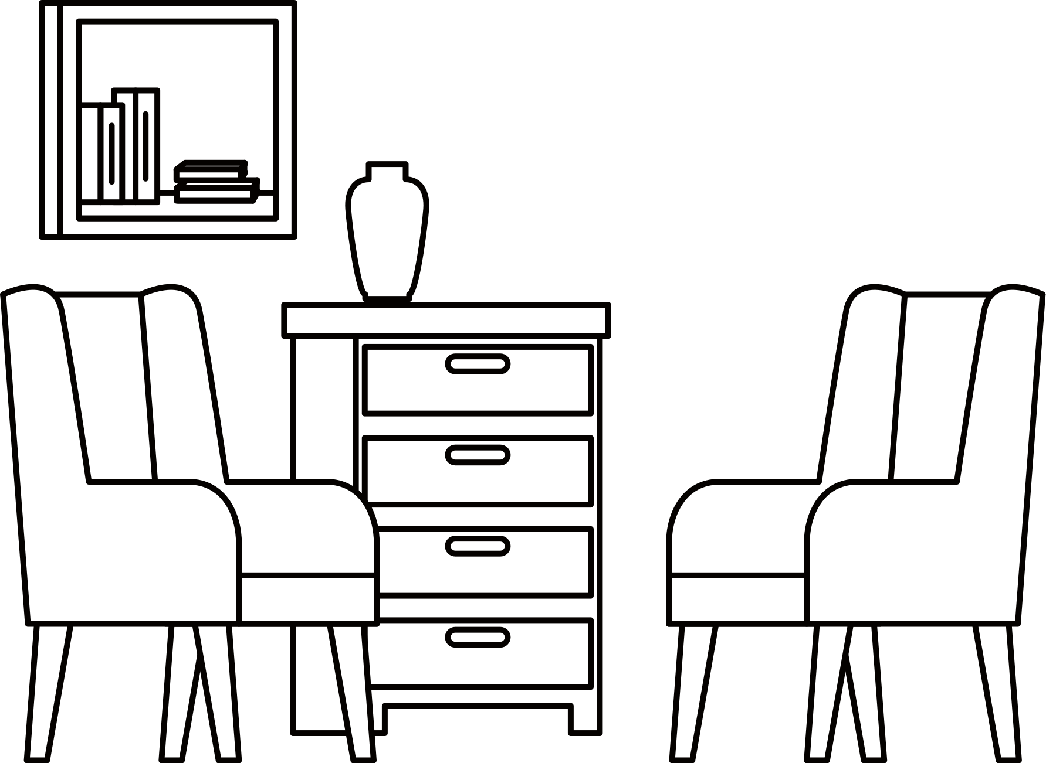
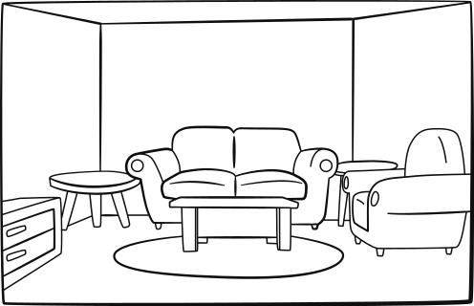

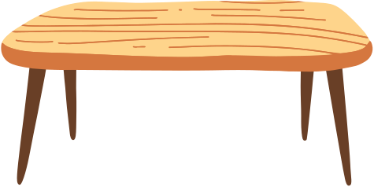



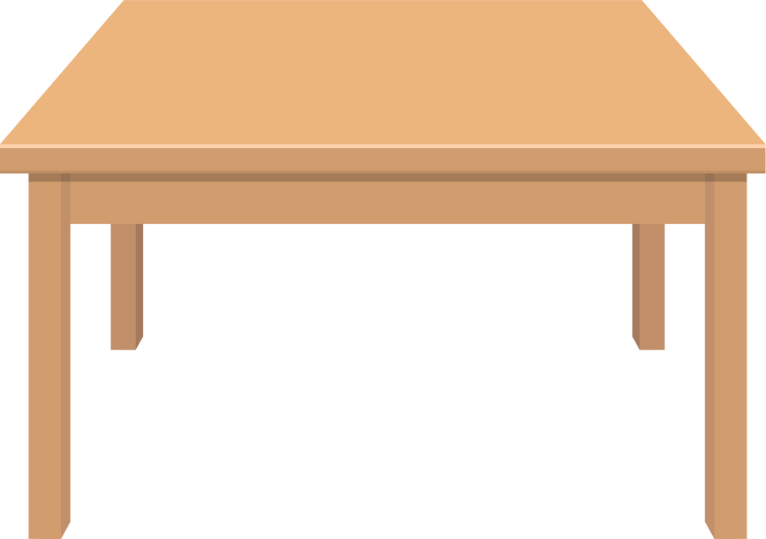
Where are the lamps?
They're on the tables

Slide 22

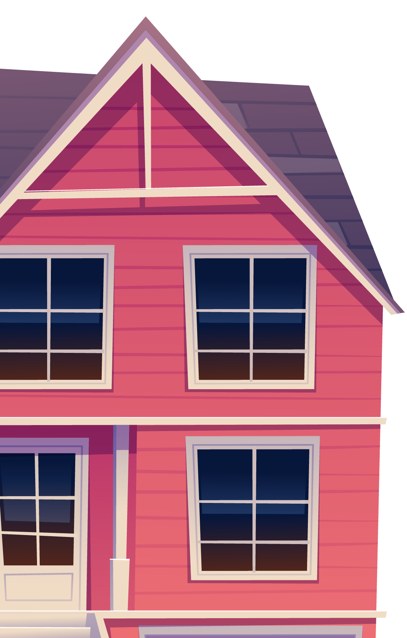
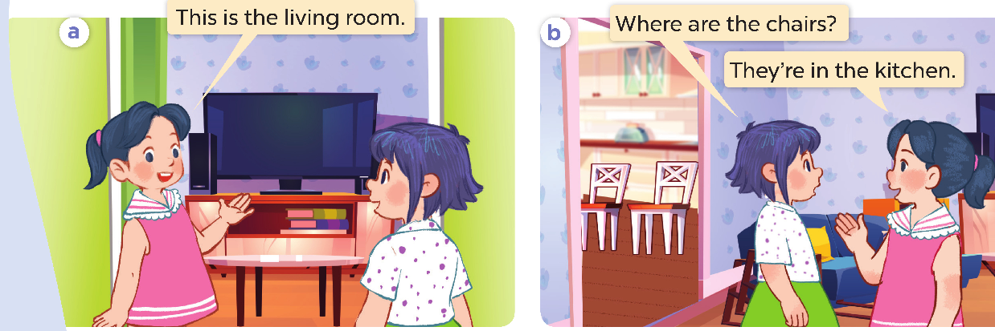
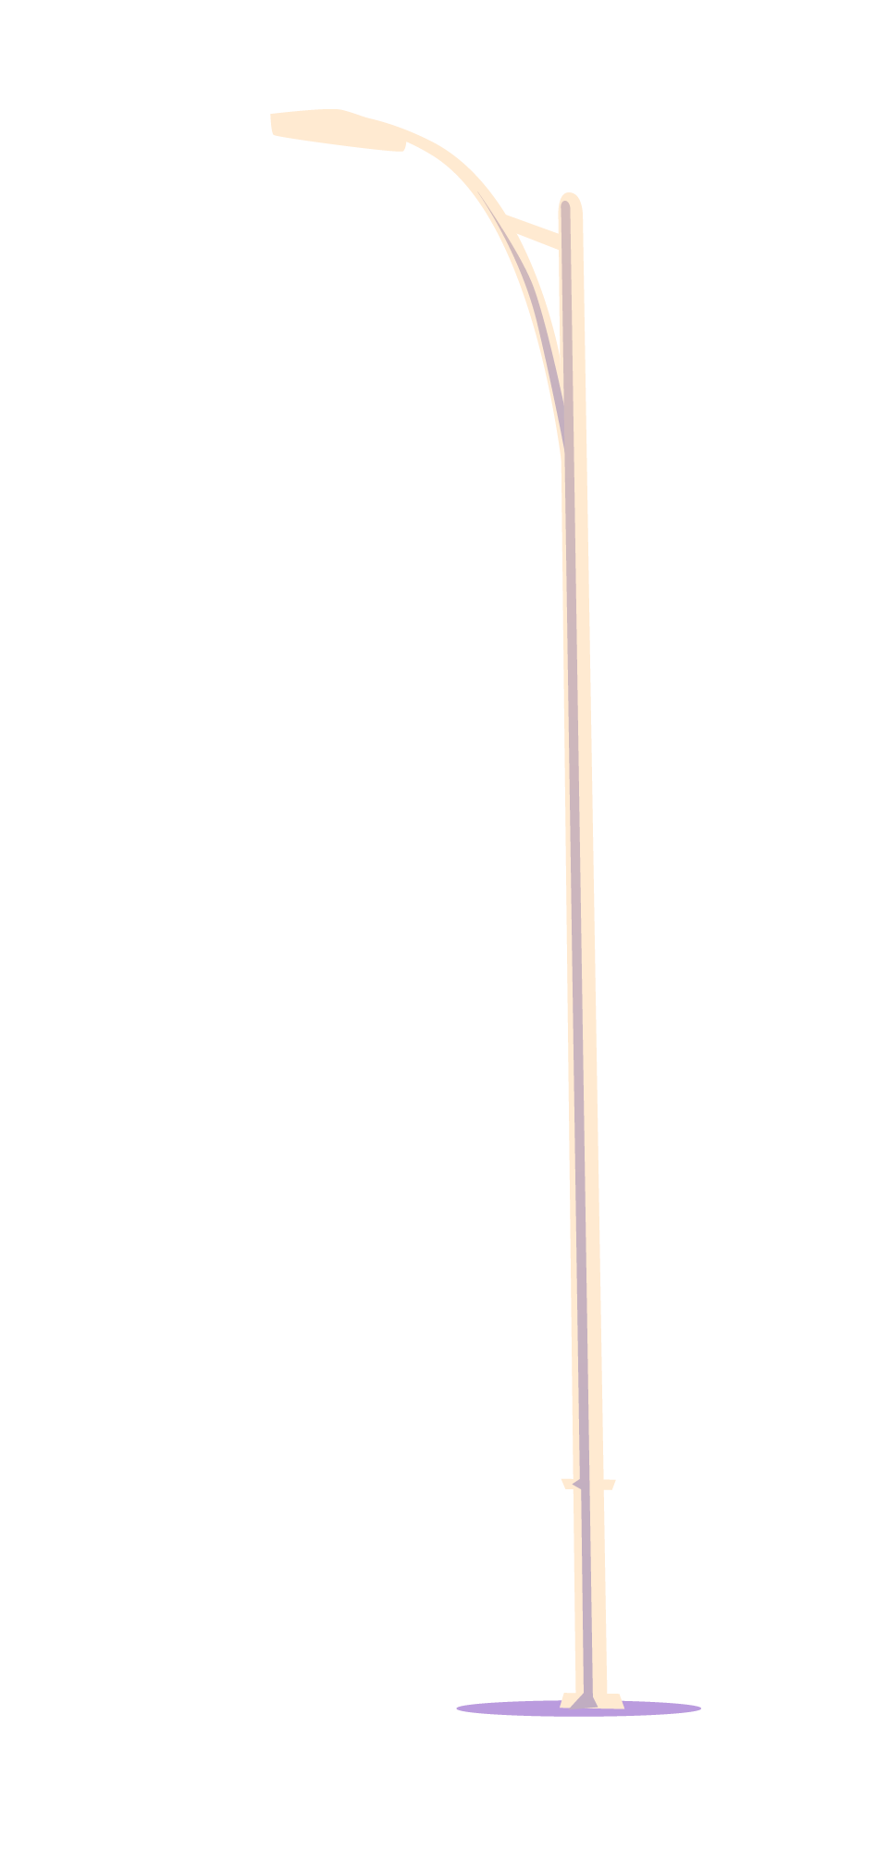
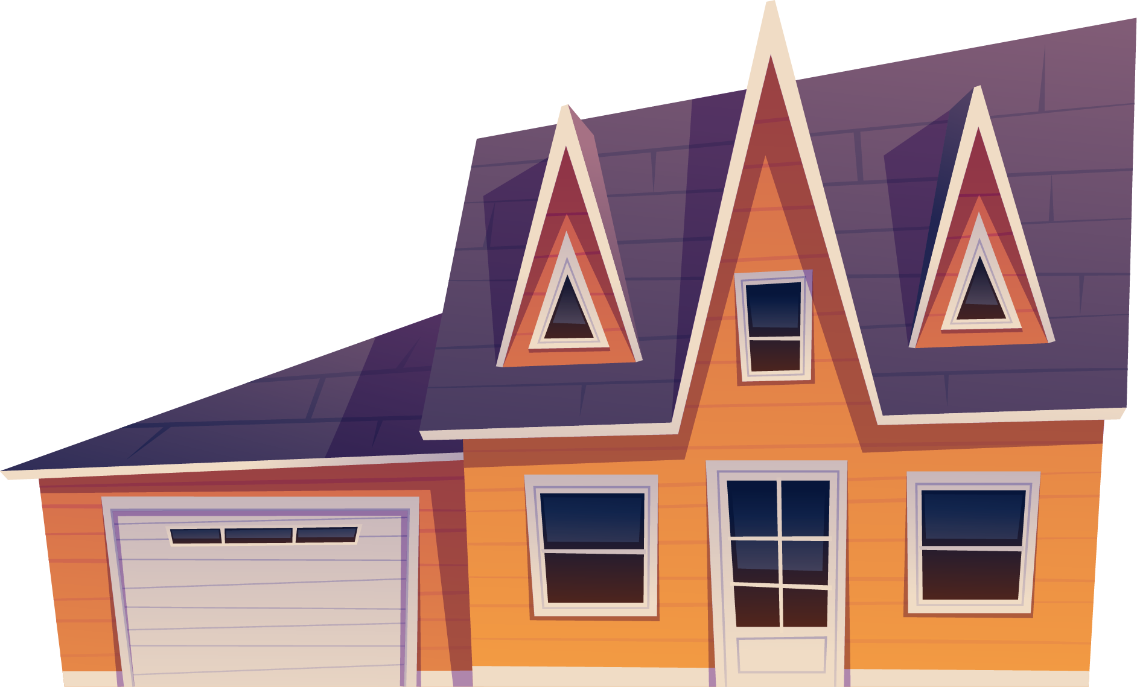
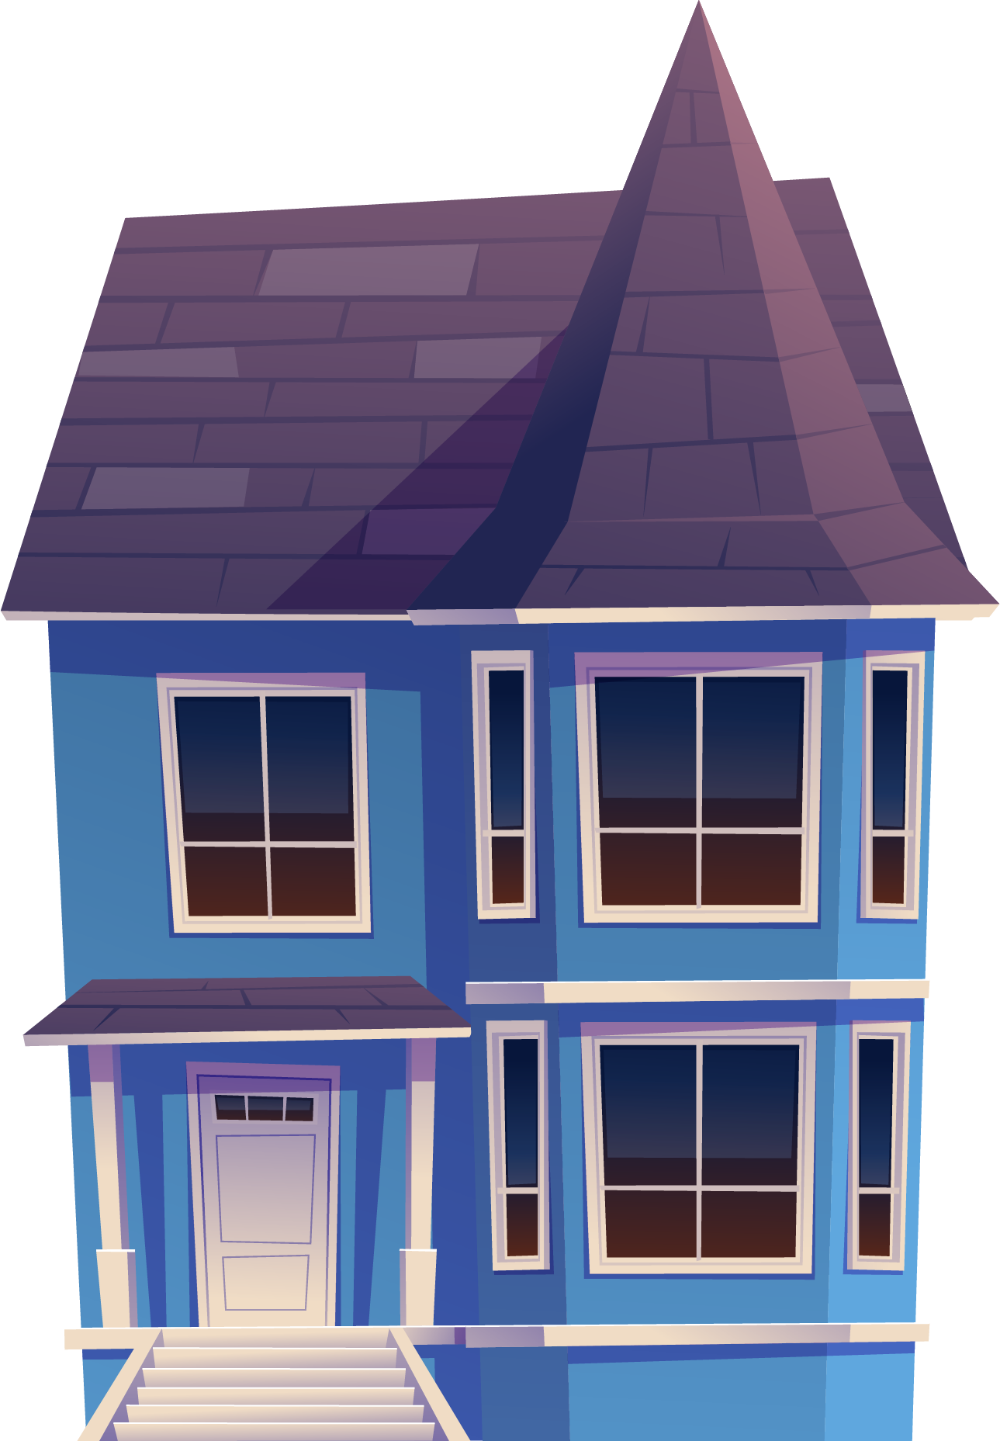

Slide 23

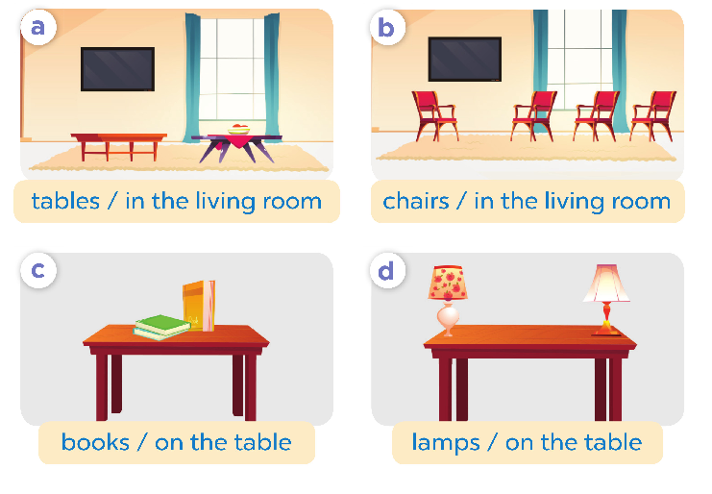
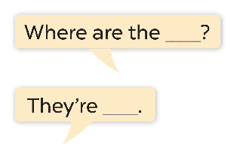

Slide 24



Slide 25
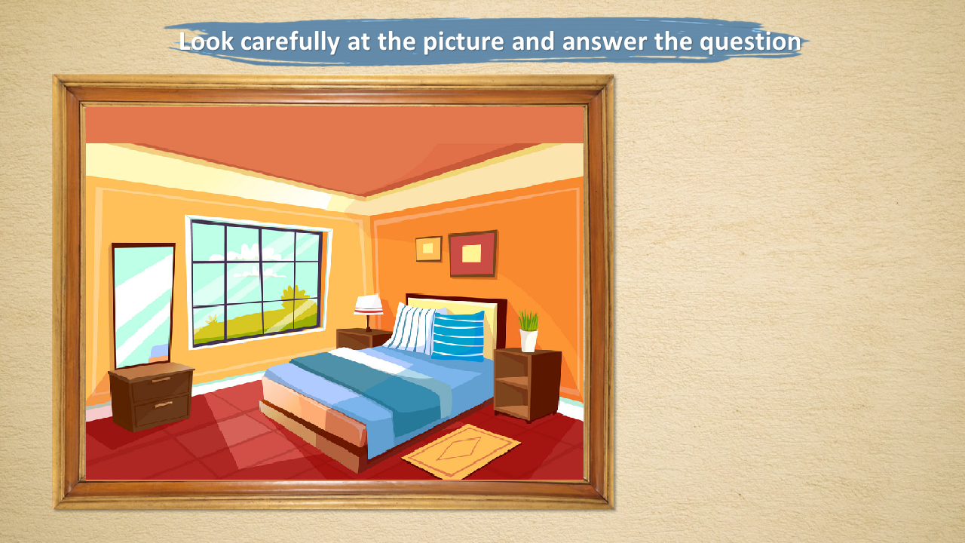
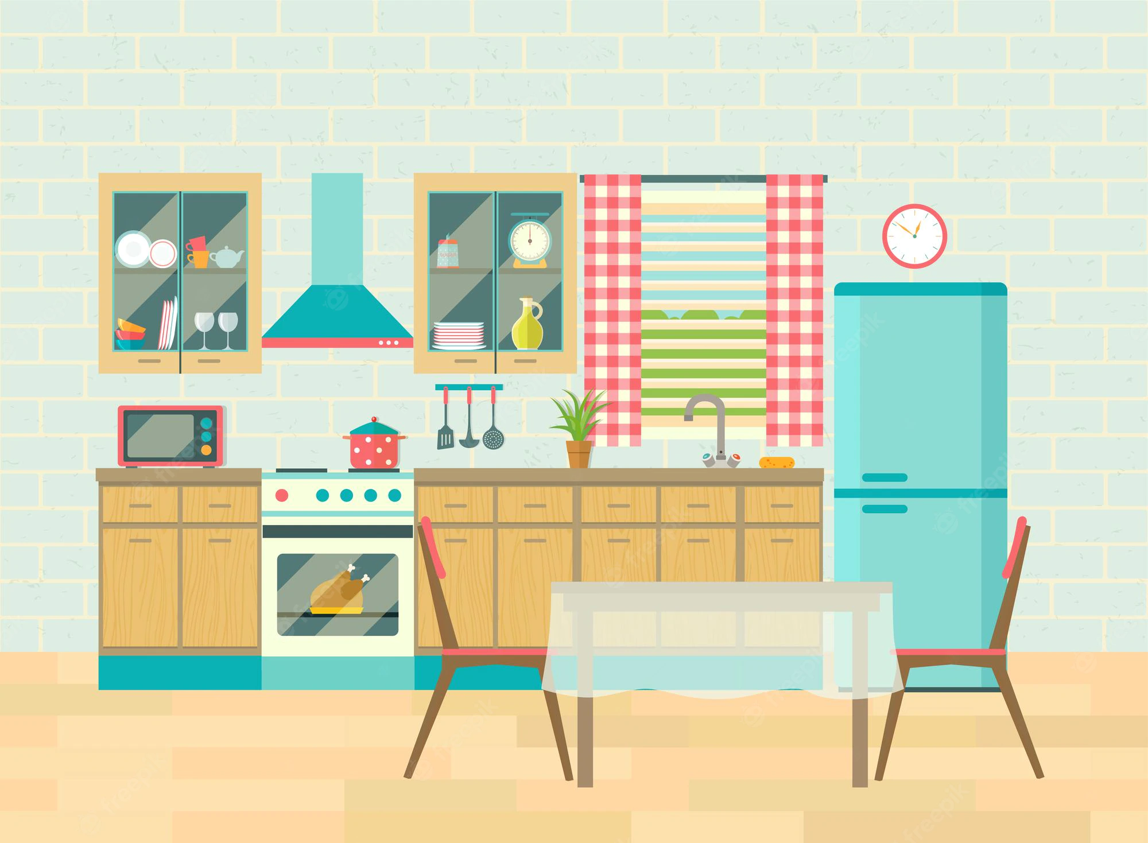




Where are the chairs?
They're in the kitchen.
They're in the living room.

Slide 26
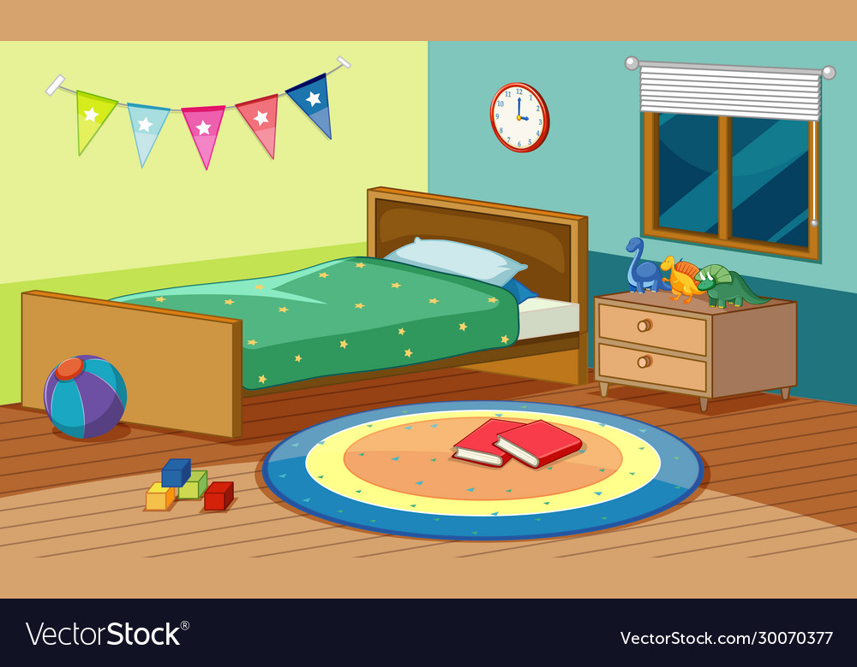
Where are the books?
They're in the kitchen.
They're in the bedroom.

Slide 27
Where is the lamp?
It's in the bedroom.
It's in the bathroom.

Slide 28
Listen and choose.

Slide 29

Where're the pencils ?
They're on the chairs.
They're in the chairs.

Slide 30
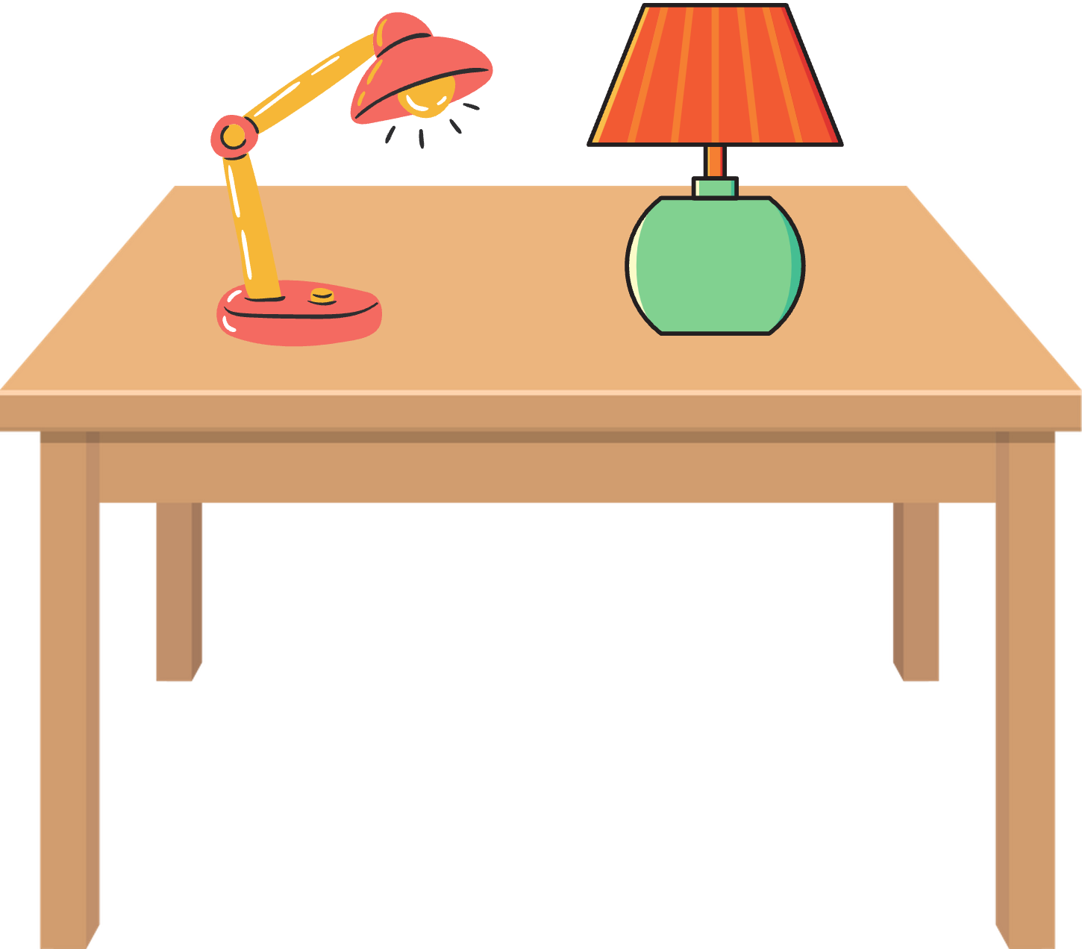
Where are the lamps?
They're on the table.
They're in the table.

Slide 31
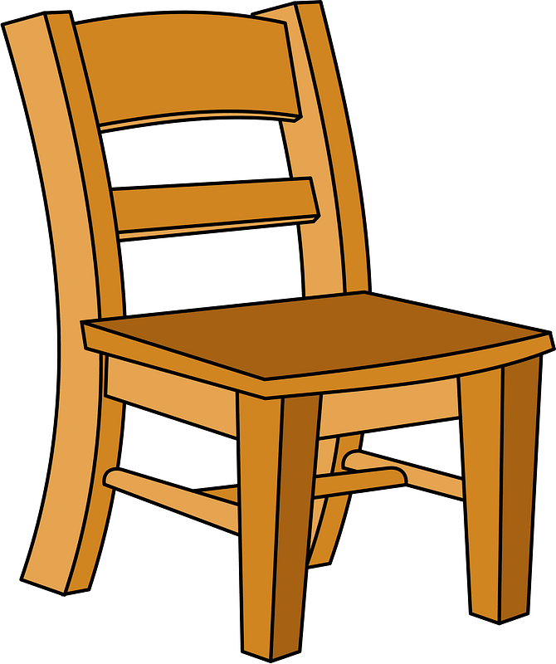
The ..... are in the bedroom.
chairs
tables

Slide 33
04
PRACTICE

Slide 34

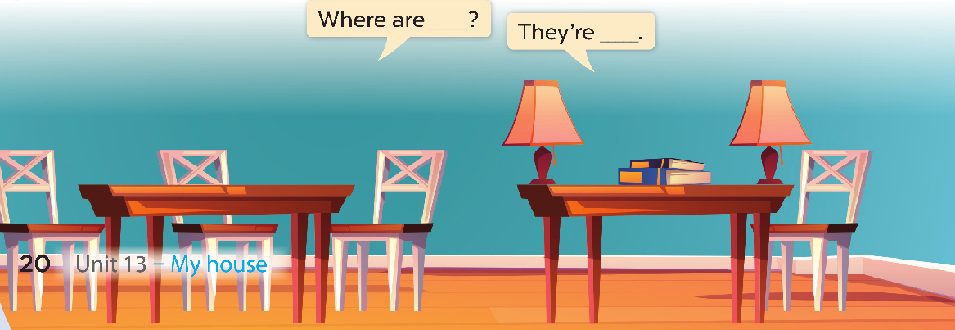

Slide 35


