Slide 1

UNIT 7
Classroom Instructions
Thanh Yến Trần 0967 255 149 zalo/ FB https://www.facebook.com/thanhyentrananhngutaymy/
LESSON 1.1

Slide 2
Table of contents
01
02
Vocabulary
Warm up
03
04
Sentence
Game Time

Slide 3
01.
Warm Up

Slide 4


Slide 5
02.
Vocabulary

Slide 6


open your book

Slide 7

close your book

Slide 8

stand up

Slide 9

sit down

Slide 10
Game Time

Slide 11







2
1
3
6
5
4

Slide 12
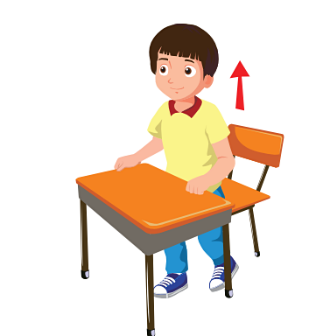


LOOK AND CHOOSE
A. Sit down
B. Hands up
C. Stand up

Slide 13


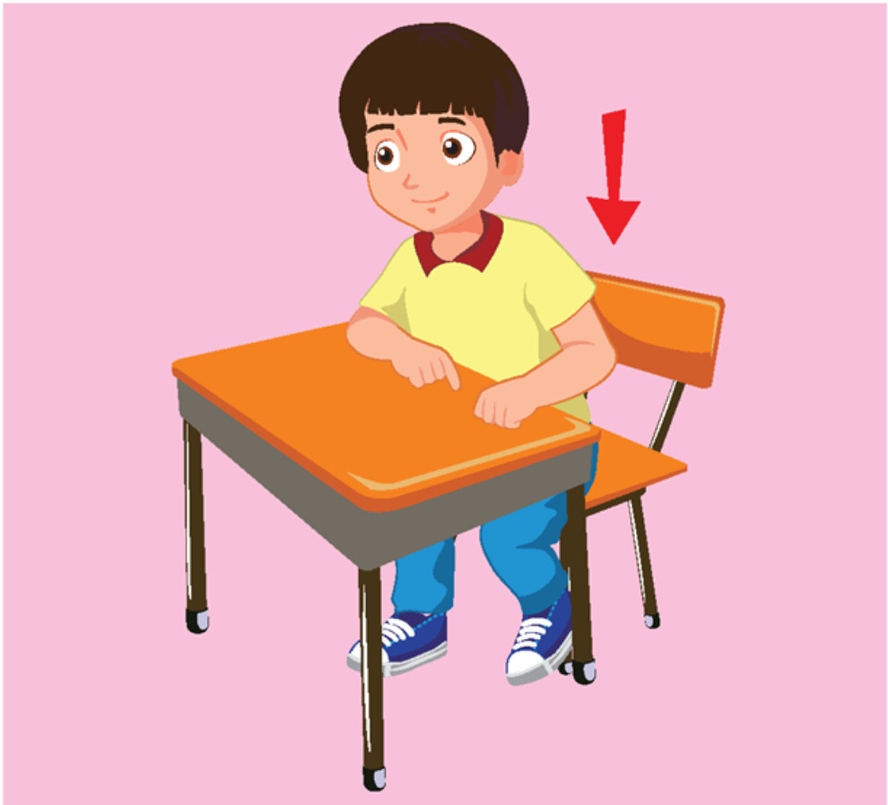
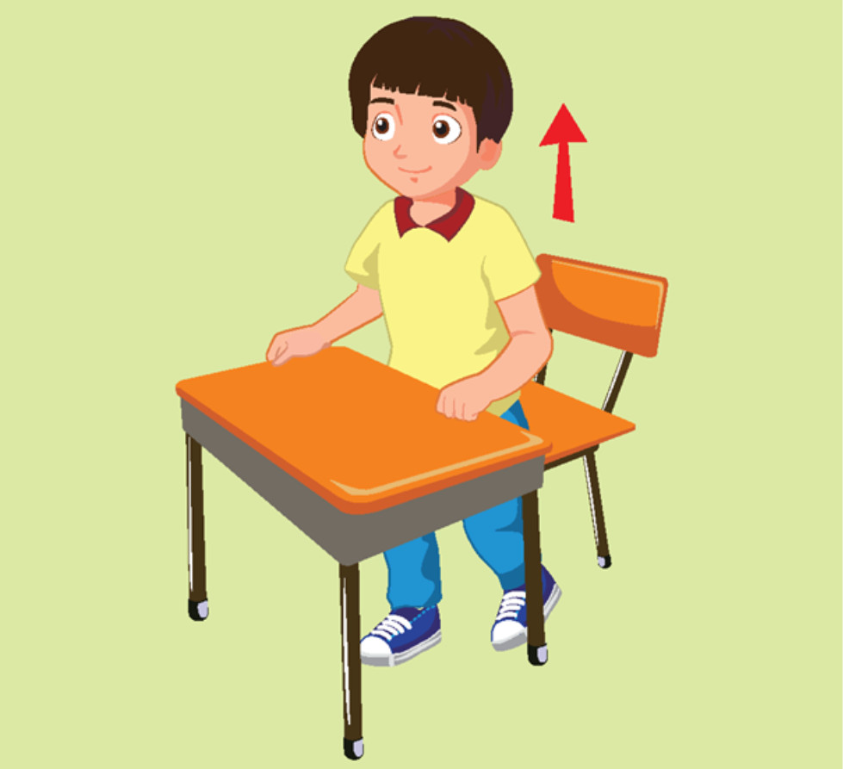
Listen and choose

Slide 14
Stand up ,please
Stand up ,please

Slide 15

Listen and choose
A. Close your book, please!
B. Open your book,please!
C. Stand up, please!

Slide 16

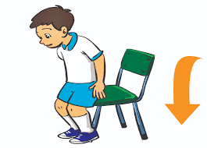
s_t d_wn
A. u-a
B. i-o
C. e-o

Slide 17

Reorder : s-t-i w-o-d-n
A. sit down
B. sti wodn
C. Go to school

Slide 18
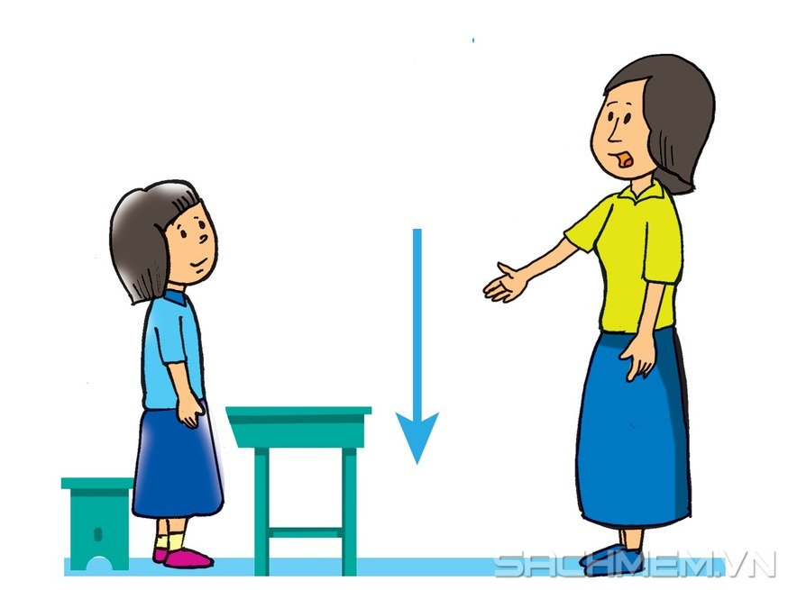
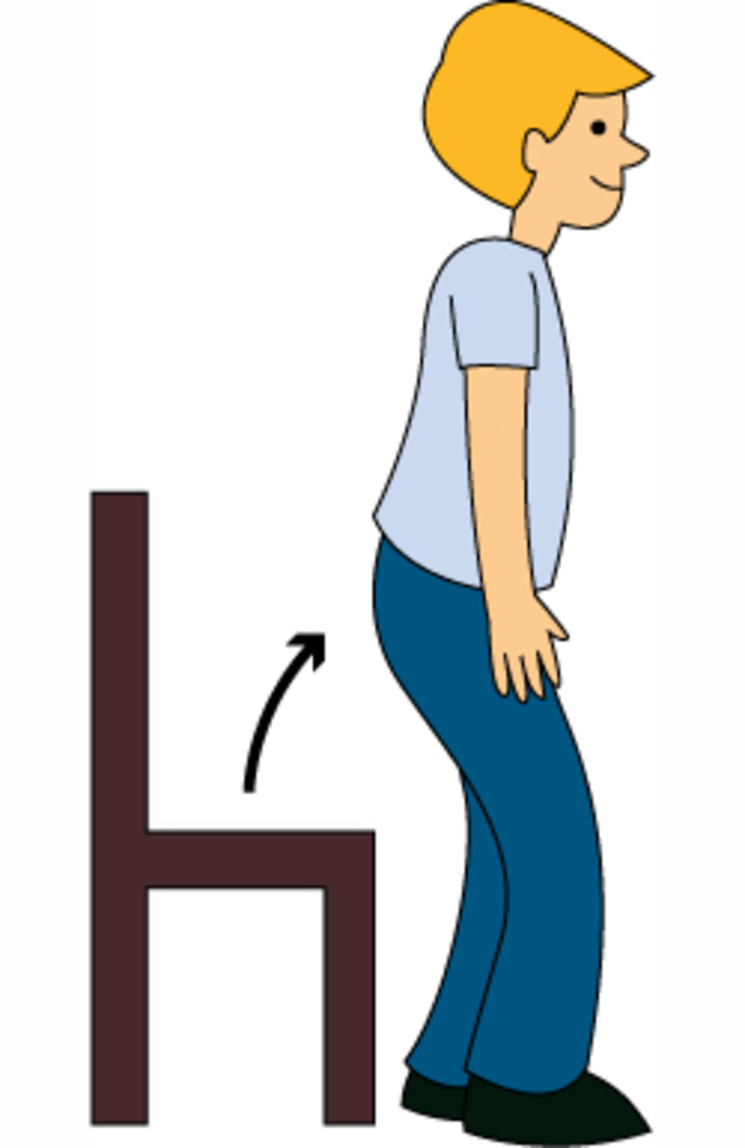

Close your book ,please

Slide 19

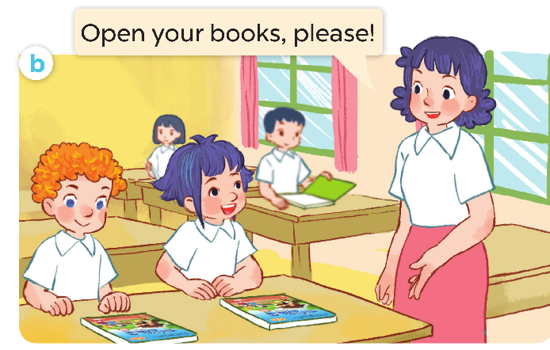
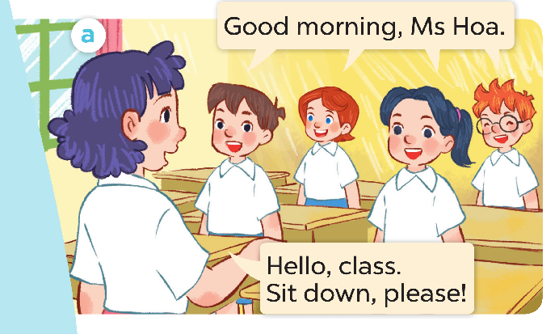

Slide 22

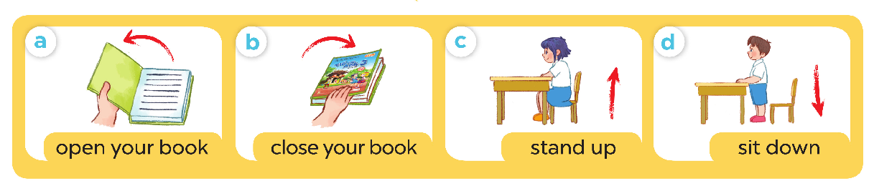

Slide 23
03.
Sentence

Slide 24


















......., please!
stand up
open your book
sit down
close your book

Slide 25
Game Time

Slide 26



MAKING
PHRASE
START

Slide 27
Look at the picture and make a phrase by clicking
on the right words.
NEXT

Slide 28

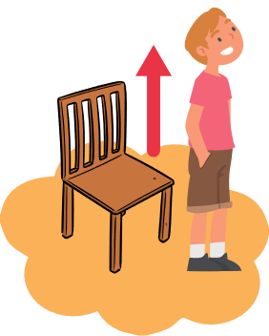

WRONG
WRONG
WRONG
Stand
clean
pick up
up
the
a
please
pond
trash
1
sit
your
and
open
down
please
stand
up
book

Slide 29

WRONG
WRONG
WRONG
close
plant
cut
your book
am
are
please
seeds
grass
3
open
the
and
close
your book
but
sit
down
please

Slide 30

WRONG
WRONG
WRONG
open
water
cut
your
the
the
book
plant
grass
2
open
a
book
close
your
please
sit
the
and

Slide 31
WRONG
WRONG
WRONG
sit
We
They
down
is
are
please
eating
playing
4
stand
down
please
sit
up
and
close
book
open

Slide 32
04.
Activity Class

Slide 33

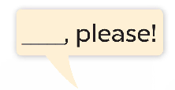
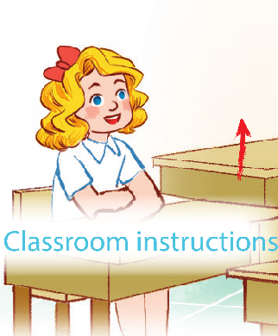
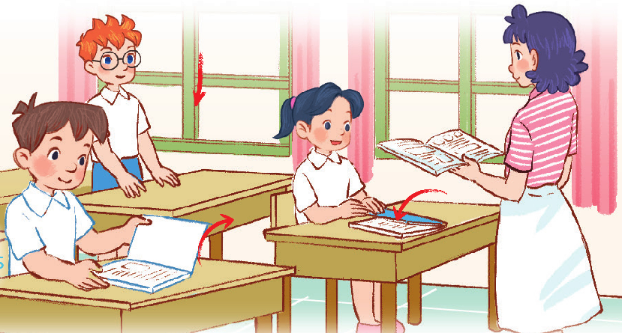

Slide 34


