Slide 1


GOOD MORNING
EVERYONE !!!

Slide 2

Unit 4: Our customs and traditions
Lesson 2: A closer look 1

Slide 3
vocabulary
1. Match the first halves of the sentences with the second halves.
1. Although they are not Christian, | A. the first person to step into your house in the new year should be a man.
2. It’s the custom | B. making sponge cakes for the Mid-Autumn Festival instead of mooncakes.
3. According to tradition, | C. the tradition of living with their parents.
4. There is a tradition in our school that | D. in that country for women to get married in white.
5. They broke with tradition by | E. the family has the custom of giving presents at Christmas.
6. Many young people do not follow | F. morning exercise at 5 a.m.
7. In my family there is a custom of doing | G. girls should wear ao dai on the first day of school.
E
D
A
G
B
C
F

Slide 4


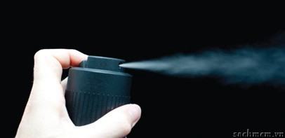
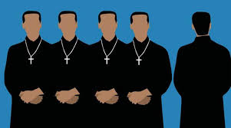

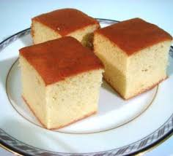

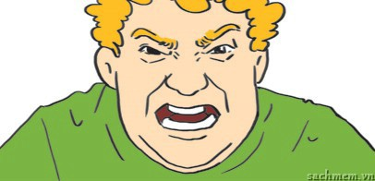
NEW WORDS
Christian /ˈkrɪs.tʃən/(n)
: người theo đạo Thiên chúa
Sponge cake /ˈspʌndʒ ˌkeɪk/(n)
: bánh xốp kem
Straw /strɔː/ (n)
: ống hút
newsprint /ˈnjuːs.prɪnt/(n)
: giấy in báo
frustrated/frʌsˈtreɪ.tɪd/ (adj)
: giận dữ
Shake /ʃeɪk/ (v)
: bắt tay
spray /spreɪ/(v)
: phun

Slide 5
spray (v)
Christian (n)
Shake hands (n)
Sponge cake (n)
newsprint (n)
straw (n)
frustrated (adj)

Slide 6
2. Read the full sentences in 1 again and complete the expressions below.
custom
it’s the ___________ for somebody to do something
there’s a ___________ that + clause/ of doing smth
3. ___________ to tradition, + clause
follow the ___________ of doing something
break ___________ tradition by doing something
have the custom ___________ doing something
there is a custom of ___________ something
tradition
according
tradition
with
of
doing

Slide 7
3. Read the following customs and traditions. Make sentences to say if you have these in your province area, using any of the expressions in 2. Remember to change the verb tense if necessary.
According to tradition, we have fireworks on New Year’s Eve.
My area broke with tradition by not having firecrackers on New Year’s Eve.
There’s a tradition in our province of having fireworks on New Year’s Eve.
1. having fireworks on New Year’s Eve
2. waiting until the guests finish eating before leaving the dinner table
3. touching children’s heads
4. decorating the house on special occasions
5. women shaking strangers’ hands

Slide 8
4. Now complete the following sentences with your own ideas.
1. It’s the custom in my country that ________________________
2. We broke with tradition by ______________________________
3. There’s a tradition in my family that _______________________
4. We have the custom of _________________________________
5. According to tradition, __________________________________

Slide 9

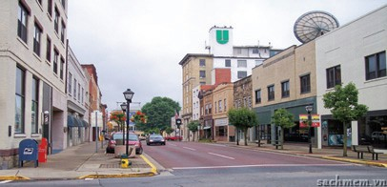
pronunciation
Clusters: /spr/ and /str/
5. Complete the words under the pictures with spr or str. Then listen and repeat.
str
str
1. ____aw
2. ____eet

Slide 10
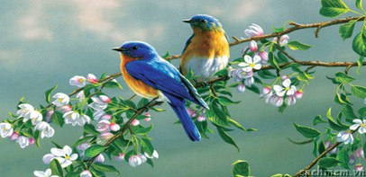
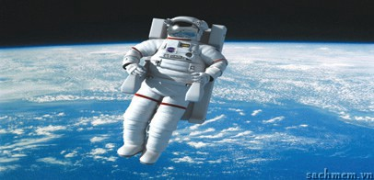
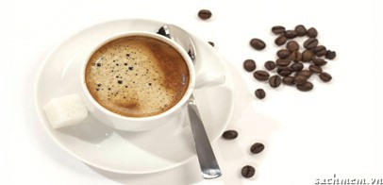
spr
spr
3. ____ing
4. ____ay
str
str
5. a____onaut
6. fru____ated
spr
spr
7. e____esso
8. new____int

Slide 11
6. Listen and circle the words with /spr/ and underline the words with /str/. Then say the sentences.
1. In my family, all the traditions of our ancestors are strictly followed.
2. The custom of saying hello to strangers has spread through our community.
3. In our district, it’s the custom for residents to sweep the streets on Saturday mornings.
4. That filmstrip really highlighted our customs and traditions.
5. Parents usually want their offspring to follow the family traditions.

Slide 12
HOMEWORK
- Learn by heart the ways to express about customs and traditions and new words

Slide 13


