Slide 1

Unit 9: Natural Disaster
•
PERIOD: 74. Skills 1

Slide 2
I. Reading
Ex1: Read an article about how to prepare for a natural disaster. Look at the words in the box, then find them in the article and underline them. What do they mean?
- evacuation - wreak havoc
- destructive - guidelines - emergency

Slide 3
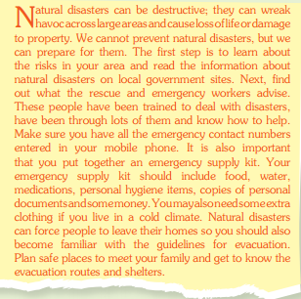

Slide 4
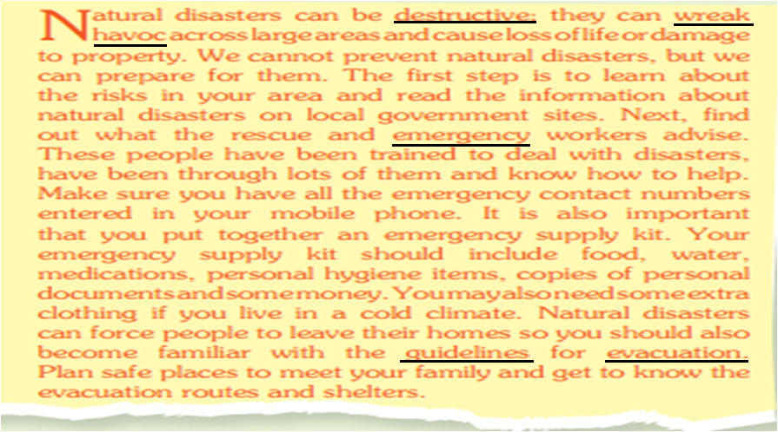
Ex1: Read an article about how to prepare for a natural disaster. Look at the words in the box,then find them in the article and underline them. What do they mean?

Slide 5
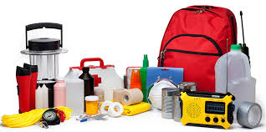

2.New words:
cần thiết
Essential (adj):
- wreak havoc:
- Destructive (adj):
- Guidelines (n):
- Emergency (n):
tàn phá
Có tính phá hoại
Lời hướng dẫn
trường hợp khẩn cấp
-emergency supply kit:
Bộ dụng cụ sơ cứu
-evacuation (n):
Việc sơ tán
-evacuate (v):
sơ tán

Slide 6
2. Read the article and answer the questions
1. Why are natural disasters destructive ?
Because they can wreak havoc across large areas and cause loss of life or damage to property
2. What are the first things to do to prepare for natural disasters ?
Learn about the risks in your area and read the information about natural disasters on local government sites.
3.What should you enter in your mobile phone ? Why ?
Enter all the emergency contact numbers in your mobile phone so you can call the rescue and emergency workers if necessary.
4. What items should an emergency supply kit include ?
Your emergency supply kit should include food, water,medication, personal hygiene items, copies of personal documents and some money.
5. What do you need to know in case of evacuation ?
We need to know the evacuation routes and shelters.

Slide 8
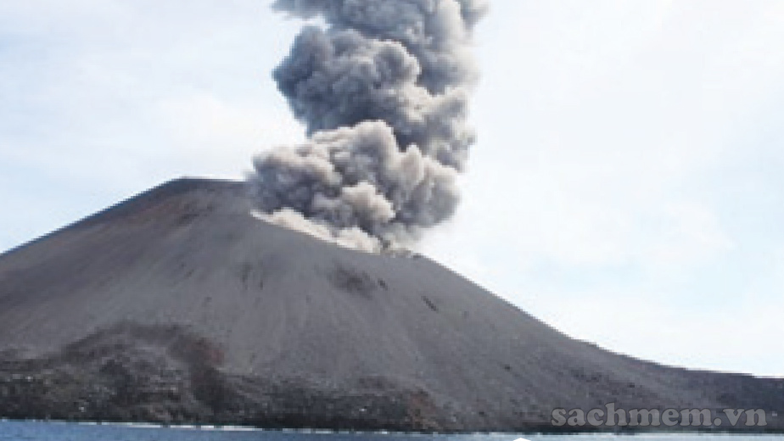
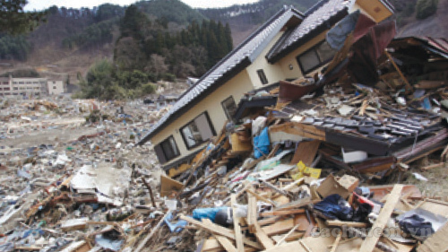
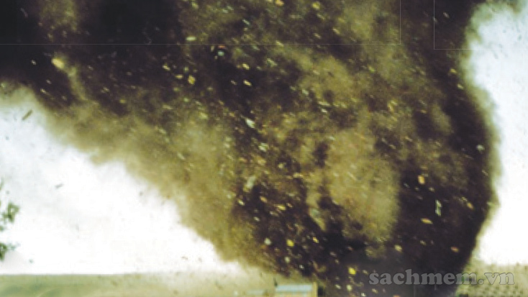
3.SPEAKING
3a. Read the news reports ( A-C) and match each one to the correct picture (1-3)
A
B
C

Slide 9
3.
Mount Sinabung in Indonesia erupted again two days ago. From where we were standing, we could see a big cloud of ash coming from the top of the mountain. As the lava ran down the volcano's sides, it destroyed everything in its path. By the next morning, several villages around Mount Sinabung were buried in ash and debris.
1. A tornado hit a small town in Missouri at 9 a.m. yesterday. People said the sky darkened very quickly. The winds were so strong that trees, cars and even houses were picked up and carried for miles. As local TV and radio stations had issued an early warning, most of the residents had had time to take shelter underground or in basements.
2.
A powerful earthquake struck the north-east of Japan at 4 p.m. last Monday. Although Japan has the most advanced warning system, there had been no early warning for this one and people were not prepared. Suddenly the ground started moving. The shaking continued for a few minutes and became stronger. People began running away from buildings as walls started to collapse.
Keys:
1.C
2.B
3.A
A volcano eruption
An earthquake
A tornado

Slide 10
3b. Work in pairs. Each pair can choose one of reports in 3a. Role play telling each about the news.
EX:
A.Did you watch the news last night ?
B. No, I didn’t. What’s happened ?
A.There was a powerful earthquake on Monday.
B. That’s shocking! Where was it ?

Slide 11
4a. Make a list of things to do before, during and after each of the disasters in your area.
Disasters | Things to do
 | Before | During | After

Slide 12
4b. Discuss what you should do in the event of a natural disaster in your area.
EX:
A. What should you do to prepare for floods in your area?
B. First. I’ll make sure I have a disaster plan...
A. What should you do during a flood ?
B. During a flood, I should try to get to higher ground as quickly as possible...

Slide 13
HOMEWORK
Learn and write new words
Write the answers for the questions in ex2
Prepare Skills 2

