Slide 1


Slide 2
WARM -UP
The Adjectives connected with cities and city life:
modern
…
busy
historical
Adjectives
fashionable
convenient
expensive
polluted
exciting

Slide 3

ENGLISH 9
UNIT 2: CITY LIFE
Lesson 2: A closer look 1

Slide 4
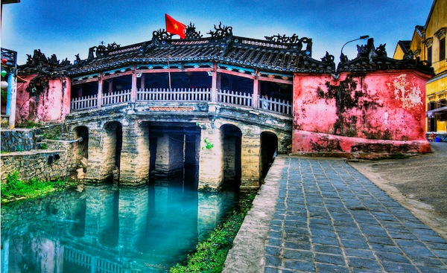
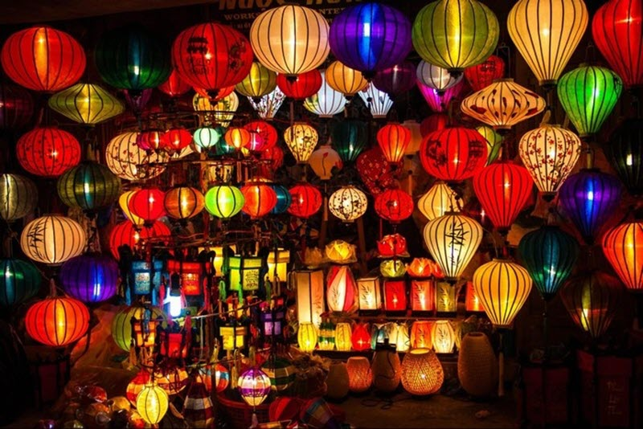
* What place are these pictures about?

Slide 5
VOCABULARY
- fabulous ['fæbjuləs] (adj):
(SYN = wonderful)
: tuyệt vời
E.g: We’re having a fabulous time here in Hoi An.
- affordable [ə'fɔ:dəbl] (adj):
(SYN = cheap enough)
: vừa túi tiền
E.g: The street food in Hoi An is tasty and affordable.
- cosmopolitan [,kɔzmə'pɔlitən] (adj):
(thuộc) toàn thế giới
E.g: There are different types of people from different countries living
in New York, so New York is a highly cosmopolitan city.

Slide 6
1a. Put one of the adjectives in the box in each blank
local delicious ancient historic
helpful warm fascinating comfortable
Dear Oggy,
We’re having a fabulous time here in Hoi An. You know, it’s a(n) (1) _________ town 30 km from Da Nang. The weather is very (2) _________ and sunny. Our hotel is small but (3) ___________. The staff are friendly and (4) __________ .
We’ve seen most of the sights of the town. The street life here is (5) ___________ . We’ve spent a lot of time wandering around and looking at the (6) _________ temples, bridges, and houses. We’ve also bought a lot of (7) _________ souvenirs, crafts, and clothing. Well, the street food in Hoi An is (8) _________ and affordable. I wish you could be here with us!
Anyway, I hope things are good with you.
Lots of love,
Jack
ancient
warm
comfortable
helpful
Fascinating
historic
local
delicious
1b. Underline all the other adjectives in the letter.

Slide 7
2. Which of the following adjectives describe city life? Put a tick (√).
√
√
1.stressful
2.exciting
3.delicious
4.historic
5.busy
6.forbidden
7.exhausted
8.modern
9.frightening
10.rural
11.populous
12.polluted
13.cosmopolitan
14.unemployed
15.annoying
16.pleased
17.cheerful
18.easy-going
19.downtown
20.fashionable
√
√
√
√
√
√
√
√
√
√
√

Slide 8
3. Put a suitable adjectives from 2 in each blank.
fashionable
She lives in one of the most ………………. parts of the city: there are lots of luxury shops there.
How ……………… ! The roads are crowded and I’m stuck in a traffic jam.
You can’t stop here. Parking is ………………… in this street.
This city is very ……………………, there are people here from all over the world.
The gallery downtown has regular exhibitions of …………………. art.
Nhieu Loc canal in Ho Chi Minh City is much less ………………….. than before.
annoying
forbidden
cosmopolitan
modern
polluted

Slide 9
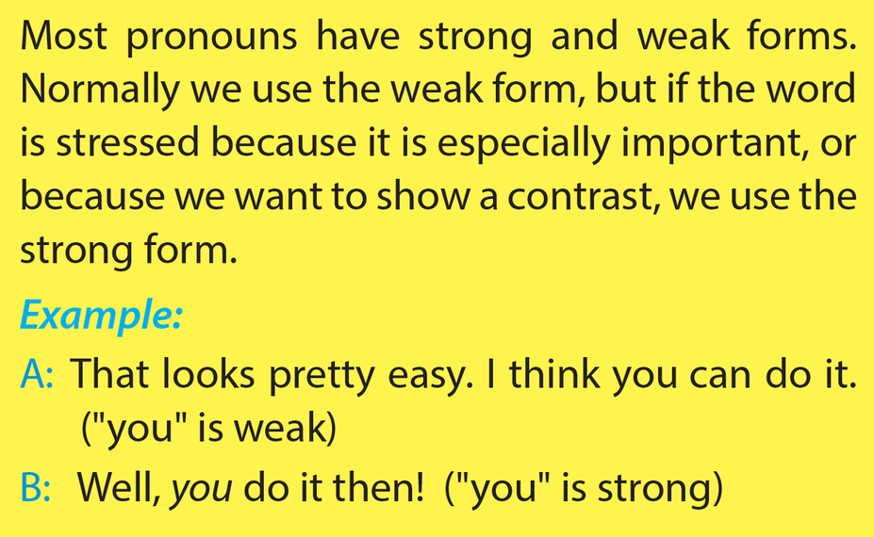
* Pronunciation:
Stress on pronouns in sentences

Slide 10
* Strong form and weak form of pronouns:
PRONOUNS | WEAK FORM | STRONG FORM
You | / jə/ | /ju:/
He | /i/ | /hi:/
She | /ʃi/ | /ʃi:/
We | /wi/ | /wi:/
Me | /mi/ | /mi:/
Him | /ɪm/ | /hɪm/
Her | /ər/ | /hɜ:r/
Us | /əs/ | / ʌs/
Them | /ðəm/ | / ðem/
Your | /jər/ | / jʊr/
His | /ɪz/ | /hɪz/
Hers | /ɜ:rz/ | /hɜ:rz/

Slide 11

4. Listen and repeat, paying attention to the difference in the underlined pronouns. Circle the pronouns that sound strong.
weak
1. A: Can you come and give me a hand? …………
B: OK. Wait for me! …………………………
2. A: Did you come to the party last night? ……………………….
B: Yes. But I didn’t see you. …………………………….
3. A: Look - it’s him! ………………………
B: Where? I can’t see him. ………………………………
4. A: They told us to go this way. …………………………………..
B: Well, they didn’t tell us! ………………………………………….
strong
weak
strong
strong
weak
weak
strong

Slide 12
5a. Listen and mark the underlined words as W( weak) or S ( strong).
--Example--:
A: Are you going to talk to him (W)?
B: No, I think he (S) should talk to me (S) first.
1.A: Is he (___) there?
B: No. Everybody else is, but he’s (___) gone home!
2.A: Do you know that woman?
B: Her (___)? Er… No. I don’t recognize her (___).
3.A: I’m afraid we (W) can’t stay any longer.
B: What do you mean ‘we’ (___)? I’ve (___) got plenty of time.
4.A: Look! Everybody’s leaving.
B: What about us (___)? Shall we (___) go, too?
W
S
S
W
S
S
S
W
5b. Work in pairs. Practise the exchanges above.

Slide 13

HOME ASSIGNMENTS
-Practice pronouncing strong form and weak form of pronouns.
- Write 6 sentences about one of the cities you have been to, using the adjectives in today’s lesson as many as possible.

Slide 14


