Slide 1
Kim’s game
Look at the pictures and remember to write
the names of famous places in Hoi An.

Slide 2
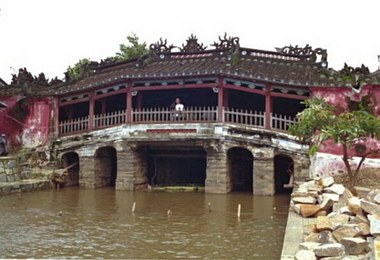
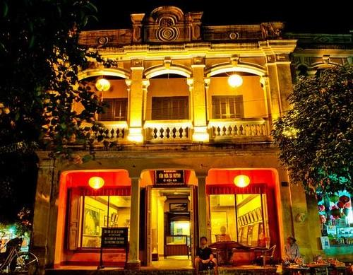
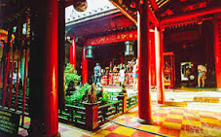
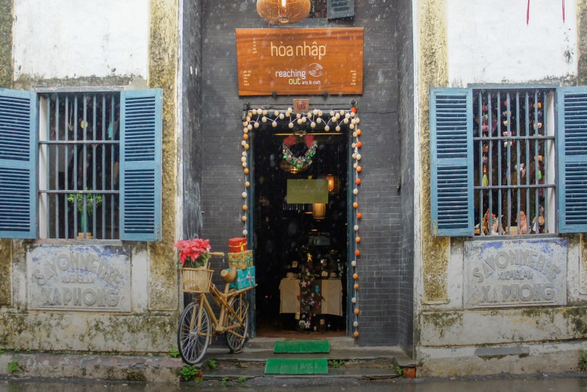
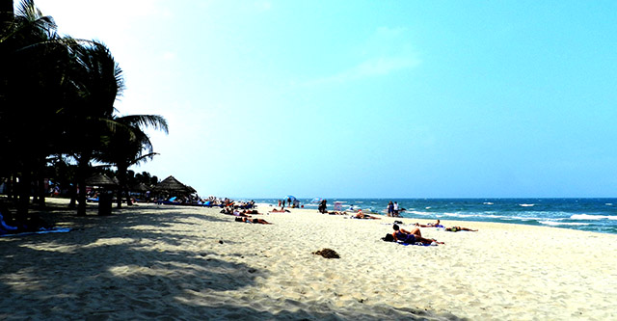


Slide 3
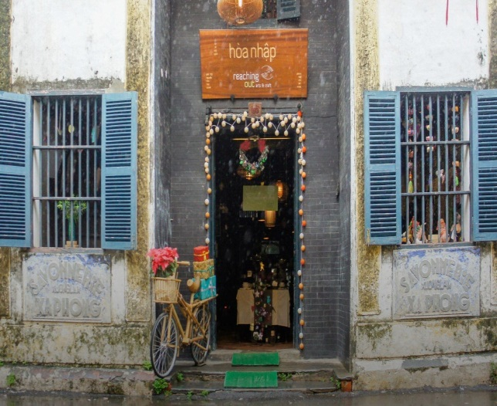
Chua Cau
Museum of Sa Huynh Culture
Quan Cong Temple
Hoa Nhap
Workshop
Cua Dai Beach
Tan Ky house

Slide 4




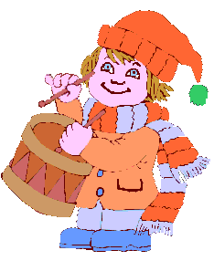

        * Answer the questions
        1. Where do you live?
        2. Is your house in the country or in the city?
        3. What are there in your neighbourhood?
        6. Do you like living in your neighbourhood? Why/ why not?

Slide 5

Unit 4: MY NEIGHBOURHOOD
Lesson 5:Skills 1

Slide 6
I. READING

Slide 7
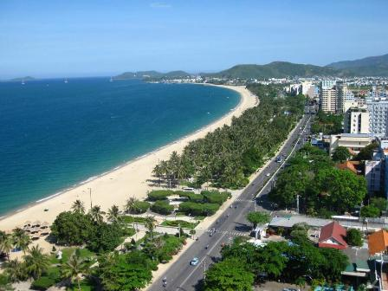
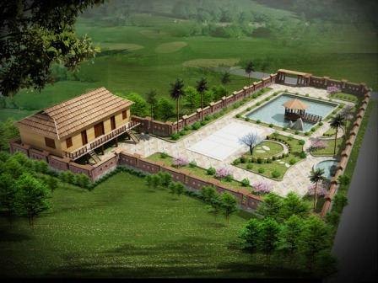

Slide 8
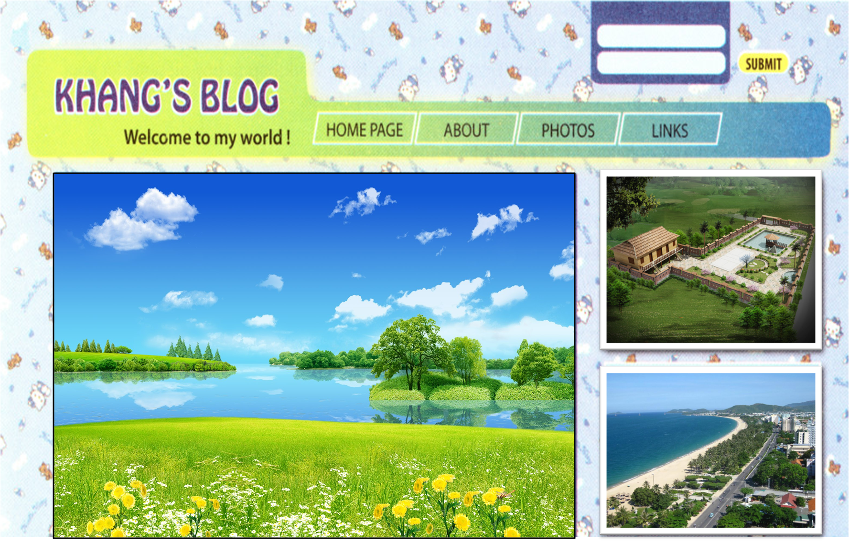
I. READING
Friday, December 23,.......
MY NEIGHBOURHOOD
I’m back home now. Hoi An was great! My neighbourhood’s very different. It’s in the suburs of Da Nang City. There are many things I like about it.
It’s great of outdoor activities because it has beautiful parks, sandy beaches, and fine weather. There’s almost everything I need here: shops, restaurants, and markets. Every house has a backyard and a frontyard. The people here are incredibly friendly. They’re friendlier than those in many other places ! And the food’s very good.
However, there is one thing I dislike about it. Now, there are many modern buildings and offices so the streets are busy and crowded during the day.
Can anyone write about what you like and don’t like about your neighbourhood ?
Posted by Khang at 4:55 PM

Slide 9
people
Khang’s neighbourhood

Slide 10
Friday, December 23,.......
MY NEIGHBOURHOOD
I’m back home now. Hoi An was great! My neighbourhood’s very different. It’s in the suburbs of Da Nang City. There are many things I like about it.
It’s great of outdoor activities because it has beautiful parks, sandy beaches, and fine weather. There’s almost everything I need here: shops, restaurants, and markets. Every house has a backyard and a frontyard. The people here are incredibly friendly. They’re friendlier than those in many other places ! And the food’s very good.
However, there is one thing I dislike about it. Now, there are many modern buildings and offices so the streets are busy and crowded during the day.
Can anyone write about what you like and don’t like about your neighbourhood ?
Posted by Khang at 4:55 PM

Slide 11
Friday, December 23,.......
MY NEIGHBOURHOOD
I’m back home now. Hoi An was great! My neighbourhood’s very different. It’s in the suburbs of Da Nang City. There are many things I like about it.
It’s great of outdoor activities because it has beautiful parks, sandy beaches, and fine weather. There’s almost everything I need here: shops, restaurants, and markets. Every house has a backyard and a frontyard. The people here are incredibly friendly. They’re friendlier than those in many other places ! And the food’s very good.
However, there is one thing I dislike about it. Now, there are many modern buildings and offices so the streets are busy and crowded during the day.
Can anyone write about what you like and don’t like about your neighbourhood ?
Posted by Khang at 4:55 PM

Slide 12

READING
1/ Find these words in Khang’s blog. What do they mean ?
suburbs backyard dislike incredibly beaches
Friday, December 23,.......
MY NEIGHBOURHOOD
I’m back home now. Hoi An was great! My neighbourhood’s very different. It’s in the suburs of Da Nang City. There are many things I like about it.
It’s great of outdoor activities because it has beautiful parks, sandy beaches, and fine weather. There’s almost everythingI need here: shops, restaurants, and markets. Every house has a backyard and a frontyard. The people here are incredibly friendly. They’re friendlier than those in many other places ! And the food’s very good.
However, there is one thing I dislike about it. Now, there are many modern buildings and offices so the streets are busy and crowded during the day.
Can anyone write about what you like and don’t like about your neighbourhood ?
Posted by Khang at 4:55 PM

Slide 13





*Extra words
- Suburn (n):
Ngoại ô
Backyard(n):
- sân sau
- Dislike
- Like (v)
Không thích > < thích:
- Incredibly:
- Đáng kinh ngạc
- Beach n):
- bãi biển

Slide 14
2/ Tick the things Khang likes and dislike about his neighbourhood.
LIKE | DISLIKE
- It’s great for outdoor activities.

The houses are small
and the buildings are old.
- There’s almost everything here.

- The houses are big and beautiful.
Every house has a backyard and a
frontyard.
The streets are busy
and crowded during the day.

- The streets are wide with less traffic.


- The people are incredibly friendly.
- The food is very good.


Slide 15
3/ Answer the questions.
Friday, December 23,.......
MY NEIGHBOURHOOD
I’m back home now. Hoi An was great! My neighbourhood’s very different. It’s in the suburbs of Da Nang City. There are many things I like about it.
It’s great of outdoor activities because it has beautiful parks, sandy beaches, and fine weather. There’s almost everythingI need here: shops, restaurants, and markets. Every house has a backyard and a frontyard. The people here are incredibly friendly. They’re friendlier than those in many other places ! And the food’s very good.
However, there is one thing I dislike about it. Now, there are many modern buildings and offices so the streets are busy and crowded during the day.
Can anyone write about what you like and don’t like about your neighbourhood ?
Posted by Khang at 4:55 PM
1.Where is Khang’s neighbourhood ?
2. Why is his neighbourhood great for outdoor activities ?
3. What are the people there like ?
4. Why are the streets busy and crowded ?
-> It’s in the suburbs of Da Nang City.
-> Because it has beautiful parks, sandy beaches, and fine weather.
-> The people here are incredibly friendly.
-> Because there are many modern buildings and offices.

Slide 16

*Tell me some expressions you can use to give directions
1.Turn right / left
2.Go straight on
3. Go along the street/ the road
4.Go past
5.Cross the street/ the road
6. Take the first turning on the left

Slide 17
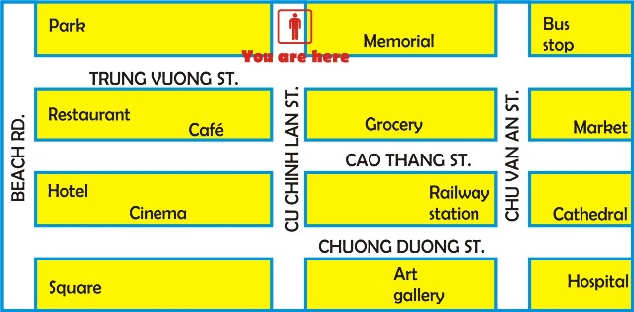
II. SPEAKING
4/ Ask and answer questions about how to get to the places on the map.
Example: A: Excuse me. Can you tell me the way to the beach?
B: Yes. First, go straight. Then turn right. After that go straight again.
It’s in front of you.
A: Thank you very much.
Market
Railway
Station
Art gallery
Square

Slide 18
II. SPEAKING
5/ Ask and answer questions about how to get to
the places near your school.

Slide 19
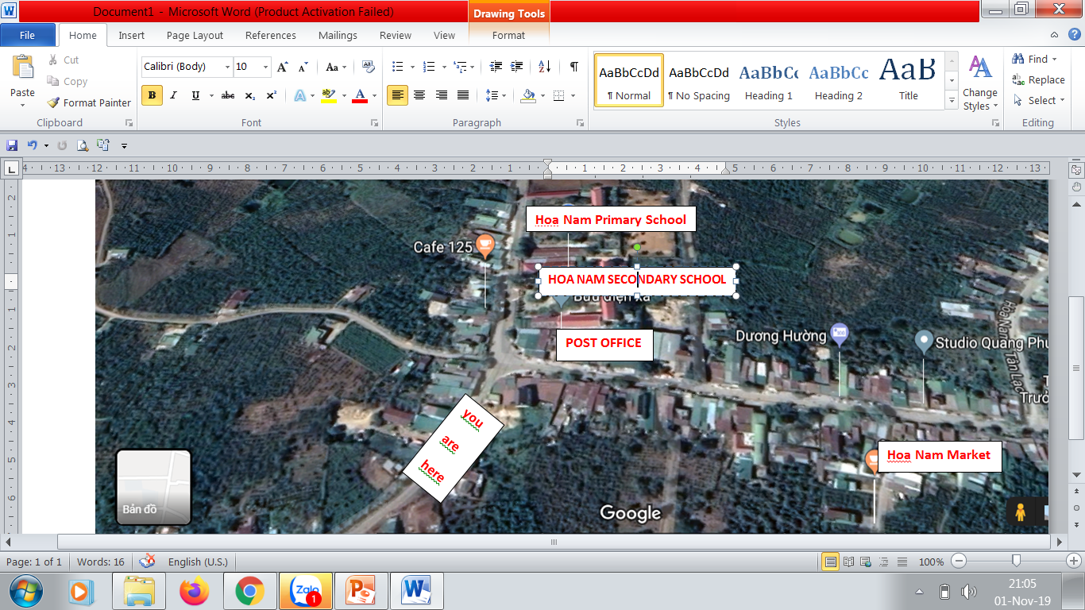

Slide 20



HOME WORK
Read and answer the questions again.
Ask for and give directions.
Prepare SKILLS 2

Slide 21


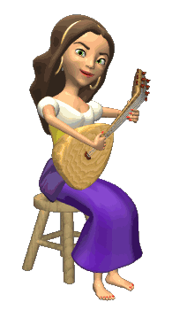


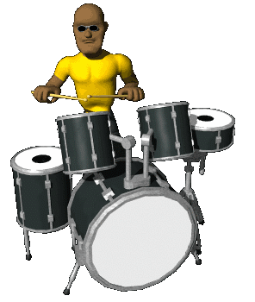





THANK YOU FOR ATTENTION!
GOOD BYE!
the end

