Slide 1

Unit 1: Home
Lesson 1.2: Grammar
Page 7

Slide 2
Objectives
By the end of this lesson, students will be able to…
Use Present Simple tense correctly.

Slide 3

WARM UP

Slide 4

Work in pairs. Ask and answer.
Where do you live?
I live in a house.
Yes, it does./
No, it doesn’t
Does it have a yard?

Slide 5

GRAMMAR
Present Simple tense
Presentation

Slide 6
FORM:
BE
(+) S + am/ is/ are + ….
(-) S + am/ is/ are + not ….
(?) Am/ is/ are + S + …. ?
Yes, S + am/is/are.
No, S + am/is/are + not.
Ex: He is a student.
They are not desks. They are tables.
Are you a doctor? - No, I am a student.

Slide 7

Watch the video and take note the sentences in the video.

Slide 8

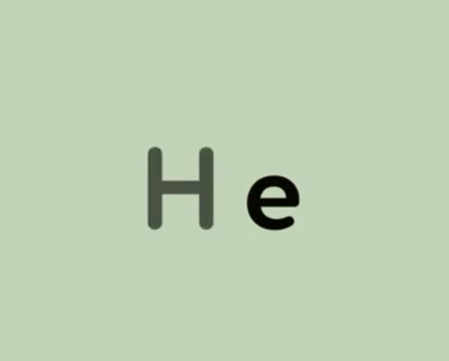



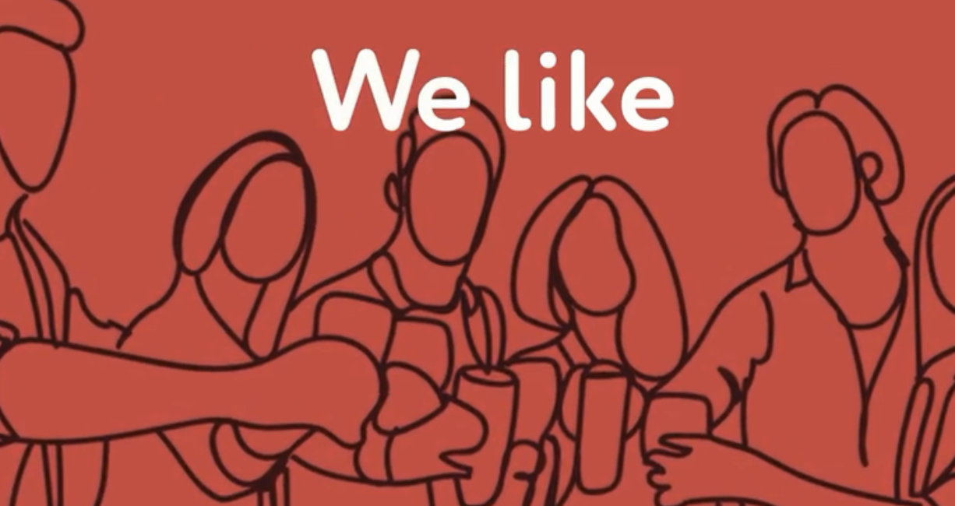



Slide 9
FORM:
V
(+) S+ V₁^{s/es}
(-) S+ do/does + not + V_{inf}….
(?) Do/does + S + V_{inf}….?
(?) Wh + do/does + S + V_{inf}….?
Yes, S + do/does.
No, S + do/does + not.
S + V₁^{s/es}.
Ex: She does exercise every morning.
They don’t have a house.
Do you like cats? – Yes I do.
Where does he live? - He lives in an apartment.

Slide 10






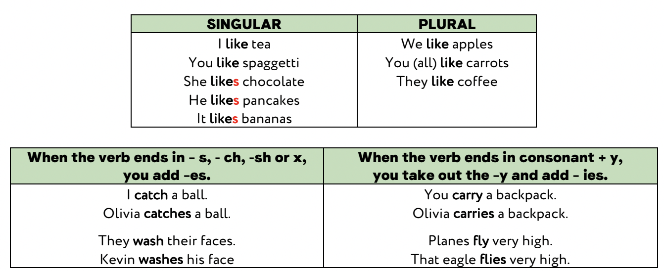
O
RULES TO ADD -S/-ES/-IES:
o

Slide 11
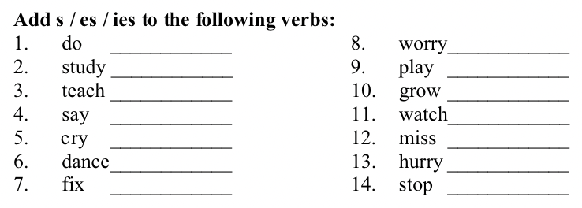

Slide 12
USAGE:
We use the Present Simple to talk about things that
are facts or are true for a long time.
SIGNALS:
always, usually, often, rarely, never,…
once, twice, …times,…
every….

Slide 13

Practice

Slide 14
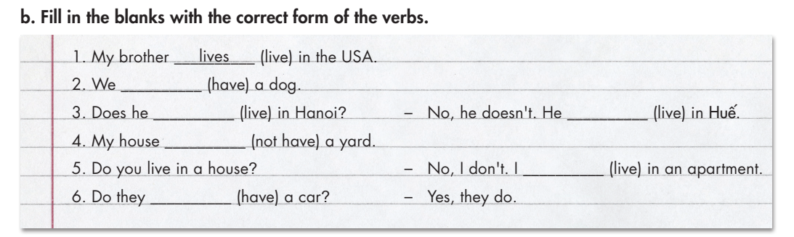
have
live
lives
doesn’t have
live
have

Slide 15
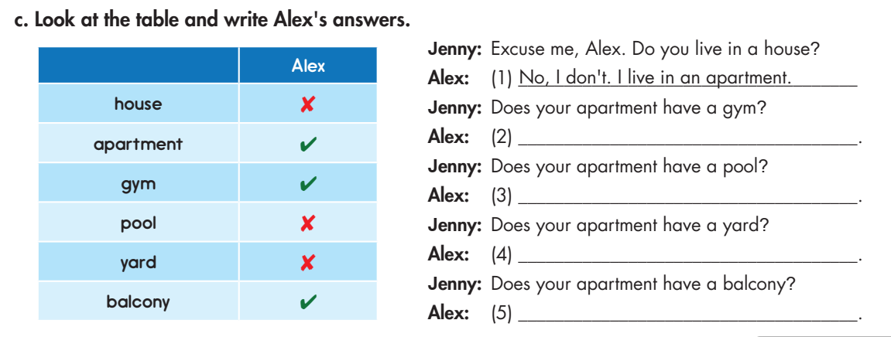
Now, practice the conversation with your partner.
Yes, it does.
No, it doesn’t.
No, it doesn’t.
Yes, it does.

Slide 16
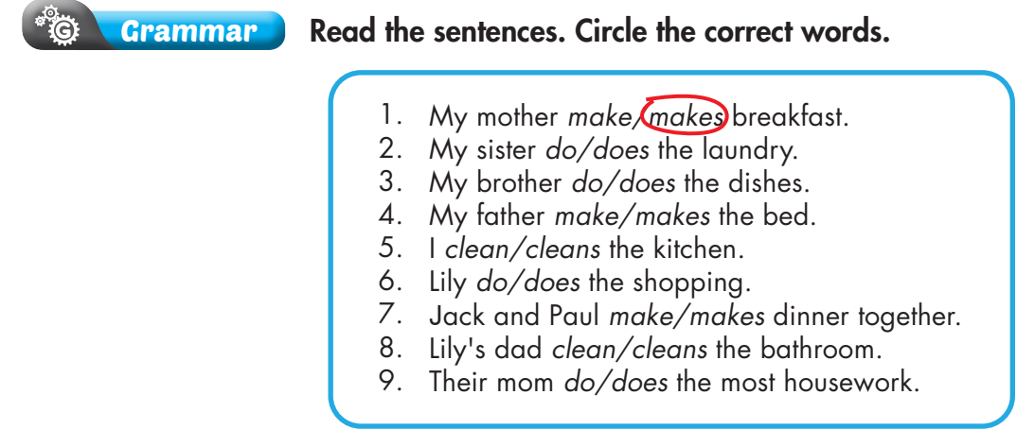
Extra Practice
WB page 5

Slide 17

Production

Slide 18

Work in pairs. Ask and answer, using the cues.
A. Hi, B. you/ live/ apartment?
B. Hello A. No, I/not. I/ live/ house.
A. it/ have/ pool?
B. Yes.
A. it/ have/ gym?
B. No.
A. it/ have/ yard?
B. Yes.

Slide 19
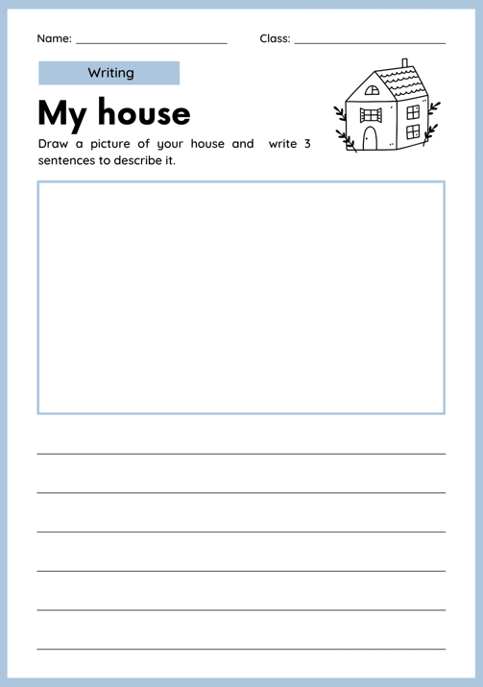

Draw a picture of your house and describe it.

Slide 20

CONSOLIDATION

Slide 21
Work in groups: Talk about your house/ apartment.
Use the grammar point:
  Present Simple tense.

Slide 22

WRAP-UP

Slide 23
Lesson 3
Today’s lesson
Grammar
The Present Simple tense

Slide 24
Lesson 3
Homework
- Review the grammar and practice using them.
- Do the exercise(s) in Tiếng Anh 6 i-Learn Smart World Workbook (page 5)
- Play the consolation games in Tiếng Anh 6 i-Learn Smart World DHA App on www.eduhome.com.vn
- Prepare the next lesson (page 8 - SB)

Slide 25

Enjoy your day!

