Slide 1

Unit 1: Home
Lesson 1.3: Pronunciation & Speaking
Page 8

Slide 2
Objectives
By the end of this lesson, students will be able to…
- Rise intonation at the end of Y/N questions.
- Ask and answer about their houses.
Tiếng anh 6 i-Learn Smart World

Slide 3

WARM UP

Slide 4
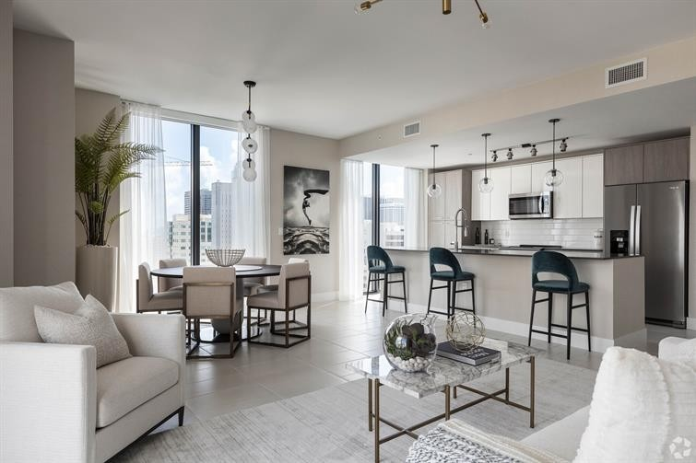
Give the correct form of the verbs in brackets.
1. I ___________ (live) in an apartment.
live

Slide 5
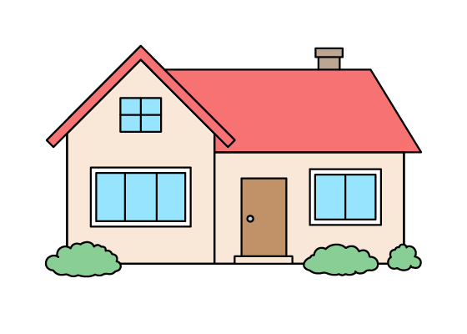
Give the correct form of the verbs in brackets.
doesn’t have
2. Her house ______________ (not have) a yard.

Slide 6
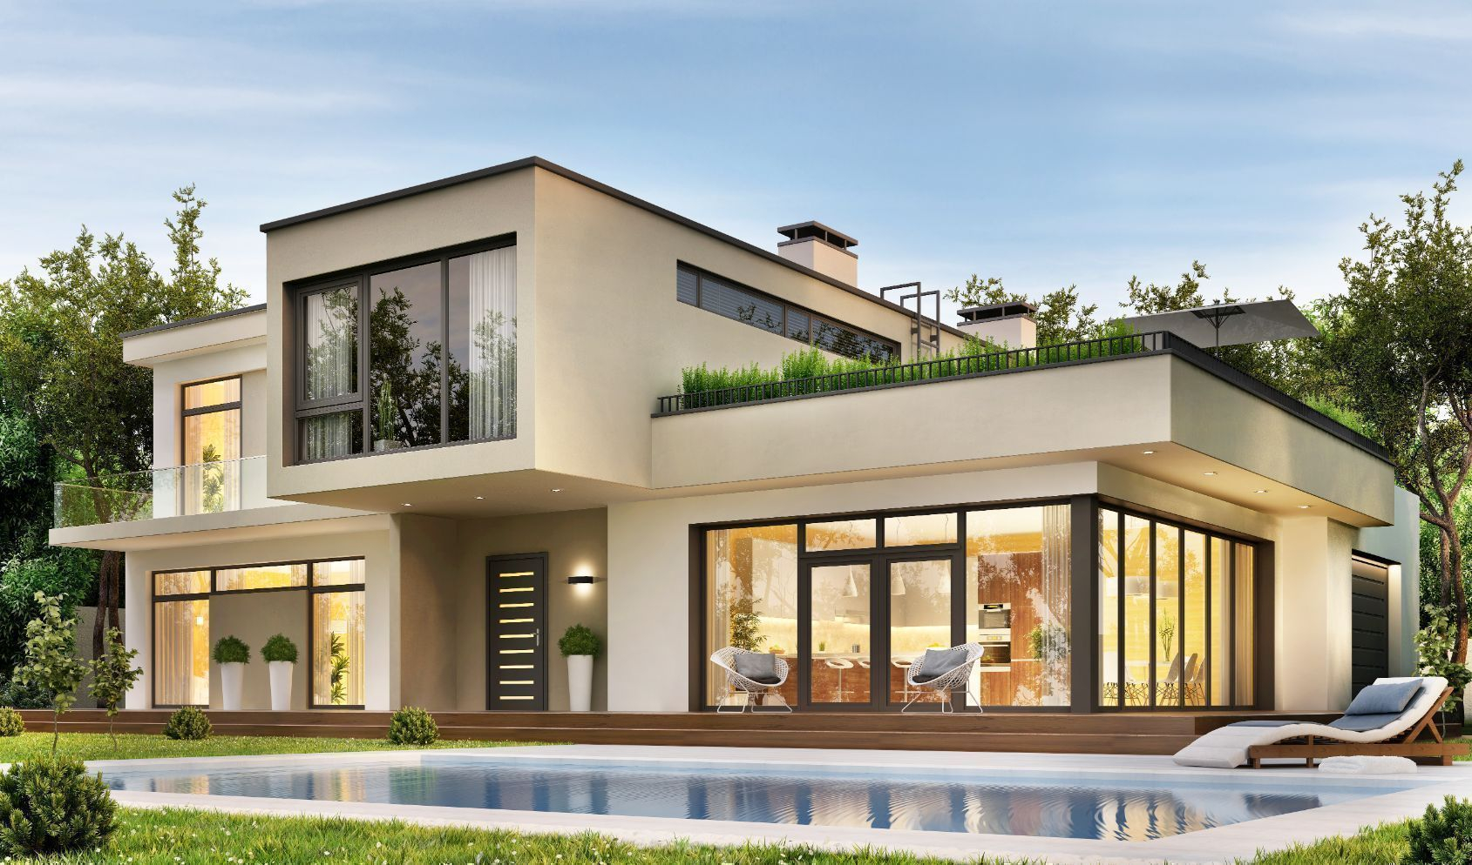
Give the correct form of the verbs in brackets.
is
3. There _______ (be) a swimming pool in his house.

Slide 7
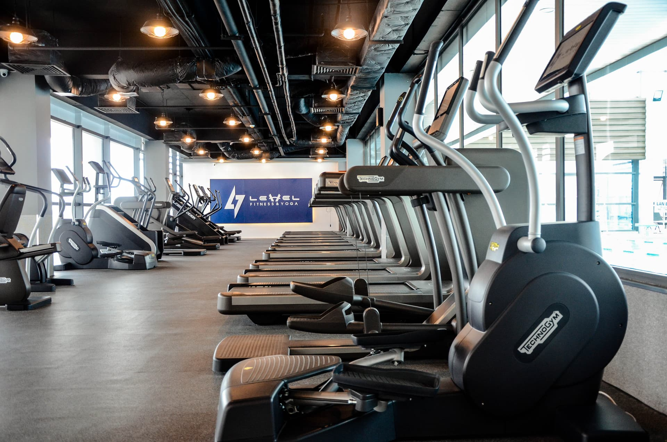
Give the correct form of the verbs in brackets.
Does
have
4. _____ your house _____ (have) a gym?

Slide 8
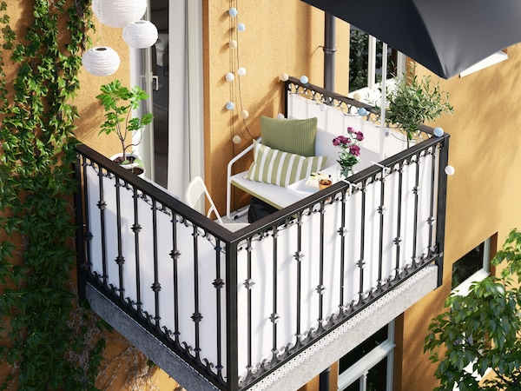
Give the correct form of the verbs in brackets.
Do
want
5. ______ you ______ (want) to have a room with a balcony?

Slide 9



Slide 10
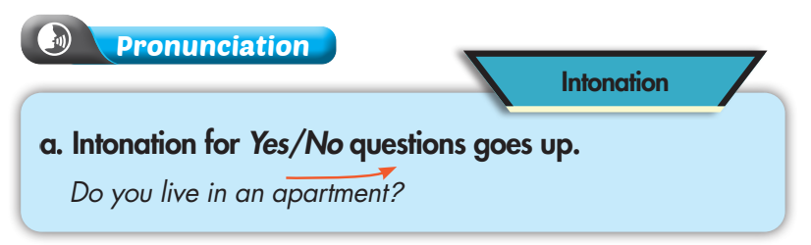
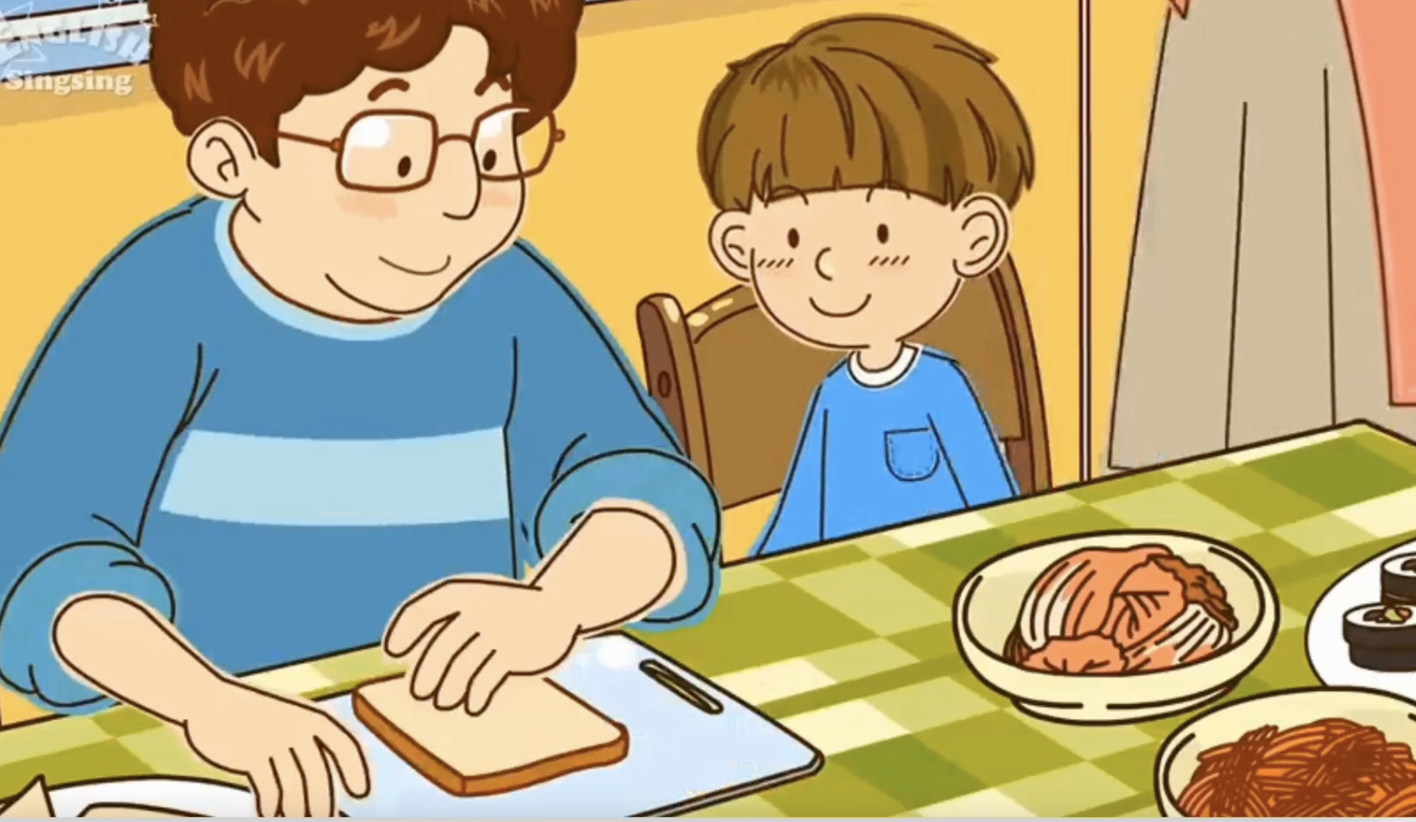
Intonation describes how the voice goes up and goes down.
INTONATION
Watch this video and listen carefully to the ending of “Do you like ….?” questions.
Tiếng anh 6 i-Learn Smart World

Slide 11
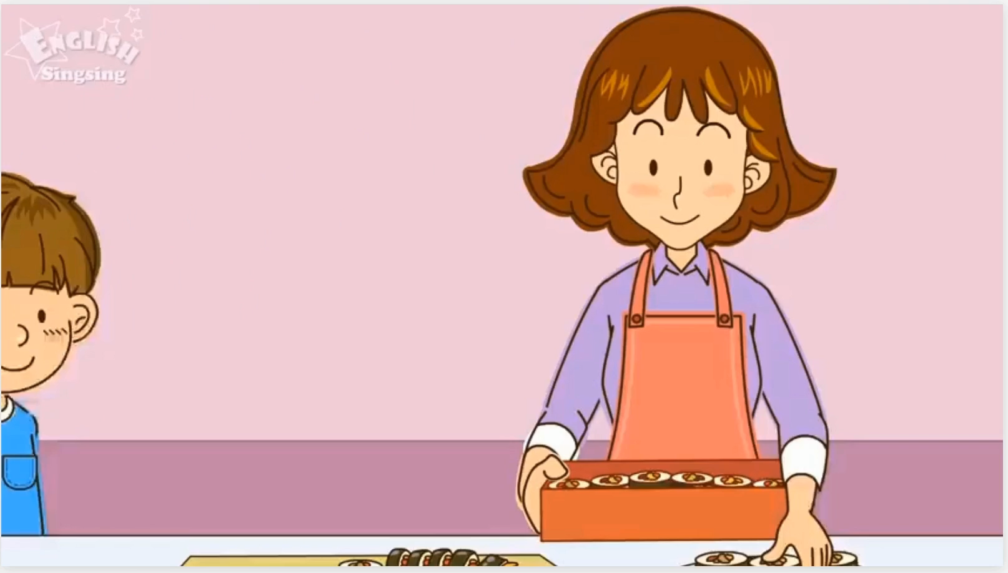
Tiếng anh 6 i-Learn Smart World

Slide 12
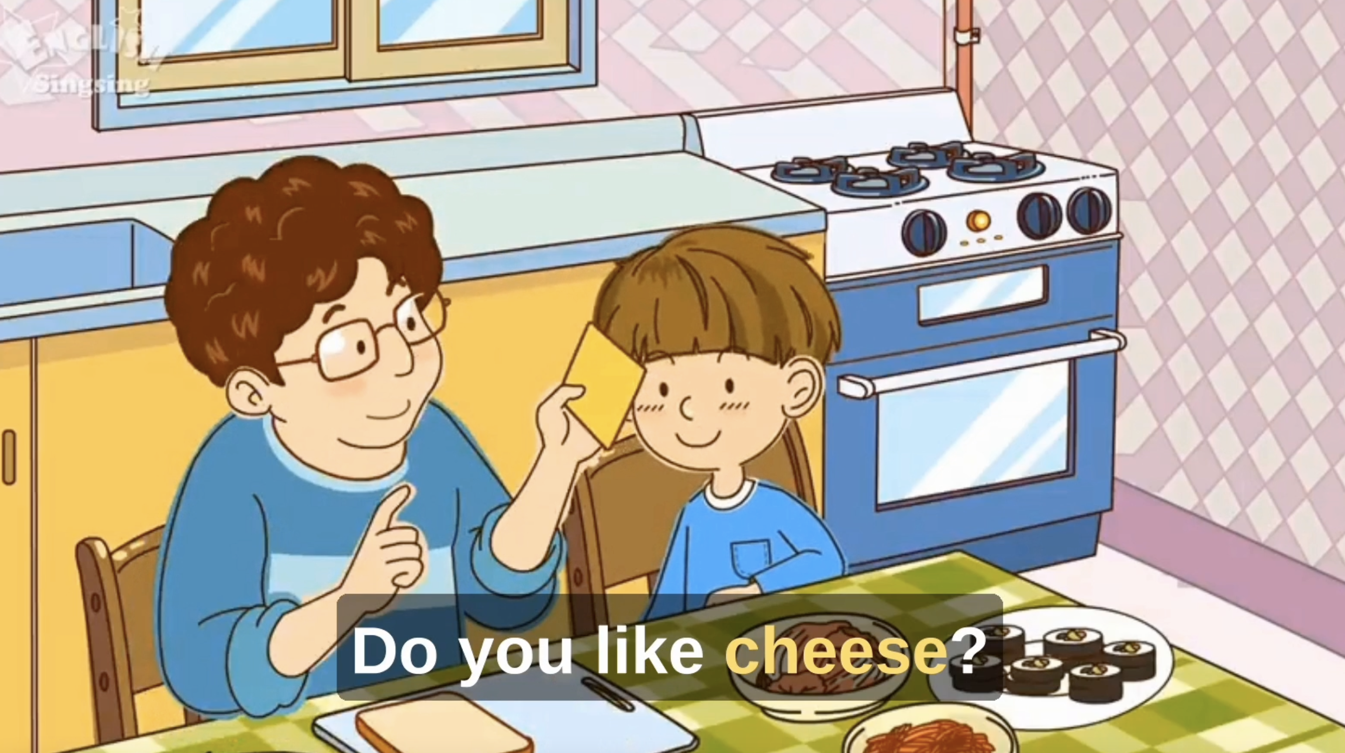
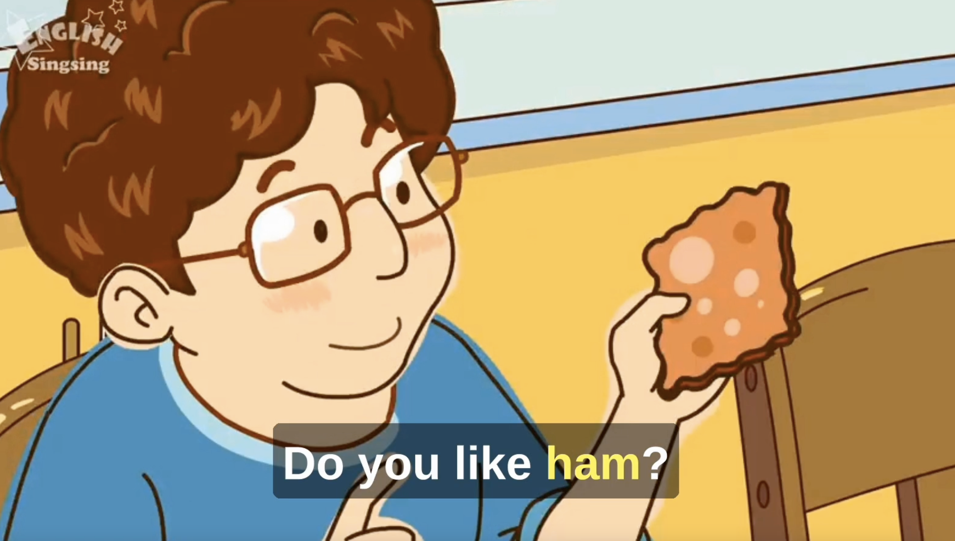
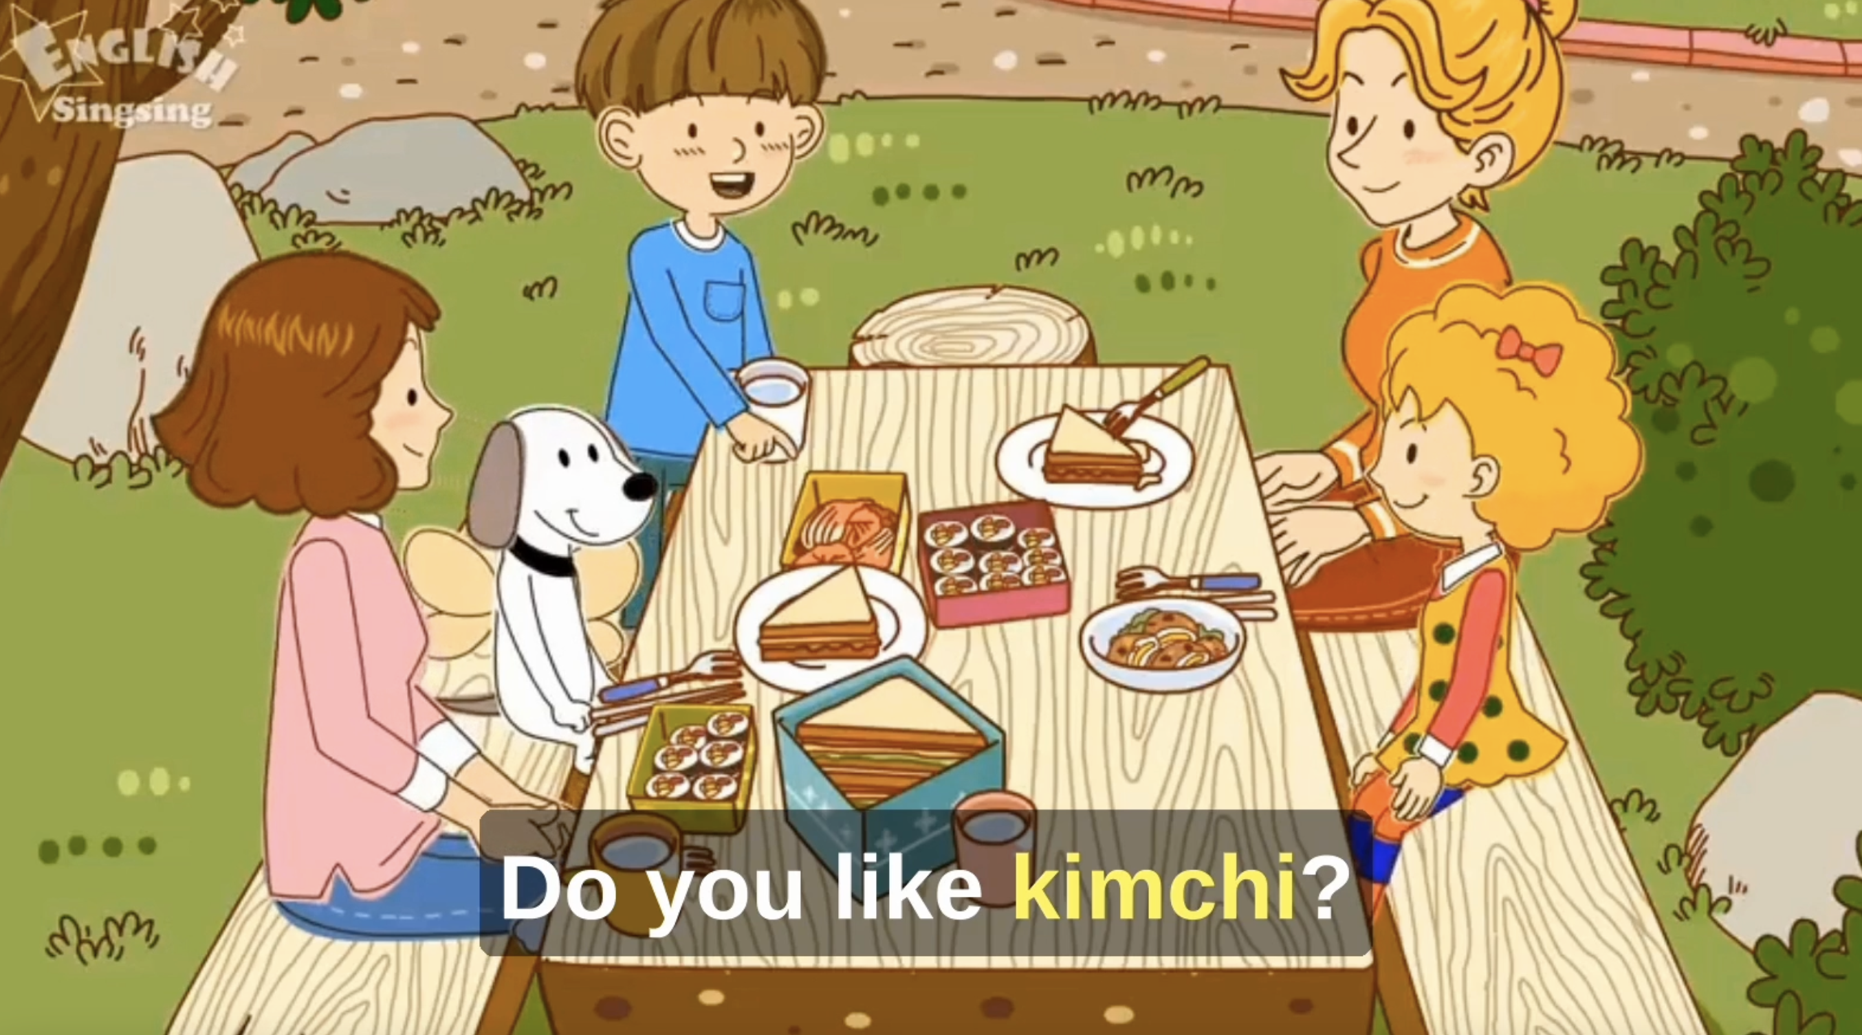
Intonation for Yes/ No questions goes up.
Tiếng anh 6 i-Learn Smart World

Slide 13
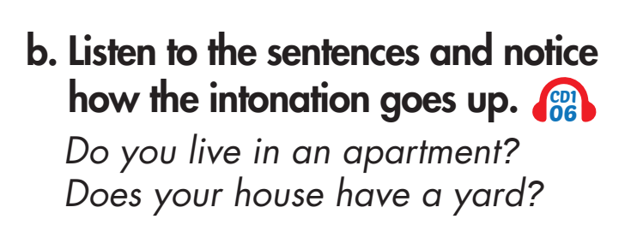

Tiếng anh 6 i-Learn Smart World

Slide 14
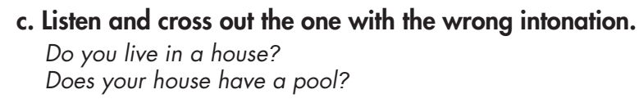

Tiếng anh 6 i-Learn Smart World

Slide 15



Practice the right intonation with a partner.
Tiếng anh 6 i-Learn Smart World

Slide 16
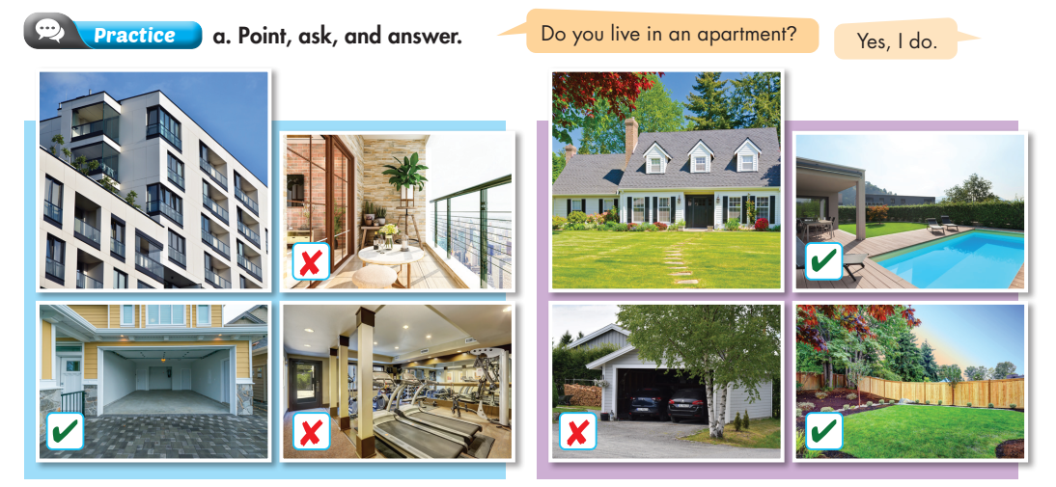
A balcony
A pool
A house
A garage
A gym
A garage
A yard
Tiếng anh 6 i-Learn Smart World

Slide 17
Yes, it does
Does it have a ____?
No, it doesn’t
Tiếng anh 6 i-Learn Smart World

Slide 18
Use your own idea
Yes, it does
Does it have a ____?
No, it doesn’t
Tiếng anh 6 i-Learn Smart World

Slide 19

Speaking

Slide 20
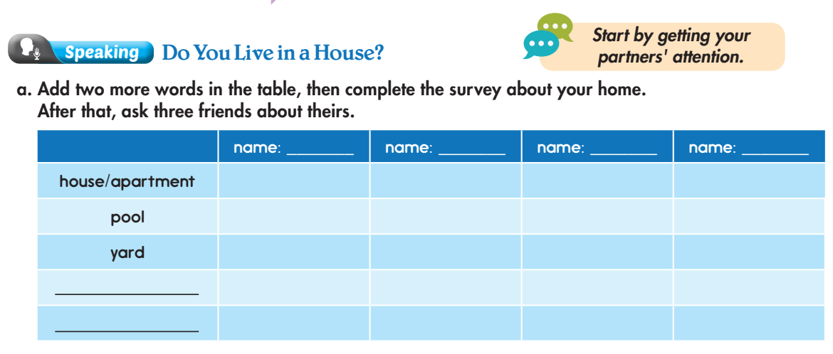
Pre-Speaking
A balcony
you
A garage
A gym
Do you live in a ____?
Yes, I do
No, I don’t
Does it have a ____?
Yes, it does
No, it doesn’t
Tiếng anh 6 i-Learn Smart World

Slide 21
Pre-Speaking
you
Do you live in a ____?
Yes, I do
No, I don’t
Does it have a ____?
Yes, it does
No, it doesn’t
Tiếng anh 6 i-Learn Smart World

Slide 22
Post-Speaking
b. Report to the class about your group.
In our group, two people live in houses.
Two people live in apartments.
Three people have balconies.
…………………………..
…………………………..
…………………………..
Tiếng anh 6 i-Learn Smart World

Slide 23

CONSOLIDATION
Tiếng anh 6 i-Learn Smart World

Slide 24

RULES:
- Add more information to the sentence to make it longer.
- The group that can make the sentence the longest with correct grammar and spelling will be the winner.
EXAMPLE:
- Teacher’s sentence: My house has a gym.
- Team 1: My house has a gym and a garage.
- Team 2: My house has a gym and a garage. The garage is very big.
- Team 3: My house has a gym and a garage. The garage is very big. There are 3 cars in the garage.
- Team 4: My house has a gym and a garage. The garage is very big. There are 3 cars in the garage. There is a yard in front of my house.
Tiếng anh 6 i-Learn Smart World

Slide 25

WRAP-UP

Slide 26
Lesson 3
Today’s lesson
Speaking:
- Rise intonation at the end of Y/N questions.
- Ask and answer about our houses.
Tiếng anh 6 i-Learn Smart World

Slide 27
Lesson 3
PROJECT UNIT 1:
Group 1: Introduce the city “Rome” – Italy by making a presentation in Powerpoint
Group 2: Introduce the place “Sapa” – Viet Nam by making a poster
Group 3: Introduce the place “Sydney” – Australia by making a video
Group 4: Introduce the city “New York” – the USA by making a presentation in Powerpoint

Slide 28

Lesson 3
PROJECT UNIT 1:
Your presentation should include this following information about the city:
Introduction
People (population, character)
Weather
Landmarks
Speciality (Food & Drink)
Conclusion

Slide 29
Lesson 3
Homework
- Review the vocabulary and grammar notes in Tiếng Anh 6 i-Learn Smart World Notebook.
- Play the consolation games in Tiếng Anh 6 i-Learn Smart World DHA App on www.eduhome.com.vn
- Prepare the next lesson (page 9 - SB)
Tiếng anh 6 i-Learn Smart World

Slide 30

Enjoy your day!

