Slide 1










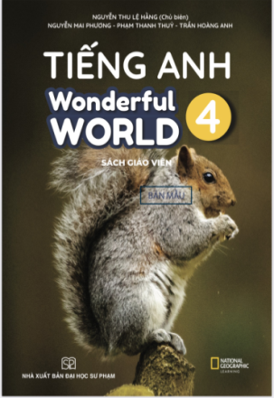








Slide 2



Unit 2 - My House
Lesson 1 – Period 2

Slide 3
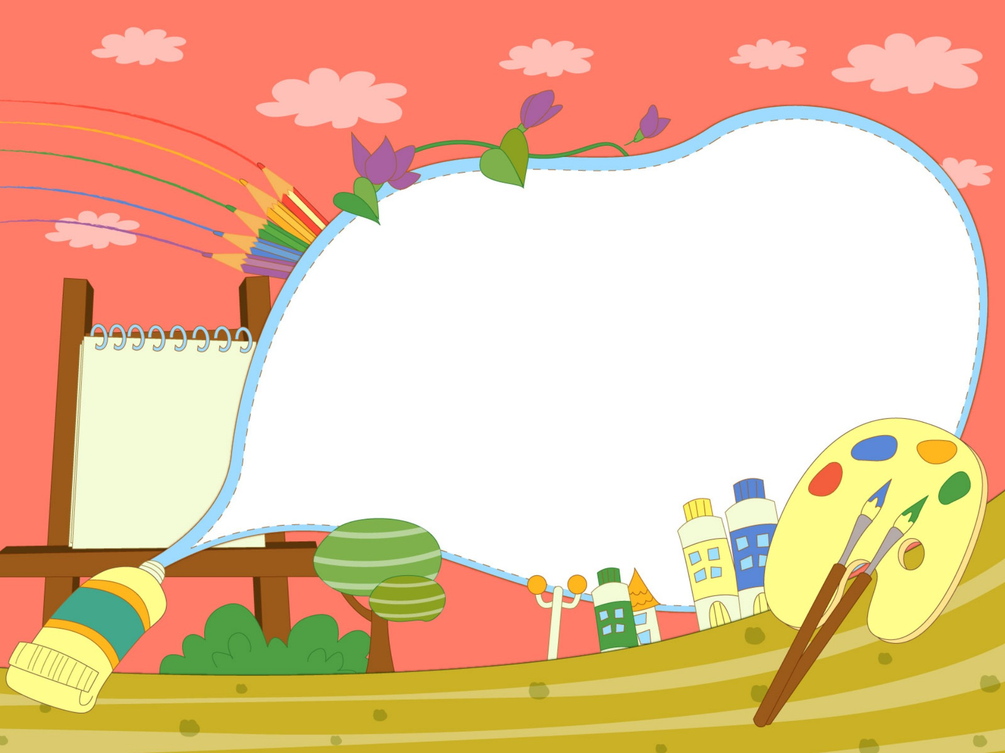

1. Warm up

Slide 4

Do a crossword in red?
6
1
B
A
T
H
R
O
O
M
2
D
I
N
I
N
G
R
O
O
M
3
C
O
M
P
U
T
E
R
4
B
O
W
L
S
5
P
E
N
Next
Notes:
Chọn số 1-5, hiện slide hình để hs trả lời
Ân back sẽ tự động hiện từ ở slide 4
Câu 6 ấn sẽ hiện key.

Slide 5
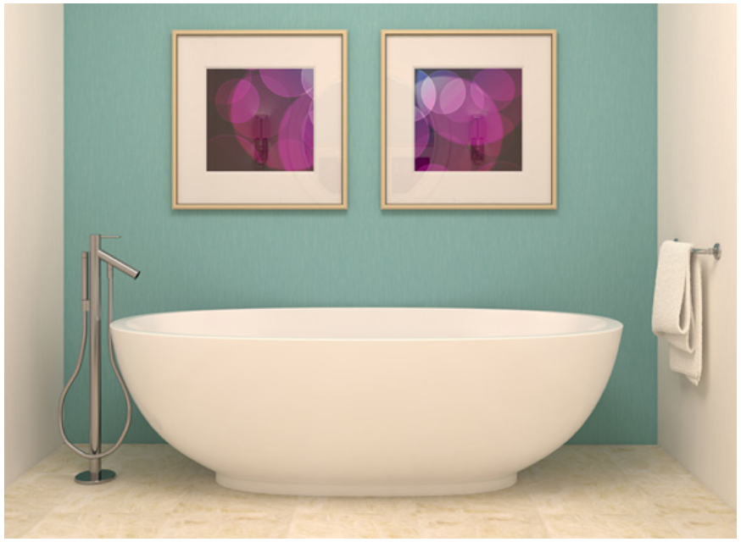
HOME

Slide 6
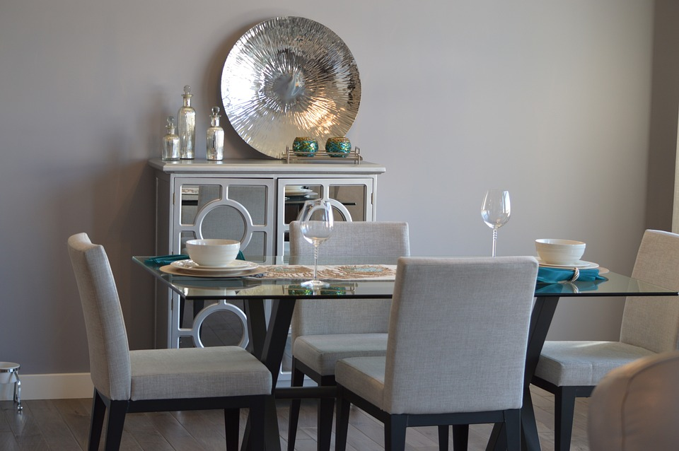
HOME

Slide 7
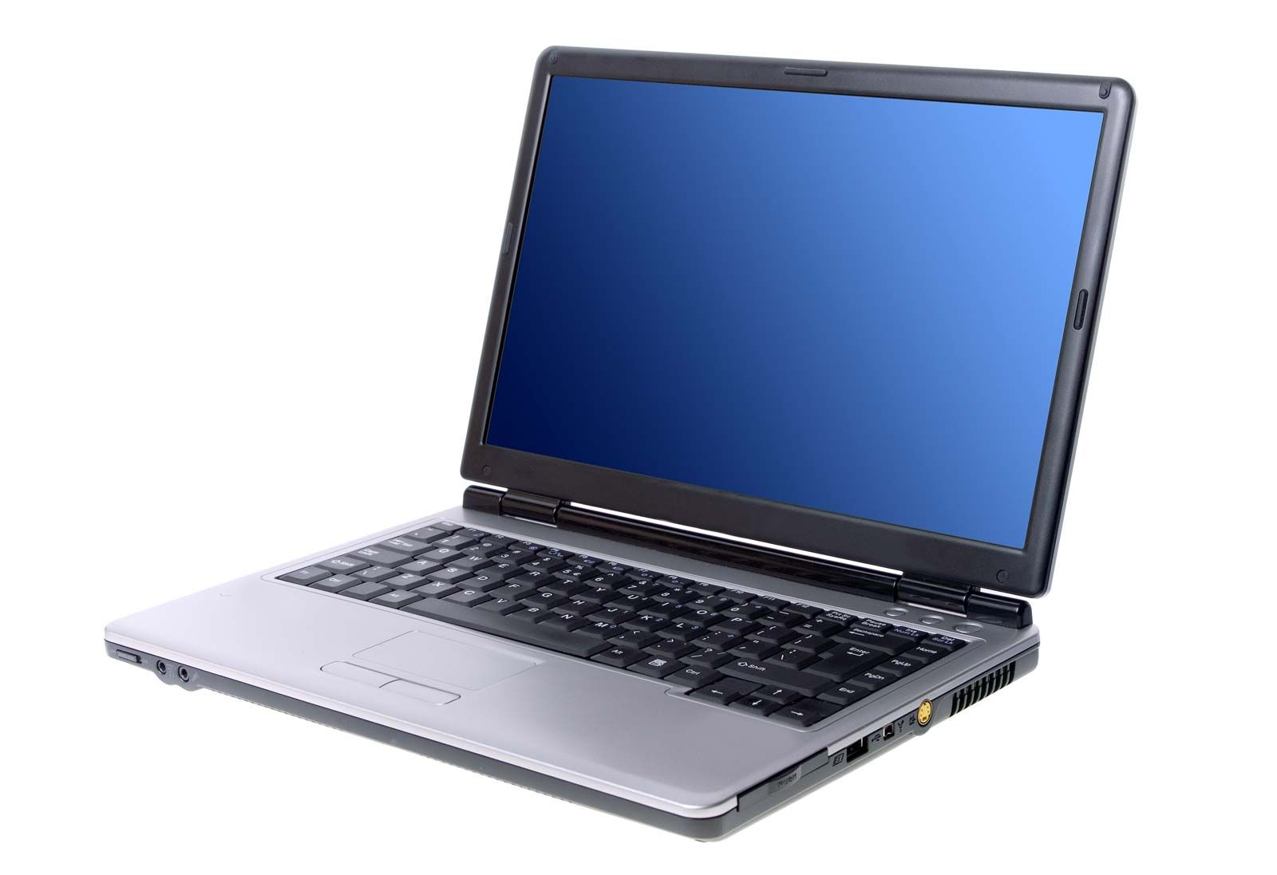
HOME

Slide 8
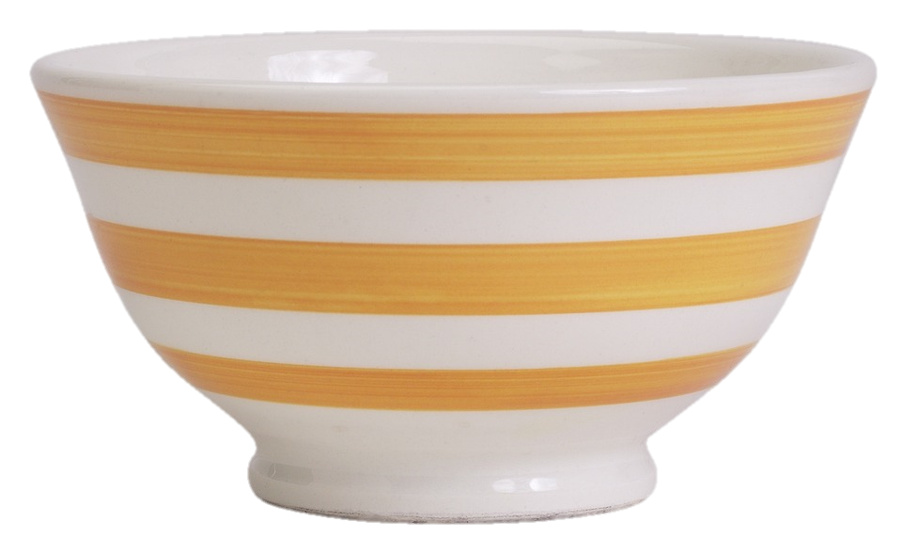
HOME

Slide 9
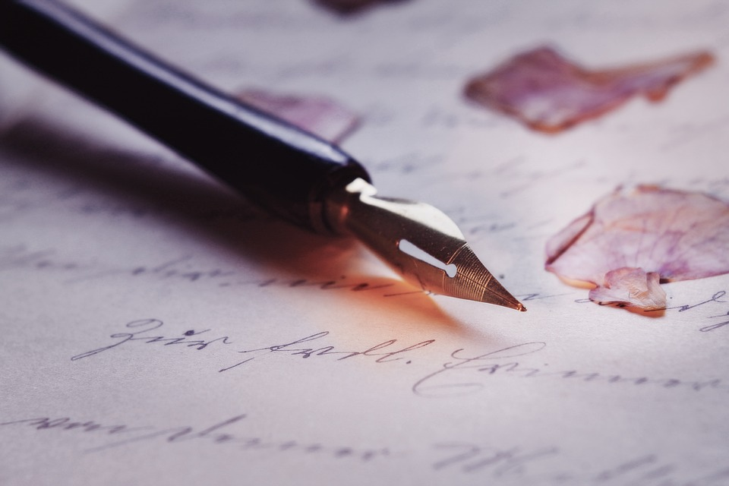
HOME

Slide 10

Presentation
4
Listen and repeat.

Slide 11


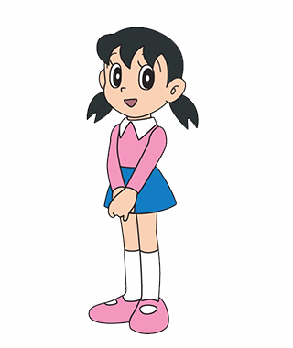

Possessive Adjective
He
- his
I
- my
We
- our
She
- her
They
- their

Slide 12

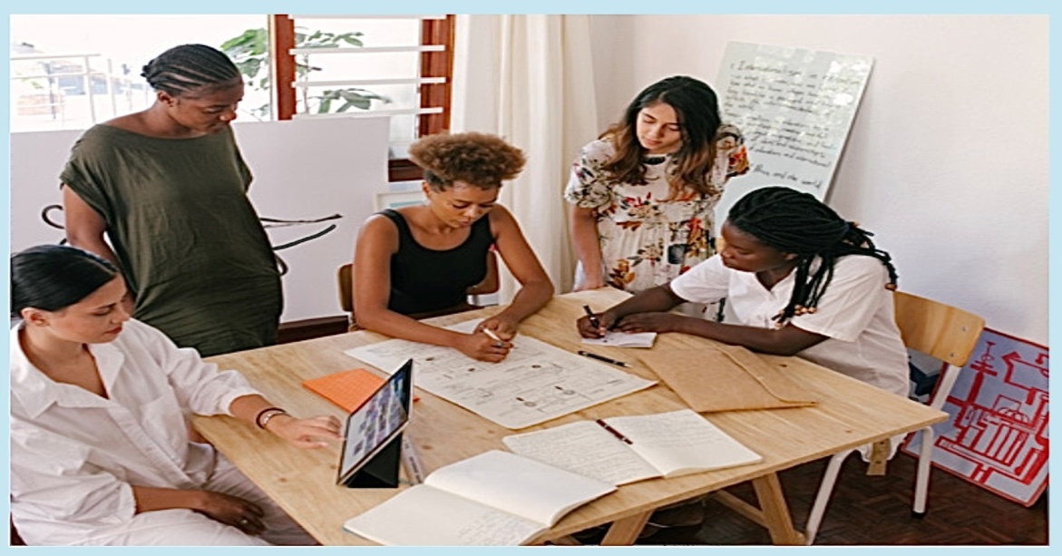
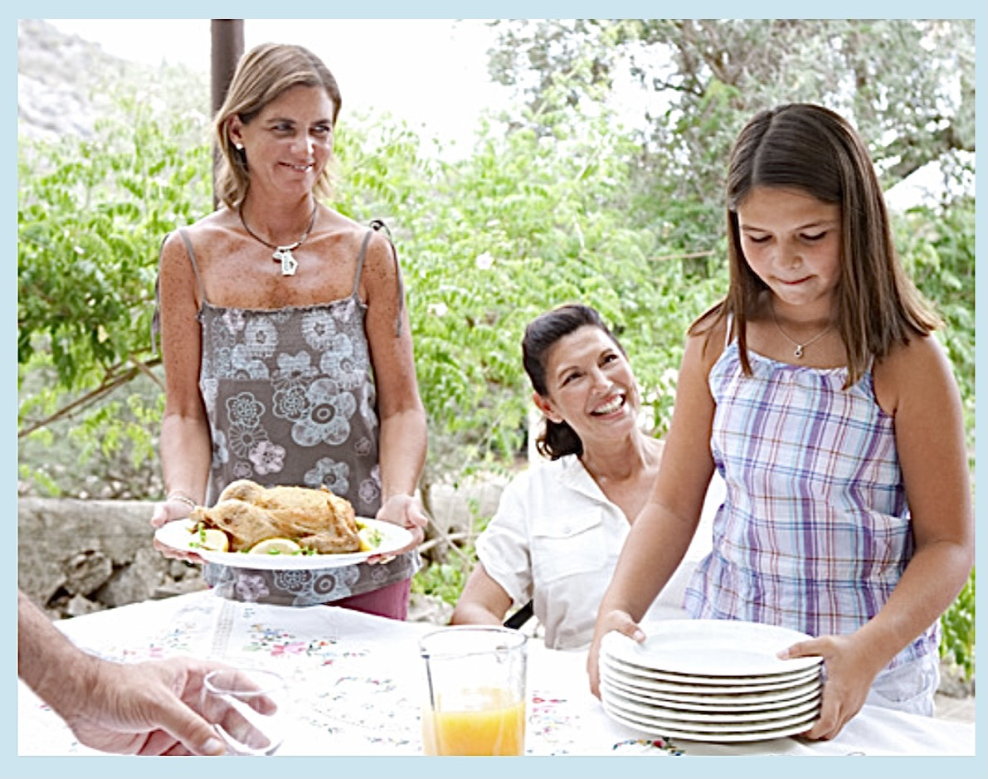
Choose the correct answer
1
Whose table is it?
2
Whose plates are they?
A. It’s their table.
A. They’re my plates.
B. It’s his table.
B. They’re his plates.
C. It’s her table.
C. They’re our plates.

Slide 13

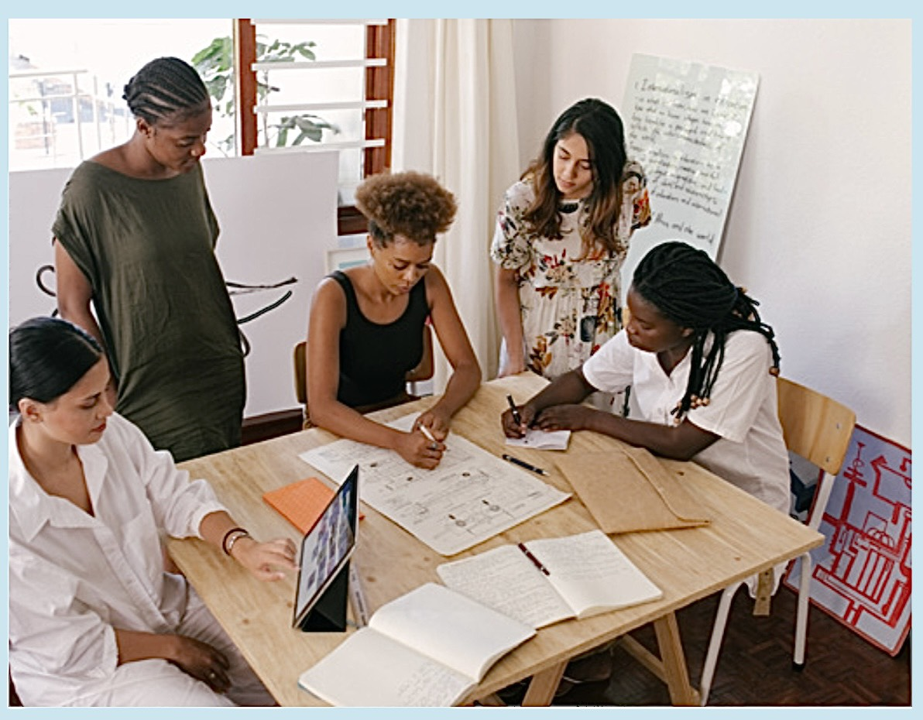
4
Listen and repeat.
1
Whose table is it?
2
Whose plates are they?
- It’s their table.
- They’re our plates.

Slide 14

Practice
5
Look and say.

Slide 15

Yes or No

Slide 16
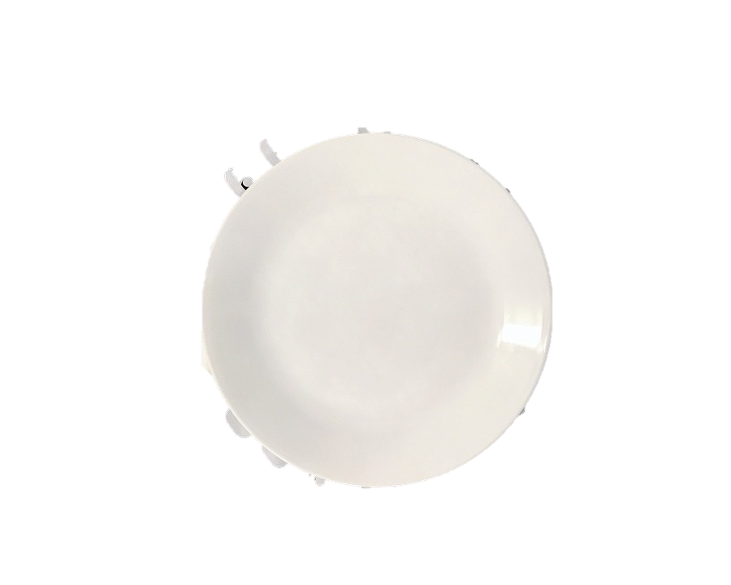
1. Is this a bowl?
2. Is this a spoon?
Yes
No
Yes
No
No, it’s a plate.

Slide 17
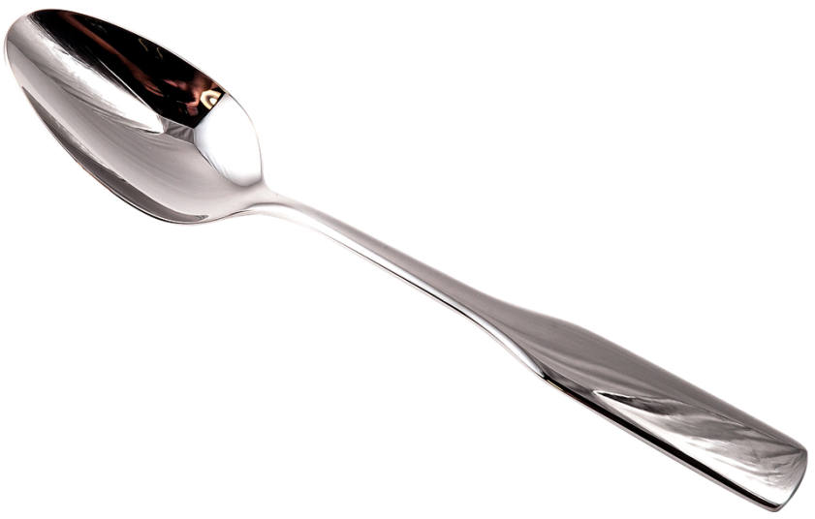

3. Are there two plates?
4. Is this a garden?
Yes
No
Yes
No
No, they are spoons.

Slide 18

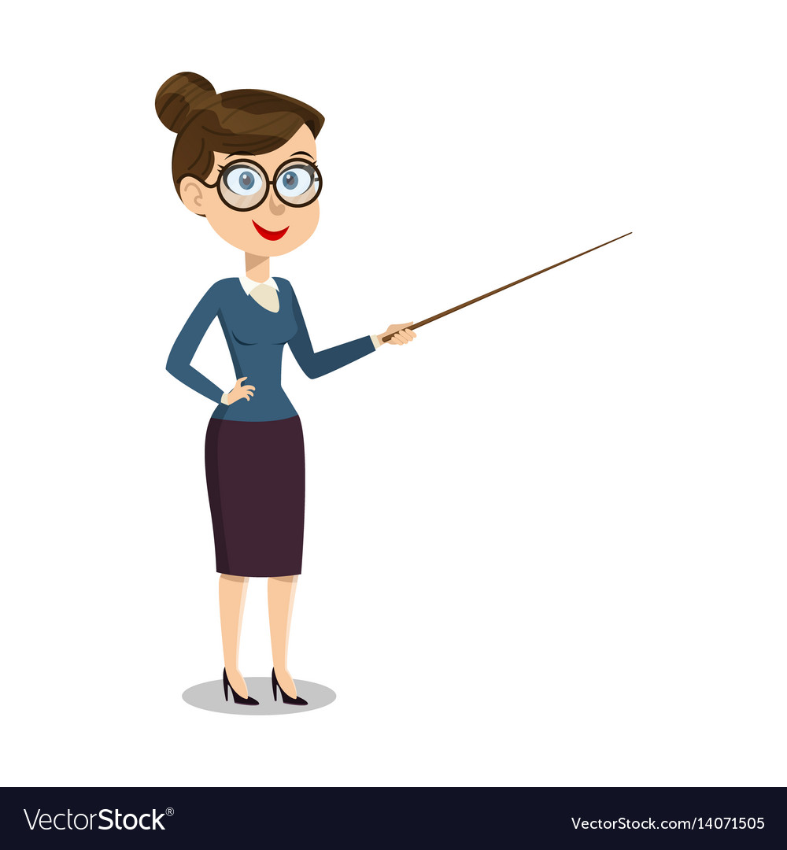
5
Look and say.
bowl/his
Whose bowl is it?
It’s his bowl.

Slide 19
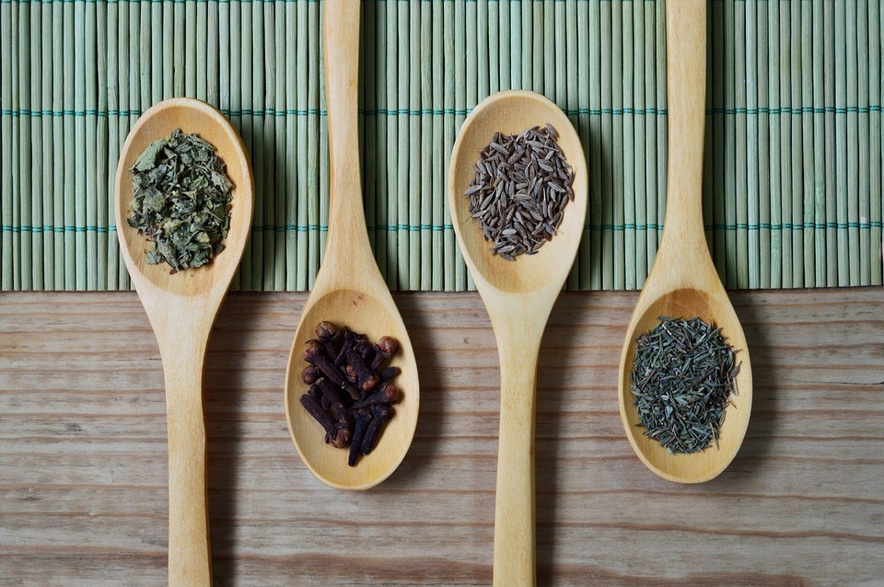


spoons/her
Whose spoons are they?
They’re her spoons.

Slide 20

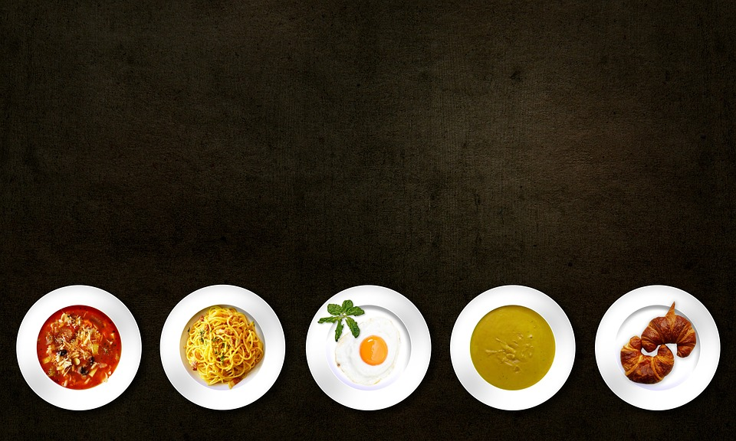
plates/our
Whose plates are they?
They’re our plates.

Slide 21

garden/their
Whose garden is it?
It’s their garden.

Slide 22
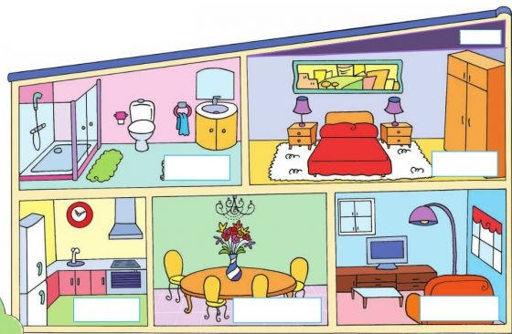
Further practice
It is…/ They are...
my …
his …
her …
our …
their…

Slide 23

Production
6
Let’s talk.

Slide 24
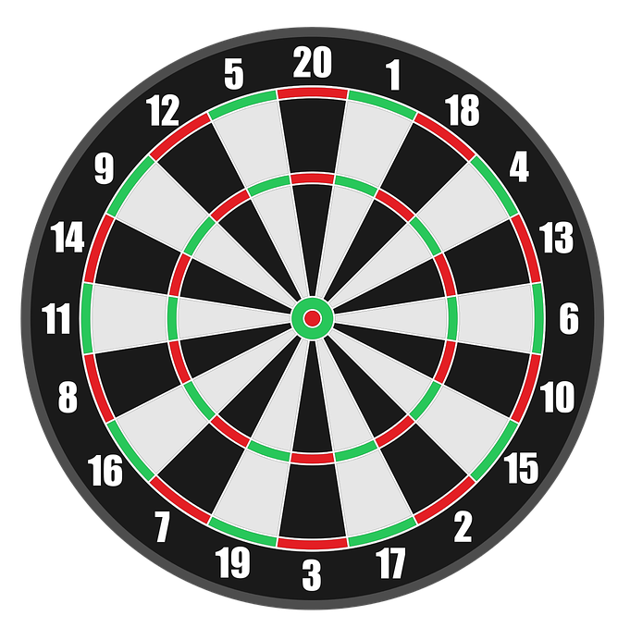
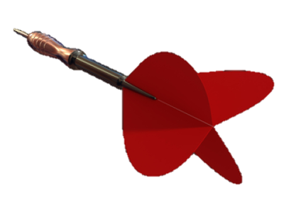

Game :Dart Board
Look and answer
1
3
5
2
4
Next

Slide 25



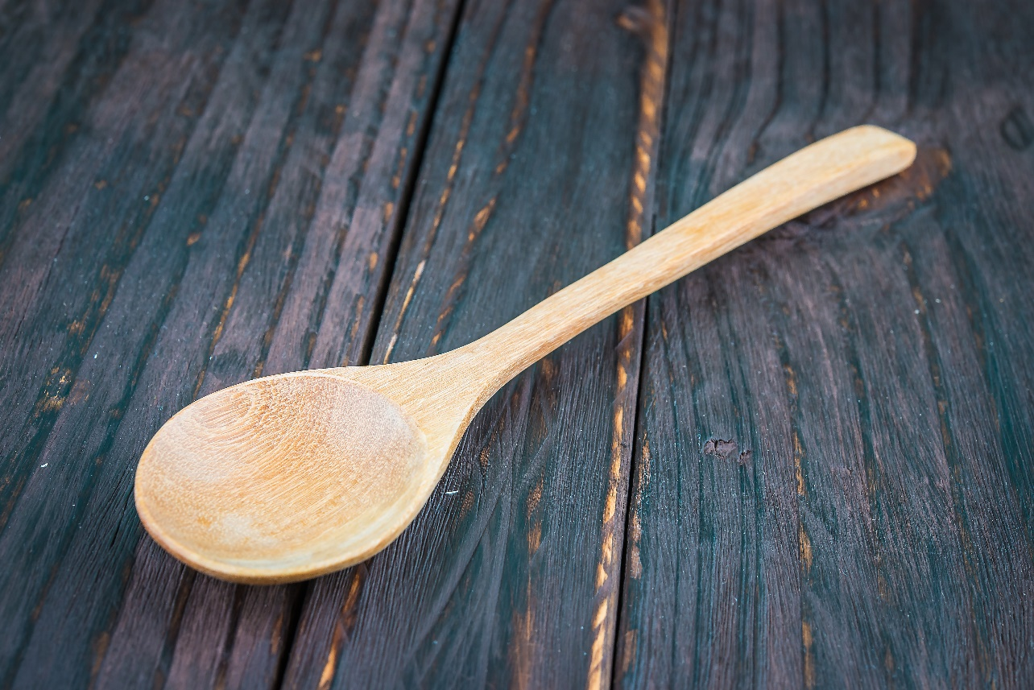


Whose spoon is it?
+ 3
It’s my spoon.
Next
They’re my spoons.
Abc.xyz789

Slide 26
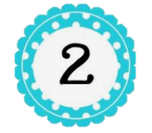
Whose pen is it?
It’s ___pen.
+5
her
his
Next
Abc.xyz789

Slide 27
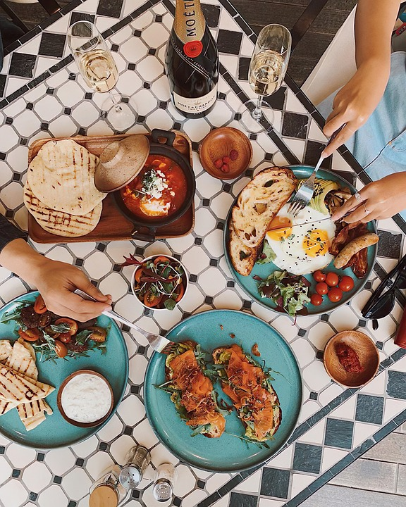

3
They’re his _____ and____.
+8
plates/table
spoons/table
Next
Abc.xyz789

Slide 28


Whose spoons are they?
+ 6
They’re my spoons.
They’re my bowls.
Next
Abc.xyz789

Slide 29


They’re___ schoolbags.
+4
his
their
Next
Abc.xyz789
Notes:
Ms Huyền Phạm - 0936.082.789 – YOUTUBE: MsPham. Facebook: Dạy và học cùng công nghệ.

Slide 30

Assessment

Slide 31
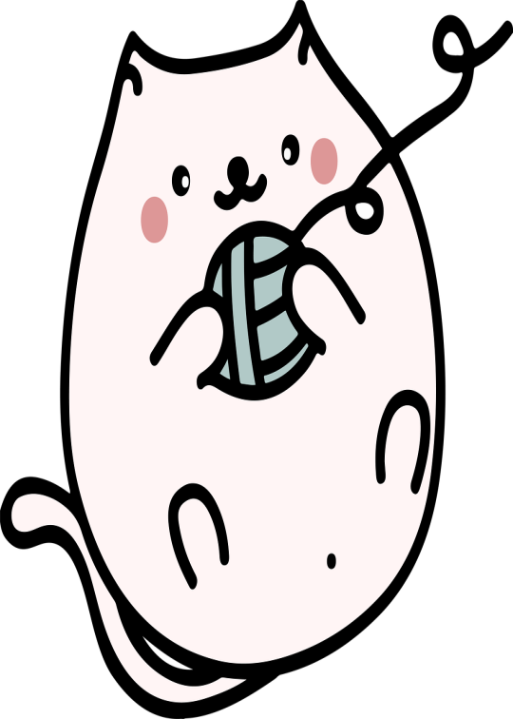
Choose the correct answers.
1. It ___ my pen and pencil.
A. is
B. are
C. do
D. does
2. They’re our ____________.
A. boke
B. bokso
C. bowk
D. books
3. Whose spoon is it? It’s ____ spoon.
A. I
B. we
C. his
D. he
4. Your _______ is so big!
A. is
B. dining room
C. do
D. does
Notes:
HOẠT ĐỘNG TƯƠNG TÁC

Slide 32
Wrap up
Notes:
Đây k phải là extra, đây là hđ 3 của bài

Slide 33
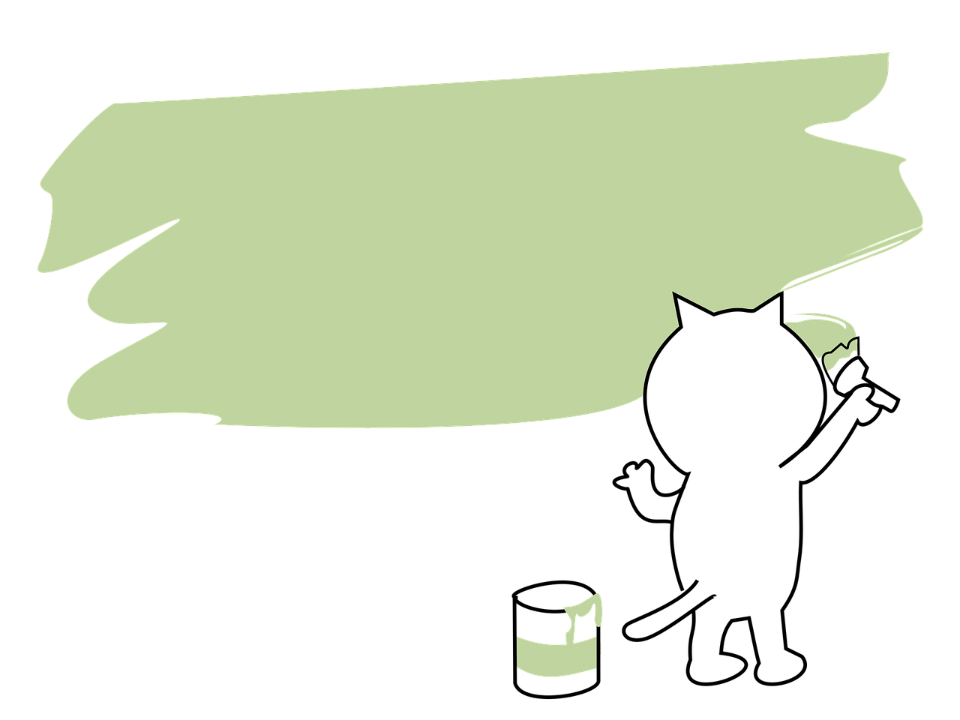
Structure
Whose ___ is it/ are they?
It’s____.
They’re ___.

Slide 34




Thank you & goodbye!

