Slide 1

English 9
UNIT 3: TEEN STRESS AND PRESSURE
PERIOD 17: A CLOSER LOOK 1
Welcome to our class

Slide 2
WARM UP: BRAINSTORMING
sadness
depression
embarrassment
frustration
NEGATIVE FEELINGS
doubt
disapointment
fear
jealousy

Slide 3
VOCABULARY
adolescence (n) /ˌædəˈlesns/:
giai đoạn vị thành niên
independence (n) /ˌɪndɪˈpendəns/:
sự độc lập, tự lập
self-aware (adj) /self-əˈweə(r)/:
tự nhận thức, ngộ ra
self-control (adj) / self-kəntroul/:
tự kiểm soát
reasoning skills /’riznɪŋ-skɪl/:
kỹ năng thuyết phục
embarrassed (adj) /ɪmˈbærəst/:
xấu hổ
informed (adj) /ɪnˈfɔːmd /:
có suy nghĩ, có cân nhắc

Slide 4
1. Complete the paragraph with the words in the box. There is one word that you don't need.
independence informed shape and height
embarrased delighted self–aware reasoning skills
Adolescence is the period between childhood and young adulthood. Your body will change in (1)____________. Your brain will grow and you'll have improved self-control and (2) ____________ . Physical changes are different for everyone, so you don't need to feel (3) ____________ or frustrated!
You'll experience emotional changes as well. You'll feel you want more (4) ____________ and responsibility. You may become more (5) ____________ and care about other people's opinions, especially those of your friends. But remember you'll need adult support and guidance to make
(6) ____________ decisions and overcome stress.
shape and height
reasoning skills
embarrased
independence
self - aware
informed

Slide 5
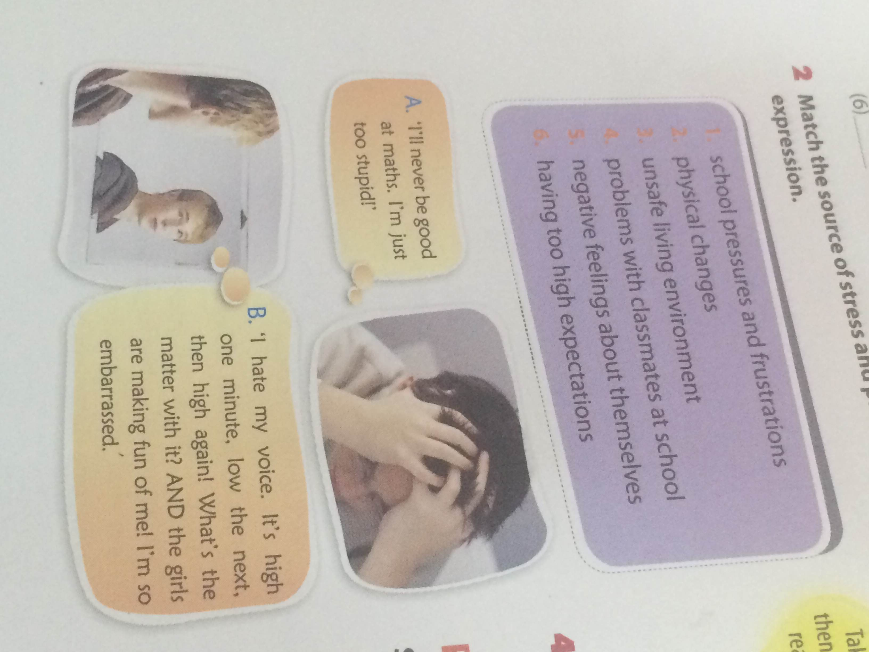
2. Match the source of stress and pressure to the expression.
1. school pressures and frustrations
2. physical changes
3. unsafe living environment
4. problems with classmates at school
5. negative feelings about themselves
6. havirig too high expectations
A. I’ll never be good at maths. I’m just too stupid.
5. negative feelings about themselves

Slide 6
2. Match the source of stress and pressure to the expression.
1. school pressures and frustrations
2. physical changes
3. unsafe living environment
4. problems with classmates at school
5. negative feelings about themselves
6. havirig too high expectations
B. 'I hate my voice. It's high one minute. low the next, then high again! What's the matter with it? AND the girls are making fun of me! I'm so
embarrassed.'
2. physical changes

Slide 7
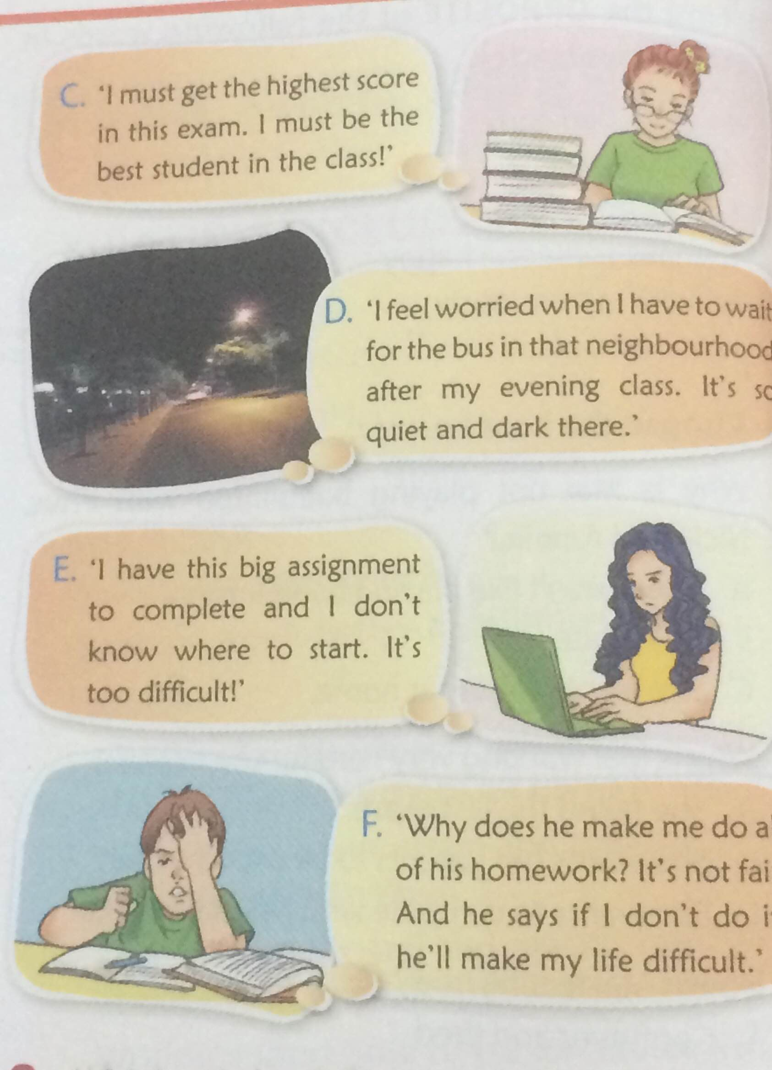
2. Match the source of stress and pressure to the expression.
1. school pressures and frustrations
2. physical changes
3. unsafe living environment
4. problems with classmates at school
5. negative feelings about themselves
6. having too high expectations
C. 'I must get the highest score in this exam.
I must be the best student in the class!'
6. having too high expectations

Slide 8
2. Match the source of stress and pressure to the expression.
1. school pressures and frustrations
2. physical changes
3. unsafe living environment
4. problems with classmates at school
5. negative feelings about themselves
6. havirig too high expectations
D. 'I feel worried when I have to wait for the bus in that neighbourhood after my evening class. It’s so quiet and dark there.'
3. unsafe living environment

Slide 9
2. Match the source of stress and pressure to the expression.
1. school pressures and frustrations
2. physical changes
3. unsafe living environment
4. problems with classmates at school
5. negative feelings about themselves
6. havirig too high expectations
E. 'l have this big assignment to complete and l don't know where to start. It’s too difficult!'
1. school pressures and frustrations

Slide 10
2. Match the source of stress and pressure to the expression.
1. school pressures and frustrations
2. physical changes
3. unsafe living environment
4. problems with classmates at school
5. negative feelings about themselves
6. havirig too high expectations
F. 'Why does he make me do all of his homework? It's not fair. And he says if I don't do it, he'll make my life difficult.'
4. problems with classmates at school

Slide 11
2. Which of the following can be done in the above situations? Discuss with your partner. (More than one solution can be suitable for one situation.)
1.Take a break, then you will feel ready to start again.
2.Break a large task into smaller tasks.
3. Focus on your strong points.
4. Talk to someone about this and/or ask them for help.
4. Have you ever been in any of these situations?
If so, what did you do to deal with them?
A. 1;3;4
B. 4
C. 1
D. 4
E. 1; 2
F. 4

Slide 12

PRONUNCIATION
Stress on the verb be in sentences
Listen again to what Veronica said in GETTING
STARTED. Notice the way she pronounced the
verb be in the sentence.
'Hi Phuc! Where's Mai?
Isn't she coming?'

Slide 13
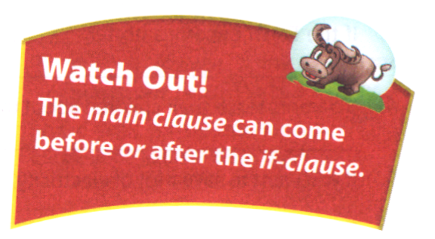
Remember!
Normally the verb be is unstressed in the middle or at the start of a sentence for a statement or question.
Example: She was stressed.
Are you worried about something?
However, the verb be is stressed in negative questions and at the end of the sentences.
Example: Aren’t you coming?
Yes, I am.
Also, it is stressed for emphasis or contrast.
Example:
She isn’t coming.
She is coming, but she’ll be a little late.

Slide 14
5. Listen to the recording and practise saying the sentences. Pay attention to the way the verb be is pronounced.
1. - Where are you? You aren't at the bus stop.
- I am at the bus stop, but I can't see you.
2. - Are you busy right now?
- Yes, I am. Sorry, could you wait for a minute?
3. - Is Ronia in?
- No, she's out ice-skating.
- But it's so cold!
- It is. But she's got all her warm clothes on.
4. - Wasn't Bill disappointed about the exam result?
- He was. But he was hiding it well.

Slide 15
6. Look at the following sentences and underline the verb forms of be which should be stressed. Then listen to the recording to check and practise.
1. - You aren't worried about the exam? Good for you!
- I am worried! But I try not to show it.
2. - Do you think Jack is good at Japanese?
- He is. But he's a bit shy to speak it.
3. - Isn't badminton her favourite sport?
- Yes, it is.
4. - Who's he?
5. - Sorry - we're late!
- Actually, you aren't. We haven't started yet.
6. - Is she happy at the new school?
- Yes, she is. She likes it a lot.

Slide 16
6. Look at the following sentences and underline the verb forms of be which should be stressed. Then listen to the recording to check and practise.
1. - You aren't worried about the exam? Good for you!
- I am worried! But I try not to show it.
2. - Do you think Jack is good at Japanese?
- He is. But he's a bit shy to speak it.
3. - Isn't badminton her favourite sport?
- Yes, it is.
4. - Who's he? (no stress)
5. - Sorry - we're late!
- Actually, you aren't. We haven't started yet.
6. - Is she happy at the new school?
- Yes, she is. She likes it a lot.

Slide 17
THANK YOU FOR YOUR ATTENTION!

