Slide 1
WELCOME  TO  OUR  CLASS
ENGLISH 7
THCS ĐÔNG QUANG
Nguyen Thi Bich Lien

Slide 2
Check homework
What do you like or not like doing/hobby?
(using liking + V_ing).
How about your family, they like or not like what you do?
My father likes watching TV, but he doesn’t likes listening to music.

Slide 3


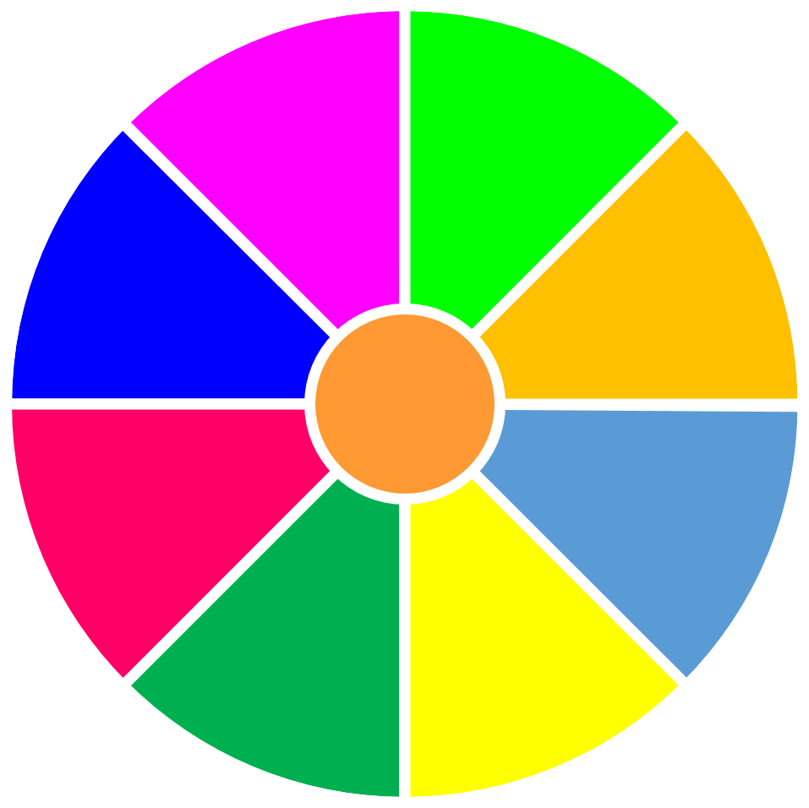



VÒNG QUAY
MAY MẮN
30
20
1
2
3
40
10
50
80
4
5
6
60
70
QUAY

Slide 4

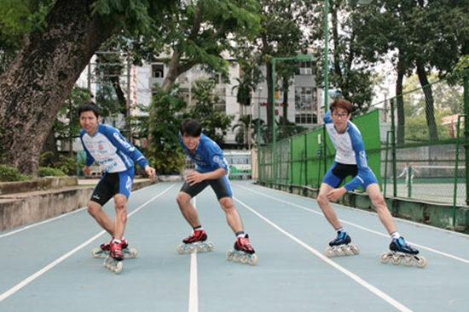
What do the boys like doing?
1
A. They like skating.
B. They are playing skating.
C. They doing skating
GO HOME

Slide 5
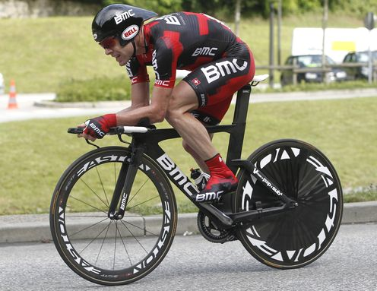
What does he like doing?
2
A. He is liking riding
B. He like riding bike.
C. He likes cycling.
GO HOME

Slide 6
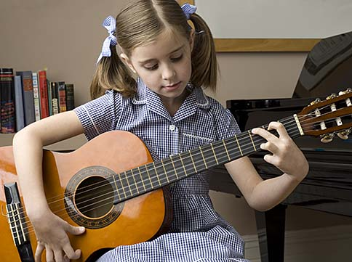
What does she like doing?
3
A. She like playing the guitar.
B. She loves playing the guitar.
C. She likes play the guitar.
GO HOME

Slide 7
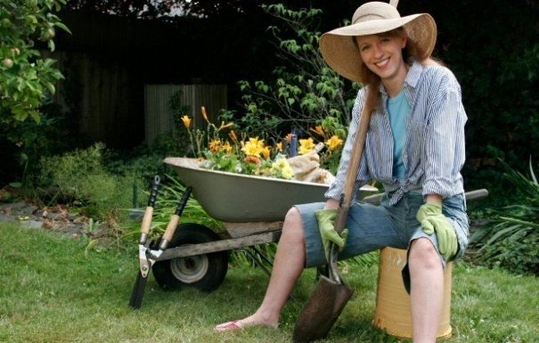
What is your mother’s hobby?
4
A. She likes gardening.
B. She like gardening.
C. She likes garden.
GO HOME

Slide 8
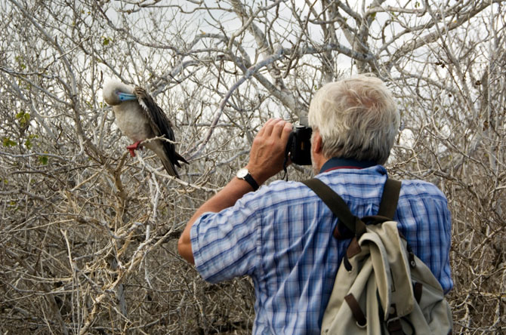
What does your grandfather like doing?
5
A. He enjoy bird – watching
B. He like bird – watching
C. He likes bird – watching
GO HOME

Slide 9
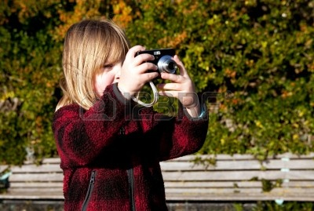
Does the girl enjoy taking photo?
6
A. Yes, she doesn’t
B. No, she does
C. Yes, She does.
GO HOME

Slide 10


Wednesday, september 15th 2021
XEM CLIP CÁCH SỬA NỘI DUNG
ĐĂNG KÝ TRỢ GIẢNG
GẮN KẾT CỘNG ĐỒNG GIÁO VIÊN
Unit 1: MY HOBBIES
SUBSCRIBE my channel, please
Period 5
Lesson 4: Communication

Slide 11
Objectives:
By the end of the lesson, students will be able to:
- Describe and give opinions about hobbies.

Slide 12
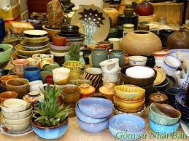
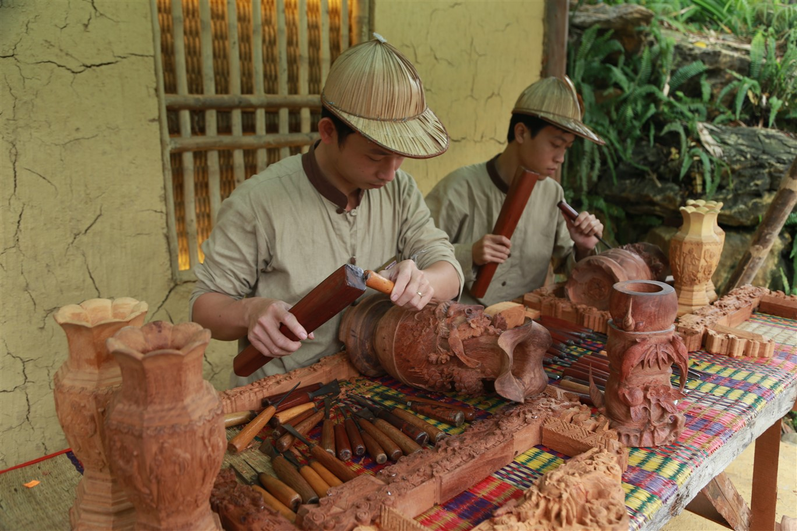
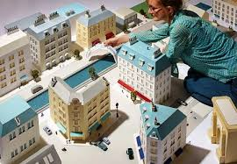
I. Vocabulary :
- Making Pottery (n):
Làm Đồ gốm.
- Carving wood (v):
Chạm/khắc gỗ
- Making Model (n):
Làm Mô hình.
- Take up + sth…
Bắt đầu một thói quen mới.
Ex: He took up jogging after his doctor advised him to get some exercise.
- unusual(adj):
Khác thường

Slide 13
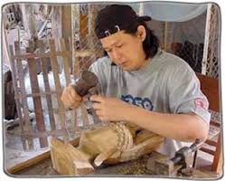
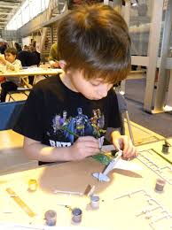
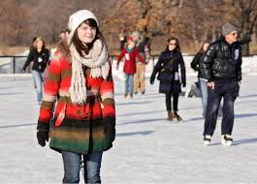
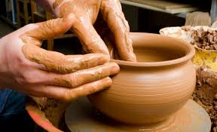


II. Practice
Task 1. Match the adjectives with the pictures. (Ex. 1/ p. 11)
A
1. MAKING MODEL
2. MAKING POTTERY
3. ICE – SKATING
4. DANCING
5. CARVING WOOD
B
1. MAKING MODEL
5. CARVING WOOD
C
D
E
3. ICE – SKATING
2. MAKING POTTERY
4. DANCING

Slide 14

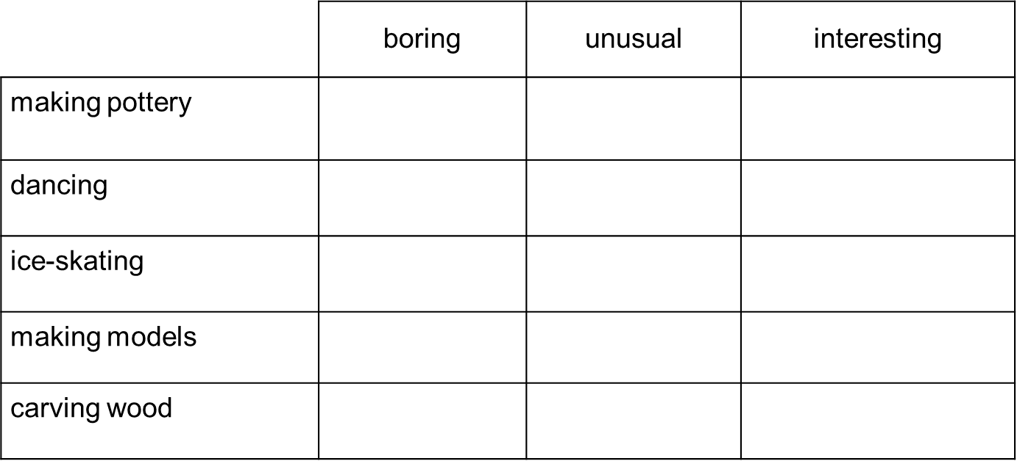
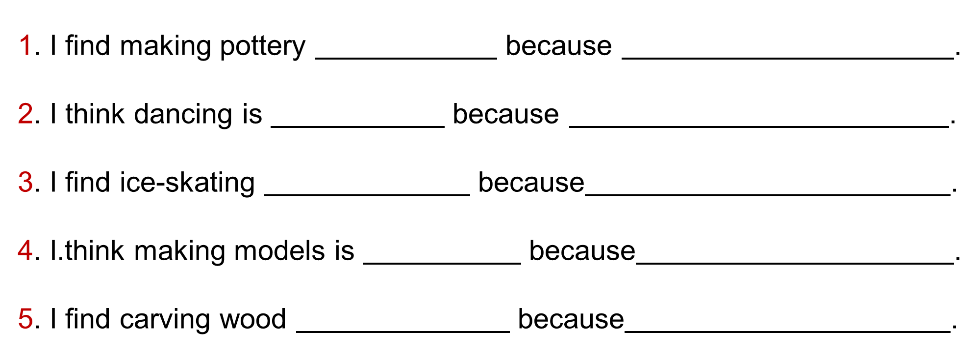
Task 2. What do you think about the hobbies in 1? Look at the table below and tick the boxes. Then, complete the sentences below by writing the reason to explain your choice.

Slide 15
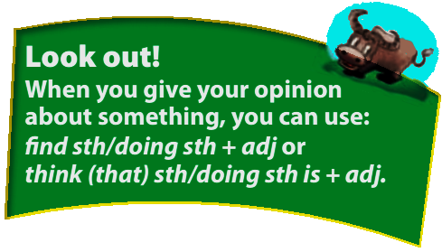
Notes: When you give your opinion about something, you can use these structures
click
S + find + sth / doing sth + adj
Ex: I find colecting doll interesting.
S + think (that) + doing sth + is + adj
Ex: I think reading book is relaxing
Ex: They think (that) swimming is interesting.

Slide 16
Example:
✓
interesting
it's takes skills to make
a pottery product

Slide 17


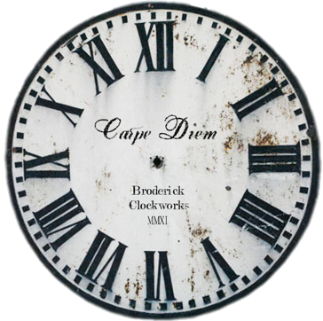

Slide 18



Slide 19
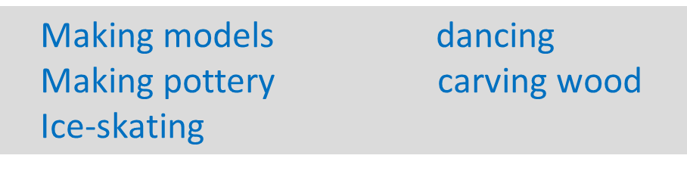
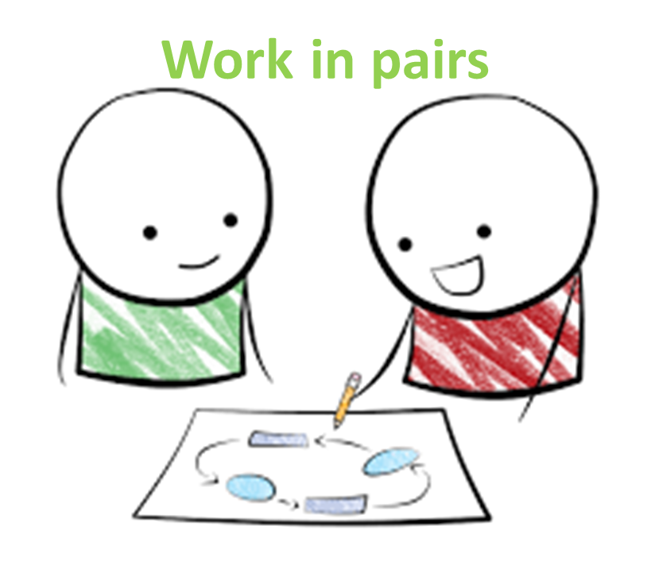
3. Now, interview a classmate about the hobbies in 1. Take notes and present your partner's answers to the class.
A: What do you think about ?/ How do you find ?
B: I think it is ./ I find it .
A: Why?
B: Because .
A: Will you take up in the future?
B: Yes, I will./ I'm not sure.

Slide 20
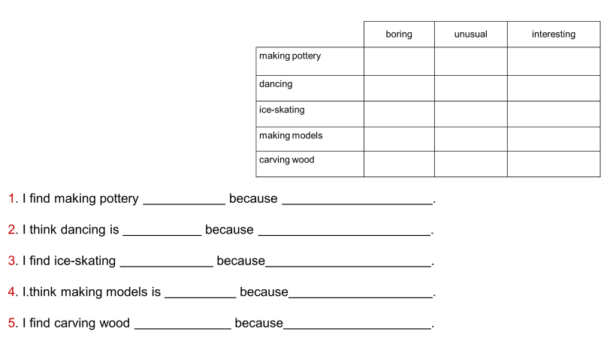
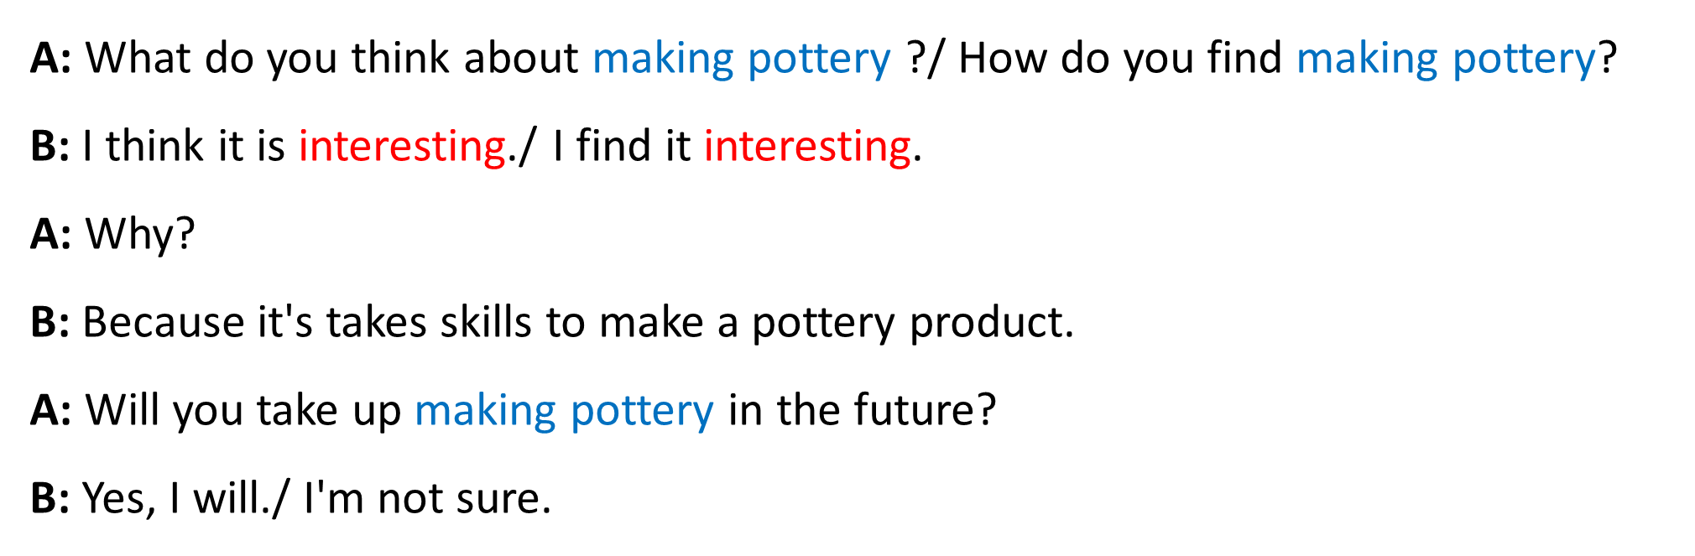
Example:
Making models dancing
Making pottery carving wood
Ice-skating

Slide 21


HOMEWORK
- Learn new words and the structures.
- Practise the exercises again.
- Do exercises C1 – C2 (page 6, 7/ workbook).
- Prepare SKILLS 1.

Slide 22
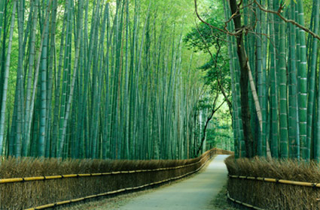
THANKS FOR YOUR ATTENTION!
Goodbye!
See you again!

