Slide 1
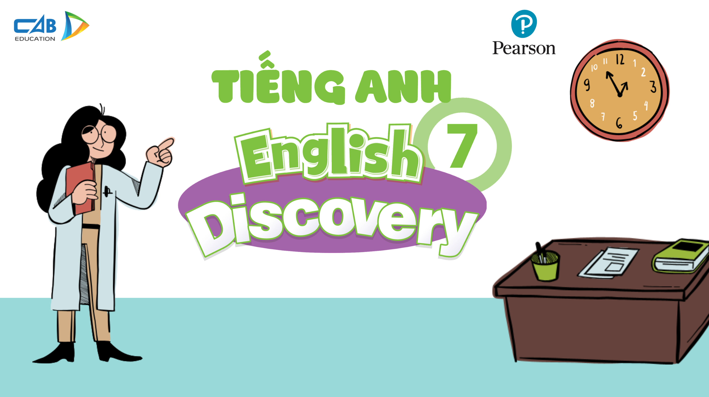

Slide 2
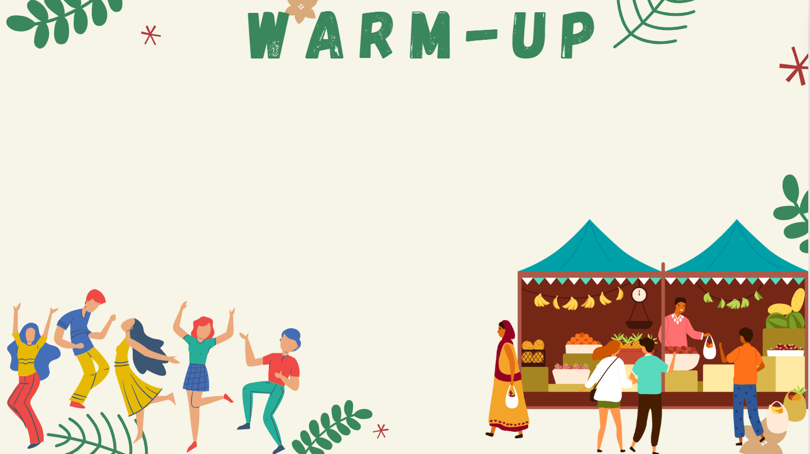


MEMORY GAME
12 numbers
Find a suitable pair
1 correct answer = 1 point

Slide 3
amazed
1
interesting
2
exciting
tired
3
4
fascinated
5
6
bored
amazing
7
8
boring
excited
9
tiring
10
interested
11
fascinating
12

Slide 4
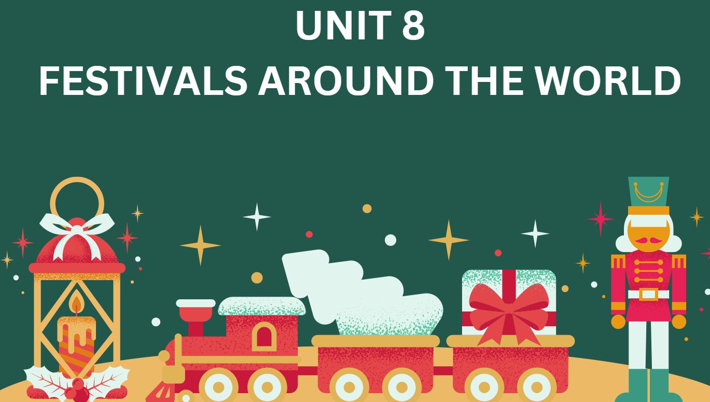
LESSON 8.3
READING AND VOCABULARY
(SB page 83)

Slide 5

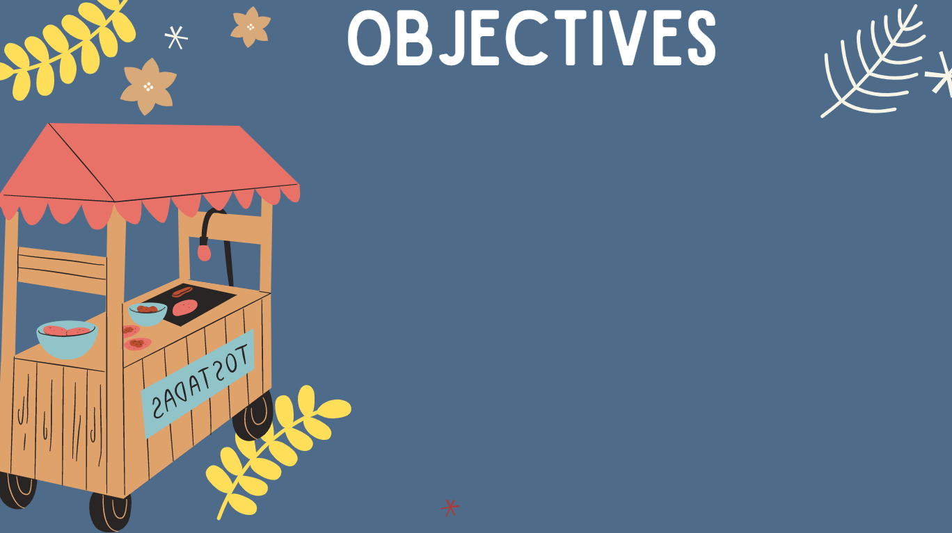
01. Use lexical items related to the topic “Festivals around the world”.
02. Read for specific details about festivals in Việt Nam.
03. Talk about the things you like or don’t like about festivals.

Slide 6
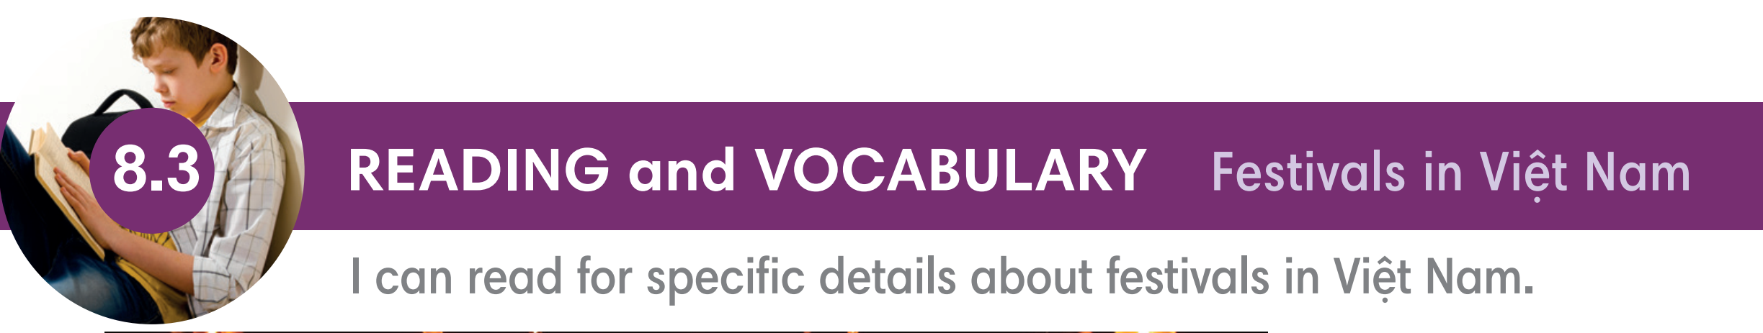
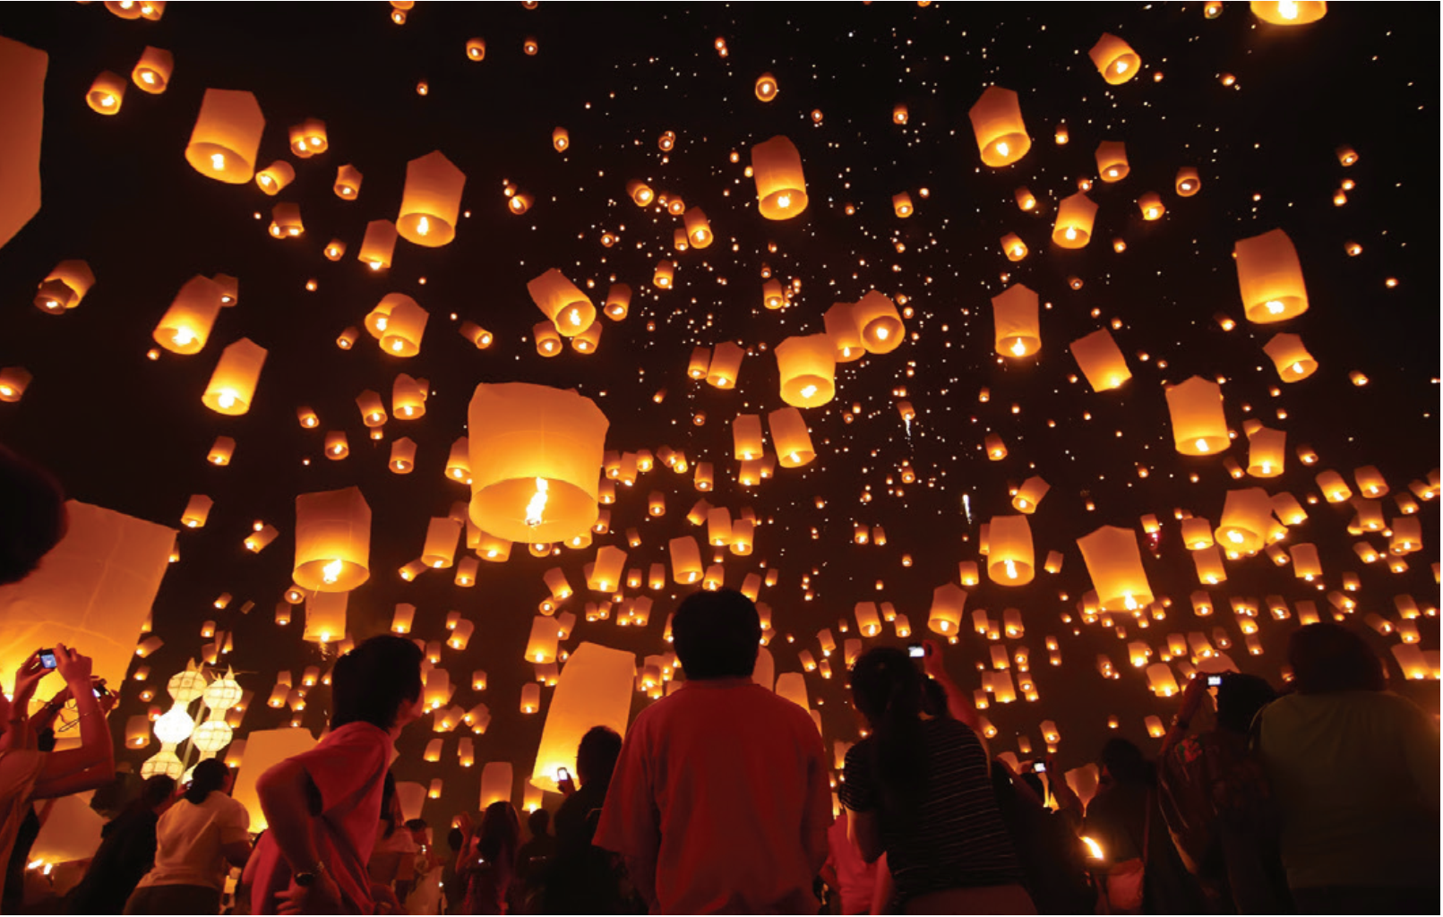

Slide 7

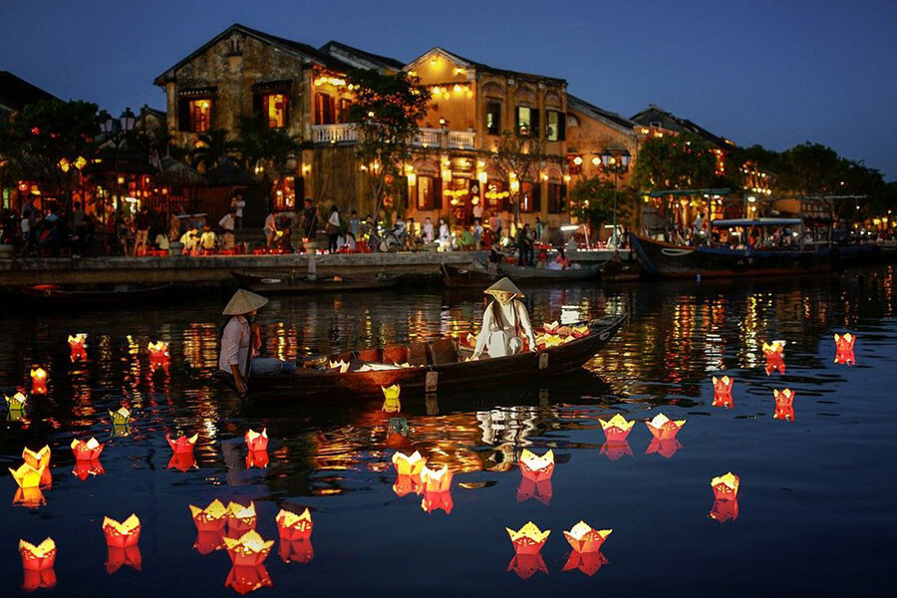
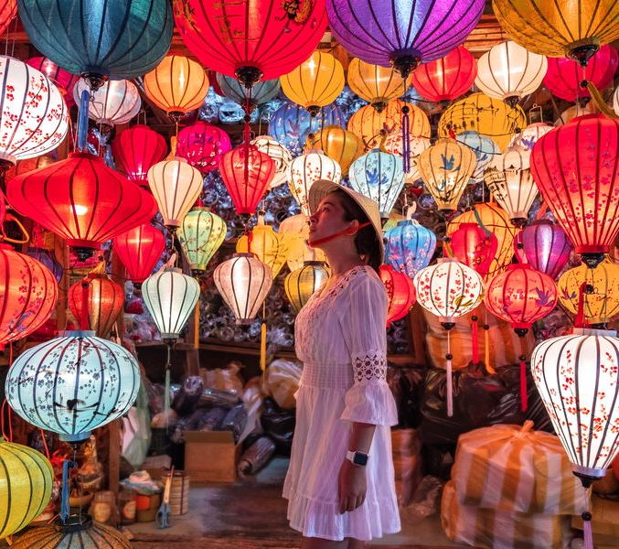
HỘI AN LANTERN FESTIVAL

Slide 8
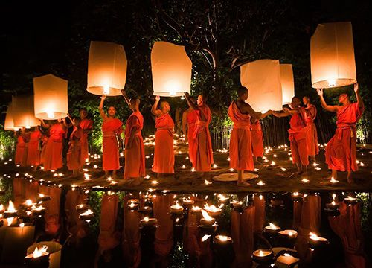
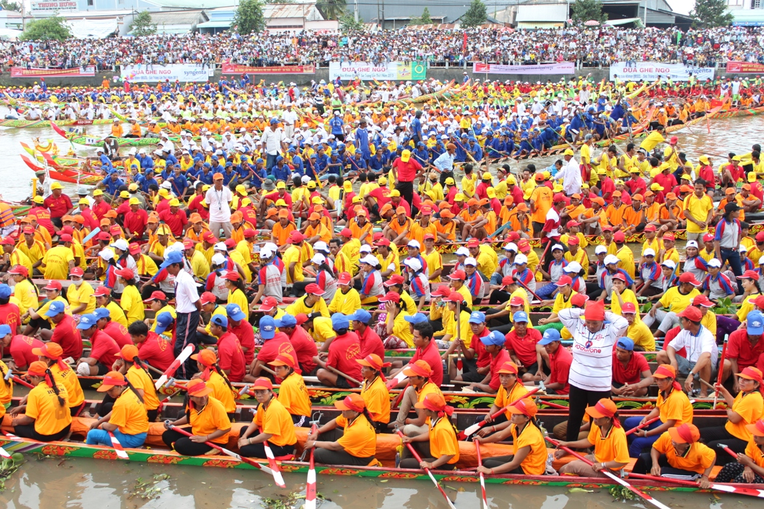
OK OM BOK FESTIVAL

Slide 9
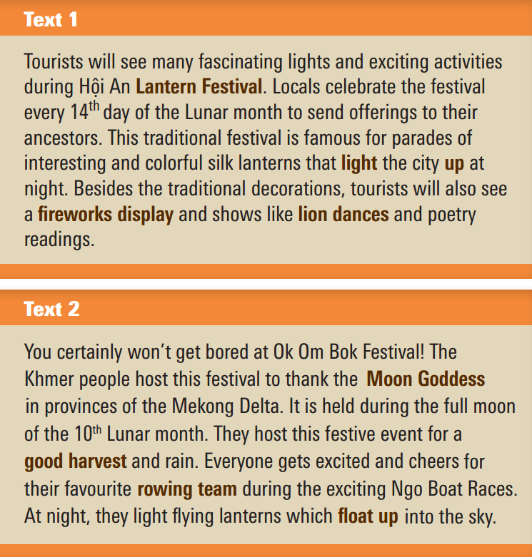
Exercise 1 (SB p.83) - In pairs, look at the words below.
Underline these words in the texts. What do they mean in your language?
offerings
ancestors
parades
decorations
festive event
ancestors
host

Slide 10

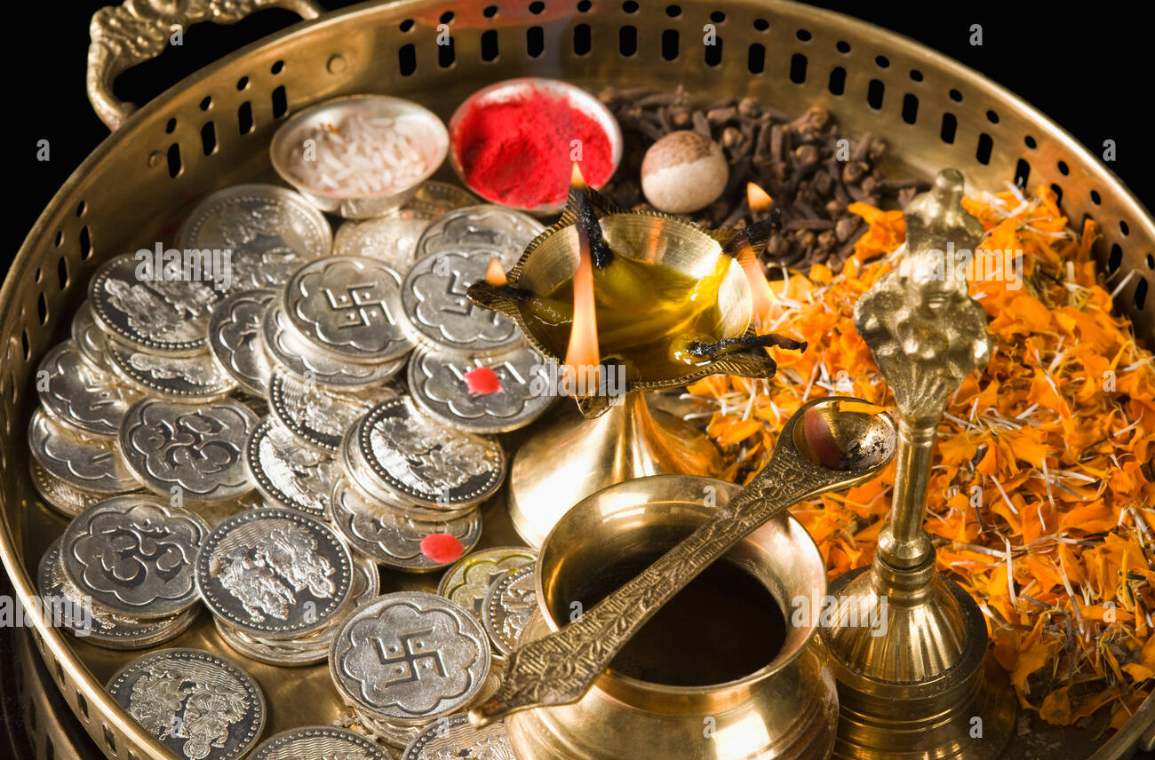
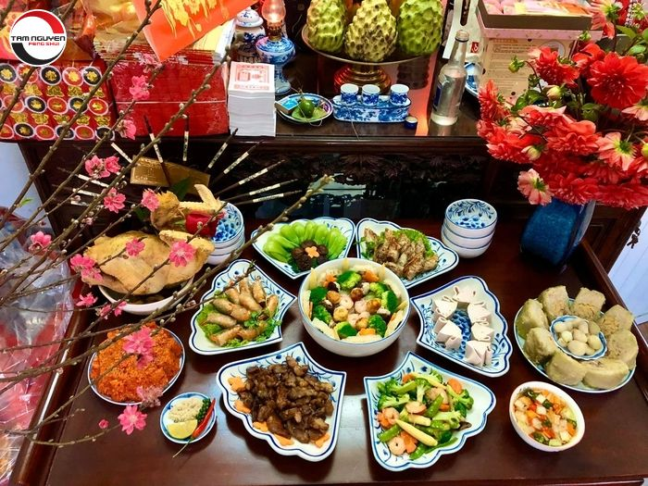
VOCABULARY
something that is given to a god
in a religious ceremony
offering (n)
/ˈɒfərɪŋ/
đồ cúng lễ

Slide 11
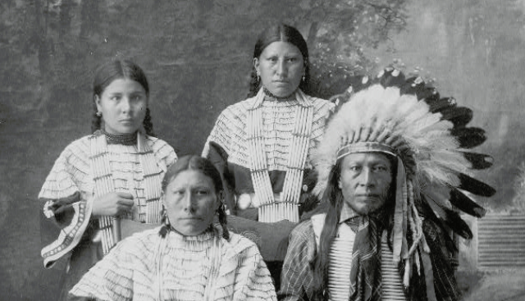
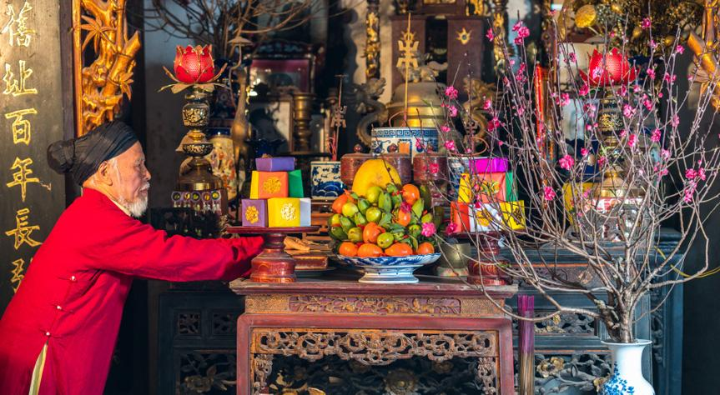
VOCABULARY
a person in your family
who lived a long time ago
ancestor (n)
/ˈænsestər/
tổ tiên

Slide 12
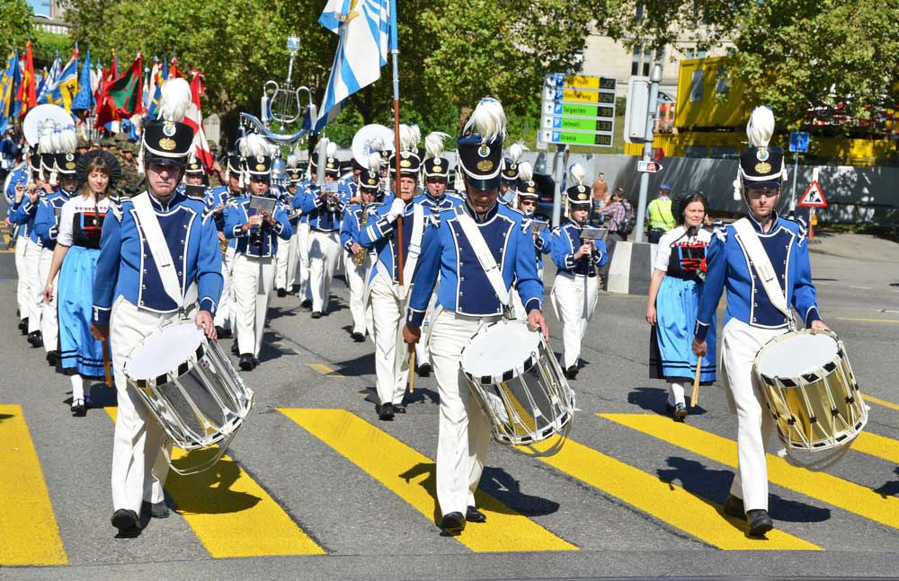
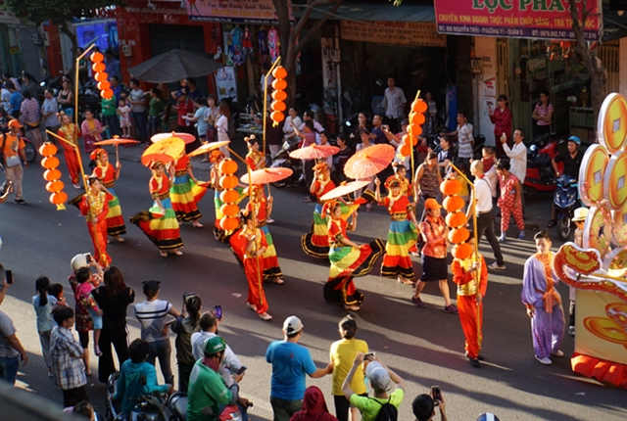
VOCABULARY
a public event with bands
in the streets and decorated vehicles
parade (n)
/pəˈreɪd/
diễu hành

Slide 13
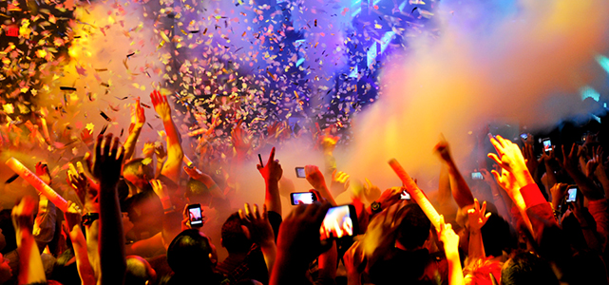
VOCABULARY
a thing that happens, especially something important
/ɪˈvent/
event (n)
sự kiện

Slide 14
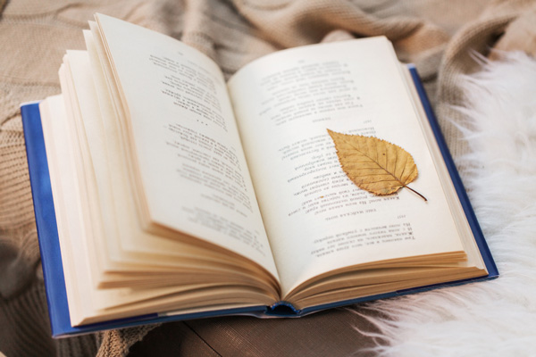
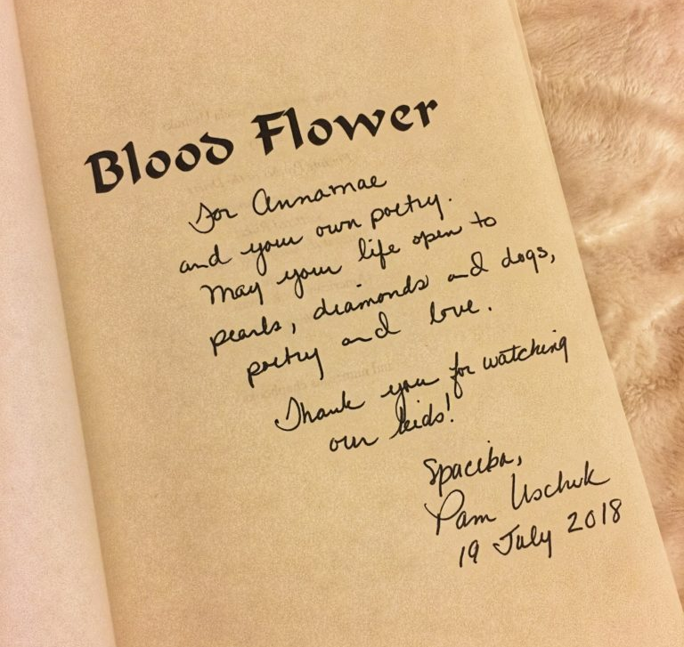
VOCABULARY
poetry (n)
poems in general
/ˈpəʊətri/
thơ ca

Slide 15
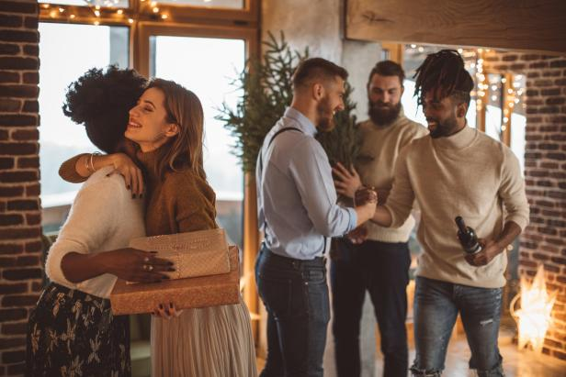
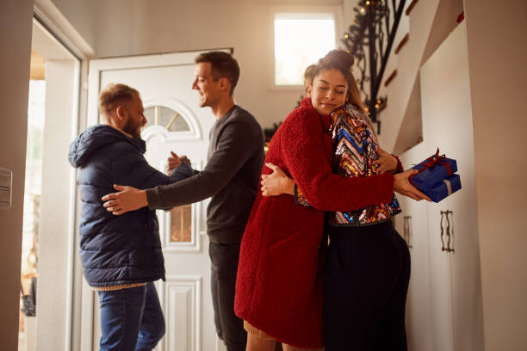
VOCABULARY
host (n/v)
= a person who invites guests to a meal, a party
= to organize an event
/həʊst/
chủ nhà
tổ chức

Slide 16
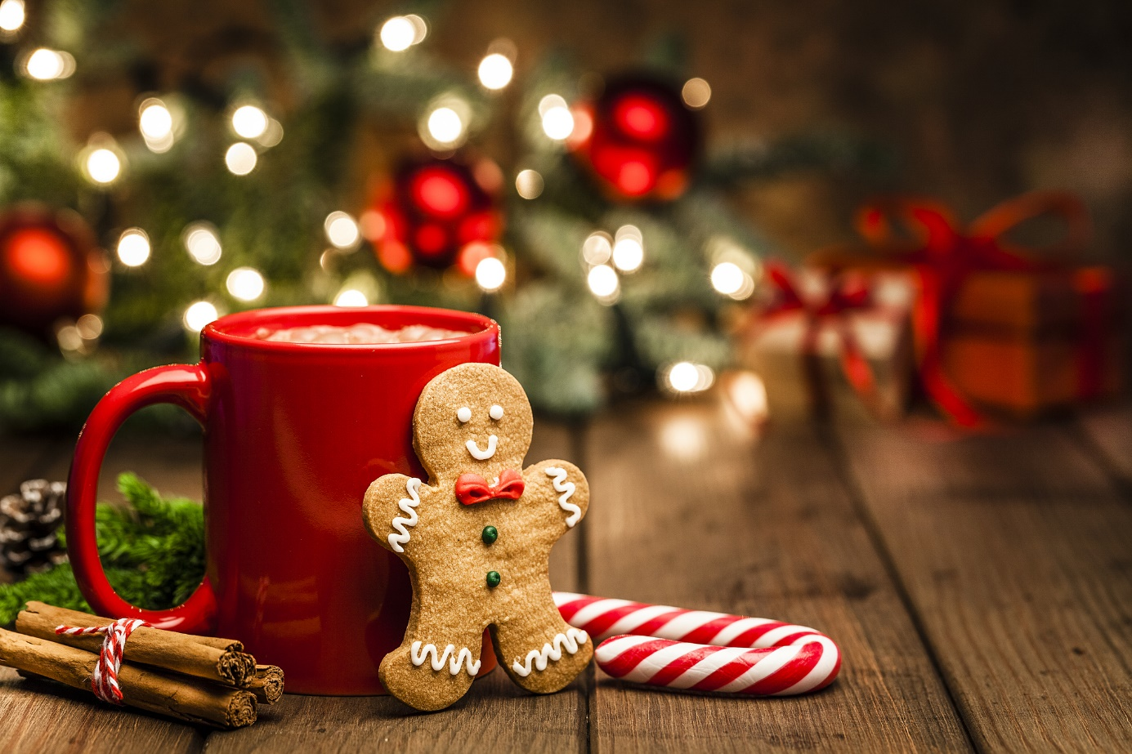
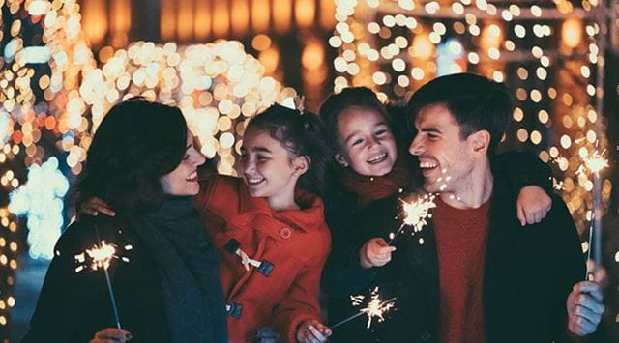
VOCABULARY
festive (adj)
An adjective of festival
/ˈfestɪv/
thuộc về lễ hội

Slide 17
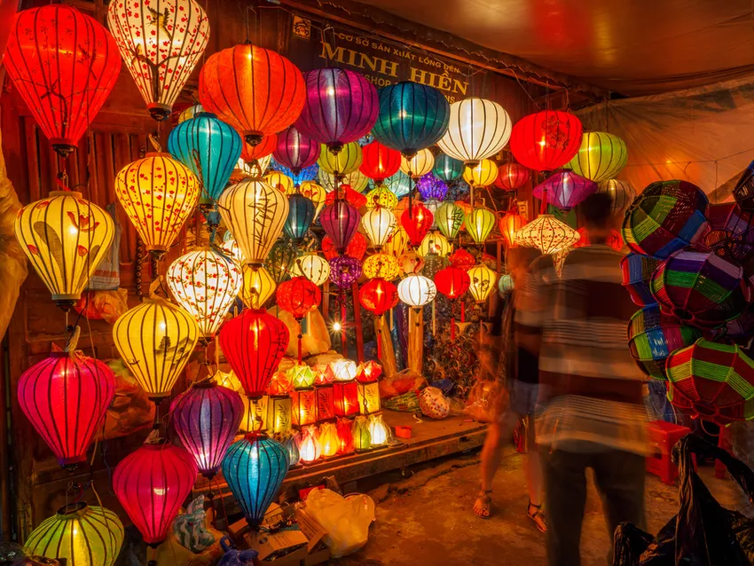
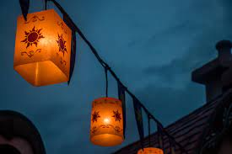
VOCABULARY
a light inside a container that has
a handle for holding/ hanging it up
lantern (n)
/ˈlæntən/
đèn lồng

Slide 18
Exercise 1 (SB p.83) - In pairs, look at the words below.
Underline these words in the texts. What do they mean in your language?
offerings
ancestors
parades
decorations
festive event
host

Slide 19
Exercise 1 (SB p.83) - In pairs, look at the words below.
Underline these words in the texts. What do they mean in your language?
Tourists will see many fascinating lights and exciting activities during Hội An Lantern Festival. Locals celebrate the festival every 14th day of the Lunar month to send offerings to their ancestors. This traditional festival is famous for parades of interesting and colorful silk lanterns that light the city up at night. Besides the traditional decorations, tourists will also see a fireworks display and shows like lion dances and poetry readings.
offerings
ancestors
parades
decorations
festive event
host

Slide 20
Exercise 1 (SB p.83) - In pairs, look at the words below.
Underline these words in the texts. What do they mean in your language?
You certainly won't get bored at Ok Om Bok Festival! The Khmer people host this festival to thank the Moon Goddess in provinces of the Mekong Delta. It is held during the full moon of the 10th Lunar month. They host this festive event for a good harvest and rain. Everyone gets excited and cheers for their favourite rowing team during the exciting Ngo Boat Races. At night, they light flying lanterns which float up into the sky.
festive event
host

Slide 21
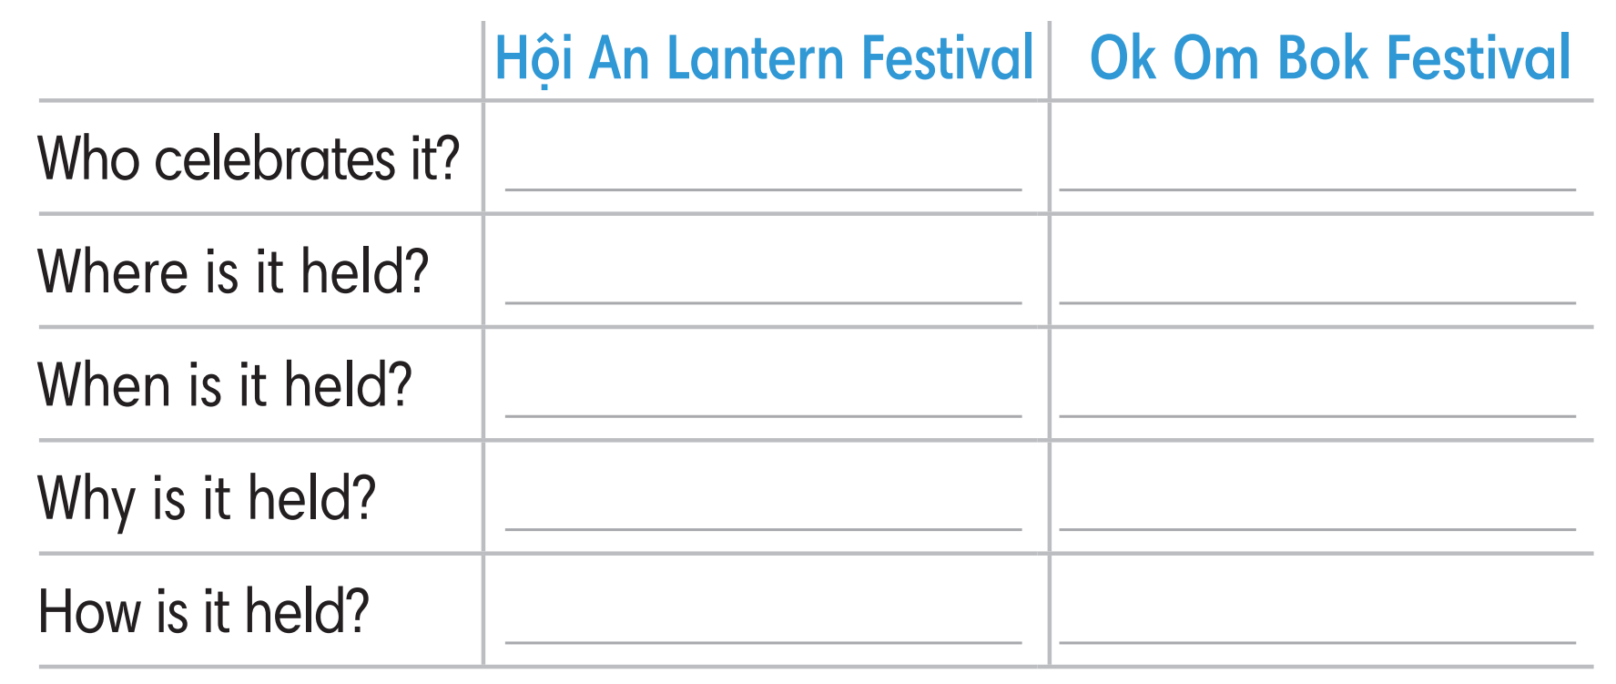
Exercise 2 (SB p.83) - Read Texts 1 and 2.
Complete the following table with NO MORE THAN TWO words.

Slide 22
Exercise 2 (SB p.83) - Read Texts 1 and 2.
Complete the following table with NO MORE THAN TWO words.
HOI AN LANTERN FESTIVAL
Tourists will see many fascinating lights and exciting activities during Hội An Lantern Festival. Locals celebrate the festival every 14th day of the Lunar month to send offerings to their ancestors. This traditional festival is famous for parades of interesting and colorful silk lanterns that light the city up at night. Besides the traditional decorations, tourists will also see a fireworks display and shows like lion dances and poetry readings.
1, Who celebrates it?
→ Locals = Local people
2, Where is it held?
→ Hội An
3, When is it held?
→ Lunar 14th
4, Why is it held?
→ Offer ancestors
5, How is it held?
→ Parade lanterns

Slide 23
Exercise 2 (SB p.83) - Read Texts 1 and 2.
Complete the following table with NO MORE THAN TWO words.
OC OM BOK FESTIVAL
You certainly won't get bored at Ok Om Bok Festival! The Khmer people host this festival to thank the Moon Goddess in provinces of the Mekong Delta. It is held during the full moon of the 10th Lunar month. They host this festive event for a good harvest and rain. Everyone gets excited and cheers for their favourite rowing team during the exciting Ngo Boat Races. At night, they light flying lanterns which float up into the sky.
1, Who celebrates it?
→ Khmer people
2, Where is it held?
→ Mekong Delta
3, When is it held?
→ Lunar 10th
4, Why is it held?
→ thank Goddess
5, How is it held?
→ Row

Slide 24
Exercise 2 (SB p.83) - Read Texts 1 and 2.
Complete the following table with NO MORE THAN TWO words.
locals
Khmer people
Hội An
Mekong Delta
Lunar 14th
Lunar 10th
Offer ancestors
thank Goddess
Parade lanterns
row

Slide 25
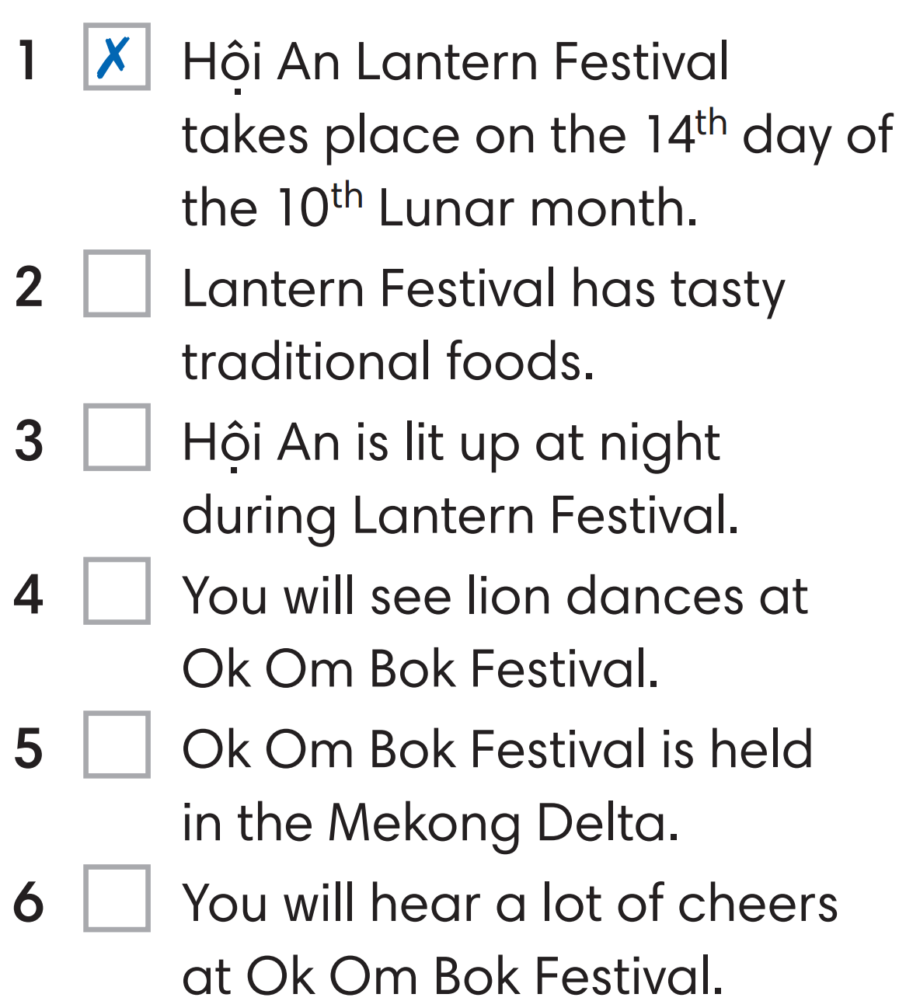
Exercise 3 (SB p.83) - Read Texts 1 and 2 again.
Mark the sentences ✓(right), X (wrong) or? (doesn't say)
You certainly won't get bored at Ok Om Bok Festival! The Khmer people host this festival to thank the Moon Goddess in provinces of the Mekong Delta. It is held during the full moon of the 10th Lunar month. They host this festive event for a good harvest and rain. Everyone gets excited and cheers for their favourite rowing team during the exciting Ngo Boat Races. At night, they light flying lanterns which float up into the sky.
You certainly won't get bored at Ok Om Bok Festival! The Khmer people host this festival to thank the Moon Goddess in provinces of the Mekong Delta. It is held during the full moon of the 10th Lunar month. They host this festive event for a good harvest and rain. Everyone gets excited and cheers for their favourite rowing team during the exciting Ngo Boat Races. At night, they light flying lanterns which float up into the sky.
Tourists will see many fascinating lights and exciting activities during Hội An Lantern Festival. Locals celebrate the festival every 14th day of the Lunar month to send offerings to their ancestors. This traditional festival is famous for parades of interesting and colorful silk lanterns that light the city up at night. Besides the traditional decorations, tourists will also see a fireworks display and shows like lion dances and poetry readings.
?
✓
✗
✓
✓

Slide 26
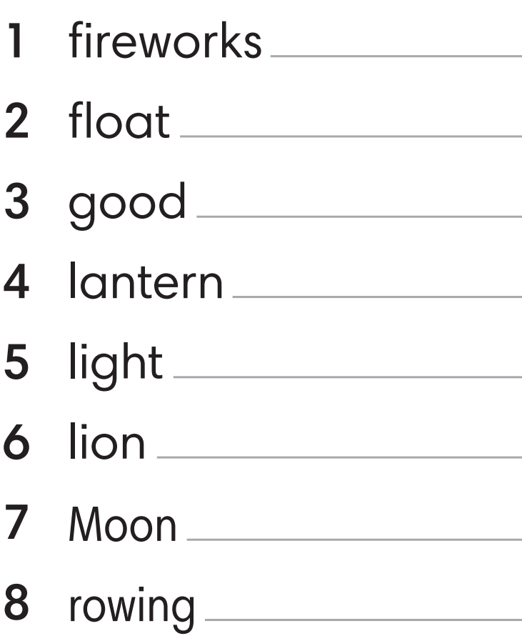
Exercise 4 (SB p.83) - WORD FRIENDS
Look at the highlighted phrases in the text and complete the Word Friends.
display
up
harvest
festival
up
dances
Goddness
team

Slide 27

Exercise 5 (SB p.83) - In pairs, choose one festival that you both know.
Decide what you like about it and what you don't like about it.
A : I think I would like all the colours of Holi Festival.
B : I would too. But I don't think I would like people throwing water on me.
A: I think I would like the colorful lanterns in Hoi An Lantern Festival.
B: I would too. However, I don’t really like crowds of people there.

Slide 28
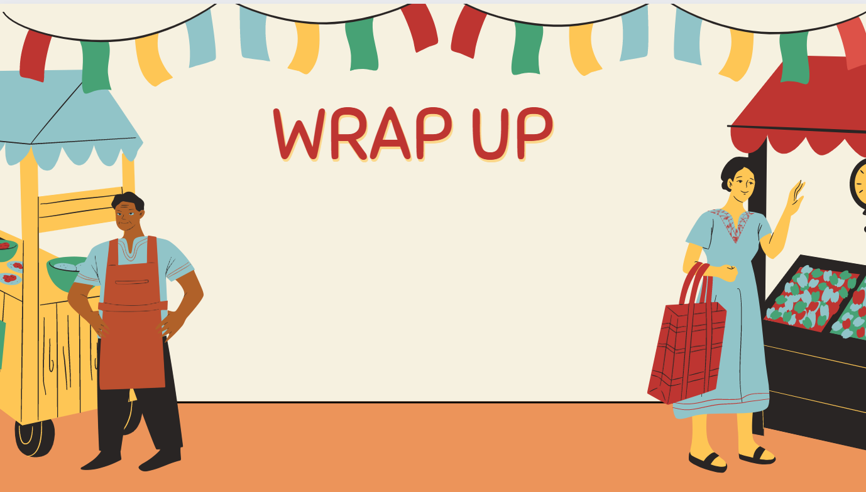
Consolidate what students
have learnt in the lesson

Slide 29

VOCABULARY REVIEW
offering (n) | /ˈɒfərɪŋ/ | something that is given to a god in a religious ceremony | đồ cúng lễ
ancestor (n) | /ˈænsestər/ | a person in your family who lived a long time ago | tổ tiên
parade (n) | /pəˈreɪd/ | a public event with bands in the streets and decorated vehicles | diễu hành
event (n) | /ɪˈvent/ | a thing that happens, especially something important | sự kiện
poetry (n) | /ˈpəʊətri/ | poems in general | thơ ca
host (n/v) | /həʊst/ | = a person who invites guests to a meal, a party = to organize an event | chủ nhà tổ chức
festive (adj) | /ˈfestɪv/ | an adjective of festival | thuộc về lễ hội
lantern (n) | /ˈlæntən/ | a light inside a container that has a handle for holding/ hanging it up | đèn lồng

Slide 30

01. Learn the vocabulary by heart
02. Do the exercises in workbook (page 71)
03. Prepare for Unit 8. Lesson 4

Slide 31


