Slide 1


Slide 2
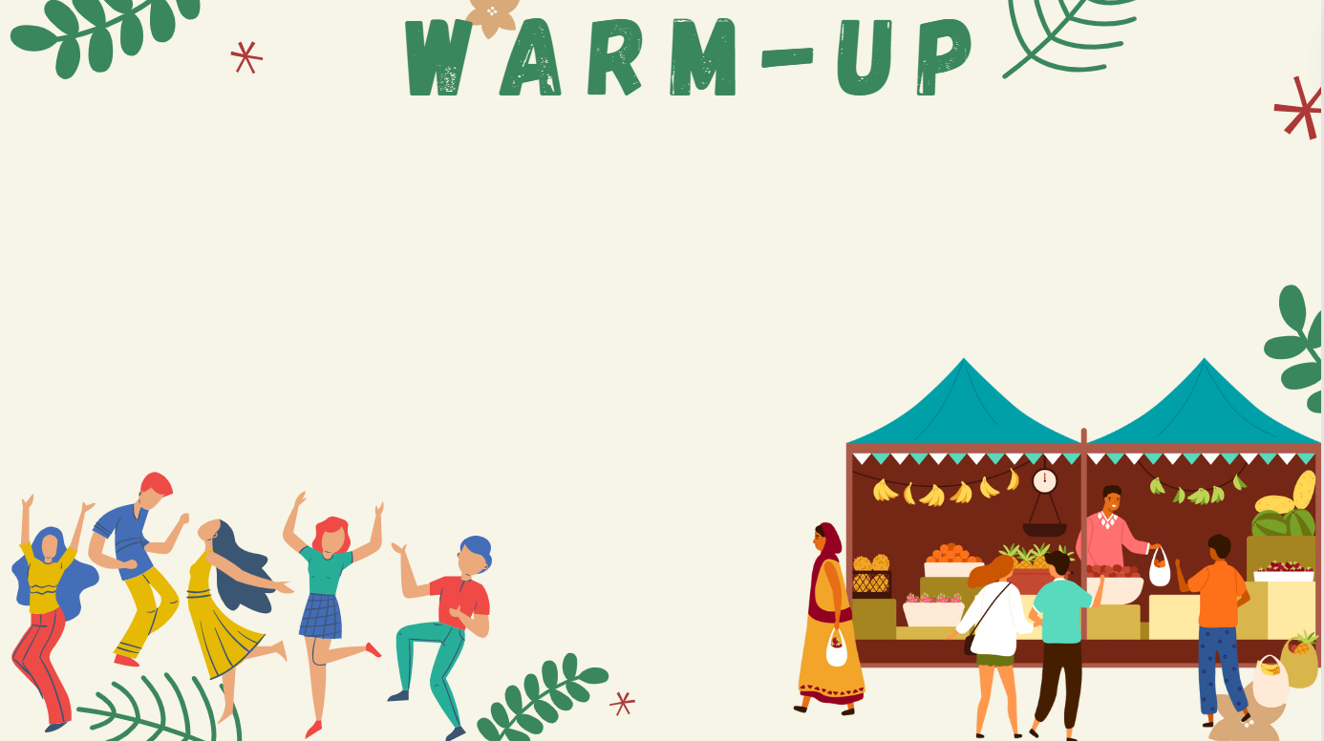


MEMORY GAME
Watch a video
Try to remember all festivals as much as possible
More answers = winner

Slide 3
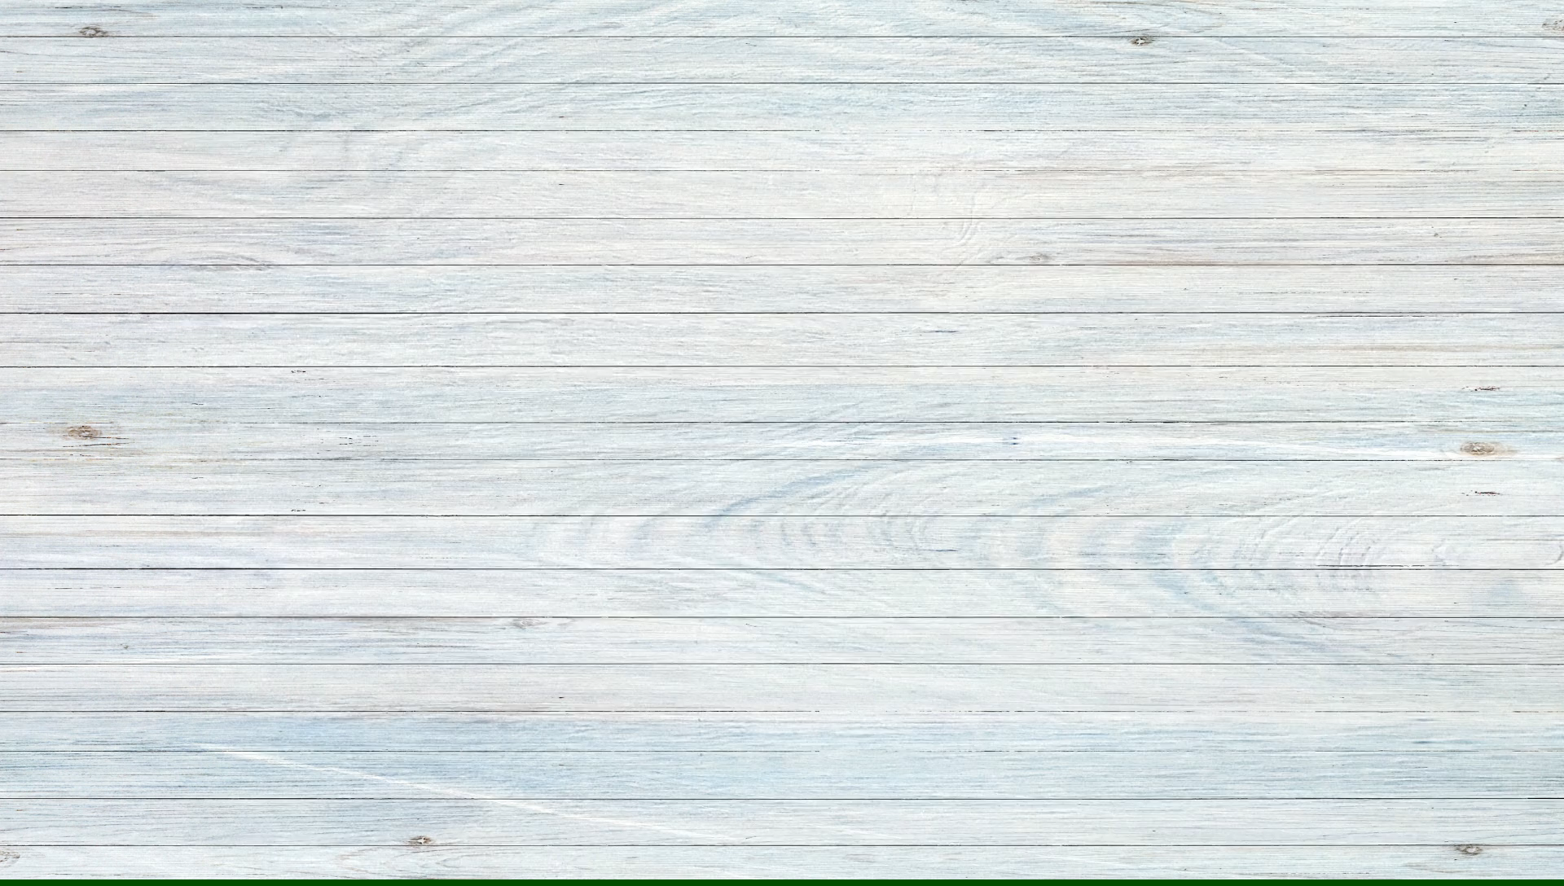

Slide 4
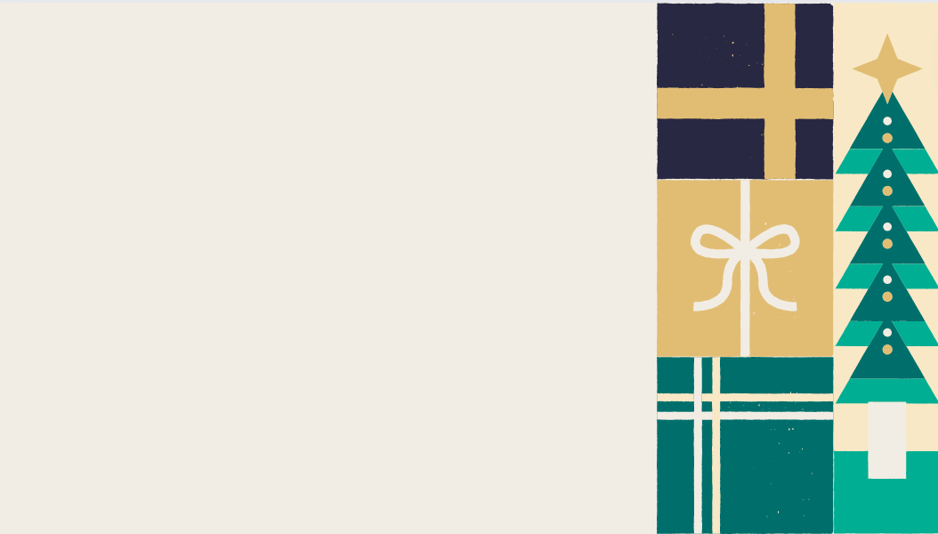
ANSWER
Christmas
La tomatina
Tết holiday
Mid Autumn
Thanksgiving
Oktoberfest
Valentine
Holi - India
Easter
Songkran
Halloween
Lim Festival

Slide 5
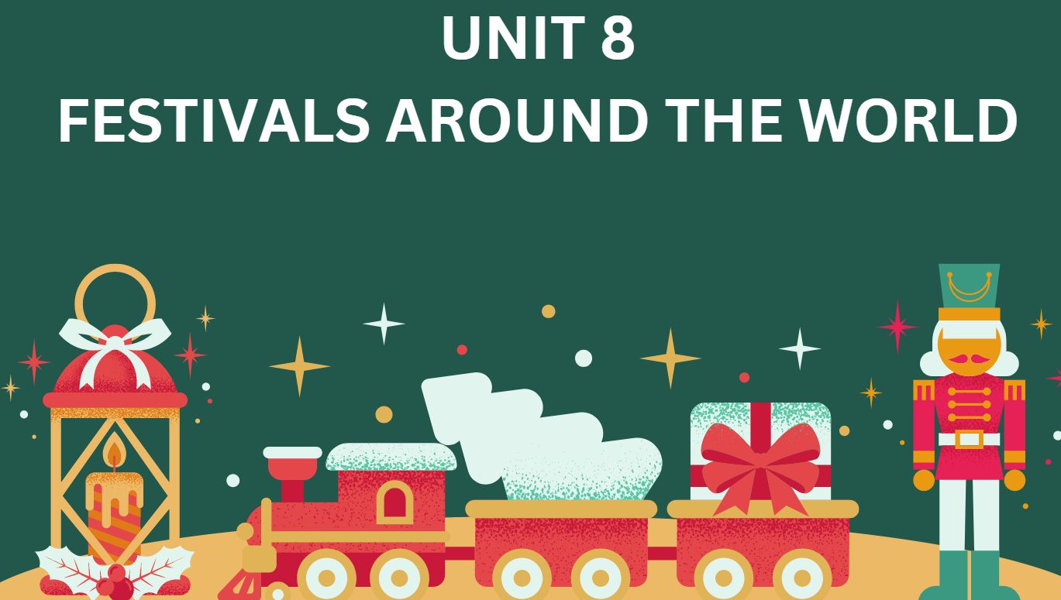
LESSON 8.7 (SB page 87)
WRITING

Slide 6

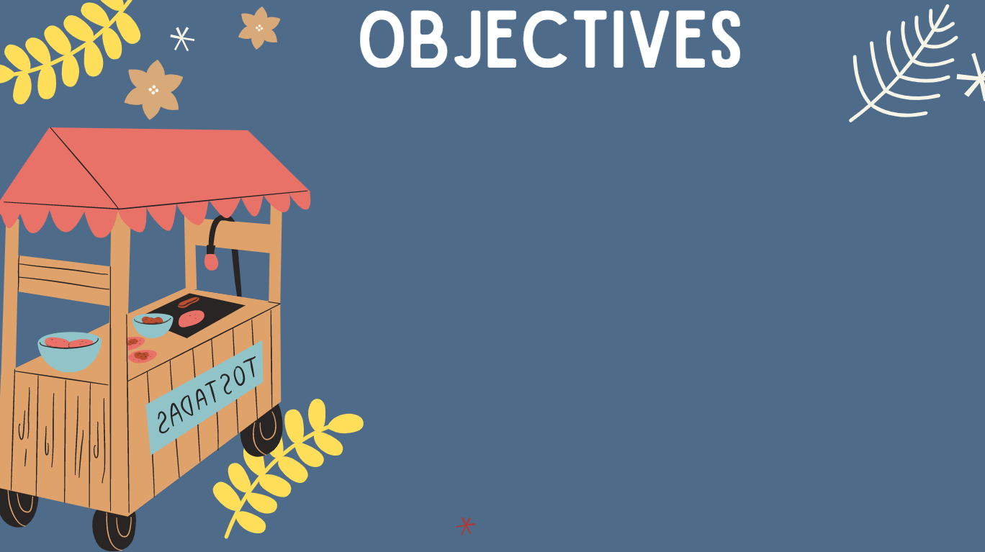
01. Use lexical items related to the topic “Festivals around the world”.
02. Use “Wh-question words” to ask questions.
03. Write some sentences about your favourite festival.

Slide 7

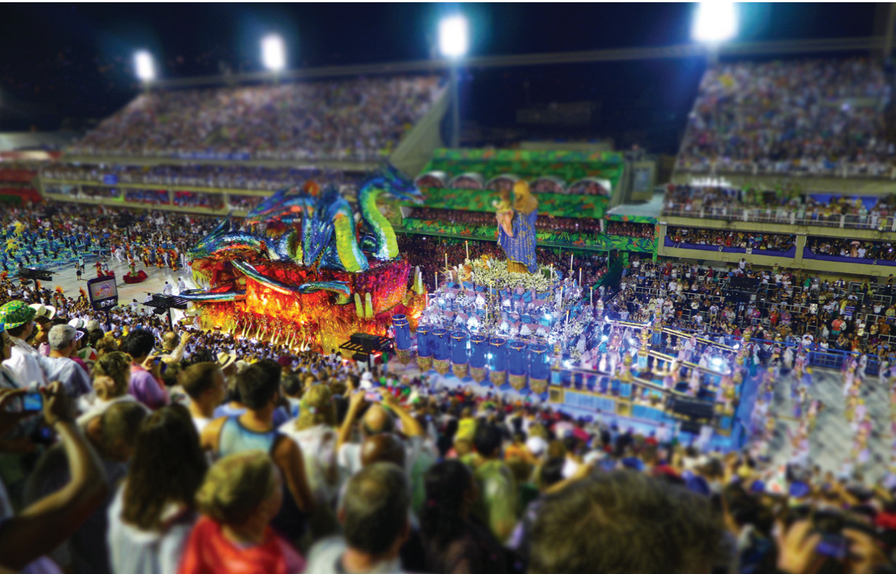
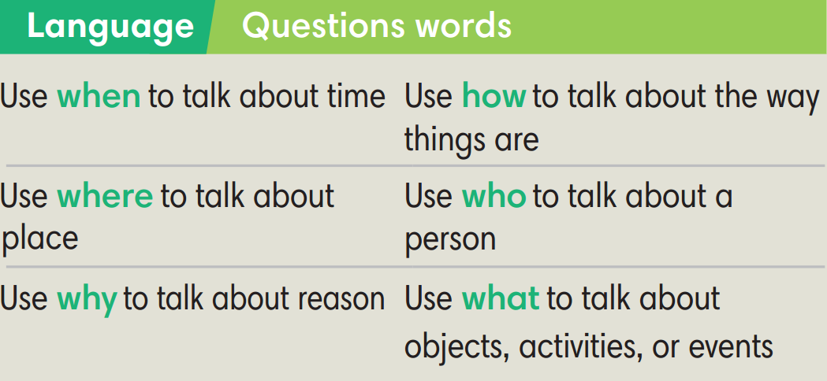

Slide 8

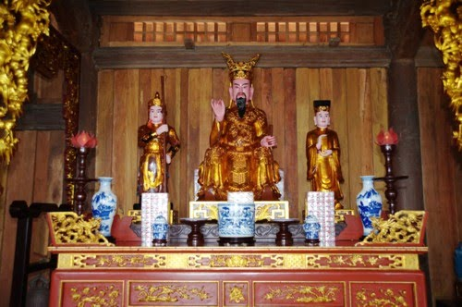
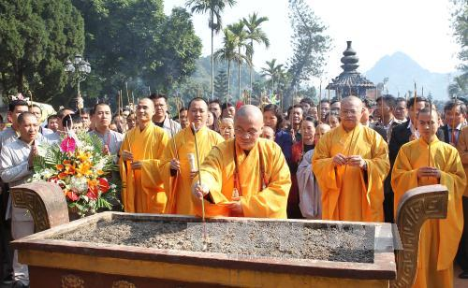
VOCABULARY
honor (v)
show great respect for somebody
/ˈɒnər/
tỏ lòng tôn kính, kính trọng

Slide 9
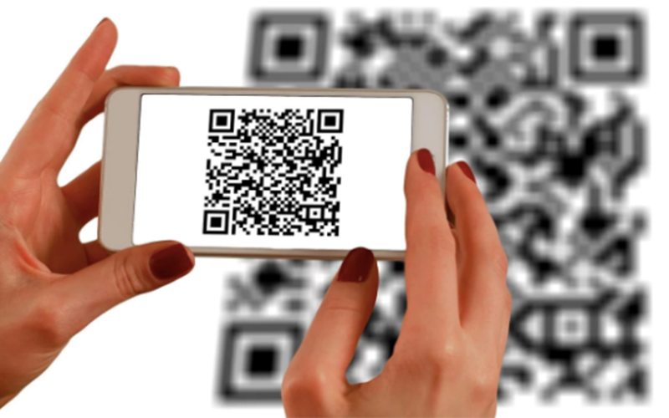
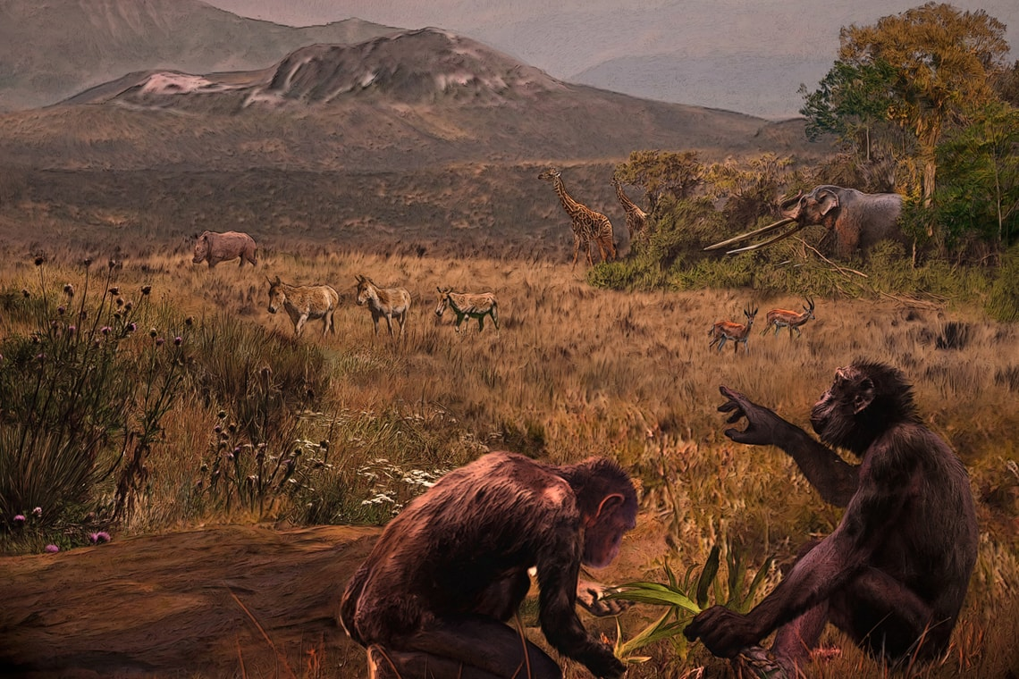
VOCABULARY
to happen or appear for the first time in a particular place or situation
originate (v)
/əˈrɪdʒɪneɪt/
bắt nguồn, có nguồn gốc

Slide 10
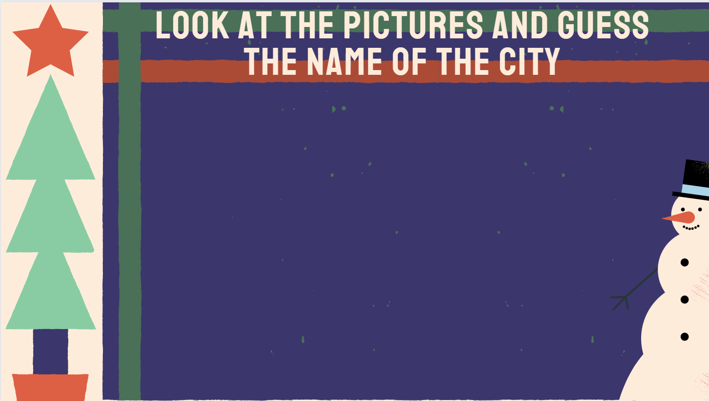
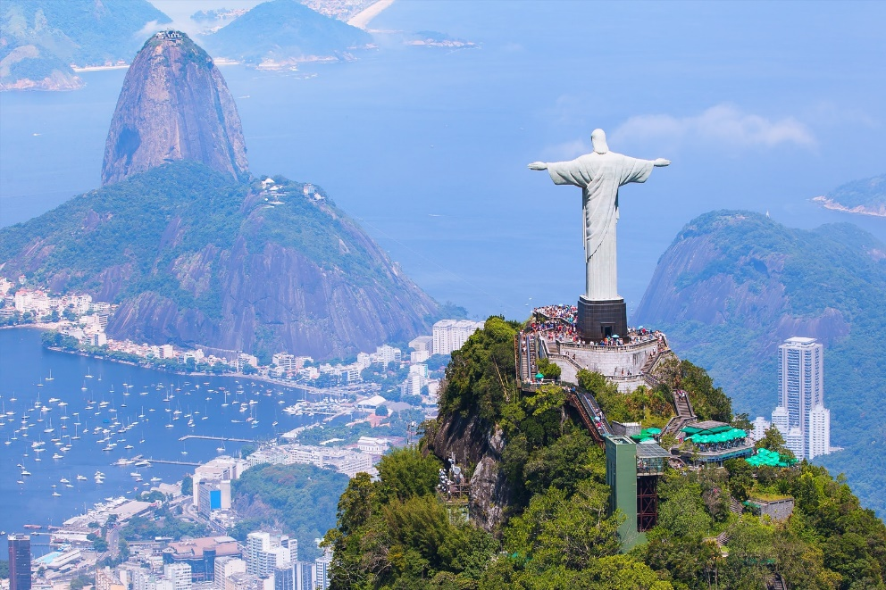
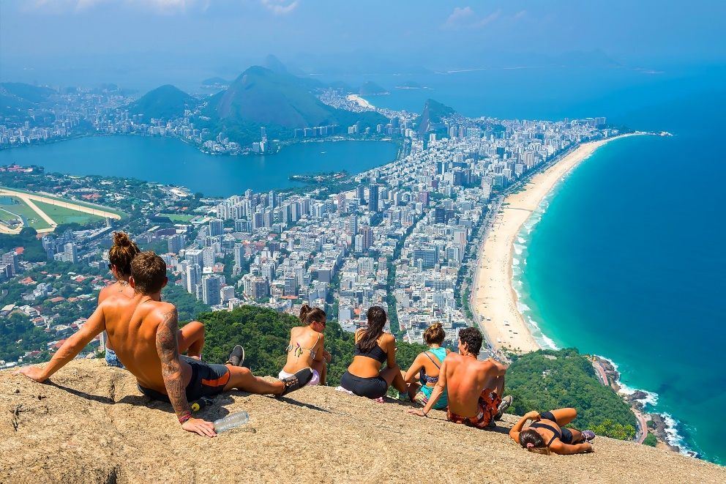
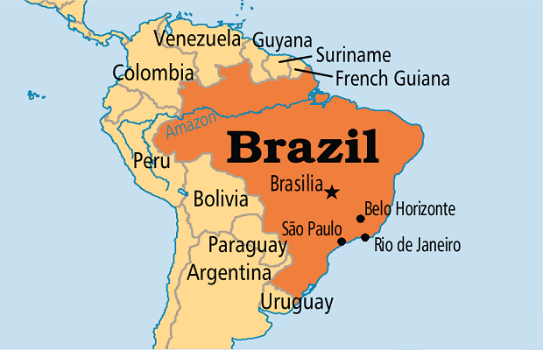
Rio de Janeiro

Slide 11
Exercise 1 (SB p.87)
Read the text and the questions. Answer the questions.
Rio Carnival is a famous festival in Rio de Janeiro in Brazil. It dates back to the 17th century when Brazilians wanted to honor the Greek wine gods. Two million Brazilians and visitors join in the festival every day on the streets. They can watch samba dancing, fireworks and a fascinating parade. The festive activities end 40 days before Easter.

Slide 12
Exercise 1 (SB p.87)
Read the text and the questions. Answer the questions.
Rio Carnival is a famous festival in Rio de Janeiro in Brazil. It dates back to the 17th century when Brazilians wanted to honor the Greek wine gods. Two million Brazilians and visitors join in the festival every day on the streets. They can watch samba dancing, fireworks and a fascinating parade. The festive activities end 40 days before Easter.
1. Where does the festival take place?
2. When did it start?
3. Why do people celebrate the festival?
4. How many people join in the festival per day?
5. What can people do during the festival?
Rio de Janeiro in Brazil
the 17th century
honor the Greek wine gods
two million
watch samba dancing, fireworks and a fascinating parade

Slide 13
Exercise 2 (SB p.87) - Study the Language box and look at Exercise 1.
Underline the Wh-question words in the text.
1. Where does the festival take place?
2. When did it start?
3. Why do people celebrate the festival?
4. How many people join in the festival per day?
5. What can people do during the festival?

Slide 14
Exercise 3 (SB p.87) - Write when, where, what, who, how,
or why to complete the questions. More than one can be used for each blank.
1. Where / How does that town hold its annual celebration to mark New Years?
2. ________ did your grandmother pass down to you?
3. ________ are you interested in those costumes?
4. ________ is it customary to have a folk-dance performance?
5. ________ is the carnival going to be held this September?
6. ________ did this strange custom originate?
When
Why
Why
Where
Where

Slide 15
Exercise 4 (SB p.87)
Make questions by putting the words in the correct order.
1. your / favourite / is / what / festival
________________________________________________________?
2. when / people / celebrate / do / it
________________________________________________________?
3. place / does / it / take / where
________________________________________________________?
4. celebrates / it / who
________________________________________________________?
5. activities / in / what / the / there / are / festival
________________________________________________________?
6. it / why / do / celebrate / people
________________________________________________________?
What
is
your
favourite
festival
When
do
people
celebrate
it
Where
does
it
take
place
Who
celebrates
it
What
activities
are
there
in
the
festival
Why
do
people
celebrate
it

Slide 16
Exercise 4 (SB p.87)
Make questions by putting the words in the correct order.
1. your / favourite / is / what / festival
________________________________________________________?
2. when / people / celebrate / do / it
________________________________________________________?
3. place / does / it / take / where
________________________________________________________?
4. celebrates / it / who
________________________________________________________?
5. activities / in / what / the / there / are / festival
________________________________________________________?
6. it / why / do / celebrate / people
________________________________________________________?
What
is
your
favourite
festival
When
do
people
celebrate
it
Where
does
it
take
place
Who
celebrates
it
What
activities
are
there
in
the
festival
Why
do
people
celebrate
it

Slide 17
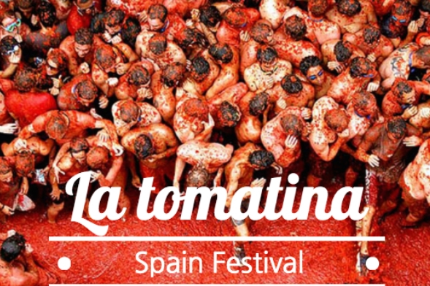
Exercise 5 (SB p.87) - Use your answers from Exercise 4
to write 6-8 sentences about your favourite festival.
My favourite festival is La Tomatina Festival in Spain. It takes place ...

Slide 18
Exercise 5 (SB p.87) - Use your answers from Exercise 4
to write 6-8 sentences about your favourite festival.
SAMPLE:
My favourite festival is La Tomatina Festival in Spain. It takes place at Rio de Janeiro in Brazil. This festival started from the 17th century and it was organized to honor the Greek wine gods. There are about two million people joining this festival every year. There are many activities they can take part in such as watching samba dancing, fireworks and a fascinating parade.
My favourite festival is La Tomatina Festival in Spain. It takes place ...

Slide 19
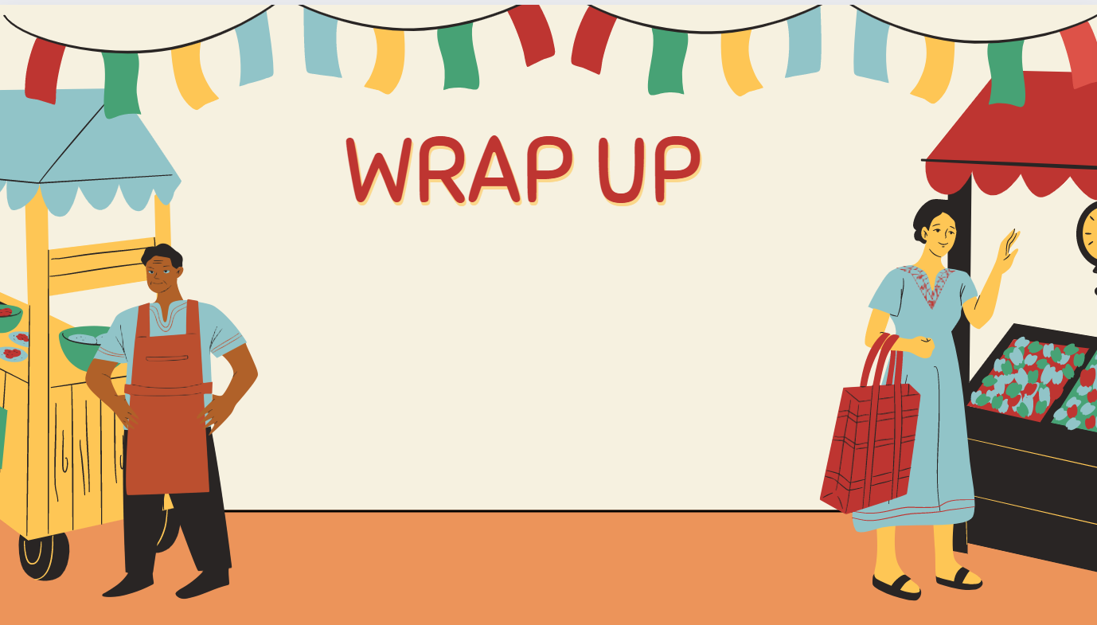
Consolidate what students
have learnt in the lesson

Slide 20

VOCABULARY REVIEW
honor (v) | /ˈɒnər/ | show great respect for somebody | tỏ lòng tôn kính, kính trọng
originate (v) | /əˈrɪdʒɪneɪt/ | to happen or appear for the first time in a particular place or situation | bắt nguồn, có nguồn gốc

Slide 21
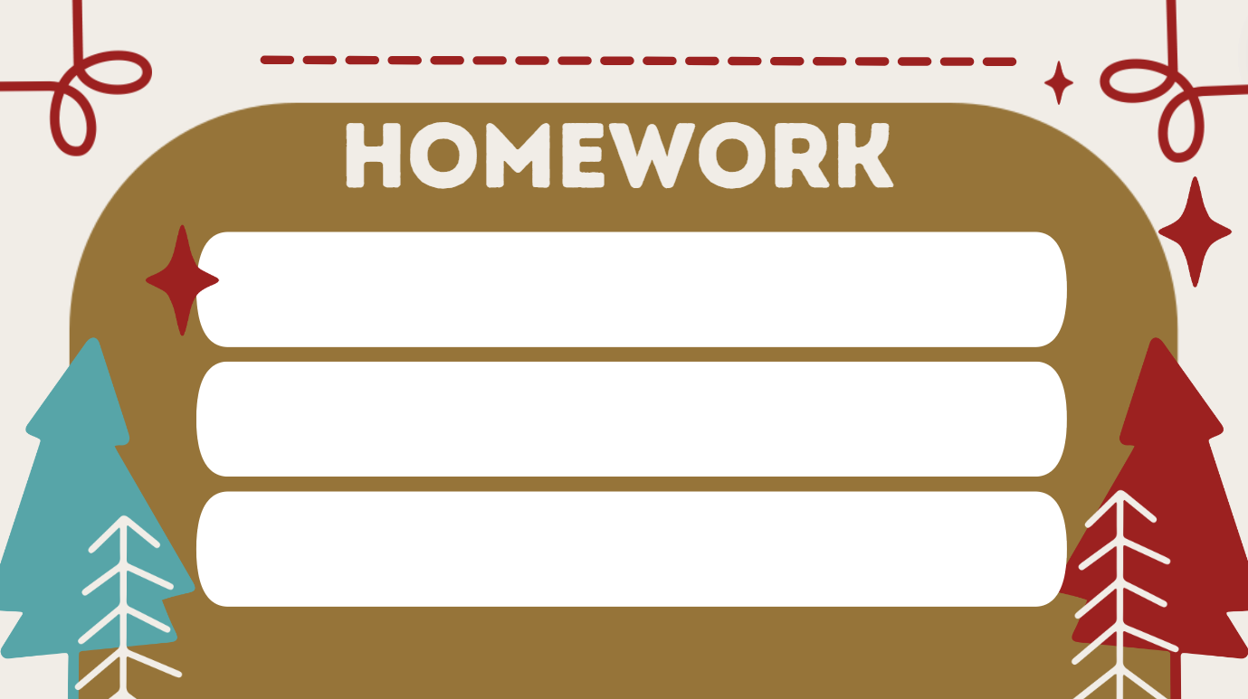
01. Learn the vocabulary by heart
02. Do the exercises in workbook (page 75)
03. Prepare for Unit 8. Lesson 8

Slide 22


